Slide 1

Week 8 – 15.6.20
5 sessions

Slide 2
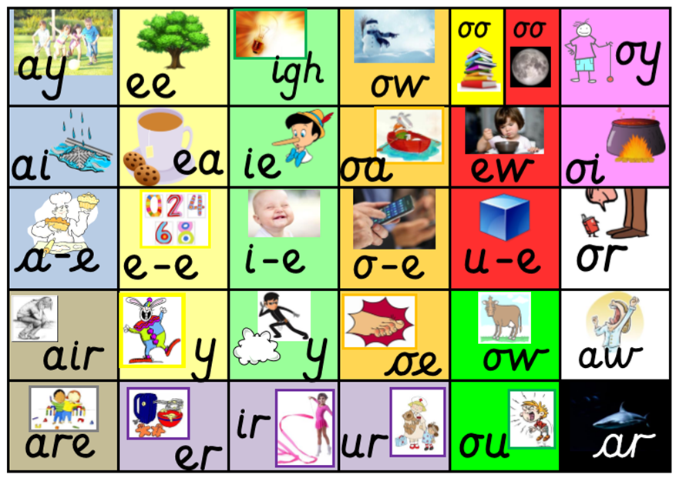
Remind yourself of all the sounds on our sound mat.
How many words can you think of with an ‘igh’ sound in?

Slide 3
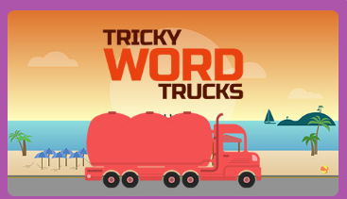
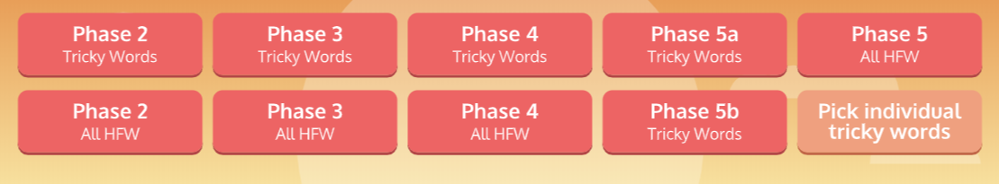
Go to https://new.phonicsplay.co.uk/resources
Enter the following details:
Username: march20
Password: home
Go to: Resources Tab (top of the screen)
Select the ‘Tricky word Truck’ game.
Children can select their starting level.
If your child correctly identifies the word, click the tick. If your child is incorrect, click the cross and this word will reappear later.
How quickly can you recall the tricky words?
You can personalise this game and choose your own words!

Slide 4
15.6.20
Session 1
Digraph
oy
Toy for a boy.

Slide 5
Split Digraph
i_e
Nice smile.

Slide 6
Sound out these words aloud.
2. Write each word and add sound buttons. Can you spot the digraph in each word?
For example, smile toy
like
prize
mile
nine
soy
annoy
joy
enjoy
cowboy

Slide 7
16.6.20
Session 2
Our focus sounds
oy
i_e
Nice smile.
Toy for a boy.

Slide 8
Go to https://new.phonicsplay.co.uk/resources
Enter the following details:
Username: march20
Password: home
Go to: Resources Tab (top of the screen)
Select the ‘Tricky word Truck’ game.
Children can select their starting level.
If your child correctly identifies the word, click the tick. If your child is incorrect, click the cross and this word will reappear later.
How quickly can you recall the tricky words?
You can personalise this game and choose your own words!

Slide 9

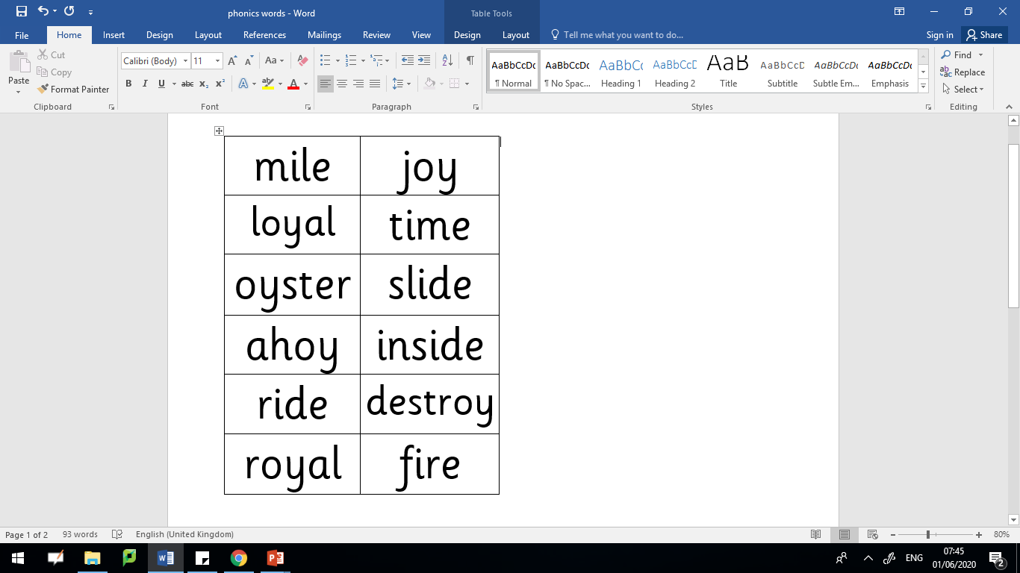
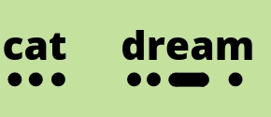

Read these words aloud. Don’t forget to use your phonics fingers to help segment the different sounds before you blend them together.

Slide 10


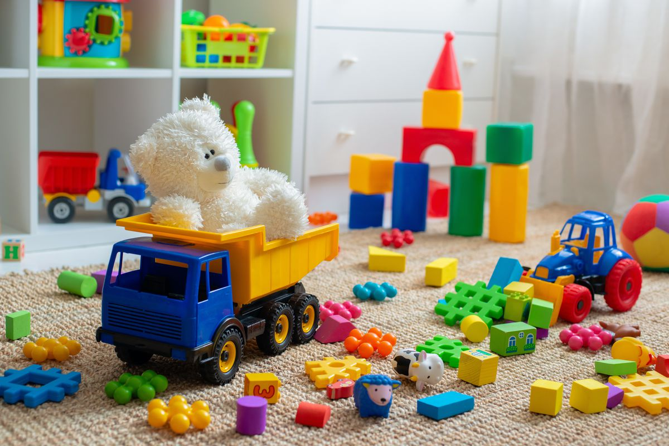



oy or i_e?
Which sound is missing? Write the words down using the correct sounds.
t___s
br_d__
r___al
ann___ed
k__t__
sl__d__

Slide 11
oy or i_e?
Answers
Which sound is missing? Write the word down using the correct sound.
toys
bride
royal
annoyed
kite
slide

Slide 12
17.6.20
Session 3
Our focus sounds
oy
i_e
Nice smile.
Toy for a boy.

Slide 13
Go to https://new.phonicsplay.co.uk/resources
Enter the following details:
Username: march20
Password: home
Go to: Resources Tab (top of the screen)
Select the ‘Tricky word Truck’ game.
Children can select their starting level.
If your child correctly identifies the word, click the tick. If your child is incorrect, click the cross and this word will reappear later.
How quickly can you recall the tricky words?
You can personalise this game and choose your own words!

Slide 14
Read these words aloud. Don’t forget to use your phonics fingers to help segment the different sounds before you blend them together.

Slide 15

I enjoy playing hide and seek with my five friends outside in the garden. The best hiding place is under the slide.
I feel annoyed when it is raining because we can’t go outside to play. I am lucky because I have lots of toys inside my house. I sometimes let my sister play with them but she did destroy my remote control motorbike last week. She drove it straight into the wall! It did make me smile.
Can you be a detective and see how many ‘oy’ and ‘i_e’ words are in this story?

Slide 16
18.6.20
Session 4
Our focus sounds
oy
i_e
Nice smile.
Toy for a boy.

Slide 17

Ask an adult to say one word at a time.
Without looking, try to spell the word.
Then check your answers together.

Slide 18
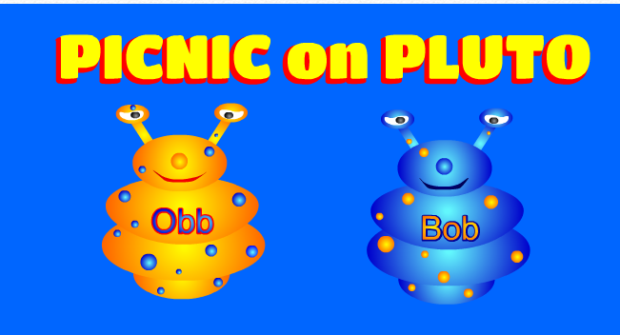
https://www.phonicsplay.co.uk/PicnicOnPluto.html
Picnic on Pluto - this is a game for children to sort real and alien words. Click on the link and follow the instructions below to make sure children are using this week’s target sound.
Once loaded, click the ‘next’ button.
Then click on Phase 5 for ‘oy’ and ‘i_e’ words.
Have fun! :)
Username: march20
Password: home

Slide 19
19.6.20
Session 5
Our focus sounds
oy
i_e
Nice smile.
Toy for a boy.

Slide 20

oy or i_e
Silly sentences!
Write some silly sentences of your own using words with either an ‘oy’ or ‘i_e’ sound in.
Here’s an example…
Nine mice were flying a kite. The cowboy was full of joy when he won his prize for the best slide.
Remember to start each sentence with a capital letter and end with a full stop.

Slide 21
https://www.phonicsplay.co.uk/PicnicOnPluto.html
Picnic on Pluto - this is a game for children to sort real and alien words. Click on the link and follow the instructions below to make sure children are using this week’s target sound.
Once loaded, click the ‘next’ button.
Then click on Phase 5 for ‘oy’ and ‘i_e’ words.
Have fun! :)
Username: march20
Password: home

