Slide 1
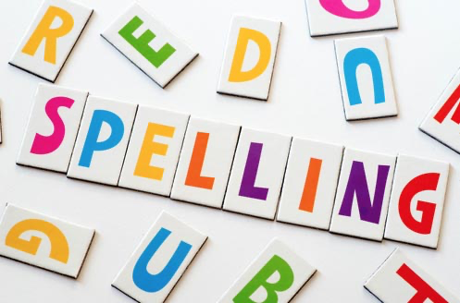
Session 1
Using the possessive apostrophe

Slide 2

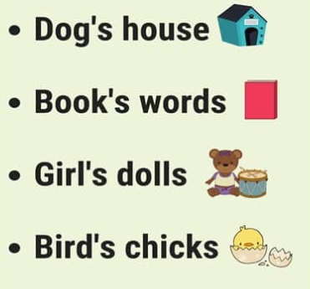
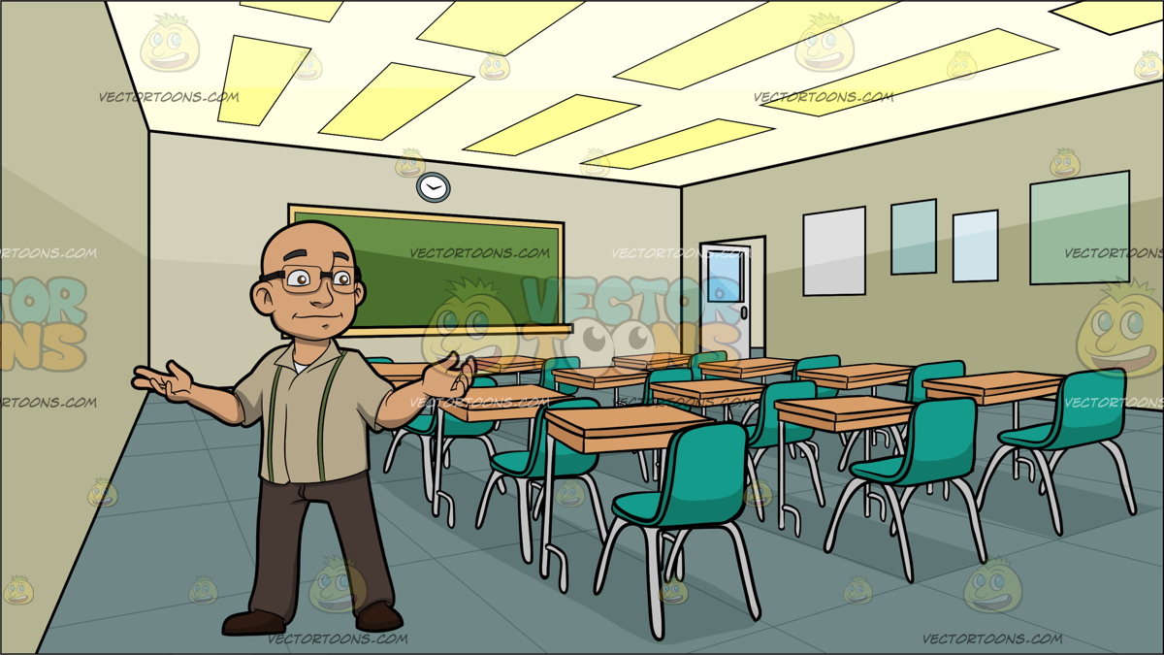
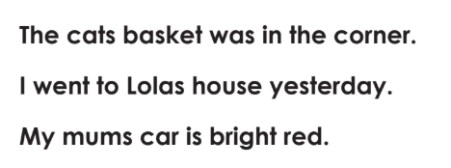
An apostrophe looks like a comma up in the air, like this -> ‘
It can be used for different things but today we are looking at where it is used to show that something belongs to someone.
Here are some examples
Today, your challenge is to copy the sentences below and to put in the missing apostrophe.
Clue: first one, the cat owns the basket so the apostrophe needs to go in the word cats.

Slide 3
Session 2
Using the possessive apostrophe

Slide 4
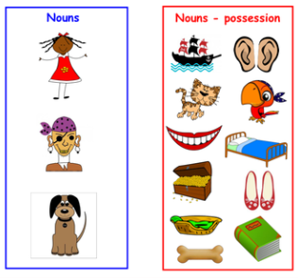
Remember the possessive apostrophe
we looked at yesterday?
Well today we are going to do some more.
Your challenge to day is to write 4 sentences. Each sentence must have one word from the blue box that owns one thing from the red box.
Here’s an example:
The dog ’s ears were floppy.

Slide 5
Session 3
Using the possessive apostrophe

Slide 6
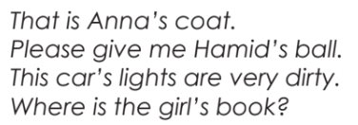
Dictation
You will need a grown-up to help you with today’s challenge.
Ask your grown-up to read each sentence to you and you must write it down.
THE IMPORTANT THING TODAY IS THAT YOU TRY AND GET THE APOSTROPHE IN THE RIGHT PLACE!

Slide 7
Session 4
Using al to spell the l sound at the end of a word.

Slide 8
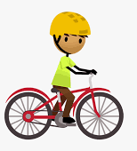
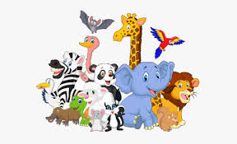




There are different spellings used to make the l sound at the end of words.
Some words use el to make this sound like model and squirrel
Some words use le to make this sound like candle and table
The words we are going to learn today have al to make this sound.
pedal
animal
petal
hospital
magical
metal

Slide 9

Your challenge today is to choose 4 of these words and see how many times you can write them down in two minutes.
Then pick a different mix of 4 words and see if you can beat your score!
pedal
animal
petal
hospital
magical
metal

Slide 10
Session 5
Using al to spell the ul sound at the end of a word.

Slide 11
Boggle
l | a | i | n
m | p | m | a
e | a | c | g
t | d | l | i
How many words can you make from the letters in the grid?
Letters must be next to each other but they can be fowards, backwards, up, down or even diagonally.
Clue: you can make the words we have been spelling this week?
Red arrows show you an example of how you could do it!

