Slide 1

Hello Year 2!
This PowerPoint contains four morning maths and maths sessions for you to complete this week. We haven’t planned lessons for Friday as it is a Bank Holiday.
Remember you can draw pictures, use part whole models and number lines to help with your working out.

Slide 2
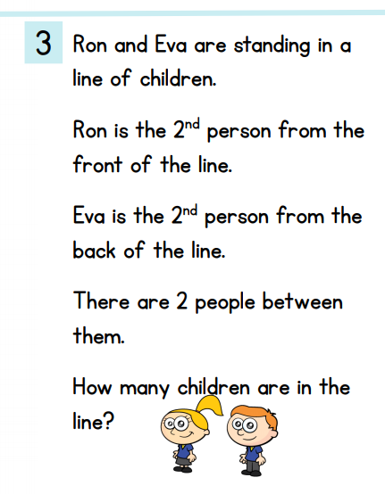
Morning maths 4.5.20
Double 4 =
Half of 14 =
12 + 5 + 8 =
3 + 7 + 13 =
__ + 6 + 5 = 16
9 + __ + 1 = 18
99 + 5 =
97 + 10 =
Challenge
A drawing may help you work it out!

Slide 3
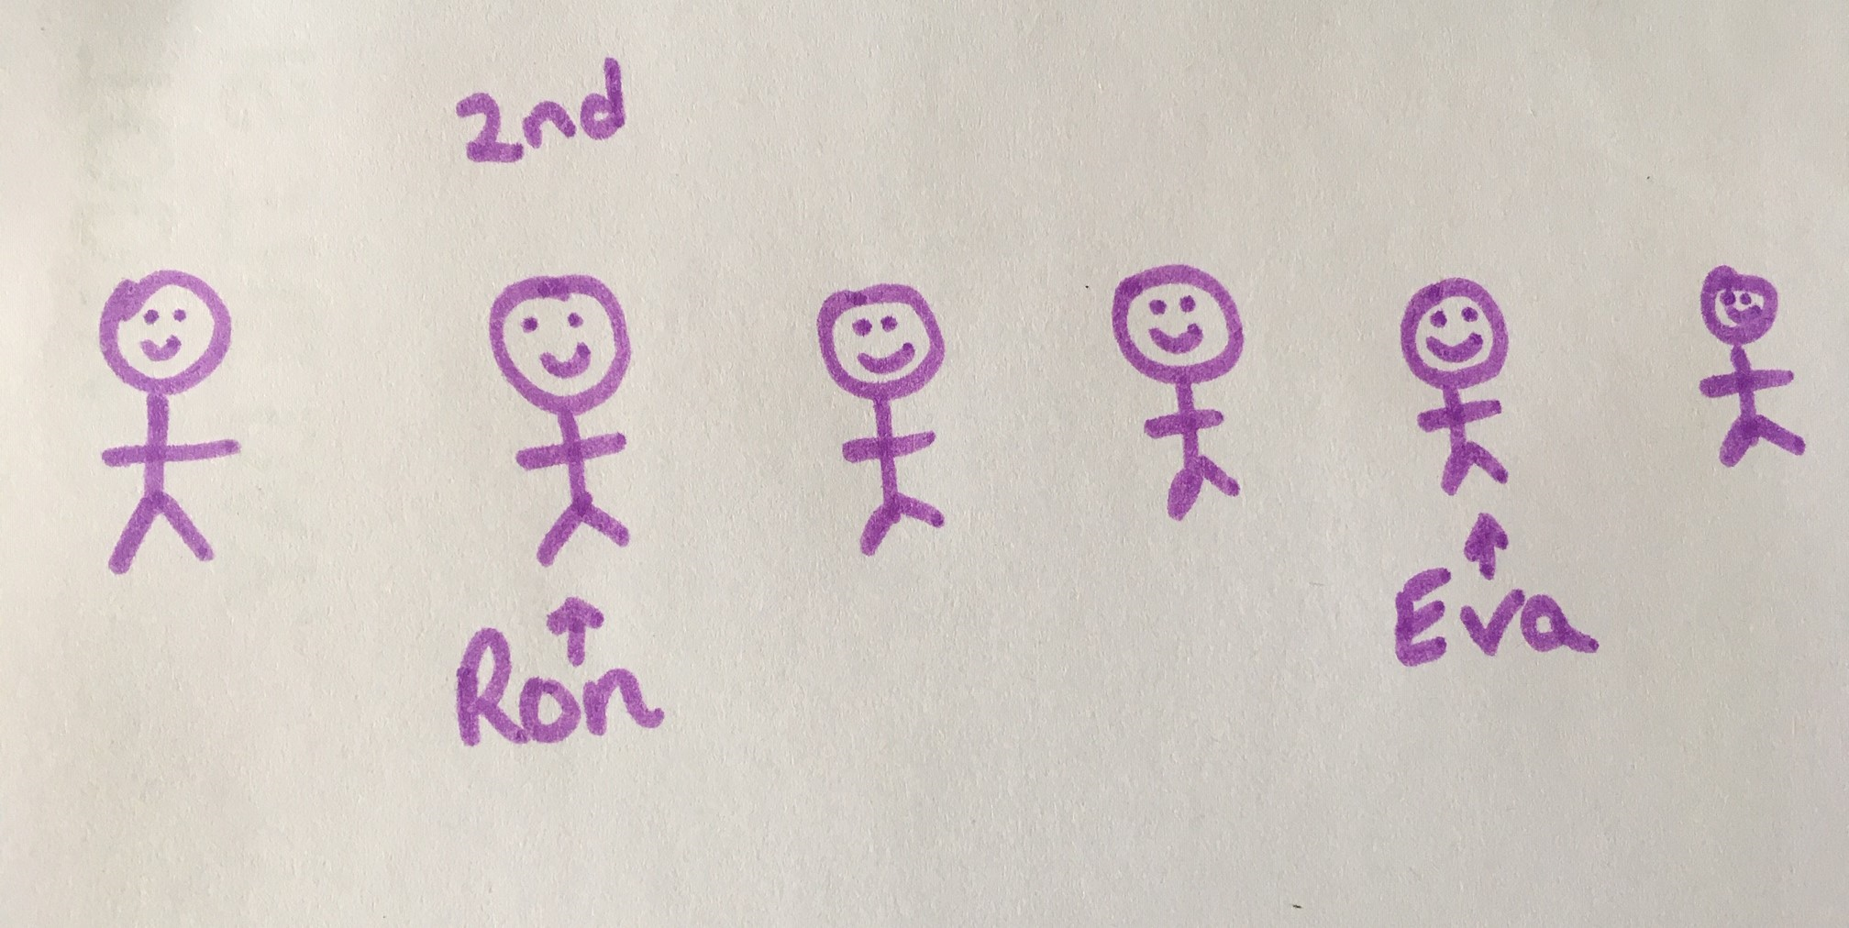
Morning maths Answers 4.5.20
Double 4 = 8
Half of 14 = 7
12 + 5 + 8 = 25
3 + 7 + 13 = 23
5 + 6 + 5 = 16
9 + 8 + 1 = 18
99 + 5 = 104
97 + 10 = 107
Challenge
6 children

Slide 4

Maths
Monday 4th May

Slide 5
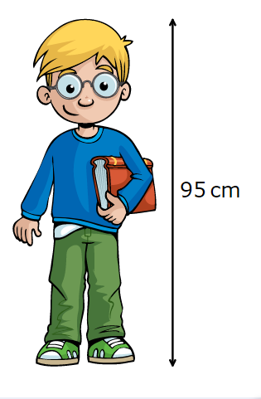
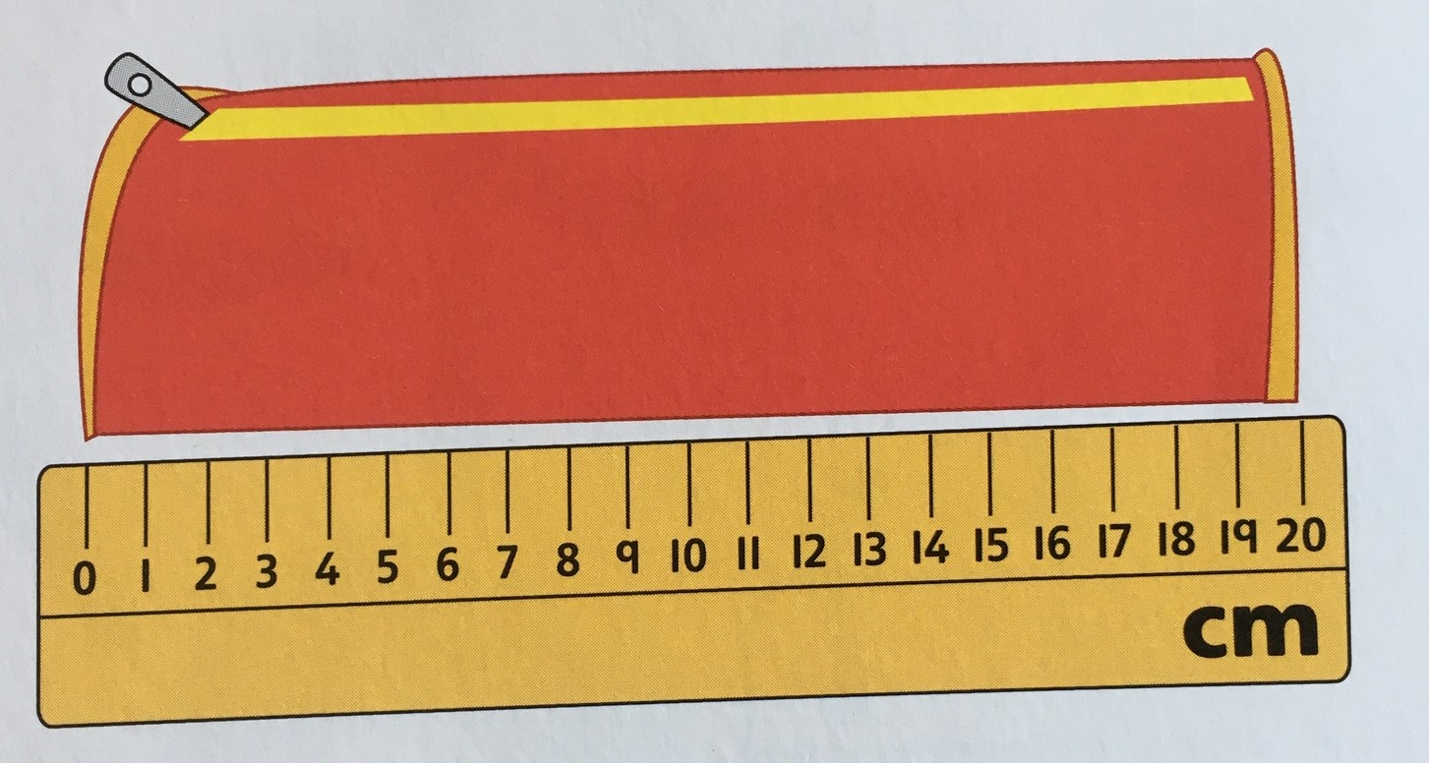
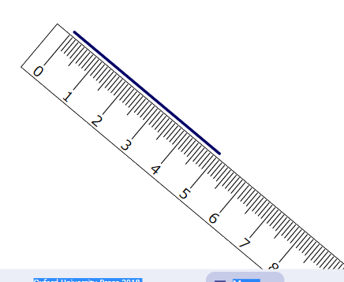
Recap on last week’s learning
We use length to measure how tall or long something is.

Slide 6
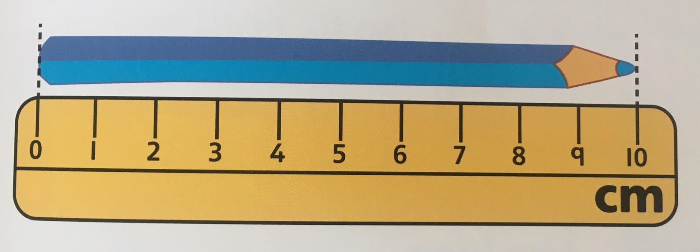
Recap...
Top tips for measuring using a ruler
Make sure you’re using the ‘cm’ side of the ruler.
Try to get the 0 at the edge of the object you are measuring.
Look at the other edge of the object you are measuring and read the measurement carefully.
Keep the ruler straight.

Slide 7

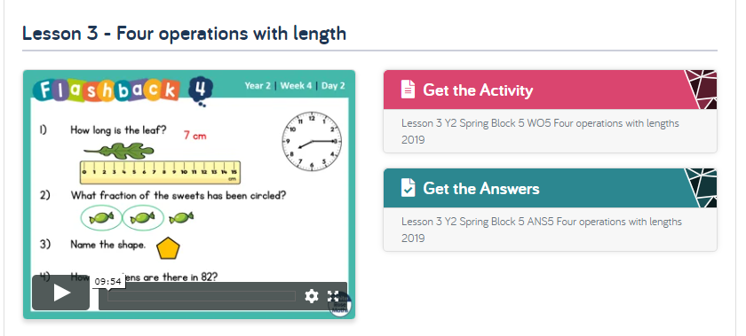
Information for Parents and Carers
At St Catherine’s we follow the Mathematic programme ‘White Rose Maths’. White Rose Maths have set up a series of daily lessons for children to follow at home. To continue our learning on length this week, we will be using a few lessons from this website.
https://whiterosemaths.com/homelearning/year-2/
Every lesson comes with a short video for you to watch and discuss with your child. After each video there is an activity for your child to complete. You may want to print this off or work from the screen and write your answers on a separate piece of paper.

Slide 8
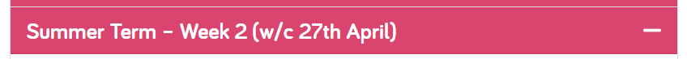
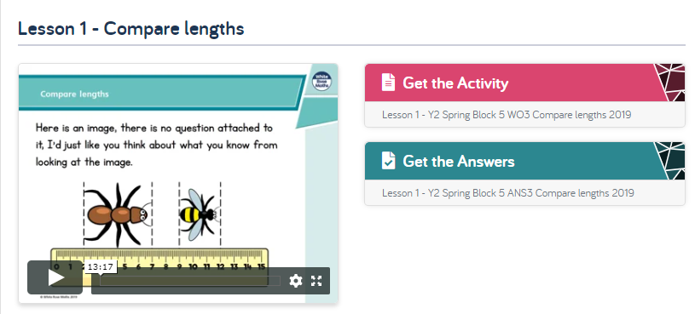
4.5.20
Session 1
Load the white rose website
https://whiterosemaths.com/homelearning/year-2/
2. Click on ‘Summer Term - Week 2’ and scroll down to Lesson 1 - Compare lengths. This will be the lesson children will complete today.
Activity
3. Watch the video and complete the activity. You can then check your answers.
Video
Answers

Slide 9
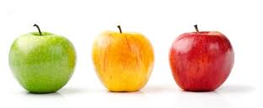
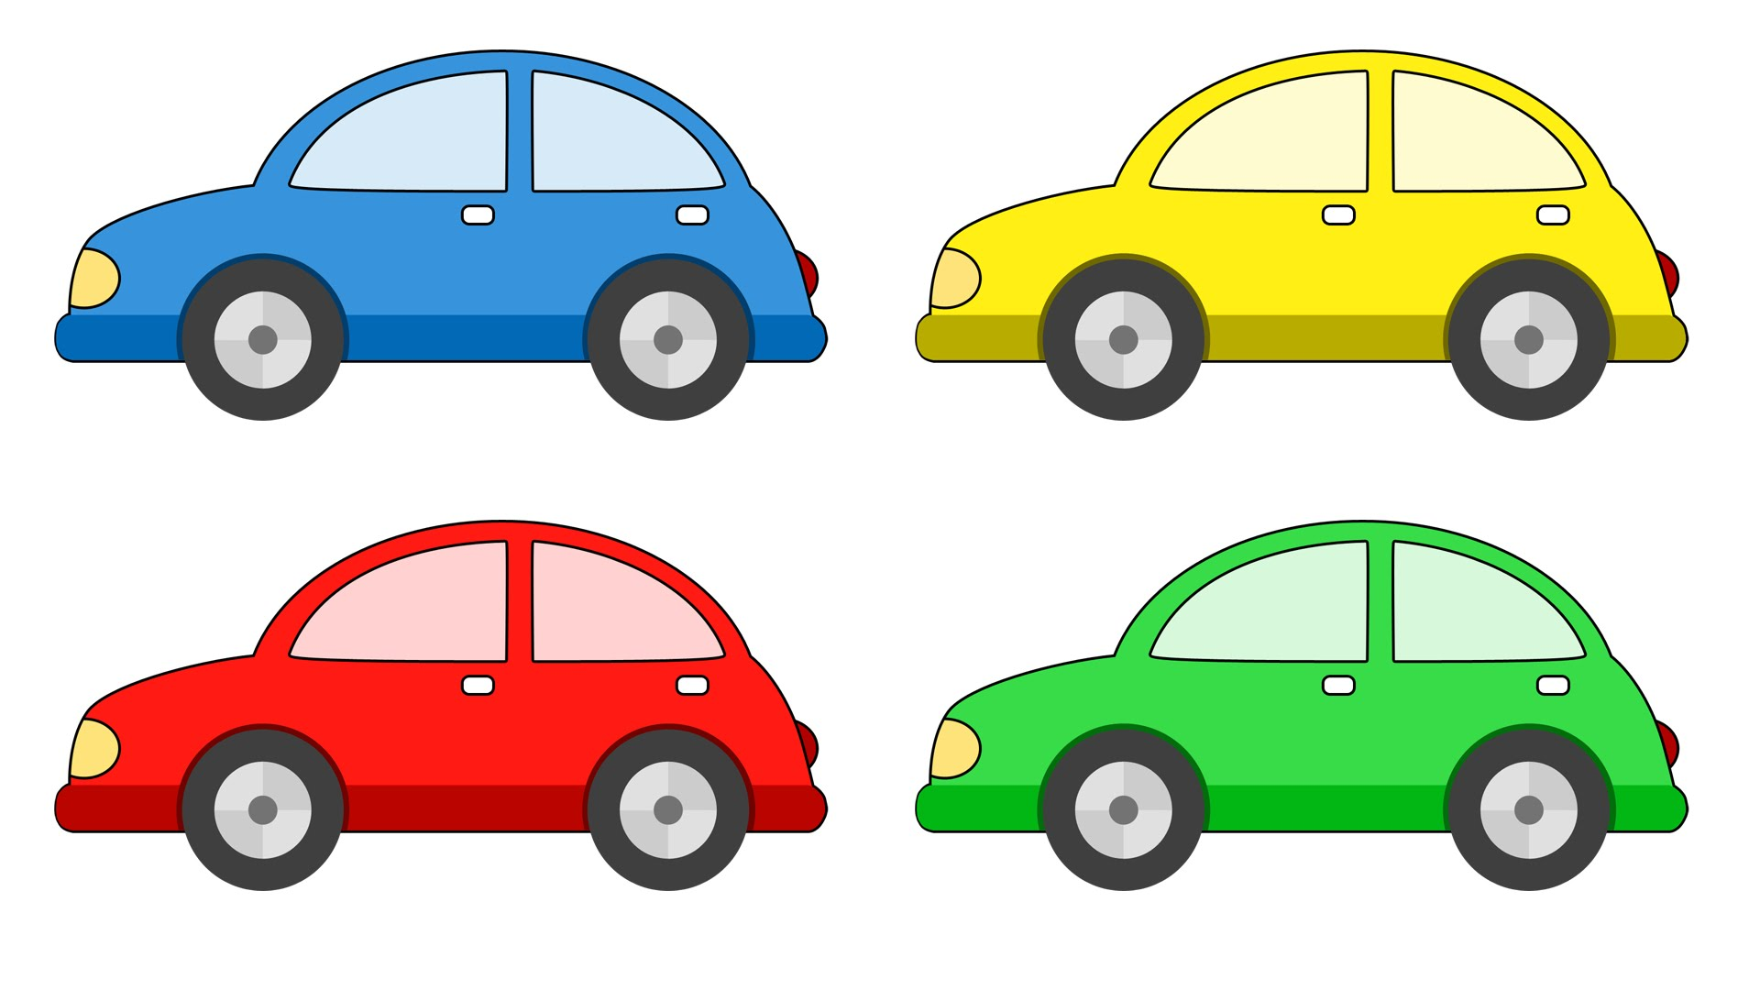
Recap on symbols
equals
3
=
<
>
8cm
4cm
fewer than or
less than
greater than or
More than

Slide 10
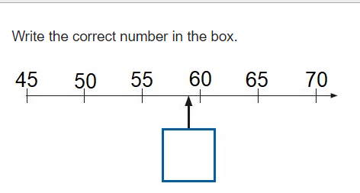
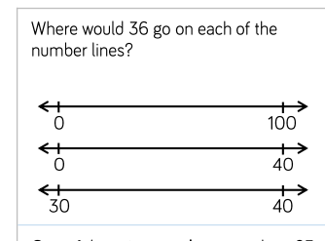
Morning maths 5.5.20
30- 4 =
31 - 6 =
24 - 7 =
100 - 5 =
36 + 7 =
48 + 4 =
57 + 5 =
36 + 8 =
Challenges

Slide 11
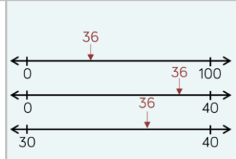
Morning maths Answers 5.5.20
30- 4 = 26
31 - 6 = 25
24 - 7 = 17
100 - 5 = 95
36 + 7 = 43
48 + 4 = 52
57 + 5 = 62
36 + 8 = 44
Challenges
59

Slide 12
Maths
Tuesday 5th May

Slide 13
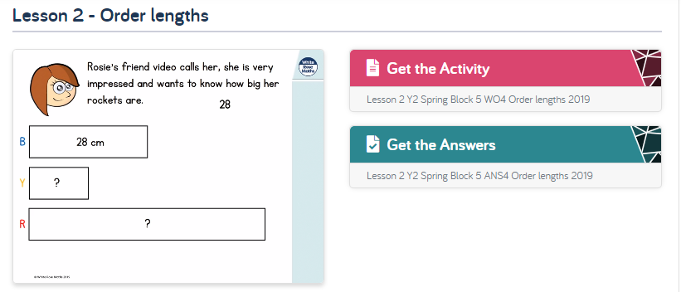
5.5.20
Session 2
Load the white rose website
https://whiterosemaths.com/homelearning/year-2/
2. Click on ‘Summer Term - Week 2’ and scroll down to Lesson 2: order lengths. This will be the lesson children will complete today.
Activity
3. Watch the video and complete the activity. You can then check your answers.
Video
Answers

Slide 14
Further task
Choose five objects in your house. Measure them using a ruler.
Order the objects from longest to shortest.
Write at least three sentences to describe the objects using the words...
shorter
longer
longest
shortest

Slide 15
Morning maths 6.5.20
7 x 2 =
__ x 5 = 25
10 x 0 =
__ = 3 x 4
55 ÷ 5 =
___ ÷ 10 = 3
___ = 18 ÷ 2
33 ÷ 3 =
Challenge
Check these calculations.
Can you spot the incorrect answer?
64 + 7 =71
26 + 24 = 60
49 + 15 = 64
83 + 17 = 100

Slide 16
Morning maths 6.5.20
7 x 2 = 14
5 x 5 = 25
10 x 0 = 0
12 = 3 x 4
55 ÷ 5 = 11
30 ÷ 10 = 3
9 = 18 ÷ 2
30 ÷ 3 = 10
Challenge
Check these calculations.
Can you spot the incorrect answer?
64 + 7 =71
26 + 24 = 60. 50
49 + 15 = 64
83 + 17 = 100
Correct answer

Slide 17
Maths
Wednesday 6th May

Slide 18
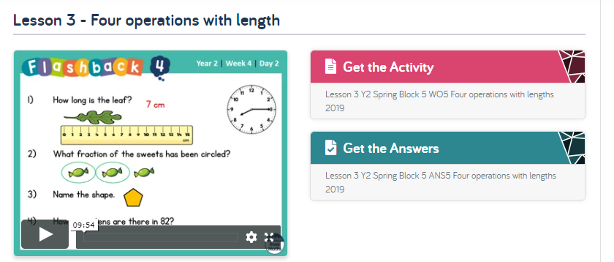
6.5.20
Session 3
Load the white rose website
https://whiterosemaths.com/homelearning/year-2/
2. Click on ‘Summer Term - Week 2’ and scroll down to Lesson 3 - Four operations with length. This will be the lesson children will complete today.
Activity
3. Watch the video and complete the activity. You can then check your answers.
Video
Answers

Slide 19
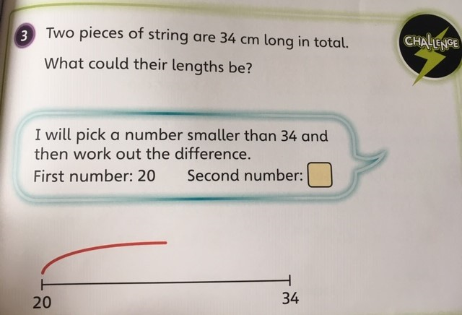
Further task
How many different answers can you find to this problem?
34cm
? | ?

Slide 20
Morning Maths
7.5.20
What can you tell me about the number 30?
Tens and ones
Odd or even?
30 +0 = 30
30
__ + __ + __ =
Draw it.
Greater than?
Fewer than?
÷ - x
fractions?

Slide 21
Maths
Thursday 7th May

Slide 22
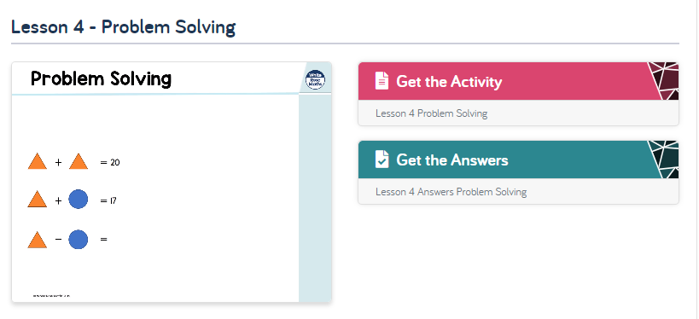
7.5.20
Session 4
Load the white rose website
https://whiterosemaths.com/homelearning/year-2/
2. Click on ‘Summer Term - Week 2’ and scroll down to Lesson 4 - Problem solving. This will be the lesson children will complete today.
Activity
3. Watch the video and complete the activity. You can then check your answers.
Video
Answers

Slide 23
Well done for all your hard work this week year 2!
Have a lovely long weekend.

