Slide 1
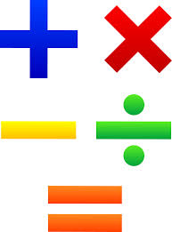
Hello Year 2!
This PowerPoint contains five morning maths and maths sessions for you to complete this week.
Remember you can draw pictures, use part whole models and number lines to help with your working out.

Slide 2
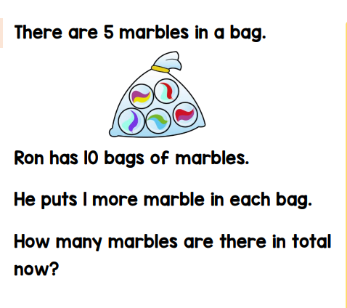
Morning maths 1.6.20
34 + 8 =
72 - 6 =
40 ÷ 5 =
7 x 5 =
Can you think of one +, - x and ÷ calculation where the answer is 12?
__ + __ = 12 ___ ÷ ___ = 12
__ + __ = 12 ___ x ___ = 12
Challenge
Draw a picture to help you!

Slide 3
Morning maths Answers 1.6.20
34 + 8 = 42
72 - 6 = 66
40 ÷ 5 = 8
7 x 5 = 35
Can you think of one +, - x and ÷ calculation where the answer is 12?
6 + 6 = 12 60 ÷ 5 = 12
20 - 8 = 12 4 x 3 = 12
Challenge
10 x 5 =50
10 bags x 5 marbles in each one
He adds 1 more marble in each bag.
1 x 10 = 10
50 + 10 = 60 marbles
Here are some examples. There are more correct answers though. :)

Slide 4

Maths
Monday 1st June

Slide 5
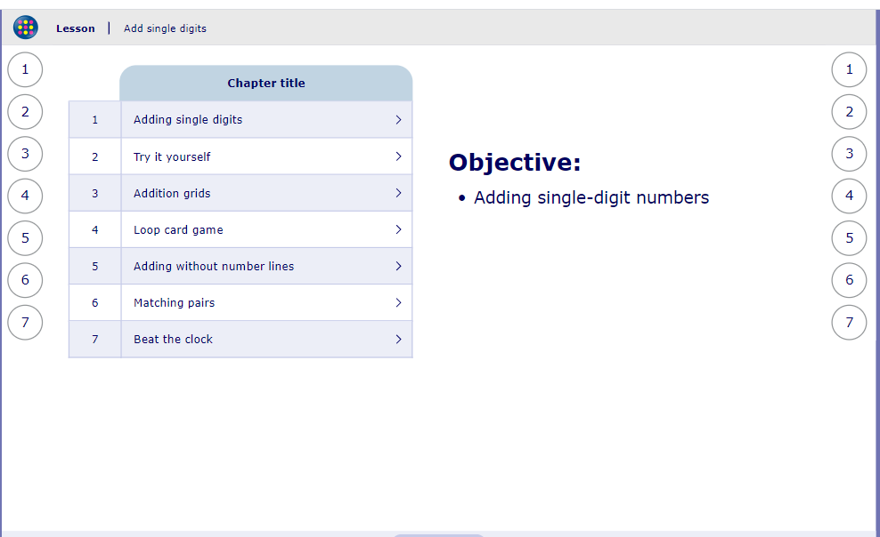
My Maths activity
Lesson: Adding single digits
To start the lesson, click on the image to the right of the screen. This will take you to an interactive lesson. This lesson will show the children how they can solve addition calculations and includes games for the children to try.
Click on the next buttons at the bottom of the page to move your learning on and take part in the mini-quizzes along the way to check your understanding.

Slide 6
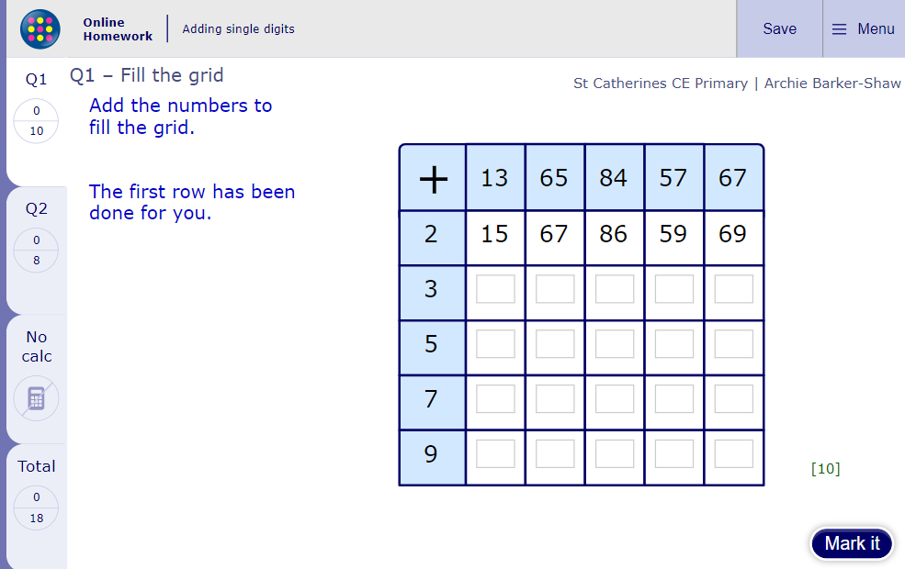
Now click the image on the left of the screen, this will take you to an online homework where you can test your understanding.
Have a go at the questions and then click ‘Mark it’ to see how you have go on.
Your login details for My Maths were sent home in your first work pack - make sure you log in so we can see how you are getting on.

Slide 7
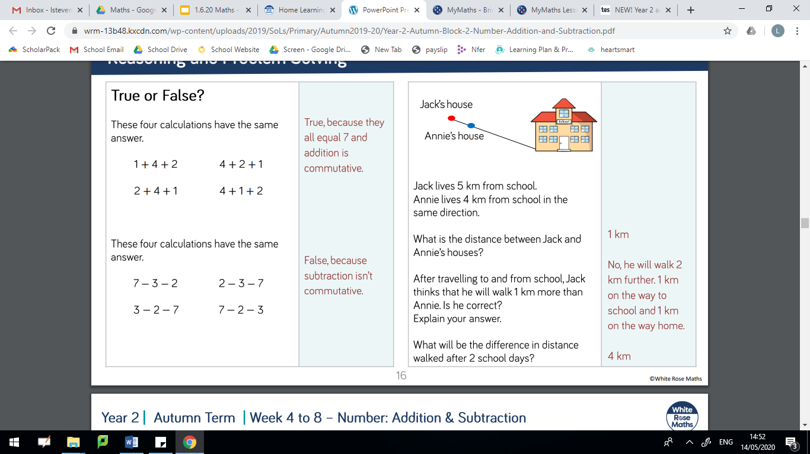
Further Challenge
1.
2.
3.

Slide 8
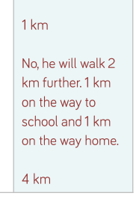
Further Challenge
Answers
1.
2.
3.
1.
2.
3.

Slide 9
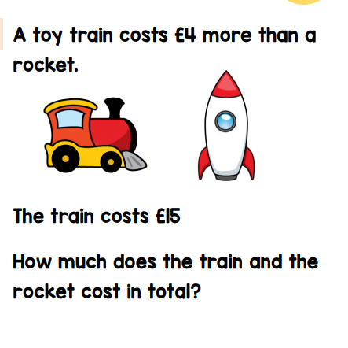
Morning maths 2.6.20
11 + 9 + 6 =
42 - 40 =
60 = __ + 20 + 20
8 x 2 =
10 ÷ 10 =
15 ÷ 3 =
7 x 3 =
¼ of 8 =
Challenge

Slide 10
Morning maths Answers 2.6.20
11 + 9 + 6 = 26
42 - 40 = 2
60 = 20 + 20 + 20
8 x 2 = 16
10 ÷ 10 = 1
15 ÷ 3 = 5
7 x 3 = 21
¼ of 8 = 2
Challenge
15 - 4 = 11
Rocket = £11
so the total is £15 + £11 = £26

Slide 11
Maths
Tuesday 2nd June

Slide 12
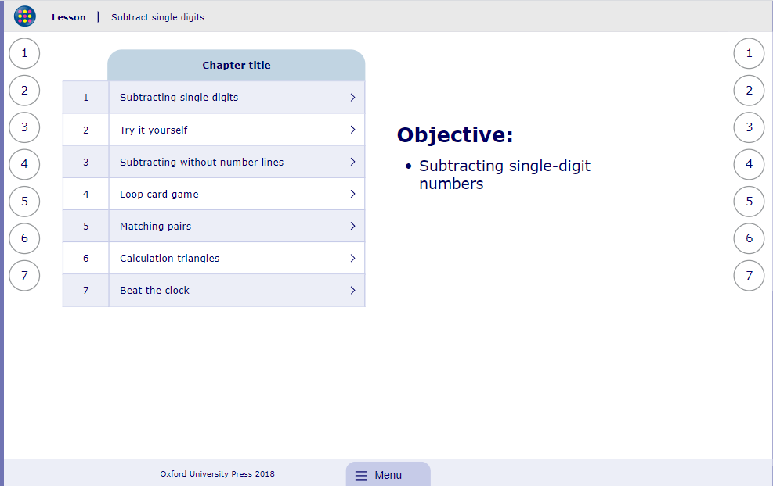
My Maths activity
Lesson: Subtract single digits
To start the lesson, click on the image to the right of the screen. This will take you to an interactive lesson. This lesson will show the children how they can solve subtraction calculations and includes games for the children to try.
Click on the next buttons at the bottom of the page to move your learning on and take part in the mini-quizzes along the way to check your understanding.

Slide 13
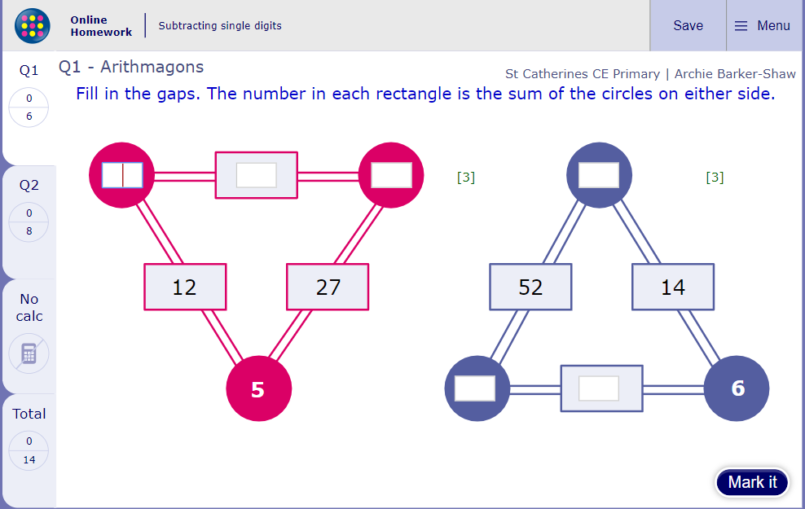
Now click the image on the left of the screen, this will take you to an online homework where you can test your understanding.
Have a go at the questions and then click ‘Mark it’ to see how you have go on.
Your login details for My Maths were sent home in your first work pack - make sure you log in so we can see how you are getting on.

Slide 14
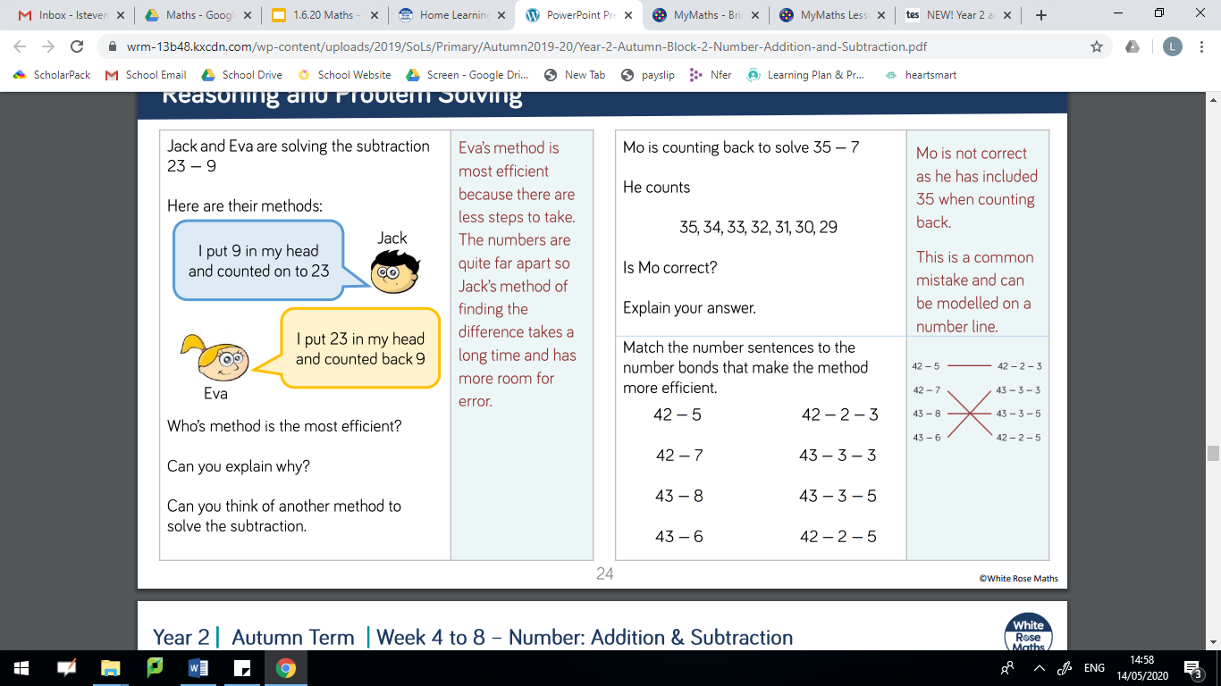
Further subtraction challenge

Slide 15
Further subtraction challenge Answer

Slide 16
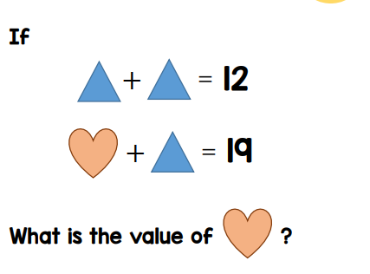
Morning maths 3.6.20
8 + 6 + 2 =
__ + 9 + 1 = 17
12 = __ + 3 + 3 + 3
___ = 48 - 8
87 = 50 + 7 + ___
___ - 40 = 13
___ - 60 = 40
Circle 3 numbers with the sum of 12.
6 5 4 3 2 1
Challenge

Slide 17
Morning maths Answers 3.6.20
8 + 6 + 2 = 16
7 + 9 + 1 = 17
12 = 3 + 3 + 3 + 3
40 = 48 - 8
87 = 50 + 7 + 30
53 - 40 = 13
100 - 60 = 40
8. Circle 3 numbers with the sum of 12.
Challenge
6 + 6
13
6
13
6 + 5 + 1 5 + 4 + 3 6 + 4 + 2

Slide 18
Maths
Wednesday 3rd June

Slide 19
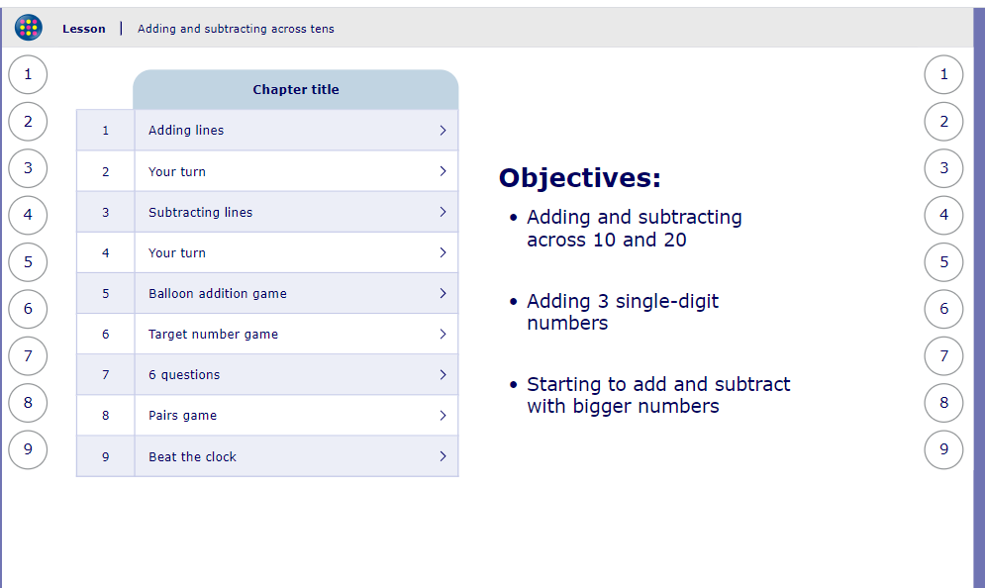
My Maths activity
Lesson: Adding and subtracting across tens
To start the lesson, click on the image to the right of the screen. This will take you to an interactive lesson. This lesson will show the children how they can solve calculations using a number line.
Click on the next buttons at the bottom of the page to move your learning on and take part in the mini-quizzes along the way to check your understanding.

Slide 20
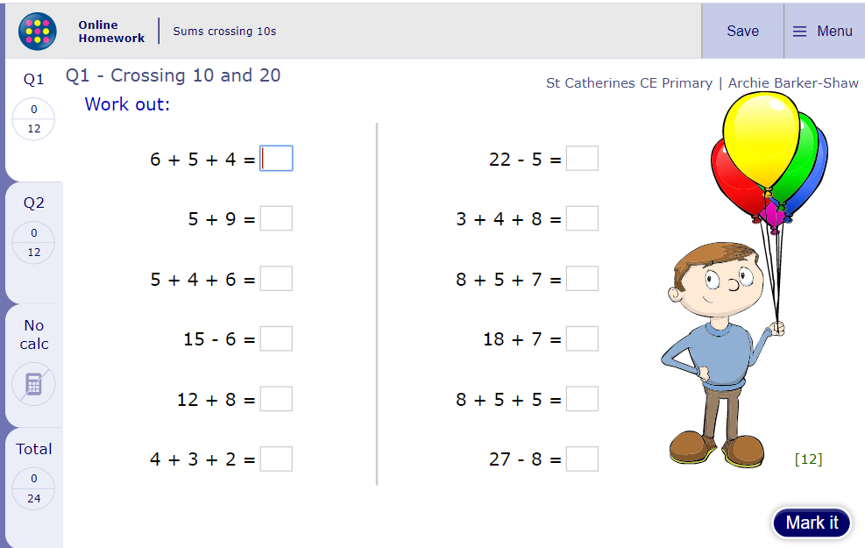
Now click the image on the left of the screen, this will take you to an online homework where you can test your understanding.
Have a go at the questions and then click ‘Mark it’ to see how you have go on.
Your login details for My Maths were sent home in your first work pack - make sure you log in so we can see how you are getting on.

Slide 21
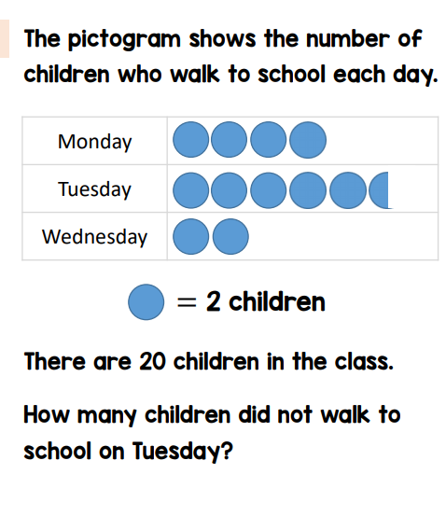
Morning maths 4.6.20
Challenge
Handy Hint!
When finding a fraction of an amount, the children are encouraged to draw a rectangle to help them create equal groups..
½ of 60 =
¼ of 80 =
⅓ of 90 =
¾ of 40 =
¾ of 80 =

Slide 22
Morning maths Answers 4.6.20
Challenge
Handy Hint!
When finding a fraction of an amount, the children are encouraged to draw a rectangle to help them create equal groups..
8
11
4
½ of 60 = 30
¼ of 80 = 20
⅓ of 90 = 30
¾ of 40 = 30
¾ of 80 = 60
20 - 11 = 9
9

Slide 23
Maths
Thursday 4th June

Slide 24
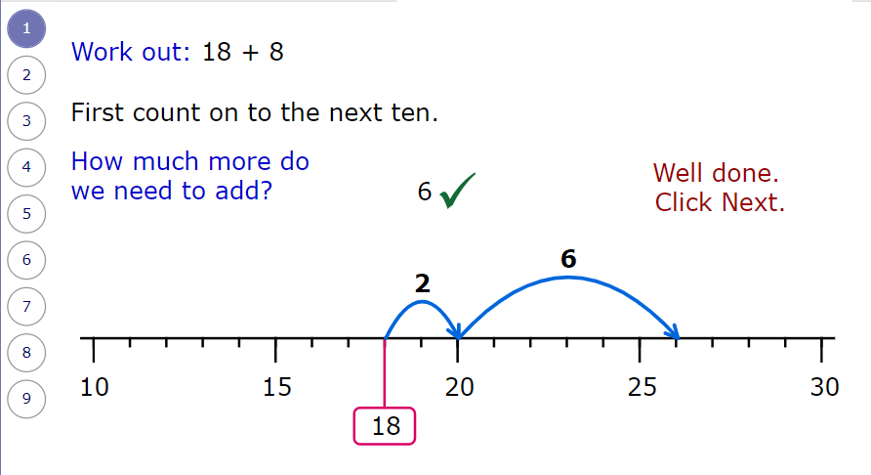
WALT: add and subtract when crossing a tens boundary
Recap on yesterday’s learning
18 + 8 = 26
2
6

Slide 25
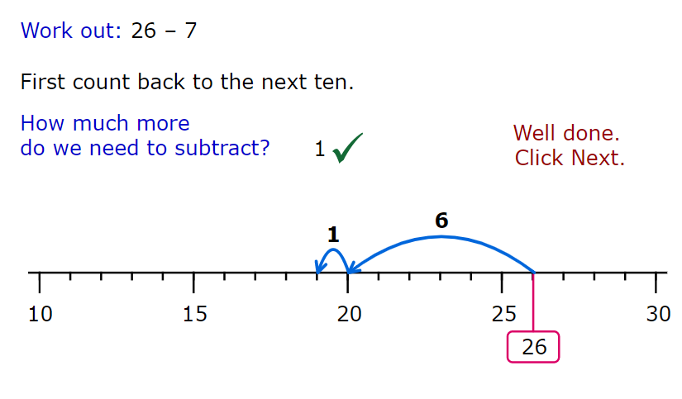
WALT: add and subtract when crossing a tens boundary
Recap on yesterday’s learning
26 - 7 = 19
6
1

Slide 26
Billy has worked out these calculations using his mental maths. Could you draw a number line or an image that will help you to check if he has got the correct answers?
23 + 9 = 32
56 + 7 = 65
46 + 8 = 54
35 + 6 = 41
54 - 6 = 58
21 - 7 = 14
63 - 5 = 58
85 - 9 = 75

Slide 27

Corrections!
Billy has worked out these calculations using his mental maths. Could you draw a number line or an image that will help you to check if he has got the correct answers?
23 + 9 = 32
56 + 7 = 65
46 + 8 = 54
35 + 6 = 41
48
54 - 6 = 58
21 - 7 = 14
63 - 5 = 58
85 - 9 = 75
63
76

Slide 28
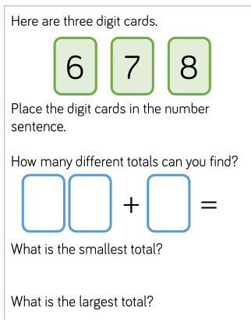
Next
Challenge

Slide 29

Challenge
Answers

Slide 30
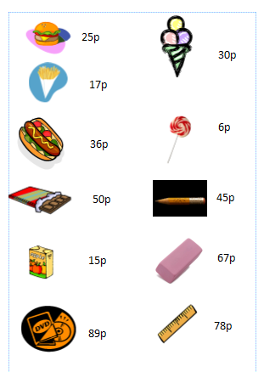
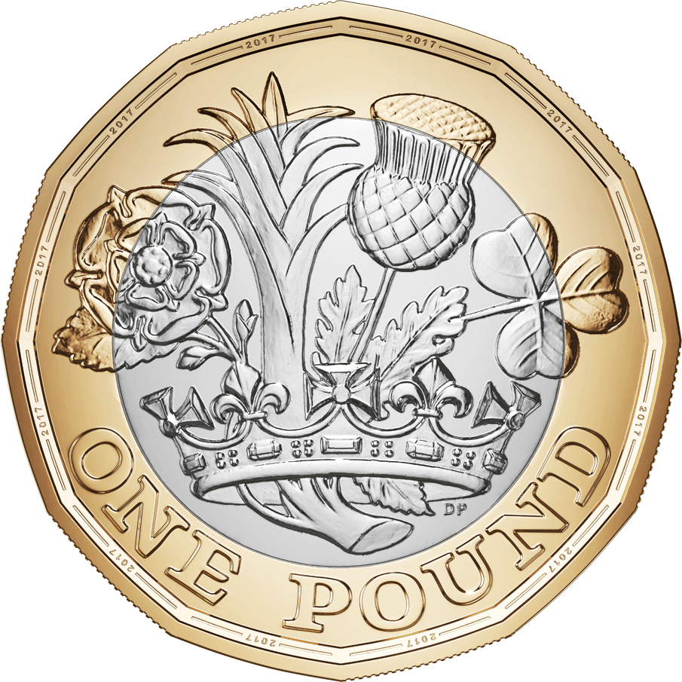
Morning Maths
Extra Challenge - you may wish to buy more than one item!
5.6.20
You have £1 to spend at the shop.
Work out how much change you would get from paying with a £1 coin.
Remember there are 100p in a £1.

Slide 31
Maths
Friday 5th June

Slide 32

Guess my number!
Take it in turns to think of a number between 1-100, but don’t show anyone else your number.
Play guess my number by giving people clues about your number but you mustn’t say the number! The vocabulary below might help you with the clues you choose to give.
odd even more than less than
two digit tens ones in between

Slide 33
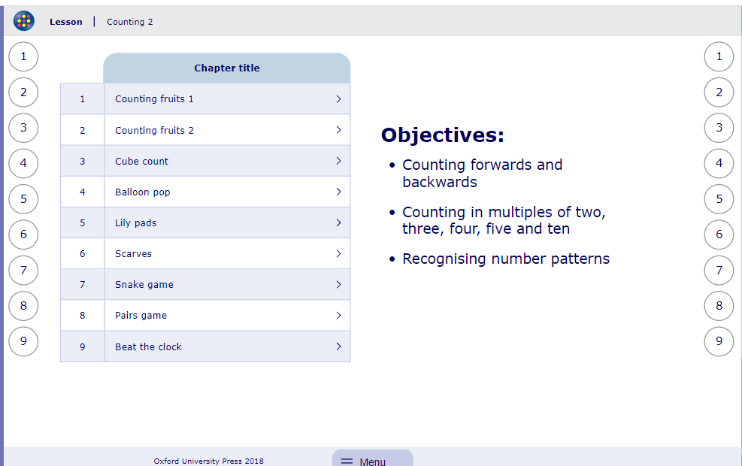
My Maths activity
Lesson: Counting 2
To start the lesson, click on the image to the right of the screen. This will take you to an interactive lesson. This lesson allows children to rehearse counting in 2s, 3s, 5s and 10s. Great practise!
Click on the next buttons at the bottom of the page to move your learning on and take part in the mini-quizzes along the way to check your understanding.

Slide 34
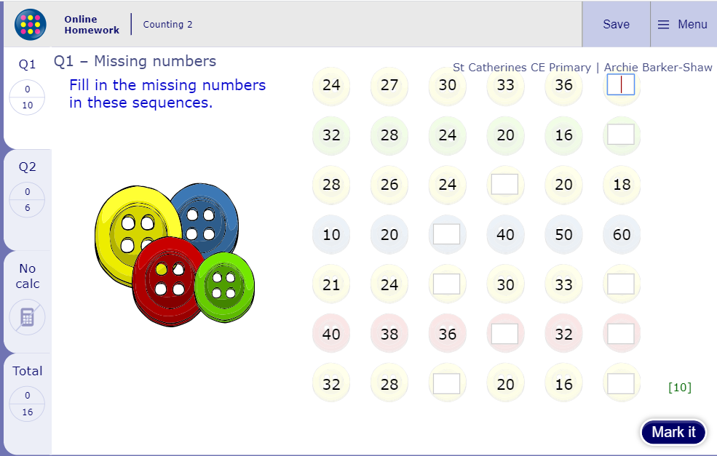
Now click the image on the left of the screen, this will take you to an online homework where you can test your understanding.
Have a go at the questions and then click ‘Mark it’ to see how you have go on.
Your login details for My Maths were sent home in your first work pack - make sure you log in so we can see how you are getting on.

Slide 35
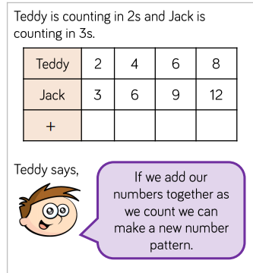
Final challenge of the week
What pattern do they make?
What happens if both Teddy and Jack count in 5’s and they add them together to make a new pattern?

Slide 36
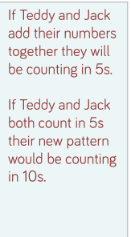
Final challenge of the week Answers
5 10 15 20

