Slide 1
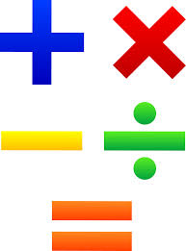
Hello Year 2!
This PowerPoint contains five morning maths and maths sessions for you to complete this week.
Remember you can draw pictures, use part whole models and number lines to help with your working out.

Slide 2
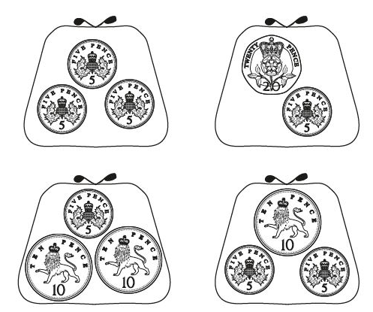
Morning maths 13.7.20
Challenge
63 - 10 - 10 =
21 + 40 =
__= 8 x 5
28 + __ = 35
69 + 11 =
8 ÷ 2 =
Six multiplied by three =
10 more than ___ = 78
Amy has 50p. She buys a pencil for 30p. Which purse shows how much money Amy has left?
B. How much money in all four purses?

Slide 3
Morning maths Answers 13.7.20
63 - 10 - 10 = 43
21 + 40 = 61
40 = 8 x 5
28 + 7 = 35
69 + 11 = 80
8 ÷ 2 = 4
Six multiplied by three =18
10 more than 68 = 78
Amy has 50p. She buys a pencil for 30p. Which purse shows how much money Amy has left?
50 - 30 = 20p
B. How much money in all four purses?
15p + 25p + 25p + 20p = 85p

Slide 4

Maths
Monday 13th July

Slide 5
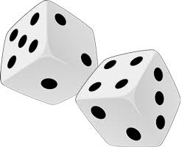
This week we are going to have some fun designing and making our own maths game. So before we start thinking about what we want to include in our games, we are going to look at some existing games to get some ideas.
There are some examples of different games on the next few slides. Choose a few of them to play.
You may need a dice and some counters for some of the games. If you don’t have these at home, you could make some of your own counters by cutting out some paper circles. There is also a link below to an interactive dice.
https://www.online-stopwatch.com/chance-games/roll-a-dice/

Slide 6
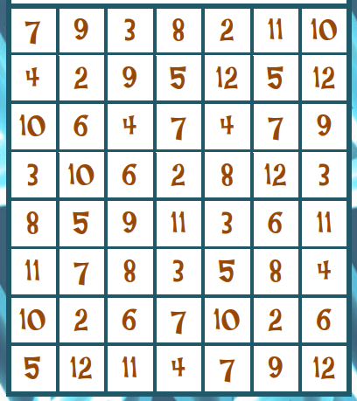
Four in a row
A game for 2 – 4 players
Players take turns to throw 2 dice. The numbers on the dice are added together. The player then finds this number on the board and covers it with a coloured counter. If none of these numbers are uncovered, the player doesn’t cover a number on this turn.
The first player to cover a row of four – vertically, horizontally or diagonally - is the winner.

Slide 7
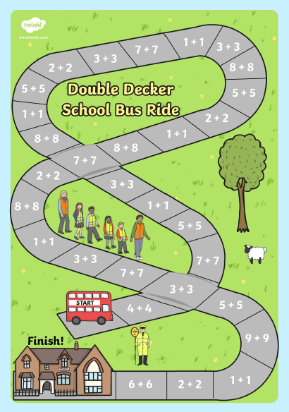
This is an example of a track game.
Start on the Red bus.
Take it in turns to roll the dice and answer the double calculation. If you answer correctly, you get to move your counter forward the amount you rolled.
If you answer incorrectly, you don’t move on.

Slide 8
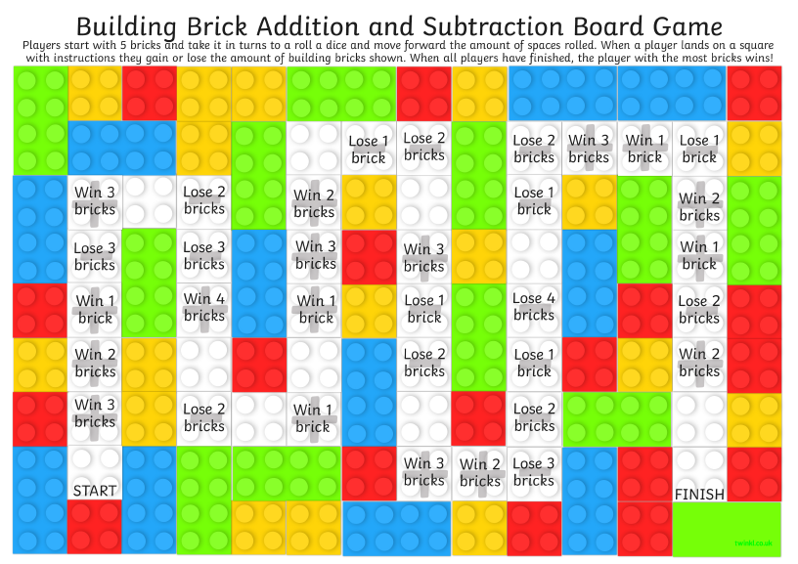
If you have some lego at home, why not try this game.

Slide 9
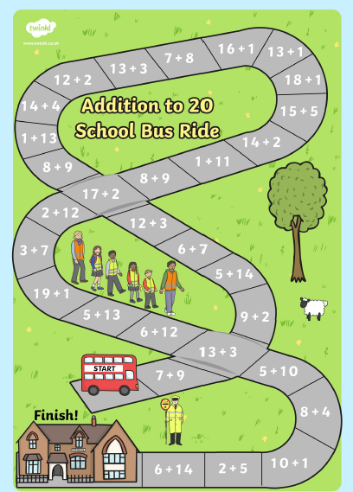
Speed Race
Start on the red bus.
How quickly can you answer all the calculations on the track?
Set a timer and away you go!
Ask someone to check you answered them all correctly.

Slide 10
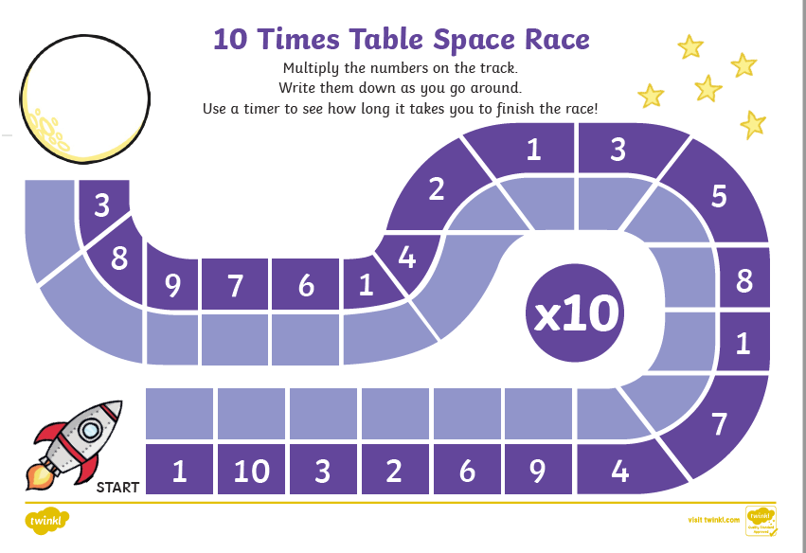

Slide 11
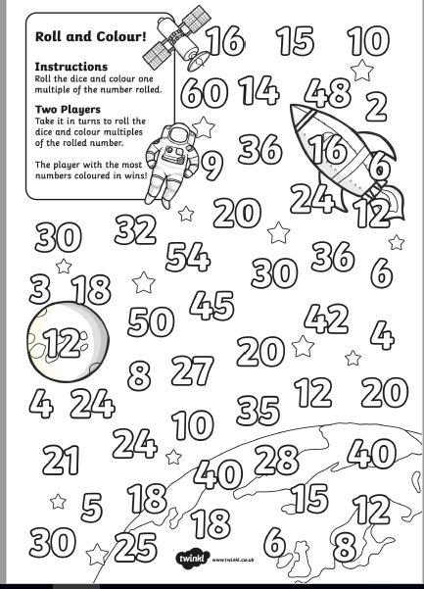

Slide 12
I hope you had fun playing these games!
Take a moment to discuss these questions with someone at home.
Which was your favourite game?
What did you like about it?
What maths skills did you use?
Who else do you think would like playing these games?

Slide 13
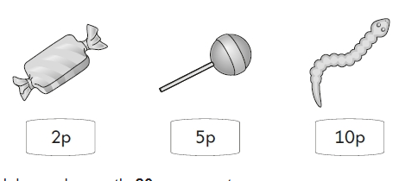
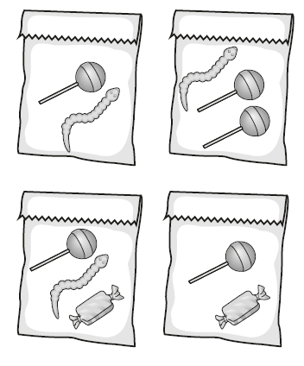
Morning maths 14.7.20
Challenge
A shop sells these sweets.
⅓ of 30 =
40 ÷ 10 =
55 ÷ 5 =
55 + 17 =
¼ of 12 =
71 - 14 =
15 + 3 + 3 =
25 + 15 = 100 - ___
Clare spends exactly 20p. Which bag of sweets does she buy?
Work out how much the other sweet bags would cost.
How much would the four bags cost altogether?

Slide 14
Morning maths Answers 14.7.20
Challenge
A shop sells these sweets.
⅓ of 30 = 10
40 ÷ 10 = 4
55 ÷ 5 = 11
55 + 17 = 72
¼ of 12 = 3
71 - 14 = 57
15 + 3 + 3 = 21
25 + 15 = 100 - 60
Clare spends exactly 20p. Which bag of sweets does she buy?
Work out how much the other sweet bags would cost.
How much would the four bags cost altogether? 59p
5p + 10p = 15p
5p + 10p + 2p = 17p
5p + 2p = 7p

Slide 15
Maths
Tuesday 14th July

Slide 16
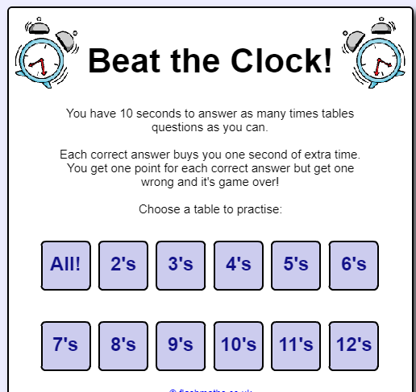
Beat the clock!
https://flashmaths.co.uk/viewFlash.php?id=2
Choose your times table and race the clock! How many calculations can you answer?

Slide 17
In yesterday’s lesson we looked at some examples of existing maths games. Today we are going to start thinking about making our own!
Here are a few questions you need to think about.
1.What skill is your maths game going to focus on?
2. What age group is your game going
to be suitable for?
3. What equipment will you need for your game?
-
doubles
Times tables

Slide 18
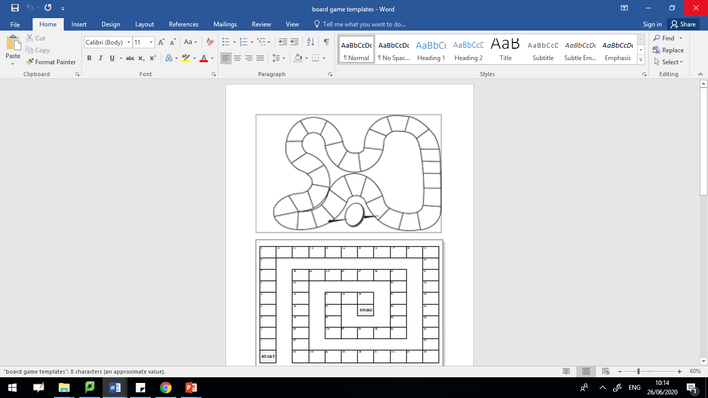
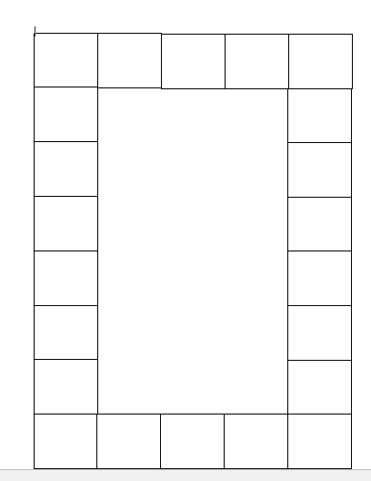
Layout
How is your game going to be laid out? Will it be a track game? How many spaces will you need?
Try not to make your game too complicated! Sometimes the simpler the game, the better it is!

Slide 19

Let’s start designing!
Once you have chosen your maths skill focus and your layout, you can start to create your game.
This may take you more than one session to complete. We will be continuing with our board games in tomorrow’s lesson as well.

Slide 20
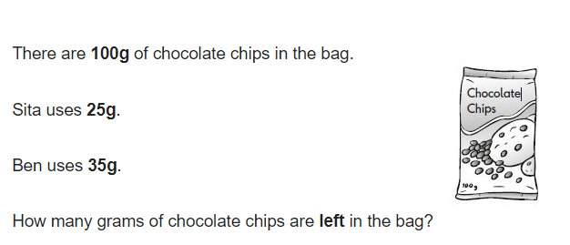
Morning maths 15.7.20
Forty plus twenty =
Nineteen minus seven =
0 = __ x 2
___ = 87 - 40
35 ÷ 5 =
¼ of 20 = __
43 + 38 =
8. 65 + _____ 93
9. __ - 9 = 8
Challenge
Show your working.

Slide 21
Morning maths Answers 15.7.20
Forty plus twenty = 60/sixty
Nineteen minus seven = 12/twelve
0 = 0 x 2
47 = 87 - 40
35 ÷ 5 = 7
¼ of 20 = 5
43 + 38 = 81
8. 65 + 28 = 93
9. 17 - 9 = 8
Challenge
25g + 35g = 60g
100g - 60g = 40g
There are 40g left in the bag.

Slide 22
Maths
Wednesday 15th July

Slide 23
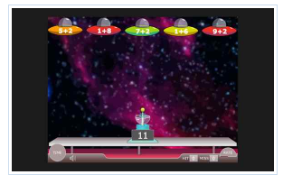
Alien Invasion
https://www.arcademics.com/games/alien
This game helps to practice your number bonds to 20. It can be quite quick but it will help improve your mental maths skills.

Slide 24
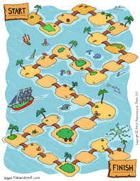
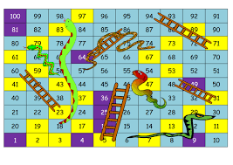
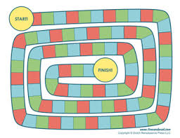
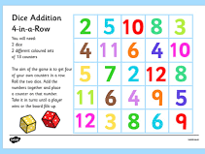
In today’s lesson we are going to continue making our maths games.
Remember board games are usually eye catching and look appealing. Try to make your boards attractive by adding colour and drawings to the layout.

Slide 25
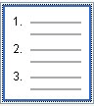
Instructions for your game
Once you have completed your board game, the last thing you have to do is to write some instructions for how to play.
Remember to keep your instructions simple and clear to follow. You may want to use bullet points and some of the useful phrases below to help you.
Useful phrases
Take it in turns When a player...
move forward move backwards
Roll the dice set a timer

Slide 26
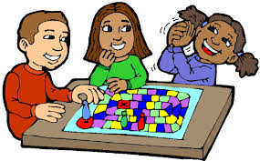
Now you have finished your board game, why not try it out with someone at home! You could evaluate the success of the game by asking the following questions.
· Did you enjoy the game?
· Do you like the design?
· Were the instructions easy to follow?
· Did you have all the equipment you needed?

Slide 27
Morning maths 16.7.20
Handy Hint!
When finding a fraction of an amount, the children are encouraged to draw a rectangle to help them create equal groups..
Write two numbers greater than 20 to make this calculation correct.
-
= 2
½ of 120 =
½ of 50 =
⅓ of 75 =
¾ of 80 =
⅔ of 60 =
Write two numbers less than 20 to make this calculation correct.
-
= 9
How many answers can you find?

Slide 28
Morning maths Answers 16.7.20
Handy Hint!
When finding a fraction of an amount, the children are encouraged to draw a rectangle to help them create equal groups..
Write two numbers greater than 20 to make this calculation correct.
Accept any numbers above 20 with a difference of 2.
-
= 2
32
30
½ of 120 = 60
½ of 50 = 25
⅓ of 75 = 25
¾ of 80 = 60
⅔ of 60 = 40
Write two numbers less than 20 to make this calculation correct.
-
= 9
19 - 10 = 9
18 - 9 = 9
17 - 8 = 9
16 - 7 = 9
15 - 6 = 9
14 - 5 = 9
13 - 4 = 9
12 - 3 = 9
11 - 2 = 9
10 - 1 = 9
9 - 0 = 9

Slide 29
Maths
Thursday 16th July

Slide 30
Beat the clock!
https://flashmaths.co.uk/viewFlash.php?id=2
Choose your times table and race the clock! How many calculations can you answer in the time limit?
Try a different times table to the one you used on Tuesday.
2’s, 5’s, 10s or even 3’s.

Slide 31

Guess my number!
Take it in turns to think of a number between 1-100, but don’t show anyone else your number.
Play guess my number by giving people clues about your number but you mustn’t say the number! The vocabulary below might help you with the clues you choose to give.
odd even more than less than
two digit tens ones in between

Slide 32
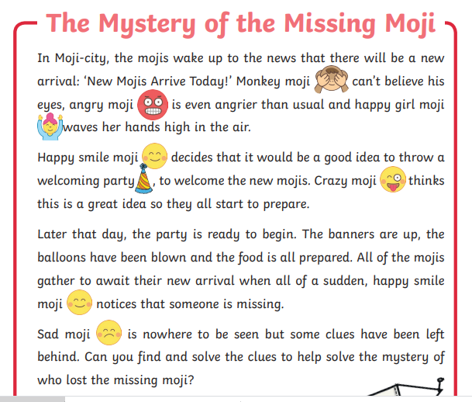
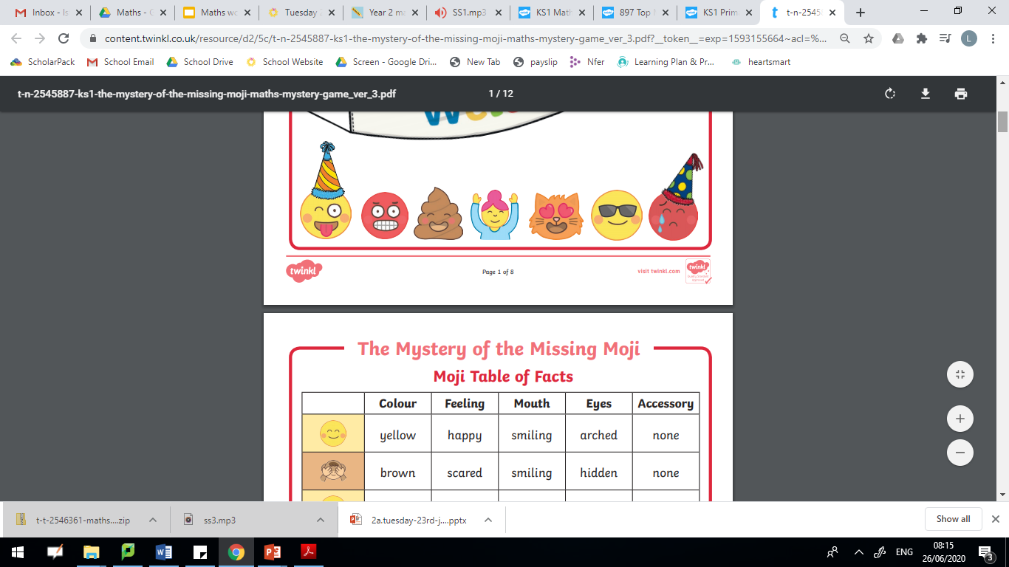

Slide 33
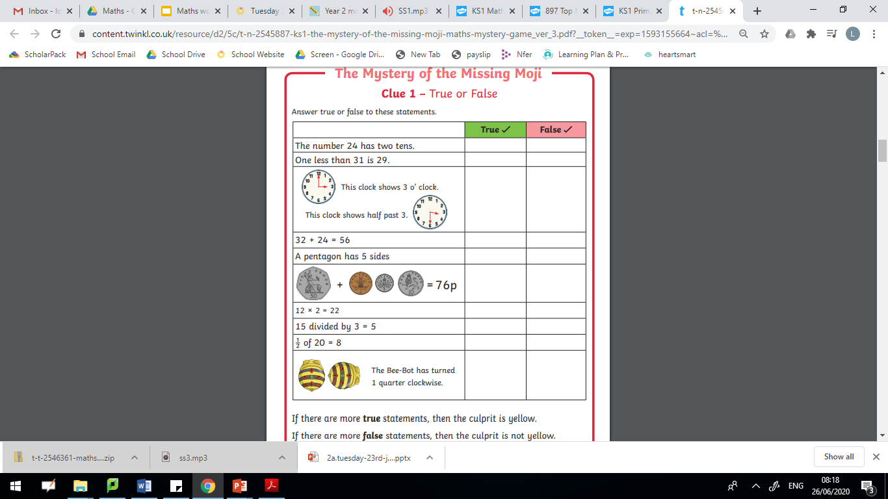
Clue 1
Answer these questions True or False.

Slide 34
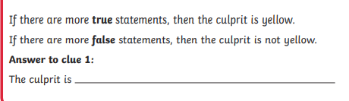
Clue 1
Answer these questions True or False.

Slide 35
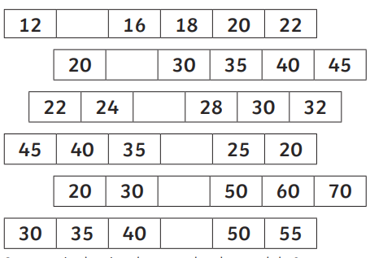
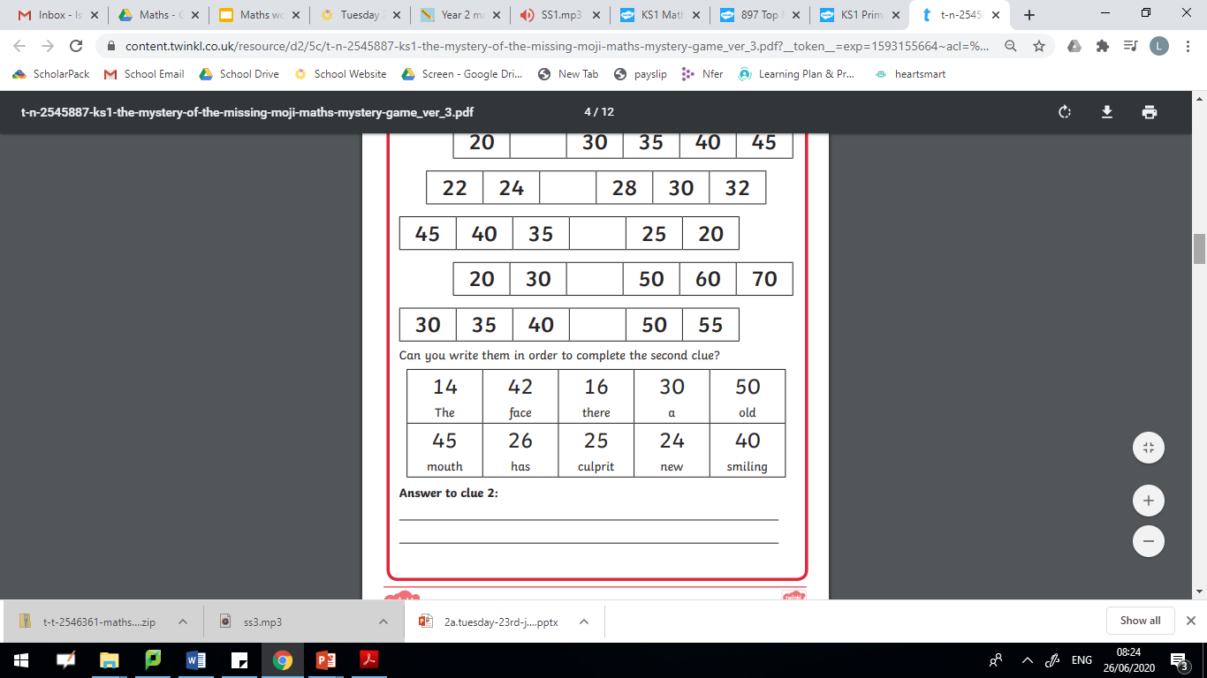
Clue 2 - Can you find all the missing numbers?
Then colour in the missing numbers.
Use the words you have coloured in to make a sentence. This is your second clue.

Slide 36
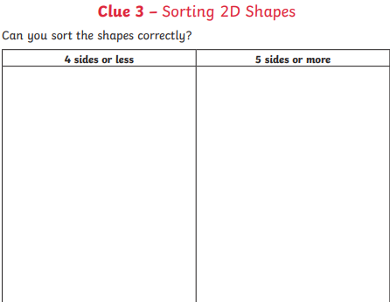
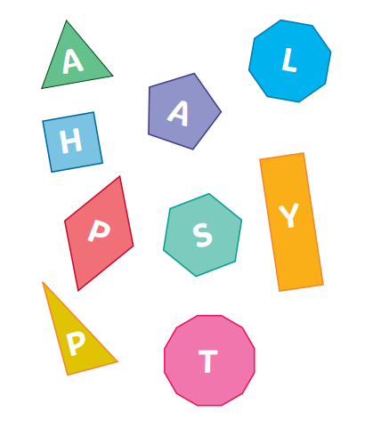
The letters on the shapes with 4 sides or less combine to make a word that describes the culprit’s feelings.

Slide 37
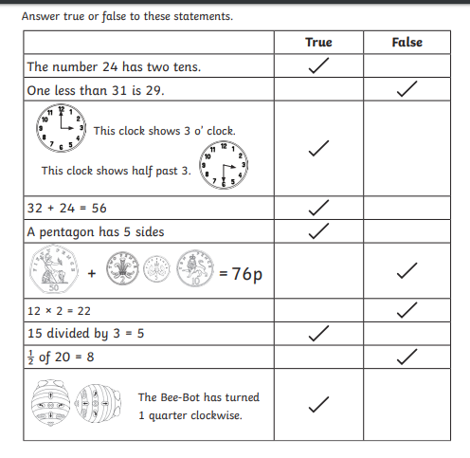
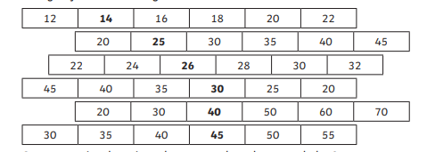
Let’s check our answers to the first 3 clues.
Answer to Clue 1
The culprit is yellow.
Answer to clue 2
The culprit has a smiling mouth.

Slide 38
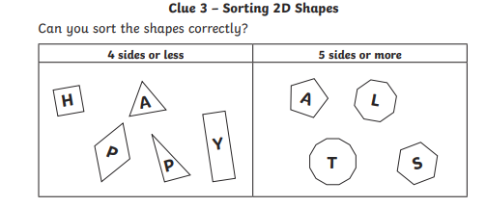
Answer to Clue 3
The culprit is happy.

Slide 39
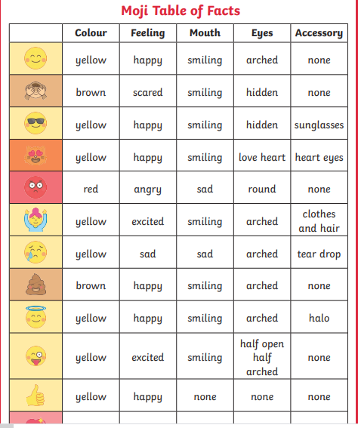
With the answers you have so far… which moji do you predict is the culprit?
To be continued….

Slide 40
Morning Maths
17.7.20
What can you tell me about the number 60?
Tens and ones
Odd or even?
60 + 0
60
__ + __ + __ =
Draw it.
Greater than?
Fewer than?
÷ - x
fractions?

Slide 41
Maths
Friday 17th July

Slide 42
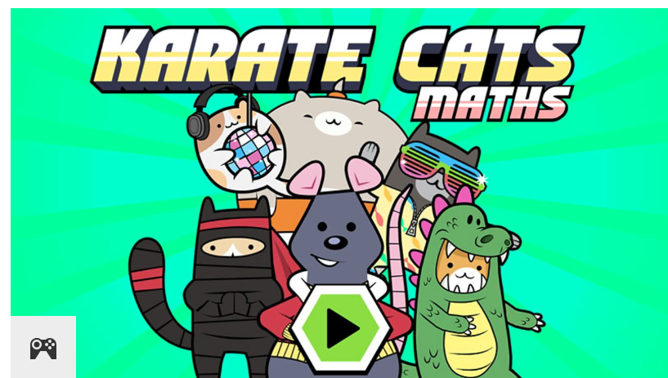
Karate Cats Maths
https://www.bbc.co.uk/bitesize/topics/zjkphbk/articles/zf4sscw

Slide 43
Moji Mystery
Who lost the missing moji?
What have we found out so far?
Clue 1 - The culprit is yellow.
Let’s solve some more clues!
Clue 2 - The culprit has a smiling mouth.
Clue 3 - The culprit is happy.

Slide 44
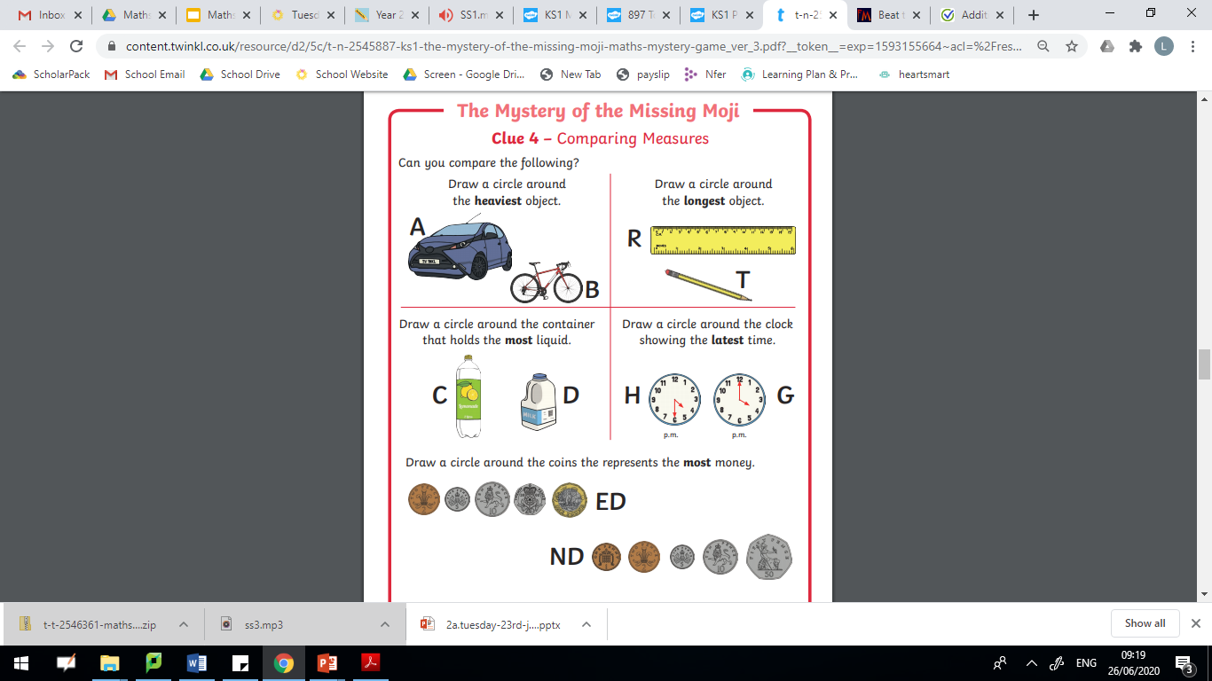

Slide 45
Clue 4 continued
Gather the letters from your answers.
What shape was the culprits eyes? ______________

Slide 46
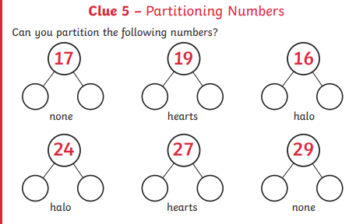
Find all the answers where the top number is even. The accessory that is underneath these answers will give you the final clue of what culprit wears.

Slide 47
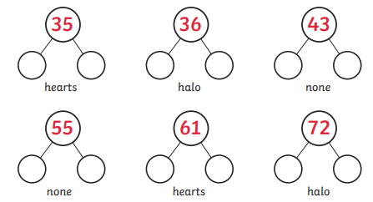
Clue 5 continued

Slide 48
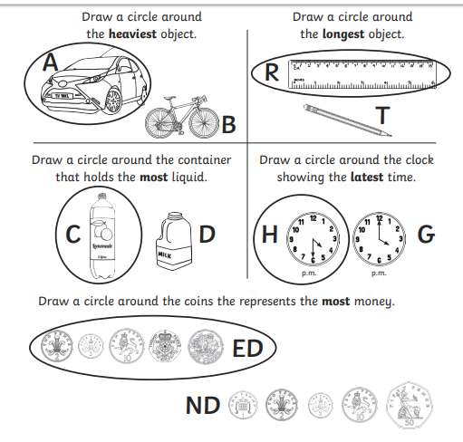
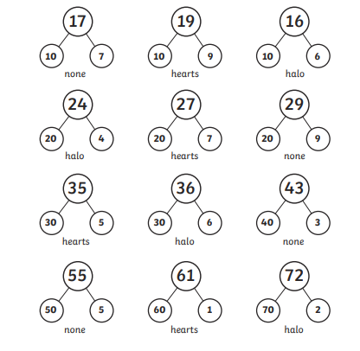
Let’s check our answers to clues 4 and 5.
Answer to Clue 4
The culprit’s eyes are arched.
Answer to clue 5
The culprit wears a halo.

Slide 49
Use this table and the clues you have found to work out who the culprit is!

Slide 50
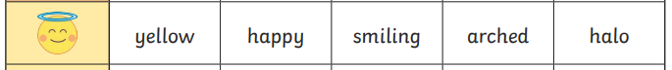
So the culprit is…..
The Halo Moji!
Well done everyone!

Slide 51
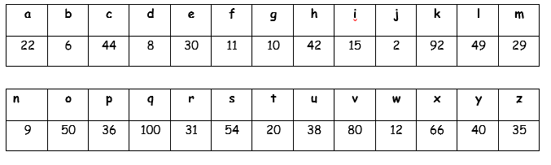
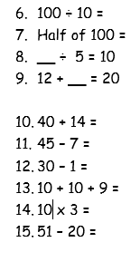
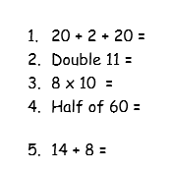

Crack the Code
Answer the questions to crack the code. Discover what the secret message is.

Slide 52

The secret message is…
Have a good summer!

Slide 53
Why not create your own ‘crack the code’ challenge using the alphabet code below?

