Slide 1
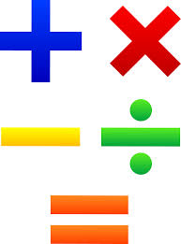
Hello Year 2!
This PowerPoint contains five morning maths and maths sessions for you to complete this week.
Remember you can draw pictures, use part whole models and number lines to help with your working out.

Slide 2
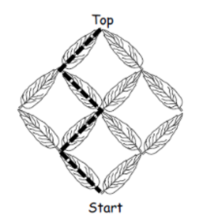
Morning maths 6.7.20
22 + 7 =
__ = 15 - 2
50 + 30 + 20 =
43 - 5 =
90 - 80 =
6 x 2 =
20 + __ = 70
2 ÷ 2 =
Challenge
Peter Pan climbs the rigging
Peter Pan was climbing the rigging on Captain Hook’s boat.
He always went up.
He first did it like this: left, right, left, right.
Find five other ways Peter can climb up the rigging.
Show your working out.

Slide 3
Morning maths Answers 6.7.20
22 + 7 = 29
13 = 15 - 2
50 + 30 + 20 = 100
43 - 5 = 38
90 - 80 = 10
6 x 2 = 12
20 + 50 = 70
2 ÷ 2 = 1
Challenge
Peter Pan climbs the rigging
Peter Pan was climbing the rigging on Captain Hook’s boat.
He always went up.
He first did it like this: left, right, left, right.
Find five other ways Peter can climb up the rigging.
Show your working out.

Slide 4

Maths
Monday 6th July

Slide 5
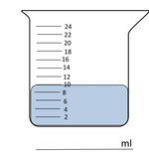
Over the next few days we are going to learn about how we measure liquids. Here is some important vocabulary you will need to understand.
Capacity
Capacity is the amount a container can hold.
Volume
Volume is the amount it is actually holding.
Comparing capacity
Watch the video to see how we can compare capacity using a <, > or = symbol.
https://www.bbc.co.uk/bitesize/topics/zt9k7ty/articles/zp8crdm

Slide 6
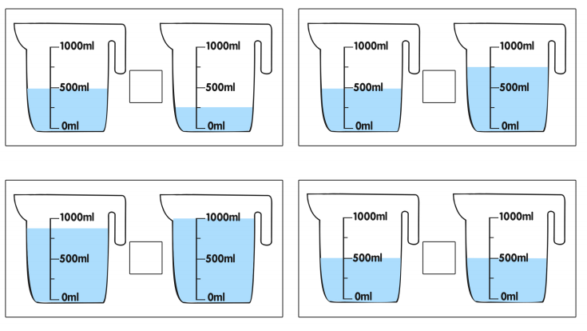
Use a <, > or = symbol to complete the comparisons below.

Slide 7
Answers
Use a <, > or = symbol to complete the comparisons below.
>
<
<
=

Slide 8
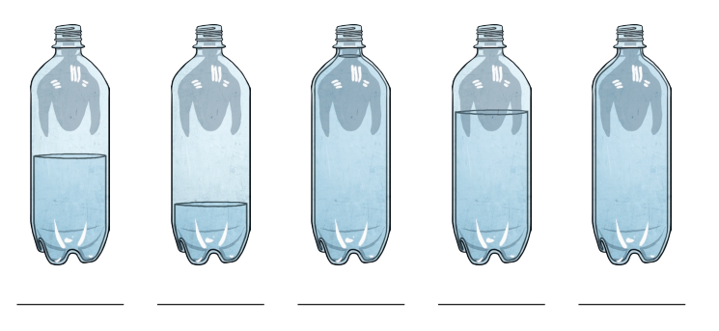

We can also use the terms full, nearly full, half full, nearly empty or empty to compare volume. See if you can match the containers with the correct labels below.

Slide 9
Answers
We can also use the terms full, nearly full, half full, nearly empty or empty to compare volume. See if you can match the containers with the correct labels below.

Slide 10
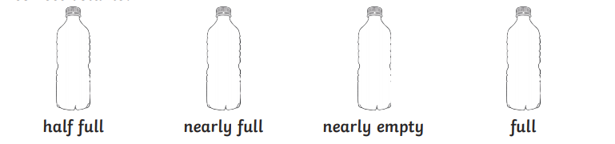
Draw 4 containers that are the same shape and height like the ones below. Then can you draw a line on each container to show the water level at the correct volume?

Slide 11
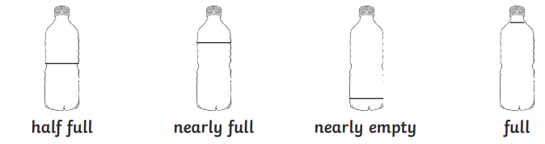
Answers
Draw 4 containers that are the same shape and height like the ones below. Then can you draw a line on each container to show the water level at the correct volume?

Slide 12
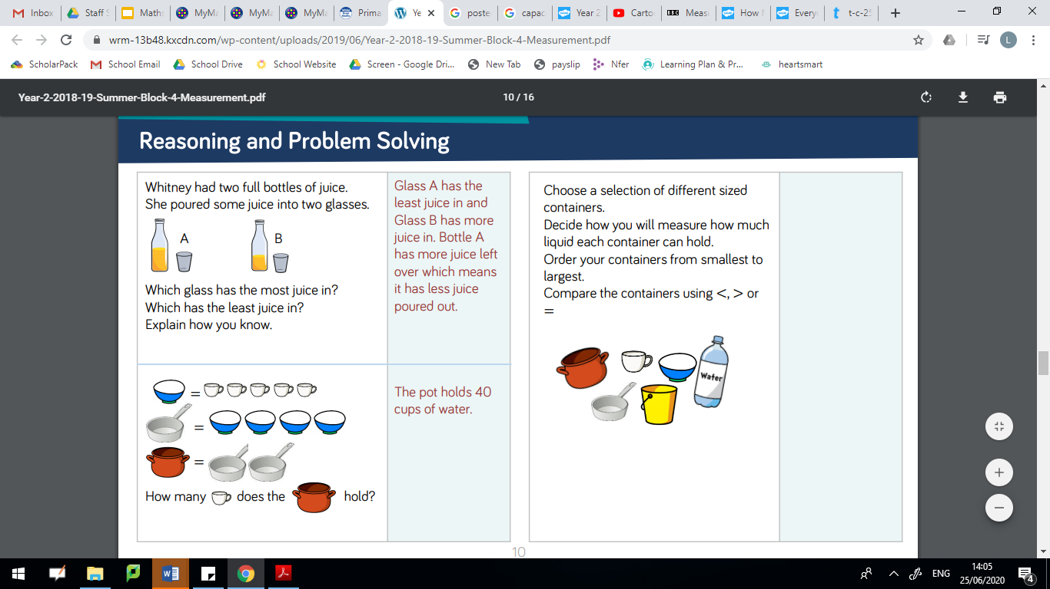
Comparing capacity challenge

Slide 13
Comparing capacity challenge answers
= 5
= 5 + 5 + 5 + 5
= 20
= 20 + 20
= 40

Slide 14
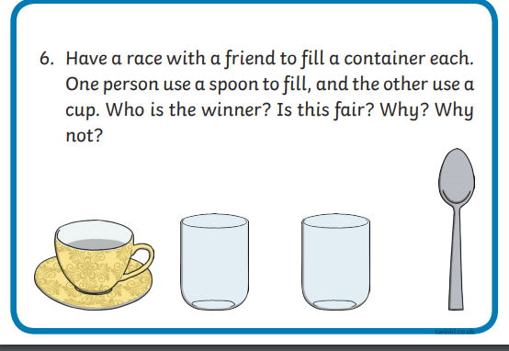
Please ask an adult before attempting any of these challenges!

Slide 15
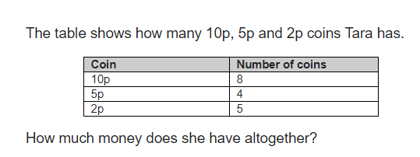
Morning maths 7.7.20
Challenge
6 x 3 =
3 + __ +6 = 16
5 x 12 =
85 - 21 =
92 - 60 =
52 + 29 =
80 ÷ 10 =
___ - 12 = 36
Show your working out!

Slide 16
Morning maths Answers 7.7.20
Challenge
6 x 3 = 18
3 + 7 +6 = 16
5 x 12 = 60
85 - 21 = 64
92 - 60 = 32
52 + 29 = 81
80 ÷ 10 = 8
48 - 12 = 36
10p x 8 = 80p
5p x 4 = 20p
2p x 5 = 10p
80p + 20p = 100p + 10p = 110p or £1.10

Slide 17
Maths
Tuesday 7th July

Slide 18
In today’s lesson we are going to continue our work on capacity and volume.
Capacity
Capacity is the amount a container can hold.
Volume
Volume is the amount it is actually holding.

Slide 19
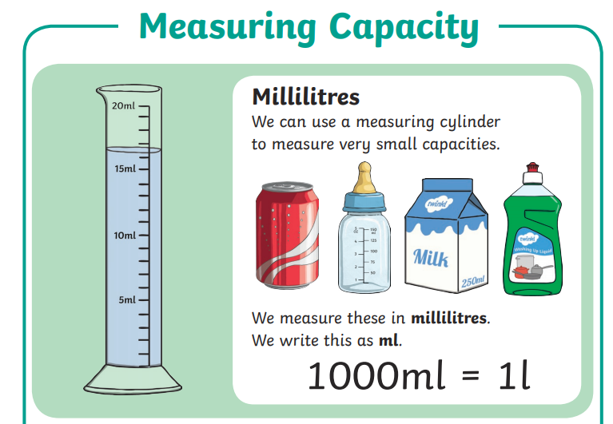

Slide 20
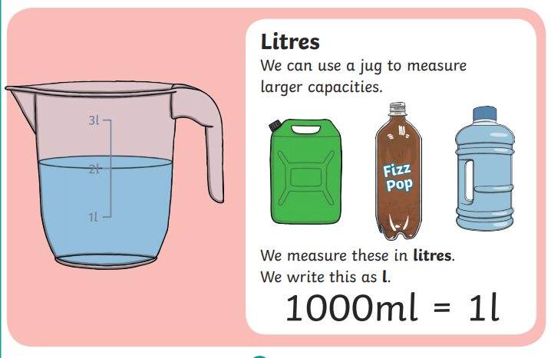
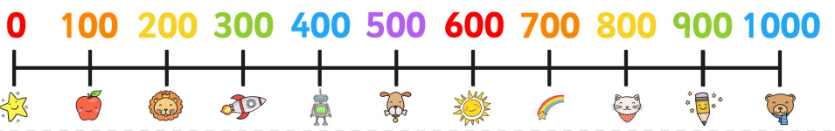
Let’s practice counting up in hundreds until we reach one thousand! Use the number line to help you.

Slide 21
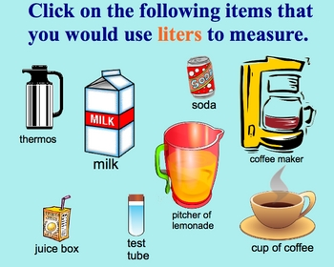
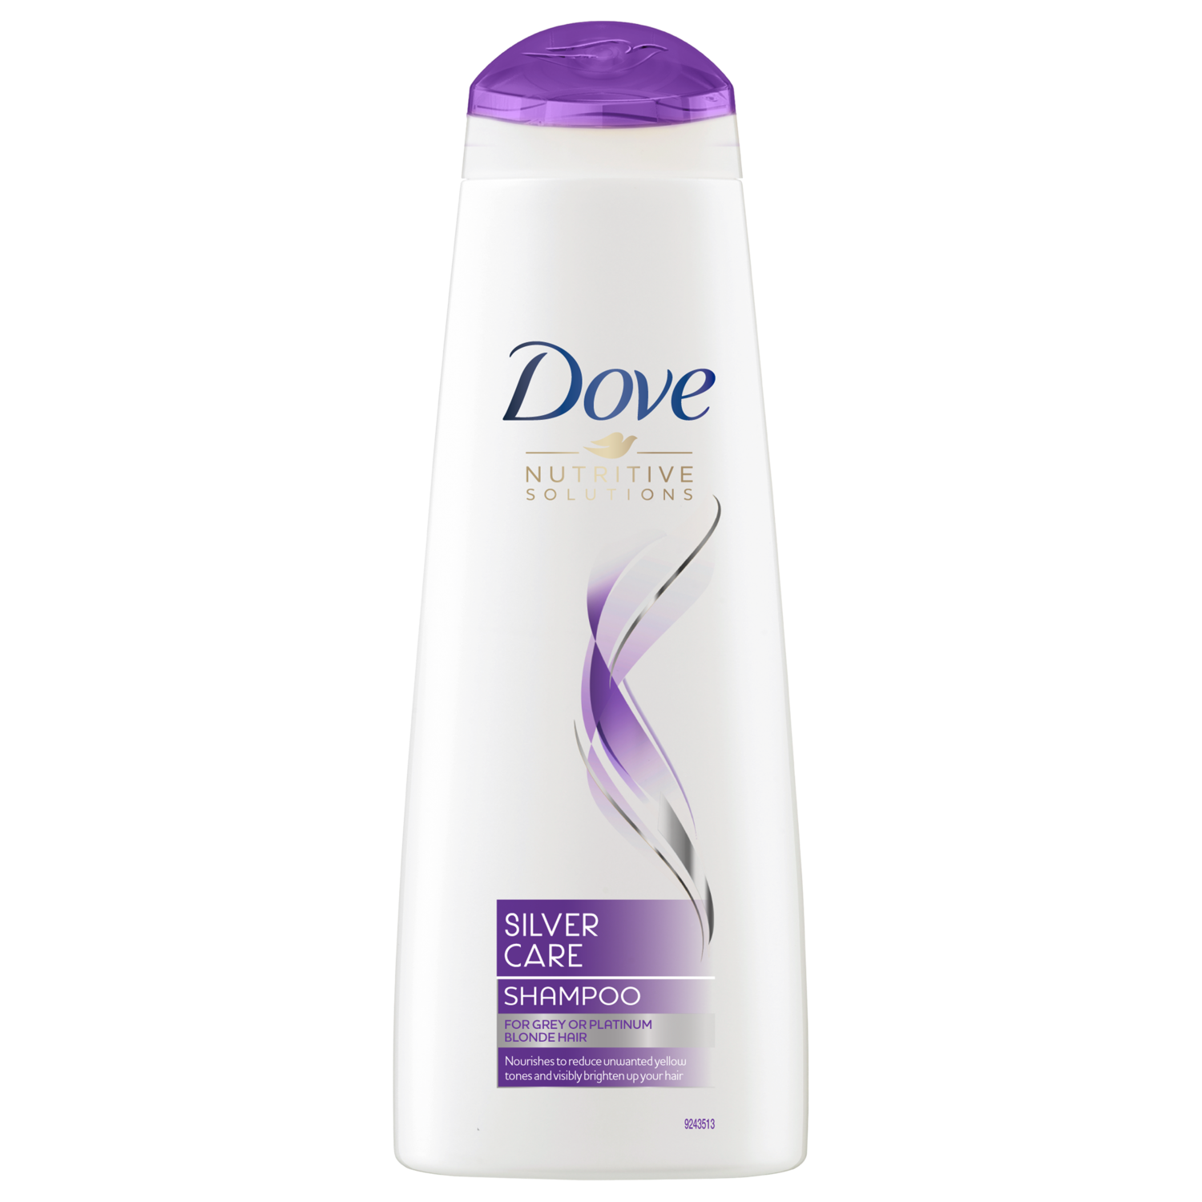
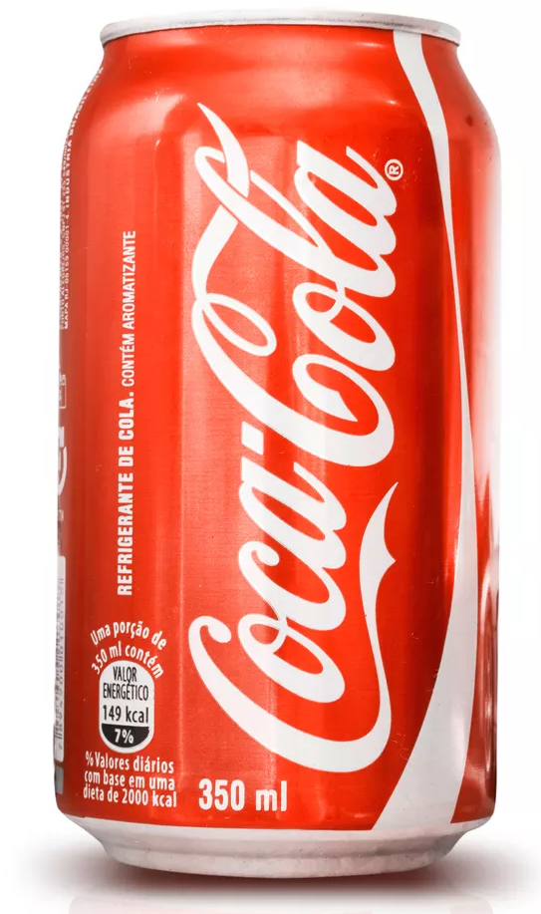
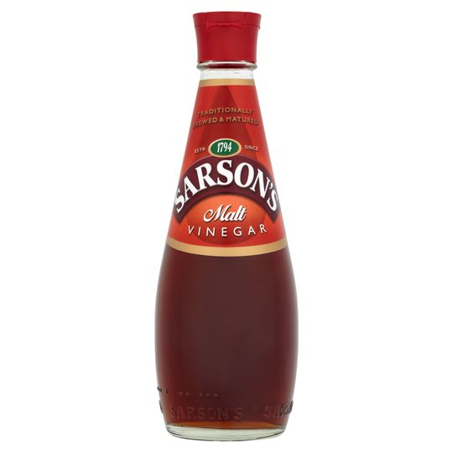
Investigate...
Before we begin looking at reading scales in more detail, you might want to find out what you have in your house that is measured in ml or l. For example, a 5ml measuring spoon, a bottle of vinegar or liquid soap.
Activity idea 1 - Compare the containers you find. Can you say which one holds a larger or smaller amount?
Activity idea 2 - Look at the containers and estimate how many ml or l you think they hold. Then check your estimates by reading the label and finding out the exact amount.

Slide 22
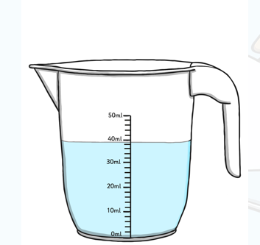
Let’s find out more about measuring in millimetres. Watch the clip below.
https://www.youtube.com/watch?v=GFTlete-nMM
Helpful hints for measuring
Look carefully at the scale to see what the divisions are measuring in.
Make sure the container is on a flat surface.
Make sure you read the scale at eye level.

Slide 23
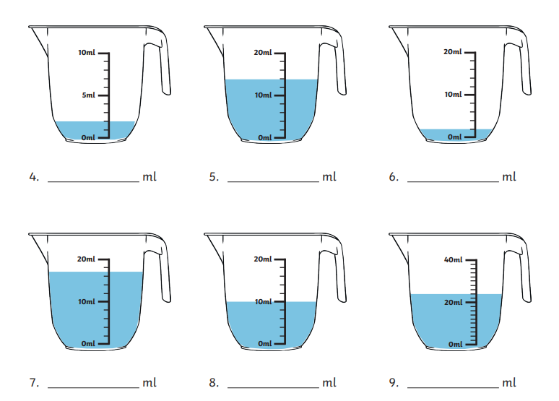
Reading scales
How much water is in the jug?
Remember to read the scales carefully!
Handy hint - counting in 2’s may be useful!

Slide 24
Reading scales
Answers
How much water is in the jug?
Remember to read the scales carefully!
Handy hint - counting in 2’s may be useful!
2ml
14ml
2ml
17ml
10ml
24ml

Slide 25
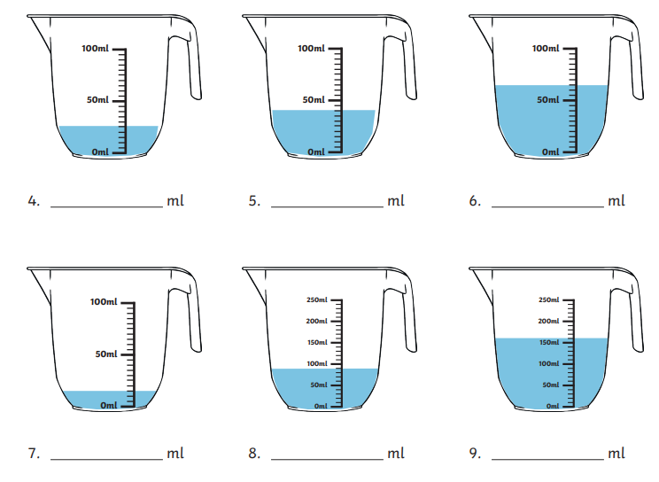
Reading scales
How much water is in the jug?
Remember to read the scales carefully!
Handy hint - counting in 5’s and 10’s may be useful!

Slide 26
Reading scales
Answers
How much water is in the jug?
25ml
40ml
65ml
90ml
15ml
160ml

Slide 27
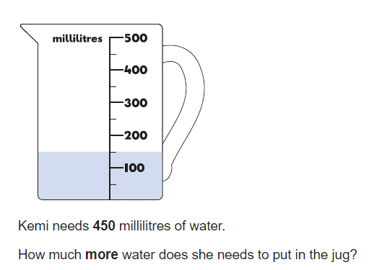
Capacity challenge 1

Slide 28
Capacity challenge Answer
450ml
450ml - 150ml = 300ml
Kemi will need 300ml more.
150ml

Slide 29
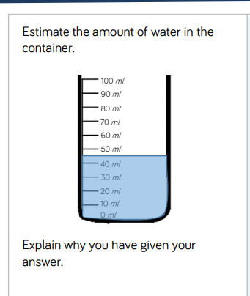
Capacity challenge 2
Look at the scale carefully!

Slide 30
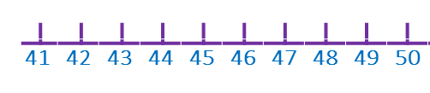
Capacity challenge 2 Answers
The water line is halfway between 40ml and 50ml.
45ml is half way between the two numbers, so I would estimate there is 45ml of water in the container.
40

Slide 31
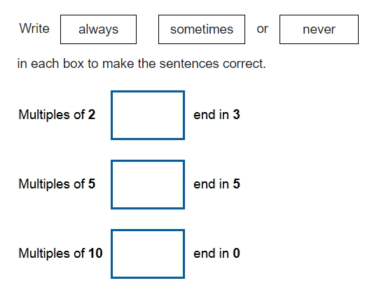
Morning maths 8.7.20
⅓ of 12 =
8 + 6 =
12 - 7 =
52 + 7 =
9 x 10 =
56 - __ = 51
___ + 90 = 107
8. 40 + 10 + 20 =
Challenge
Remember to prove it!

Slide 32
Morning maths Answers 8.7.20
⅓ of 12 = 4
8 + 6 = 14
12 - 7 = 5
52 + 7 = 59
9 x 10 = 90
56 - 5 = 51
17 + 90 = 107
8. 40 + 10 + 20 = 70
Challenge
Multiples of 2 end in 0,2,4,6,8.
Never
sometimes
Multiples of 5 end in 0 and 5.
always
Multiples of 10 only end in 0.

Slide 33
Maths
Wednesday 8th July

Slide 34
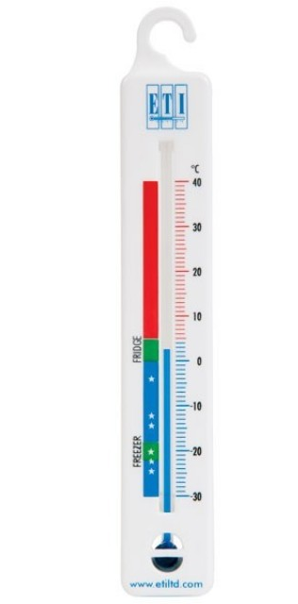
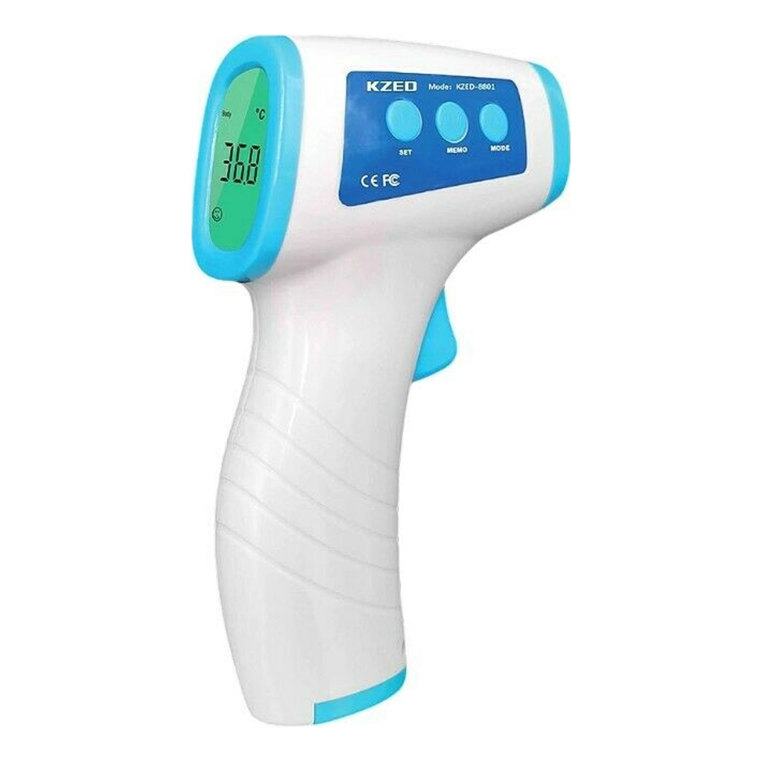
Today we are going to learn about measuring temperature.
We use a thermometer to measure the temperature.
Can you think of some examples when we might need to measure the temperature of something?

Slide 35
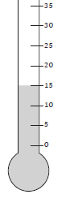
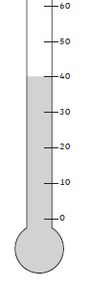
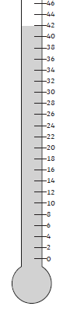
We measure the temperature using ‘degrees centigrade’.
This is sometimes written as ℃.
When the temperature is higher it means it is warmer.
You must always look carefully at the scale to see what each interval represents.
Sometimes you can count in 2’s, 5’s or 10’s when reading different scales on a thermometer.
15 ℃
40 ℃
42 ℃

Slide 36
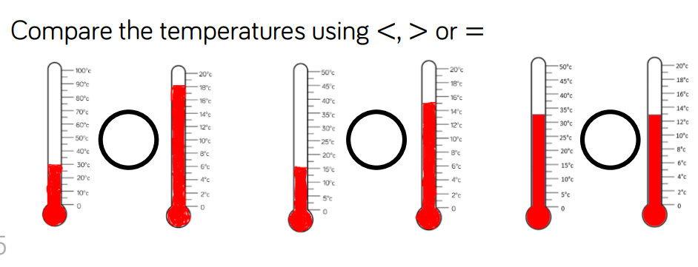
Activity 1

Slide 37
Answers
>
=
>
30 ℃
18 ℃
15 ℃
15 ℃
32.5 ℃
13 ℃

Slide 38
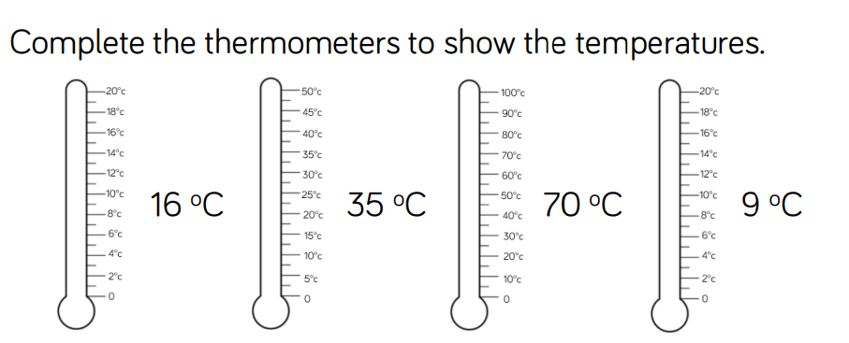
Activity 2

Slide 39
Answers

Slide 40
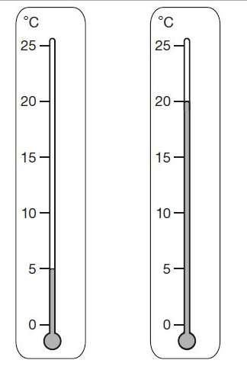
Challenge 1
The temperature on the playground is lower than the temperature in the classroom.
How much lower?
Playground classroom

Slide 41
Challenge 1 Answer
The temperature on the playground is lower than the temperature in the classroom.
How much lower?
20 - 5 = 15 ℃
15
10
5
Playground classroom

Slide 42
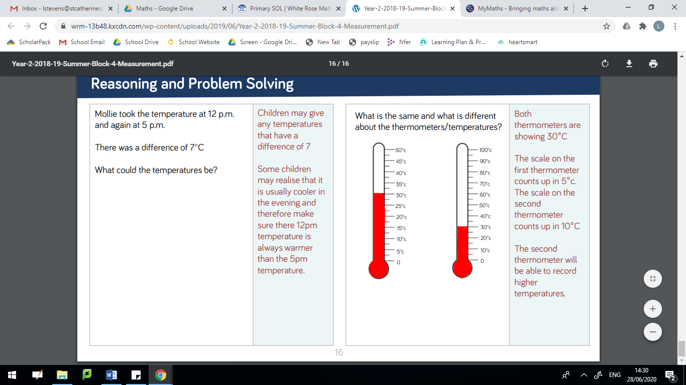
Challenge 2

Slide 43
Challenge 2
Answer

Slide 44
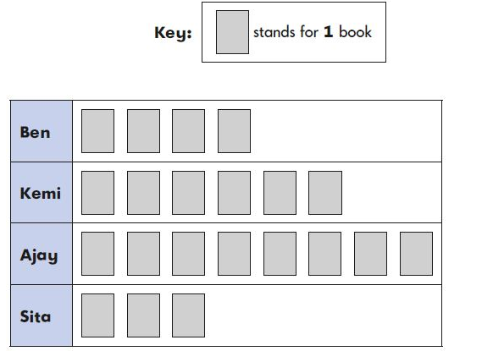
Morning maths 9.7.20
Challenge
Some children made a chart of how many books they read in a week.
Handy Hint!
When finding a fraction of an amount, the children are encouraged to draw a rectangle to help them create equal groups..
½ of 40 =
¼ of 36 =
⅓ of 9 =
⅔ of 15 =
¾ of 32 =
Write 5 sentences about their results.
Useful vocabulary - more than, less than, same as, favourite, most, least, total, altogether

Slide 45
Morning maths Answers 9.7.20
Some children made a chart of how many books they read in a week.
Handy Hint!
When finding a fraction of an amount, the children are encouraged to draw a rectangle to help them create equal groups..
½ of 40 = 20
¼ of 36 = 9
⅓ of 9 = 3
⅔ of 15 = 10
¾ of 32 = 24
Some example sentences…
Ajay read the most books.
Ben read 4 books.
Kemi read 2 more books than Ben.
They read 21 books altogether.
Sita read the least amount of books.

Slide 46
Maths
Thursday 9th July

Slide 47
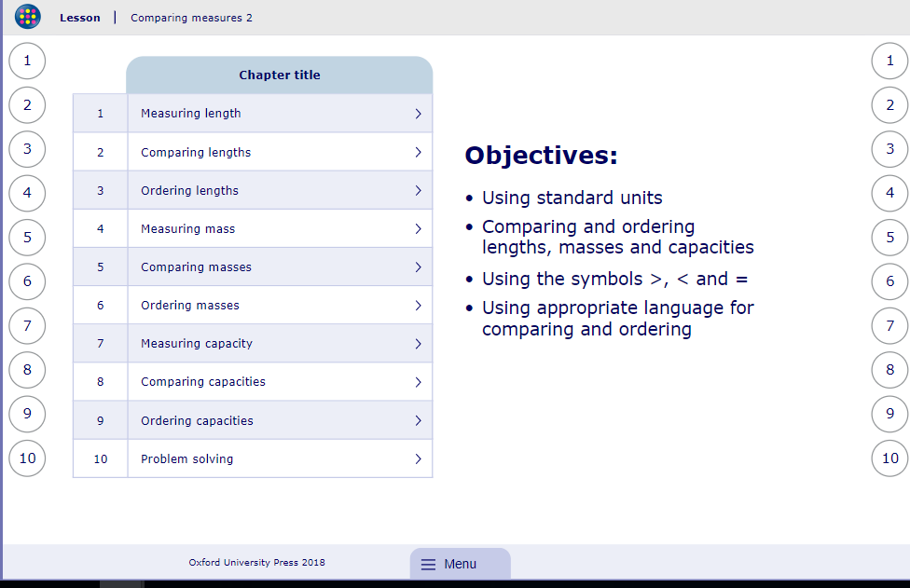
My Maths activity
Lesson: Comparing measures 2
To start the lesson, click on the image to the right of the screen. This will take you to an interactive lesson.
Click on the next buttons at the bottom of the page to move your learning on and take part in the mini-quizzes along the way to check your understanding.

Slide 48
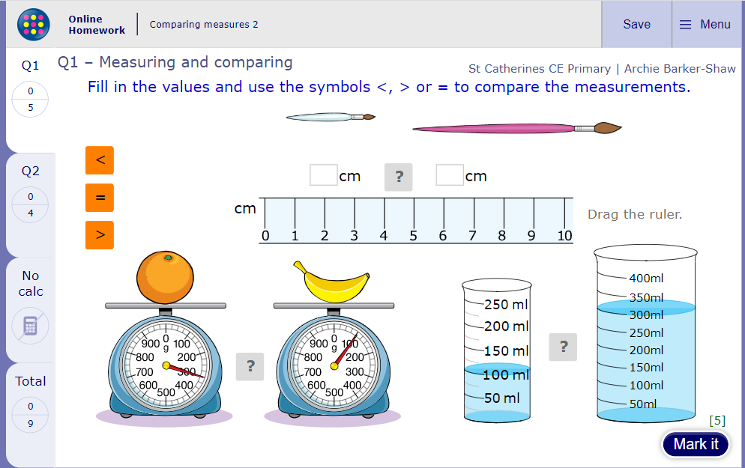
Now click the image on the left of the screen, this will take you to an online homework where you can test your understanding.
Have a go at the questions and then click ‘Mark it’ to see how you have go on.
Your login details for My Maths were sent home in your first work pack - make sure you log in so we can see how you are getting on.

Slide 49
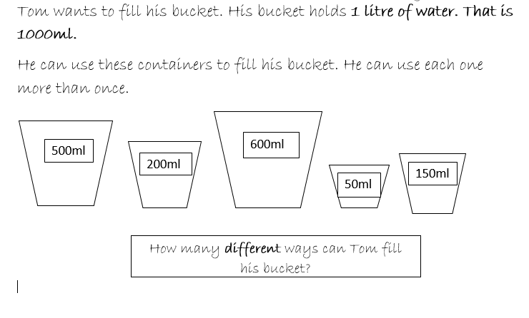
Challenge!
This numberline might help you!

Slide 50
Morning Maths
10.7.20
What can you tell me about the number 90?
Tens and ones
Odd or even?
100
__ + __ + __ =
Draw it.
Greater than?
Fewer than?
÷ - x
fractions?

Slide 51
Maths
Friday 10th July

Slide 52
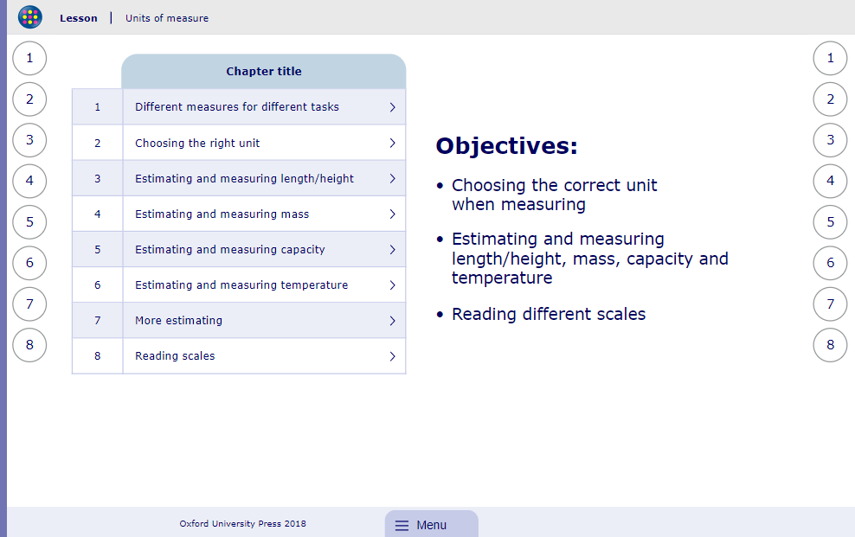
My Maths activity
Lesson: Units of measure
To start the lesson, click on the image to the right of the screen. This will take you to an interactive lesson. This lesson will help the children to order units of time and compare different lengths of time.
Click on the next buttons at the bottom of the page to move your learning on and take part in the mini-quizzes along the way to check your understanding.

Slide 53
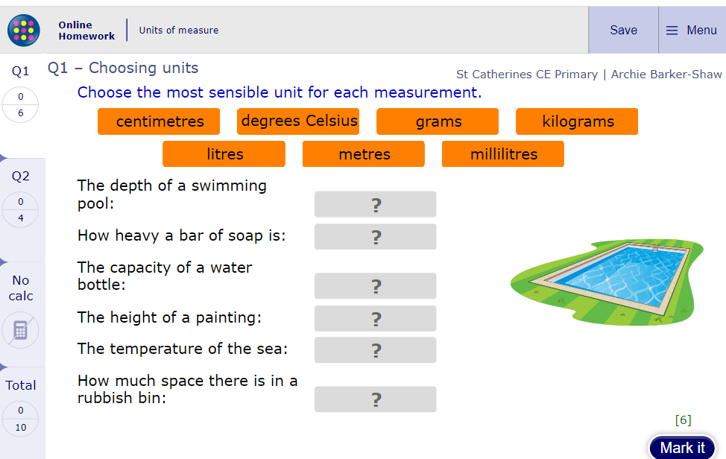
Now click the image on the left of the screen, this will take you to an online homework where you can test your understanding.
Have a go at the questions and then click ‘Mark it’ to see how you have go on.
Your login details for My Maths were sent home in your first work pack - make sure you log in so we can see how you are getting on.

Slide 54
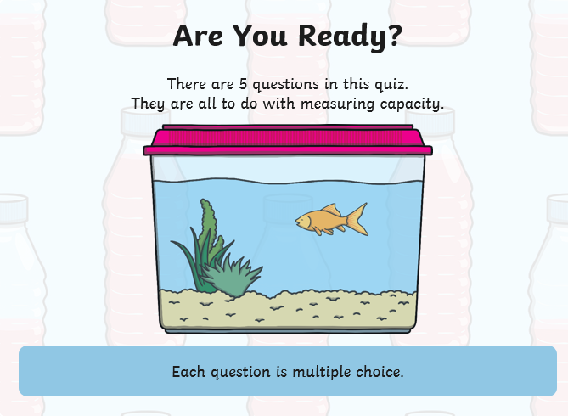
Capacity Quiz
Answers are on the last slide! Good luck!

Slide 55
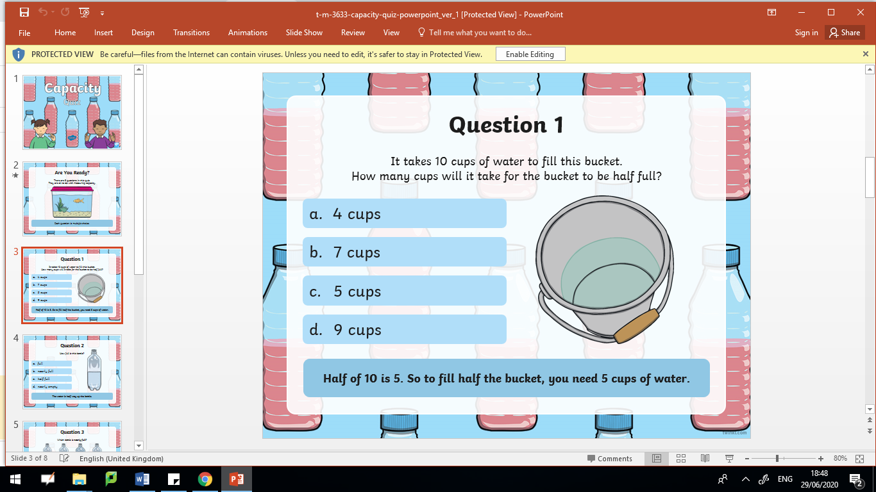

Slide 56
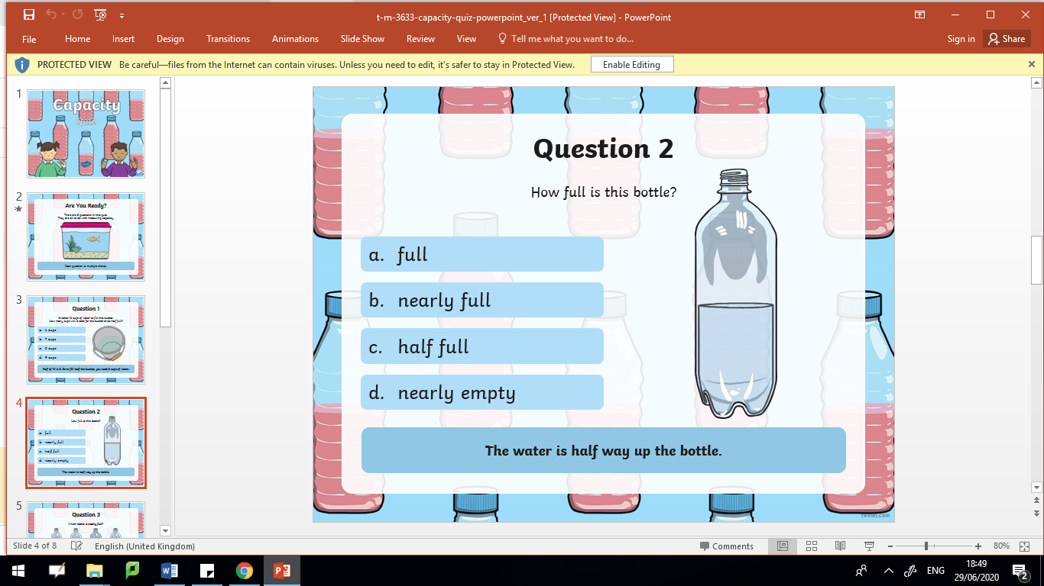

Slide 57
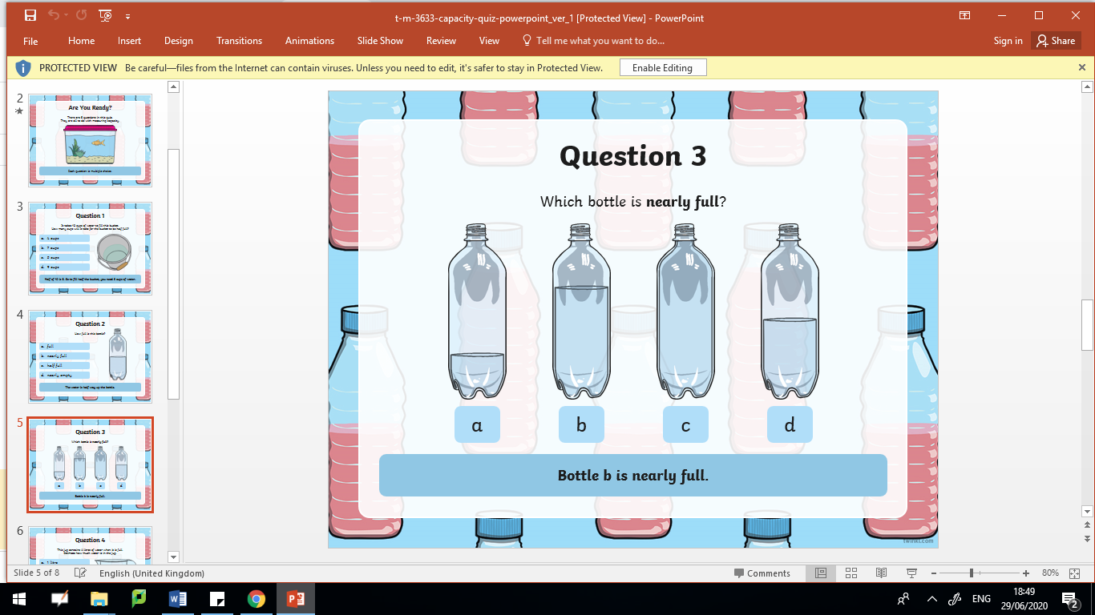

Slide 58
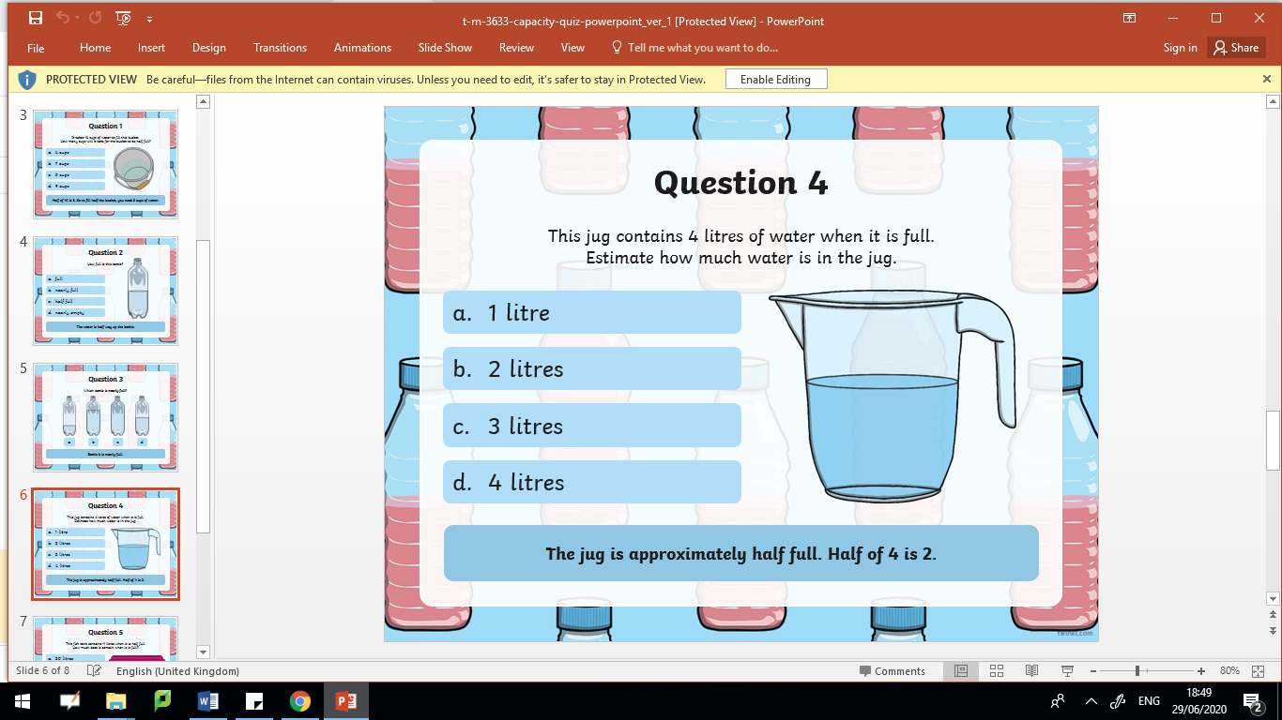

Slide 59
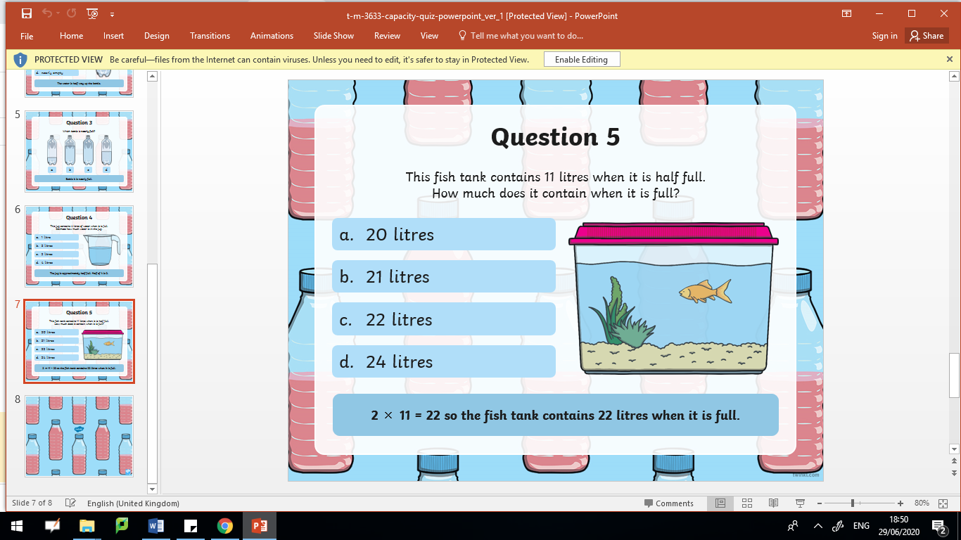

Slide 60
Quiz Answers
1.
2.
3.
4.
5.

