Slide 1
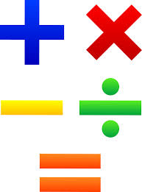
Hello Year 2!
This PowerPoint contains five morning maths and maths sessions for you to complete this week.
Remember you can draw pictures, use part whole models and number lines to help with your working out.

Slide 2
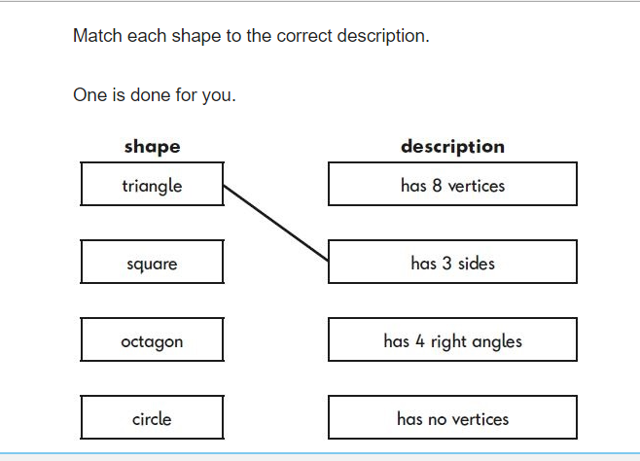
Morning maths 15.6.20
59 + 5 =
81 - 6 =
15 ÷ 5 =
9 x 3 =
Can you think of one +, - x and ÷ calculation where the answer is 6?
__ + __ = 6 ___ ÷ ___ = 6
__ - __ = 6 ___ x ___ = 6
Challenge

Slide 3
Morning maths Answers 15.6.20
59 + 5 = 64
81 - 6 = 75
15 ÷ 5 = 3
9 x 3 = 27
Can you think of one +, - x and ÷ calculation where the answer is 6?
2 + 4 = 6 12 ÷ 2 = 6
36 - 30 = 6 3 x 2 = 6
Challenge

Slide 4

Maths
Monday 15th June

Slide 5
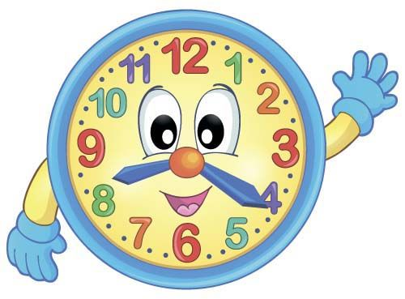
This week’s learning is all about time. Before you start today’s lesson, you might like to make your own clock to use throughout the week.
We have provided a clock template for you to use, which can be found in the Week 8 Maths folder in year 2’s home learning area.
If you have not got the resources to make your own clock at home, the links below will take you to an interactive clock you can use instead.
http://www.time.virneth.co.uk/index.php?topic_name=e-clock&page_name=interactive-clock
https://www.topmarks.co.uk/time/teaching-clock

Slide 6
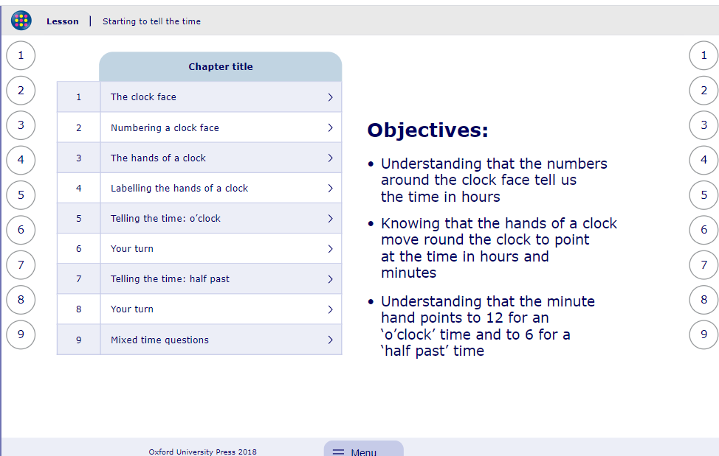
We haven’t looked at the topic of ‘time’ for a while, so today’s lesson will recap on our previous learning.
My Maths activity
Lesson: Starting to tell the time
To start the lesson, click on the image to the right of the screen. This will take you to an interactive lesson.
Click on the next buttons at the bottom of the page to move your learning on and take part in the mini-quizzes along the way to check your understanding.

Slide 7
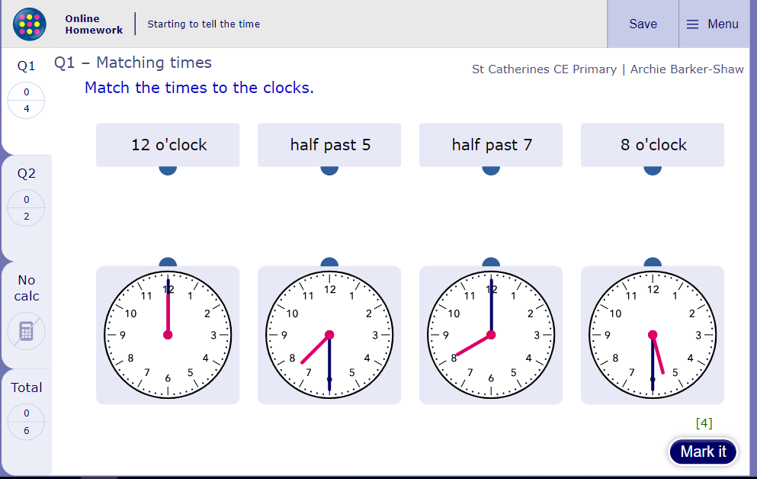
Now click the image on the left of the screen, this will take you to an online homework where you can test your understanding.
Have a go at the questions and then click ‘Mark it’ to see how you have go on.
Your login details for My Maths were sent home in your first work pack - make sure you log in so we can see how you are getting on.

Slide 8
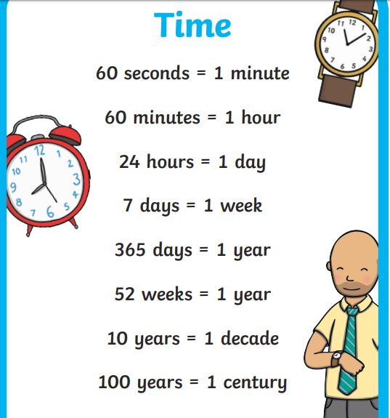

As well as telling the time, we need to learn some time facts.
Task
Make your own time fact poster to remind you of the facts you don’t know!
Find a place at home where you can display it so you become familiar with them.

Slide 9
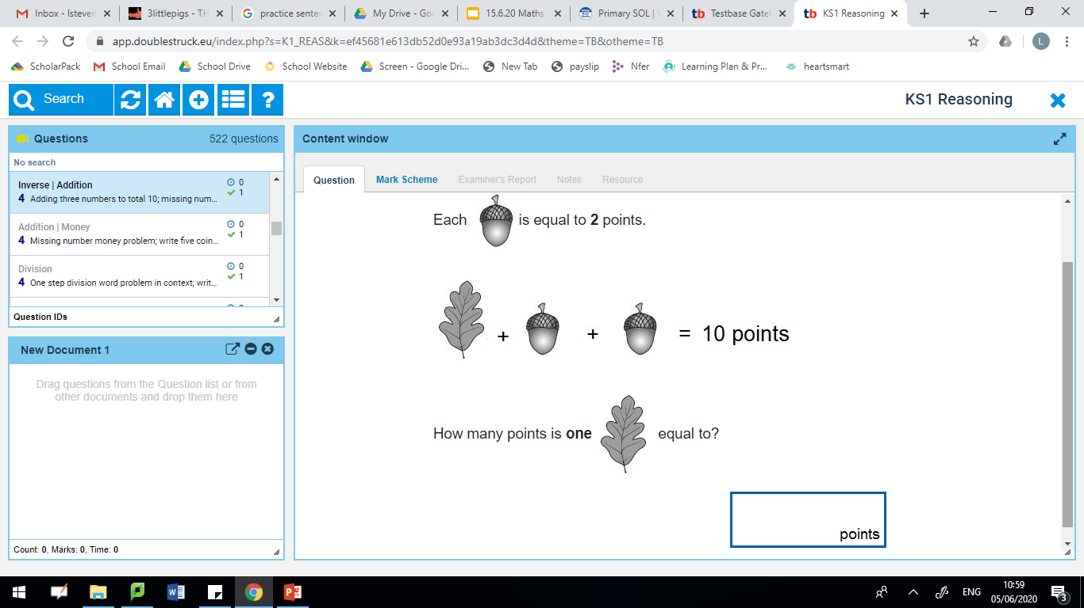
Morning maths 16.6.20
Challenge
Double 50 =
Double 6 =
Double __ = 24
Double __ = 30
24 ÷ 3 =
18 ÷ 2 =
11 x 10 =
¾ of 8 =
+
=
How many acorns would you need for 12 points?

Slide 10
Morning maths Answers 16.6.20
Challenge
Double 50 = 100
Double 6 = 12
Double 12 = 24
Double 15 = 30
24 ÷ 3 = 8
18 ÷ 2 = 9
11 x 10 = 110
¾ of 8 = 6
6
+
=
12
How many acorns would you need for 12 points?
6
2 + 2 + 2 + 2 + 2 + 2 = 12

Slide 11
Maths
Tuesday 16th June

Slide 12
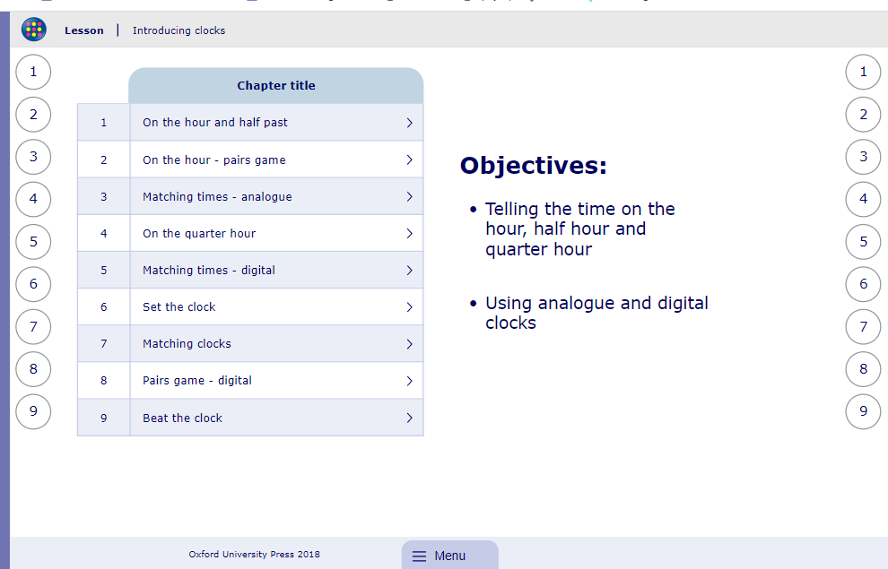
My Maths activity
Lesson: Introducing clocks
To start the lesson, click on the image to the right of the screen. This will take you to an interactive lesson.
Click on the next buttons at the bottom of the page to move your learning on and take part in the mini-quizzes along the way to check your understanding.

Slide 13
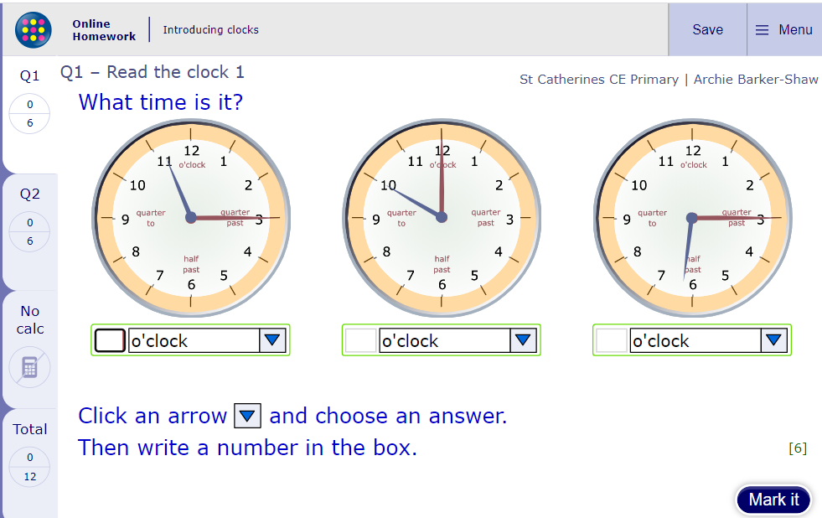
Now click the image on the left of the screen, this will take you to an online homework where you can test your understanding.
Have a go at the questions and then click ‘Mark it’ to see how you have go on.
Your login details for My Maths were sent home in your first work pack - make sure you log in so we can see how you are getting on.

Slide 14
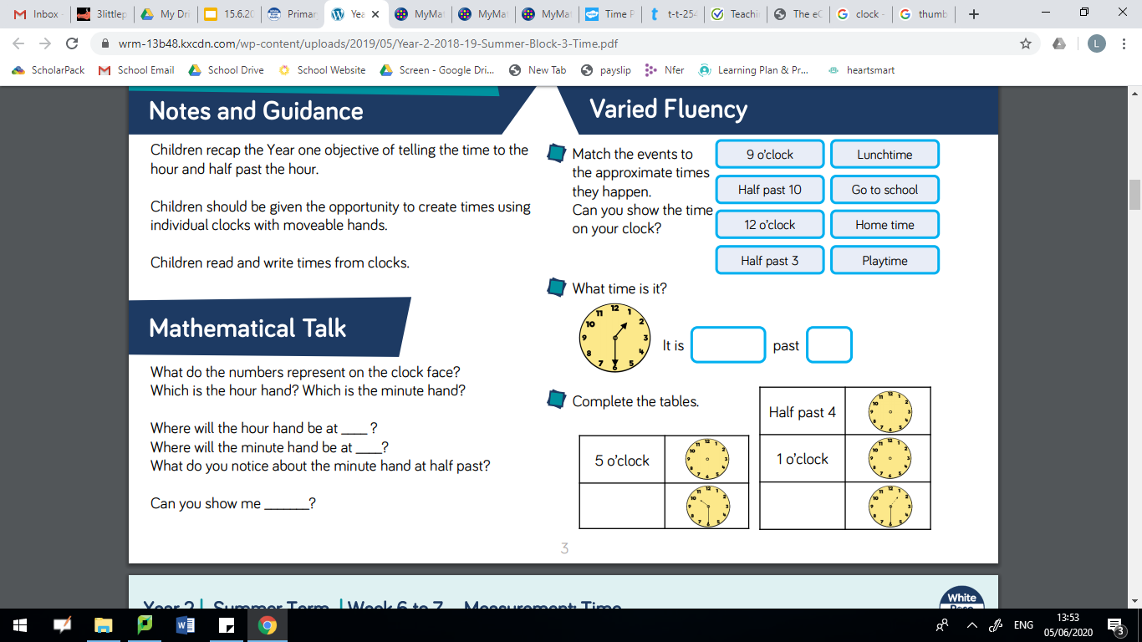
Draw a line to match the events to the approximate times they happen. Can you show the time on your clock?

Slide 15
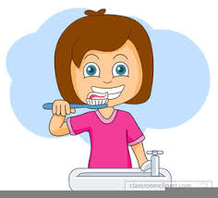
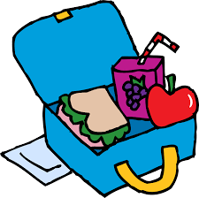
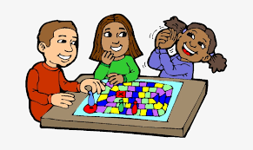
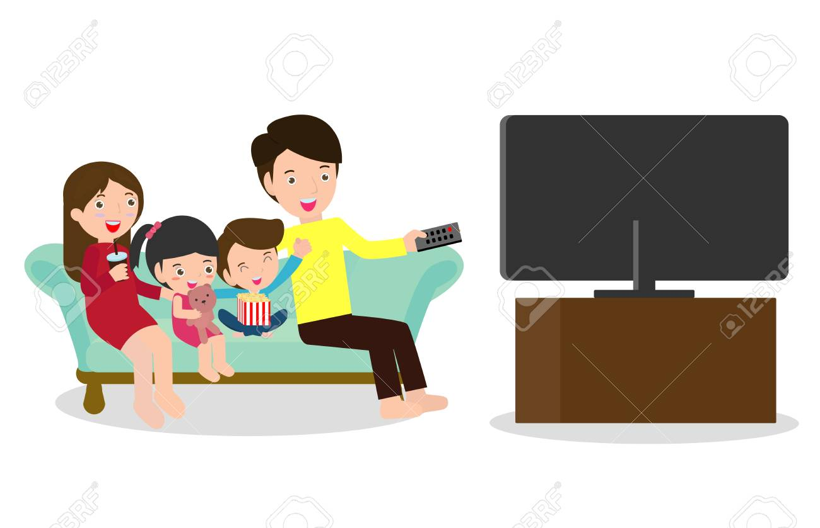
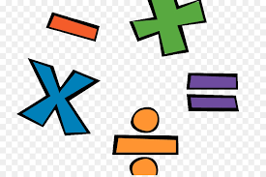
Your Routine
Whilst we have been learning at home, we have all had to adapt to a new routine. Choose 5 tasks you complete throughout the day and draw a picture to represent them. Then either draw a clock or write the time you would complete that task.Put the tasks in time order from the earliest time to the latest time. Here is an example...
Half past 7 | 9 o’clock | Half past 12 | Quarter past 5 | Half past 6

Slide 16
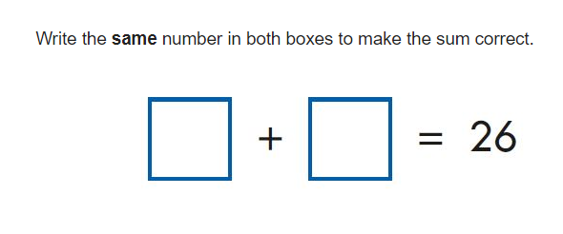
Morning maths 17.6.20
1 + 6 + 9 =
__ + 5 + 7 = 17
___ x 5 = 45
___ = 4 x 10
65 = 20 + 15 + ___
___ - 20 = 24
___ - 90 = 10
8. Circle all the odd numbers.
Challenge
34
34 61 99 108
13 70 47

Slide 17
Morning maths Answers 17.6.20
1 + 6 + 9 = 16
5 + 5 + 7 = 17
9 x 5 = 45
40 = 4 x 10
65 = 20 + 15 + 30
44 - 20 = 24
100 - 90 = 10
8. Circle all the odd numbers.
Challenge
13
13
16
16
34
34 61 99 108
13 70 47

Slide 18
Maths
Wednesday 17th June

Slide 19
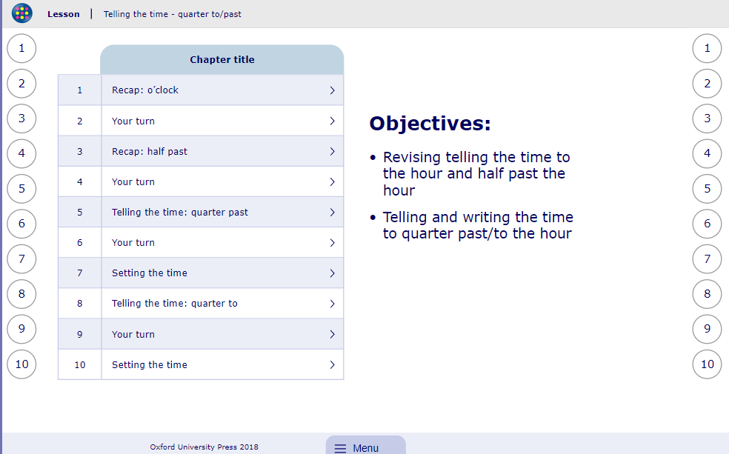
My Maths activity
Lesson: Telling the Time - quarter to/past
To start the lesson, click on the image to the right of the screen. This will take you to an interactive lesson.
Click on the next buttons at the bottom of the page to move your learning on and take part in the mini-quizzes along the way to check your understanding.

Slide 20
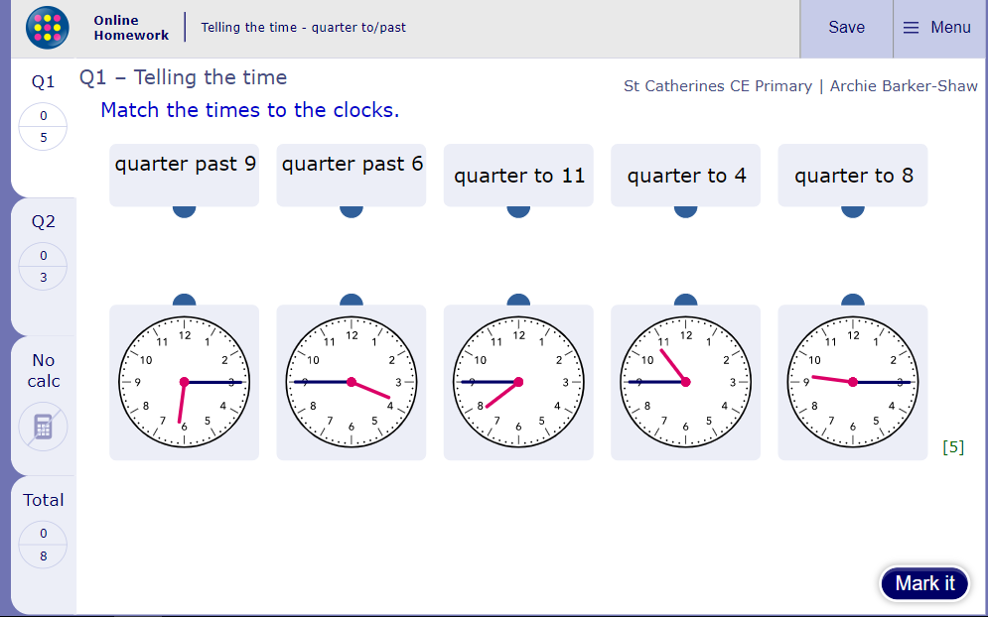
Now click the image on the left of the screen, this will take you to an online homework where you can test your understanding.
Have a go at the questions and then click ‘Mark it’ to see how you have go on.
Your login details for My Maths were sent home in your first work pack - make sure you log in so we can see how you are getting on.

Slide 21
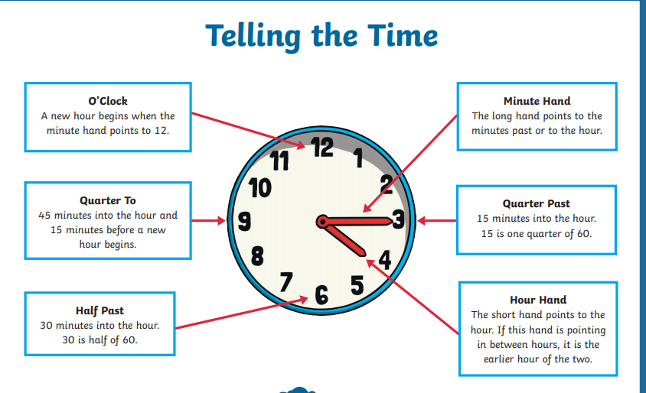
Recap...

Slide 22
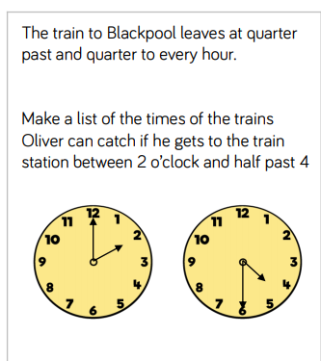
Use your clock to help you!

Slide 23
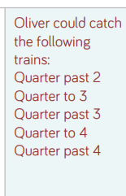
Answer
Use your clock to help you!

Slide 24
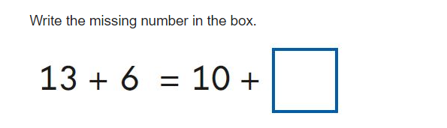
Morning maths 18.6.20
Challenge
Handy Hint!
When finding a fraction of an amount, the children are encouraged to draw a rectangle to help them create equal groups..
A ½ is 2, what is the whole?
A ¼ is 5, what is the whole?
A ¼ is 10, what is the whole?
Think of 5 ways to complete this number sentence.
5 x 3 = _________
It could be a +, -, x or a ÷ calculation.

Slide 25
Morning maths Answers 18.6.20
Challenge
Handy Hint!
When finding a fraction of an amount, the children are encouraged to draw a rectangle to help them create equal groups..
9
A ½ is 2, what is the whole? 4
A ¼ is 5, what is the whole? 20
A ¼ is 10, what is the whole?
Think of 5 ways to complete this number sentence.
2
2
5 x 3 = Any calculation that equals 15
5
5
5
5
It could be a +, -, x or a ÷ calculation.
10
10
10
10

Slide 26
Maths
Thursday 18th June

Slide 27
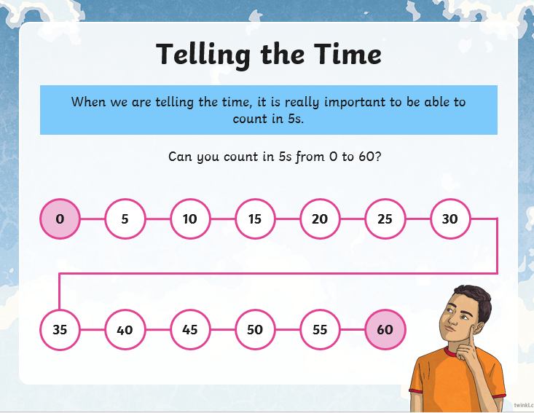

Slide 28
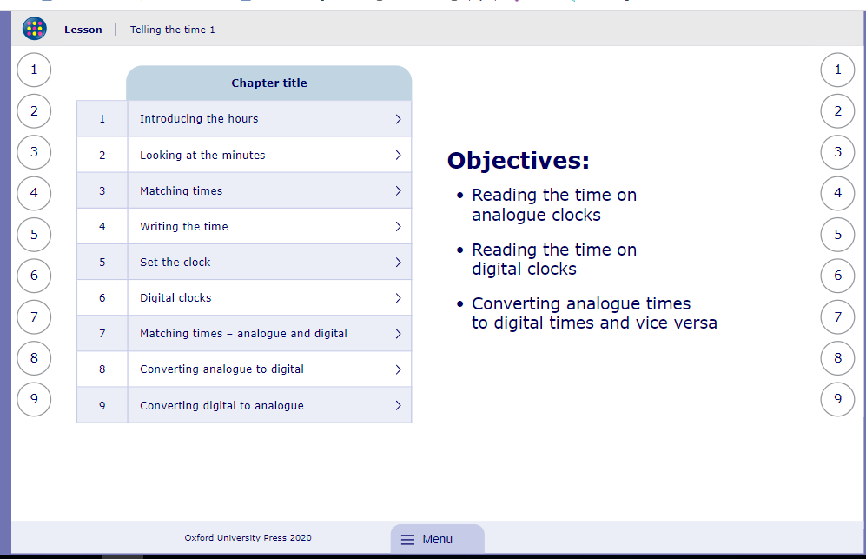
My Maths activity
Lesson: Telling the Time 1
To start the lesson, click on the image to the right of the screen. This will take you to an interactive lesson. This lesson will
Click on the next buttons at the bottom of the page to move your learning on and take part in the mini-quizzes along the way to check your understanding.

Slide 29
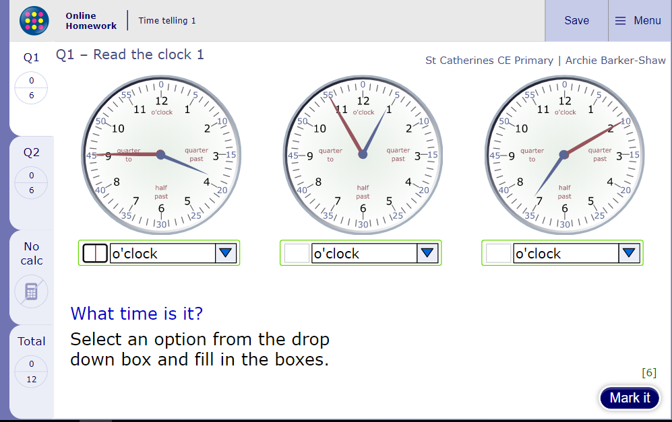
Now click the image on the left of the screen, this will take you to an online homework where you can test your understanding.
Have a go at the questions and then click ‘Mark it’ to see how you have go on.
Your login details for My Maths were sent home in your first work pack - make sure you log in so we can see how you are getting on.

Slide 30
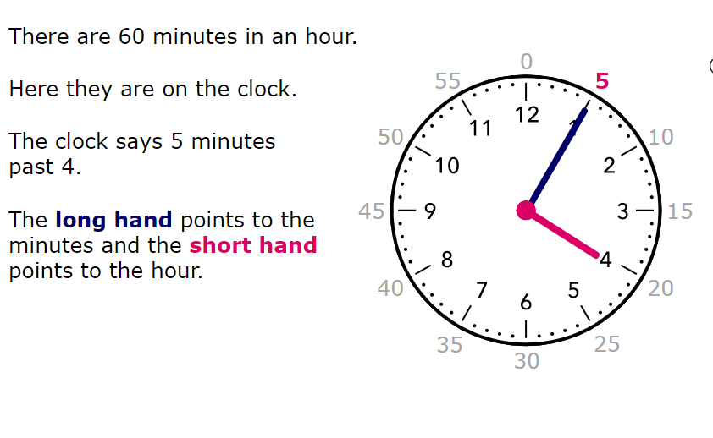
Recap...

Slide 31
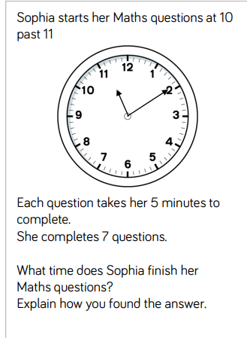
Use your clock to help you!

Slide 32
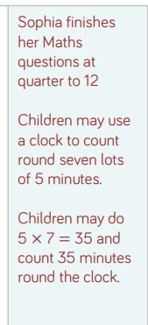
Answers

Slide 33
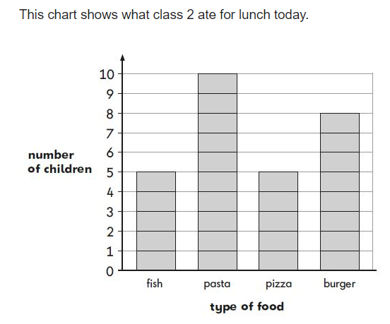
Morning Maths
19.6.20
1.How many children had a burger for lunch?
2. How many children had fish for lunch?
3. Fewer children ate pizza than a burger. How many fewer?
4. What type of food was the most popular?
5. How many children are there in class 2?

Slide 34
Morning Maths Answers
19.6.20
1.How many children had a burger for lunch? 8
2. How many children had fish for lunch? 5
3. Fewer children ate pizza than a burger. How many fewer? 3
4. What type of food was the most popular? pasta
5. How many children are there in class 2? 28

Slide 35
Maths
Friday 19th June

Slide 36

Guess my number!
Take it in turns to think of a number between 1-100, but don’t show anyone else your number.
Play guess my number by giving people clues about your number but you mustn’t say the number! The vocabulary below might help you with the clues you choose to give.
odd even more than less than
two digit tens ones in between

Slide 37
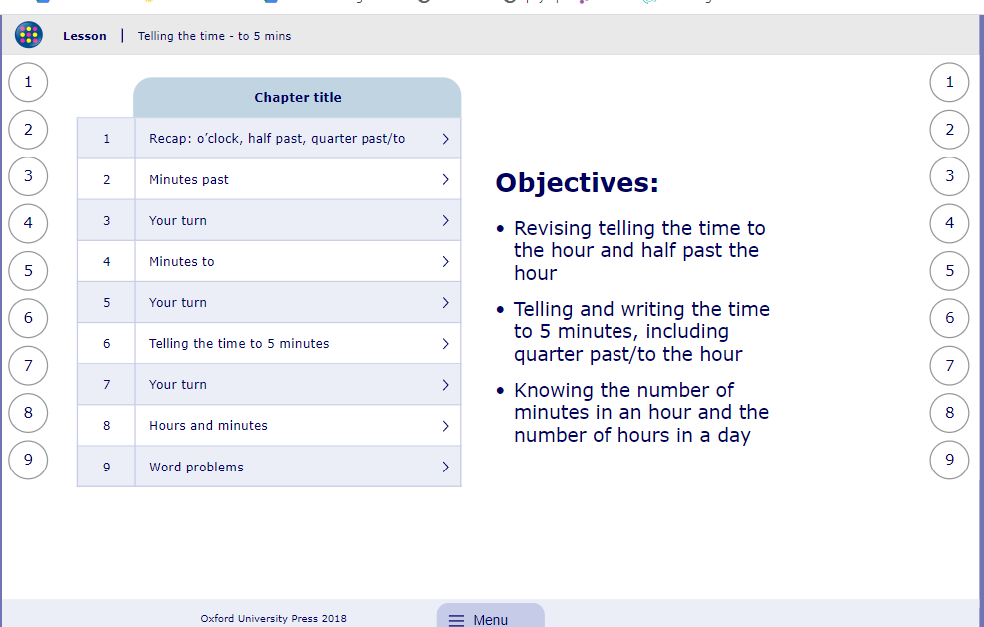
My Maths activity
Lesson: Telling the Time - to 5mins
To start the lesson, click on the image to the right of the screen. This will take you to an interactive lesson. This lesson will teach the children to read the time in 5 minute intervals.
Click on the next buttons at the bottom of the page to move your learning on and take part in the mini-quizzes along the way to check your understanding.

Slide 38
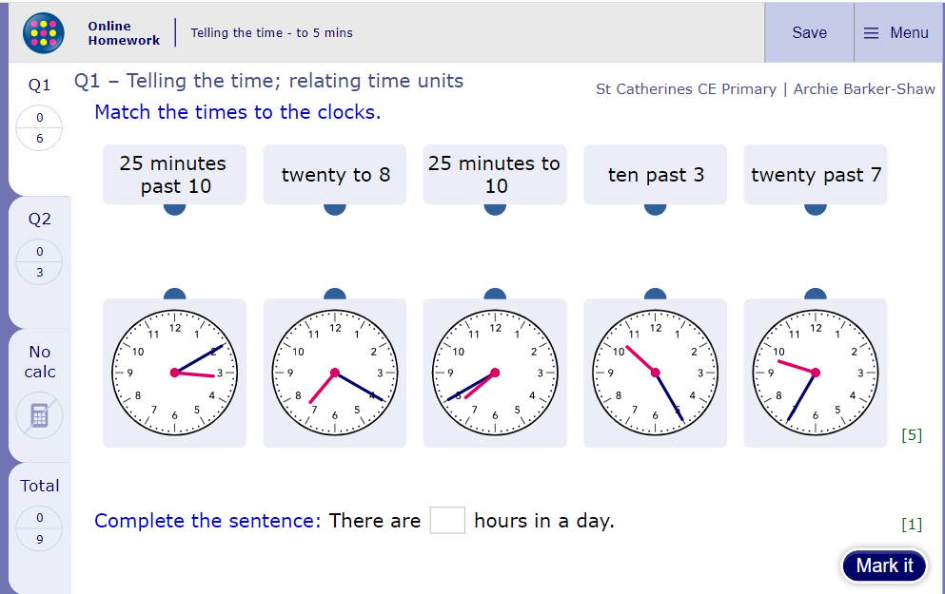
Now click the image on the left of the screen, this will take you to an online homework where you can test your understanding.
Have a go at the questions and then click ‘Mark it’ to see how you have go on.
Your login details for My Maths were sent home in your first work pack - make sure you log in so we can see how you are getting on.

Slide 39
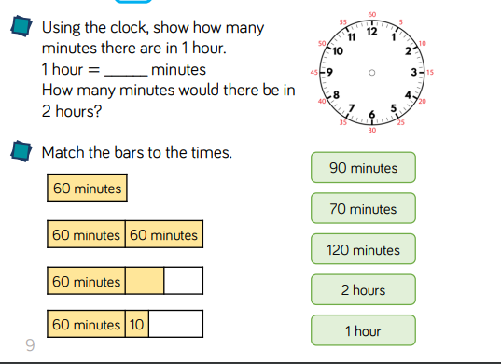

Slide 40
Answers
60
60 + 60 = 120 minutes

Slide 41

Well done for all
your hard work this week

