Slide 1
Washing our Hands
Earlier in the year, we learnt how to wash our hands properly. We even made some videos instructing others on how to do this correctly.
Watch this link if you need a reminder on how to wash your hands thoroughly.
https://www.youtube.com/watch?v=S9VjeIWLnEg

Slide 2
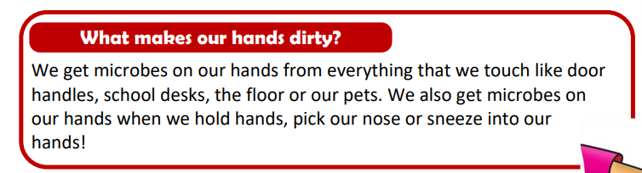
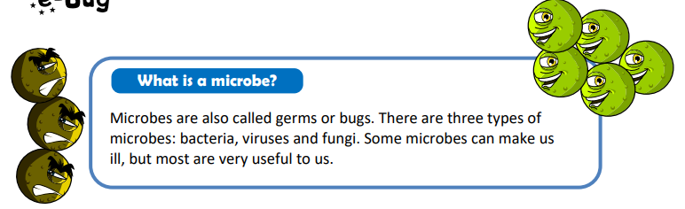
Why do we wash our hands?
Session 1

Slide 3
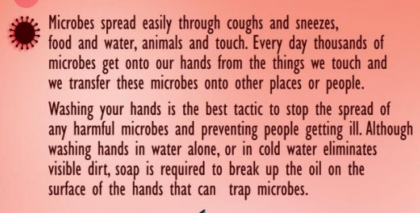
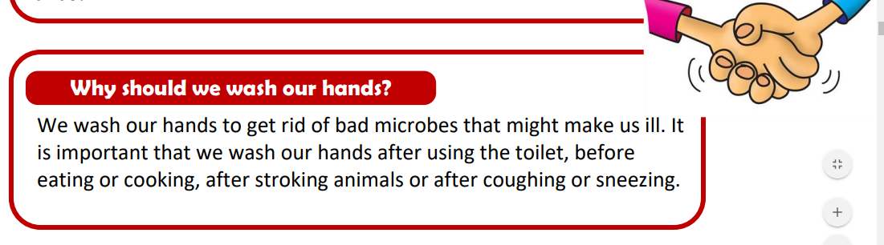

Slide 4
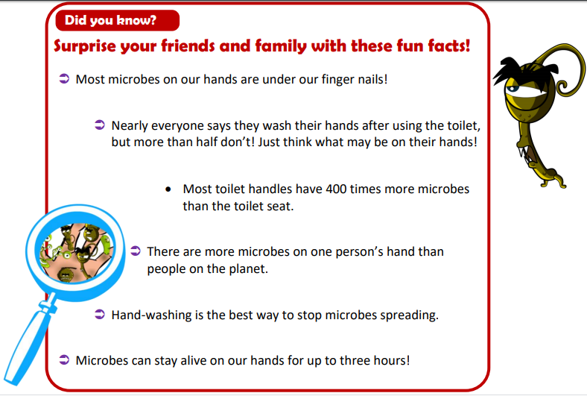

Slide 5
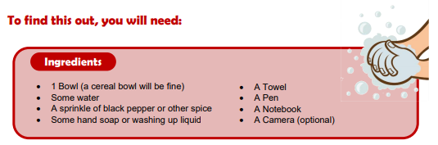
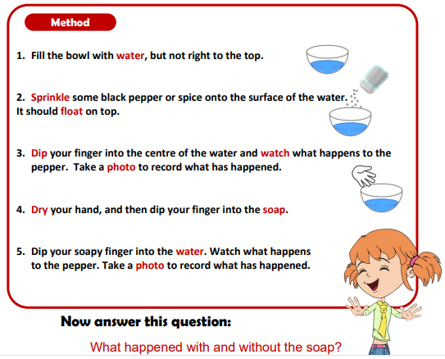
Why do we use soap to wash our hands?
Try this experiment to find out the answer. ☺

Slide 6
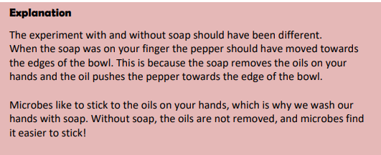

Slide 7
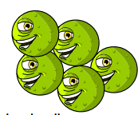
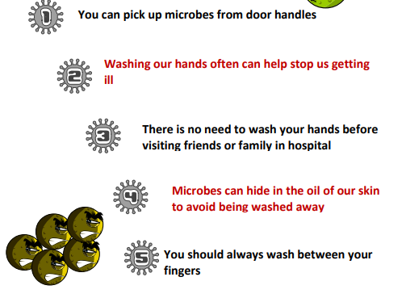
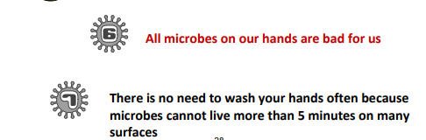
Quiz
True or False?
Check your answers on the next slide…

Slide 8
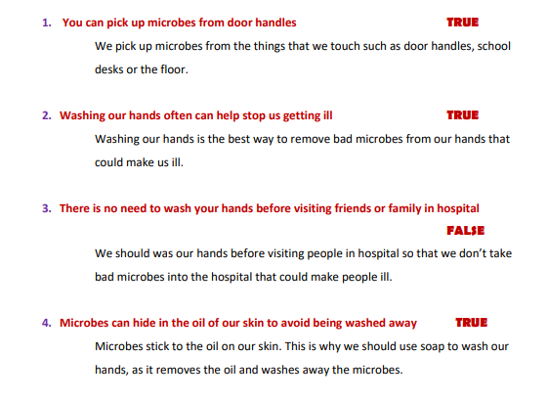
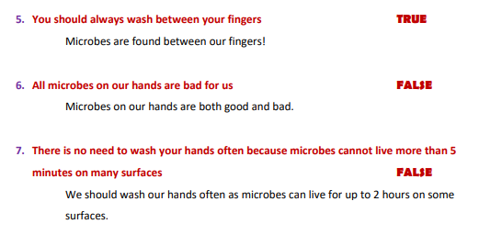
Quiz Answers
How did you do?
Well done! ☺

Slide 9
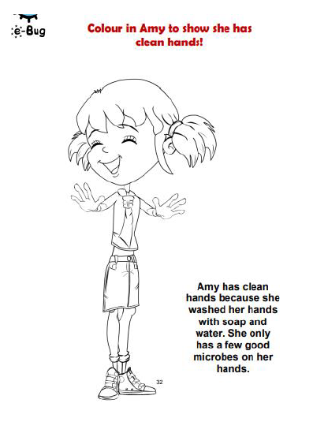
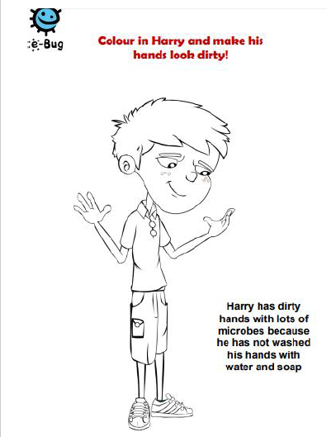
Further Activity
These colouring pages are saved separately in the Foundation Subject folder in week 5&6.
Read about Harry and Amy and colour the pictures in appropriately!

Slide 10
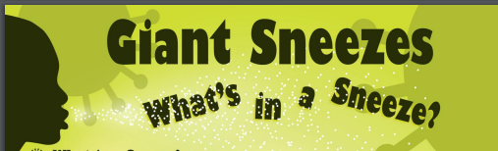
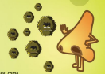
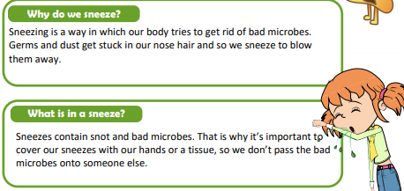
Session 2

Slide 11
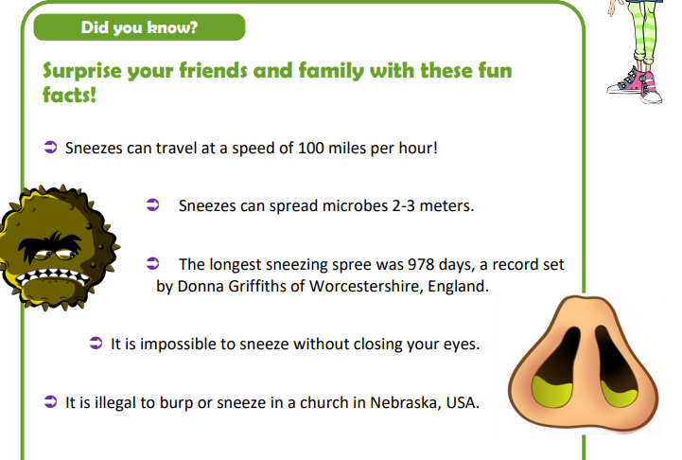

Slide 12
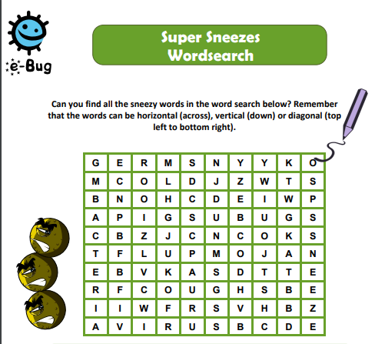
Why not have a go at the Super Sneezes word search?
You will find a copy of the word search in the Foundation Subject Folder under Week 5&6.
Good luck ☺

Slide 13
Recap…
Session 3
Do you remember our learning about microbes?
Sometimes when we are poorly, our bodies need help to feel well again. This might involve going to the doctor and having to take some medicine that can help kill the bad bacteria in our body.
These medicines are called Antibiotics.

Slide 14
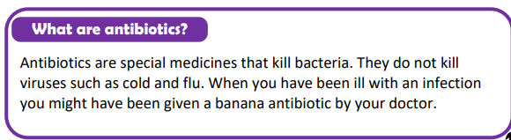
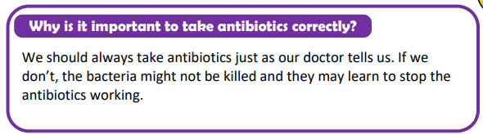
Antibiotics

Slide 15
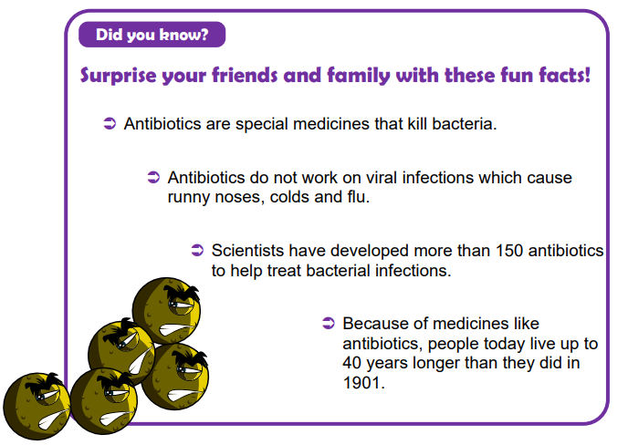

Slide 16
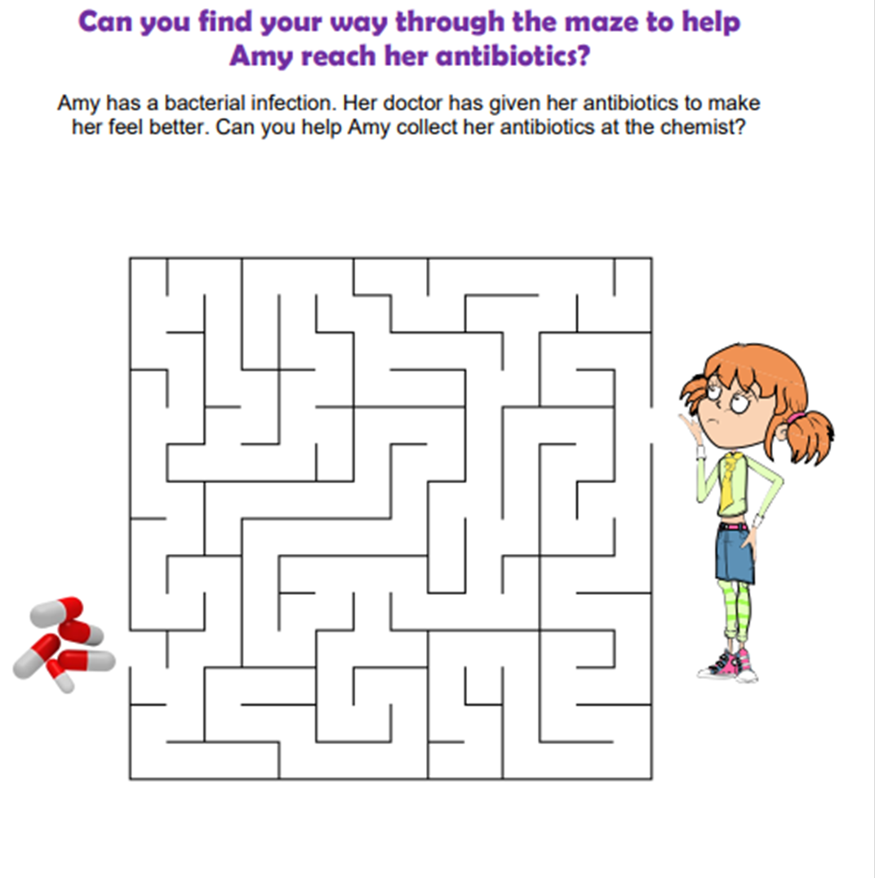
Activity
You can find a copy of the maze in the Foundation Subject folder in week 5&6.
Help Amy by finding a way through the maze to reach the antibiotics she needs to fight her infection.

