Slide 1


Slide 2

In these sessions, we are going to help Finn find his way at sea.
We are going to need to use the compass points - North, East, South and West. We also need to help him use a map.

Slide 3
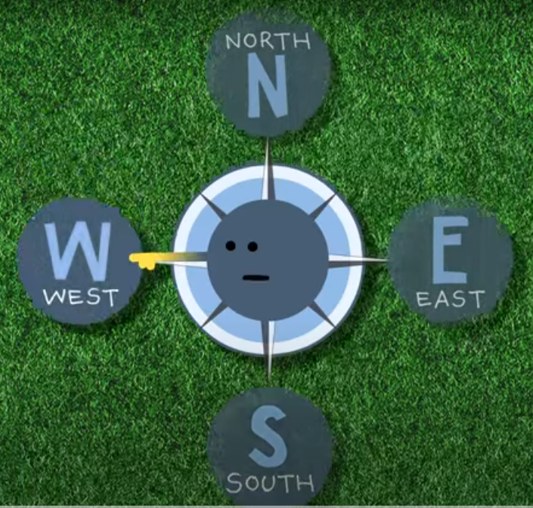
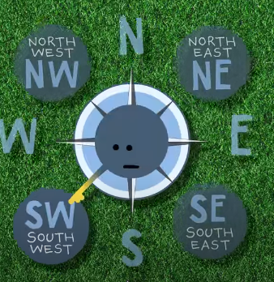
Compass Points
Compass points help us to describe what direction to travel.
The 4 main points of a compass are North (N), East (E), South (E) and West (W).
In between these we have 4 more,
North-East (NE), South-East (SE), South-West (SW) and North-West (NW).
Now watch this video to help you understand.
https://www.youtube.com/watch?v=6Due3L2QeQM

Slide 4
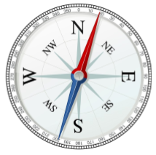
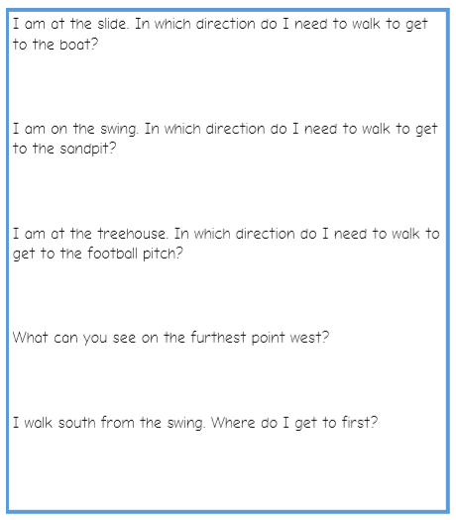
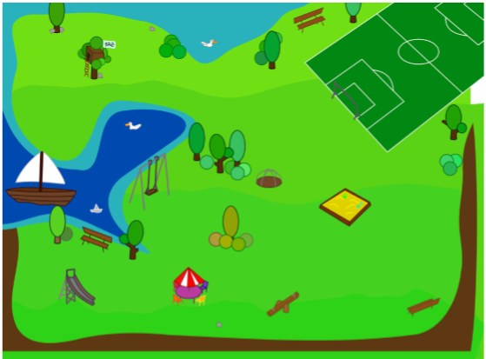
Compass Points
Use the compass and the map of the park to see if you can answer these questions.

Slide 5
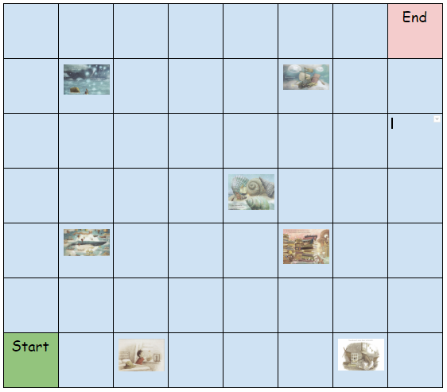
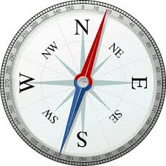
Compass Points
Help Finn travel to every picture on the map by giving him directions usings the compass points: N,E,S,W and NE, SE, SW and NW.
The directions for the first two pictures have been done for you.
Start, E,E, N, NW,

Slide 6
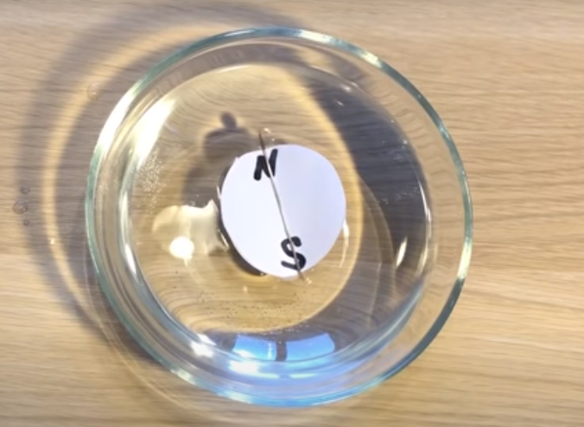
Make your own compass at home.
Ask a grown-up to help you.
You could use a fridge magnet.
https://www.youtube.com/watch?v=4_tQQFHpSa4

Slide 7
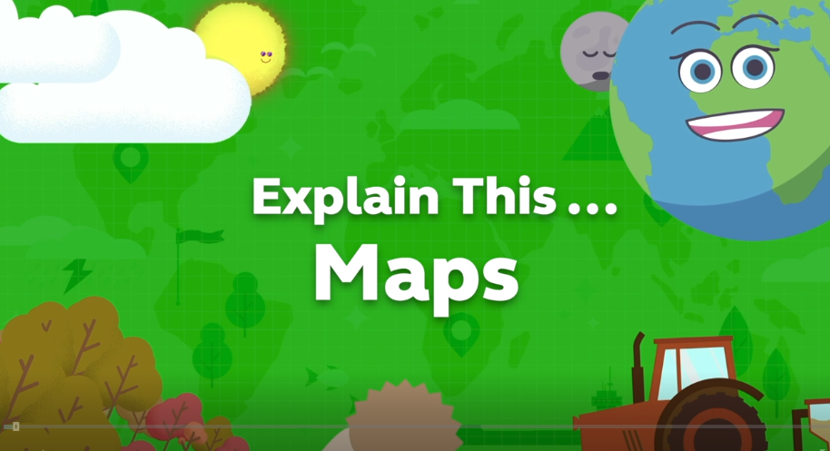
Maps
Next, we are going to draw a map to help Finn.
We need to include lots of detail on our map.
Click on the link to watch the video about reading maps.
https://www.bbc.co.uk/teach/class-clips-video/geography-ks1--ks2-maps/zdwhpg8

Slide 8
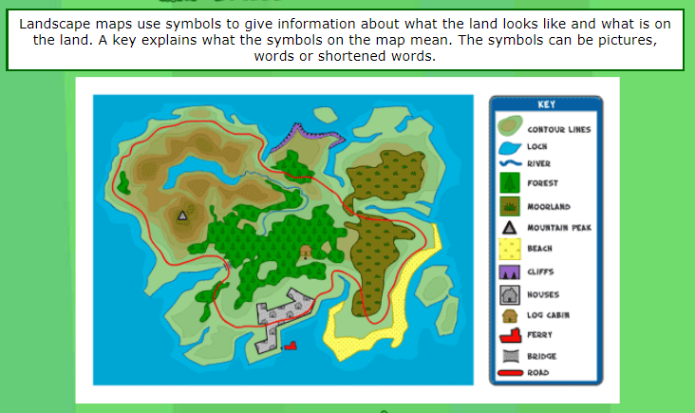
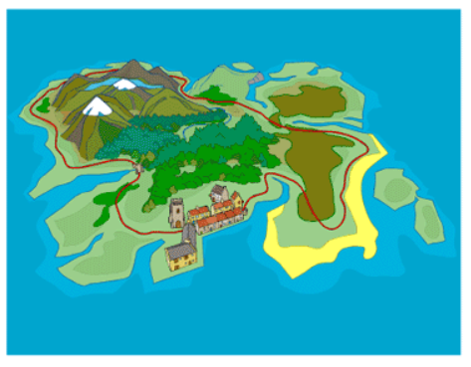
Symbols

Slide 9
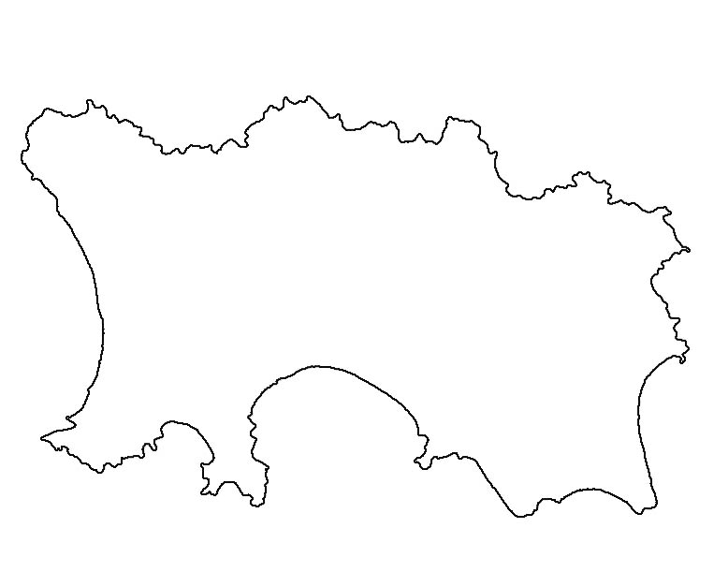
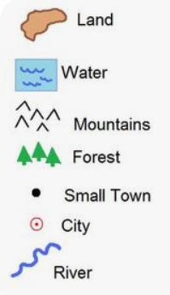
Symbols
Now you are ready to your own map.
On his travels, Finn is going to visit an island.
Draw a map of an island - use the key here to add your own symbols onto the map. You can design the map however you want!
Can you invent some symbols of your own for these things:
beach
path
village
cave
swamp
rocks
bridge

