Slide 1


Slide 2
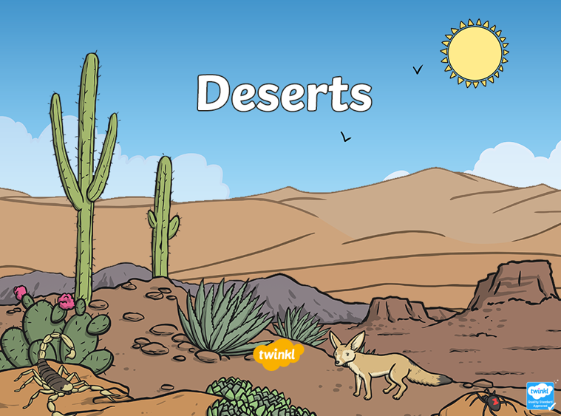


Slide 3
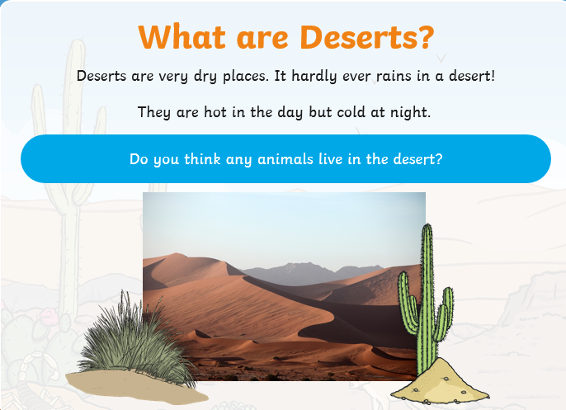

Slide 4

Click the link to watch the video
https://www.youtube.com/watch?v=gaZKEc59g1w

Slide 5
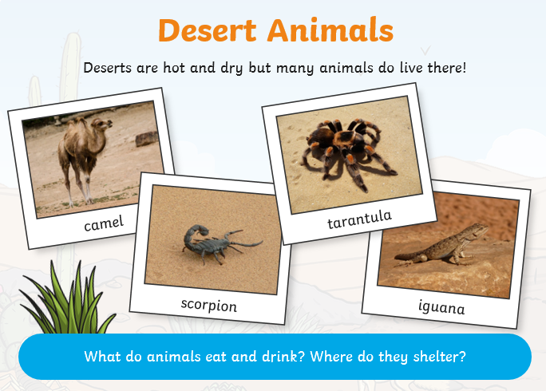

Slide 6
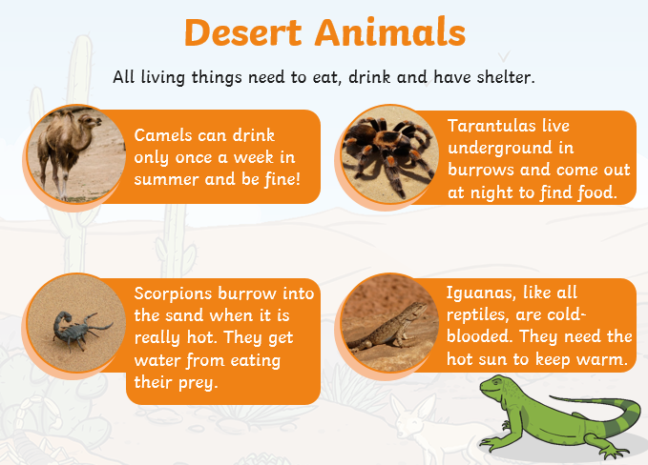

Slide 7
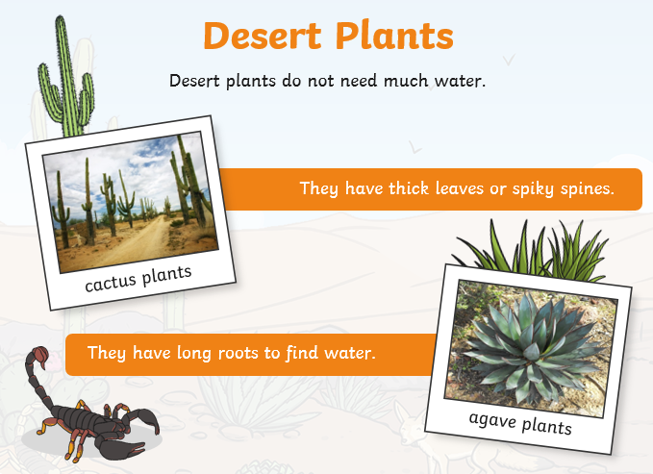

Slide 8
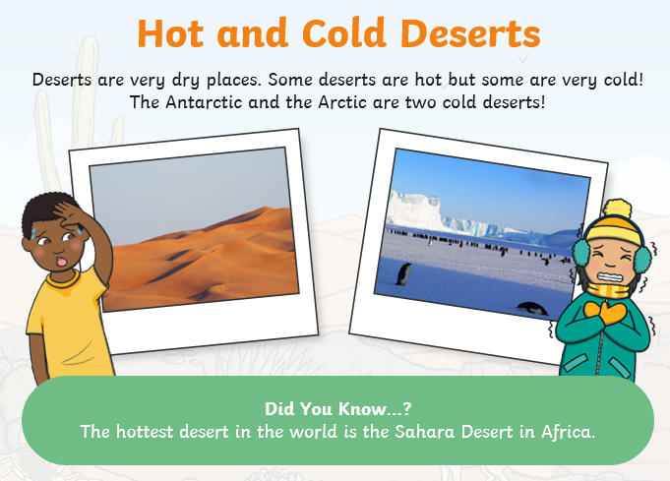

Slide 9

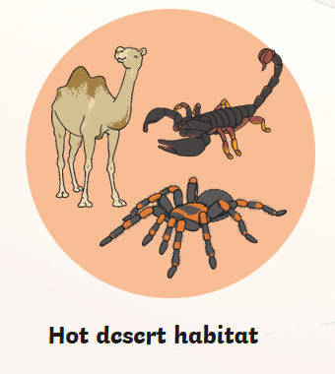
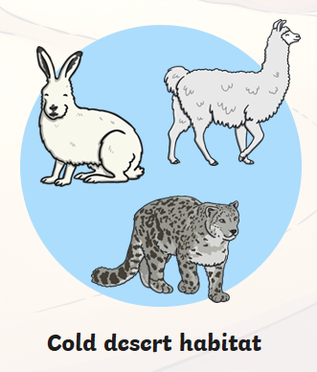
As well as hot deserts, there are also cold desert habitats. Just like hot deserts, hardly any rain falls.
Different animals live in these different habitats. They all have to be specially adapted (something special about them) to survive.

Slide 10
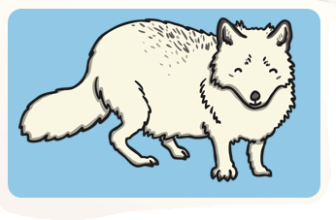
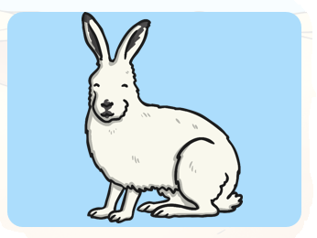
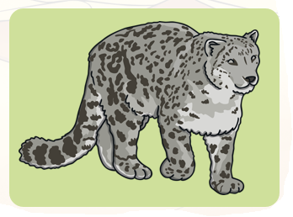
Cold Desert Animals
Arctic Foxes burrow under the snow to keep warm. They are omnivores and eat mice, birds and friut.
Arctic Hares live in the snows of the North Pole. They have thick white fur to keep warm.
Snow Leoparts live in the mountains of Asia. They have strong legs to jump from rock to rock.

Slide 11
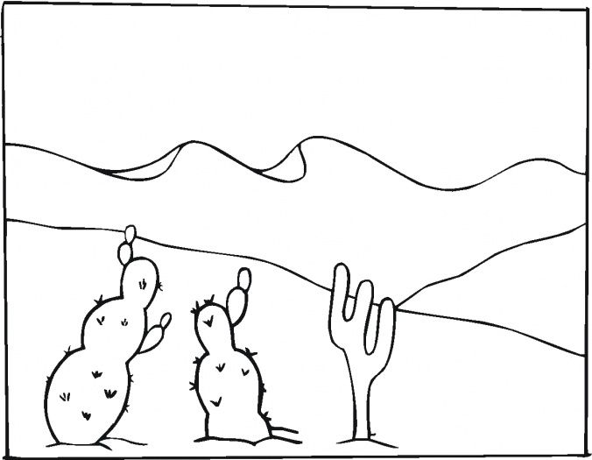
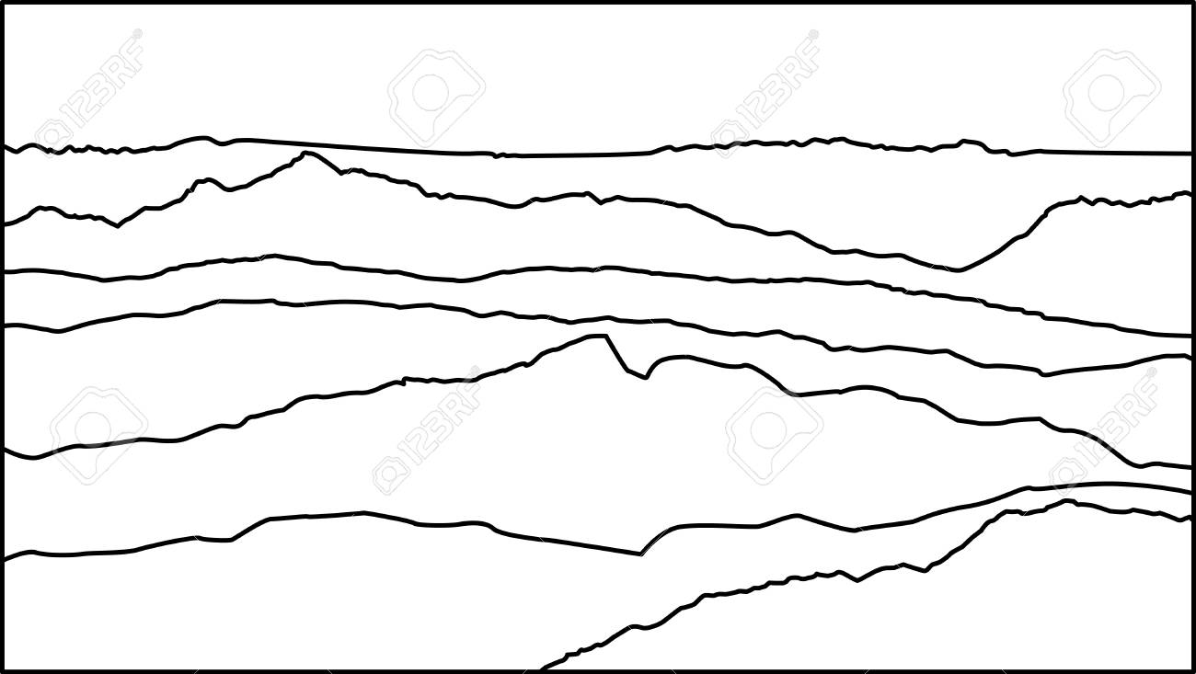








Activity 1 Here are two habitats. One is a hot desert, the other is a cold desert. Choose one to copy. Then you need to draw the correct animals in your habitat. Use the slides you have just read to add one fact for each animal
Hot Desert
Cold Desert

Slide 12
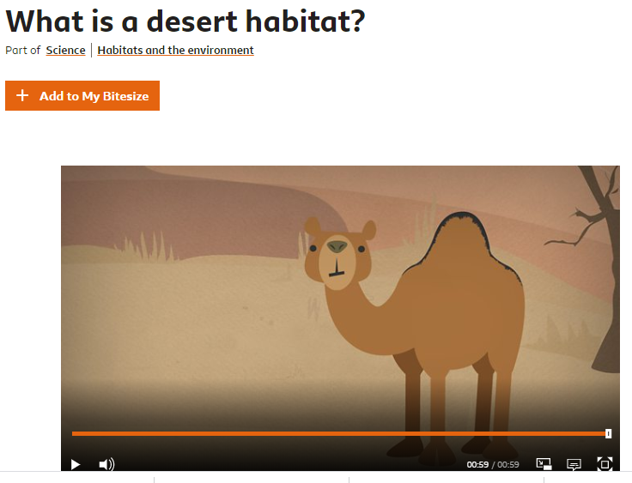
Activity 2 Click on the link below.
Watch the video
Do the activity
Do the quiz
https://www.bbc.co.uk/bitesize/topics/zx882hv/articles/zsqnfg8

Slide 13

Activity 3
Create an animal suitable for the desert habitat. Label and explain why it is suitable.

Slide 14
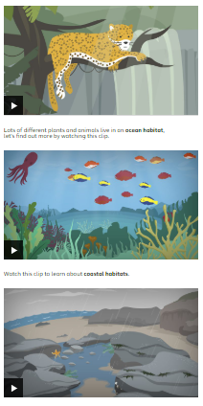
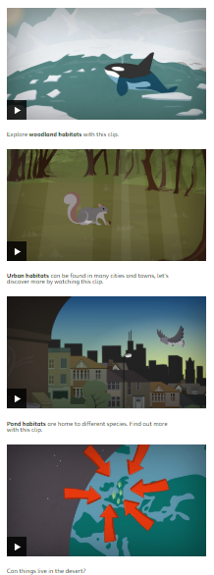
Activity 4
Watch the videos of other habitats and draw your favourite one. Don’t forget to include some of the animals you might find there. Click here to follow the link.

