Slide 1
Reception’s
Daily challenges
Week 5
You can choose to record how you have completed these challenges in whatever way works best for you.
You may want to take photos, draw/write/video.
We can’t wait to see how you have got on! ☺
This week there are a selection of challenges for you to choose from.

Slide 2
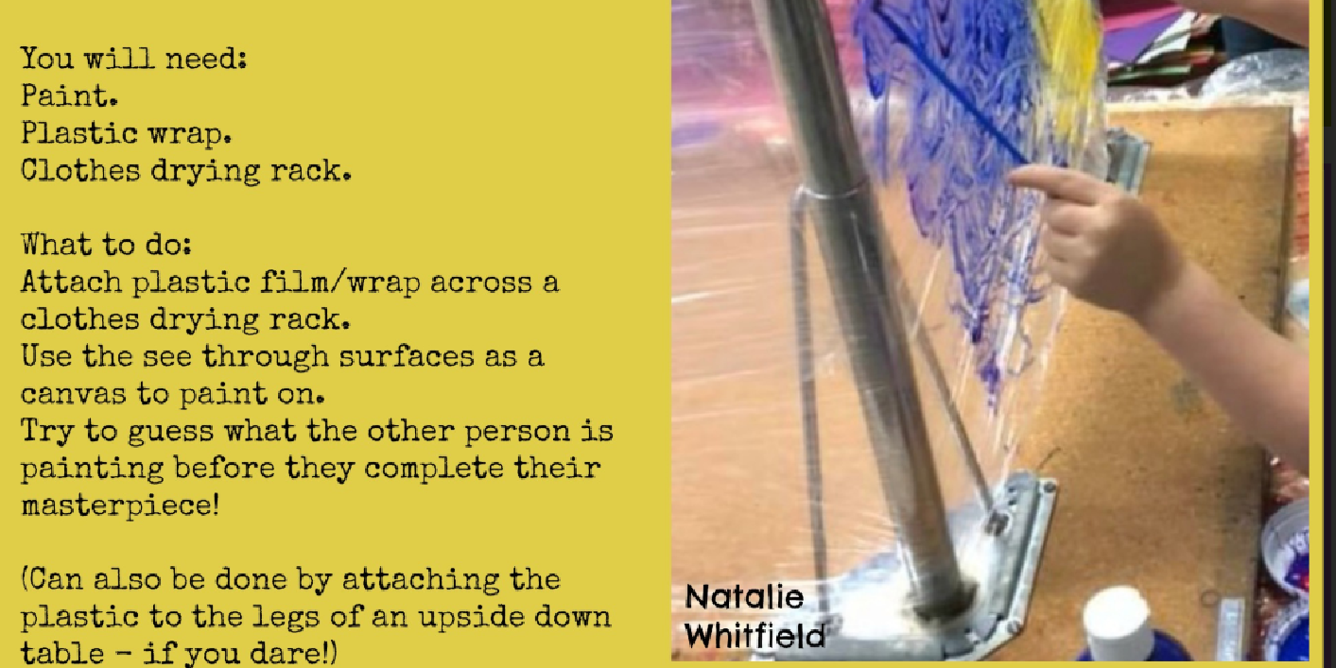

Slide 3
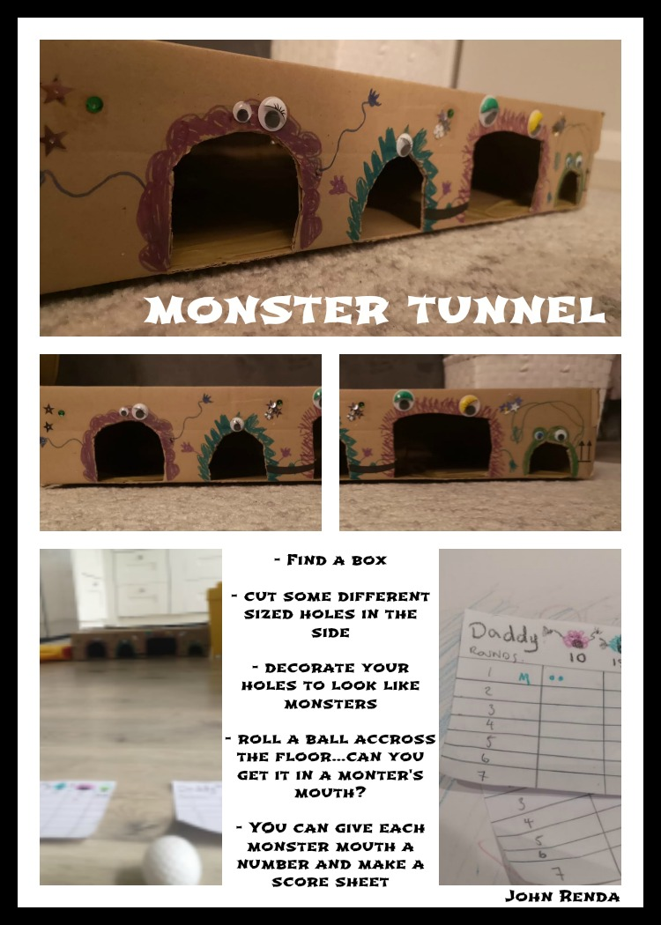

Slide 4
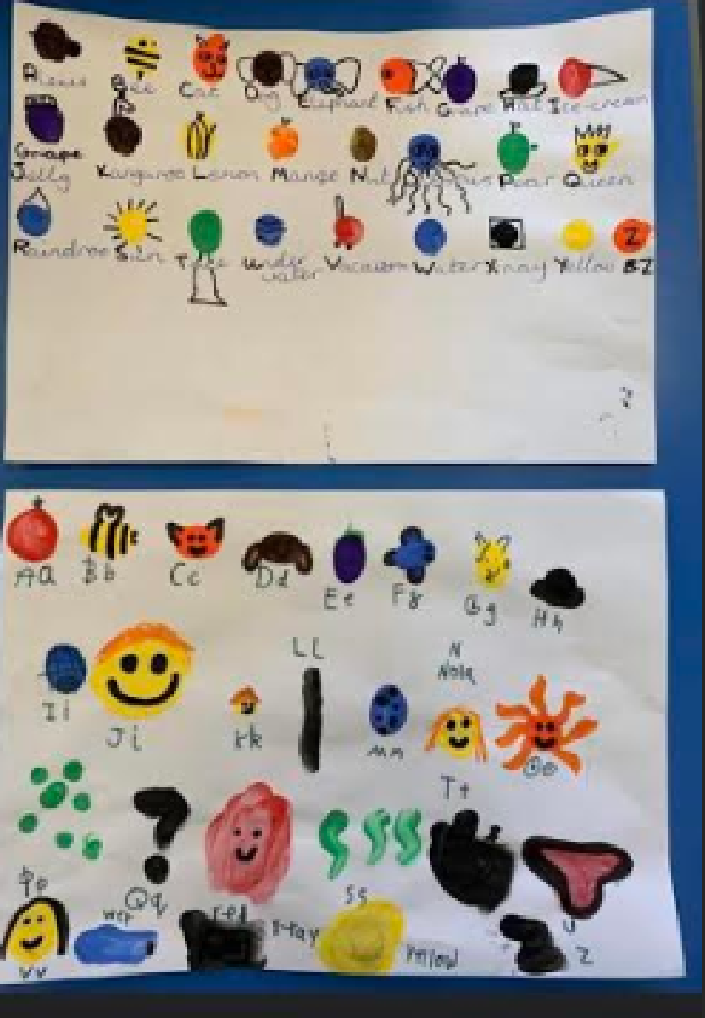
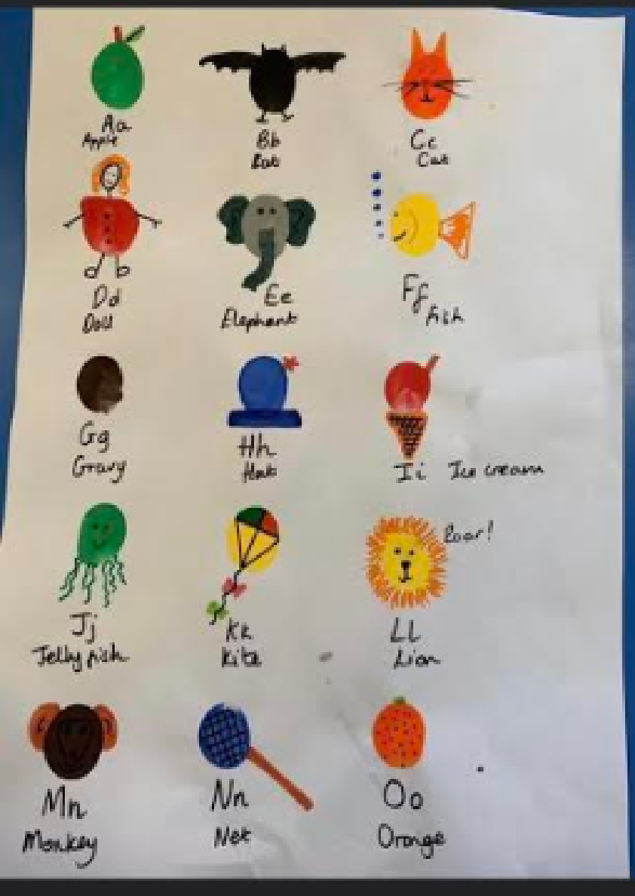
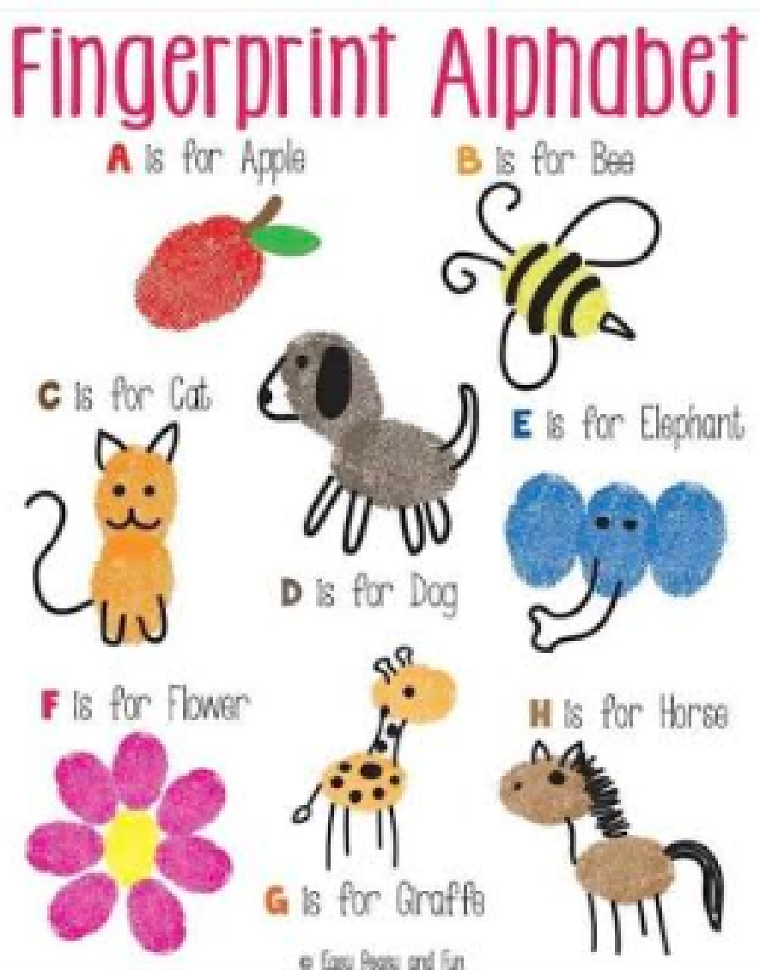
If you like painting, this activity will be a good choice for you!
1) Think of a different animal/object that begins with each letter of the alphabet.
2) Dip your finger in the relevant colour paint and create mini pictures for each letter.

Slide 5
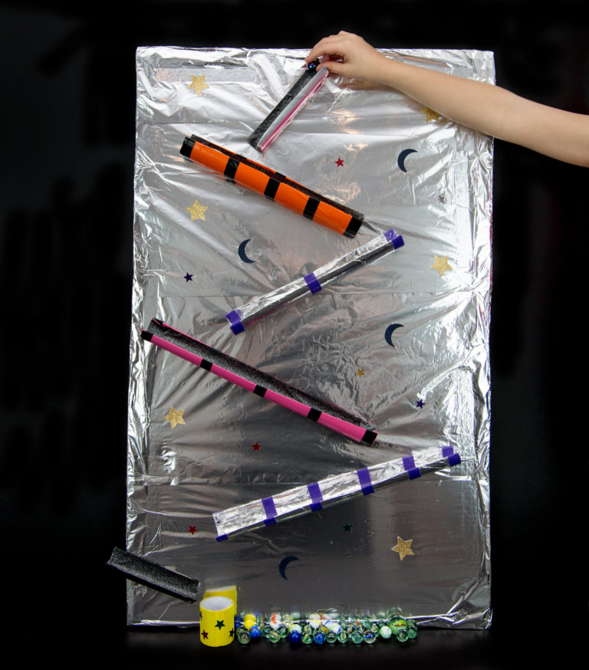
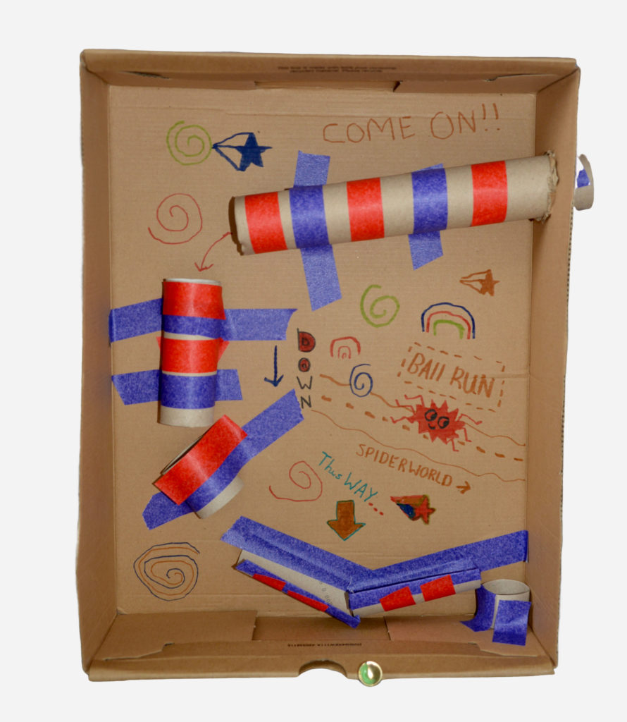
Make your own marble run
You will need:
Tape
Cardboard tubes
Recyclable packaging eg. Bottles, cardboard boxes, egg cartons, yogurt pots
Large box or sheet to build against it
Scissors
Space themed
Can you create your own marble run? You could time how long it takes your ball to get to the bottom. Could you make your ball go slower or faster?

Slide 6
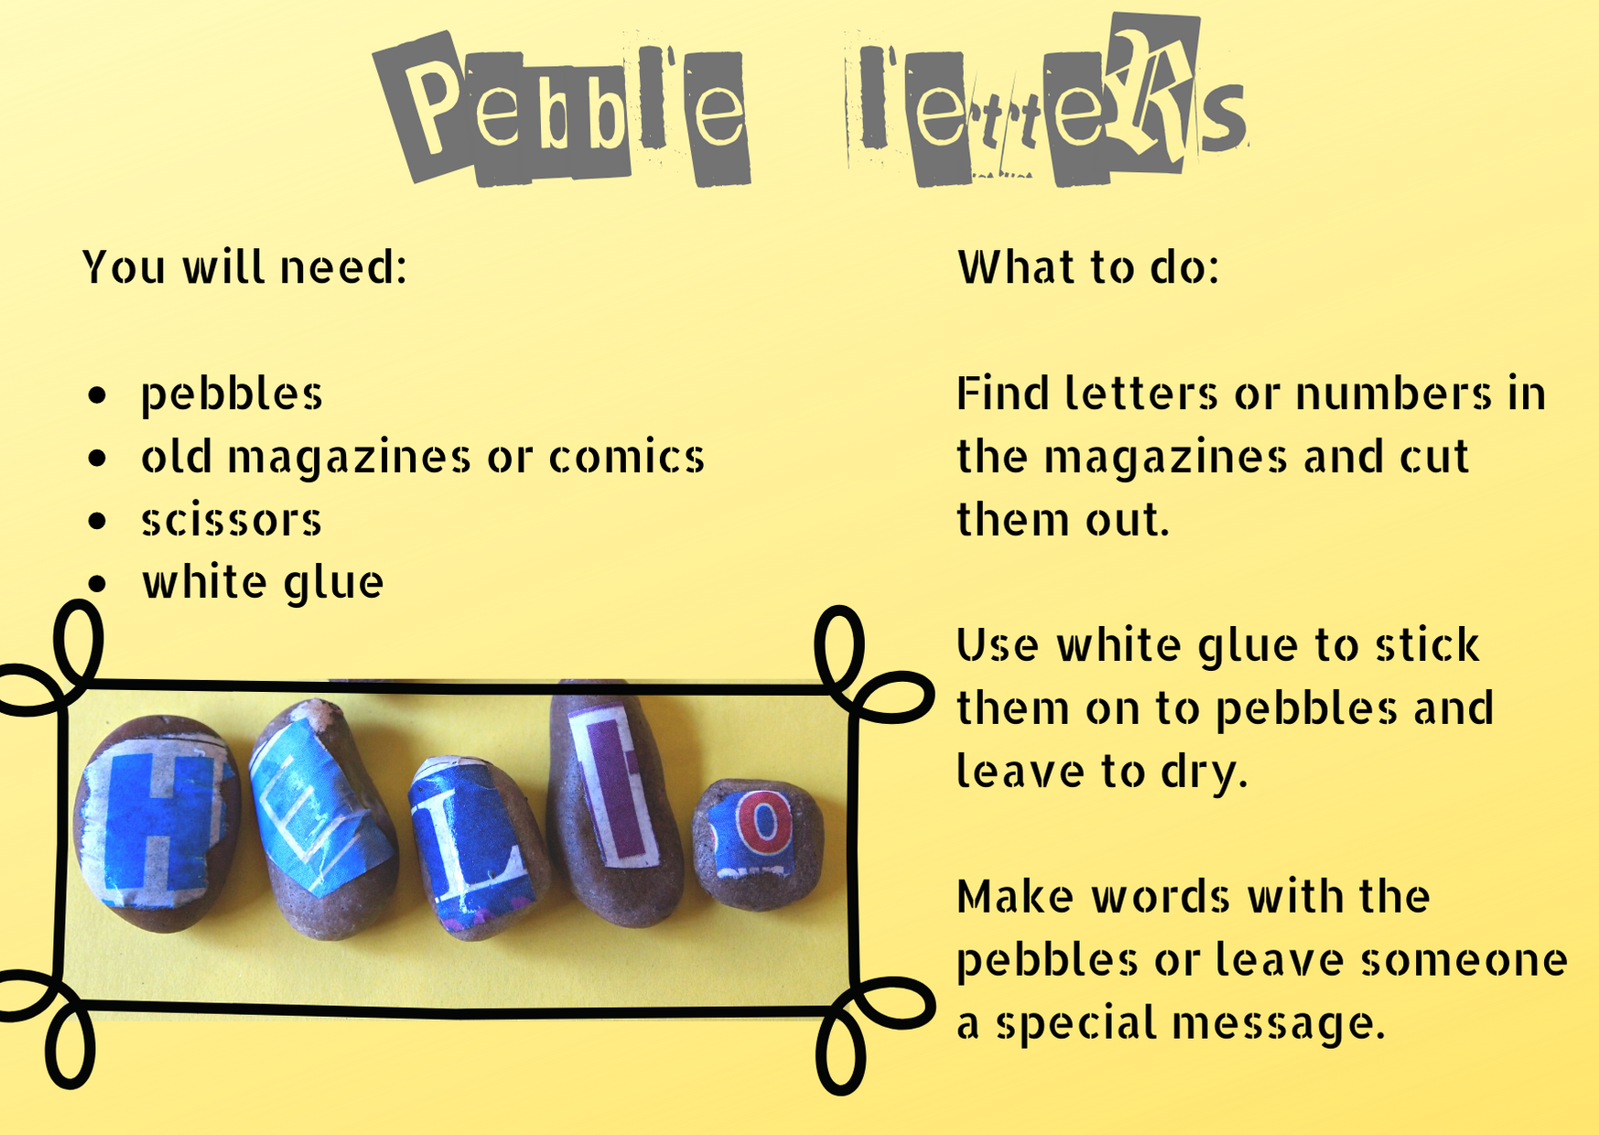

Slide 7
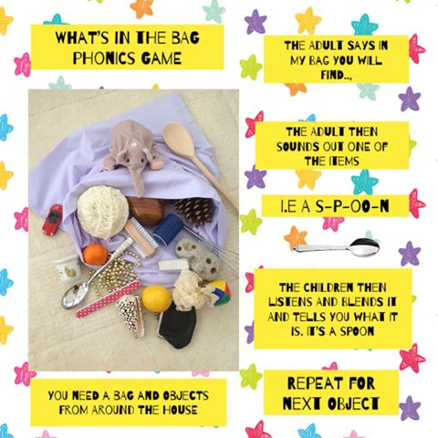

Slide 8


