Slide 1
Reception’s
Daily challenges
Week 8 & 9
You can choose to record how you have completed these challenges in whatever way works best for you.
You may want to take photos, draw/write/video.
These are just suggestions – you do not have to record it at all if you choose not to.
We can’t wait to see how you have got on! ☺

Slide 2
Week 8

Slide 3
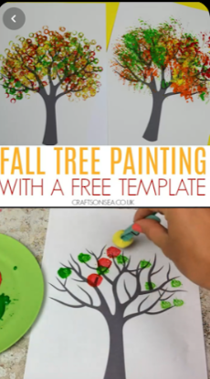
This is a really nice idea…
You will need:
Paint
Pom-poms/small sponges
A peg
Tree trunk template (or you could draw your own) ☺

Slide 4
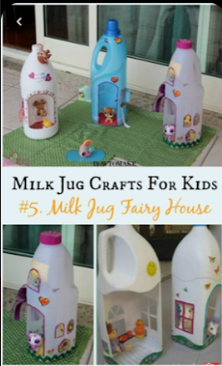
These are fairy houses made out of milk cartons but you could use your imagination and create a spaceship or a superhero house for any characters you may have at home.

Slide 5
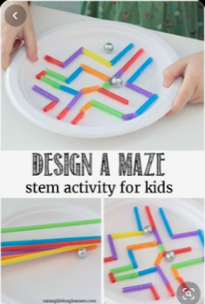
Can you design and make your own maze?
You could use a plastic straw cut into little pieces like this picture or loo roll tubes to make a game.

Slide 6
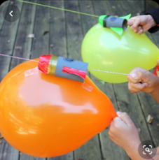
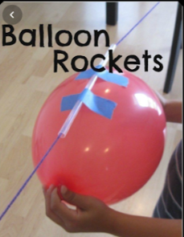
Watch this clip to see how it is done.
These balloon rockets are great fun!
https://www.youtube.com/watch?v=r8BiJs4EfbI
You will need:
A ball of string/wool
A balloon
A plastic straw
Scissors
Tape
Glue

Slide 7
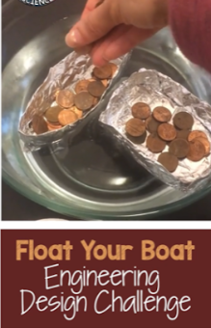
Experiment
You will need to make a ‘boat’ out of tin foil
Add some money (pennies) and see if your boat continues to float
See how much money you can add to the boat before it sinks!
Remember to count your pennies at the end. ☺

Slide 8
Week 9

Slide 9
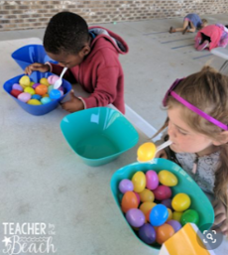
Can you transfer objects from one bowl to another simply using your mouth and a spoon?
Give it a try!
You could always have a race with a sibling/family member...

Slide 10

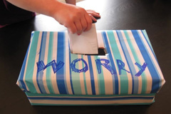
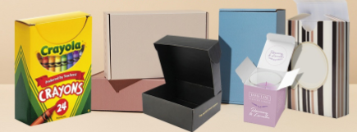
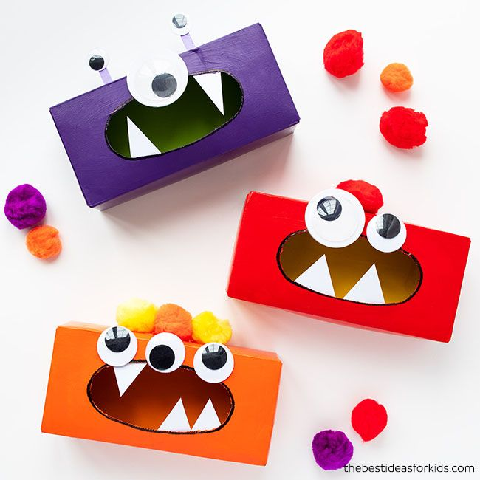
Your challenge is to create a worry box/happy box and fill it with your thoughts.
This is such a lovely short story to remind children of ways to make others’ happy even if we can’t give/receive hugs at the moment.
https://www.youtube.com/watch?v=2PnnFrPaRgY
The worry monster will eat up all of your worries so you don’t need to worry about them anymore! ☺
You could turn these into happy/worry boxes

Slide 11
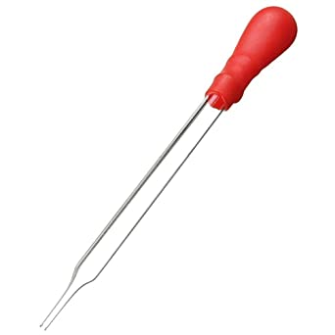
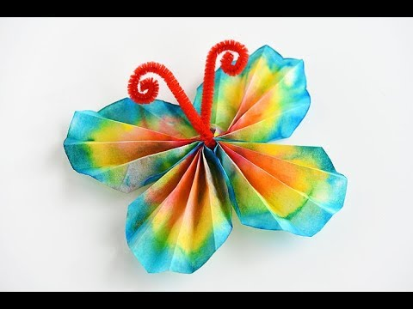
You will need: x2 large cake cases
Water
Pipette (if you have one)
Felt-tips
Pipe cleaner
Watch the clip to see how to make this lovely butterfly ☺
https://www.youtube.com/watch?v=4SwzId86GeA

Slide 12

Alphabet scavenger hunt
Can you find:
something beginning with a …
something beginning with b …
something beginning with c …
something beginning with d …
something beginning with e …
something beginning with f …
something beginning with g …
something beginning with h …
something beginning with i …
something beginning with j …
something beginning with k …
something beginning with l …
something beginning with m …
Search around the house/garden or on your daily walk to find something beginning with each letter of the alphabet ☺

Slide 13
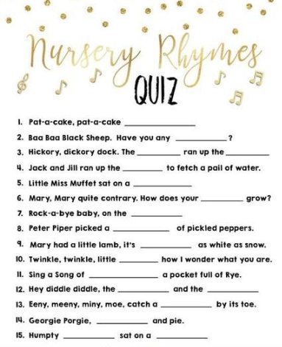
Can you fill in the missing blanks?
You could also try this with your favourite song if your grown-up finds the lyrics online.

