Slide 1
Reception’s
Daily challenges
Week 1
You can choose to record how you have completed these challenges in whatever way works best for you.
You may want to take photos, draw/write/video.
We can’t wait to see how you have got on! ☺

Slide 2
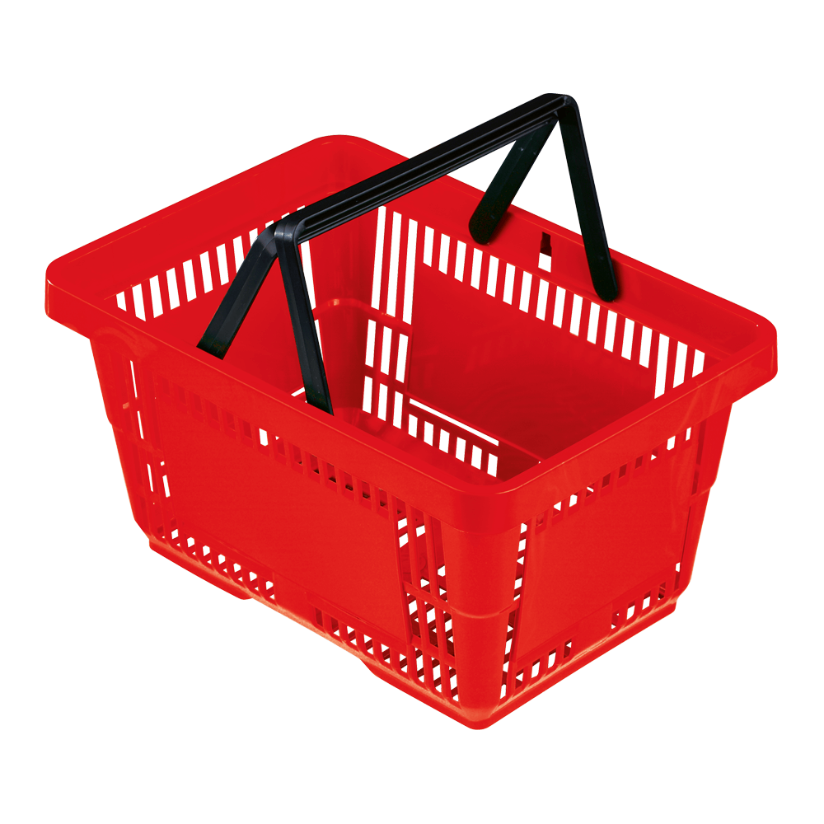
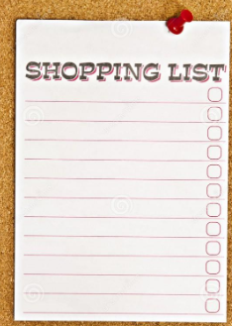
Play a ‘shopping’ game. Set out some items in your pretend ‘shop’ and ask your child to remember the items that you have requested on the shopping list. They can go to the ‘shop’ and put the items in their bag and bring them ‘home’ to you.
If you write a list each time, you and your child can read them when they return ‘home’ and tick them off. The list can get longer and longer; how many items can they remember? For example, write ‘2 potatoes’ first and let your child go to the ‘shop’. Return and check their bag for the items and tick them off the list. Put the potatoes back and write a second list, for example 2 potatoes and three apples and so on. The game continues.

Slide 3
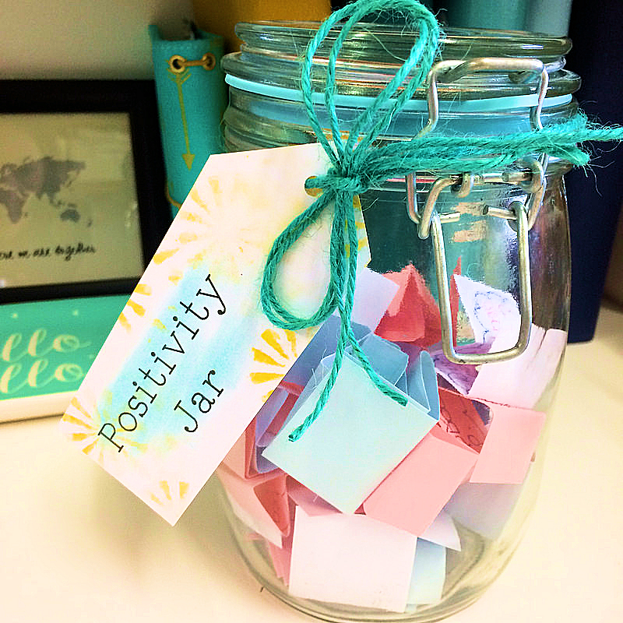

An extra idea! Why not make a positivity jar (We certainly need some positive thoughts at the moment!)
Ask your child/children to think of some the things that they have really enjoyed from the day. Write them on a piece of paper and pop them in the jar. Enjoy reading these either everyday or at the end of the week!

Slide 4
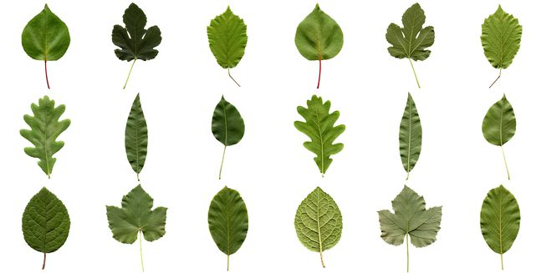
Gather some leaves from your garden.
Look at the differences between them and talk about what you see, describe the patterns, colour, texture and smell. You may want to make rubbings of them or a picture.

Slide 5
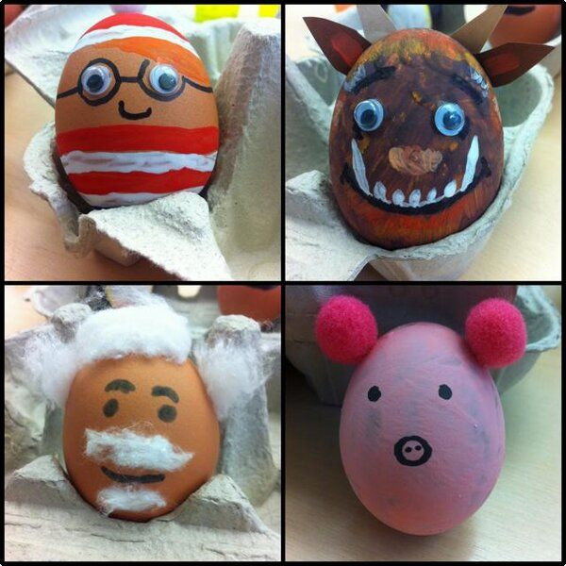
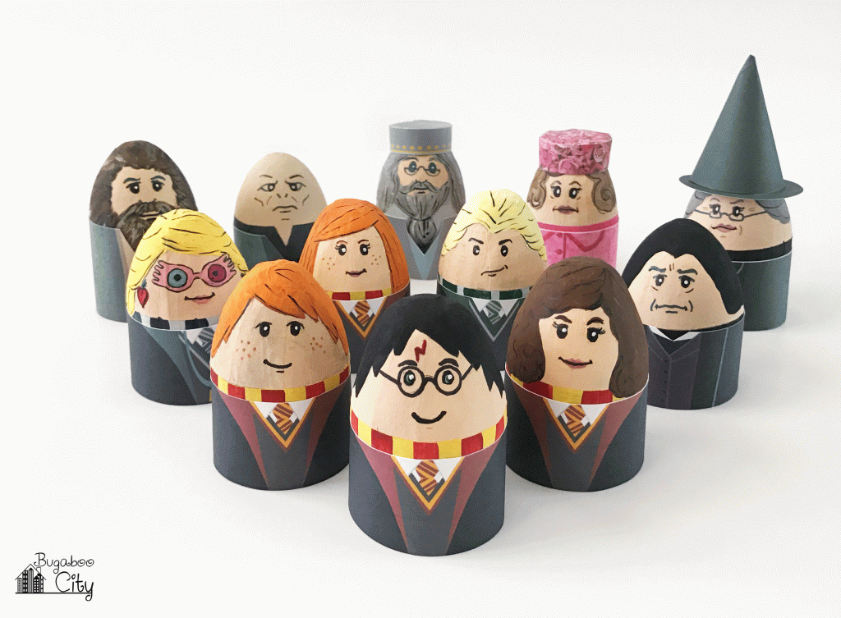
Hard boil some eggs (If you have managed to get hold of any and can spare them!!) or use pebbles and decorate them with felt pens and small items that can be stuck on such as sequins.
Could you make some of your favourite characters from a book?

Slide 6
Make models from either construction sets, playdough or junk materials. Allow your child to use safe tools. Talk to your child as they work. Discuss what they’re doing and make suggestions of how things might be created or adapted. Encourage your child to talk as they work, ask questions such as ‘tell me about this bit’, ‘I wonder why you’ve put that there…?’ Could they draw a plan/ design what they are going to build first? Can they label their model when they have built it? This may take longer than a day!

Slide 7
Play ‘What’s in the box?’ by placing an item or picture in a box and then encouraging your child to ask questions to find out what the item is. For example, if a teddy bear, they might ask, “Is it a toy?” “Is it hard or soft?” “Does it have arms and legs?” “Can it fly?” “Does it move?” The rules could mean that you will just answer “yes” or “no” to these questions. Aim to have a limit of 10 questions. Consider keeping count using a tally such as adding 10 pegs onto a piece of card, placing 10 pieces of pasta in a bowl, 10 ticks on a piece of paper. Your child will then have to guess after the 10 questions have been asked. Swap roles and allow your child to answer your questions.
Could your child write the questions down and then read them to you?

Slide 8
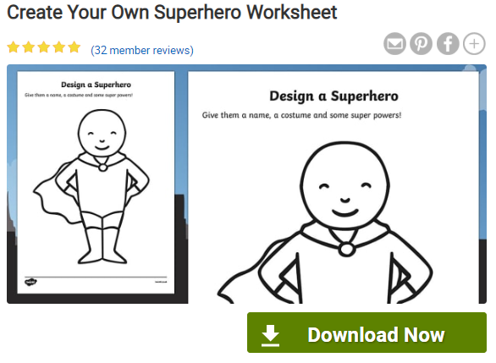
Find out what Superhero's the people in your family would be.
What special powers would they have?
Could you design them a superhero costume?
https://www.twinkl.co.uk/resource/t-t-7877-design-a-superhero-worksheets

Slide 9
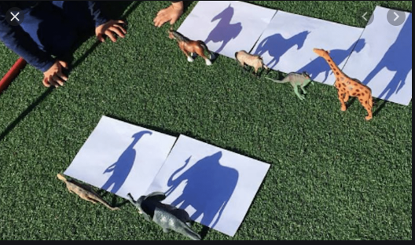
Have a go at animal shadow drawing. You may have to change the day you do this depending on the weather. Fingers crossed for some sun!!

Slide 10
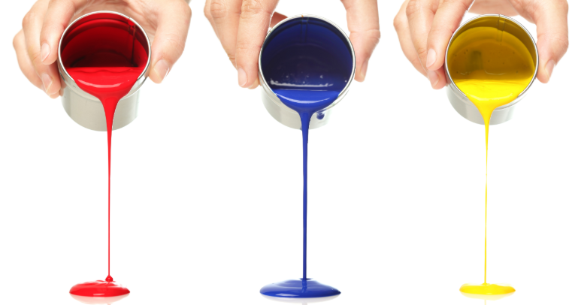
Mix some primary coloured paints (red blue and yellow). Place each colour onto an old plate and encourage your child to place each of their hands in a different coloured paint, for example; one in blue and one in green.
Then tell your child to rub their hands together and watch the magic happen!
Print onto paper with their hands.
If you don’t want your child to use their hands let them explore with a paint brush to see what colours they can make.

Slide 11
Enjoy doing things together and talk whilst you’re doing them, for example making play dough and then playing with it, preparing meals, cleaning the house, gardening, sorting and putting the washing away.
Talk all the time by doing a running commentary on what you and your child are doing.

Slide 12
Invite your child to help tidy up. For example, put the washing up away/empty the dishwasher.
Teach your child how to do ‘jobs’ safely, for example, how to carry a pair of scissors carefully, how to put a glass jug in a cupboard, how to stack plates/dishes so that they don’t fall.
Explain to them that this is giving them a responsibility that they need to carry out to the best of their ability.
Talk about being responsible and what other responsibilties might you have at home/in school/as a big brother/sister, etc.

