Slide 1
Reception’s
Daily challenges
Week 6 & 7
You can choose to record how you have completed these challenges in whatever way works best for you.
You may want to take photos, draw/write/video.
These are just suggestions – you do not have to record it at all if you choose not to.
We can’t wait to see how you have got on! ☺

Slide 2
Week 6

Slide 3
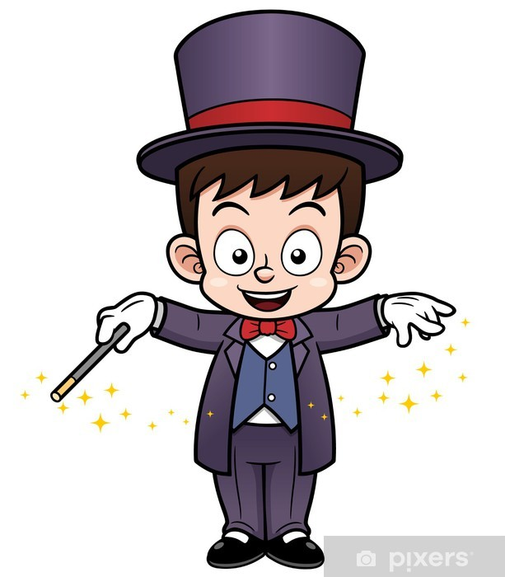
Monday:
Have you ever wanted to be a magician?
Well now is your chance.
Watch the link below to learn some cool ‘magic’ tricks you could then perform to your family ☺
https://www.youtube.com/watch?v=nl_Mr_4JZwk

Slide 4
Tuesday: challenge continued
Have you ever wanted to be a magician?
Well now is your chance.
Watch the link below to learn some cool ‘magic’ tricks you could then perform to your family ☺
https://www.youtube.com/watch?v=nl_Mr_4JZwk

Slide 5

Wednesday:
Scavenger Hunt
Have a look around your house and see if you can find the items on the scavenger hunt list.
Can you find:
something blue
something that rolls
something that makes a loud noise
something light
something that makes you feel happy
something smaller than your thumb
something that smells nice
something that makes a scratchy noise
something multi-coloured
something that makes a quiet noise
something green
something bigger than your hand

Slide 6
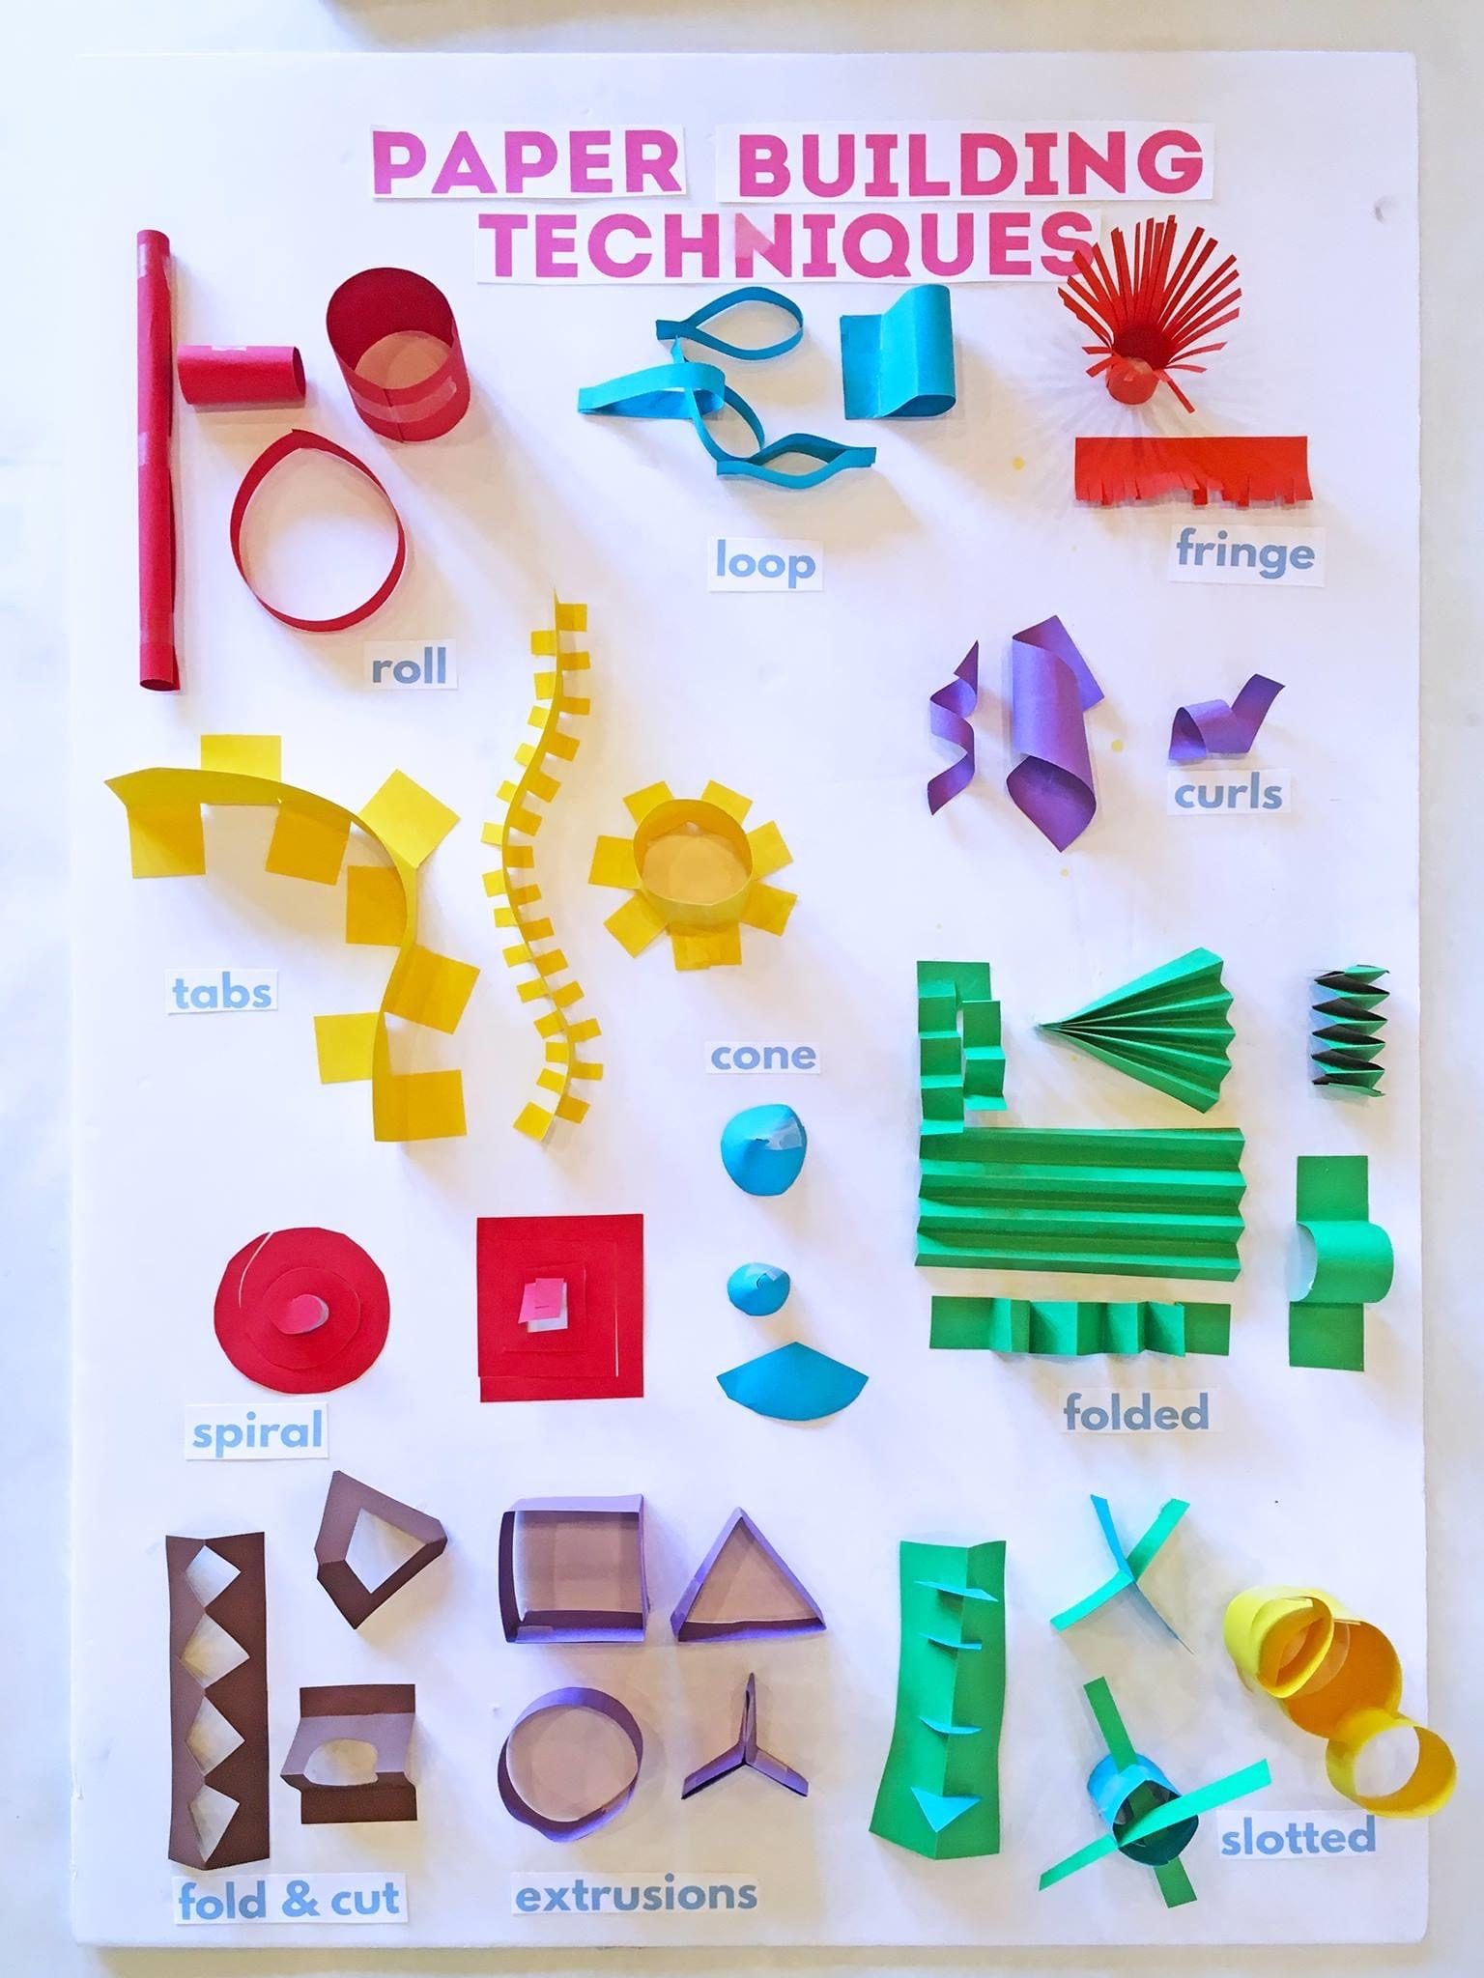
Thursday:
How many of these techniques can you do?

Slide 7
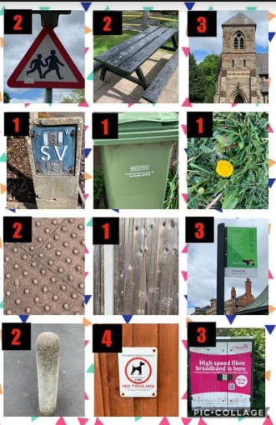
Friday:
Look out for these things whilst out on your daily walk.
Each picture is numbered so you can add up how many points you get each day.
Could you possibly try a different route the following day to see if you could get more points? ☺

Slide 8
Week 7

Slide 9
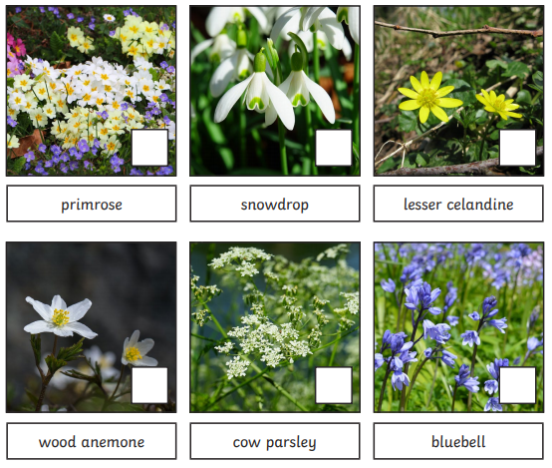
Monday:
Do you have any of these flowers in your garden? Or have you seen them on your travels?
If not, what flowers do you have? Could you look on the internet with a grown-up to find out it’s name?
Could you make your own list of garden flowers with drawings?

Slide 10
Tuesday:
Today’s challenge is to find 3 jobs around the house/garden that you could help your grown-ups with. Here are some suggestions…
Lay the table at dinner time
Learn how to make your bed
Tidy your room/help a younger sibling tidy theirs too?
Help with the washing/drying up
Help prepare food
Fold the laundry

Slide 11
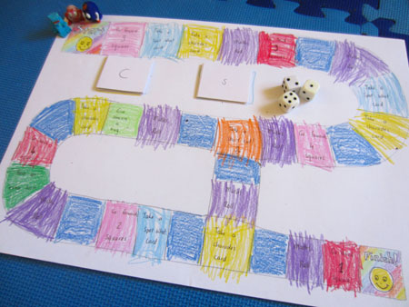
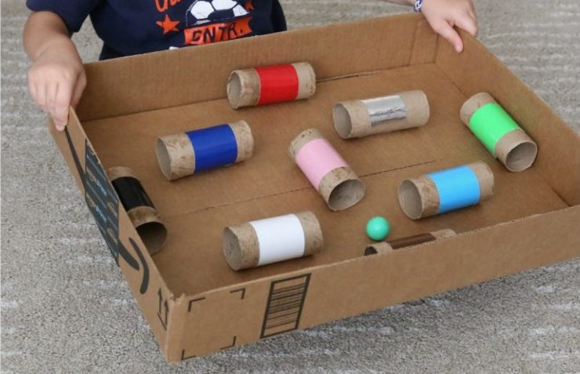
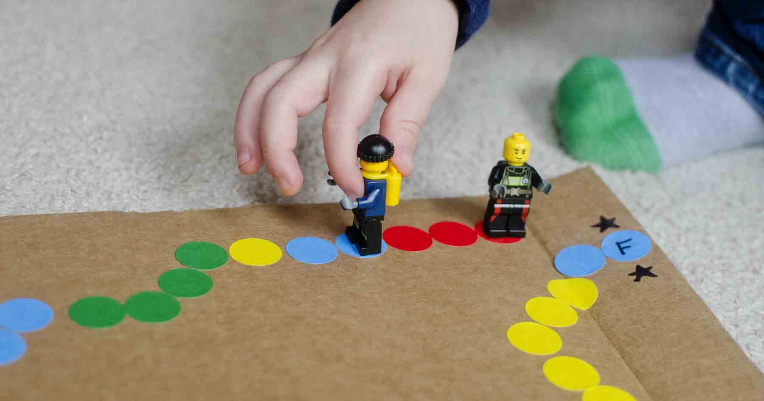
Wednesday: Family time! ☺
Time to play a game!
Choose a board game to play or make your own game for all of the family to get involved with.
* Remember to take it in turns and it is ok not to win!! *

Slide 12
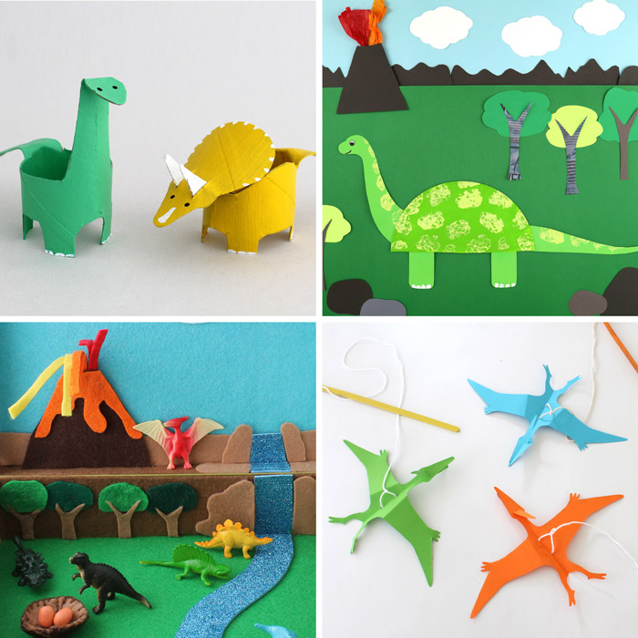
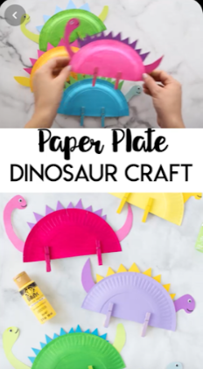

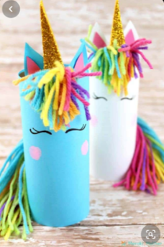
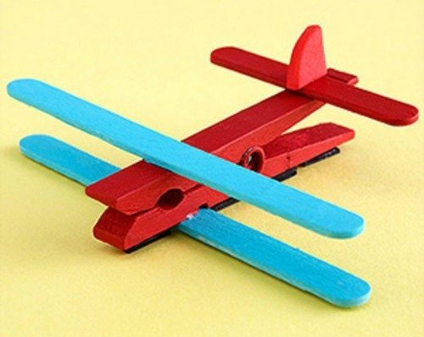
Thursday:
Let’s get ‘crafty’!
Choose any of the following to have a go at making ☺

Slide 13
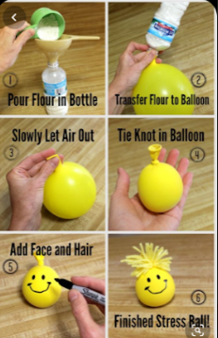
Friday:
Make a stress ball
This seems easy to make and will be ideal if you start to feel frustrated and need to give it a good squeeze!

