Slide 1
Reception’s
Daily challenges
Week 12
You can choose to record how you have completed these challenges in whatever way works best for you.
You may want to take photos, draw/write/video.
These are just suggestions – you do not have to record it at all if you choose not to.
We can’t wait to see how you have got on! ☺

Slide 2
Week 12

Slide 3
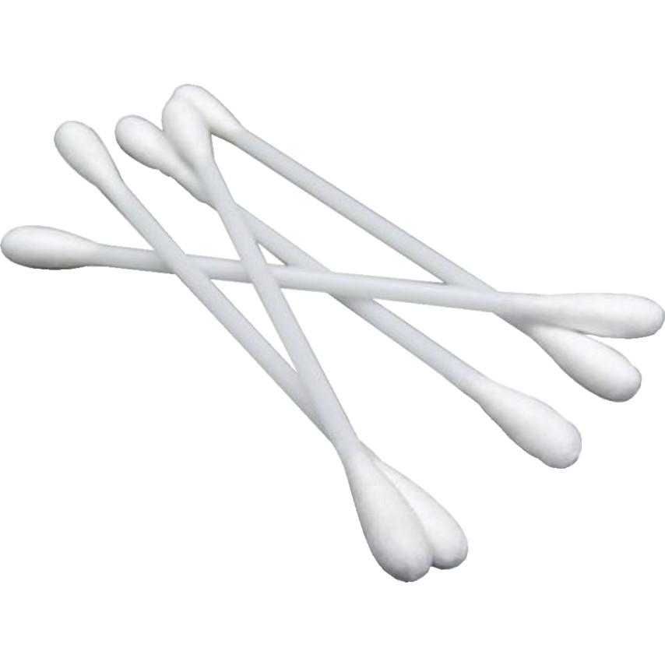
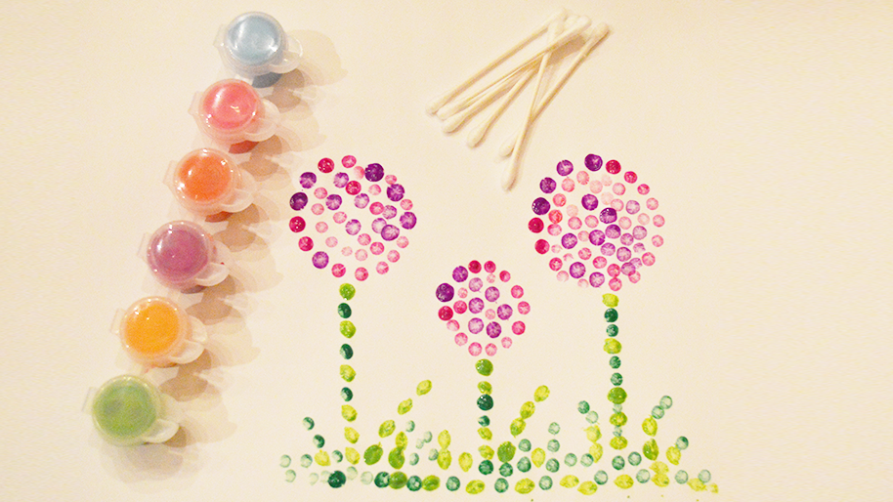
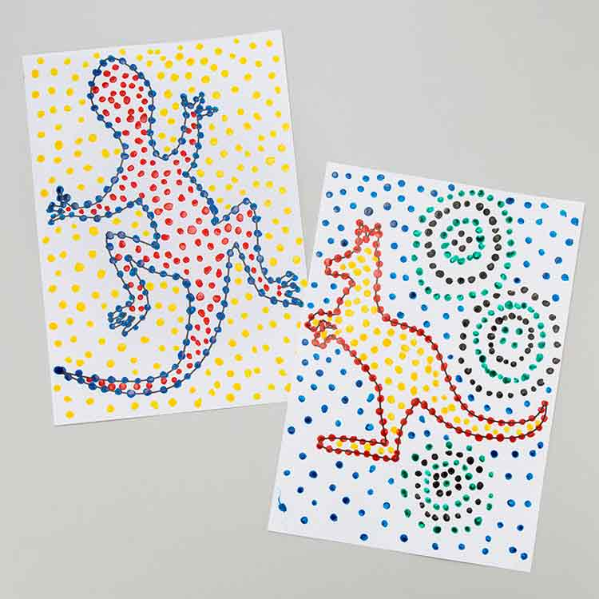
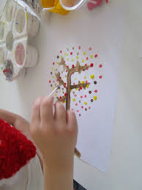
Cotton bud shapes
Relax and unwind…
Use cotton buds to create a dotty painting. Ask your grown up to draw an outline of a picture for you to paint using only dots.
Maybe even as your grown up to put some quiet, calming music on to help with mindfulness ☺
Monday

Slide 4
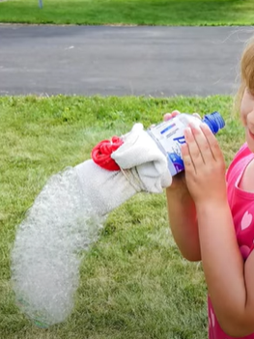
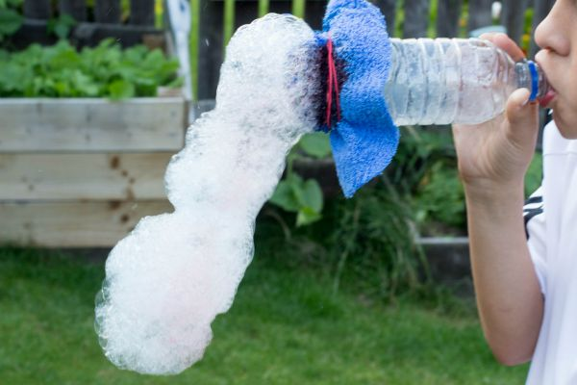
Tuesday
Bubble fun!
Create your very own bubble snake.
Follow the instructions on either of the links below …
https://www.youtube.com/watch?v=n_d7kFfYkjc
https://www.youtube.com/watch?v=w_XO3x3_A_8
Note: you can easily make ‘bubble mix’ using washing up liquid and water ☺

Slide 5
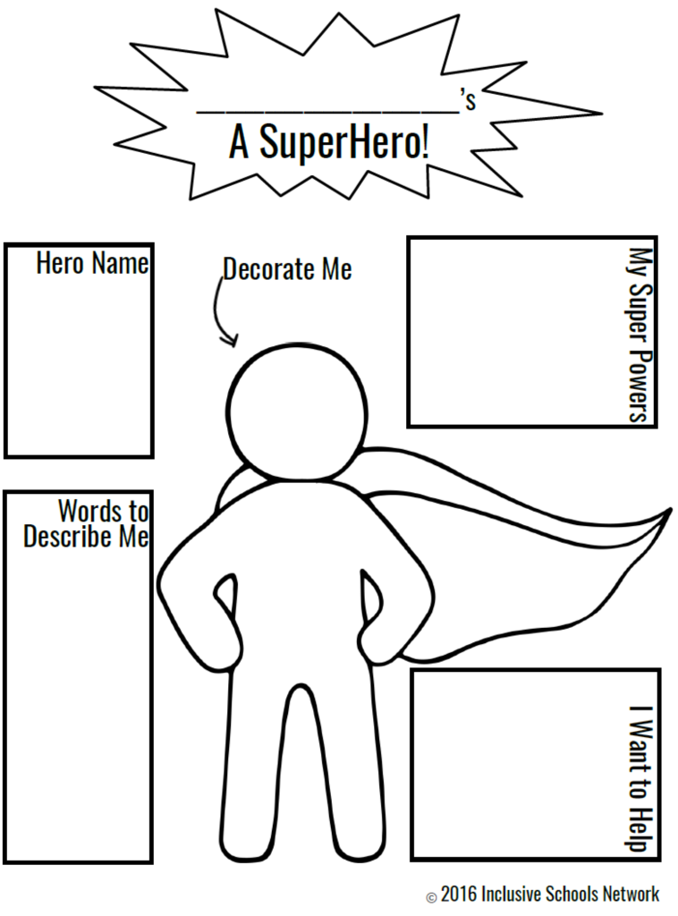

Wednesday
Superheroes
Design your own superhero!
Give them amazing powers and a colourful cape too.
Have you got any dressing up costumes or clothes you could put on to become a real superhero yourself? ☺

Slide 6
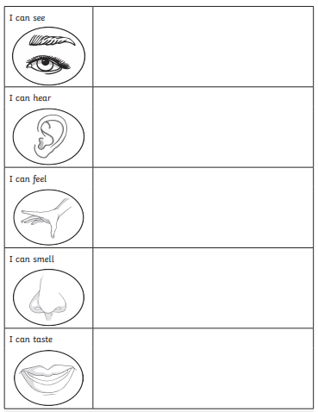
Thursday
Use your senses
Go on a relaxing senses walk with your family and record what you can see, hear, smell and touch!
(If you aren’t planning on going out for a walk today you could do the same in your house or garden).

Slide 7
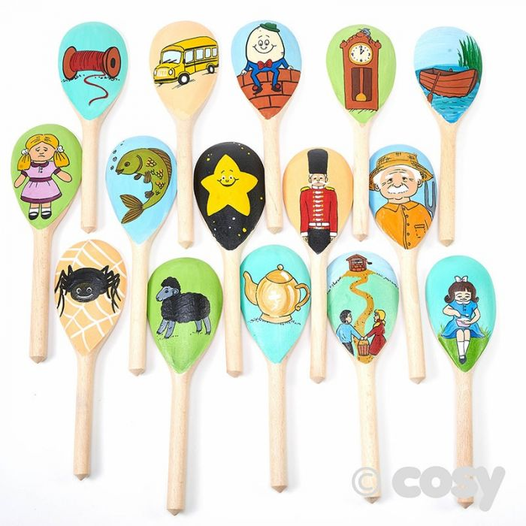
Friday
Nursery Rhymes
How many nursery rhymes do you know off by heart?
See if you can sing as many as you can.
Extra challenge: Ask your grown up to hum the tune of a familiar nursery rhyme for you to guess!
Listen carefully ☺

