Slide 1
Reading in Reception

Slide 2
Reading in Reception
All children will be reading at different levels during Reception. Here are the steps we go through when reading with a range of abilities. This should help you to see where your child is at and what their next steps are.

Slide 3
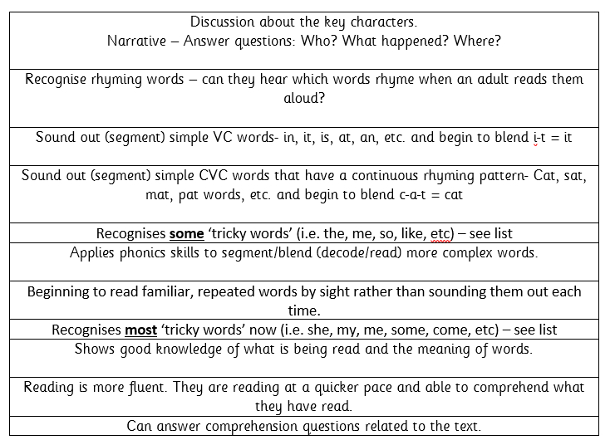

Slide 4
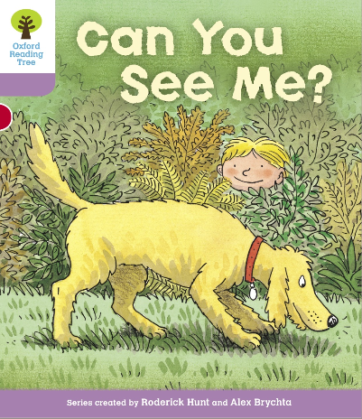
Example of talking through this stage 1+ book…
Tricky word focus: these words are to be read by sight.
Start the session by ensuring your child knows the following:
you, me, my, are & the
Digraphs to focus on: ee, y (teddy), er, oo, ng
Use the jolly phonics sound mats to point to each of these sounds.
Begin reading.
P1) “Can you see my teddy bear?” This is a question. Talk to your child about what a question is. Point to the question mark. This is how we know it is a question. Practise reading this ‘question’ in a different tone of voice. Ask your child the question. “Can you see my teddy bear?” See if the child can find the teddy bear. Q) What else can you find?
P2-3) Notice that “Can you see my …” is repeated. Show your child that it says the same thing. See if they can remember any of these words purely by sight on the next page. Q) Who is that in the shed? Could it be Biff or Chip? What might they be doing in the shed? (Discuss real life experiences of what you might find/do in a shed).
P4-5) Some words such as ‘picture’ are very difficult to read. It is ok to read this word for them. See if they can read it independently when you go through the book again another time.
This time we are looking for Kipper’s picture of a big, red frog. What other pictures can you see? Encourage your child to describe the pictures using two adjectives like Kipper has used ‘big’ and ‘red’.
i.e. I can see a beautiful, blue butterfly. I can see a tall, yellow dog with a brown, chewy bone.
P6-7) Where have we got to look for the tiger? … In the tree.
P8) Describe what you can see. Now ask your grown up some questions.
i.e. “Mummy, can you see the soldier?”
You could play a quick game of ‘eye-spy’ for the last page.
“I spy with my little eye, something beginning with … d” = dog, etc.
Book title: Can you see me?
Stage: 1+
Book focus: Asking questions

Slide 5
Week 1 w/c: 20.4.20

Slide 6
Oxford Owl books to try:
https://www.oxfordowl.co.uk/api/digital_books/1223.html
Suggestions for Week 1:
Stage 1W: Big bad bug- (Your child may need support to read the words in this book. You can model sounding out and blending and then they can have a go).
Stage 1+ Big bad bug
Stage 2 The ox and the yak
Stage 3 Silver foil rocket
Stage 4 No tricks Gran!
Stage 5 A monster mistake
Stage 6 Paris adventure
Stage 7 Animal magic
Stage 10 Cornflake coin

Slide 7
Week 1 CHALLENGE!
Find things out from books or use the internet to find out about things your child is interested in.
Encourage your child to make their own non-fiction book about something they’re interested in, for example animals, superheroes, space, unicorns, transport and so on. Your child could draw pictures or/and write some words or sentences about the facts that they discover!

Slide 8
Week 2 w/c: 27.4.20

Slide 9
Oxford Owl books to try:
https://www.oxfordowl.co.uk/api/digital_books/1223.html
Suggestions for Week 2:
Stage 1W The dragon balloon
Stage 1+ Kippers diary
Stage 2 Dad can you do this
Stage 3 The ice rink
Stage 4 Stuck in the mud
Stage 5 Sue kangaroo
Stage 6 Paris adventure
Stage 7 Red planet
Stage 10 A life in the sky

Slide 10
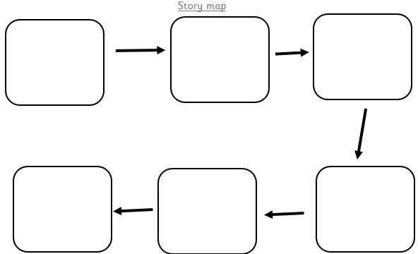
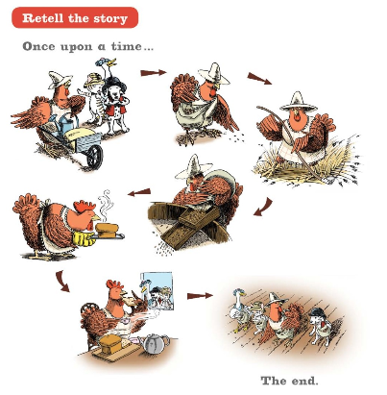
Week 2 CHALLENGE!
Make a story map with your child.
Draw a large road on a piece of wallpaper or flattened out cardboard box. Plot the story from beginning to end along the road. It could be a well known story or one you make up together. You can write the words/sentences for your child and they can write some if they are able.
They can add objects to help tell the story, for example, a house they’ve made from Lego.

