Slide 1
Reading in Reception
Week 3 & 4

Slide 2
Reading in Reception
All children will be reading at different levels during Reception. Here are the steps we go through when reading with a range of abilities. This should help you to see where your child is at and what their next steps are.

Slide 3
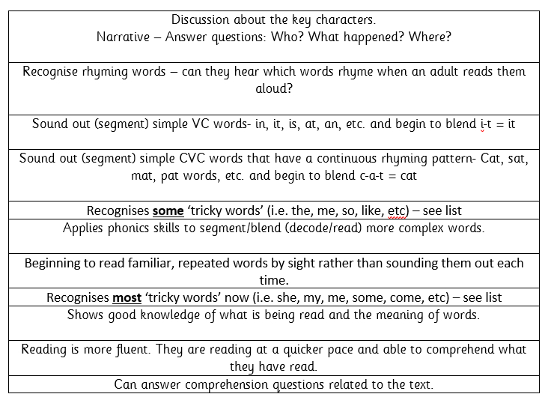

Slide 4
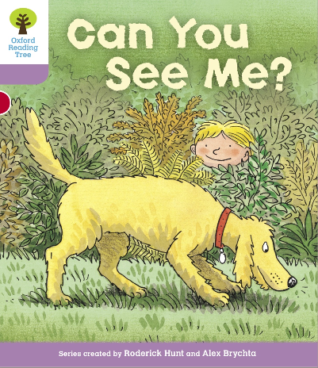
Example of talking through this stage 1+ book…
Tricky word focus: these words are to be read by sight.
Start the session by ensuring your child knows the following:
you, me, my, are & the
Digraphs to focus on: ee, y (teddy), er, oo, ng
Use the jolly phonics sound mats to point to each of these sounds.
Begin reading.
P1) “Can you see my teddy bear?” This is a question. Talk to your child about what a question is. Point to the question mark. This is how we know it is a question. Practise reading this ‘question’ in a different tone of voice. Ask your child the question. “Can you see my teddy bear?” See if the child can find the teddy bear. Q) What else can you find?
P2-3) Notice that “Can you see my …” is repeated. Show your child that it says the same thing. See if they can remember any of these words purely by sight on the next page. Q) Who is that in the shed? Could it be Biff or Chip? What might they be doing in the shed? (Discuss real life experiences of what you might find/do in a shed).
P4-5) Some words such as ‘picture’ are very difficult to read. It is ok to read this word for them. See if they can read it independently when you go through the book again another time.
This time we are looking for Kipper’s picture of a big, red frog. What other pictures can you see? Encourage your child to describe the pictures using two adjectives like Kipper has used ‘big’ and ‘red’.
i.e. I can see a beautiful, blue butterfly. I can see a tall, yellow dog with a brown, chewy bone.
P6-7) Where have we got to look for the tiger? … In the tree.
P8) Describe what you can see. Now ask your grown up some questions.
i.e. “Mummy, can you see the soldier?”
You could play a quick game of ‘eye-spy’ for the last page.
“I spy with my little eye, something beginning with … d” = dog, etc.
Book title: Can you see me?
Stage: 1+
Book focus: Asking questions

Slide 5
Week 3 w/c: 4.5.20
Continue to read books from home or suggested texts on the Oxford Owl website.
Have a go at answering some comprehension questions linked to our writing focus text:
The Three Billy Goats Gruff

Slide 6
Oxford Owl books to try:
https://www.oxfordowl.co.uk/api/digital_books/1223.html
Suggestions for Week 3:
Stage 1W:Max’s rocket
Stage 1+ The fishing trip
Stage 2 Nok can fix it
Stage 3 Stuck in the mud
Stage 4 Cats painting
Stage 5 The parachute
Stage 6 Don’t press the buttons
Stage 7 Things that sting
Stage 10 Jungle shorts

Slide 7
Week 3 CHALLENGE!
Using the books at home can you be a reading detective and find as many tricky words inside as you can?
Write them down and create your own tricky word inventory for as many of your books as you can.

Slide 8
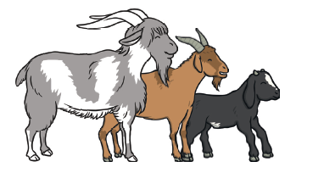
Comprehension Questions
The Three Billy Goats Gruff
(Note for parents: depending on your child’s ability, you may want to re-read the story to them and then ask the questions or you may ask your child to read the text and questions themselves if they are at that level). Within the Reading folder you will see a differentiated reading comprehension resource for this story. You can choose which questions are appropriate to ask your child. There is an example on the next slide of a question and answer using the text).

Slide 9
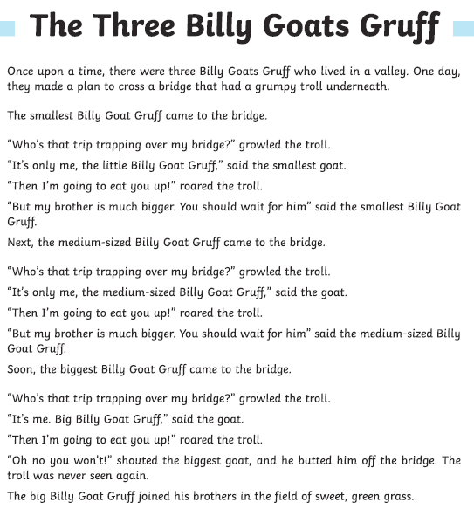
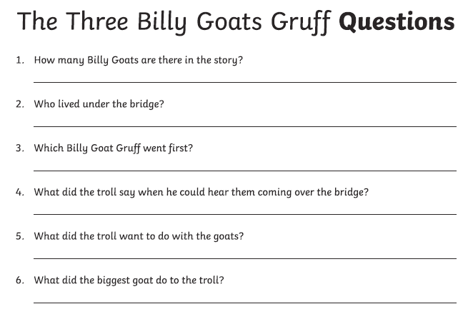




It is really important to emphasise the most important words in the question!
Who?
Where?
What happened?
When?

Slide 10
Week 4 w/c: 11.5.20
Continue to read books from home or suggested texts on the Oxford Owl website.
Have a go at answering some comprehension questions linked to our writing focus text:
Goldilocks and the Three Bears

Slide 11
Oxford Owl books to try:
https://www.oxfordowl.co.uk/api/digital_books/1223.html
Suggestions for Week 4:
Stage 1W Splat
Stage 1+ Let’s bake
Stage 2 Tigers fish
Stage 3 Popcorn surfing
Stage 4 It’s too hot
Stage 5 Claws
Stage 6 Worm song
Stage 7 Into the pyramid
Stage 10 Eric’s talking ears

Slide 12
Week 4 CHALLENGE!
Can you find any of the phonics sounds we are learning this week in your books?
You can search through books suggested by school or any books you may have at home.
*Remember- there are other reading materials such as a newspaper, magazine, catalogue, etc to look in too!*

Slide 13
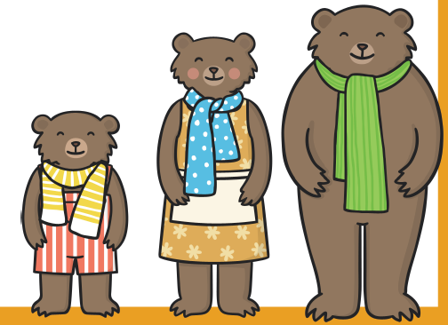
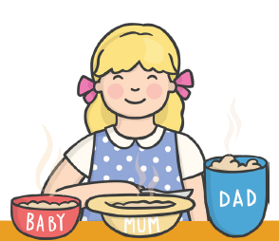
Comprehension Questions
Goldilocks and the Three Bears
(Note for parents: depending on your child’s ability, you may want to read the story to them and then ask the questions or you may ask your child to read the text and questions themselves if they are at that level). Within the Reading folder you will see a differentiated reading comprehension resource for this story. You can choose which questions are appropriate to ask your child. There is an example on the next slide of a question and answer using the text).

