Slide 1
Reading in Reception
Week 8 & 9

Slide 2
Reading suggestions:
Oxford owl library Free e-book library
Literacy Trust Online Library
Fun Brain Free e-book library
Audible stories

Slide 3
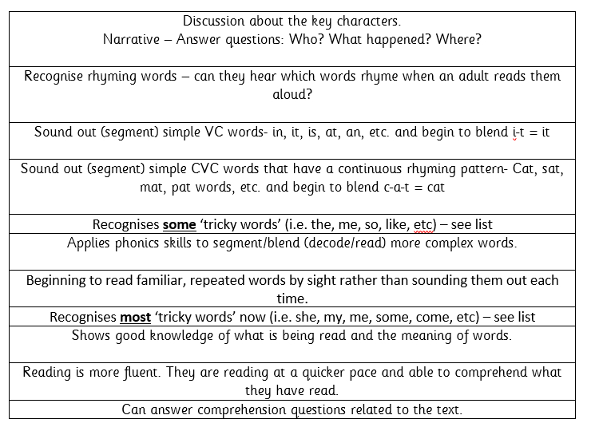
Reading in Reception
All children will be reading at different levels during Reception. Here are the steps we go through when reading with a range of abilities.
This should help you to see where your child is at and what their next steps are.

Slide 4
Week 8 & 9 w/c: 15.6.20 / 22.6.20
Continue to read books from home or suggested texts from the website suggested on slide 1.
For the next few weeks we will be focussing on how many words your child is able to read in 1 minute. We call this a ‘running record’…

Slide 5
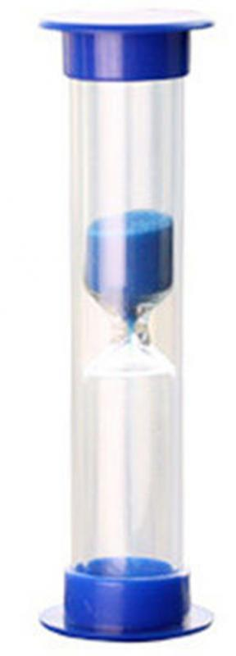
Running Reading Record
In order to track your child’s progress and also give them something to challenge themselves, we assess to see how many words they can read within 1 minute.
We continue to practise reading the same book each day as we would normally and try the running record again. This should show an improvement with an increase in the amount of words that your child can now read.
Children usually like this as it is a little bit like a ‘race’ with themselves. You could use a mini sand timer, egg timer or a stop watch on your phone to tell them when to stop. As the child reads, it is a good idea to note down any words that they really struggle with and come back to this at the end.
*Remember to praise them each time & continue to practise, practise, practise! * ☺

Slide 6
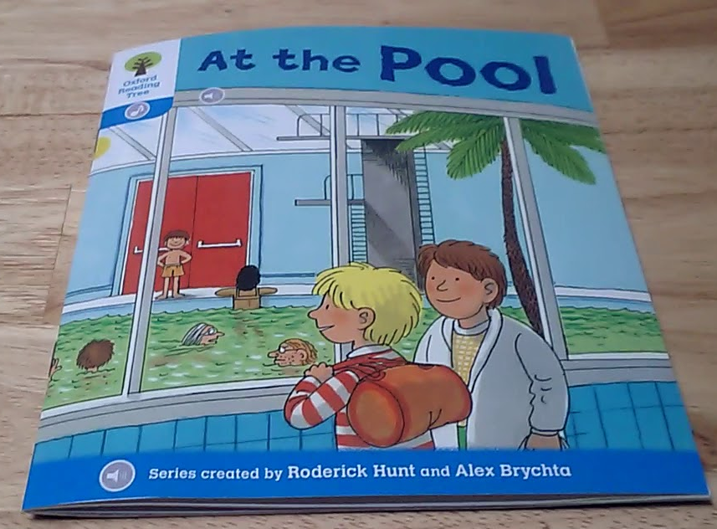
Running Reading Record
Stage 3- At the Pool
Adult reads this passage:
Kipper went to the swimming pool. Wilma’s mum took him. She took Biff and Chip, too. It was a new pool. Everyone wanted to swim. Kipper looked for his trunks. He couldn’t find them.
Child reads:
Kipper couldn’t go in the pool.
“Sorry”, said the man.
Wilma’s mum was in the water.
“Oh dear”, she said.
Etc…
Here’s an example of a running record we would do in school …
✓
✓
✓
✓
✓
✓
✓
✓
✓
✓
✓
✓
Words to practise…
✓
✓
✓
✓
couldn’t
sorry
water

Slide 7
Running Reading Record
At home …
Choose a reading book (paper copy or oxford owl online e-book)
Adult read a few sentences to model the correct pace of reading
Press START on the stop watch (1 minute)
Your child will continue to read as normal
(Take a mental note/written note of any words they really struggle with to help at the end – don’t try and support during the timed activity)
STOP the timer at 1 minute and get your child to keep their finger on the word they ended up on.
Count the amount of words they were able to read independently
Make a note of their ‘score’ and try again another day ☺
(If your child finishes the book/has extra time remaining, try them on the next stage up to see how they get on with more complex words).
Monday
Number of words read:
Wednesday
Number of words read:

Slide 8
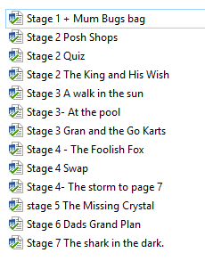
Examples
You will find some example of running records we have previously used for Oxford Reading Tree book which you will find on the Oxford Owl website as an e-book.
You do not need to have all of the words written down like we have done but they are there if you wanted to highlight/use ☺

