Slide 1
Reading in Reception
Week 5
18.05.20

Slide 2
Reading in Reception
All children will be reading at different levels during Reception. Here are the steps we go through when reading with a range of abilities. This should help you to see where your child is at and what their next steps are.

Slide 3
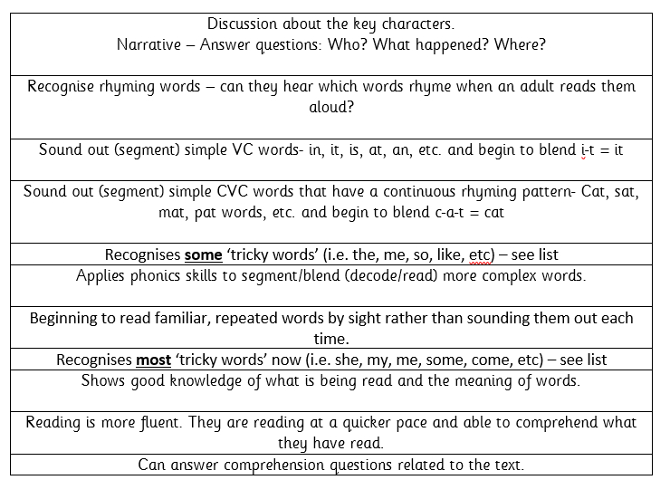

Slide 4
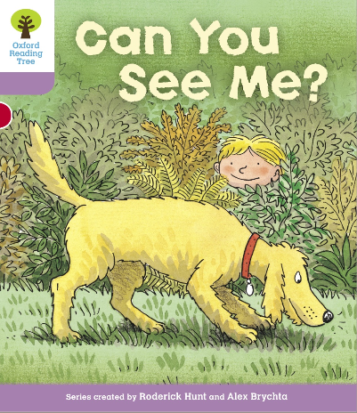
Example of talking through this stage 1+ book…
Tricky word focus: these words are to be read by sight.
Start the session by ensuring your child knows the following:
you, me, my, are & the
Digraphs to focus on: ee, y (teddy), er, oo, ng
Use the jolly phonics sound mats to point to each of these sounds.
Begin reading.
P1) “Can you see my teddy bear?” This is a question. Talk to your child about what a question is. Point to the question mark. This is how we know it is a question. Practise reading this ‘question’ in a different tone of voice. Ask your child the question. “Can you see my teddy bear?” See if the child can find the teddy bear. Q) What else can you find?
P2-3) Notice that “Can you see my …” is repeated. Show your child that it says the same thing. See if they can remember any of these words purely by sight on the next page. Q) Who is that in the shed? Could it be Biff or Chip? What might they be doing in the shed? (Discuss real life experiences of what you might find/do in a shed).
P4-5) Some words such as ‘picture’ are very difficult to read. It is ok to read this word for them. See if they can read it independently when you go through the book again another time.
This time we are looking for Kipper’s picture of a big, red frog. What other pictures can you see? Encourage your child to describe the pictures using two adjectives like Kipper has used ‘big’ and ‘red’.
i.e. I can see a beautiful, blue butterfly. I can see a tall, yellow dog with a brown, chewy bone.
P6-7) Where have we got to look for the tiger? … In the tree.
P8) Describe what you can see. Now ask your grown up some questions.
i.e. “Mummy, can you see the soldier?”
You could play a quick game of ‘eye-spy’ for the last page.
“I spy with my little eye, something beginning with … d” = dog, etc.
Book title: Can you see me?
Stage: 1+
Book focus: Asking questions

Slide 5
Oxford Owl books to try:
https://www.oxfordowl.co.uk/api/digital_books/1223.html
Suggestions for Week 5:
Stage 1W:Big bad bug
Stage 1+ The dragon balloon
Stage 2 Moths
Stage 3 The lost cow
Stage 4 The scarf
Stage 5 The orchid thief
Stage 6 A pony for a day
Stage 7 What was it like?
Stage 10 Tom thumb and the football team

Slide 6
Week 5 w/c: 18.5.20
Continue to read books from home or suggested texts on the Oxford Owl website. If your child is able to read all of the words by sight and is able to comprehend what they have read by all means try reading books on the next stage up. You can filter these on the oxford owl website.
See the next slide for this weeks activity…

Slide 7



Week 5
Oliver Jeffers has released videos of himself reading his fantastic books. You can find these on this website
https://www.oliverjeffers.com/abookaday
There are fantastic titles such as: How to catch a star, Lost and found, The great paper caper, The day the crayons quit and many more.
We would like you to watch a video a day.
Can you tell your grown ups what happened in the story?
Which part did you like the best?
Who was your favourite character? Why did you like them?
Could you make the characters and retell the story as a puppet show?

