Slide 1
Reading in Reception
Week 6 & 7

Slide 2
Reading suggestions:
Oxford owl library Free e-book library
Literacy Trust Online Library
Fun Brain Free e-book library
Audible stories

Slide 3
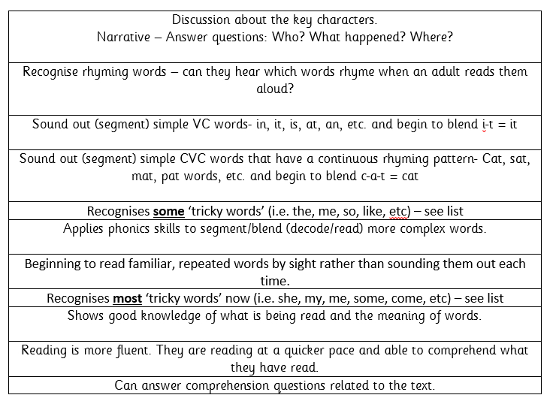
Reading in Reception
All children will be reading at different levels during Reception. Here are the steps we go through when reading with a range of abilities.
This should help you to see where your child is at and what their next steps are.

Slide 4

Example of talking through this stage 1+ book…
Tricky word focus: these words are to be read by sight.
Start the session by ensuring your child knows the following:
you, me, my, are & the
Digraphs to focus on: ee, y (teddy), er, oo, ng
Use the jolly phonics sound mats to point to each of these sounds.
Begin reading.
P1) “Can you see my teddy bear?” This is a question. Talk to your child about what a question is. Point to the question mark. This is how we know it is a question. Practise reading this ‘question’ in a different tone of voice. Ask your child the question. “Can you see my teddy bear?” See if the child can find the teddy bear. Q) What else can you find?
P2-3) Notice that “Can you see my …” is repeated. Show your child that it says the same thing. See if they can remember any of these words purely by sight on the next page. Q) Who is that in the shed? Could it be Biff or Chip? What might they be doing in the shed? (Discuss real life experiences of what you might find/do in a shed).
P4-5) Some words such as ‘picture’ are very difficult to read. It is ok to read this word for them. See if they can read it independently when you go through the book again another time.
This time we are looking for Kipper’s picture of a big, red frog. What other pictures can you see? Encourage your child to describe the pictures using two adjectives like Kipper has used ‘big’ and ‘red’.
i.e. I can see a beautiful, blue butterfly. I can see a tall, yellow dog with a brown, chewy bone.
P6-7) Where have we got to look for the tiger? … In the tree.
P8) Describe what you can see. Now ask your grown up some questions.
i.e. “Mummy, can you see the soldier?”
You could play a quick game of ‘eye-spy’ for the last page.
“I spy with my little eye, something beginning with … d” = dog, etc.
Book title: Can you see me?
Stage: 1+
Book focus: Asking questions

Slide 5
Week 6 w/c: 1.6.20
Continue to read books from home or suggested texts from the website suggested on slide 1.
This week we will be focussing on reading in different contexts. This should hopefully help to keep your child engaged with reading and also enjoy it! ☺

Slide 6
Week 6 w/c: 1.6.20
Over the next few weeks we will be focussing on a reading challenge we’d like your child to complete each day. Each activity will involve some aspect of reading/understanding.
Please continue to encourage your child to read their books and read books to them too as this is also important. ☺

Slide 7
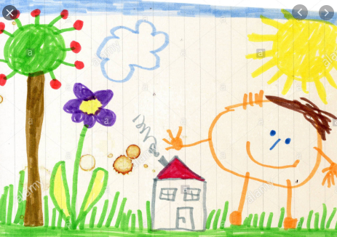
Week 6 w/c: 1.6.20
Monday’s Reading Challenge: listen & draw
Your grown-up needs to read the following passage to you.
2) You need to listen very carefully to the information as you will need to draw a picture of what is being described.
For example:
“I can see some green grass and one purple flower.
There is a tall apple tree with lots of red apples growing on it.
You are stood next to nanny’s house waving.
The bright, yellow sun is out and there is only one cloud in the sky”.
Obviously, this passage was very long to demonstrate with the picture I found however you could keep it really simple such as: the green tree has three red apples on it. (Your child will need to draw the tree with three apples using the correct colours).

Slide 8
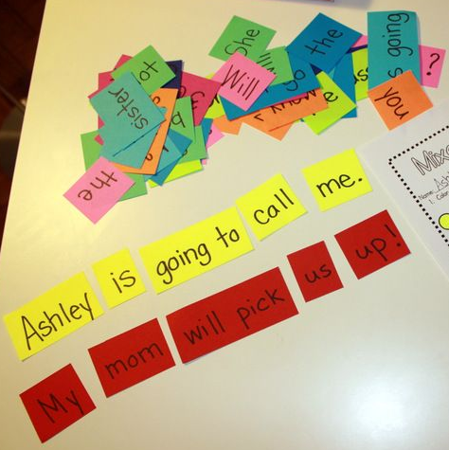
Week 6 w/c: 1.6.20
Tuesday’s Reading Challenge: sentence sorting
Ask your grown up to write a simple sentence on a piece of paper, spacing out each word (without telling you what it says!)
Cut up the words & the full stop.
Jumble it all up.
You need to sort out the sentence so that it makes sense.
For example:
doge
one
sate
Thee
.e
loge
thee
Look for the capital letter as that word must be at the beginning. Make sure the full stop is at the end. Then sort the words.
Thee
doge
sate
one
thee
loge
.e

Slide 9

Week 6 w/c: 1.6.20
Wednesday’s Reading Challenge: Reading clues
Ask your grown-up/older sibling to hide something in the house/garden (could be your favourite teddy or a random object).
Your grown-up will write you some clues for you to read in order to find your missing item. They could be as simple as ‘on the chair’, ‘next to the door’ or you could make them much more challenging.

Slide 10

Week 6 w/c: 1.6.20
Thursday’s Reading Challenge: bedtime story
Read a bedtime story to your grown-up, sibling or your favourite teddy.

Slide 11
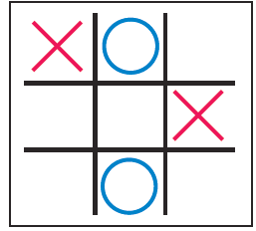
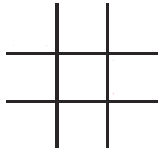
Week 6 w/c: 1.6.20
Friday’s Reading Challenge: Noughts & Crosses game
Ask your grown-up to draw a grid with 9 blank squares.
They will write some sentences in each of the squares for you to read.
Choose who is going to be noughts and who is going to be crosses.
Take it in turns to choose where you are going to draw/place your counter. You must read the sentence correctly to get that square.
See who can get three in a row first!
The cat sat on the mat.
I want to go to bed now.
The sun is shining today.
I hope it does not rain today.
I can smell something sweet.
My brother shares his toys with me.
I love to play in the garden.
My sister is really kind to me.
Today is Friday and tomorrow is Saturday.

Slide 12
Week 7 w/c: 8.6.20
Continue to read books from home or suggested texts from the website suggested on slide 1.
This week we will be continuing to focus on reading in different contexts. This should hopefully help to keep your child engaged with reading and also enjoy it! ☺

Slide 13
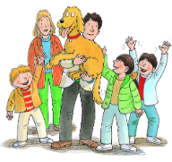

Week 7 w/c: 8.6.20
Monday’s Reading Challenge: Who is your favourite character?
Read a book of your choice to yourself or someone else and decide who your favourite character is and why?
You could draw/write about them to share with others.
Why are they your favourite?
Do they have a super power?
Do you like what they look like?
Are they kind to others?
Are they like you?
Are they funny?

Slide 14

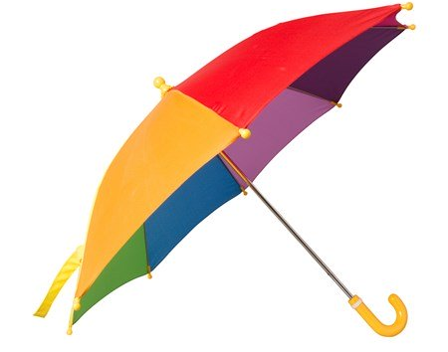
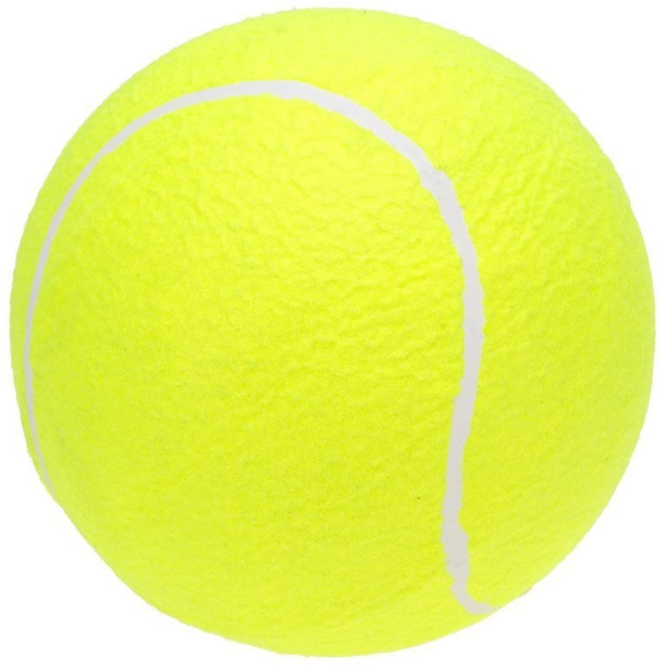
Week 7 w/c: 8.6.20
Tuesday’s Reading Challenge:
Read and match object to statement
Select some objects from around the house/garden.
Ask a grown-up to write some descriptions/statements to match to the object.
Example:
You will need to use this when it rains. e
This is needed when you play a sport called Tennis. e
What is the time?

Slide 15




Week 7 w/c: 8.6.20
Wednesday’s Reading Challenge: Asking questions
Read a book with someone else in your house.
Instead of them asking you comprehension questions about the story, why don’t you ask them.
You could ask the following question to see if they have been listening! ☺
Use these narrative prompts to help (we use these in school during guided reading)
Who did that?
What happened when…
Where were they?
When did that happen?

Slide 16
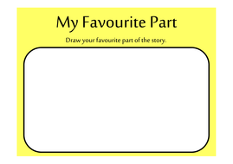
Week 7 w/c: 8.6.20
Thursday’s Reading Challenge:
Draw a picture of your favourite part of the story
After having read a book with someone, I would like you to have a go at drawing a picture you may want to show someone else to encourage them to also read the book.
You could choose your favourite part/page to draw.

Slide 17
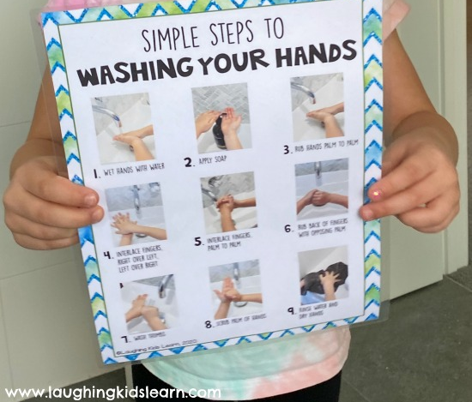
Week 7 w/c: 8.6.20
Friday’s Reading Challenge: Following instructions
Ask an grown-up to write some instructions or find some simple instructions on the computer for you to read and follow.
It may be a set of instructions for how to make a sandwich, how to bake a cake, how to make a rocket, how to do hopscotch, how to make your bed, etc.
Simple steps to follow for washing your hands correctly is a very good one to have a go at! ☺ e

