Slide 1
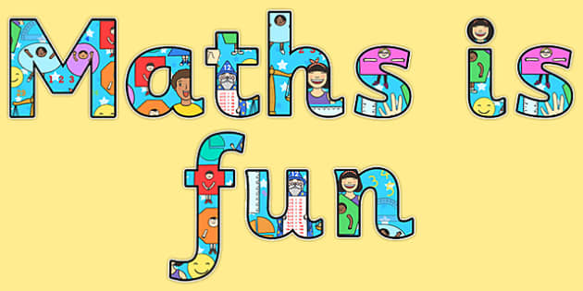

Maths in Reception
This week Jack Hartmann is showing us numbers in lots of different ways.
Watch this clip to get you in the mood for Maths! ☺
Enjoy!
https://www.youtube.com/watch?v=lAQ2HTqTl2w

Slide 2
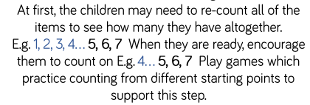
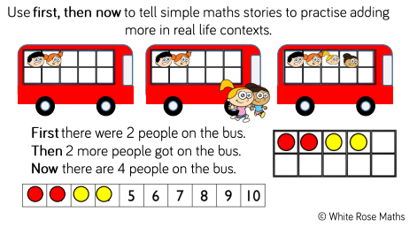
Week 8 – W/C: 15.6.20
This week we are focusing on addition by counting on.
There are many different ways to solve addition calculations from using practical resources to working it out mentally in your head.
It is really important that children learn the skill to
‘count on’ when adding, rather than needing to start
back at ‘1’ every time they are working out a whole amount.
This week we will:
Practise counting amounts by counting on (not starting back at 1)
Work out some simple addition calculations by counting on
Add two items together to find out the total amount by counting on

Slide 3
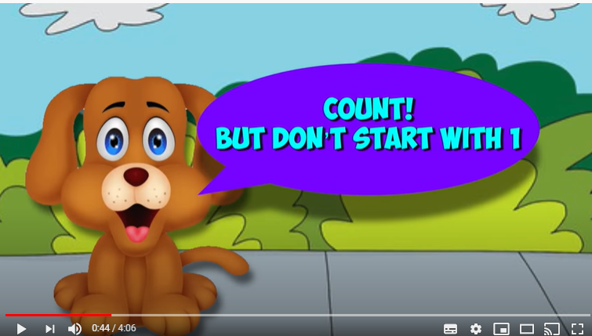
Monday:
Starter- Listen to the counting on song
https://www.youtube.com/watch?v=p2W0I06Nq5s

Slide 4
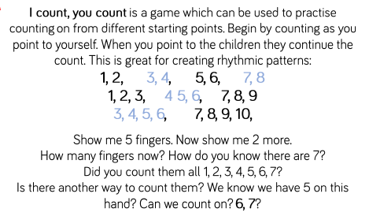
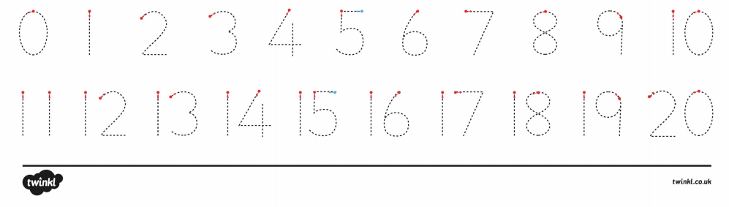
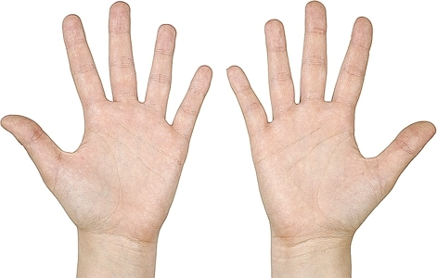
Monday
Counting on practise
Ask your grown up to shout out a number.
You need to count on from that number
13, 14, 15
122

Slide 5
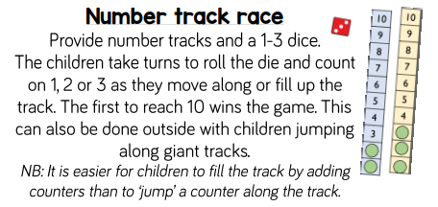
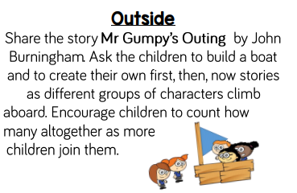
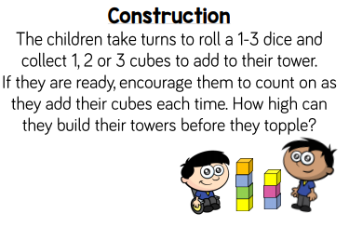
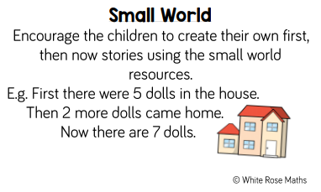
Monday: Counting on in different contexts…
Listen to Mr Gumpy’s Outing story:
https://www.youtube.com/watch?v=Mi_DV_DWN8M

Slide 6
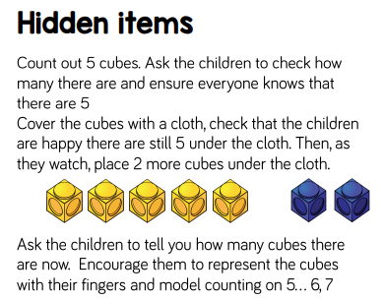
Monday: Counting on in different contexts…
You could use any object, it does not have to be ‘cubes’.

Slide 7

Tuesday
Counting on practise with objects
Count the objects in the red box first.
Now add on the additional objects by counting on (not starting back at 1)
5,6,7
4

Slide 8

Tuesday
Counting on practise with objects
Count the objects in the red box first.
Now add on the additional objects by counting on (not starting back at 1)

Slide 9

Tuesday
Counting on practise with objects
Count the objects in the red box first.
Now add on the additional objects by counting on (not starting back at 1)

Slide 10

Tuesday
Counting on practise with objects
Count the objects in the red box first.
Now add on the additional objects by counting on (not starting back at 1)

Slide 11
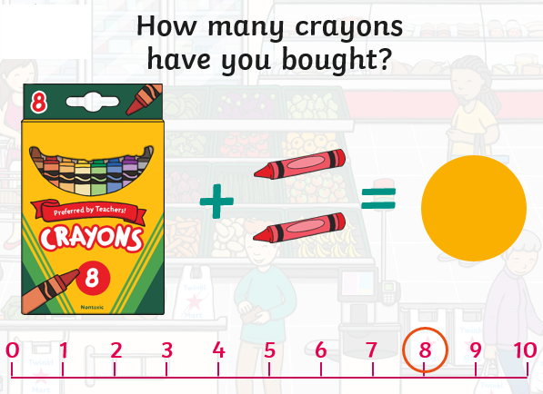

Wednesday – counting on
We’re going to the shops! ☺
You are going to pretend that you are going to the shop to buy some items. You need to work out how many items you have bought by adding together the two amounts.
When doing this, you need to remember to count on.
Hold 8 in you head and count on 2 more
8 … 9,10

Slide 12
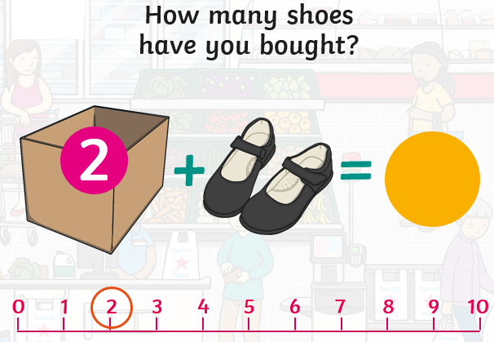
Wednesday – counting on
We’re going to the shops! ☺
You are going to pretend that you are going to the shop to buy some items. You need to work out how many items you have bought by adding together the two amounts.
When doing this, you need to remember to count on.
Hold 2 in you head and count on…

Slide 13
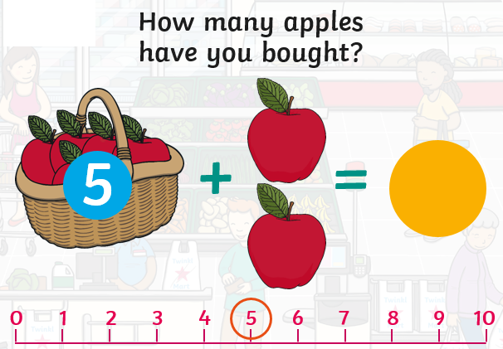
Wednesday – counting on
We’re going to the shops! ☺
You are going to pretend that you are going to the shop to buy some items. You need to work out how many items you have bought by adding together the two amounts.
When doing this, you need to remember to count on.
Hold 5 in you head and count on…

Slide 14
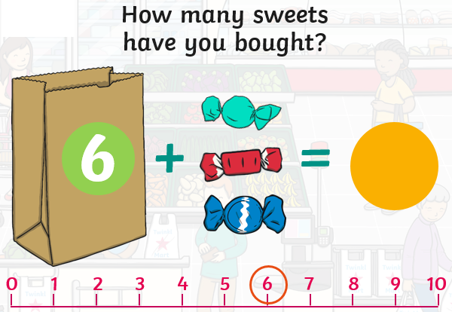
Wednesday – counting on
We’re going to the shops! ☺
You are going to pretend that you are going to the shop to buy some items. You need to work out how many items you have bought by adding together the two amounts.
When doing this, you need to remember to count on.
Hold 6 in you head and count on…

Slide 15
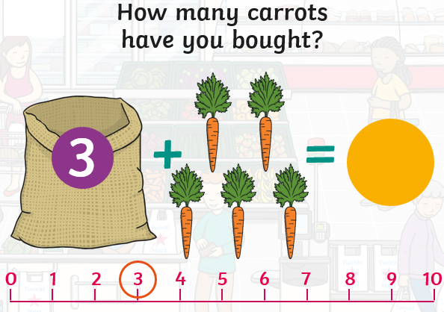
Wednesday – counting on
We’re going to the shops! ☺
You are going to pretend that you are going to the shop to buy some items. You need to work out how many items you have bought by adding together the two amounts.
When doing this, you need to remember to count on.
Hold 3 in you head and count on…

Slide 16
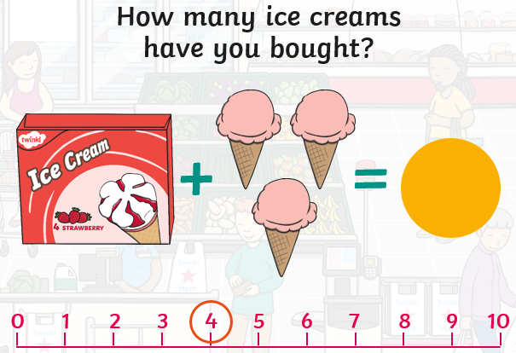
Wednesday – counting on
We’re going to the shops! ☺
You are going to pretend that you are going to the shop to buy some items. You need to work out how many items you have bought by adding together the two amounts.
When doing this, you need to remember to count on.
Hold 4 in you head and count on…

Slide 17
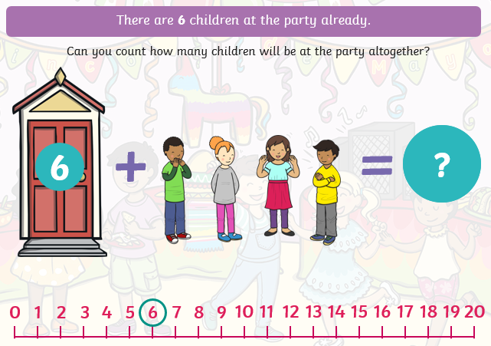
Thursday – counting on
We’re going to a party! ☺
You are going to pretend that you are going to a party. You need to work out how many children are going to be at the party altogether by counting on to find the total amount.
Hold 6 in you head and count on…

Slide 18
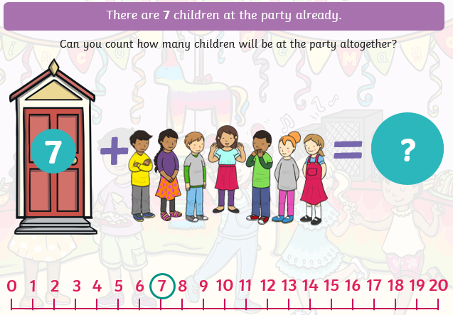
Thursday – counting on
We’re going to a party! ☺
You are going to pretend that you are going to a party. You need to work out how many children are going to be at the party altogether by counting on to find the total amount.
Hold 7 in you head and count on…

Slide 19
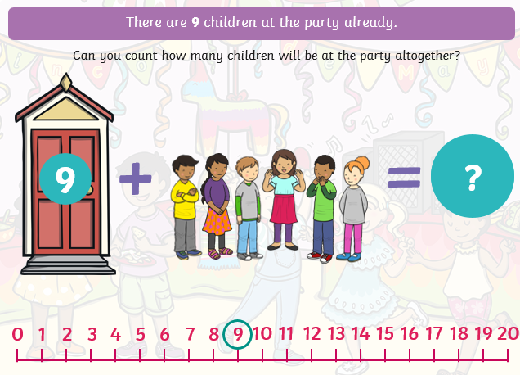
Thursday – counting on
We’re going to a party! ☺
You are going to pretend that you are going to a party. You need to work out how many children are going to be at the party altogether by counting on to find the total amount.
Hold 9 in you head and count on…

Slide 20
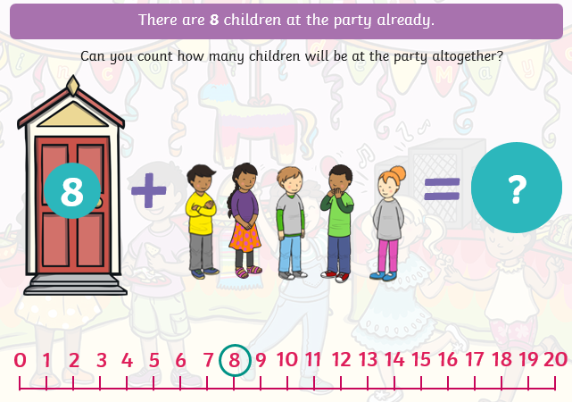
Thursday – counting on
We’re going to a party! ☺
You are going to pretend that you are going to a party. You need to work out how many children are going to be at the party altogether by counting on to find the total amount.
Hold 8 in you head and count on…

Slide 21
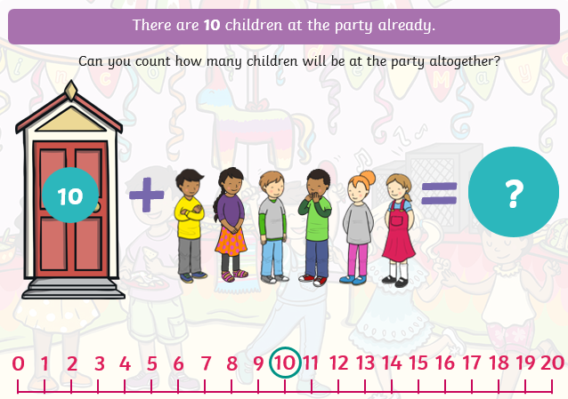
Thursday – counting on
We’re going to a party! ☺
You are going to pretend that you are going to a party. You need to work out how many children are going to be at the party altogether by counting on to find the total amount.
Hold 10 in you head and count on…

Slide 22
Friday – counting on
Have a go at solving these addition calculations by counting on. You may wish to use practical objects to count to help you or you might want to try and count on mentally in your head.
There are differentiated calculations to try – please try the calculations most relevant for your child’s ability. ☺
3 + 2 =
4 + 3 =
5 + 2 =
6 + 3 =
5 + 5 =
7 + 2 =
5 + 4 =
8 + 3 =
6 + 4 =
9 + 2 =
10 + 2 =
11 + 5 =
14 + 3 =
18 + 2 =
16 + 4 =
12 + 7 =
15 + 5 =
11 + 9=
20 + 2 =
24 + 3 =
10 + 6 = ___
10
__ , __ , __ , __ , __ , __ = __

