Slide 1


Maths in Reception
Jack Hartmann is back yet again!
He has created a new ‘2020’ version of ‘count to 100’ (which the children have previously loved)! ☺
Have a go at these exercise before starting this week’s maths activities.
Enjoy!
https://www.youtube.com/watch?v=MiUw36s9V_g

Slide 2
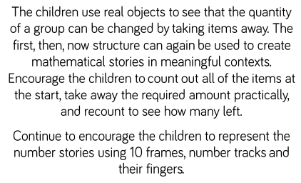
Week 8 – W/C: 22.6.20
This week we are focusing on subtraction by counting back.
There are many different ways to solve subtraction calculations from using practical resources to working it out mentally in your head.
This week we will:
Practise counting back
Work out some simple subtraction calculations by counting back

Slide 3
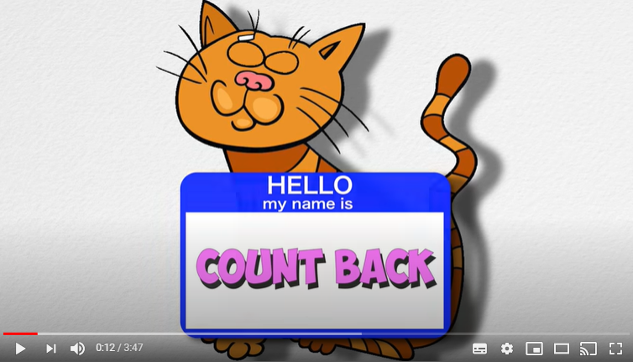
Monday:
Starter- Listen to the counting back song
https://www.youtube.com/watch?v=F6a2W8UQP5w

Slide 4
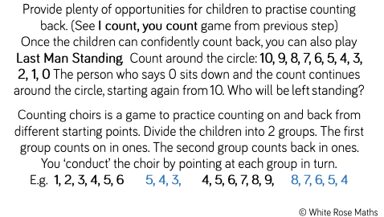
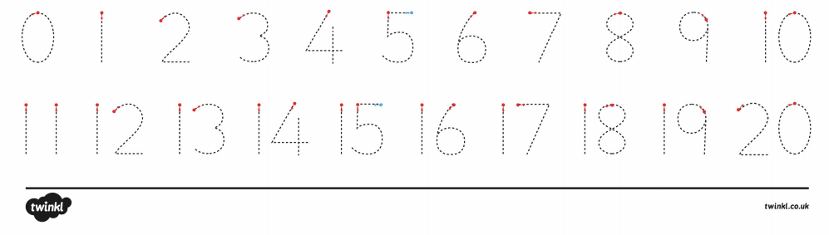
Monday
Counting back practise
Ask your grown up to shout out a number.
You need to count back from that number
11, 10, 9
122

Slide 5
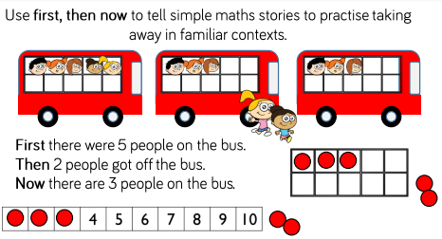
Monday: Counting back in different contexts…

Slide 6
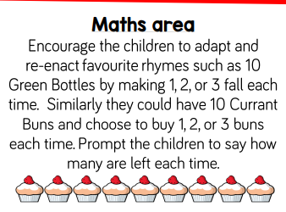
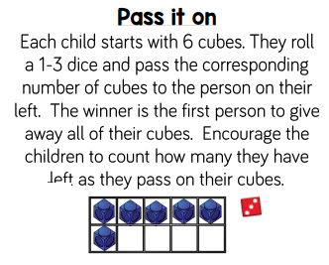
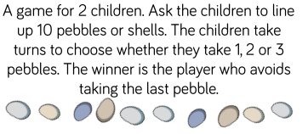
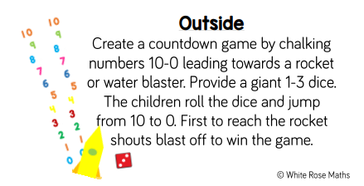
Monday: Counting back in different contexts…

Slide 7
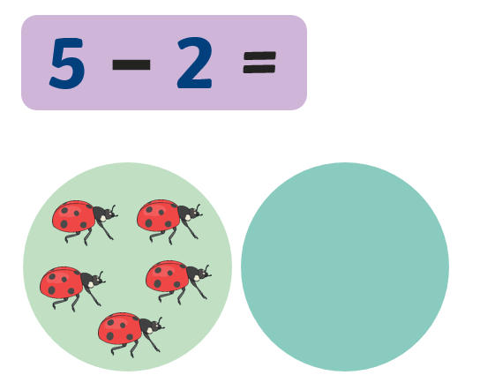
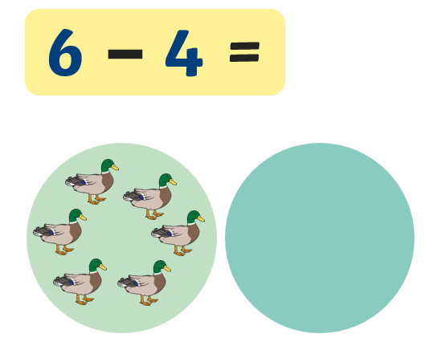
Tuesday Counting back – simple subtraction
You can have a go at doing this mentally, holding the first number in your head and counting back OR you can use these pictures to help you.
If looking at the computer screen, use your fingers to cover up the amount that are being ‘taken away’. If you have it as a paper copy you can cross out the amount that have been taken away to find the answer. ☺

Slide 8
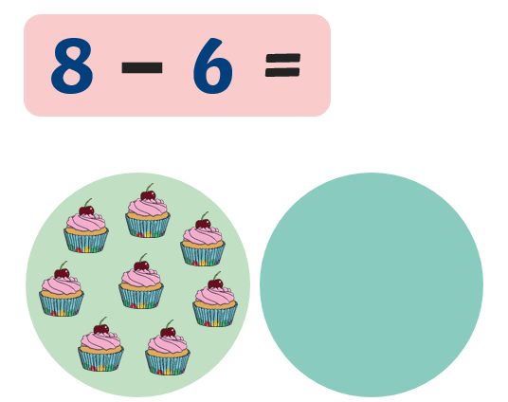
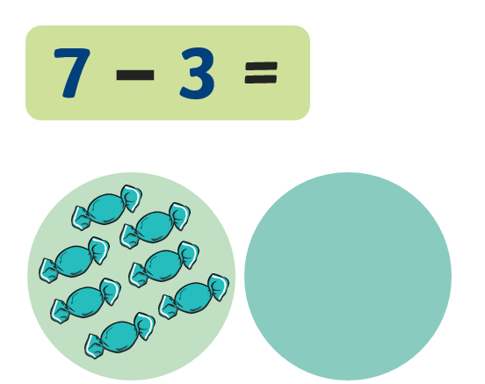
Tuesday Counting back – simple subtraction

Slide 9
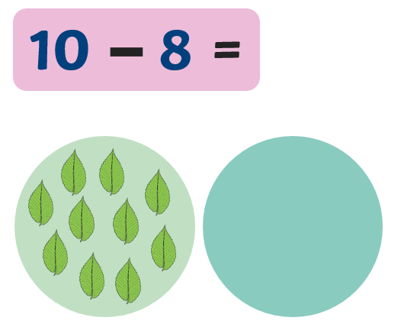
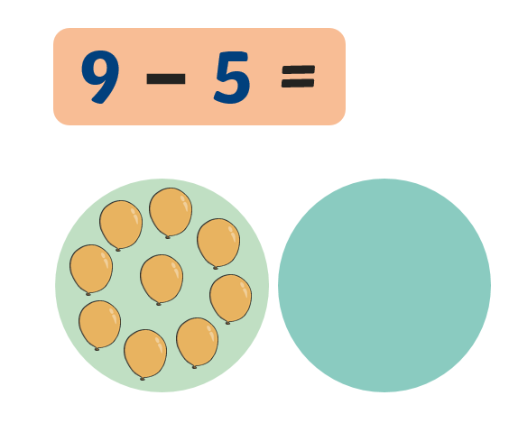
Tuesday Counting back – simple subtraction

Slide 10
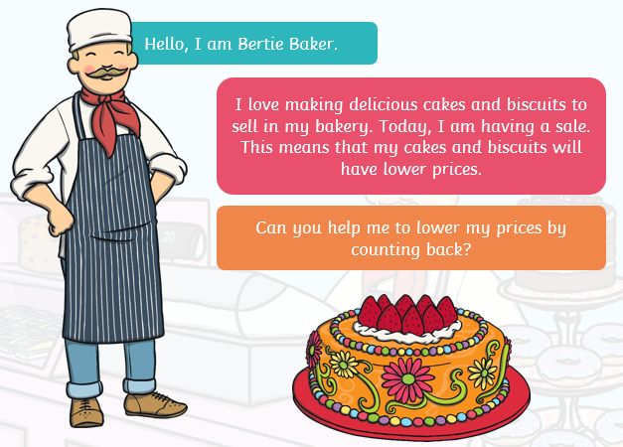
Wednesday – counting back
Bertie the baker needs our help!

Slide 11
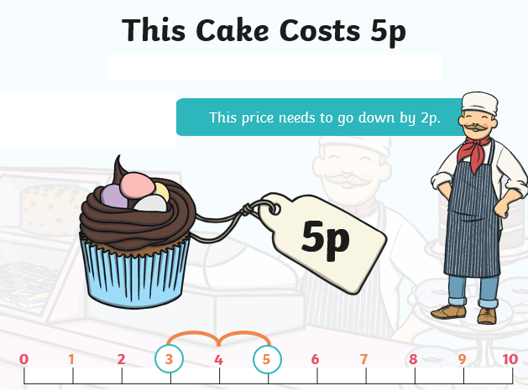

Wednesday – counting back
5 – 2 = ?
Hold 5 in you head and count back…

Slide 12
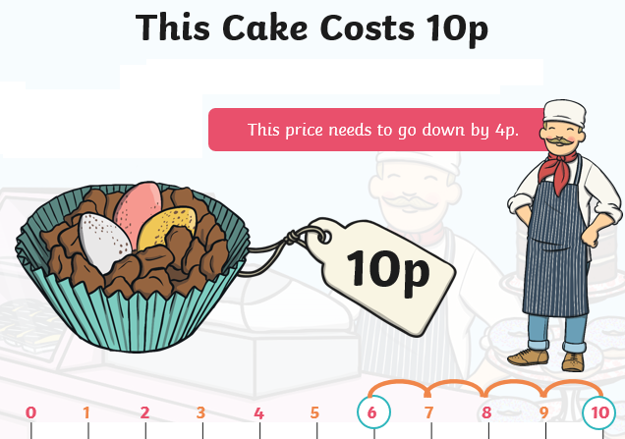
Wednesday – counting back
10 – 4 = ?
Hold 10 in you head and count back…

Slide 13
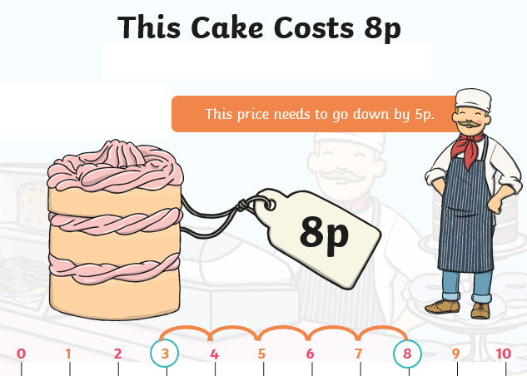
Wednesday – counting back
8 – 5 = ?
Hold 8 in you head and count back…

Slide 14
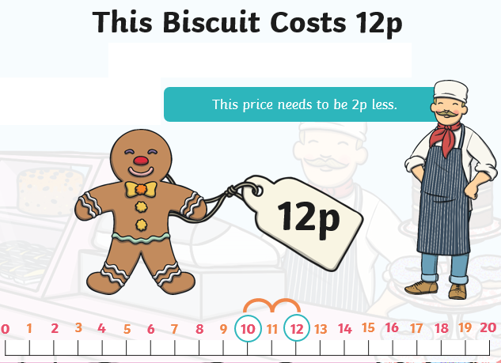
Wednesday – counting back
12 – 2 = ?
Hold 12 in you head and count back…

Slide 15
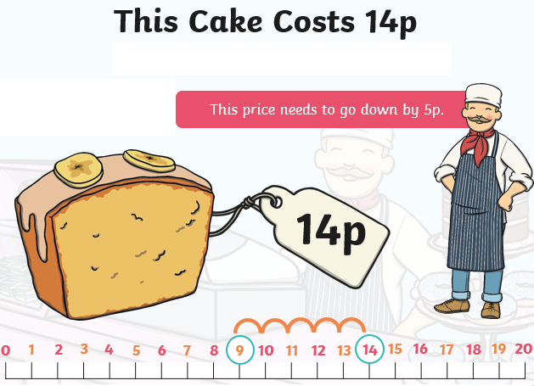
Wednesday – counting back
14 – 5 = ?
Hold 12 in you head and count back…

Slide 16
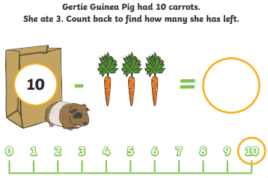
Thursday – counting back
10 – 3 = ?
Hold 10 in you head and count back…

Slide 17
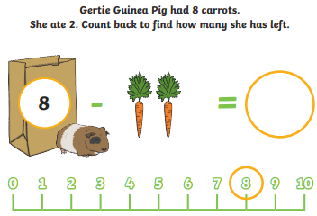
Thursday – counting back
8 – 2 = ?
Hold 8 in you head and count back…

Slide 18
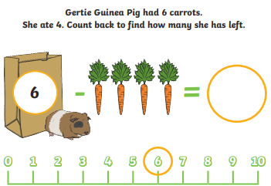
Thursday – counting back
6 – 4 = ?
Hold 6 in you head and count back…

Slide 19
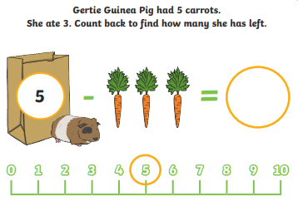
Thursday – counting back
5 – 3 = ?
Hold 5 in you head and count back…

Slide 20
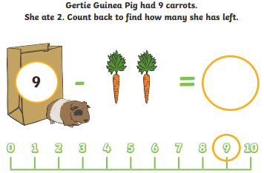
Thursday – counting back
9 – 2 = ?
Hold 9 in you head and count back…

Slide 21
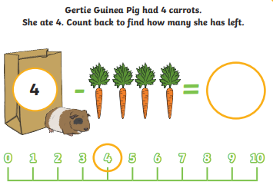
Thursday – counting back
4 – 4 = ?
Hold 4 in you head and count back…

Slide 22
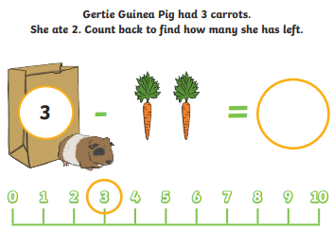
Thursday – counting back
3 – 2 = ?
Hold 3 in you head and count back…

Slide 23
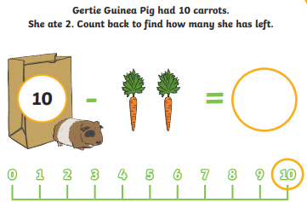
Thursday – counting back
10– 2 = ?
Hold 10 in you head and count back…

Slide 24
Friday – counting back
Have a go at solving these subtraction calculations by counting back. You may wish to use practical objects to take away to help you or you might want to try and count back mentally in your head.
There are differentiated calculations to try – please try the calculations most relevant for your child’s ability. ☺
2 – 1 =
4 – 3 =
2 - 2 =
6 – 4 =
5 – 3 =
6 – 3 =
5 – 5 =
8 – 8 =
8 – 6 =
9 - 5 =
12 – 4 =
11 – 2 =
16 – 6 =
19 – 3 =
18 – 5 =
16 – 8 =
17 – 6 =
20 – 3 =
19 – 8 =
20 – 11 =
10 - 2 = ___
10
__ , __ , __ , __ , __ , __ = __

