Slide 1


Maths in Reception
Just in case lockdown hasn’t sent us crazy enough we thought we would introduce you to Jack Hartman! Some of the children may have shown you some of the videos we use in school already. He has his own Youtube channel and has some great maths warmups to get us going. In school we use Count to 100, Subitise (there are many versions try and find the one where he doesn’t pronounce it soo-bitize!) and teen numbers in the air.
This week if you haven’t already try count to 100 with Grandma and Grandpa!

Slide 2
Week 5:
Weight

Slide 3
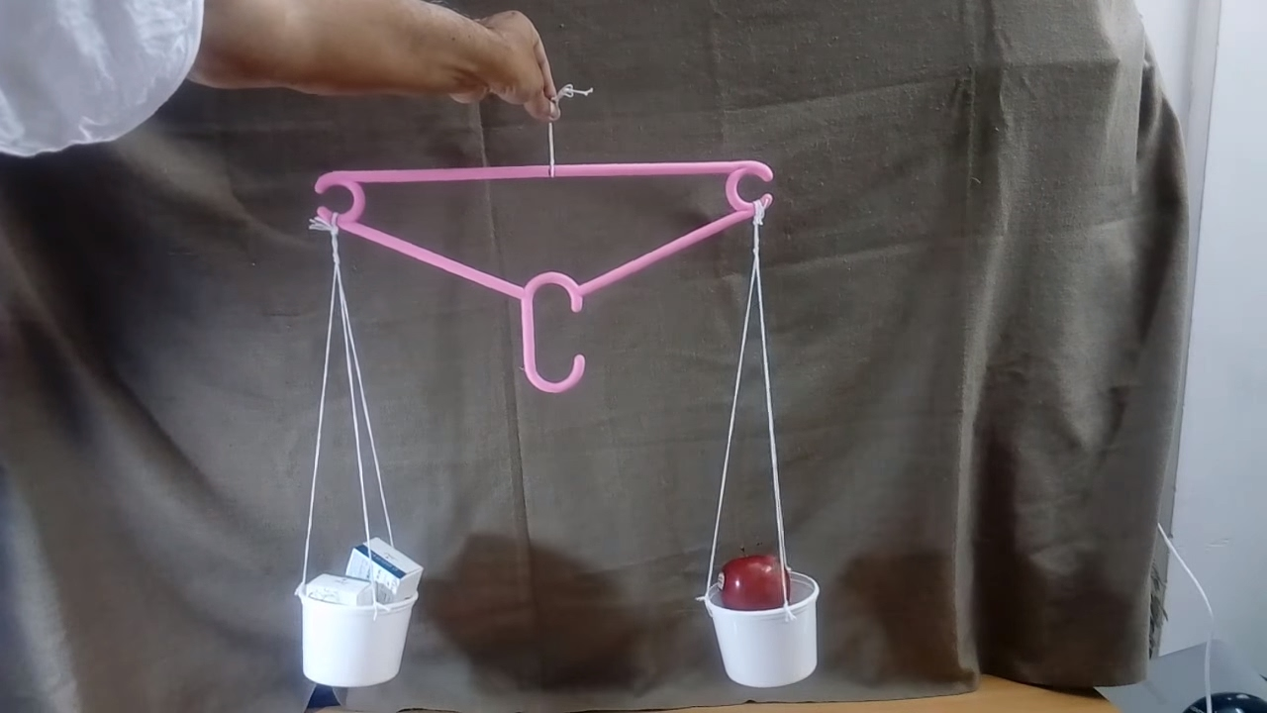
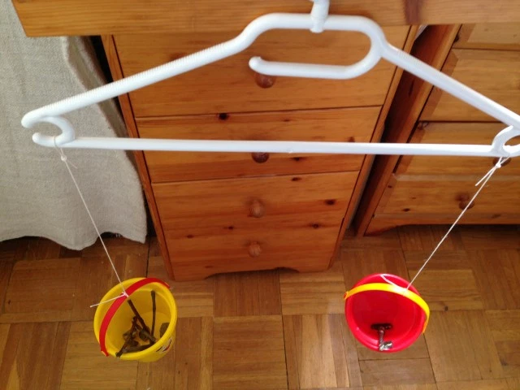
Weight- Encourage your child to use the mathematical vocabulary heavy, heavier, heaviest. Light, lighter, lightest. Start off by using objects that have an obvious difference in weight.
Make your own balancing scales (unless you have your own!) First, use your child as a human balancing scale place an item on each hand and ask them to tip to show which item is heavier. They can then use their home made balancing scales to check if they were right. Your child could hold buckets or bags in each hand and feel which one has the most downward pull.
Give your child an item, challenge them to find something heavier and lighter, they could sort them into sets.
Check them on the balancing scales. Are all the heavier things bigger than your item? Can you find something that is bigger but lighter?

Slide 4
Length & Height
How long or short…
How tall or short…

Slide 5
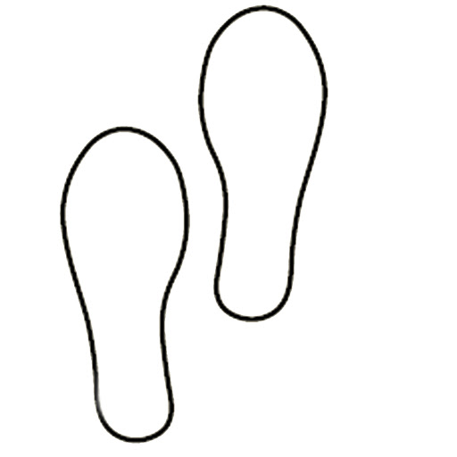
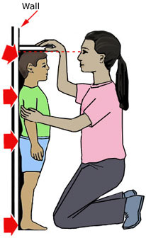
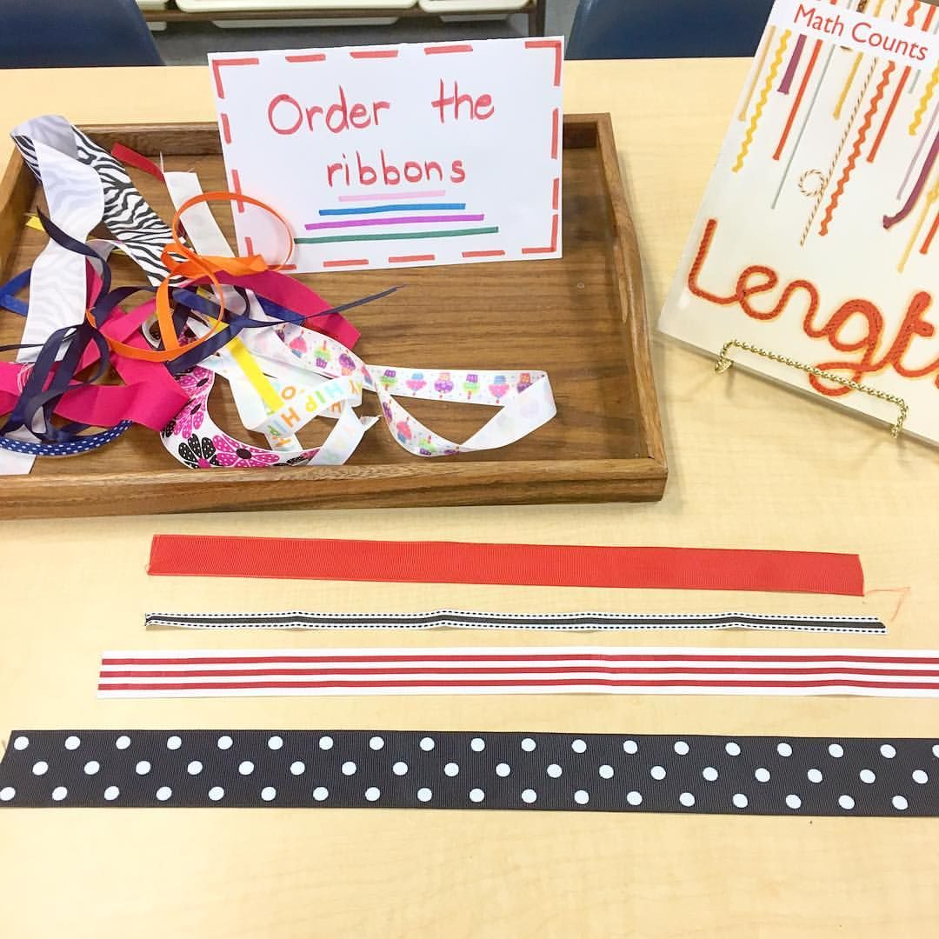

Length- Encourage your child to use the mathematical language of longer and shorter rather than bigger and smaller.
Draw a footprint on a piece of paper. Ask your child to find things that are the longer than the footprint.
Can they find things that are shorter? What about the same? Your child could use cubes or blocks to measure things. They could record their findings.
Height- Encourage your child to use the mathematical language of taller and shorter rather than bigger and smaller.
Can they find things that are taller than them? Shorter than them?
Can you measure your family and see who is the tallest and who is the shortest- putting them in height order.
What about things that are the same height?
Have a variety of lengths of ribbon or string. Select one piece and ask your child to sort the other pieces into groups of same as, longer than and shorter than the example piece. Can your child line them up from shortest to longest.

Slide 6
Capacity

Slide 7
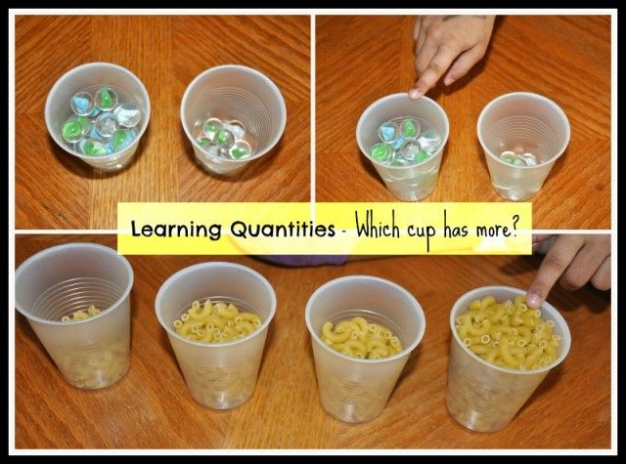
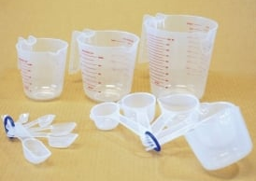
Capacity- Encourage your child to use the mathematical vocabulary of full, empty, nearly full, half full, nearly empty.
You will need a variety of different sized containers. You will also need materials such as water, rice, sand, cereal.
Provide your child with a container ask them to make it full, make it empty, nearly full, nearly empty, about half full.
Can they find a container that holds more than their container? Can they find one that holds less?
Provide your child with a selection of different sized containers. Ask them to investigate which container holds the most.
They could use a small cup and count how many cup-fulls it takes to fill each container. They could record their results however they wish. Maybe they could use a tally chart that they have previously practised?
Children could use spoons. Do you think it would take more spoonful's or less if your spoon was bigger/smaller?

Slide 8
Distance

Slide 9
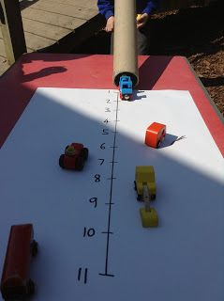
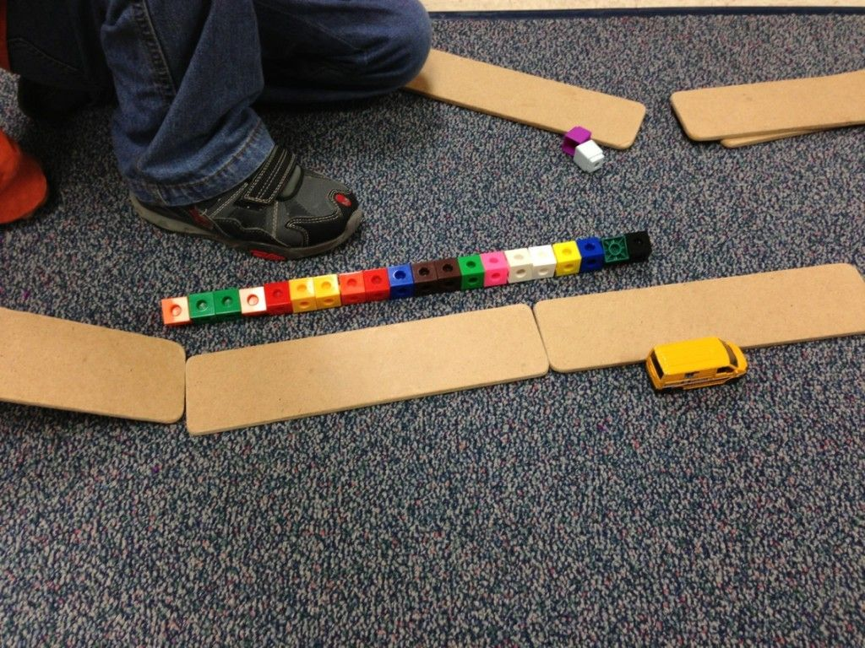
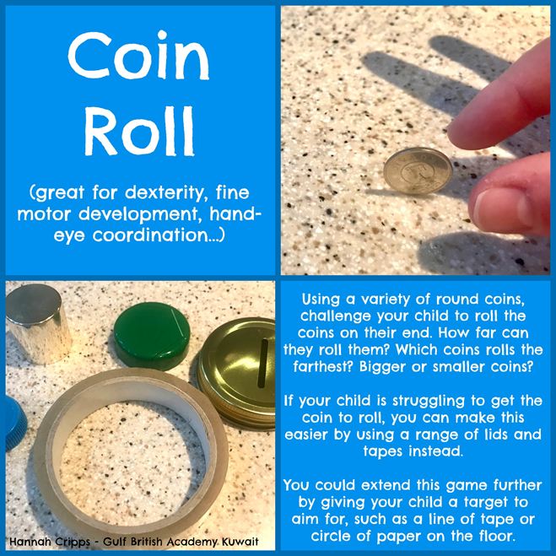
Distance- Encourage your child to use mathematical language with regards to distance such as further, furthest, nearer, nearest. You could also use positional language such as which one came first, second, third, fourth?
Make a ramp and collect some cars of different sizes. If you don’t have cars use any round objects that roll. On the floor put a length of paper so that you can mark how far they travel. Using cars or balls (anything that rolls) let them go down the ramp. Mark the distance it travelled on your piece of paper. How far do you think the next thing will travel? Adjust the height of the ramp what do you think will happen now?
When changing the height of the ramp you could measure how far it is off the floor and record your findings.

Slide 10
Time

Slide 11
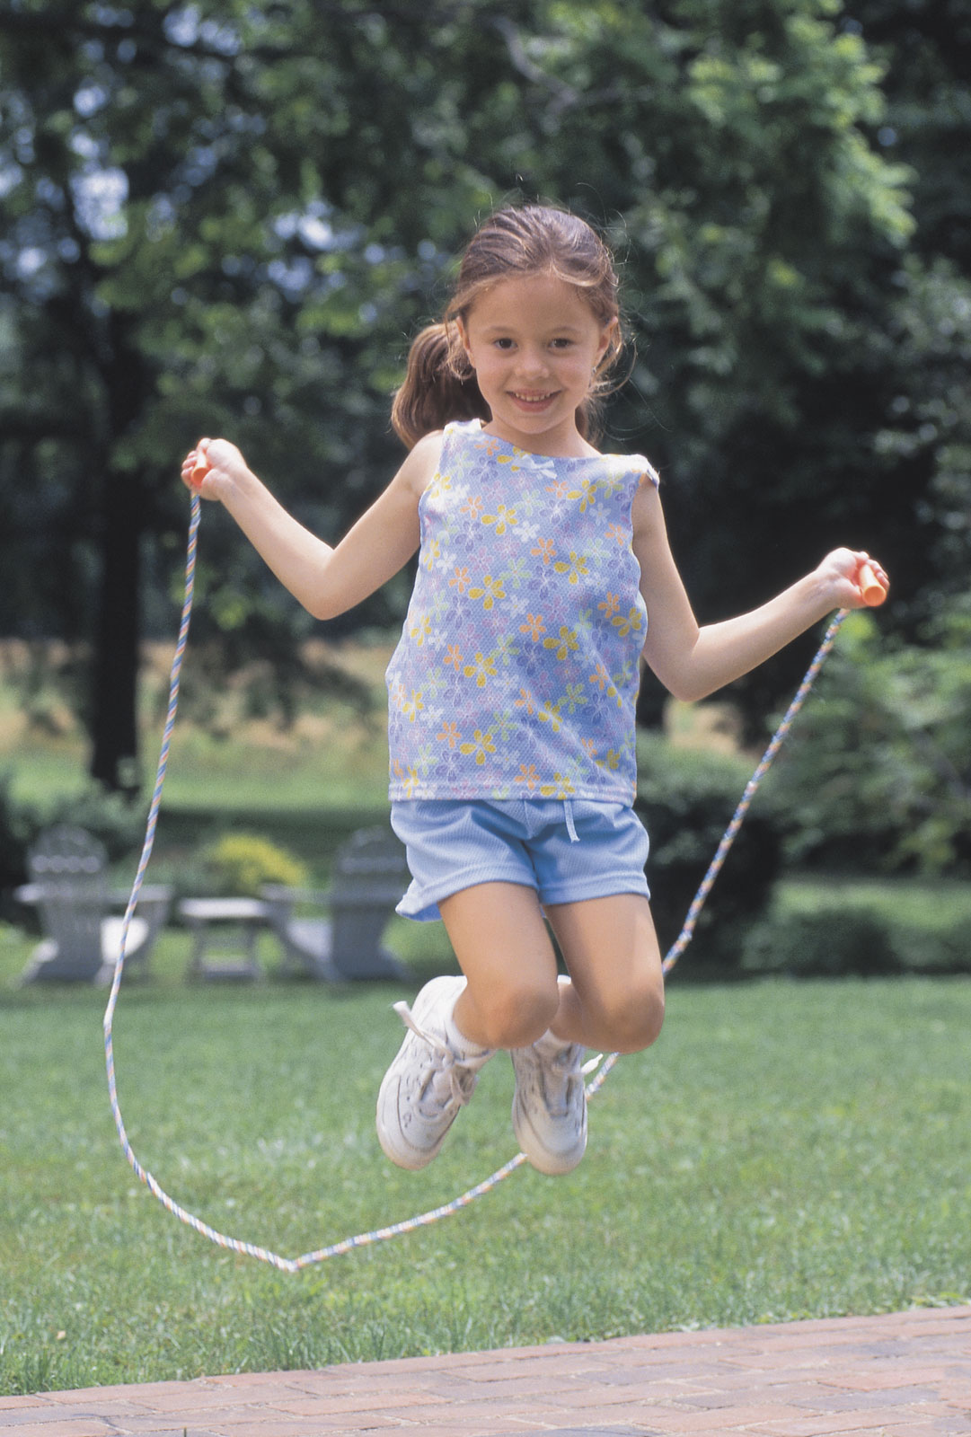
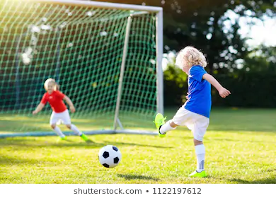
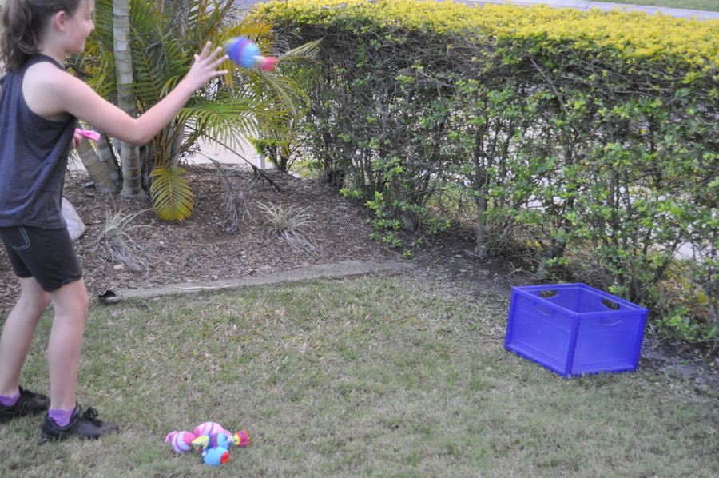
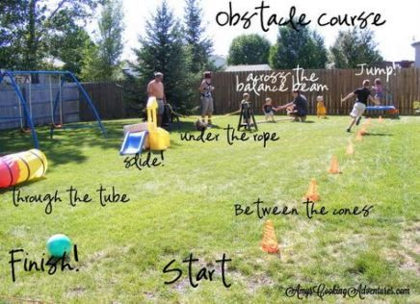

Time- Encourage children to use the mathematical vocabulary of now, before, later, soon, after, next, faster, quicker, slower.
Set up a circuit outside or inside.
For example; How many bean bags can you throw in a bucket? How many skips can you do with a skipping rope? How many goals can you score in football? How many bricks can you use to build a tower?
How many of each can you do in one minute? Can you record your score for each activity?
Can you do it again and beat your score?
Make an obstacle course outside.
Ask your child:
What do we need to do first?
What comes next?
Can you make picture cards to explain the instructions to someone else?
Use a timer to time yourself.
How will we know if we get faster if we do it again?
Will the number of minutes go up or down?

