Slide 1
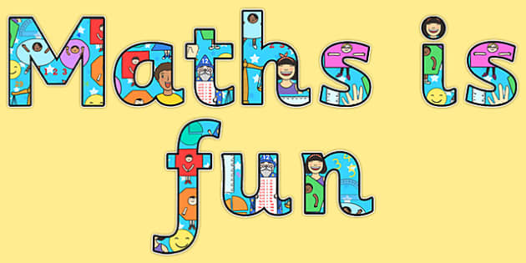

Maths in Reception
Just in case lockdown hasn’t sent us crazy enough we thought we would introduce you to Jack Hartman! Some of the children may have shown you some of the videos we use in school already. He has his own Youtube channel and has some great maths warmups to get us going. In school we use Count to 100, Subitise (there are many versions try and find the one where he doesn’t pronounce it soo-bitize!) and teen numbers in the air.

Slide 2
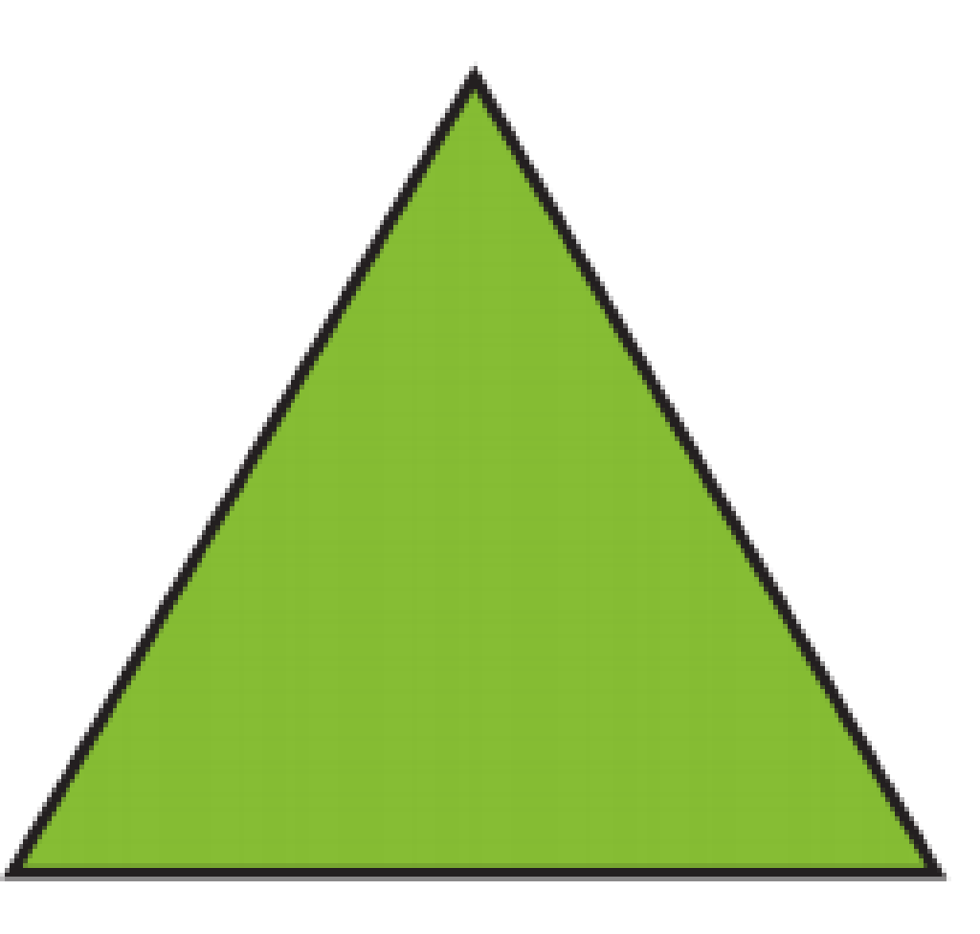


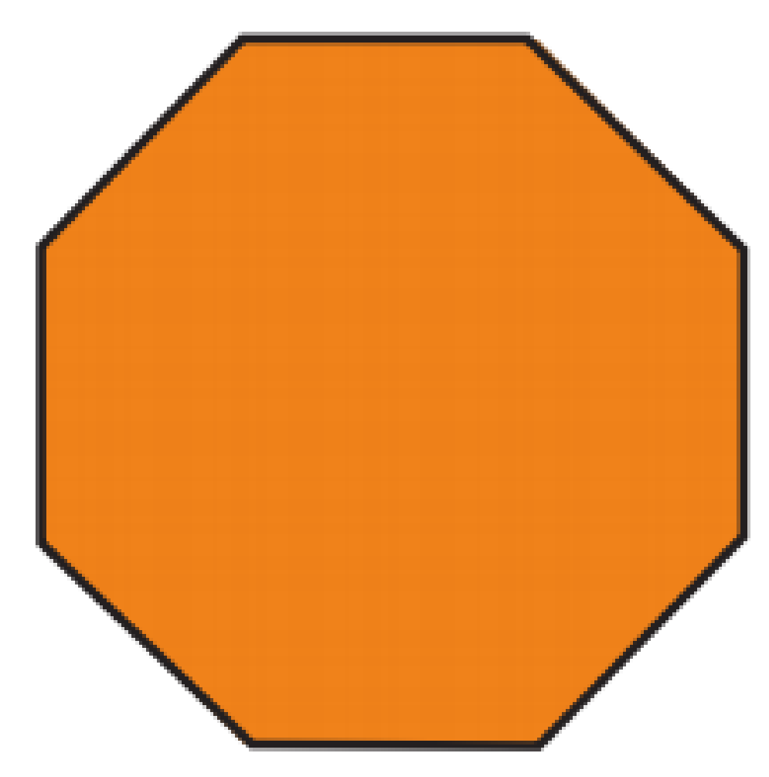

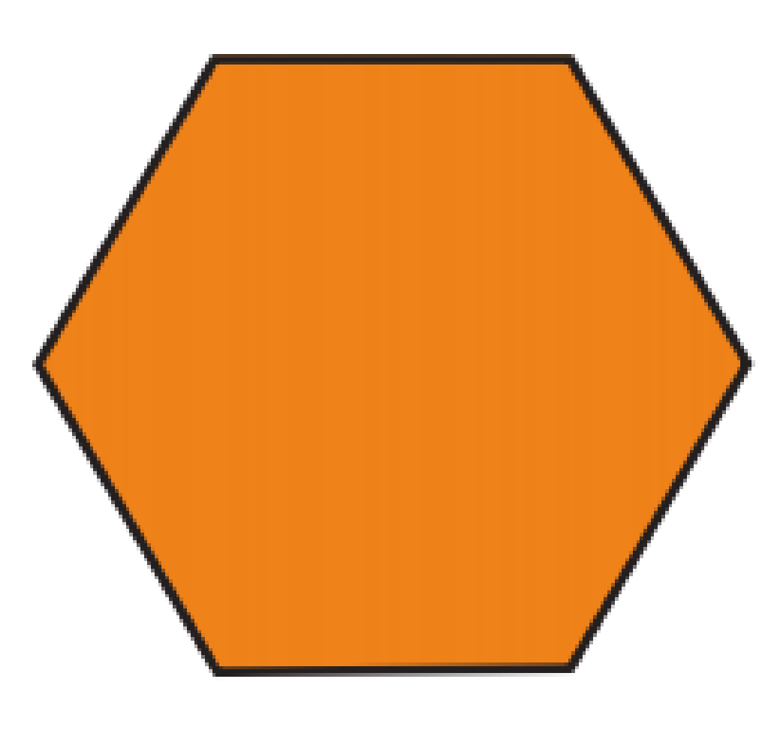
Week 3- 2-D and 3-D shapes.
This week we are going to test our shape knowledge and attempt to use mathematical language to describe them.
Children in Reception need to know the basic terminology when it comes to shape such as sides and corners.
We describe a 2-D shape as being flat.
We would like children to be able to describe these shapes using some mathematical terminology.

Slide 3
Circle- A circle has 1 side that goes all the way around and no corners.
Triangle- A triangle has 3 sides and 3 corners.
Square- A square has 4 sides and 4 corners. It is different to a rectangle as it has 4 equal sides.
Rectangle- A rectangle has 4 sides and 4 corners. It is different to square as it has 2 long sides and 2 short sides.
Hexagon- A hexagon has 6 sides and 6 corners. We use the x in hexagon to help us remember it has six sides.
Octagon- An octagon has 8 sides and 8 corners. We know that oct means eight, we relate that to an octopus that has 8 tentacles to help us remember.

Slide 4

Jack Hartman has two great videos that the children may like to watch about 2-D shapes and 3-D shapes. They could be used before each activity as a warm up reminder.
https://www.youtube.com/watch?v=zPZegz690Mg 3-D shapes
* Pipe cleaners and lollipop sticks are great for making your own 2-D shapes if you have some! *
Activity 1:
Look at slide 6, ask your child to see what 2-D shapes they can spot in the picture. When your child finds a shape ask them how they know that it is that shape? Ask them to describe it. When you have found them all can you think of any other things Woody may need to take on holiday that are different 2-D shapes?
At the end of each activity we would like your child to practise their number formation, beginning with 1-10. When they are forming these numbers correctly then move onto 11-20. (See next slide).
https://www.youtube.com/watch?v=svrkthG2950&t=57s 2-D shapes

Slide 5

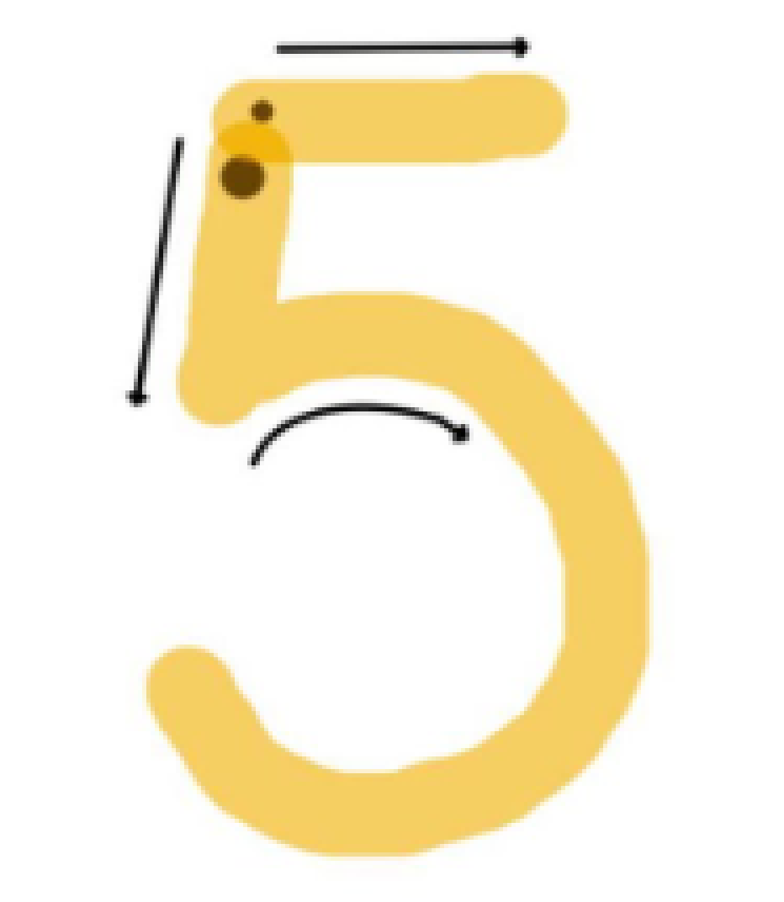
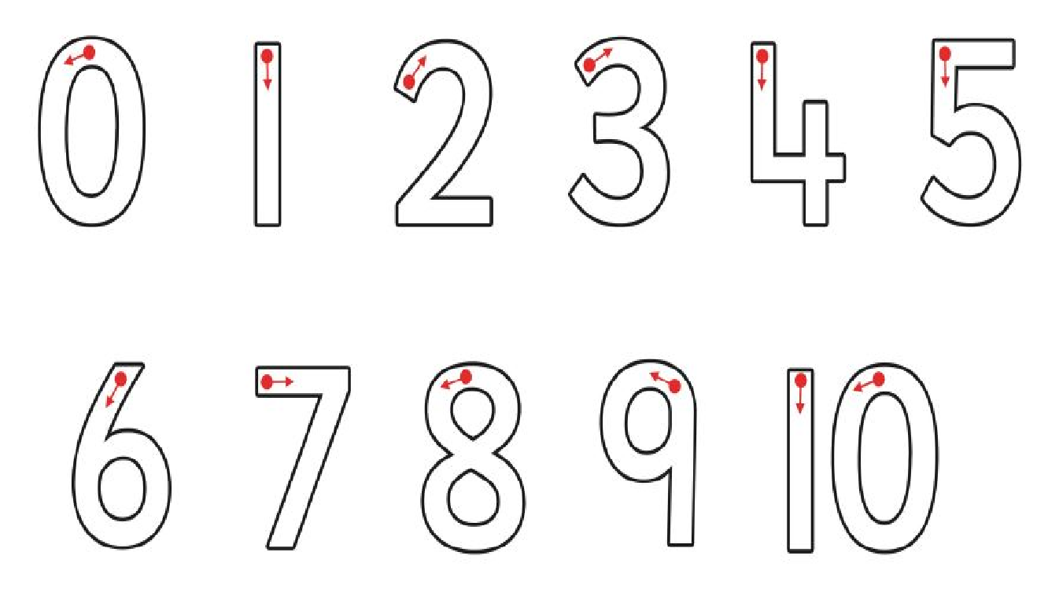
Here is a reminder of where we start our numbers. Number 5 starts by going down, give it a belly and a hat on top.

Slide 6
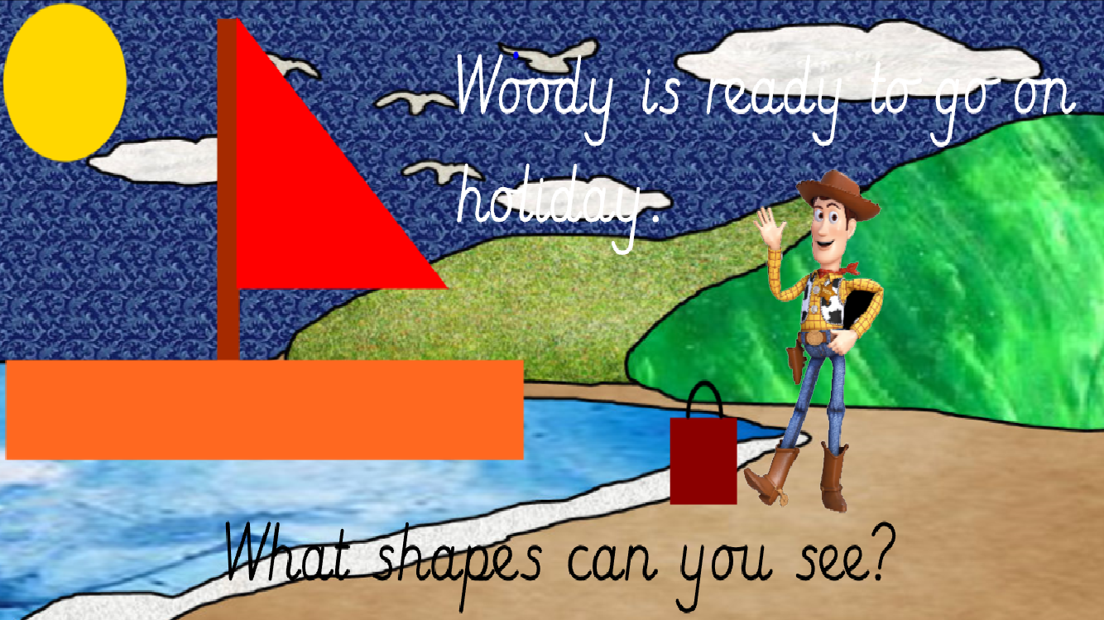

Slide 7
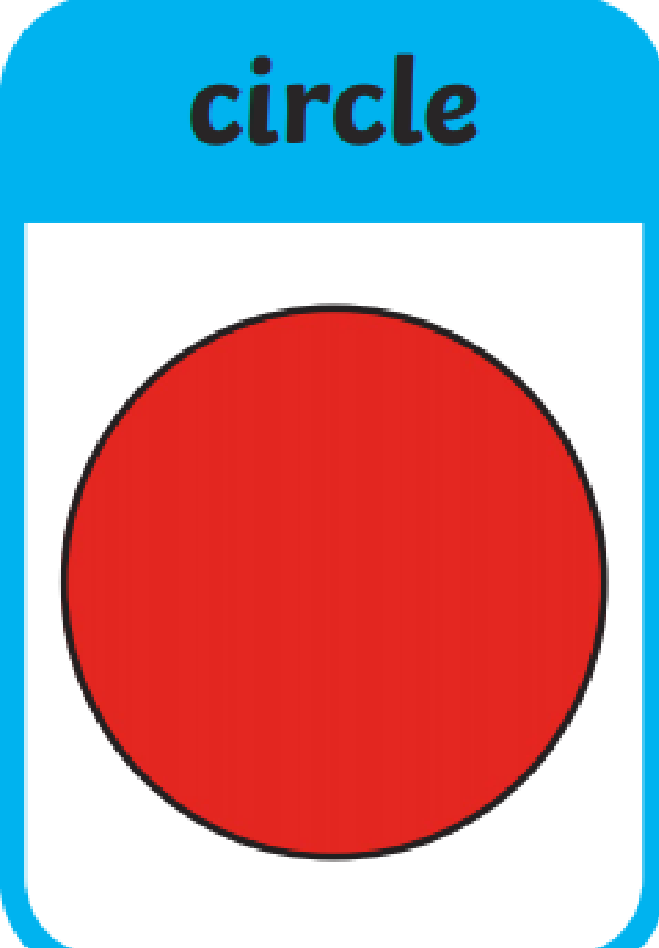
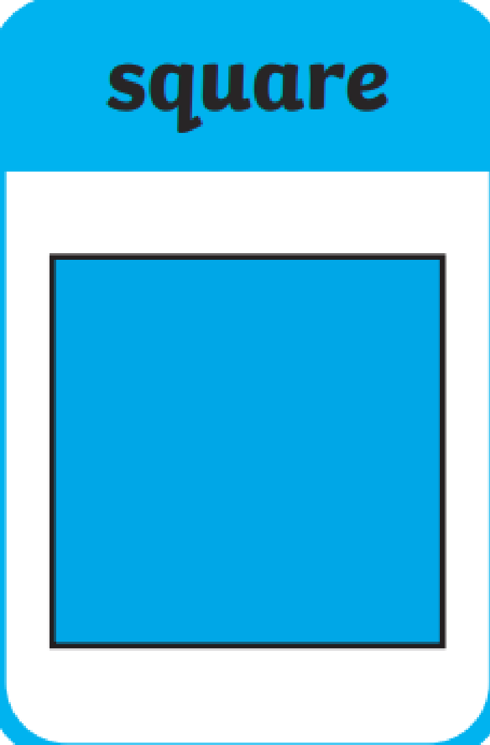
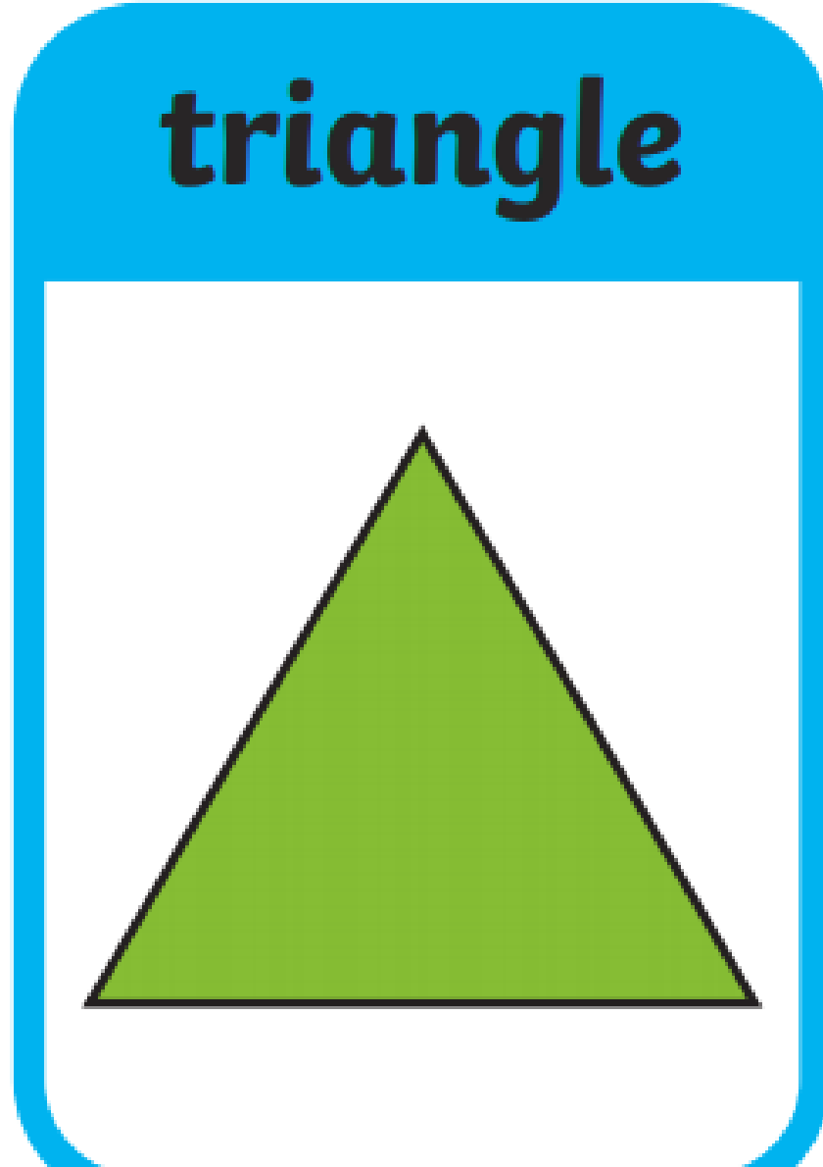
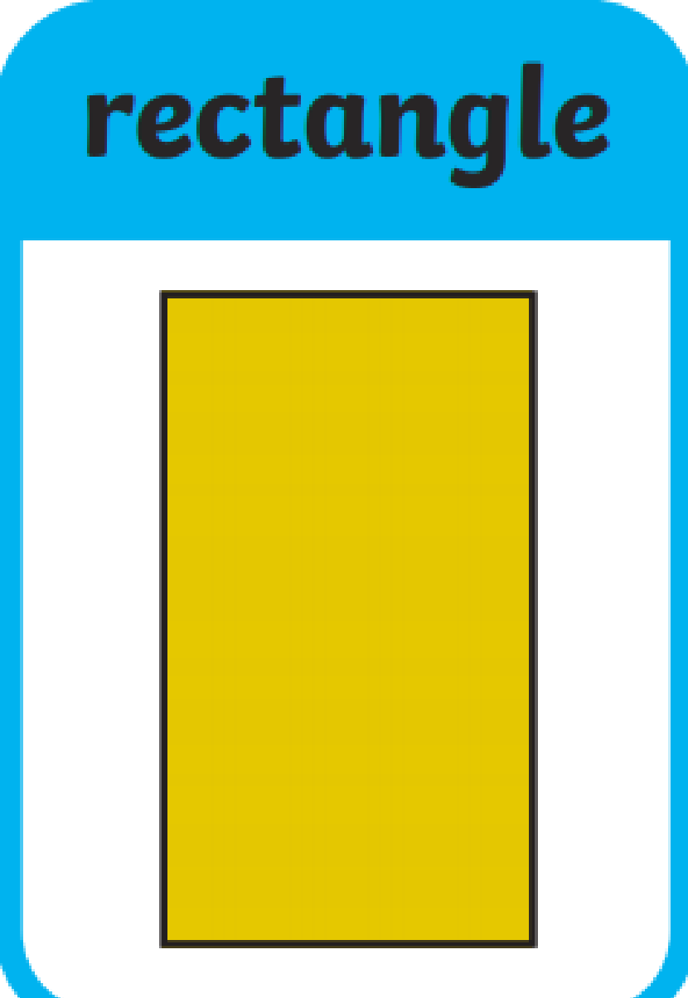
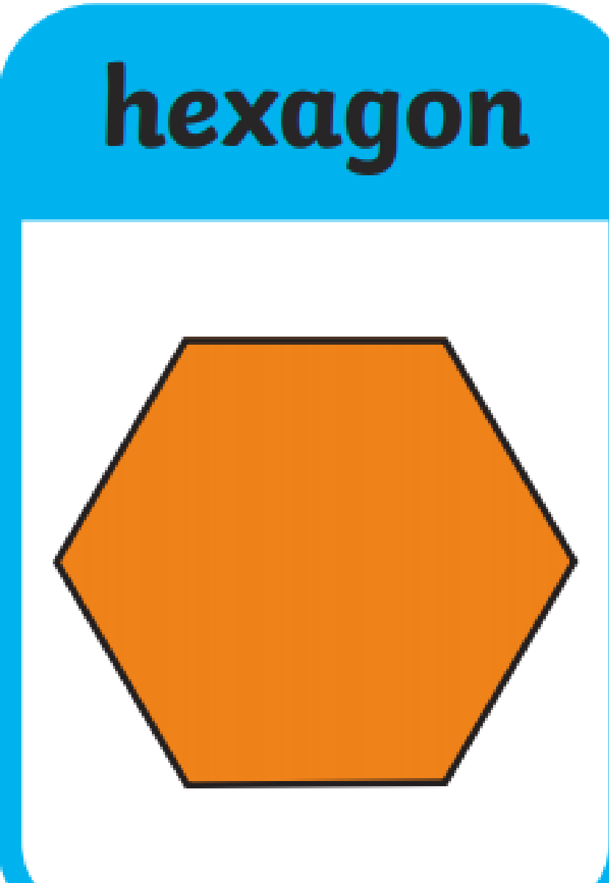
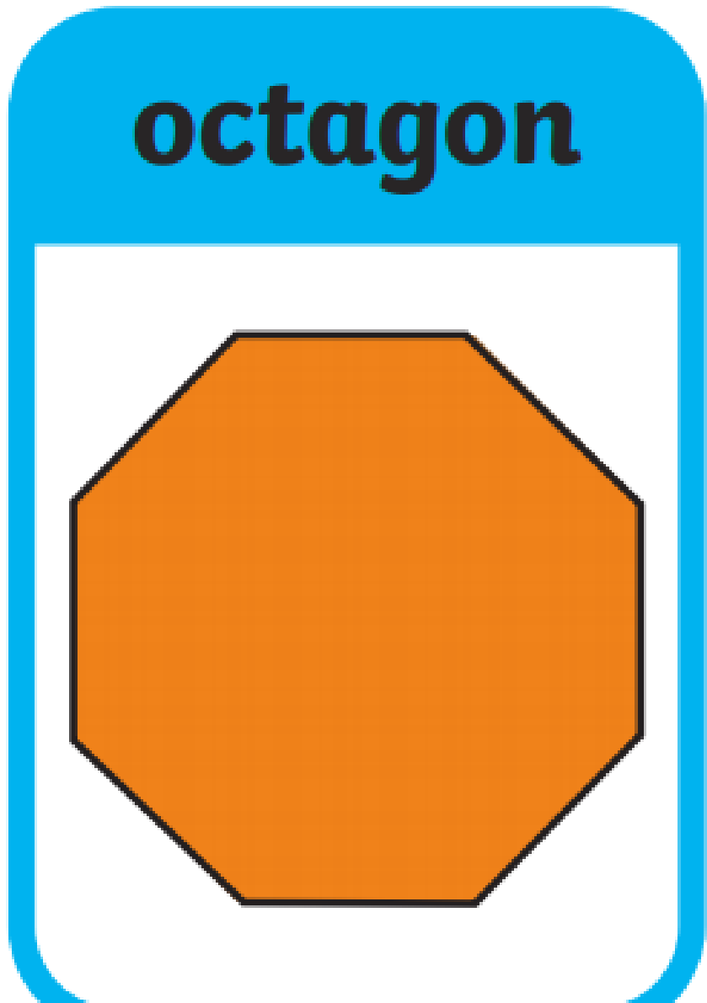
Activity 2:
Shapes in a bag- Before you start this activity you may want to ask your child to help you to make some shapes to put in the bag. You could cut them out of cereal boxes. This is good practice at drawing shapes.
Place a selection of 2-D shapes in a bag.
Choose a shape but leave it in the bag so your child can’t see it. Describe the shape to your child eg. It has 2 short sides and 2 long sides.
Swap roles - can your child describe the shape to you?
Write the names of the shapes on pieces of paper can your child match them to the appropriate shapes. They may have to use their detective reading skills as most shapes are tricky words!

Slide 8
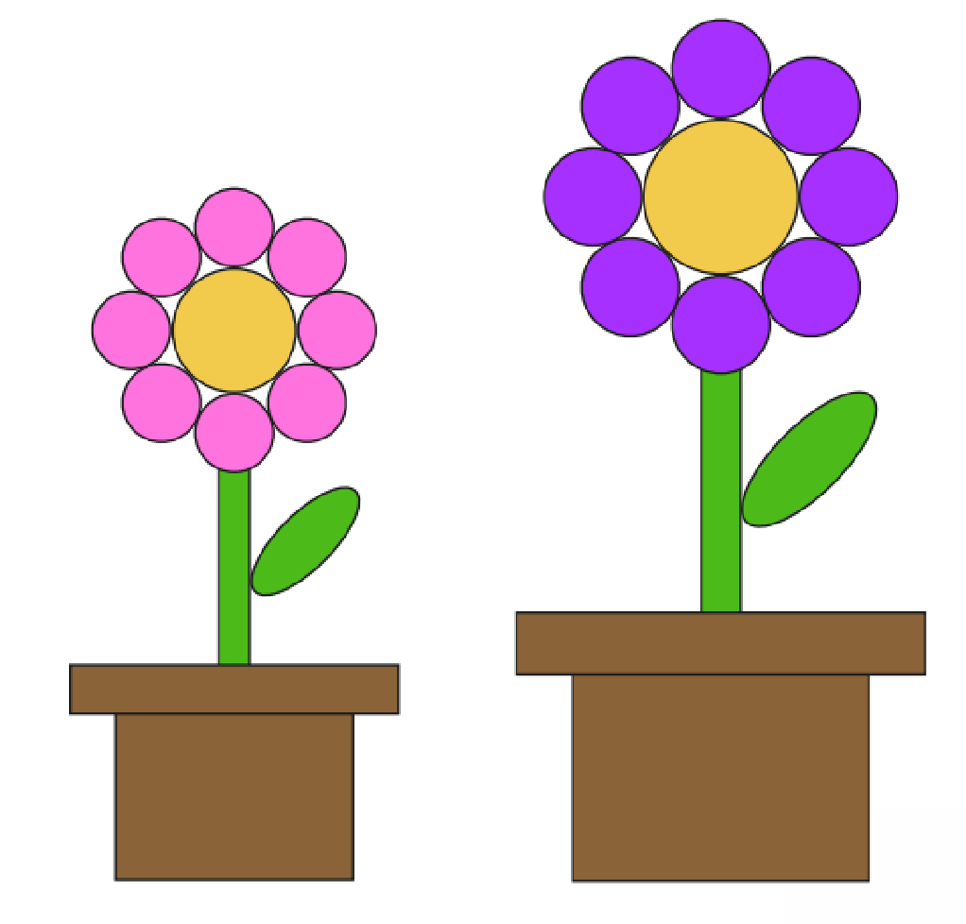
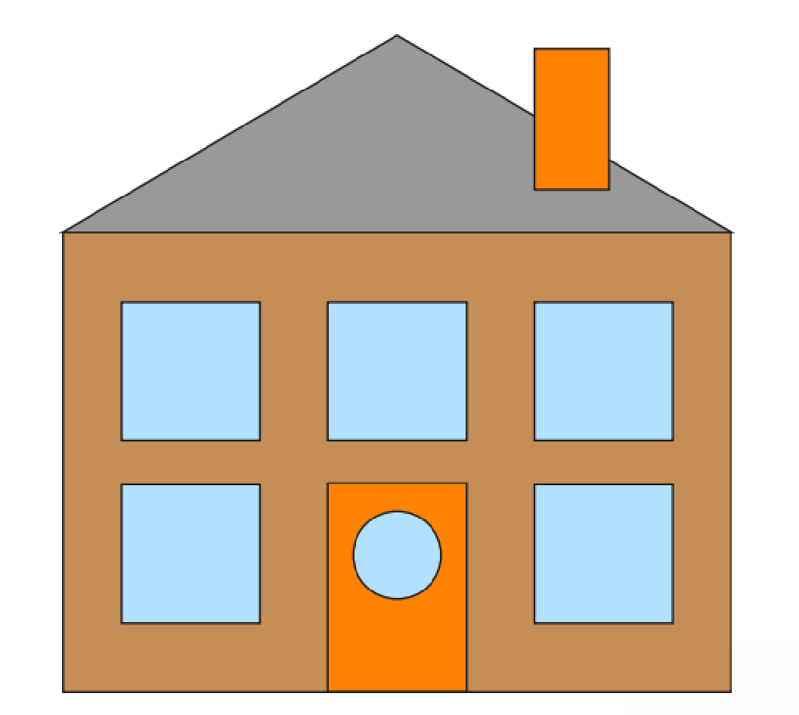
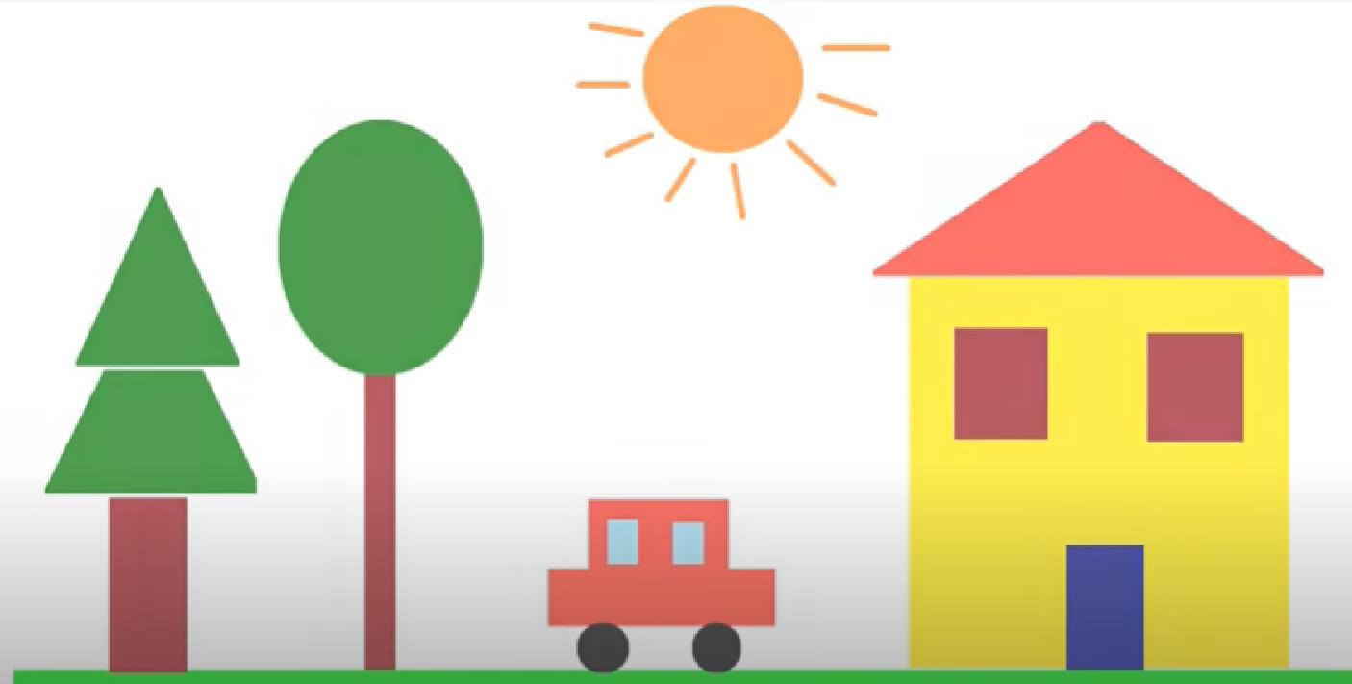
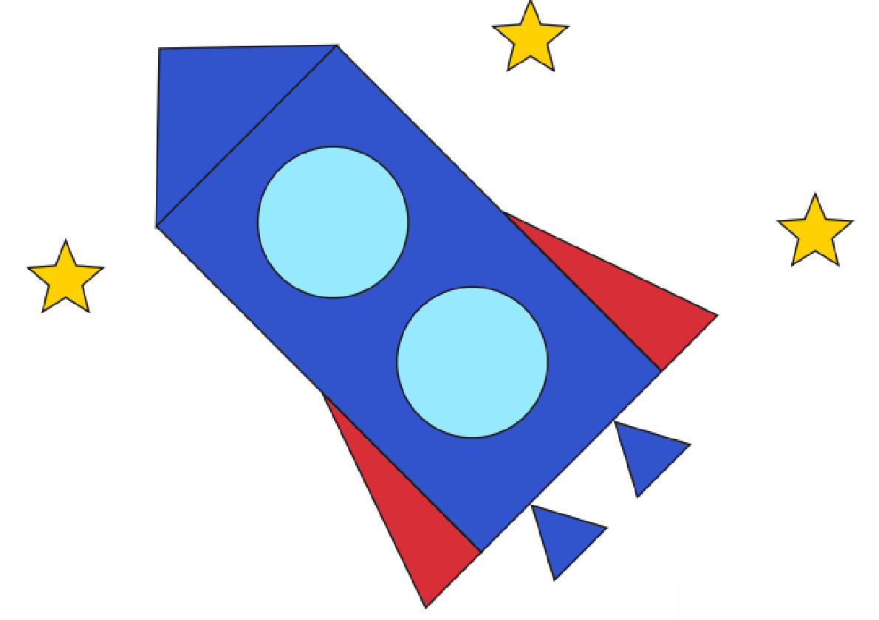
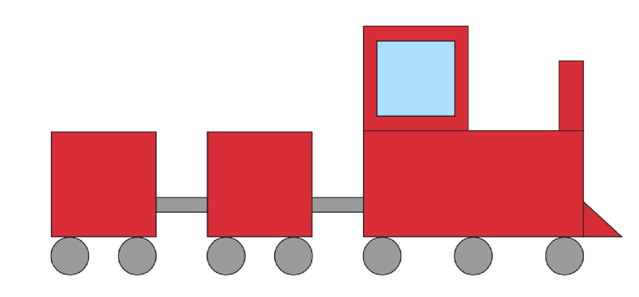
Activity 3- Can you make a picture using different 2-D shapes?
Using the shapes that you made before, you will probably need to make lots more! You could also use fuzzy felt or foam craft shapes if you have them. Can you make your own picture using shapes? There are lots of examples below. You could stick the shapes down or draw round them.
Encourage your child to talk about the shapes that they are using as they are making their pictures. What shape is it? How do you know? Why is that a good shape for this part of the picture?

Slide 9
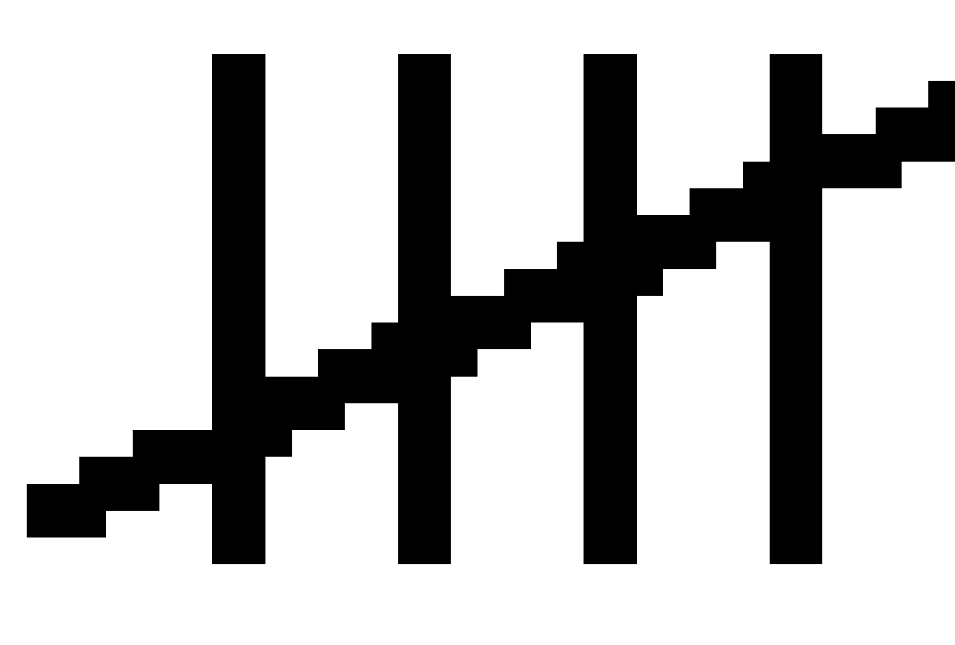
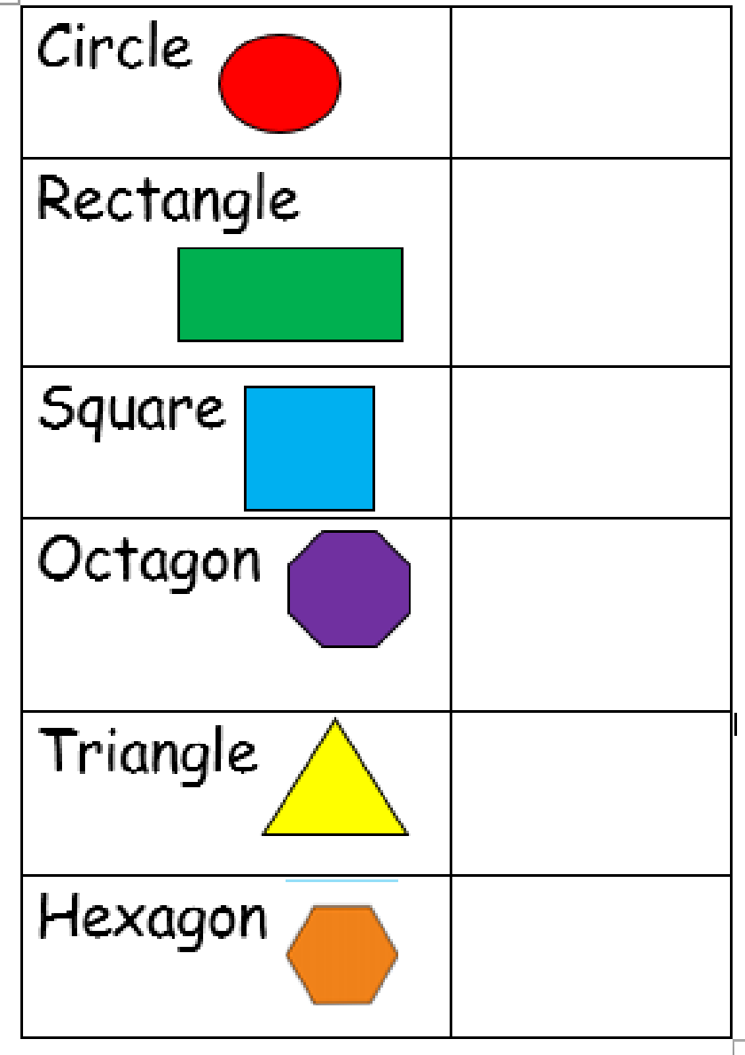
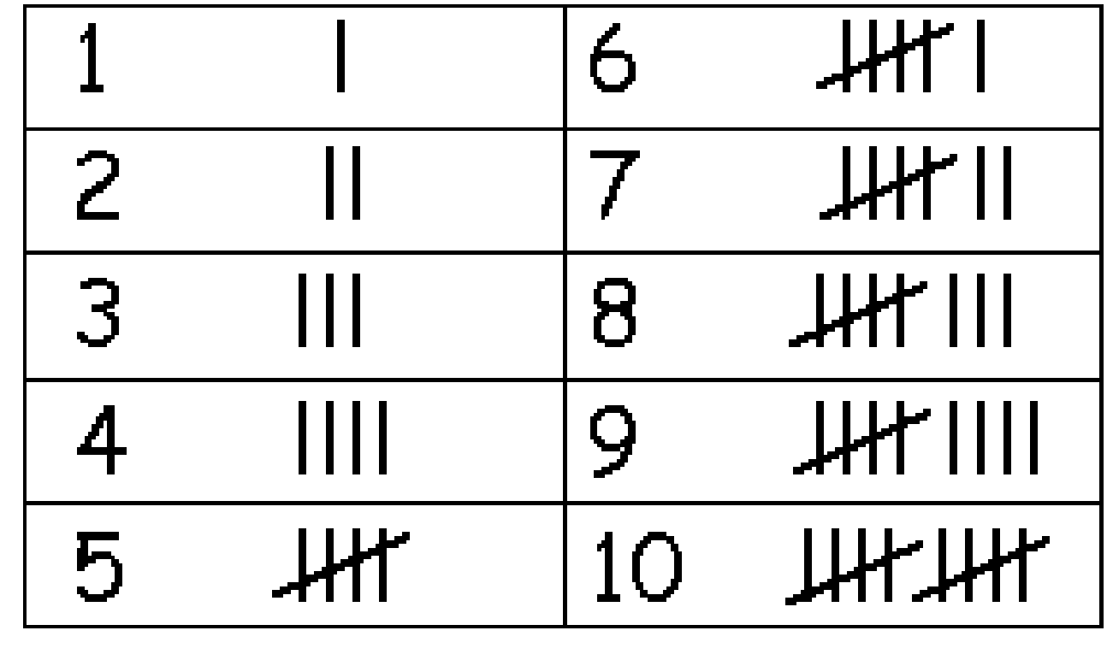
Activity 4- Make your own tally survey.
Ask your child to make a tally chart sheet so they can tally how many different shapes they can find in the house. Tally marks are useful in counting, for recording amounts and tallying ongoing amounts. We have used these in school before so hopefully the children should be familiar with them. They may need reminding that when they get to 5 this is represented by a line through the middle of the group of 4 (we sometimes call this a ‘gate’).
Tally marks help the children to subitise instead of having to count them all. When looking at the results encourage your child to count on eg. If the total is 7 they know that this is 5 so count on 2 more.
Could you take your shape tally survey outside on your daily
exercise to see how many different shaped things you can find
outside?

Slide 10
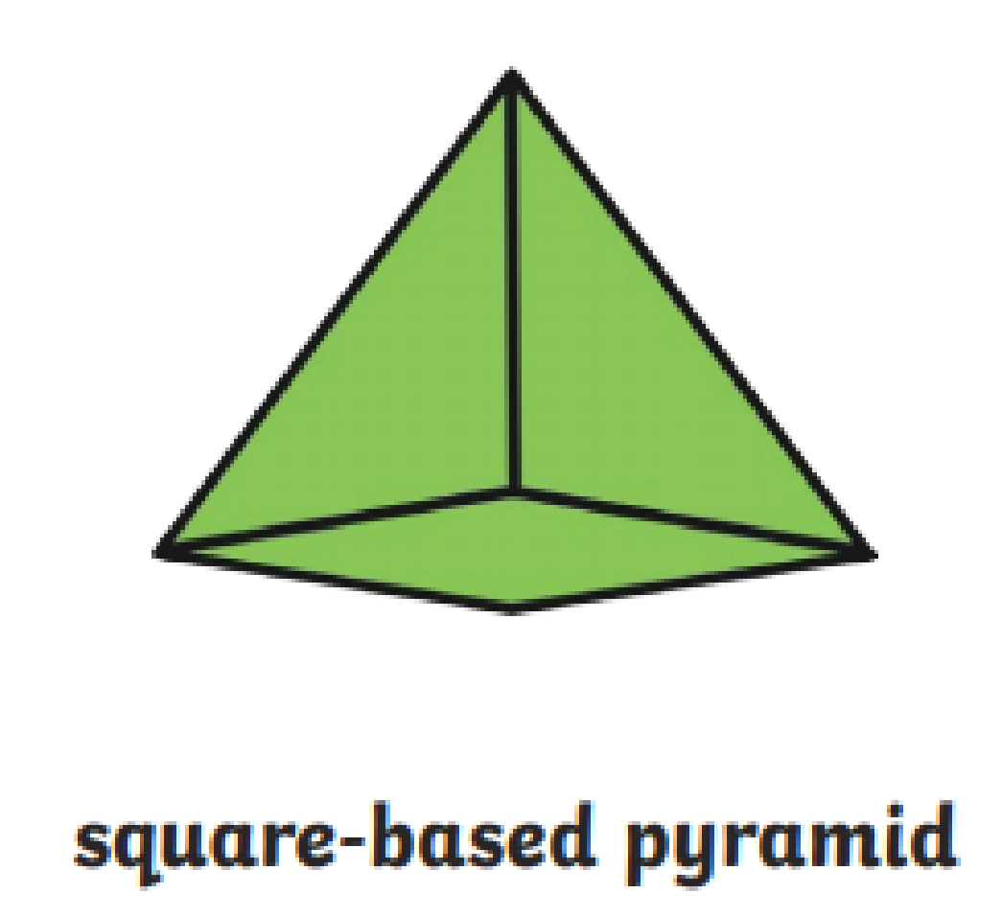
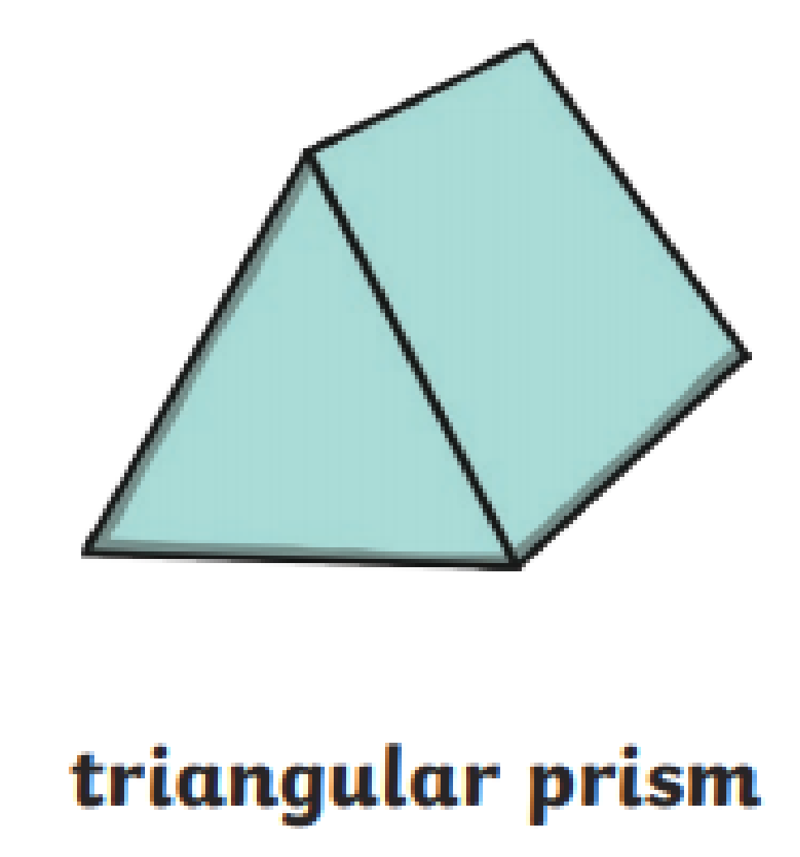
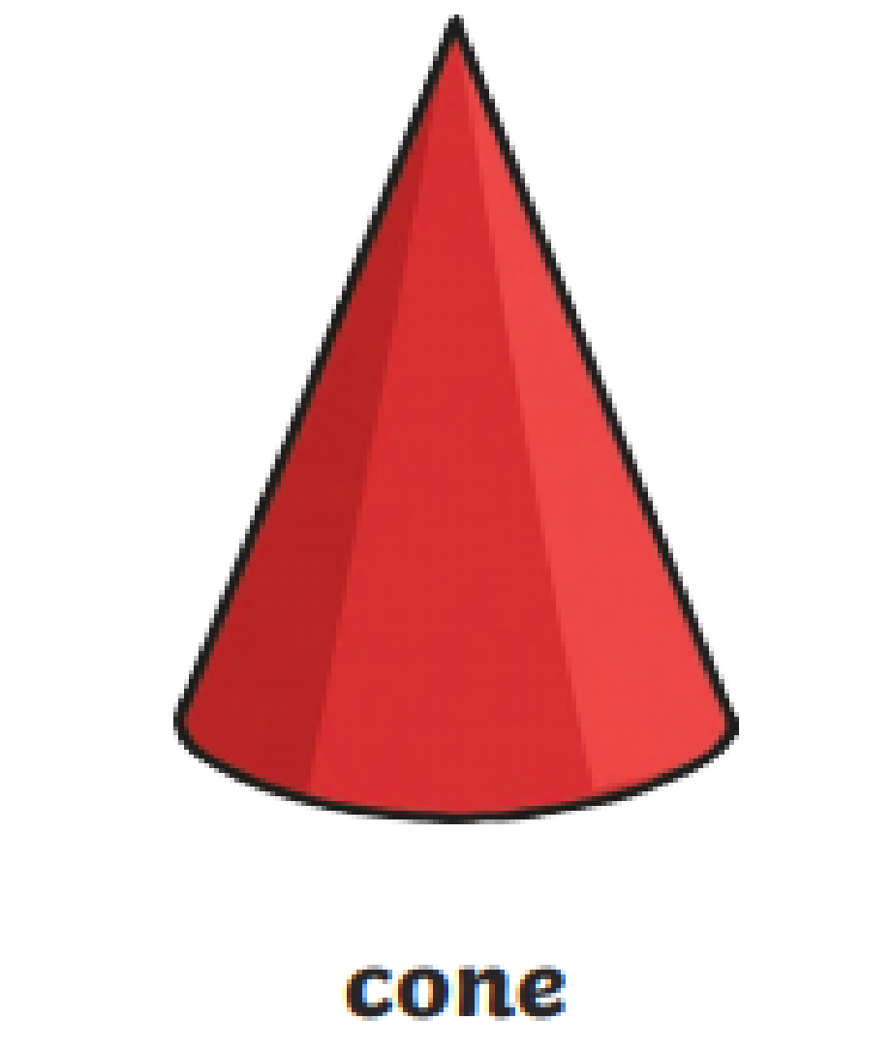
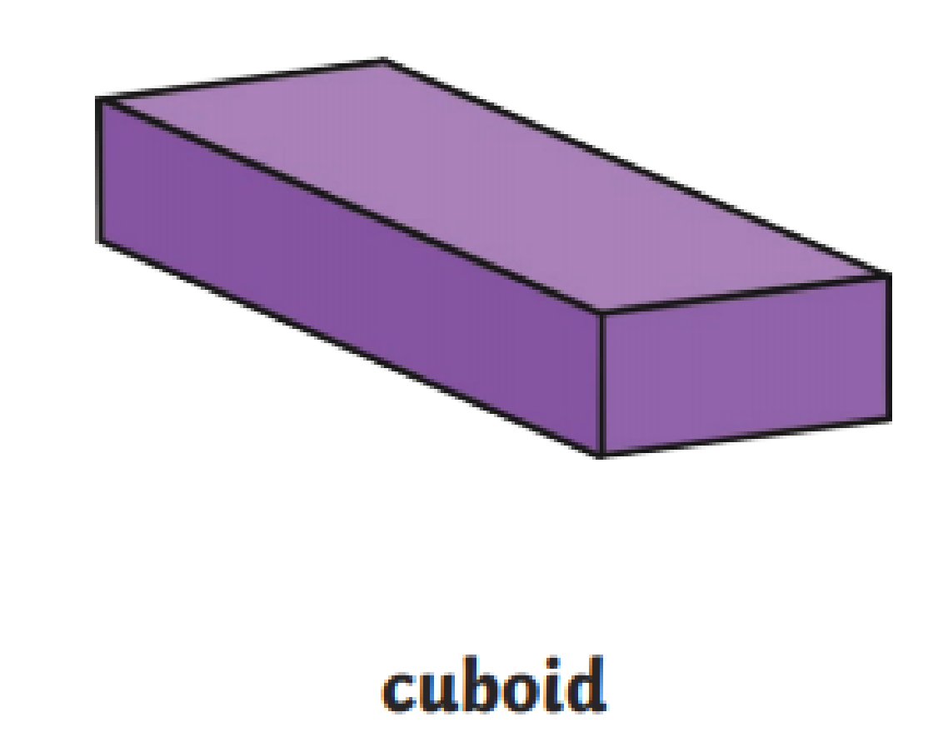
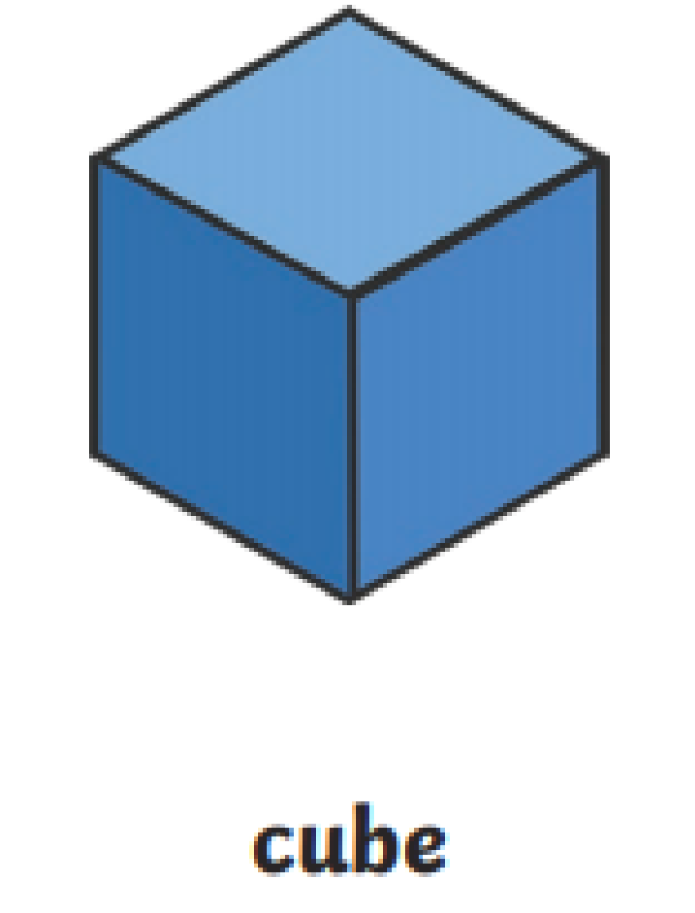
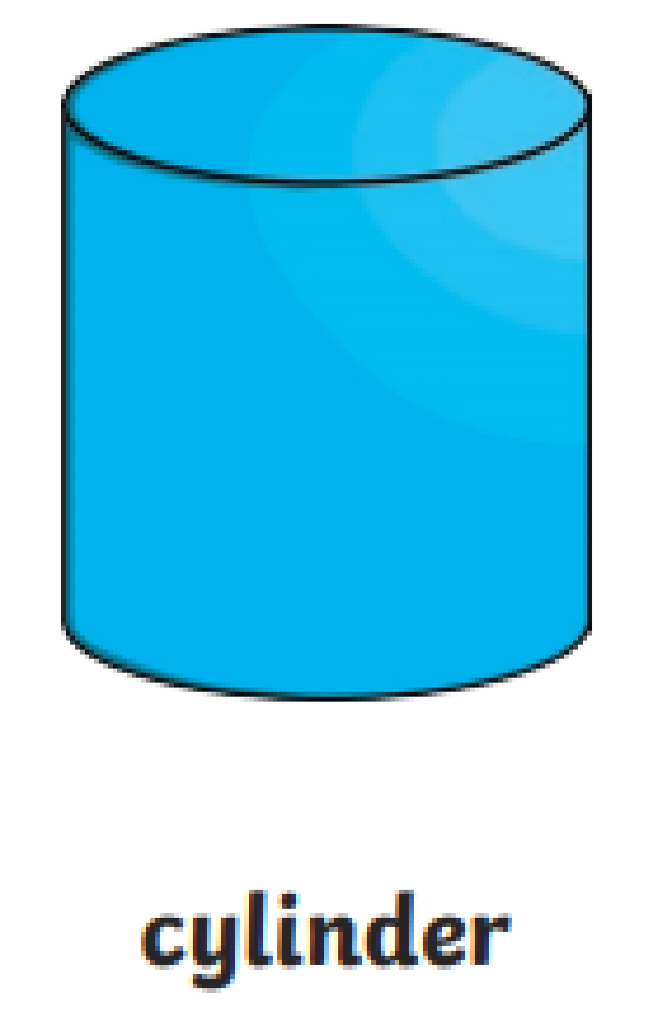
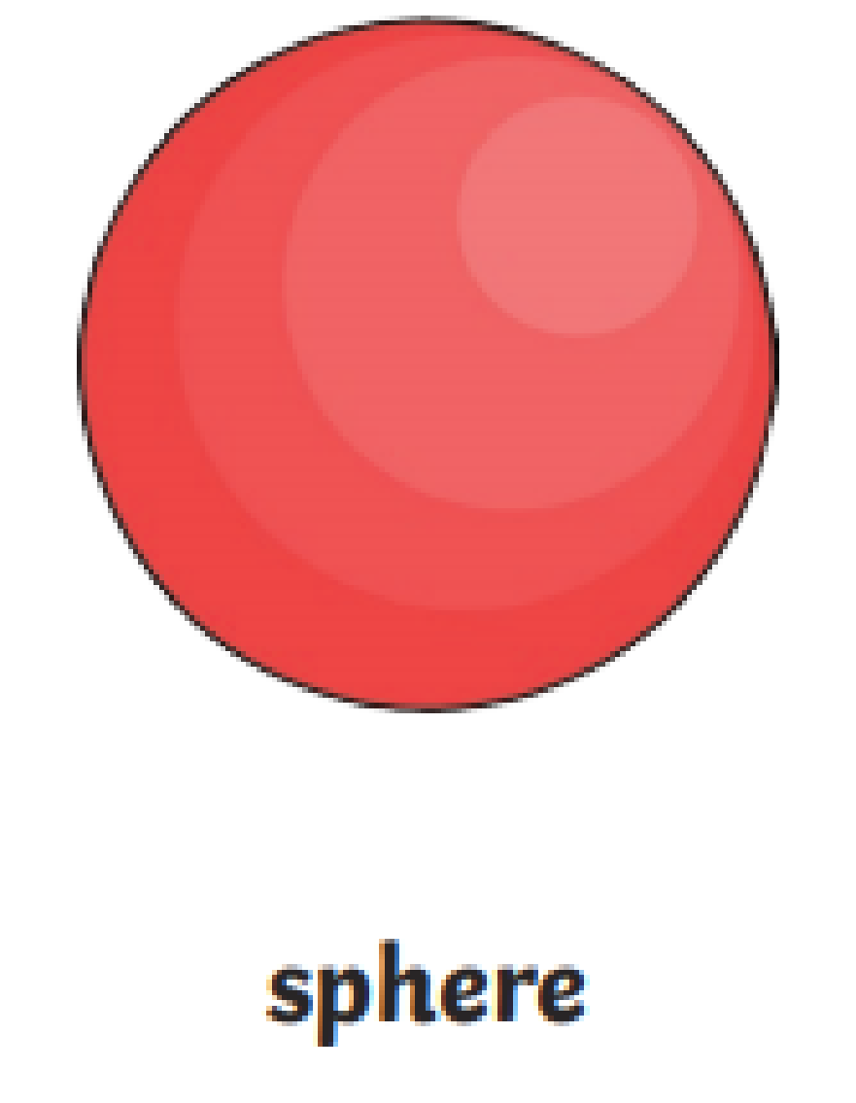
3-D shapes- Reminder you can use this Jack Hartman video on 3-D shapes as a warm up.
When describing 3-D shapes we describe them as solid rather than flat. We encourage the children to see the 2-D shapes on the flat faces of the 3-D shapes.
Activity 5– Can you make some 3-D shapes out of playdough or salt dough?
Which shapes are the easiest to make? Why do you think that?
Which shapes are harder to make and why?
Which shapes roll and which don’t?
Can you put the shapes into 2 groups? Ones that roll and ones that don’t. What do you notice about each set of shapes?
This could prompt a discussion about the faces of 3-D shapes how some are flat and some are curved.

Slide 11


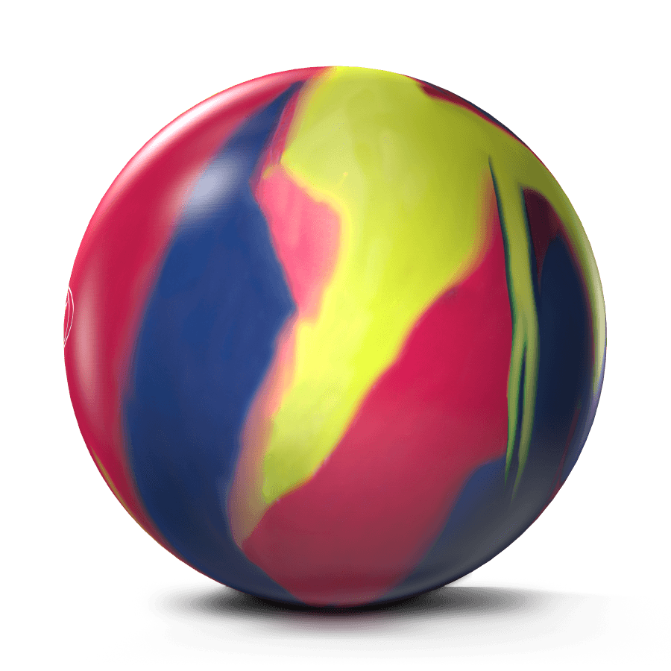


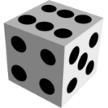
As an extra activity you could make another tally chart survey using 3-D shapes.
Can you spot any 3-D shapes outside if you go out for your daily exercise?
3-D shapes
3-D shapes are fat not flat.
A cone is like a party hat.
A sphere is like a bouncy ball.
A cuboid is a building tall.
A cylinder is like a can of pop.
A cube is like a dice you drop.
3-D shapes are here and there.
3-D shapes are everywhere!

Slide 12

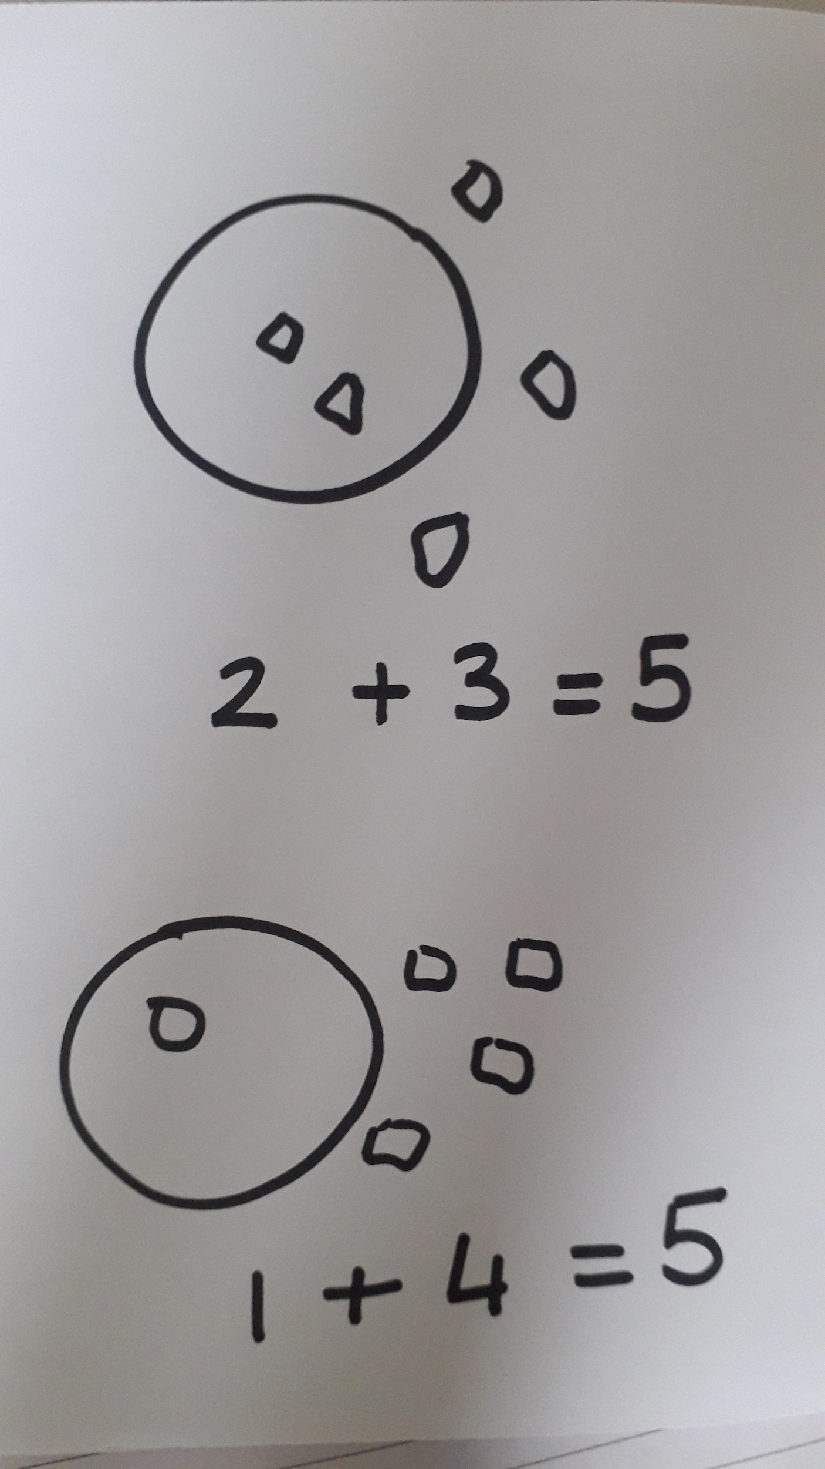
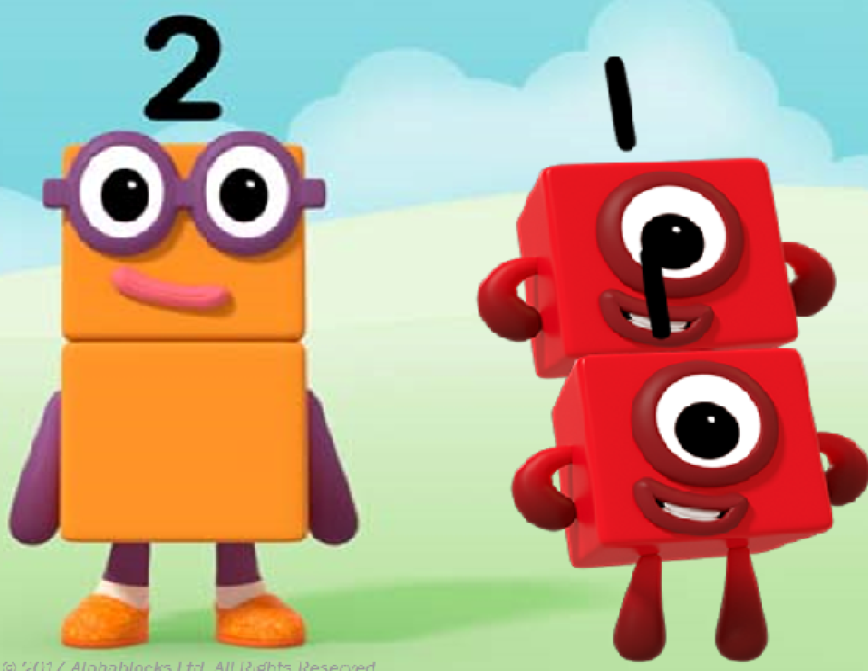
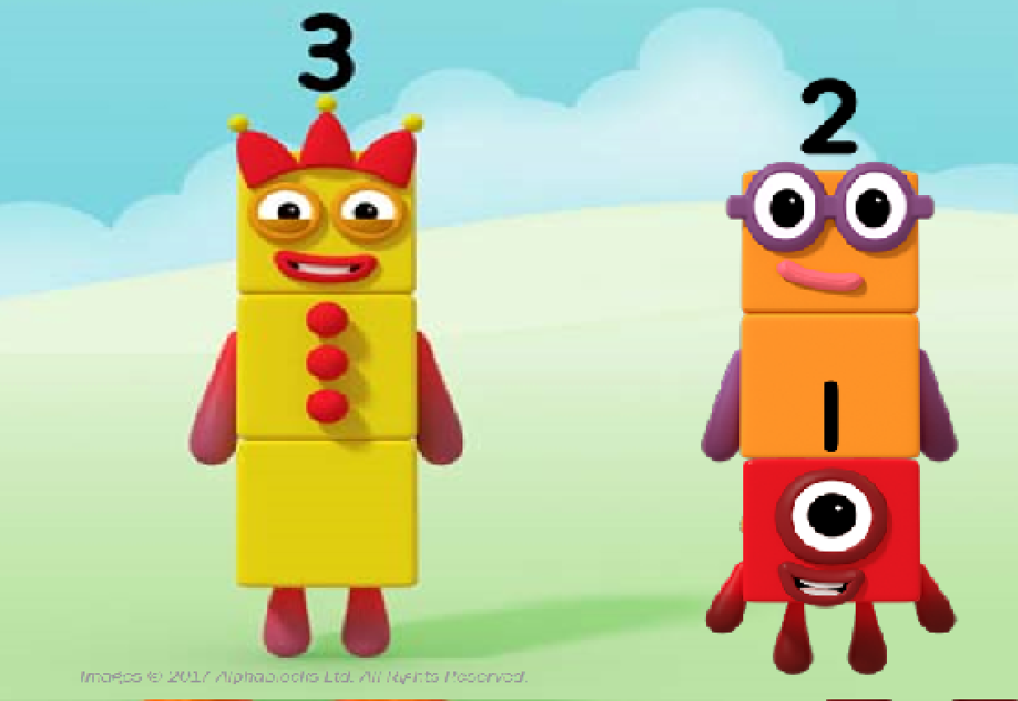
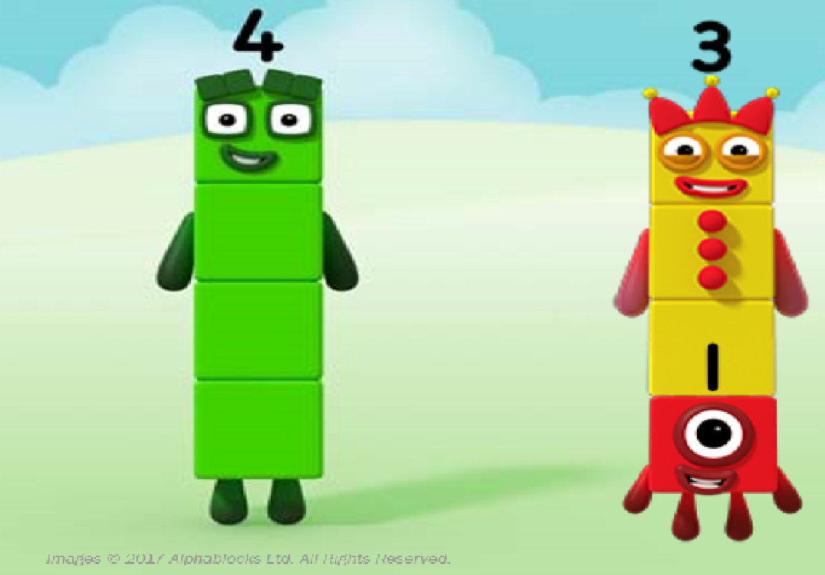
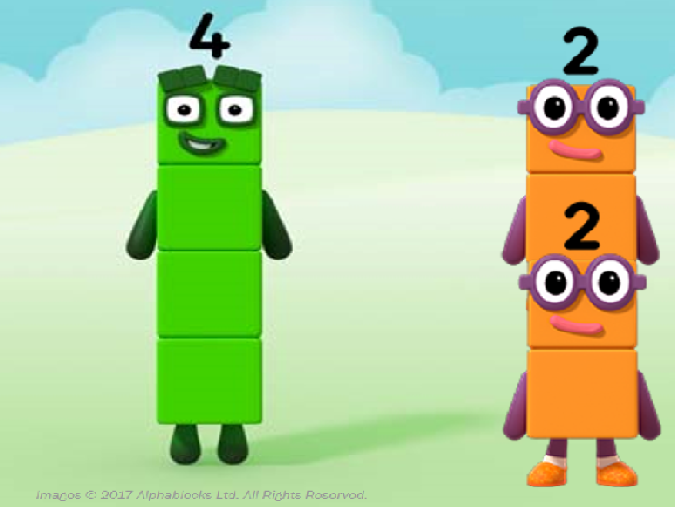
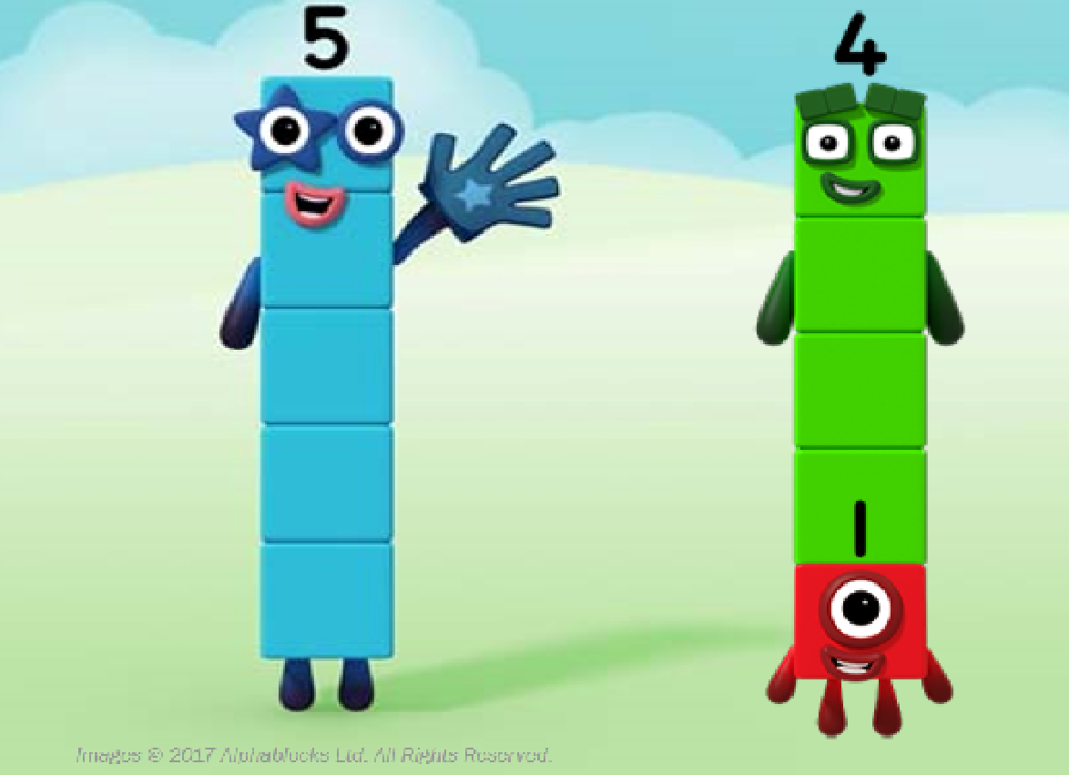
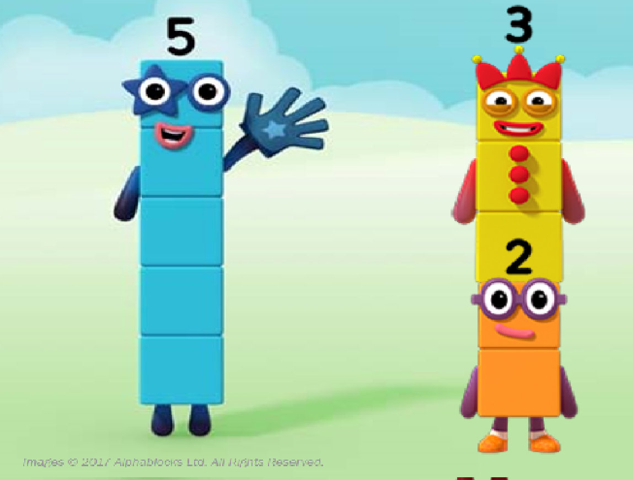
Week 4- Number bonds to 5.
In all of your number activities, please remember that children need to work through 3 stages of understanding. We continually revisit each stage, right through school - even year 6 work with counters and blocks!
Concrete
Experience the number / concept practically, with real objects
Pictorial
Represent the number / concept with pictures
Abstract
Represent the number / concept with written numbers to
Reception maths work should have a lot of concrete and pictorial activities.

Slide 13
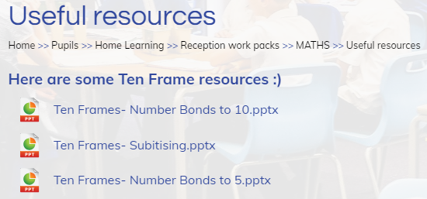
Week 4- Number bonds to 5.
We would like the children to learn that small numbers (including zero) can be combined together to make a number.
These are called number bonds. (Please see ten frame resource)
Begin by watching the numberblocks episode The whole of me https://www.bbc.co.uk/iplayer/episode/b08dr1l3/numberblocks-series-1-the-whole-of-me
We use these episodes as a stimulus for discussion. You may want to re-watch the episode and pause it at certain points that you could discuss.
Ask your child what they noticed in the episode. Discuss how the numberblocks split up into smaller numberblocks.
The episode provides some examples of how numbers can be partitioned into smaller numbers.
It is really important that children understand that numbers can be partitioned in different ways but the whole always remains the same.

Slide 14
Activity 1-
Make a circle on the floor, a hoop would be great to use. If you don’t have one you can improvise!
Give the children 5 bean bags (again you may have to improvise).
Ask your child to throw the bean bags in the hoop.
How many land inside the hoop?
How many land outside?
Do you still have the same amount of beanbags even though they have partitioned?
How could you record your results? Encourage your child to draw their results and begin to think about writing them as a calculation eg. 4+1=5. The drawing is really important for understanding.
Change the total number of beanbags you have. What does your child predict may happen then?
This activity can be extended to using 10 objects and exploring number bonds to 10. Please do not move onto number bonds to 10 unless your child has a really good understanding of number bonds to 5. To ensure this practise all of the activities provided using number bonds to 5 and then return and use number bonds to 10.
Encourage your child to record their findings by drawing representations and writing calculations.

Slide 15
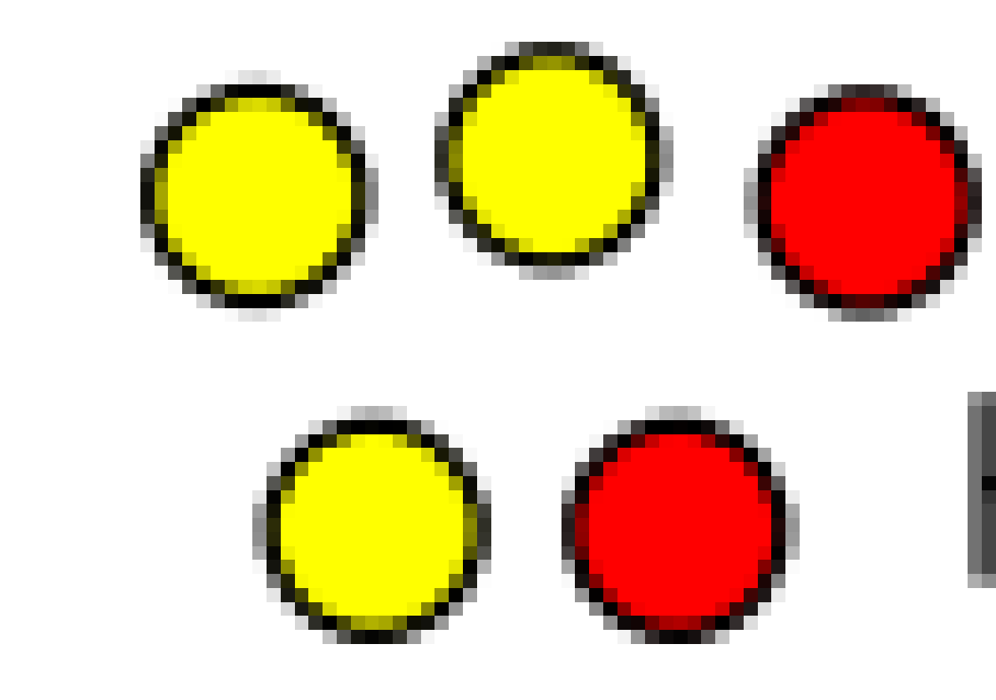
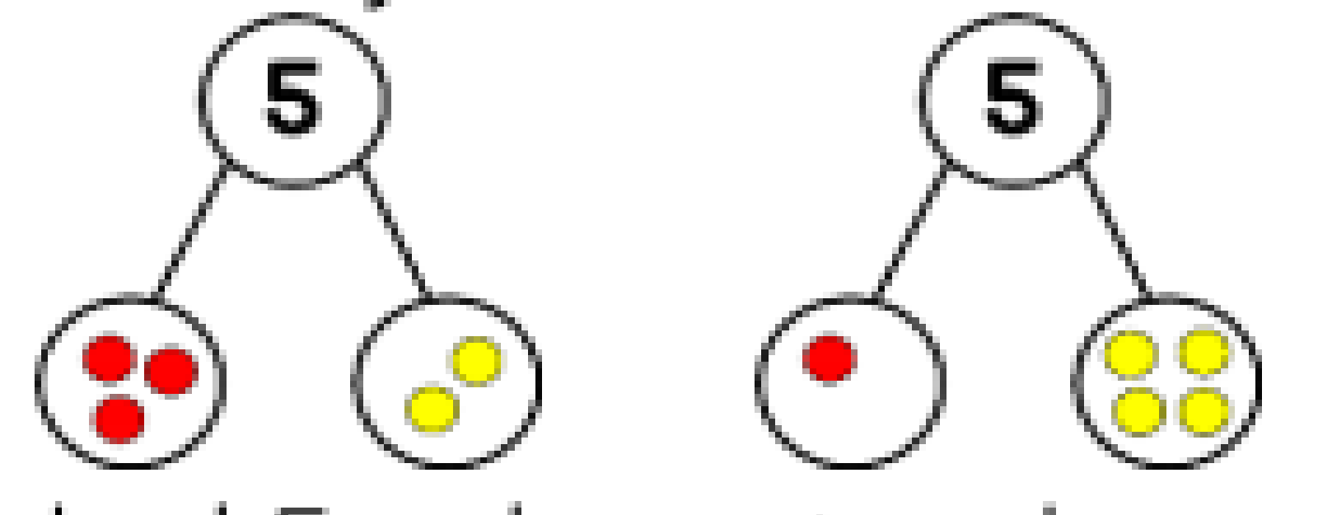
Activity 2-
Cut out 5 circles, colour one side red and the other side yellow.
Shake the counters and drop them on the table.
How many are red, how many are yellow?
If you dropped them again would they land the same?
Drop them again, what has changed? Again ensure your child knows that the whole remains the same.
A part-whole method is a great way of looking at partitioning numbers.
The whole is always in the top circle and the 2 parts are represented underneath. This model is a great visual representation of partitioning.
Using the part-whole method ask your child to draw their results from the counter activity.
This activity can also be extended to using 10 counters. Encourage your child to record their findings by drawing and writing calculations.

Slide 16
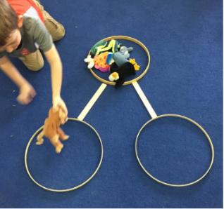
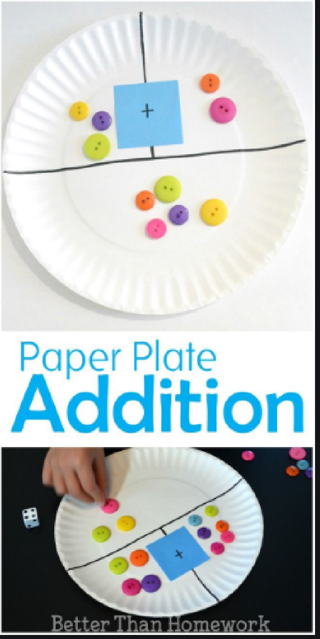
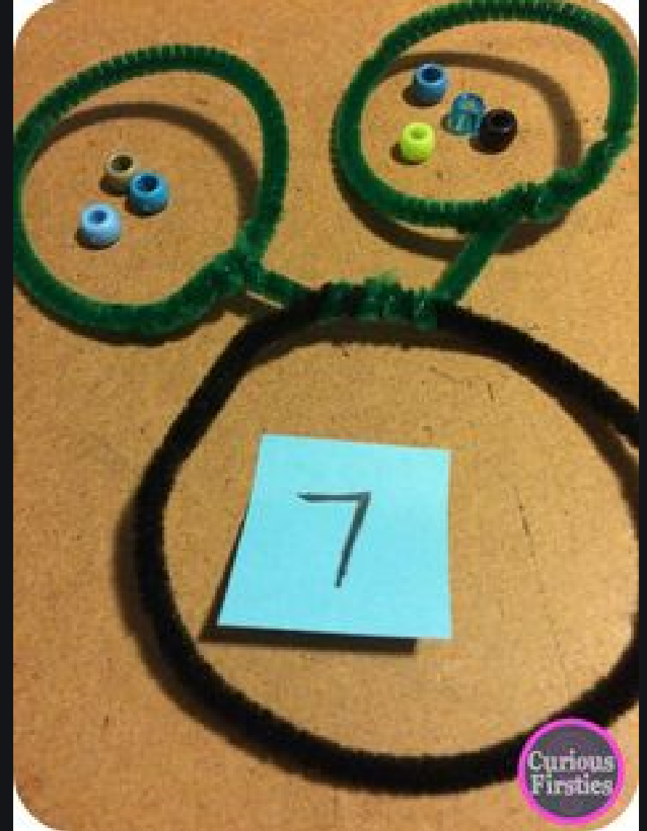
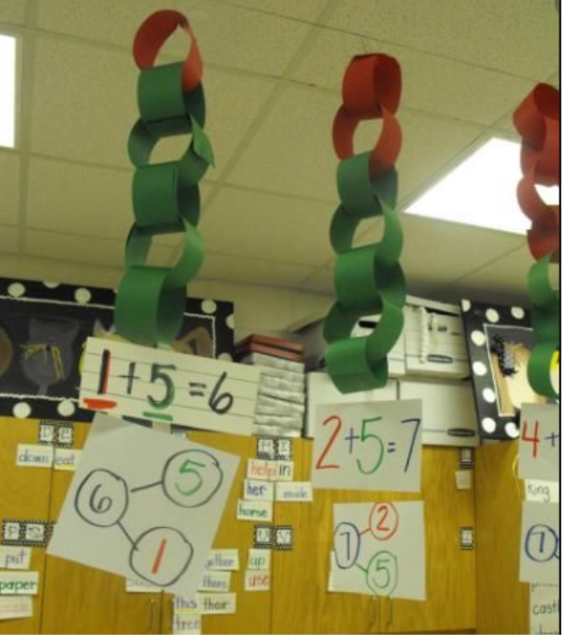
Here are some practical ways that you can explore number bonds. Have fun!

Slide 17
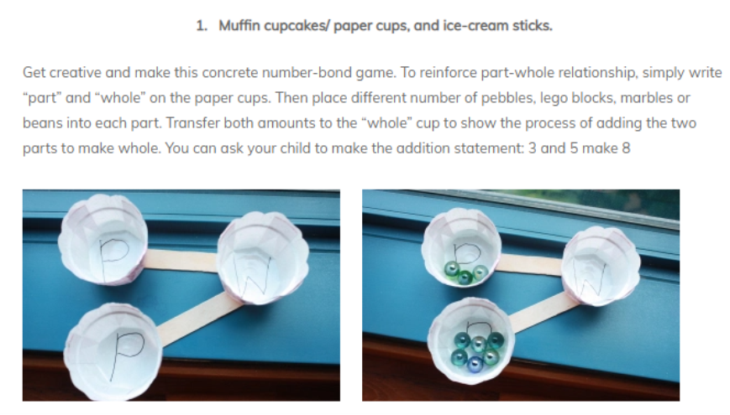
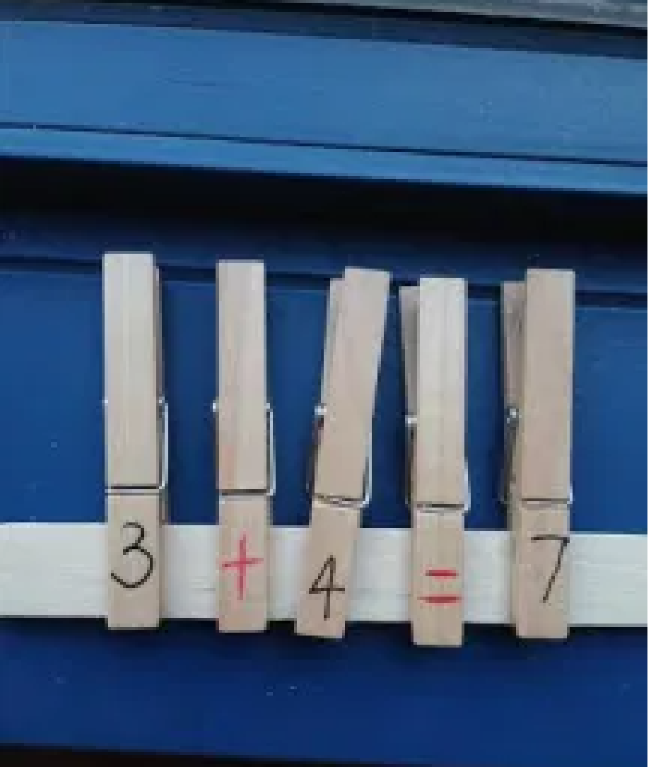
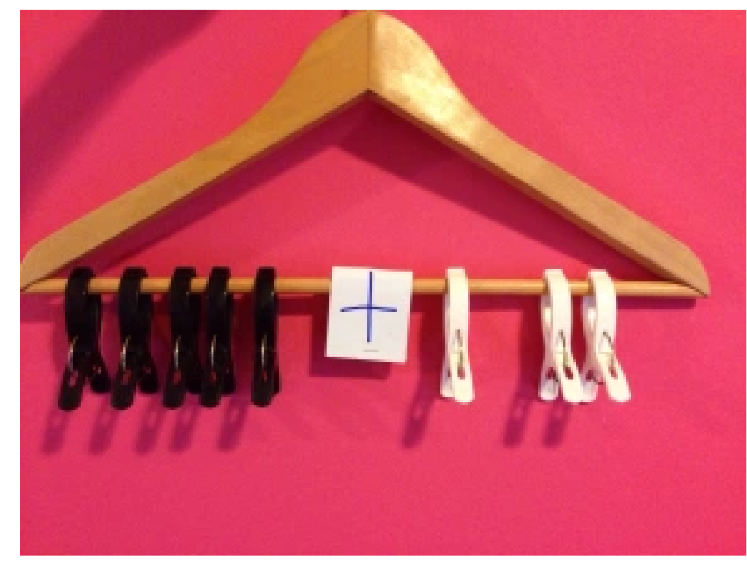
Write numbers 1-5 a + and = onto pegs or lollipop sticks. Explore how many different ways you can make 5.
Use a coat hanger and pegs to explore the different ways you can make 5.

Slide 18
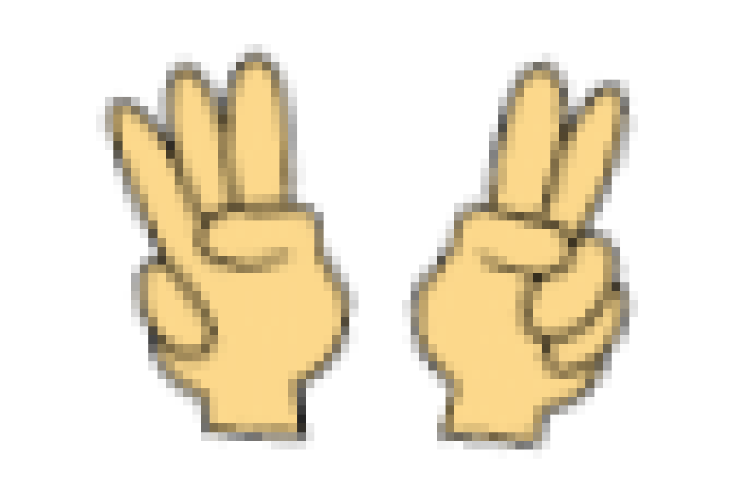
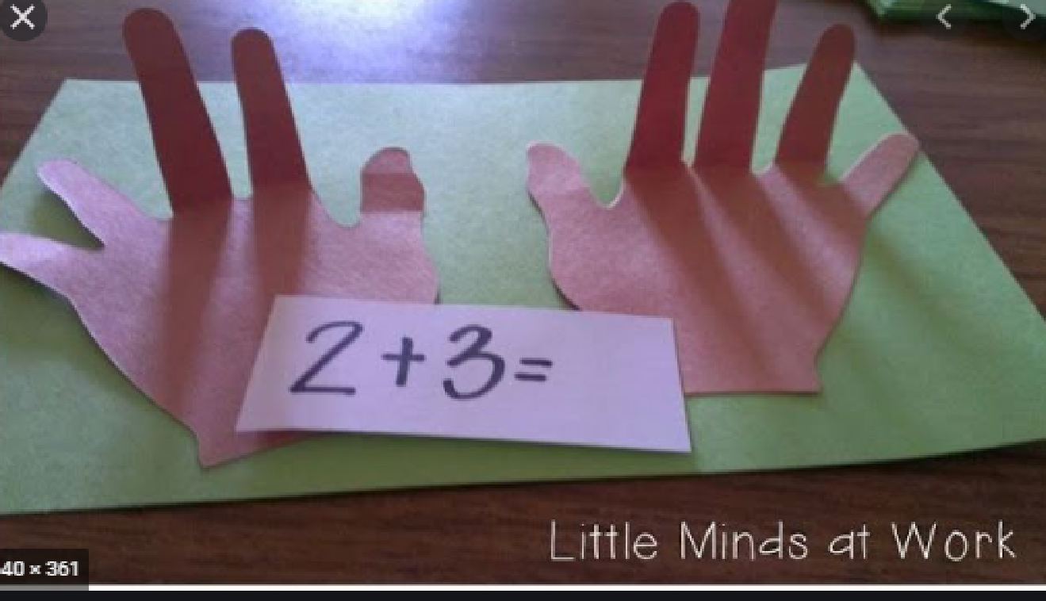
Activity 3- Bunny ears
Using 2 hands to be ears, how many ways can you show 5?
Can you see what number I have made? Can you make ears the same as mine?
Can you make the same number in a different way?
You could make your own hands where the fingers fold over.
Encourage your child to record their findings by drawing and writing calculations.

Slide 19
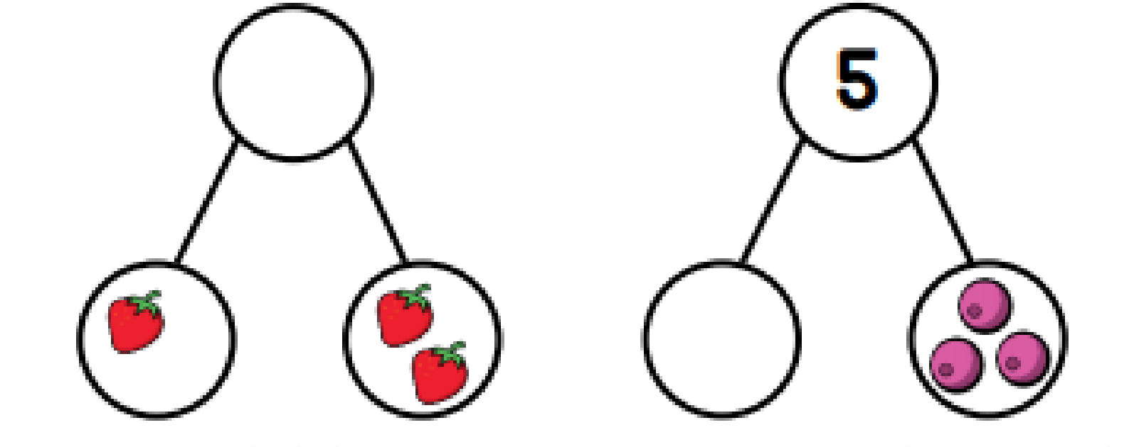
Activity 4
Make a part whole model. You could draw one or use some of the practical ideas on slide 14.
Display the model with either one of the parts or the whole missing.
What is missing? Use concrete objects or draw a picture to explain how your child knows what is missing.
This activity can also be done using number bonds to 10.
Encourage your child to record their findings by drawing and writing calculations.

Slide 20
Activity 5-
Get an empty bag.
Together with your child count 4 objects into the bag.
Ask your child to close their eyes and remove an amount.
Ask your child to discuss how many objects could be in your hand.
How many objects could be left in the bag?
If I have 3 cubes in my hand how many would be in the bag?
If I have 3 cubes in my hand could there be 4 cubes in the bag?
This activity can also be extended using number bonds to 10.
Encourage your child to record their findings by drawing and writing calculations.

