Slide 1

Maths in Reception

Slide 2
20/04 - This week we are going to look at solving problems involving halving.
When halving we are sharing items into 2 equal groups. I’m sure the children will already have an understanding of what is fair and unfair! This helps the children to understand the idea of half being one of two equal parts. We are not looking for the children to be able to halve numbers. This also includes halving shapes. Use the first day for your child to practically explore.
Can you find things in your house that can be halved? Can you fold your clothes in half? Cut fruit, cakes, pizzas, sandwiches in half?
Reiterate that when something is halved it has to be equal.
If you have playdough or plasticine can you make some shapes and see if they can be halved? Adults you could draw some shapes and cut them out. Can your child fold them in half?
Have a teddy bears picnic. Can your child halve the food between them and their favourite teddy bear?
Play with your child's toys such as cars. Can they halve the cars between you both?
These practical activities can be done throughout the week in order for your child to develop a good understanding of halving. If you feel that your child is ready they could attempt some of the questions on the next slide.

Slide 3
Show the children a bowl of fruit such as grapes/ strawberries/ blueberries. Explain that you are going to share them into 2 equal groups so that there will be half for you and half for them. Put a handful of fruit into one bowl (ensure that one bowl has much more fruit than the other). Ask your child if they think that is fair. Ask them how you can share them fairly and explain that they have also split the fruit in half. Explore using different amounts of fruit.
April made 6 cupcakes and ate half of them. How many did she eat? How many did she have left? Can you draw a picture of the cupcakes that April had left?
Draw 8 bottles of paint on a classroom shelf. Colour half of the paint bottles blue. How many bottles are blue?
There are 12 children in Mrs Yeoman’s class. Half the children are girls. How may children are girls? How many children are boys?
There are 22 footballers on a field and half of them are wearing red. How many footballers are wearing red? Draw 22 football shirts and colour half of them in red to check.
If there were 16 cars in the carpark in the morning, half drove away at lunchtime how many cars were left? You could use toy cars to work it out if you have some.

Slide 4
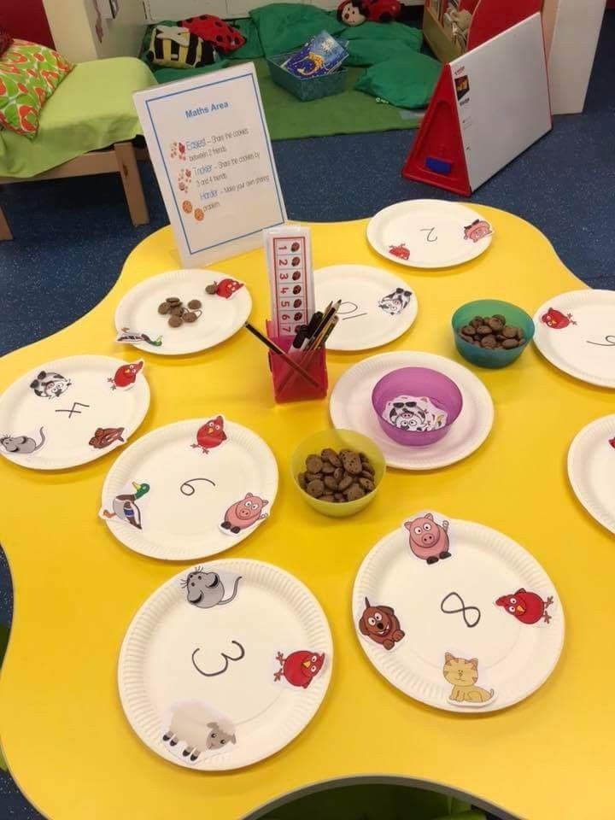
This week we are going to look at solving problems involving sharing.
Monday 27/04 Sharing- We would like the children to be introduced to the idea of sharing things equally between more than 2 groups. Many of the practical ideas from the halving slide can be used to grasp the concept of sharing all you need to do is divide things up between more than 2. Eg Have a teddy bears picnic can you share the food between more than 2 teddy bears.
Get 3 containers and give your child a handful of small objects. Can they share them between the 3 containers?
You could use the idea as shown in the picture. If you write the amount you are sharing in the middle of a piece of paper and have some of your childs dolls/ lego figures/ superheros that they are going to share the amount between. You could then use lego figures, beads, sparkly gems to practically share the amount.

Slide 5
Sam has 3 rabbits that love eating carrots, he has 6 carrots that he shares between them. How many carrots will each rabbit have? Draw 3 rabbits and share the carrots out to check.
A squirrel collects 10 nuts to share between her 5 babies. How many nuts will each baby have? Draw the nuts to check.
If a packet has 20 sweets in and you share them equally between 4 friends, how many will you get in each? Draw 20 sweets in the middle of a piece of paper, share them equally into the 4 corners of the paper. Count how many are in each corner.
You may need to revisit these problems to ensure your children has a good understanding of sharing. You could change the quantities in the problems if you would like to.

