Slide 1


Maths in Reception
Jack Hartmann is always good to get us started on a Monday! This time he is encouraging us to ‘pump up the pattern’
https://www.youtube.com/watch?v=hoFhVdYsmPg

Slide 2
Week 6 – W/C: 1.6.20
This week we are focusing on exploring patterns.
Children need to be able to do the following:
Copy a repeated pattern (above, below, to the side)
Continue a repeated pattern
Create your own repeated pattern
We start with ABABAB patterns, moving on to ABCABCABC patterns with at least three full units to repeat. It is important to practise creating patterns both vertically and horizontally so that they can see them represented in different ways. Using different objects and contexts are also crucial.

Slide 3
Monday
Copy a repeated pattern

Slide 4




Copy
Activity 1: try copying these repeated patterns. Ensure your child understands that you are repeating the action each time. Say the pattern out loud each time and encourage your child to join in.
clap
clap
clap
touch your head
touch your head
touch your head
stamp your foot
stamp your foot
stamp your foot

Slide 5
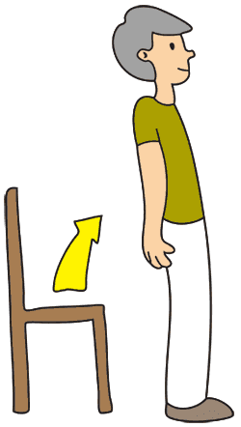
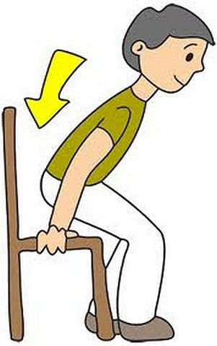

Copy
Challenge: try copying these repeated patterns. Ensure your child understands that you are repeating the action each time. Say the pattern out loud each time and encourage your child to join in.
Keep going…
Stand up
Sit down
touch your head
Stand up
Sit down
touch your head
clap
clap
clap
clap
clap
clap
Arms up
Arms up
Arms up

Slide 6


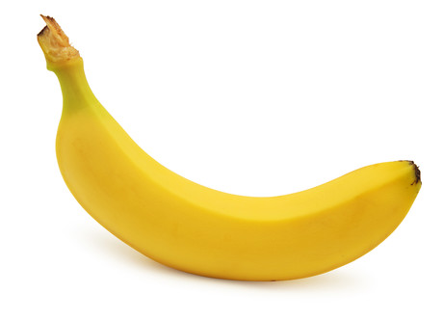
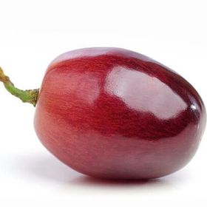
Copy
Activity 2: find two objects to create a pattern.
Adult creates a pattern and encourages child to copy it. See if you can do this with as many different things around the house as possible. ☺

Slide 7

Copy
Activity 2: find two objects to create a pattern.
Adult creates a pattern and encourages child to copy it. See if you can do this with as many different things around the house as possible. ☺
3
5
3
5
3
5

Slide 8
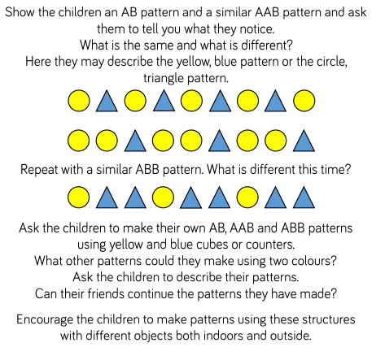


Tuesday
More complex patterns
Show your child these patterns and ask them to describe:
What is the same and what is different?
(look at shape AND colour)
Ask the same about this pattern…

Slide 9

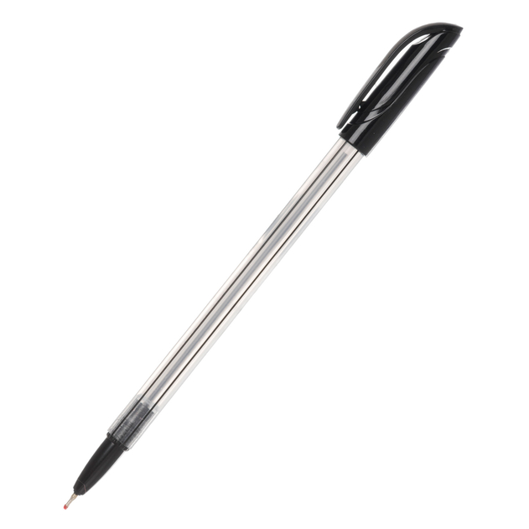
Copy
Challenge: find three objects to create a pattern.
Adult creates a pattern and encourages child to copy it. See if you can do this with as many different things around the house as possible. ☺

Slide 10


Copy
Challenge: find three objects to create a pattern.
Adult creates a pattern and encourages child to copy it. See if you can do this with as many different things around the house as possible. ☺
2
3
4
2
3
4
2
3
4

Slide 11
Wednesday
Continue a repeated pattern

Slide 12
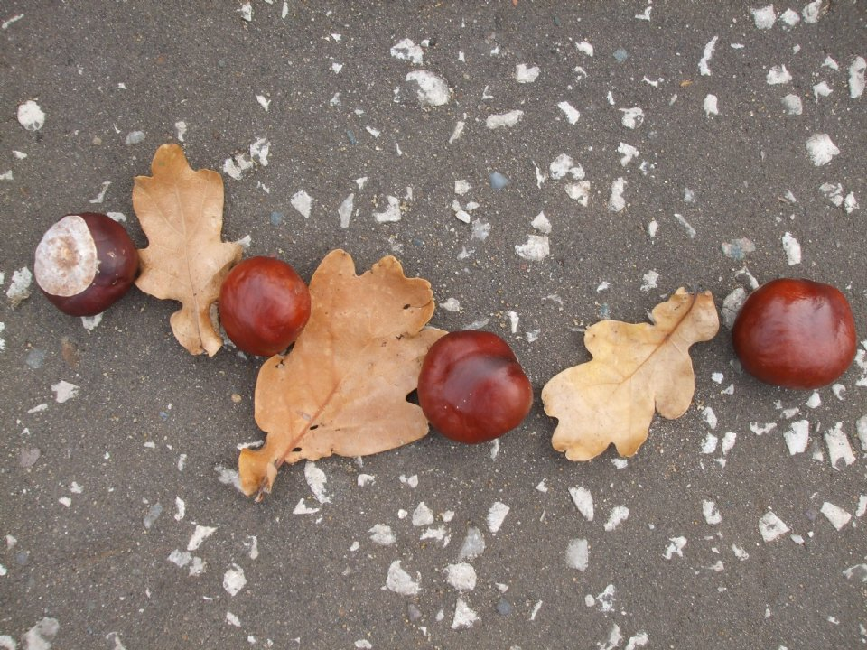
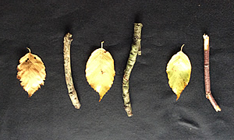
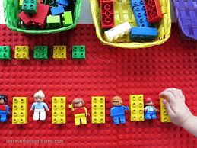
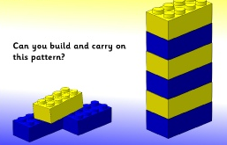
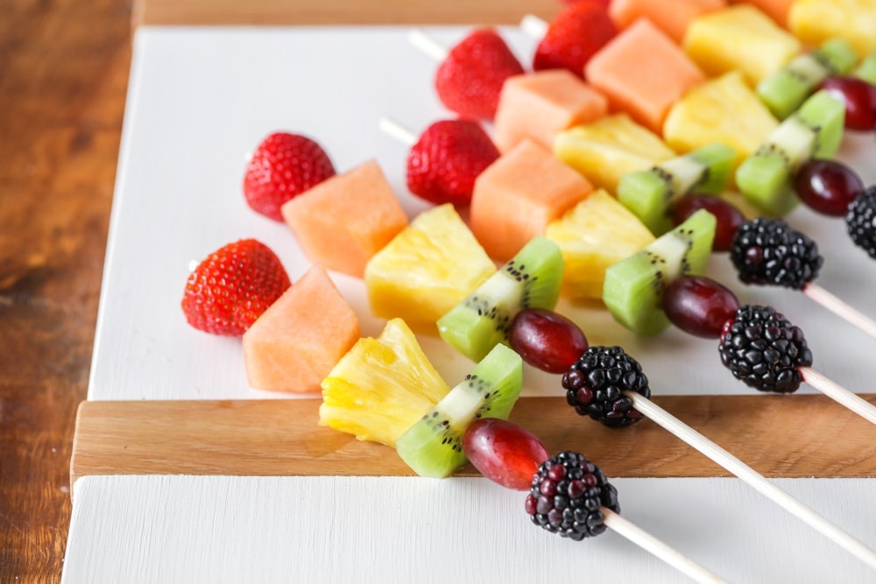
Continue
Activity 3: find two objects to create a pattern for your child to continue (carry it on)…
What comes next?
Ideas…

Slide 13

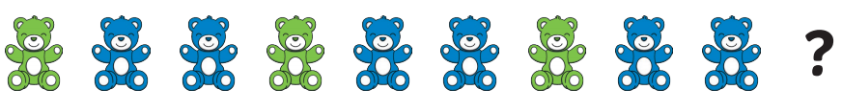
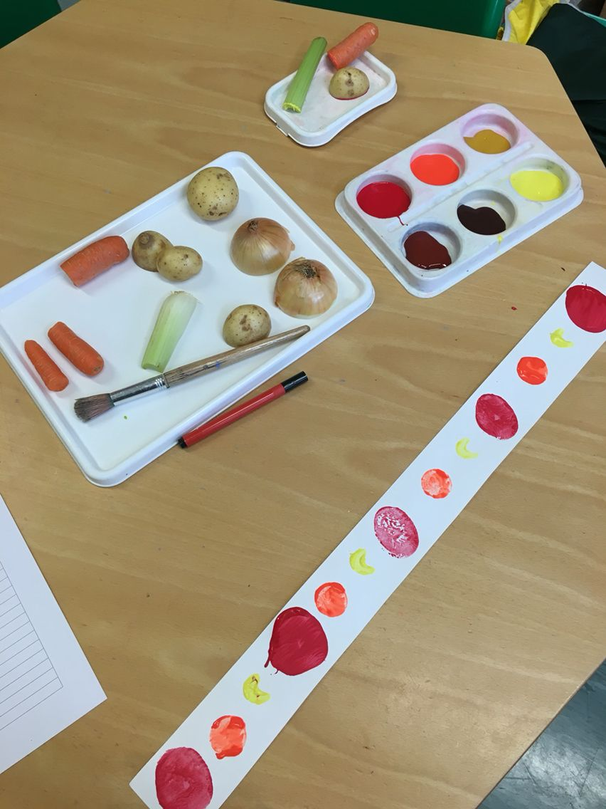
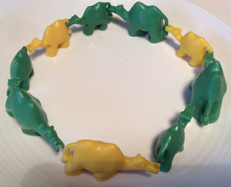
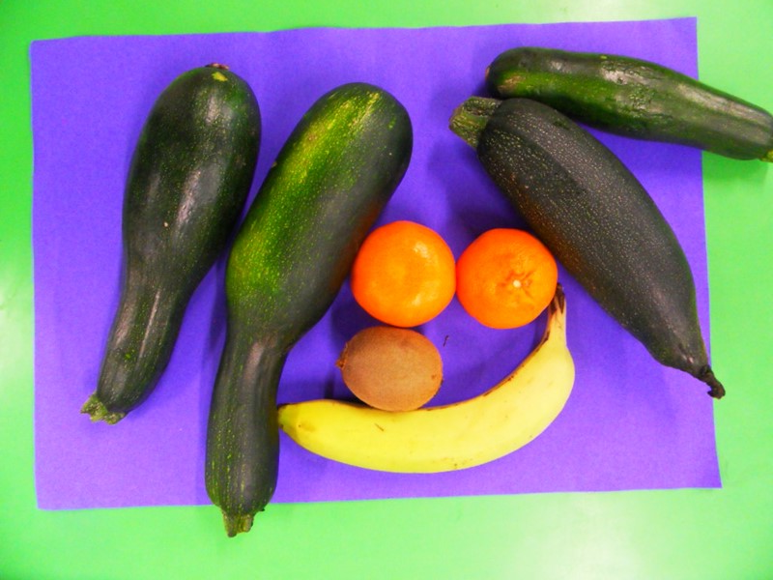
Continue
Challenge: find three objects to create a pattern for your child to continue (carry it on)…
What comes next?
What comes next?
Ideas..

Slide 14
Thursday
Create your own repeated patterns
The next two slides give examples of how you can create your own patterns…

Slide 15
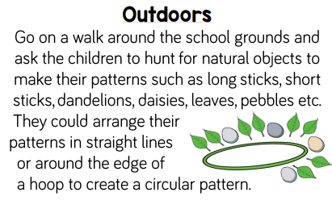
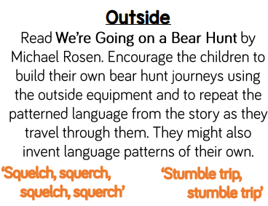
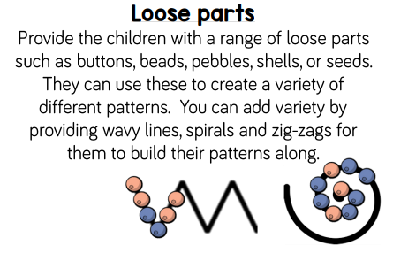
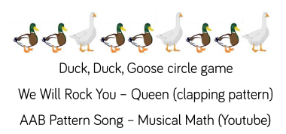
Extra ideas to try related to pattern …

Slide 16
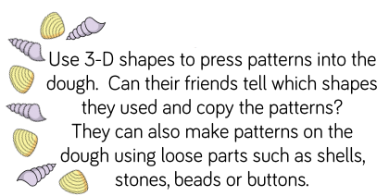
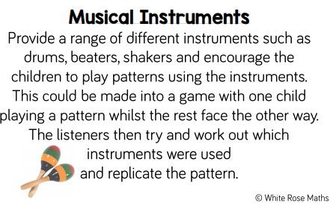
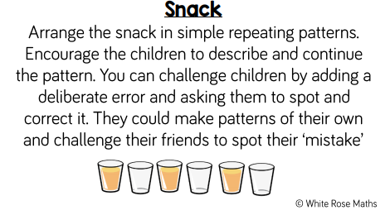
Extra ideas to try related to pattern …

Slide 17
Friday
Extra challenges…
What is missing?

Slide 18
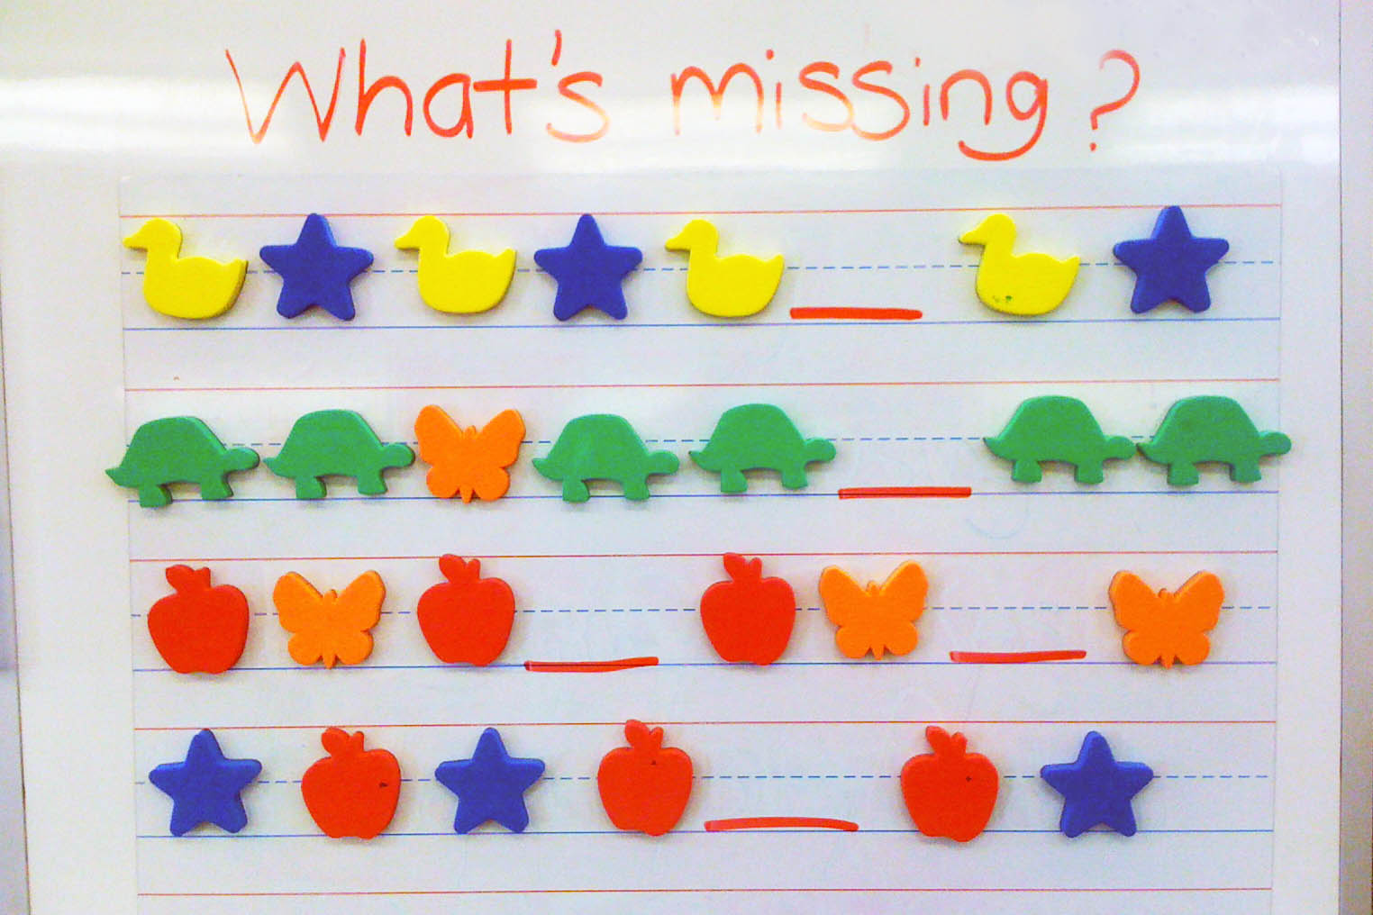
Can your child work out which shapes/colours are missing?
Could you create your own patterns and remove some for someone else to work out the missing part?

Slide 19
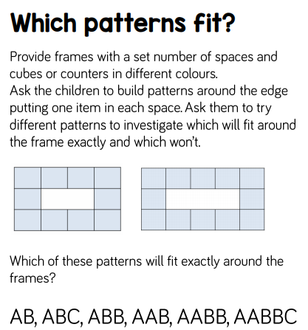
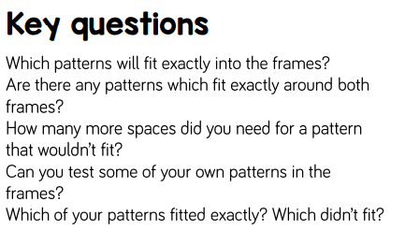
Extra ideas to try related to pattern …

