Slide 1
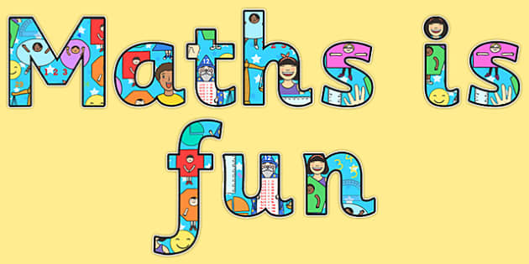

Maths in Reception
Jack Hartmann is telling us about teen numbers this week.
Here he is explaining about place value:
https://www.youtube.com/watch?v=xrg3eHSYMFg
We are also going to be practising forming teen numbers this week. He does a great video called ‘teen numbers in the air’. The children love this and it is good for their core muscles:
https://www.youtube.com/watch?v=aDPPHVG6TAE

Slide 2
Week 7 – W/C: 8.6.20
This week we are focusing on place value to 20.
Often you get very excited when your child can rote count to 20 independently- which is great! However, it is really important that your child understands the concept of each number and how it is made.
They will be able to say “13, 14, 15” but do they really know what those numbers look like in different forms?
This week we will:
Practise forming numerals correctly (11-20)
Recap what these teen numbers look like in different representations
Sort numbers into tens and ones
Look at number bonds to 20
* Note for parents: Previously ‘ones’ were known as ‘units’-
we no longer use the term ‘units’ and we tend to use the terminology ‘little ones’ now to make it easier for our younger children. ☺ *

Slide 3
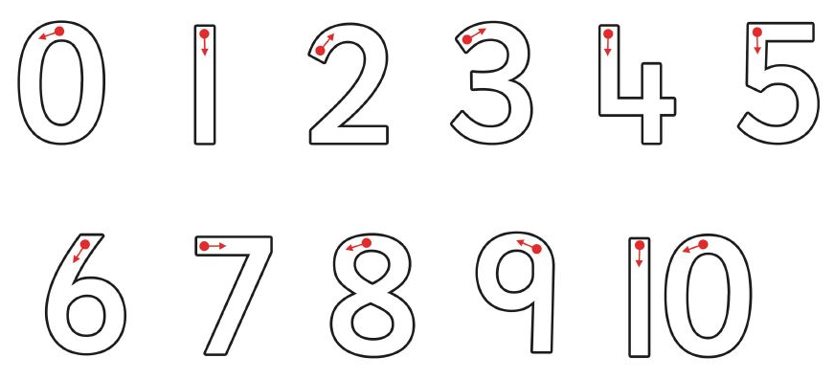
Monday Number formation practise
https://www.youtube.com/watch?v=aDPPHVG6TAE Remember to watch Jack Hartmann’s clip to warm up before you start! ☺

Slide 4
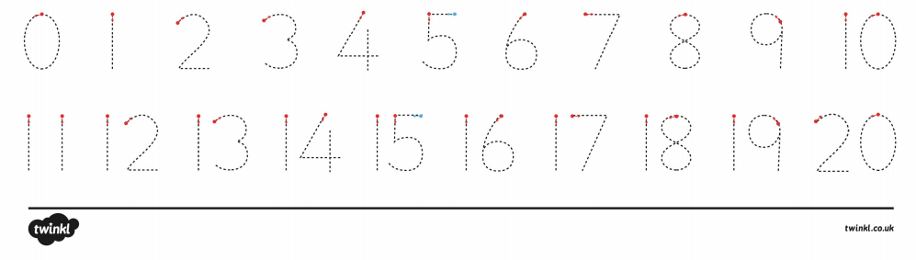
Monday
Number formation practise
https://www.youtube.com/watch?v=aDPPHVG6TAE Remember to watch Jack Hartmann’s clip to warm up before you start! ☺

Slide 5
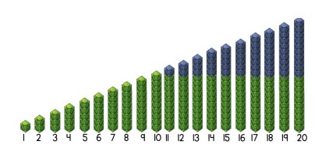
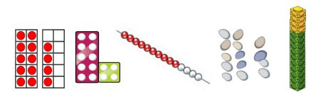
Tuesday
Counting to 20
Here are a few examples of resources we can use to ‘represent’ numbers.
You can use any ‘everyday object’ to represent a number such as; dried pasta, buttons, pom-poms, pencils, pegs, counters, etc..
Cubes
Ten frames
Numicon
Bead strings
Natural resources

Slide 6
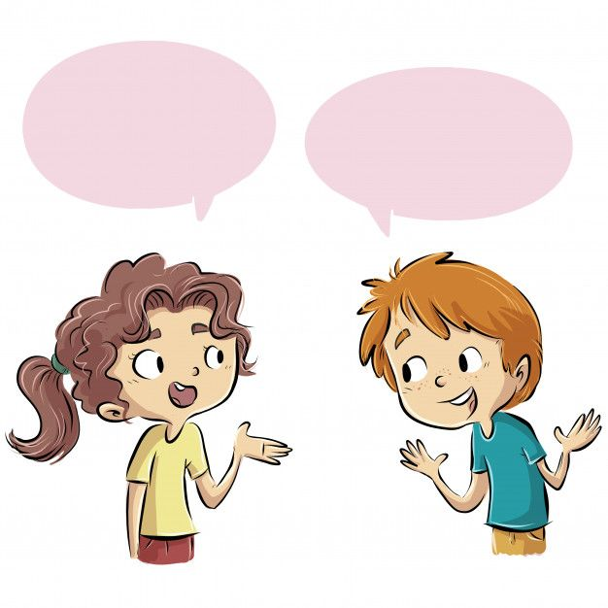
Tuesday
Counting to 20
Firstly, ensure that your child is able to count from 1-10.
Then encourage them to keep counting to 20.
You can practise taking it in turns to play ‘I count, you count’.
(You say a number, your child says the next number and so on)
15
16

Slide 7
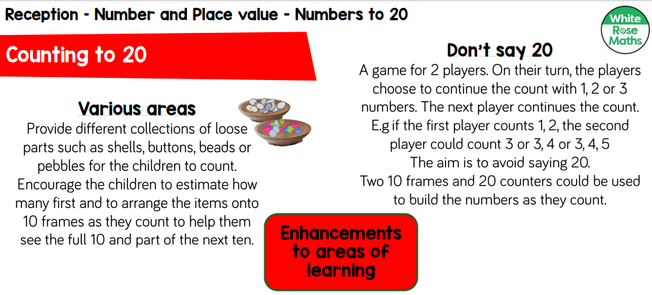
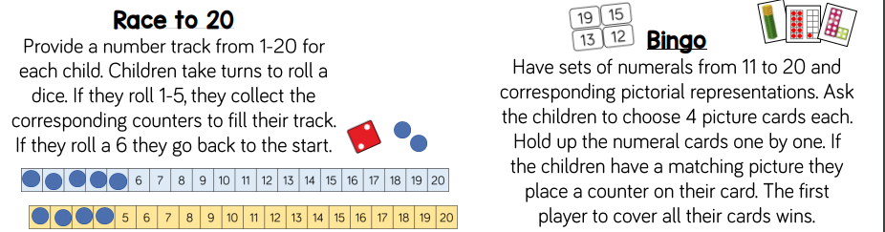
Tuesday
Counting to 20
Some suggested activities you could try ☺

Slide 8
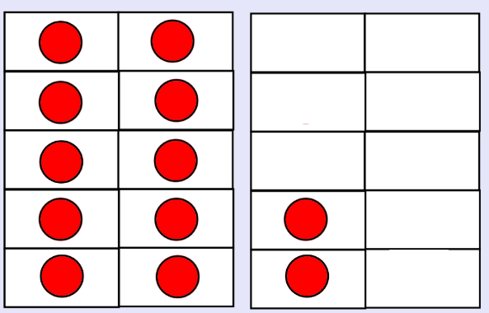
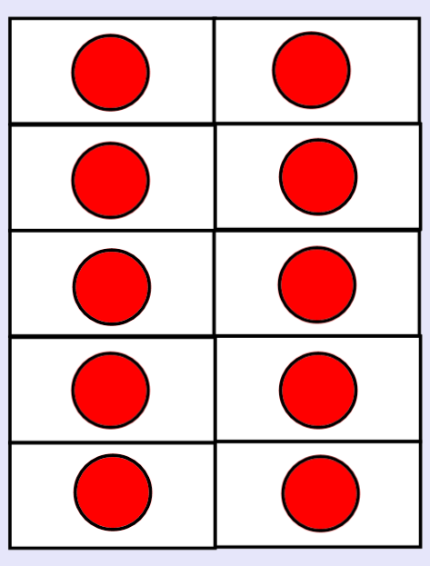
Wednesday Place Value
Recap the teen numbers on the ten frames (next slide)
You will need to explain there is one 10 and ___ little ones… until you get to twenty where it changes to having two tens.
Here’s an example…
1
2
2
0
ten
ones
tens
ones
20
12

Slide 9
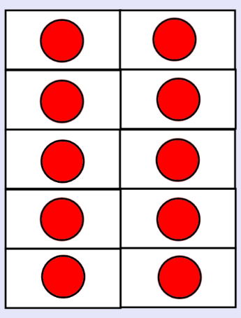
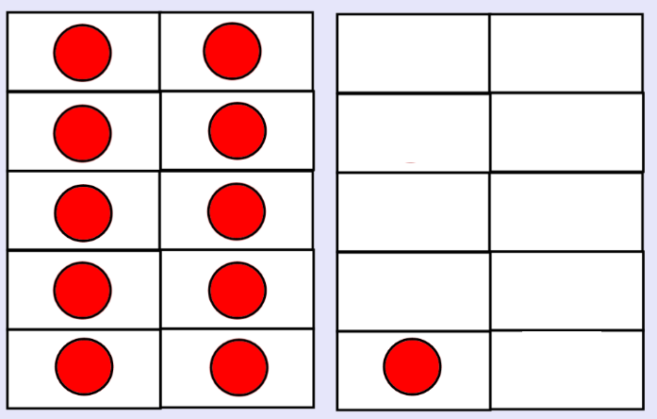
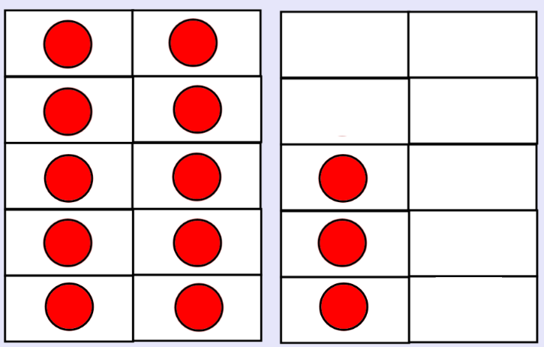
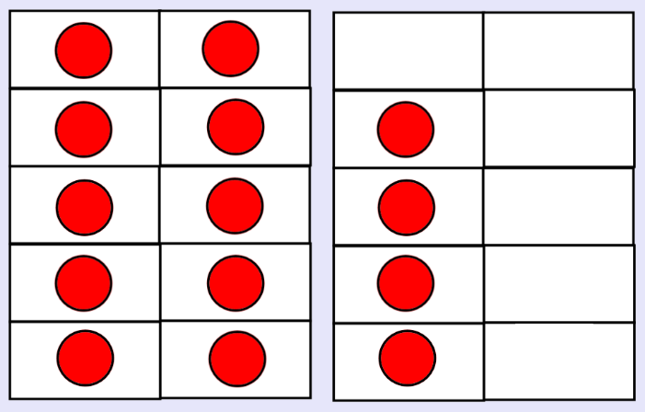
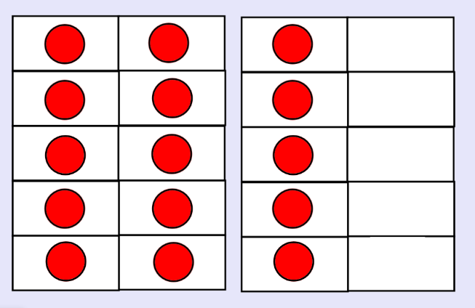
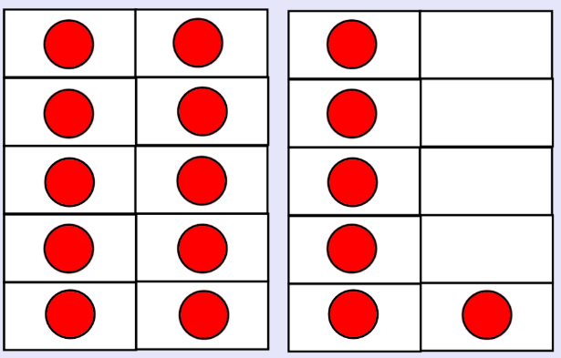
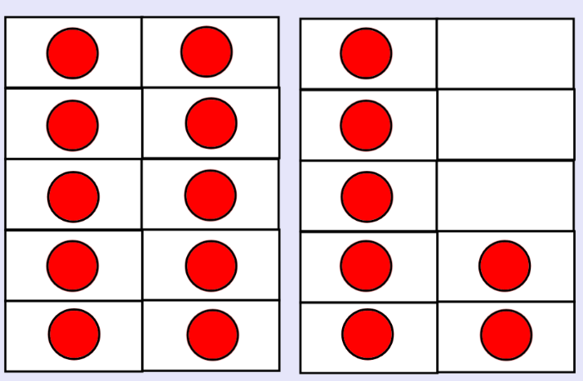
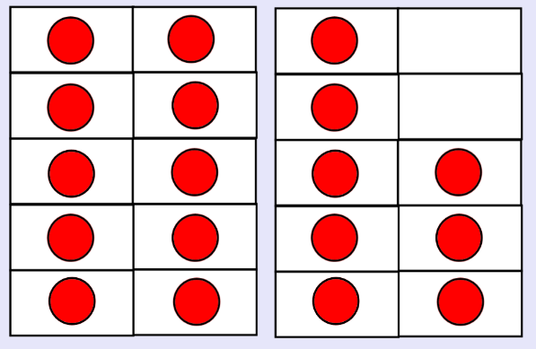
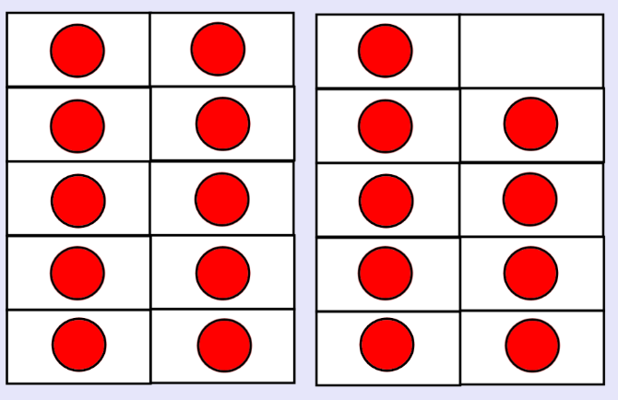
Recap the teen numbers on the ten frames- explain there is one 10 and ___ little ones.
10
11
12
13
14
15
16
17
18
10 + 10 =
19
20

Slide 10

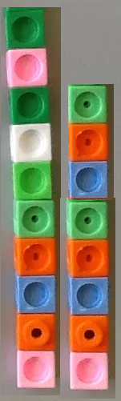
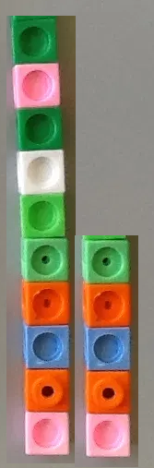
Match the ten frame to the relevant numeral/objects
15
18
10

Slide 11
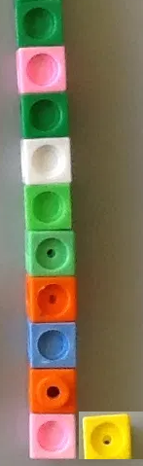
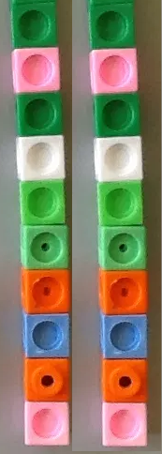
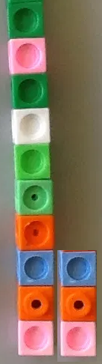
Match the ten frame to the relevant numeral/objects
13
20
11

Slide 12
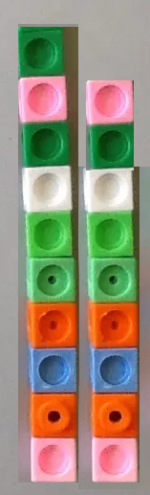
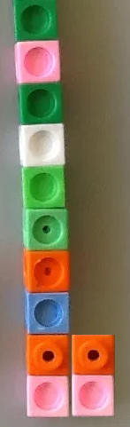
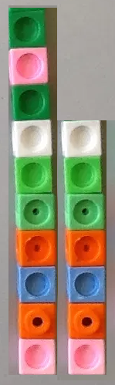
Match the ten frame to the relevant numeral/objects
12
19
17

Slide 13
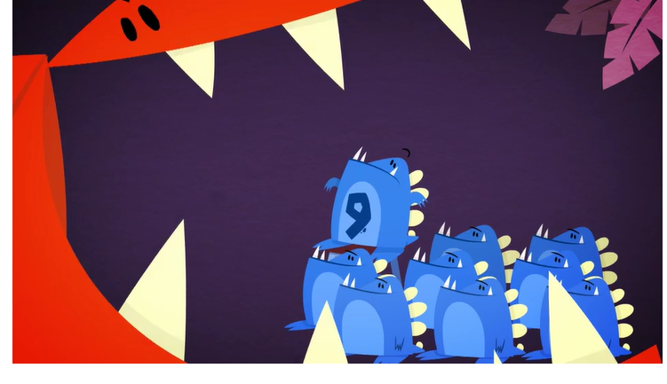
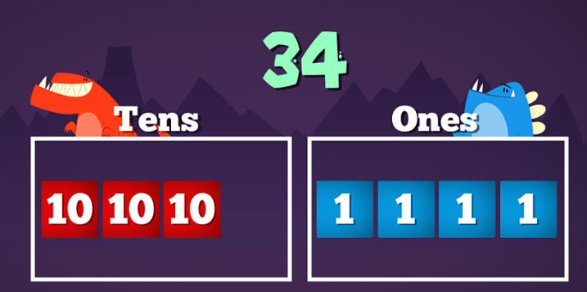
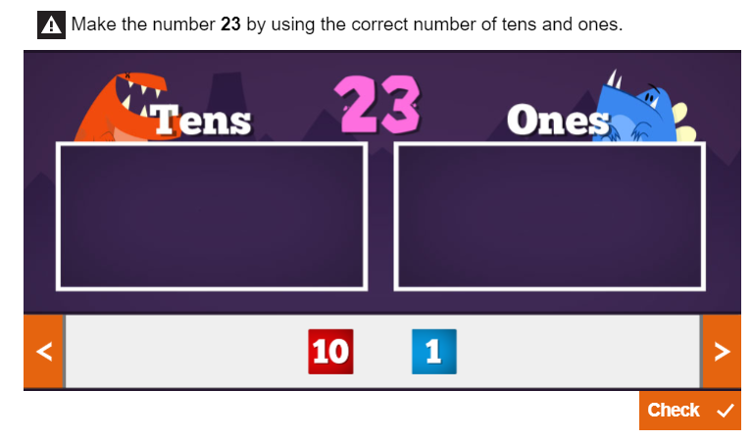
Thursday
Place Value
https://www.bbc.co.uk/bitesize/topics/z8sfr82/articles/zw4g2nb
Watch this clip on BBC Bitesize with your child to understand ‘tens’ and ‘ones’.
If you feel your child is really up for an additional challenge, continue to have a go at making larger numbers using tens and ones on this site.
* Please note- this is an extra challenge for some children. Please don’t worry if your child is not ready for this yet!*

Slide 14



Thursday Place Value
Have a go at writing/drawing how many tens and ones are in each of these teen numbers. Here are examples are both…
1
1
3

Slide 15
Thursday Place Value

Slide 16
Thursday Place Value

Slide 17
Thursday Place Value

Slide 18
Thursday Place Value
Extra Challenge

Slide 19
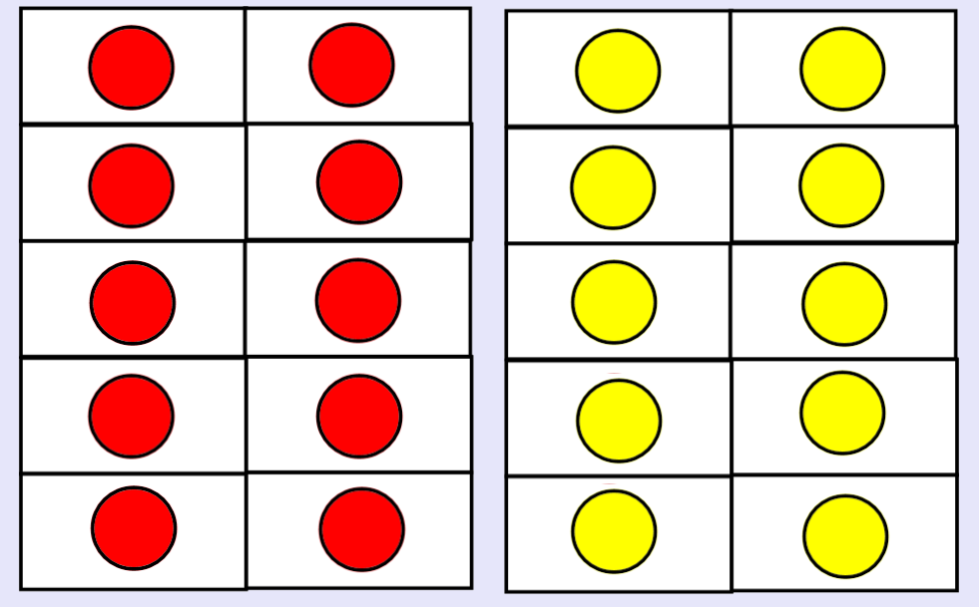
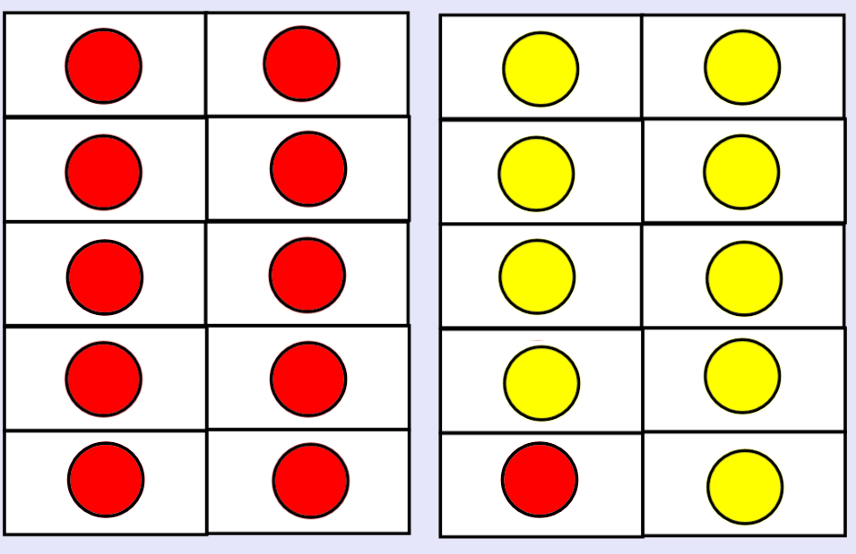
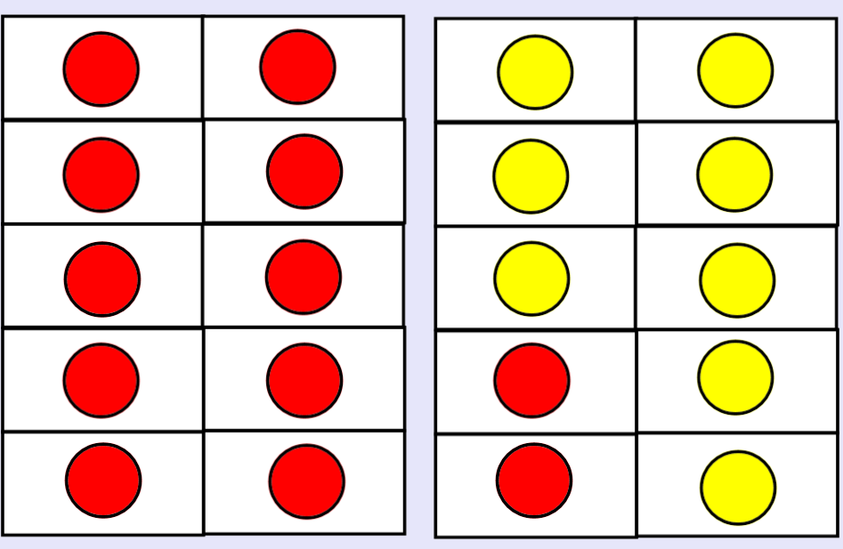
Friday Number bonds to 20
10 + = 20
11 + = 20
12 + = 20

Slide 20
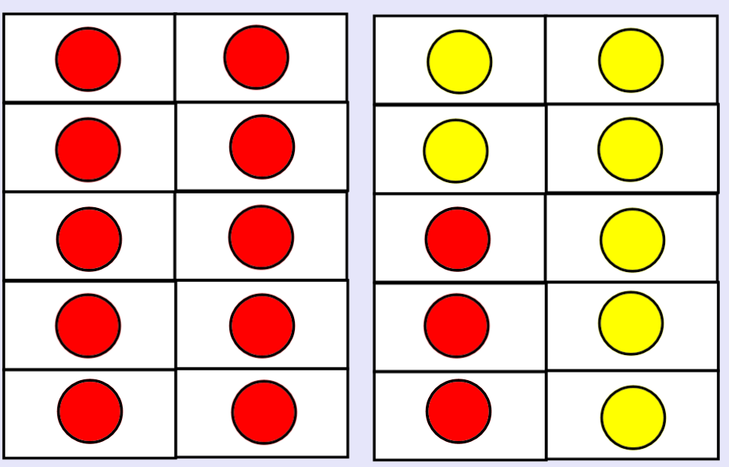
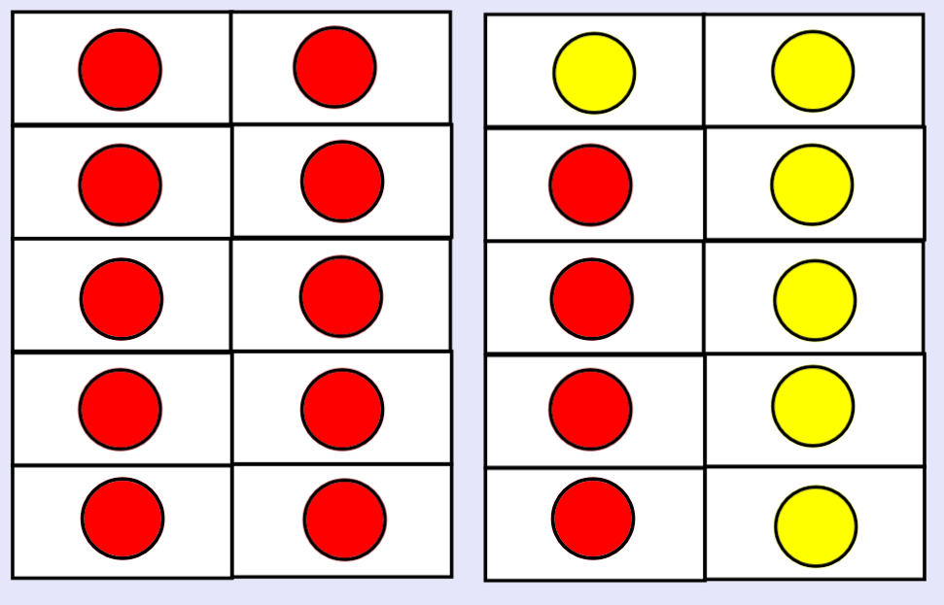
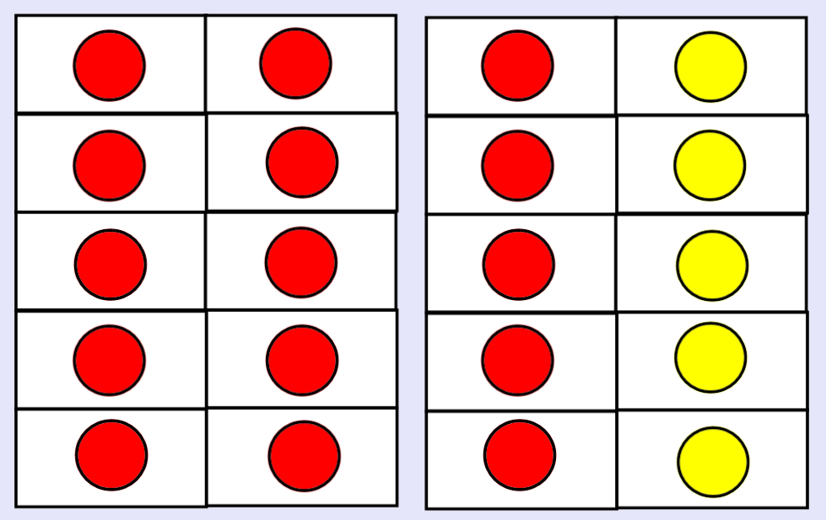
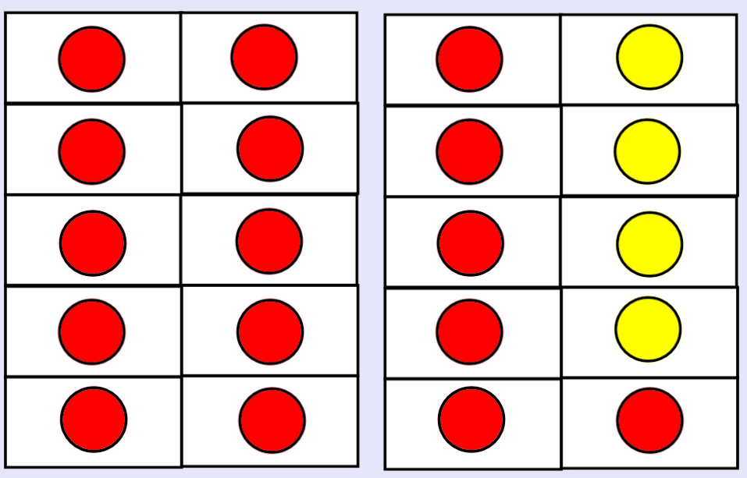
13 + = 20
14 + = 20
15 + = 20
16 + = 20

Slide 21
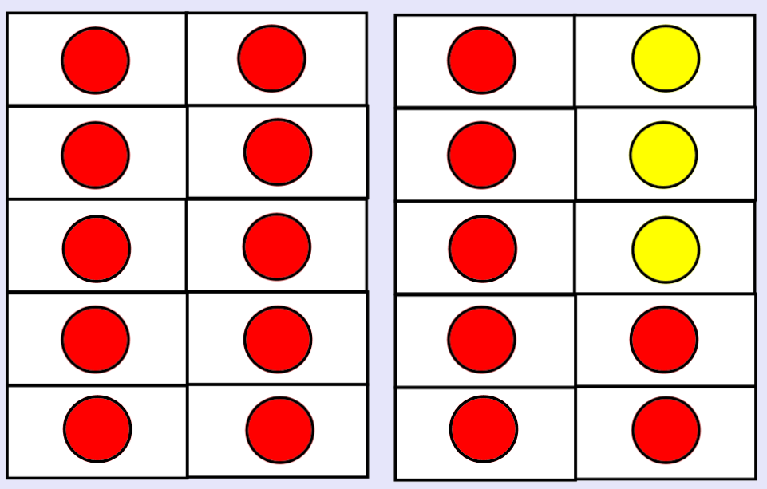
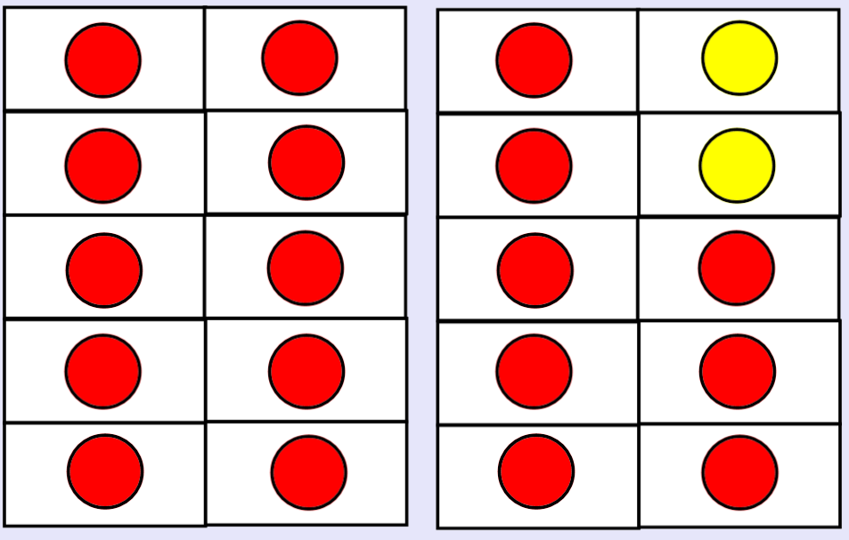
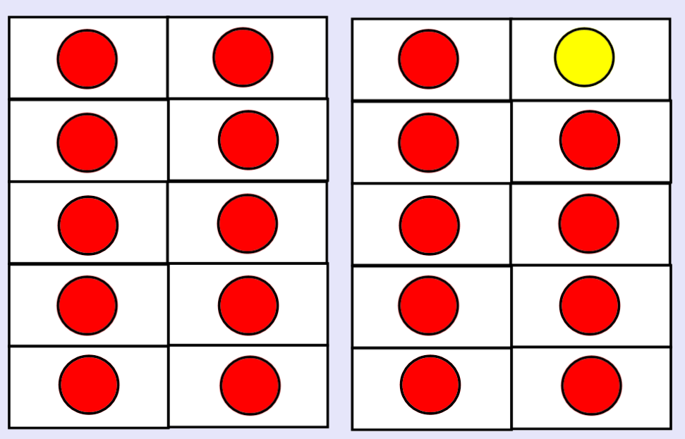
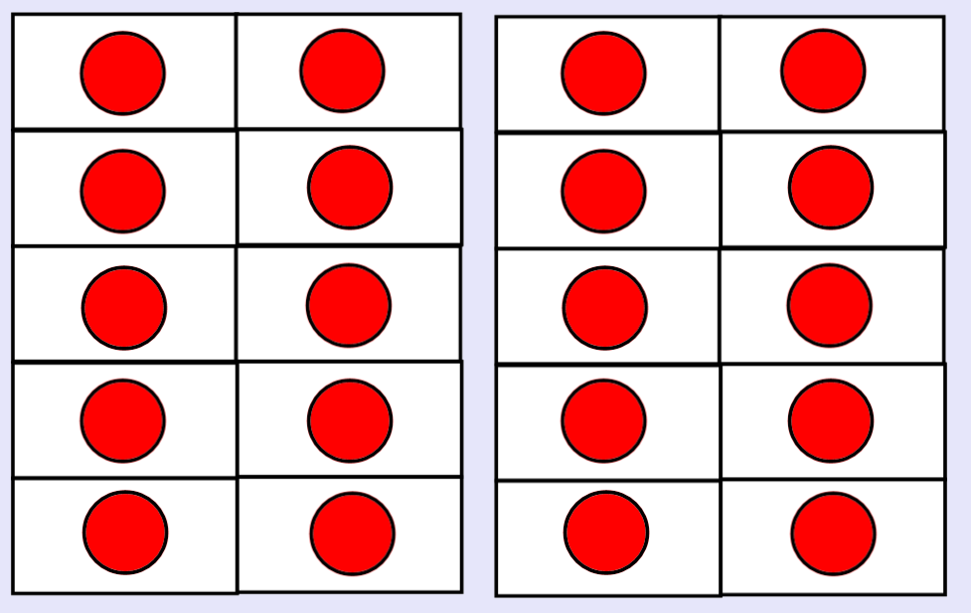
17 + = 20
18 + = 20
19 + = 20
20 + = 20

