Slide 1
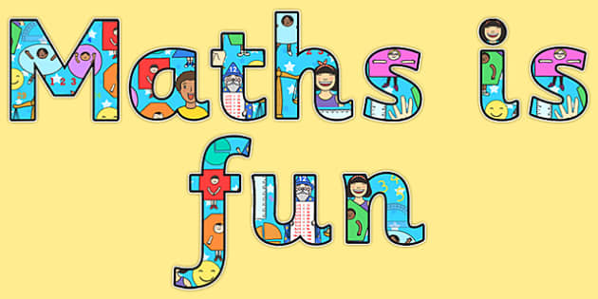
Maths in Reception

Slide 2
Week 12 – W/C: 13.7
This week we are going to set some daily maths challenges for you…

Slide 3
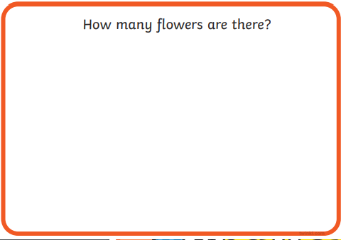

Monday’s 1st challenge: Can you count how many flowers there are by subitising… (notice the amount by sight rather than counting individual objects).

Slide 4
Answers:
5
6
9
10
8
10

Slide 5
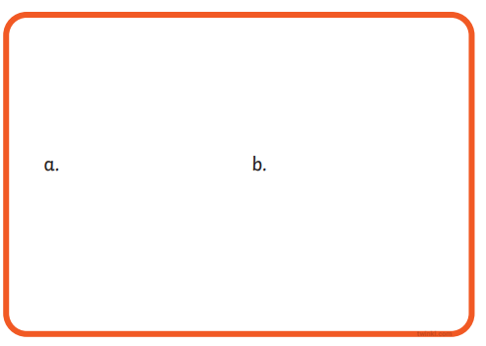

Monday’s 2nd challenge:
Which has More? Less? Fewer? The same amount?
Which box has more apples in it?
Which box has fewer apples in it?
Which box shows 2 less apples?
Which box has more apples in it?
Do both boxes have the same amount?
Remember to use the correct vocabulary to explain.

Slide 6

Answers:
Which box has more apples in it?
Which box has fewer apples in it?
Which box shows 2 less apples?
Which box has more apples in it?
Do both boxes have the same amount?
Neither, they both have the same amount.
No
Remember to use the correct vocabulary to explain.

Slide 7
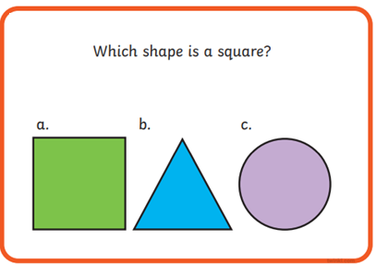
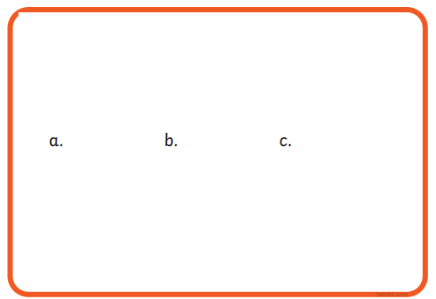
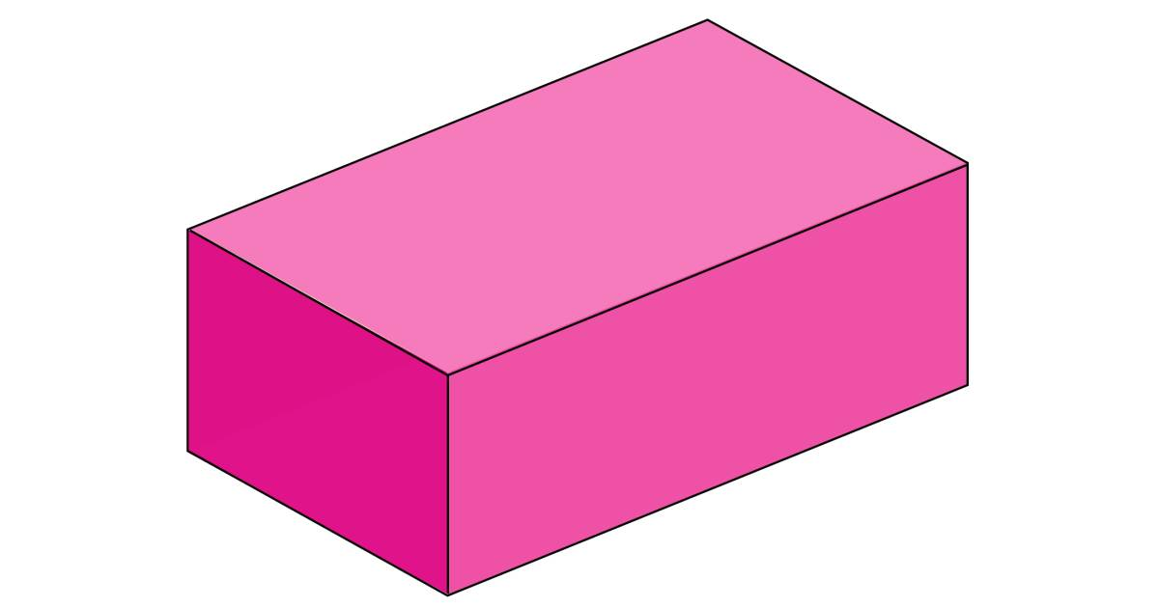

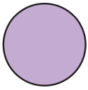




Tuesday’s 1st challenge: 2D and 3D Shapes
Which shape is a 3D shape?
Remember:
3D shapes are solid
2D shapes are flat
Which shape is a 2D shape?
Which shape is not a sphere?

Slide 8
Answers:
Which shape is a 3D shape?
Which shape is a 2D shape?
The circle is a 2D shape and is flat.
A sphere is a 3D solid shape.
Which shape is not a sphere?

Slide 9
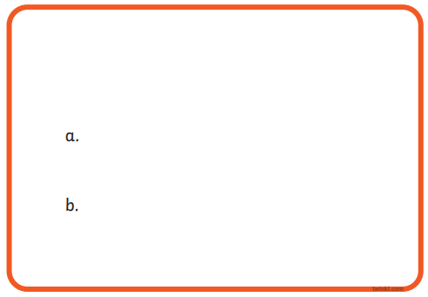
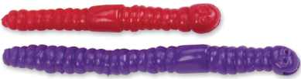

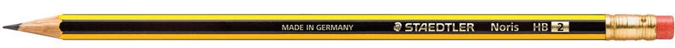
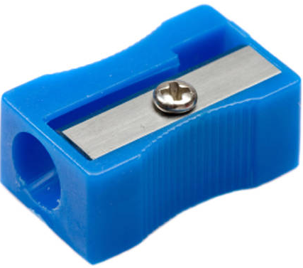
Tuesday’s 2nd challenge: length
Which worm is the longest?
Which worm is the shortest?
Is the pencil the shortest?
Which pencil is the longest?
Remember to verbally explain your answer.

Slide 10

Answers:
Which worm is the longest?
Which worm is the shortest?
Is the pencil the shortest?
No
Which pencil is the longest?
They are both the same length.
Remember to verbally explain your answer.

Slide 11
Wednesday’s 1st challenge: Number Bonds to 10
Which calculation makes 10?
Which calculation makes 10?
5 + 5
10 + 1
5 + 4
9 + 1
Which calculation makes 10?
Which calculation makes 10?
Remember to verbally explain your answer.
3 + 6
8 + 2
6 + 4
2 + 8

Slide 12
Answers:
Which calculation makes 10?
Which calculation makes 10?
5 + 5
10 + 1
Remember to verbally explain your answer.
5 + 4
9 + 1
Which calculation makes 10?
Which calculation makes 10?
They both make 10.
(The numbers are the same they are just reversed).
3 + 6
8 + 2
6 + 4
2 + 8

Slide 13
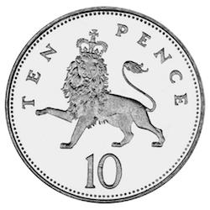
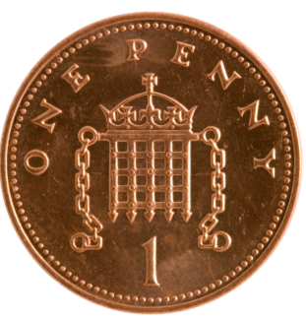
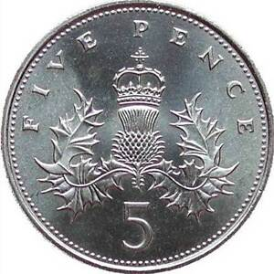
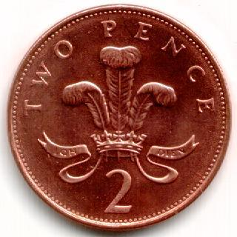
Wednesday’s 2nd challenge: Money
Which coin is worth 5p?
Which coin is worth 2p?
Which coins together make 10p?
Which coin is worth 10p?
a.
b.
c.

Slide 14
Answers:
Which coin is worth 5p?
Which coin is worth 2p?
Which coins together make 10p?
Which coin is worth 10p?
a.
b.
c.

Slide 15
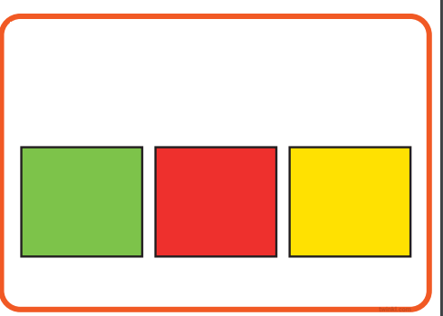

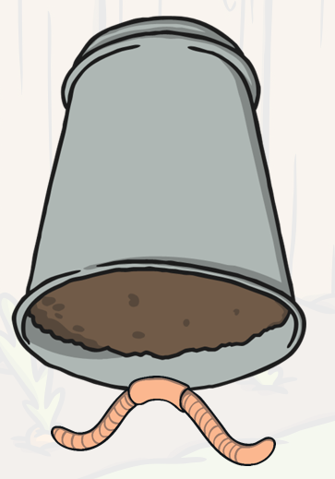
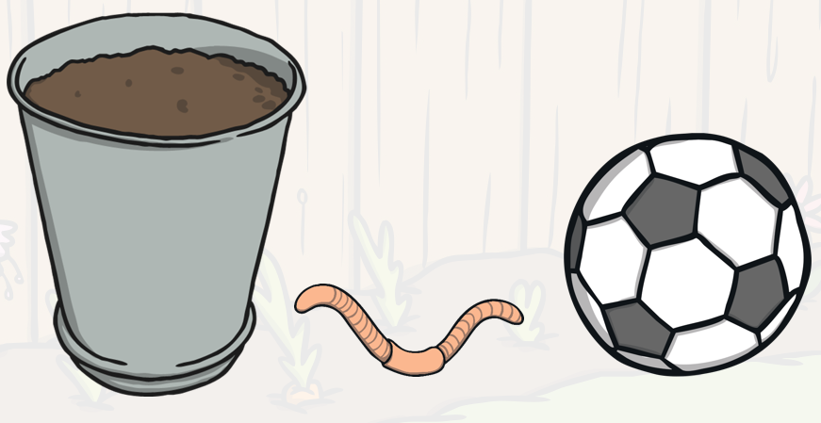
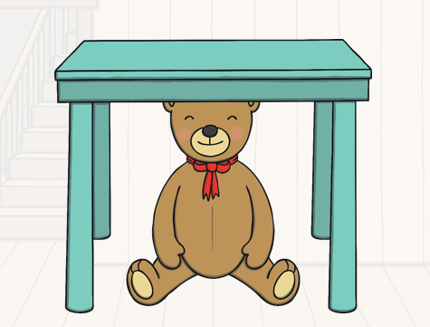
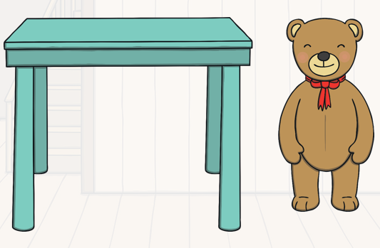
Thursday’s 1st challenge: positional language/prepositions
Where is the worm?
Where is the worm?
What colour square is in the middle?
Use the correct words to describe…
under
Where is the teddy?
Where is the teddy?
on top of
beside
between
middle

Slide 16
Answers:
Where is the worm?
Where is the worm?
What colour square is in the middle?
The worm is under the pot.
The worm is between the pot and the football.
Use the correct words to describe…
Where is the teddy?
Where is the teddy?
The teddy is under the table.
The teddy is beside the table.
on top of
beside
between
middle

Slide 17
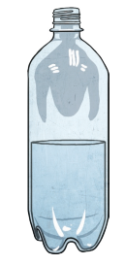
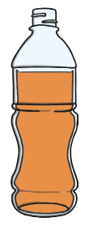
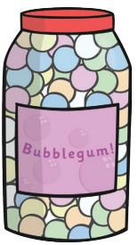

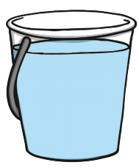
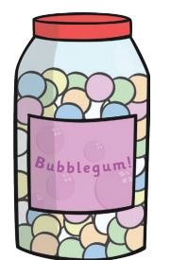
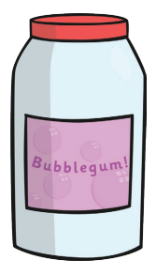
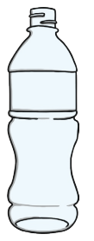
Thursday’s 2nd challenge: capacity
Which container is full?
Which container is nearly full?
Which container is half full?
Which containers are empty?

Slide 18
Answers:
Which container is full?
Which container is nearly full?
Which container is half full?
Which containers are empty?

Slide 19
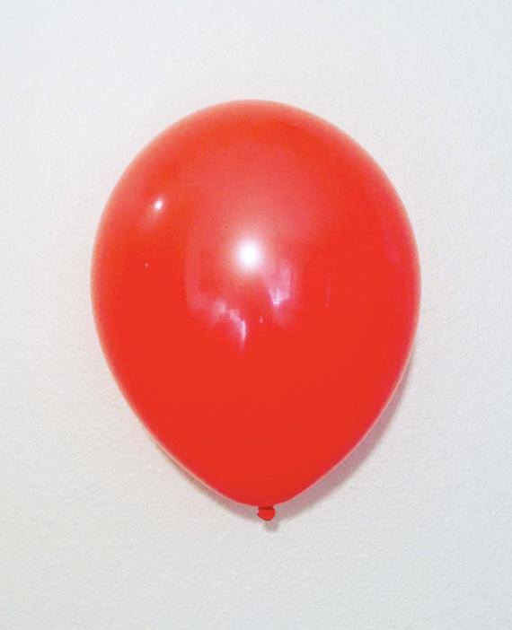
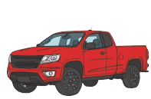

Friday’s 1st challenge: weight
Which is the heaviest?
Which is the heaviest?
Which is the heaviest?

Slide 20
Answers:
Which is the heaviest?
Which is the heaviest?
Which is the heaviest?

Slide 21

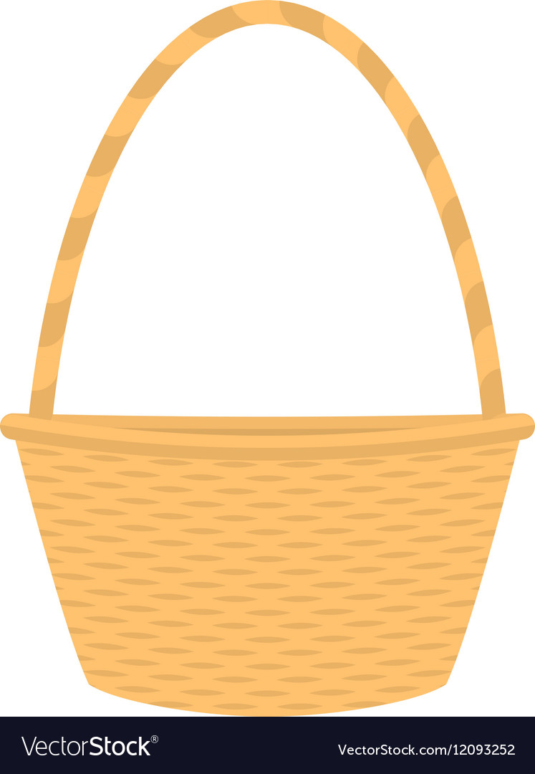
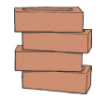
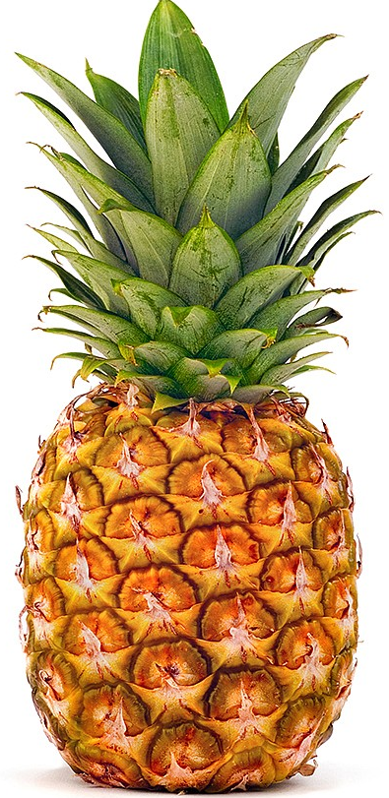
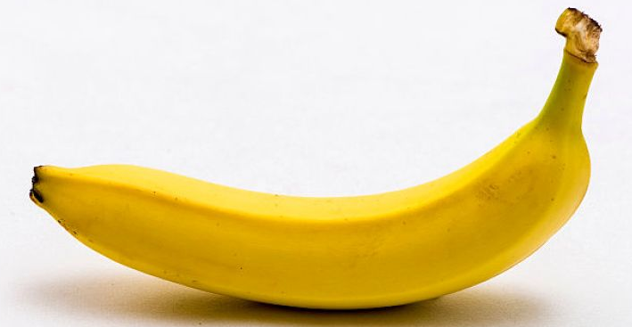
Friday’s 2nd challenge: weight
Which is the lightest?
Which is the lightest?
Which is the lightest?

Slide 22
Answers:
Which is the lightest?
Which is the lightest?
Which is the lightest?

