Slide 1
Writing in Reception
Week 8 (w/c: 15.6.20)
Using ‘because’ to explain why

Slide 2

Writing in Reception
Notes for parents
Letter formation
It is really important that the children are forming their letters correctly, starting and finishing in the correct place. Please support your child with this ☺

Slide 3
Writing in Reception
Notes for parents
d h e l s p g
“Up into the sky”
“Stay sat in the grass”
“Go down into the soil”
In Reception we use ‘garden writing’ handwriting lines to explain to the children which letters need to be tall and which have tails under the line.

Slide 4
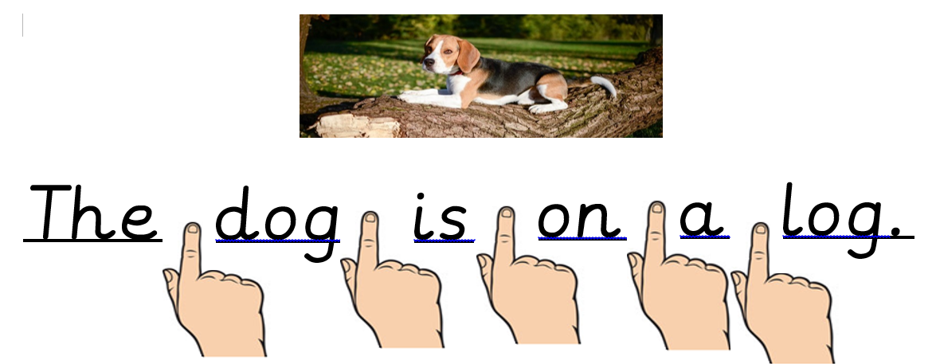
Writing in Reception
Notes for parents:
Please remind your children to use finger spaces between each word.

Slide 5
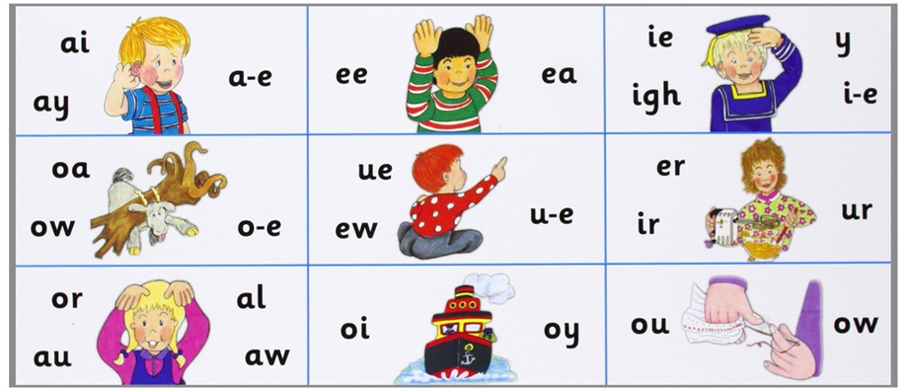
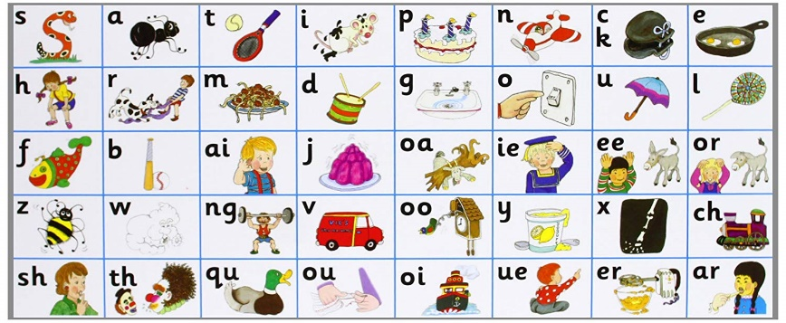
Writing in Reception
Notes for parents
When writing sentences, your child will not always spell words correctly. We encourage the children to have a go independently, using the newest sound mats to help them. They will need to segment (sound out the word) and then choose the correct digraph/trigraph/split digraph to write.
i.e. when writing the word ‘teacher’ your child needs to break the word down as:
t – ea – ch – er
There are different ways of writing ‘ea’ and ‘er’ so if they write:
‘teechur’ they will have used their phonics knowledge to select the appropriate sound however in this instance they have choose the wrong grapheme. This is reasonable for your child’s age.
If your child writes:
‘taicher’ you will need to talk them through what they have written and explain that ‘ai’ is not in teacher it is in fact the ‘ea’ sound. Look together to find the ‘ea’ ‘ee’ sounds on the sound mat and this will help them for next time.

Slide 6
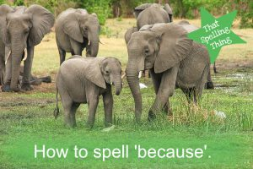
Monday:
Learn to spell tricky word ‘because’
‘Because’ is a tricky word as we are not able to ‘sound it out’ using phonics when trying to spell it. There are many different ways to learn how to spell ‘because’. We like to use Mnemonics to help us remember …
b e c a u s e
Big elephants can always understand small elephants

Slide 7
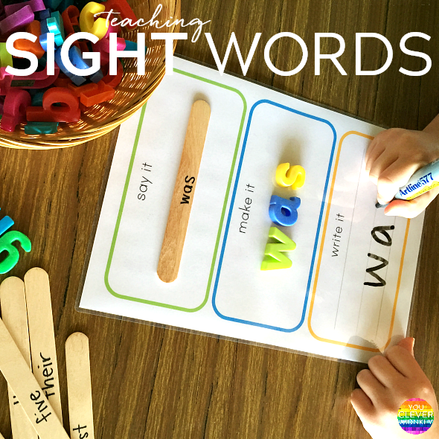
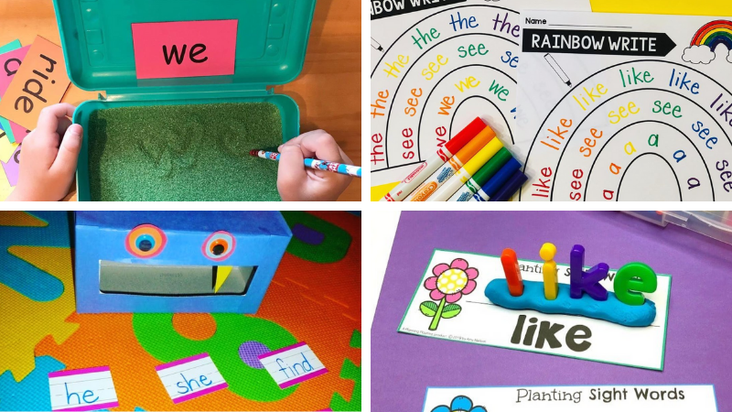

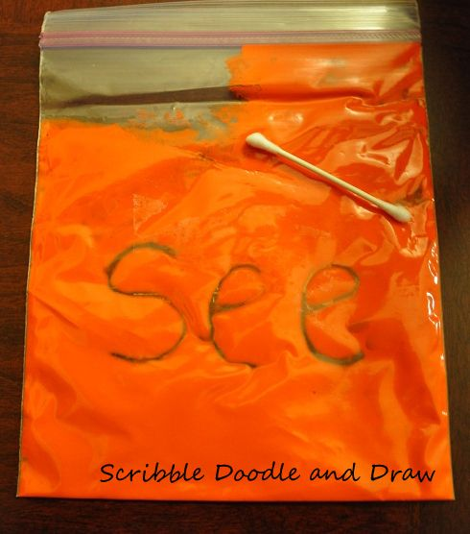

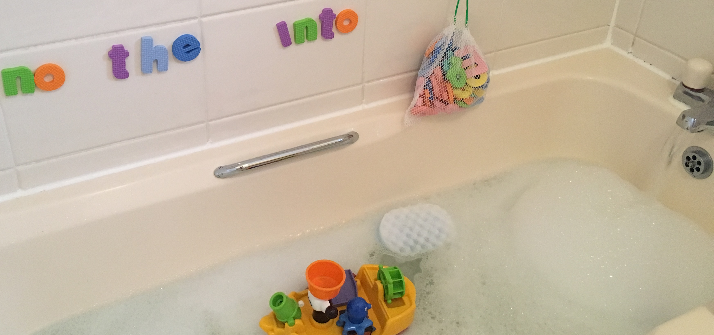
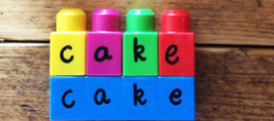
Monday:
Learn to spell tricky word ‘because’
Your task:
Have a go at writing ‘because’ in as many different ways as you can.
Remember to say to yourself: Big elephants can always understand small elephants
Here are some examples how to make spelling ‘tricky words’ fun. Have a go at some of these when spelling ‘because’……

Slide 8
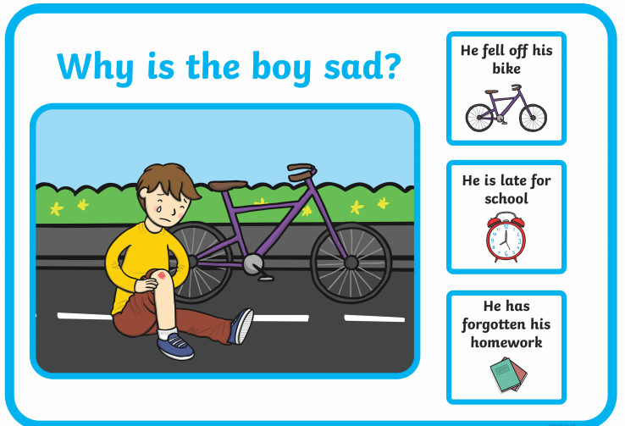
Tuesday:
Answering questions verbally using ‘because’
Your task today is to think of answers to my questions. You can ask an adult to help you read the question but you must answer using ‘because’.
Here’s an example…
Why is the boy sad?… “because he fell off his bike”

Slide 9
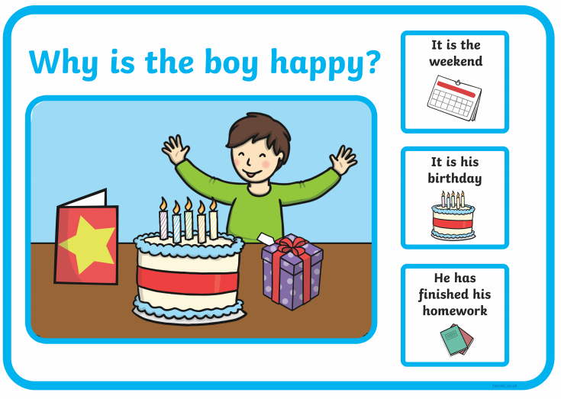
Tuesday:
Answering questions verbally using ‘because’
Your task today is to think of answers to my questions. You can ask an adult to help you read the question but you must answer using ‘because’.

Slide 10
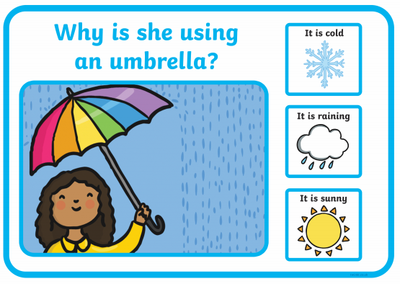
Tuesday:
Answering questions verbally using ‘because’
Your task today is to think of answers to my questions. You can ask an adult to help you read the question but you must answer using ‘because’.

Slide 11
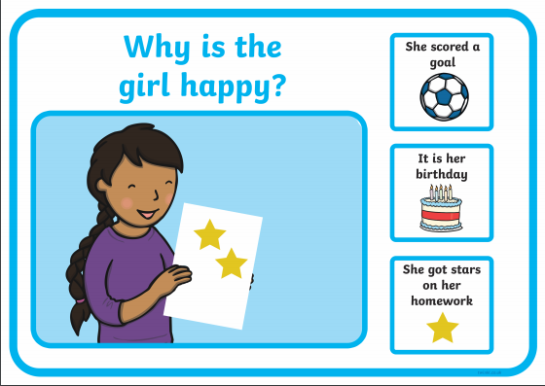
Tuesday:
Answering questions verbally using ‘because’
Your task today is to think of answers to my questions. You can ask an adult to help you read the question but you must answer using ‘because’.

Slide 12
Wednesday:
Answering questions verbally using ‘because’
Your task today is to repeat yesterday’s activity, answering the questions using ‘because’… however this time I would like you to have a go at writing it down.
Here’s an example:
You write:
The boy is happy because it is his birthday.
Big elephants can always understand small elephants
Remember:
Capital letter at the beginning
Finger spaces between each word
Spell ‘because’ using the taught Mnemonic
Full stop at the end of your sentence.

Slide 13
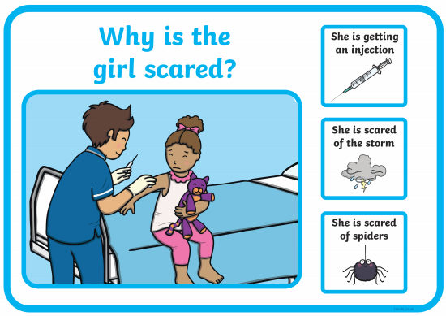
Wednesday:
Writing answers using ‘because’
Write a full sentence to answer these questions using ‘because’.
Big elephants can always understand small elephants

Slide 14
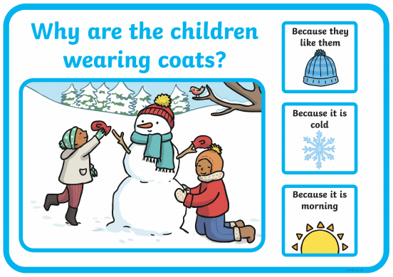
Wednesday:
Writing answers using ‘because’
Write a full sentence to answer these questions using ‘because’.
Big elephants can always understand small elephants

Slide 15
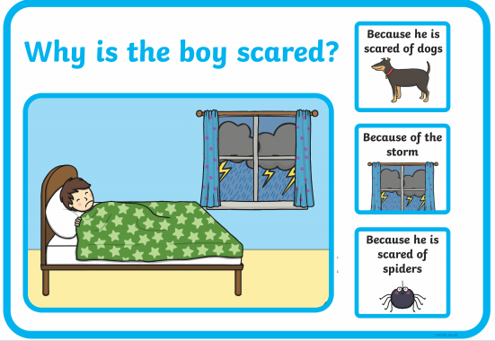
Wednesday:
Writing answers using ‘because’
Write a full sentence to answer these questions using ‘because’.
Big elephants can always understand small elephants

Slide 16
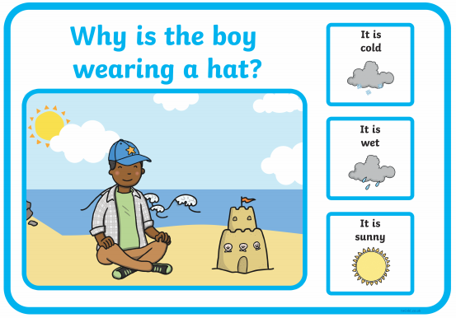
Wednesday:
Writing answers using ‘because’
Write a full sentence to answer these questions using ‘because’.
Big elephants can always understand small elephants

Slide 17
Wednesday:
Writing answers using ‘because’
Write a full sentence to answer these questions using ‘because’.
Big elephants can always understand small elephants

Slide 18
Wednesday:
Writing answers using ‘because’
Write a full sentence to answer these questions using ‘because’.
Big elephants can always understand small elephants

Slide 19
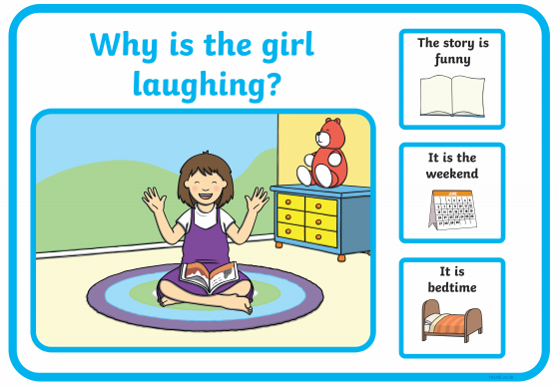
Wednesday:
Writing answers using ‘because’
Write a full sentence to answer these questions using ‘because’.
Big elephants can always understand small elephants

Slide 20
Wednesday:
Writing answers using ‘because’
Write a full sentence to answer these questions using ‘because’.
Big elephants can always understand small elephants

Slide 21

Thursday:
Write full sentences using ’because’
Your task for today and tomorrow is to have a think about your own answers for these questions and write full sentences for each using ‘because’
Big elephants can always understand small elephants
For example:
Who do you love?
I love my mummy because she gives me lots of cuddles when I am sad.

Slide 22

Thursday:
Write full sentences using ’because’
Big elephants can always understand small elephants
Who do you love?
and why…

Slide 23
Thursday:
Write full sentences using ’because’
Big elephants can always understand small elephants
Who is your best friend?
and why…

Slide 24
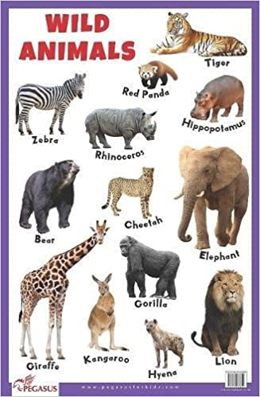
Thursday:
Write full sentences using ’because’
Big elephants can always understand small elephants
What is your favourite animal?
and why…

Slide 25
Thursday:
Write full sentences using ’because’
Big elephants can always understand small elephants
If you could be an animal what would you be? and why…

Slide 26
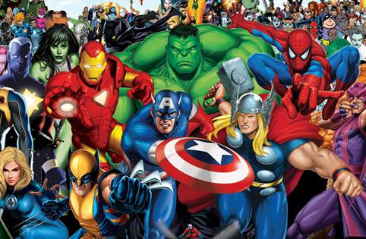
Friday:
Write full sentences using ’because’
Big elephants can always understand small elephants
If you could be a superhero who would it be?
and why…

Slide 27
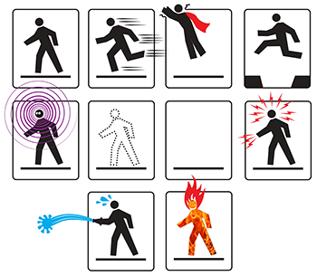
Friday:
Write full sentences using ’because’
Big elephants can always understand small elephants
If you could have a superpower what would it be?
and why?

Slide 28

Friday:
Write full sentences using ’because’
Big elephants can always understand small elephants
When you grow up what job would you like to do?
and why?

Slide 29

Friday:
Write full sentences using ’because’
Big elephants can always understand small elephants
What is your favourite book?
and why?

Slide 30
Can you think of your own questions to ask someone in your family? ☺

