Slide 1




Writing in Reception
Week 9 (w/c: 22.6.20)
Writing sentences using narrative features
Who did that?
What happened when…
Where were they?
When did that happen?

Slide 2
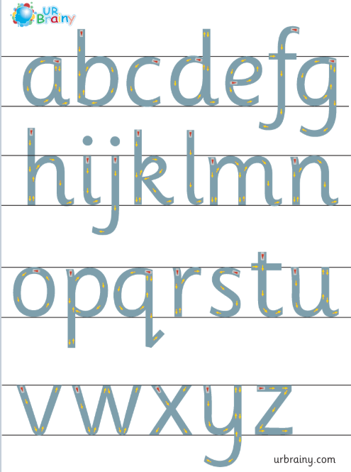
Writing in Reception
Notes for parents
Letter formation
It is really important that the children are forming their letters correctly, starting and finishing in the correct place. Please support your child with this ☺

Slide 3
Writing in Reception
Notes for parents
d h e l s p g
“Up into the sky”
“Stay sat in the grass”
“Go down into the soil”
In Reception we use ‘garden writing’ handwriting lines to explain to the children which letters need to be tall and which have tails under the line.

Slide 4
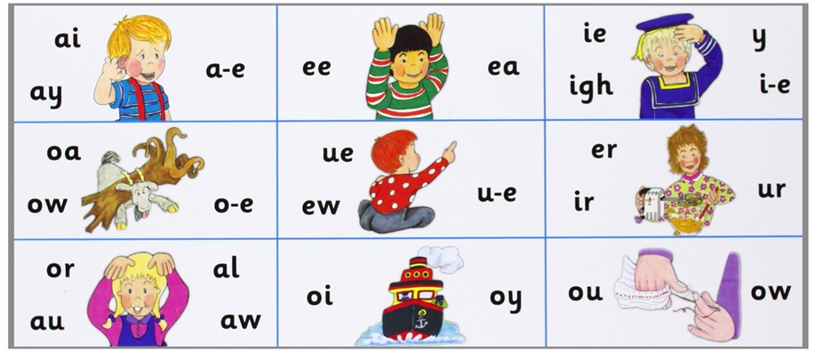
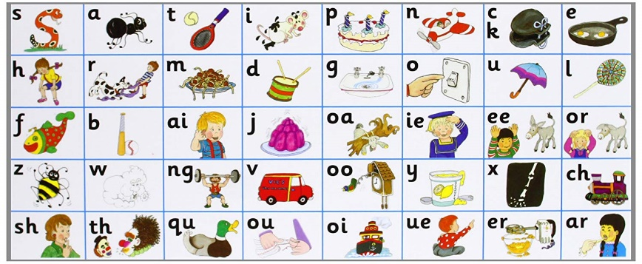
Writing in Reception
Notes for parents
When writing sentences, your child will not always spell words correctly. We encourage the children to have a go independently, using the newest sound mats to help them. They will need to segment (sound out the word) and then choose the correct digraph/trigraph/split digraph to write.
i.e. when writing the word ‘teacher’ your child needs to break the word down as:
t – ea – ch – er
There are different ways of writing ‘ea’ and ‘er’ so if they write:
‘teechur’ they will have used their phonics knowledge to select the appropriate sound however in this instance they have choose the wrong grapheme. This is reasonable for your child’s age.
If your child writes:
‘taicher’ you will need to talk them through what they have written and explain that ‘ai’ is not in teacher it is in fact the ‘ea’ sound. Look together to find the ‘ea’ ‘ee’ sounds on the sound mat and this will help them for next time.

Slide 5

This week we are going to be focussing on writing short stories using the narrative prompts below.
When doing this in school, we like to use ‘story sacks’. These can be made out of decorated tissue boxes, spare gift bags or just small containers for each.
The children will select a picture card from each to create their story. (It may end up being a silly/funny story! This is fine as the children really love it!) ☺
Who did that?
What happened when…
Where were they?
When did that happen?

Slide 6
Please note you do not have to print out pictures for your child to choose from, you could use the electronic resources provided on here for them to select ☺
Fill each bag with relevant pictures
Ask your child to choose one picture from each.
Have a look at the 4 pictures together and verbally discuss the story.
Allow your child plenty of time to write their story.
* Please don’t expect your child to write a full story in one go- some children may want to write a little bit and come back to it!* ☺

Slide 7

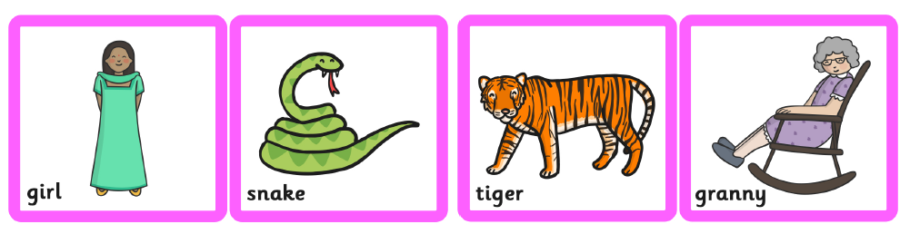

Who?
Select one…

Slide 8



What?
Select one…

Slide 9



Where?
Select one…

Slide 10




When?
Select one…

Slide 11
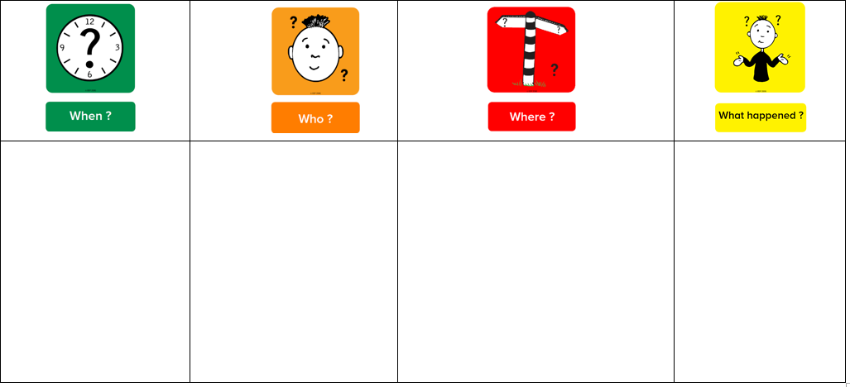


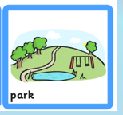


Here’s an example of the four picture cards I have selected…
Here’s an example of what you might write for your silly story…
It was a very sunny morning and the sky was blue. Leo the Lion wanted to play. He went to the park to meet his friends. Tilly the tiger was also at the park. She was on her scooter and Leo was riding on his bike. Leo let Tilly have a go on his bike but she fell off!

Slide 12
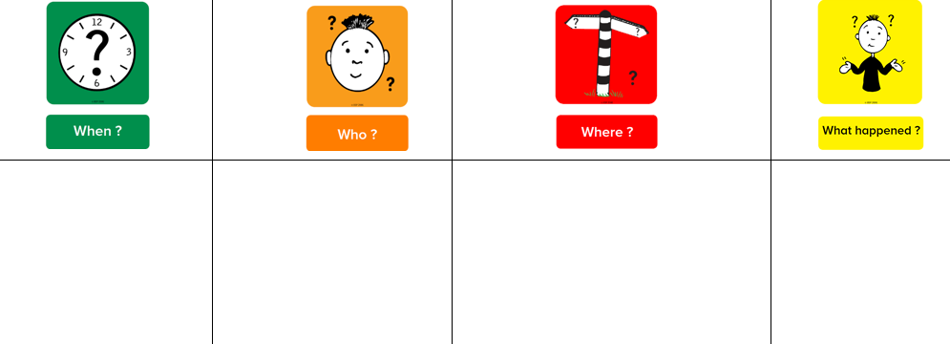
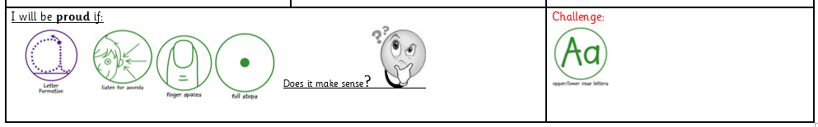
Your task this week:
Write your own silly stories
You can choose to use the picture cards provided or make up/choose your own characters/settings, etc.

