Slide 1
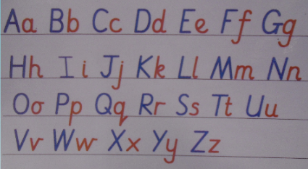
Writing in Reception
W/C: 18.05.20
After discussions with many parents, we are aware that some of you are still working on the previously set tasks. This is absolutely fine and if you wish to continue with the previously set tasks please do so! ☺
This week we would like you to focus on the formation of lower case letters and also begin to practise capital letters alongside. It is important to use this terminology with the children as they sometimes tend to call them little & big letters which is not necessary correct.

Slide 2
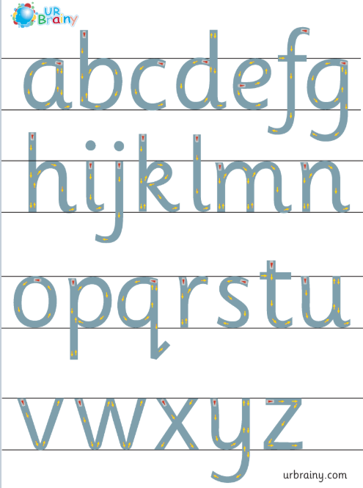
Letter formation
It is really important that the children are forming their letters correctly, starting and finishing in the correct place. Please support your child with this ☺

Slide 4
In Reception we use ‘garden writing’ handwriting lines to explain to the children which letters need to be tall and which have tails under the line.
“Up into the sky”
d h e l s p g
“Stay sat in the grass”
“Go down into the soil”
We teach writing letters in groups using shape families. We separate the letters into groups depending on the movement used to form them.
Group 1- c o a d g q using the anti-clockwise circular movement.
Group 2- e s f
Group 3- i l t
Group 4- u y j k
Group 5- r n m
Group 6- h b p
Group 7- v w x z

Slide 5
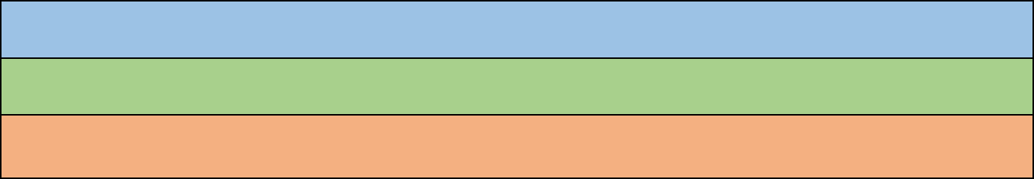
Group 1 c o a d g q
Curly caterpillar letters
It is extremely important that these letters are formed using the anti-clockwise movement. Practise 1 letter at a time, do not move on until your child is independently forming them correctly. Practise the lower case letter first, then the capital letter.
C c
G
O o
A a
D d
g
Q q
All capital letters start off in the sky and sit at the bottom of the grass.

Slide 6
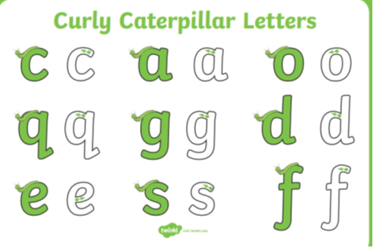
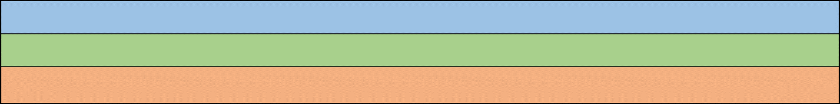
Group 2 e s f Curly caterpillar letters
E e
F
S s
f

Slide 7
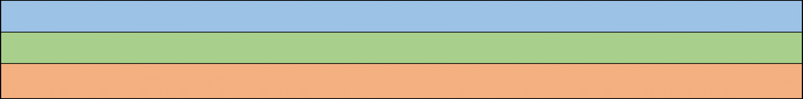
Group 3 i l t ladder letters
I i
L l
T t

Slide 8
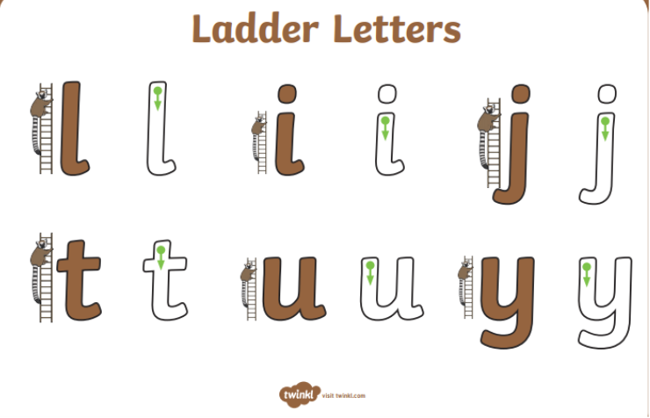
Group 4 u y j k ladder letters
K k
J j
Y y
U u

Slide 9
Group 5 r n m one armed robot letters
M m
R r
N n

Slide 10
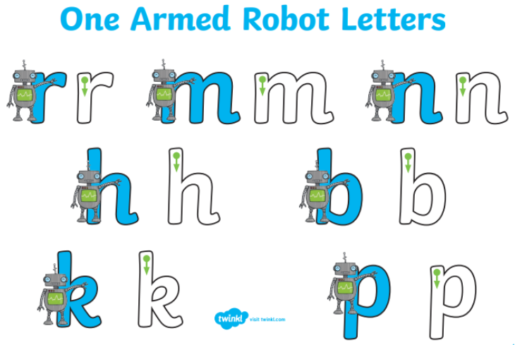

Group 6 h b p one armed robot letters
H h
P p
B b

Slide 11
Group 7 v w x z zig zag monster letters
V v
W w
X x
Z z

