Slide 1
Writing in Reception
W/C: 4.5.20 The Three Billy Goats Gruff
W/C:11.5.20 Goldilocks and the Three Bears

Slide 2
Notes for parents about writing in Reception…

Slide 3
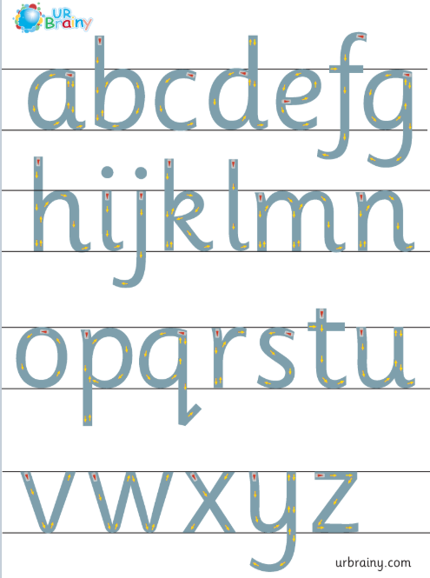
Letter formation
It is really important that the children are forming their letters correctly, starting and finishing in the correct place. Please support your child with this ☺

Slide 4
In Reception we use ‘garden writing’ handwriting lines to explain to the children which letters need to be tall and which have tails under the line.
d h e l s p g
“Up into the sky”
“Stay sat in the grass”
“Go down into the soil”

Slide 5
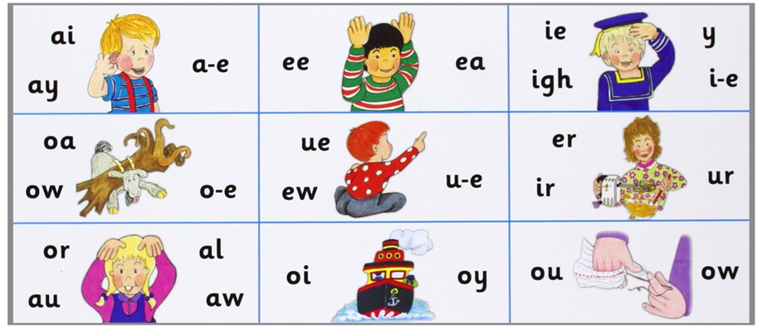
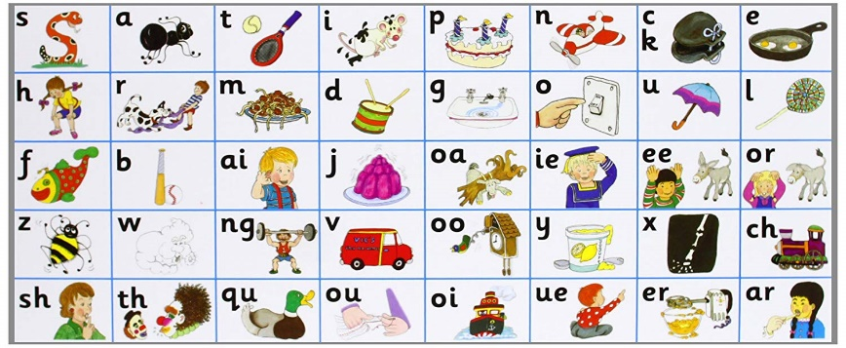
When writing sentences, your child will not always spell words correctly. We encourage the children to have a go independently, using the newest sound mats to help them. They will need to segment (sound out the word) and then choose the correct digraph/trigraph/split digraph to write.
i.e. when writing the word ‘teacher’ your child needs to break the word down as:
t – ea – ch – er
There are different ways of writing ‘ea’ and ‘er’ so if they write:
‘teechur’ they will have used their phonics knowledge to select the appropriate sound however in this instance they have choose the wrong grapheme. This is reasonable for your child’s age.
If your child writes:
‘taicher’ you will need to talk them through what they have written and explain that ‘ai’ is not in teacher it is in fact the ‘ea’ sound. Look together to find the ‘ea’ ‘ee’ sounds on the sound mat and this will help them for next time.

Slide 6
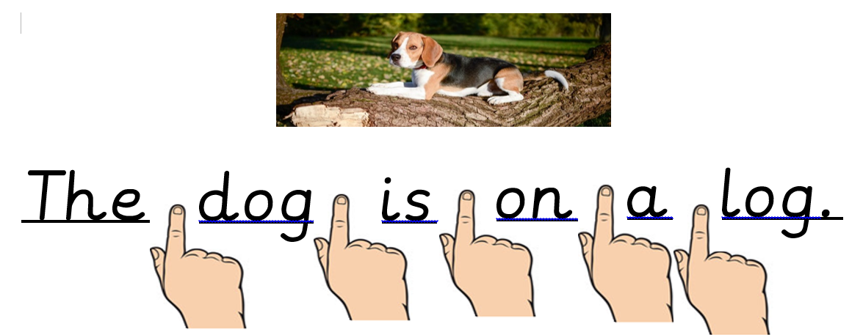
Please, please, please encourage your child to use finger spaces between each word.
They will often go back to read what they have written and find it too difficult if all of the words are ‘stuck together’. If they find it tricky to hold their finger in place, you can use any item such as a lollipop stick to act as a finger spacer. If they are forgetting their finger spaces it often means that they are rushing to write their next idea. Encourage them to slow down, check they have written the whole word and not just the initial sound before moving on.
Please remember to use finger spaces between each word!

Slide 7
Over the next two weeks we are going to focus writing on traditional tales that the children will have heard before. We have uploaded Twinkl ppts of both stories for your child to read through if you don’t have your own copy at home. (See separate file)
Week 3 - The Three Billy Goats Gruff
Week 4 - Goldilocks and the Three Bears
The following suggested activities are to be covered over the next two weeks. Please do not encourage your child to rewrite the whole story in one go as this will be quite overwhelming.
It is a good skill to get your child to come back to check what they have already written and try and add some more another day.

Slide 8
Week 3: The Three Billy Goats Gruff
Differentiated activities to choose from:
By now you will have got a better understanding of your child’s ability and at what level they are working. Here are some suggestions you can try, starting with easier activities getting more and more complex. Please focus on the activity that suits your child’s ability best. (Please do not feel like you need to complete every slide- they are simply suggestions for you to try). ☺
Home Learning Challenge
Label pictures with initial sound/attempt to write word.
Write simple sentences to describe what is happening in each picture throughout the story.
Re-write the story.
Re-write the story but change the characters to make it your own!

Slide 9
The Three Billy Goats Gruff
To support their writing, children need to be really familiar with the story. Read the story, re-read the story, read the story again….you get the idea!
Practice telling the story throughout the day, while you are cooking dinner, while they are in the bath, when you go for a walk.
Try singing parts of the story or take it in turns to say the next line of the story. Say a line of the story with a word missing - who can guess what is missing …..
If you are fed up of the story, then you are doing it well! ☺

Slide 10
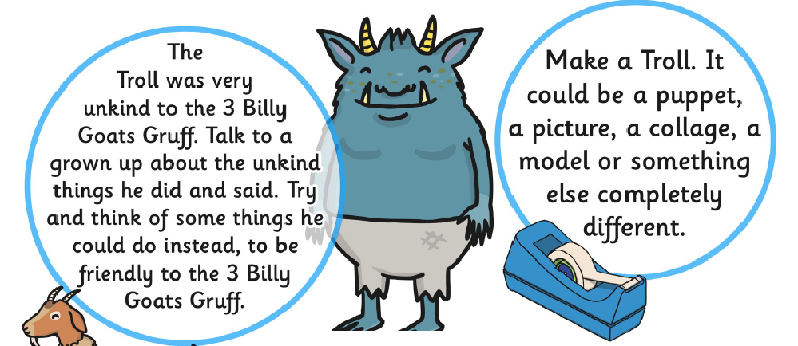
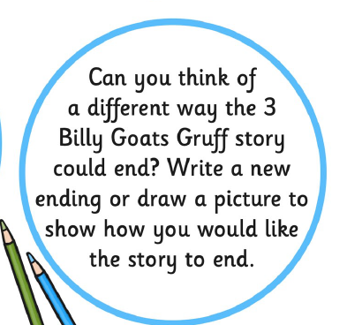

The Three Billy Goats Gruff
Home learning challenge…

Slide 11
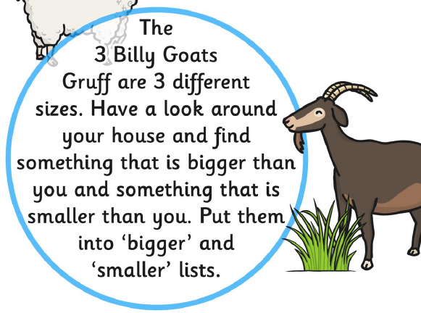
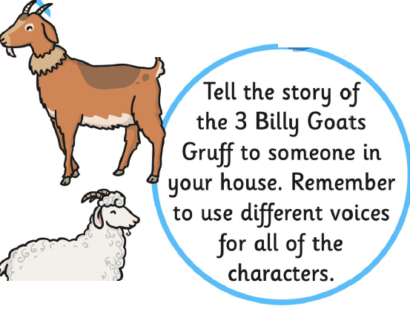

The Three Billy Goats Gruff
Home learning challenge…

Slide 12
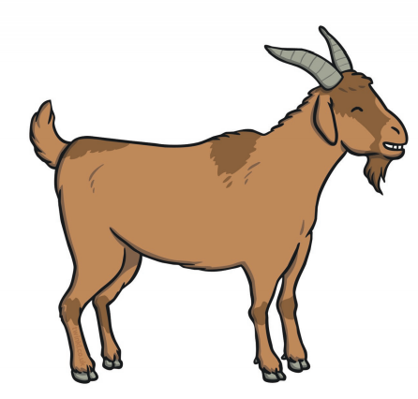
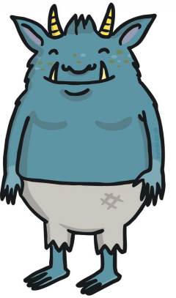
The Three Billy Goats Gruff
Label pictures with initial sound/attempt to write word.

Slide 13


The Three Billy Goats Gruff
Label pictures with initial sound/attempt to write word.

Slide 14
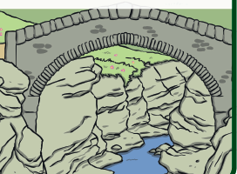
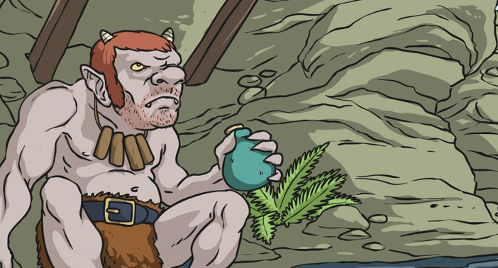
The Three Billy Goats Gruff
Label pictures with initial sound/attempt to write word.
r
The troll was
cr

Slide 15
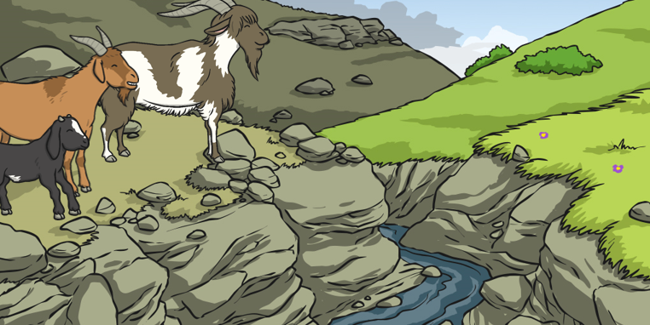
The Three Billy Goats Gruff
Write simple sentences to describe what is happening in each picture throughout the story.

Slide 16
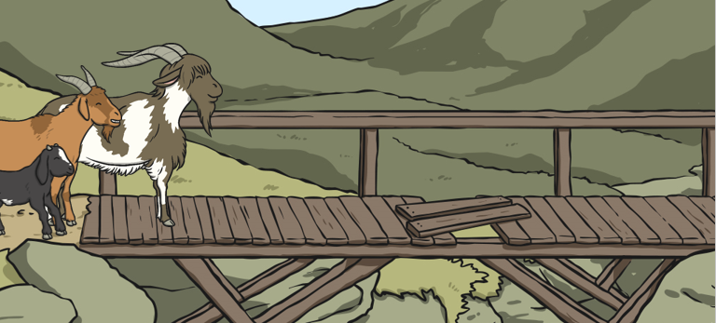
The Three Billy Goats Gruff
Write simple sentences to describe what is happening in each picture throughout the story.

Slide 17
The Three Billy Goats Gruff
Write simple sentences to describe what is happening in each picture throughout the story.

Slide 18
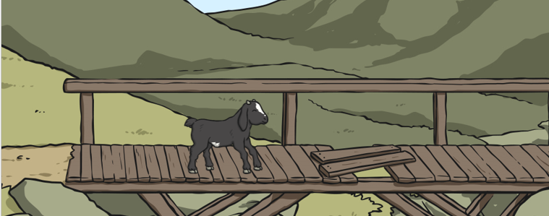
The Three Billy Goats Gruff
Write simple sentences to describe what is happening in each picture throughout the story.

Slide 19
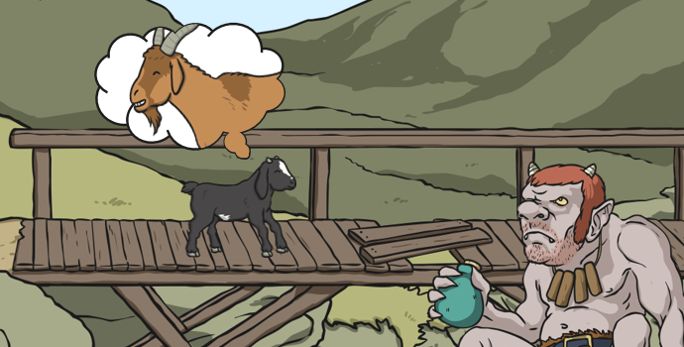
The Three Billy Goats Gruff
Write simple sentences to describe what is happening in each picture throughout the story.

Slide 20
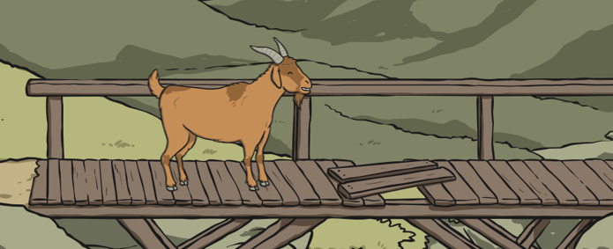
The Three Billy Goats Gruff
Write simple sentences to describe what is happening in each picture throughout the story.

Slide 21
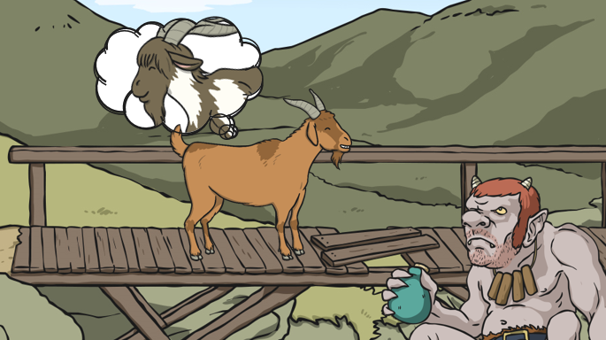
The Three Billy Goats Gruff
Write simple sentences to describe what is happening in each picture throughout the story.

Slide 22
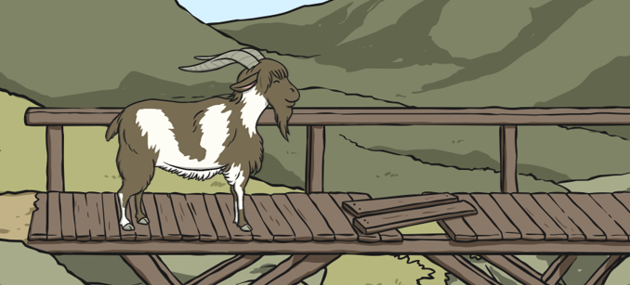
The Three Billy Goats Gruff
Write simple sentences to describe what is happening in each picture throughout the story.

Slide 23
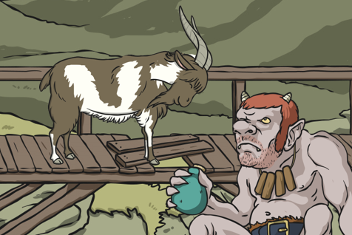
The Three Billy Goats Gruff
Write simple sentences to describe what is happening in each picture throughout the story.

Slide 24
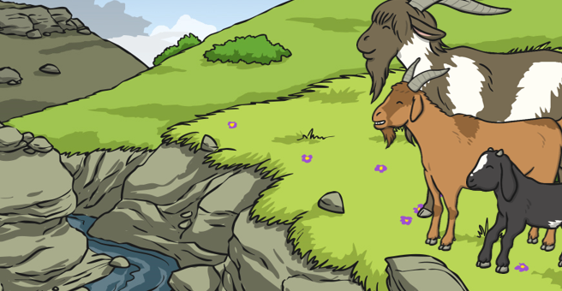
The Three Billy Goats Gruff
Write simple sentences to describe what is happening in each picture throughout the story.

Slide 25
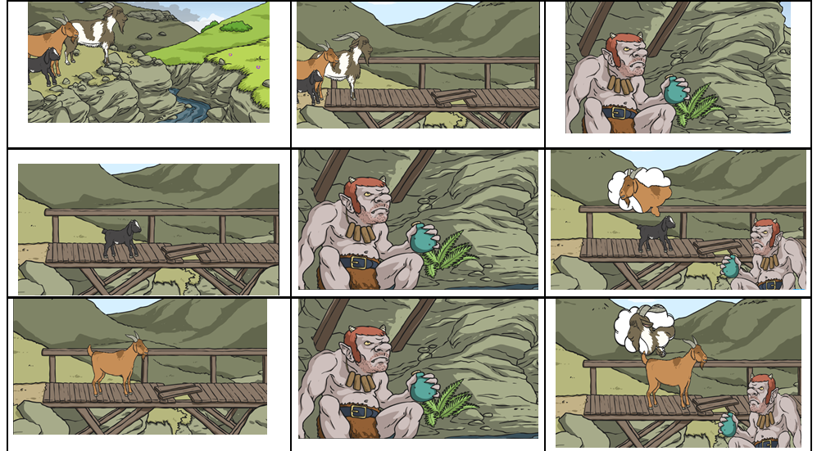
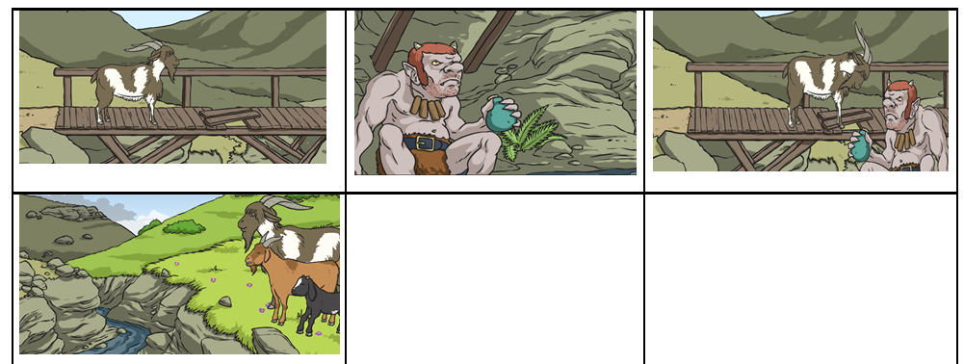
The Three Billy Goats Gruff
Story map to help with re-writing the story…

Slide 26
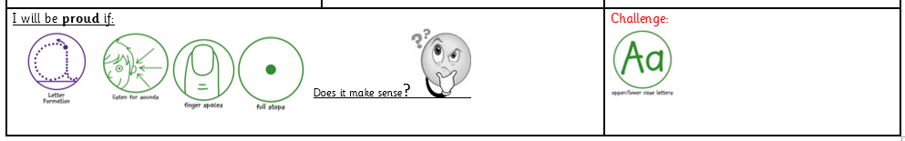
The Three Billy Goats Gruff
Re-write the story using your story map to remind you of the sequence.

Slide 27
Goldilocks and the Three Bears
To support their writing, children need to be really familiar with the story. Read the story, re-read the story, read the story again….you get the idea!
Practice telling the story throughout the day, while you are cooking dinner, while they are in the bath, when you go for a walk.
Try singing parts of the story or take it in turns to say the next line of the story. Say a line of the story with a word missing - who can guess what is missing …..
If you are fed up of the story, then you are doing it well! ☺

Slide 28
Week 4: Goldilocks and the Three Bears
Differentiated activities to choose from:
By now you will have got a better understanding of your child’s ability and at what level they are working at. Here are some suggestions you can try, starting with easier activities getting more and more complex. Please focus on the activity that suits your child’s ability best. (Please do not feel like you need to complete every slide- they are simply suggestions for you to try). ☺
Home Learning Challenge
Label pictures with initial sound/attempt to write word.
Write simple sentences to describe what is happening in each picture throughout the story.
Re-write the story.
Re-write the story but change the characters to make it your own!

Slide 29
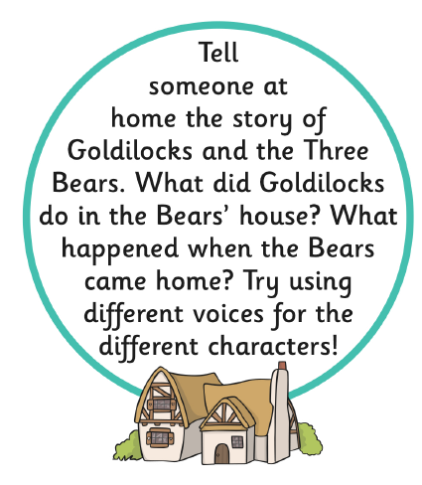
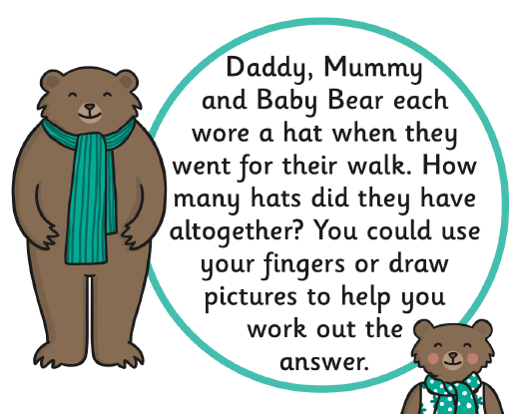
Goldilocks and the Three Bears
Home learning challenge…

Slide 30

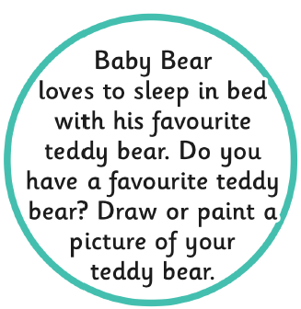
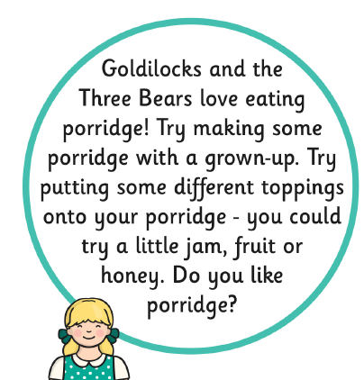
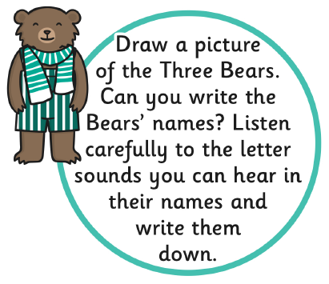
Goldilocks and the Three Bears
Home learning challenge…

Slide 31

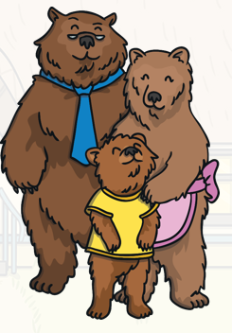
Goldilocks and the Three Bears
Label pictures with initial sound/attempt to write word.
bear
bear
bear

Slide 32
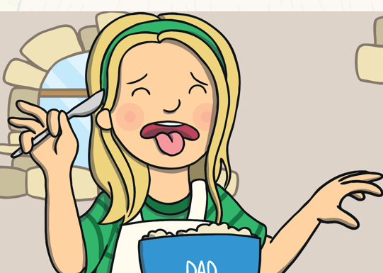
Goldilocks and the Three Bears
Label pictures with initial sound/attempt to write word.
What might she be saying?

Slide 33
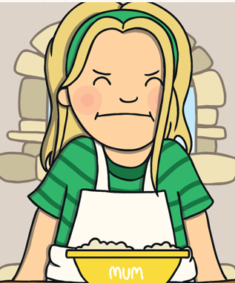
Goldilocks and the Three Bears
Label pictures with initial sound/attempt to write word.
How is she feeling now?
Goldilocks was .

Slide 34
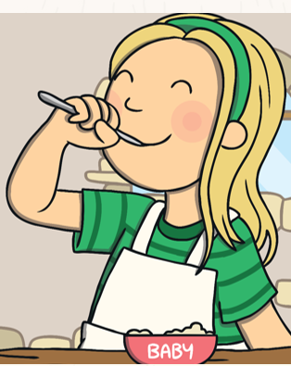
Goldilocks and the Three Bears
Label pictures with initial sound/attempt to write word.
How is she feeling now?
Goldilocks was .

Slide 35
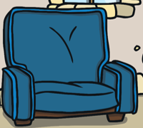
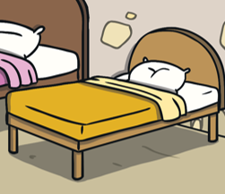
Goldilocks and the Three Bears
Label pictures with initial sound/attempt to write word.
___air

Slide 36
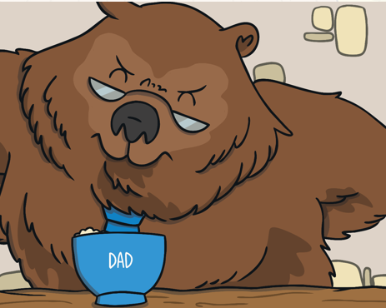
Goldilocks and the Three Bears
Label pictures with initial sound/attempt to write word.
Dad was feeling .

Slide 37
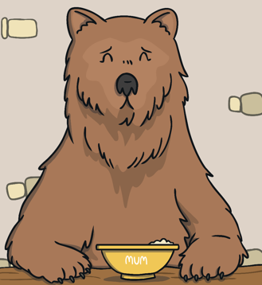
Goldilocks and the Three Bears
Label pictures with initial sound/attempt to write word.
Mum was feeling .

Slide 38
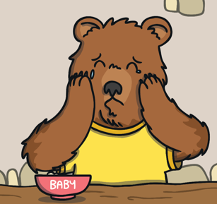
Goldilocks and the Three Bears
Label pictures with initial sound/attempt to write word.
Baby bear was feeling .

Slide 39
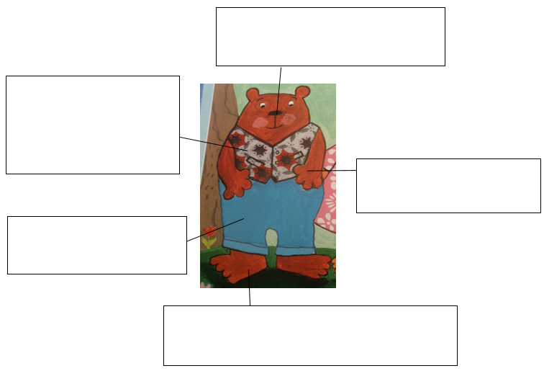
Goldilocks and the Three Bears
Label pictures with initial sound/attempt to write word.

Slide 40
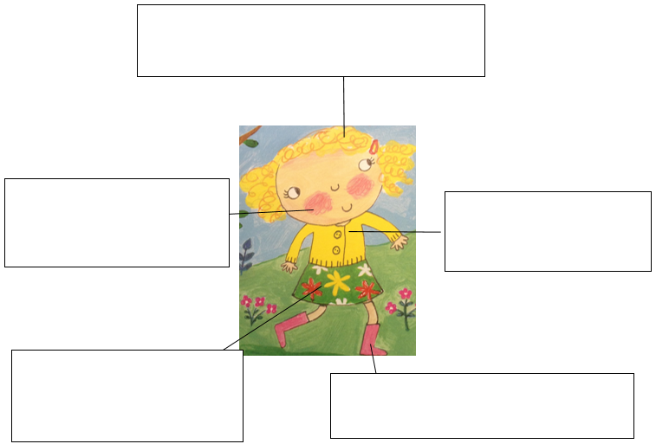
Goldilocks and the Three Bears
Label pictures with initial sound/attempt to write word.

Slide 41
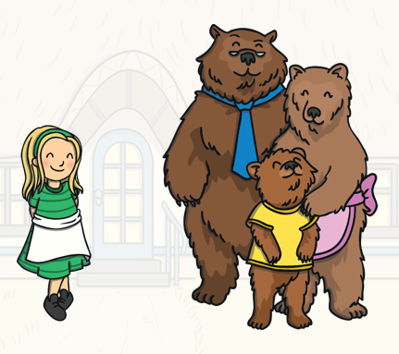
Goldilocks and the Three Bears
Write simple sentences to describe what is happening in each picture throughout the story.

Slide 42
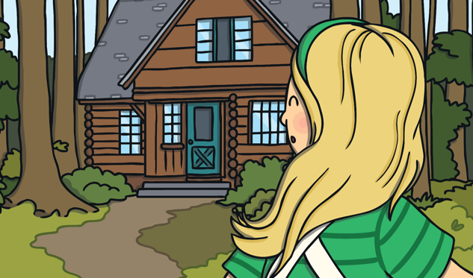
Goldilocks and the Three Bears
Write simple sentences to describe what is happening in each picture throughout the story.

Slide 43
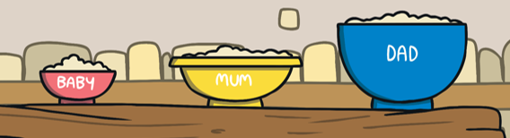
Goldilocks and the Three Bears
Write simple sentences to describe what is happening in each picture throughout the story.

Slide 44
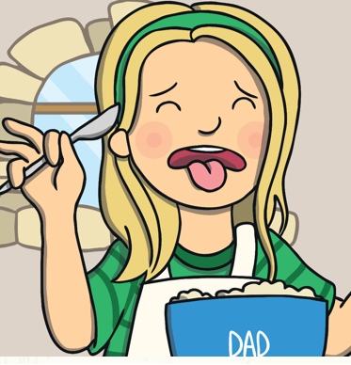
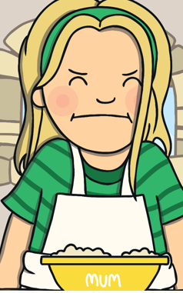
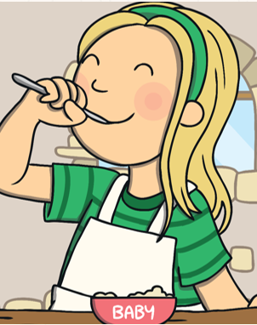
Goldilocks and the Three Bears
Write simple sentences to describe what is happening in each picture throughout the story.

Slide 45
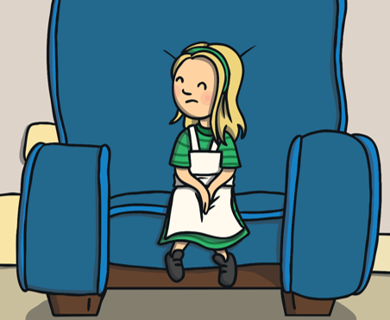
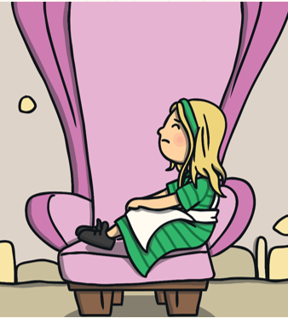
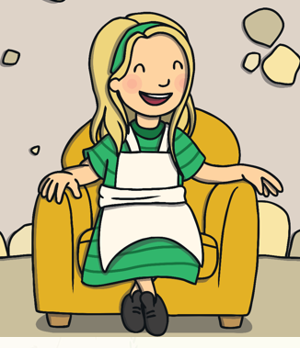
Goldilocks and the Three Bears
Write simple sentences to describe what is happening in each picture throughout the story.

Slide 46
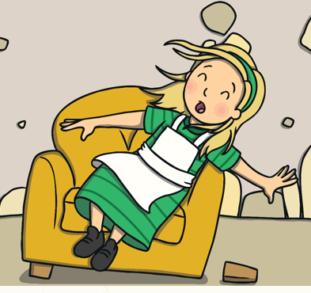
Goldilocks and the Three Bears
Write simple sentences to describe what is happening in each picture throughout the story.

Slide 47

Goldilocks and the Three Bears
Write simple sentences to describe what is happening in each picture throughout the story.

Slide 48

Goldilocks and the Three Bears
Write simple sentences to describe what is happening in each picture throughout the story.

Slide 49

Goldilocks and the Three Bears
Write simple sentences to describe what is happening in each picture throughout the story.

Slide 50


Goldilocks and the Three Bears
Story map to help with re-writing the story…

Slide 51
Goldilocks and the Three Bears
Rewrite the story using your story map.

