Slide 1
Writing in Reception

Slide 2
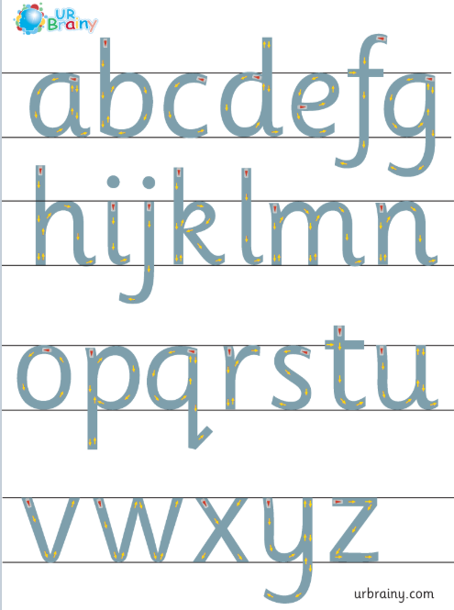
Letter formation

Slide 3
There are many different opportunities for your child to practise writing.
‘Writing’ will look different for each child depending on their currently ability.
Some children may simply be ‘mark-making’ giving meanings to the marks they make, whereas others may be writing full sentences.
We have suggested a few tasks your child could try over the next two weeks. These are suggestions only- please do not feel as though your child needs to have completed them all after week 1!

Slide 4
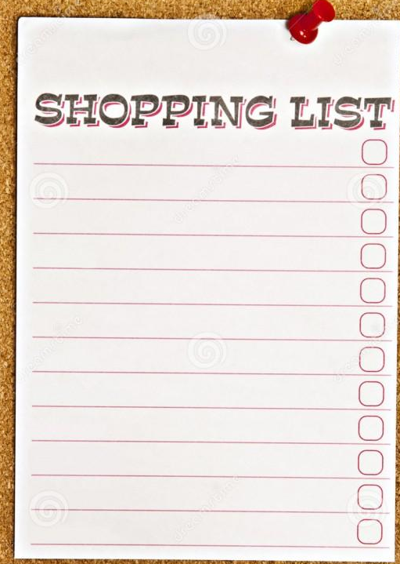
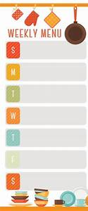
Write a shopping list
Write a weekly menu for what you plan to have for tea each night
(practise writing days of the week spelt correctly! ☺)

Slide 5

Write a daily diary
Encourage your child to reflect on each day thinking about what they have done and what they should be thankful for. They can then choose their favourite part of the day they want to draw/write about and keep it as a ‘diary’ for the period of time they are away from school.
______________________________________________________________________________________________________________________________

Slide 6

Write a letter to a friend/family member
We understand that the children will be missing their school friends and also family members that they are not able to see at the moment. One way of communicating is writing letters. The children will be familiar with what a question mark looks like experiencing them within reading books.
Encourage your child to think of some questions they might want to ask- i.e.
How are you?
What have you been doing?
Did you like it when it was sunny?

Slide 7
Write to your teacher what you are most looking forward to when returning to school.
I really like _______ because _________ .
Remember to spell tricky words ‘like’ and ‘because’ correctly ☺
We understand that the children will be desperate to tell us things that they have been up to whilst staying at home but also they will enjoy getting back into a routine and continuing their learning in school.
Encourage your child to talk about what they enjoy most in school and what they are really looking forward to doing when they return.

Slide 8
“I can …” book
I can …
We would like your children to think about all the things they can now do since they started school in September! We would like you to make an ‘I can...’ book together. Write the title ‘I can…’ on the front and then on each page write something your child is able to do. You can scribe your child’s words, saying each letter/word as you write, or they could write independently if they are able to. They can also have the option to draw a picture on each page of the things they can do. We look forward to seeing these when we return to school!

Slide 9
Make some posters to go up around your house. Examples include keep your drawers tidy, wash your hands for 20 seconds, daily jobs that need doing (you never know the children may be more inclined to do them!).

Slide 10
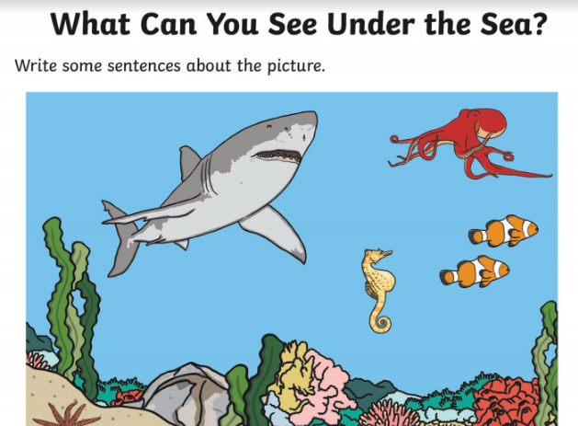
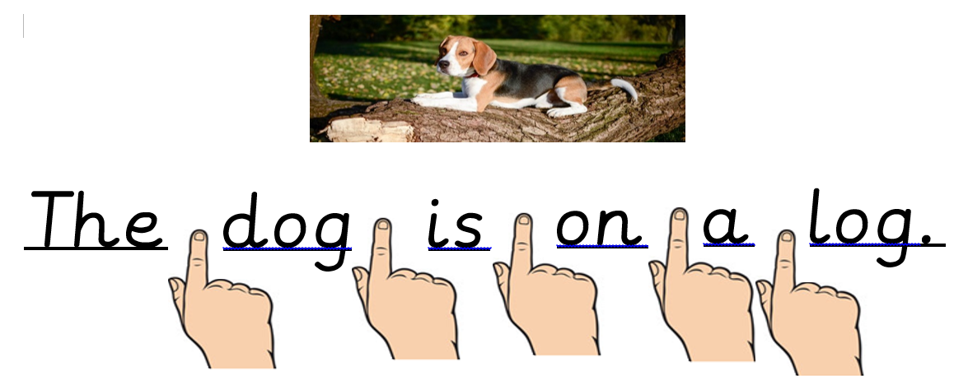
Tell me about the picture …
Some children really enjoy describing what they can see in the picture. We have uploaded some sheets from Twinkl for them to write about.
Please remember to use finger spaces between each word!

