Slide 1
Writing in Reception
Week 7 (w/c: 8.6.20)
Using ‘and’ to extend sentences
Additional challenge:
Using ‘and’ to join two ideas

Slide 2
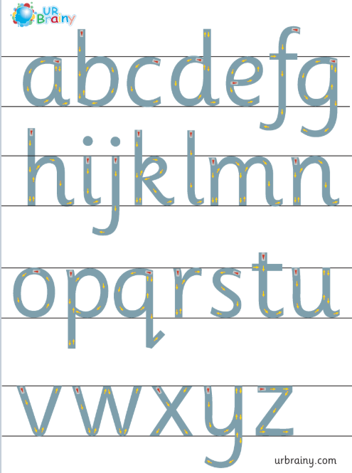
Writing in Reception
Notes for parents
Letter formation
It is really important that the children are forming their letters correctly, starting and finishing in the correct place. Please support your child with this ☺

Slide 3
Writing in Reception
Notes for parents
d h e l s p g
“Up into the sky”
“Stay sat in the grass”
“Go down into the soil”
In Reception we use ‘garden writing’ handwriting lines to explain to the children which letters need to be tall and which have tails under the line.

Slide 4
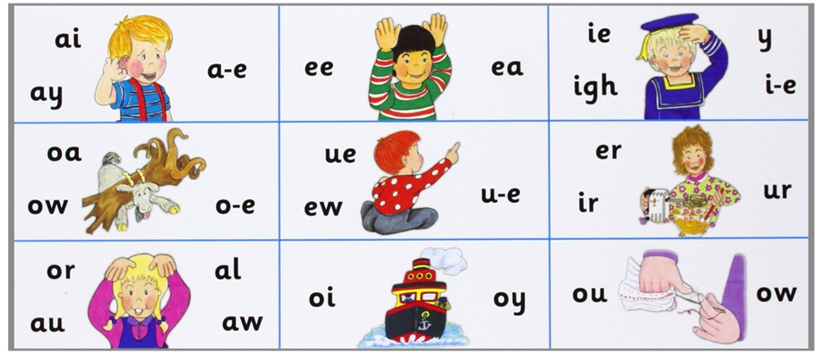
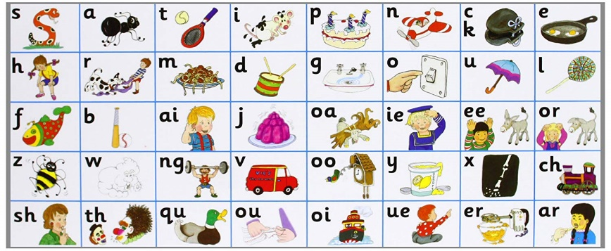
Writing in Reception
Notes for parents
When writing sentences, your child will not always spell words correctly. We encourage the children to have a go independently, using the newest sound mats to help them. They will need to segment (sound out the word) and then choose the correct digraph/trigraph/split digraph to write.
i.e. when writing the word ‘teacher’ your child needs to break the word down as:
t – ea – ch – er
There are different ways of writing ‘ea’ and ‘er’ so if they write:
‘teechur’ they will have used their phonics knowledge to select the appropriate sound however in this instance they have choose the wrong grapheme. This is reasonable for your child’s age.
If your child writes:
‘taicher’ you will need to talk them through what they have written and explain that ‘ai’ is not in teacher it is in fact the ‘ea’ sound. Look together to find the ‘ea’ ‘ee’ sounds on the sound mat and this will help them for next time.

Slide 5
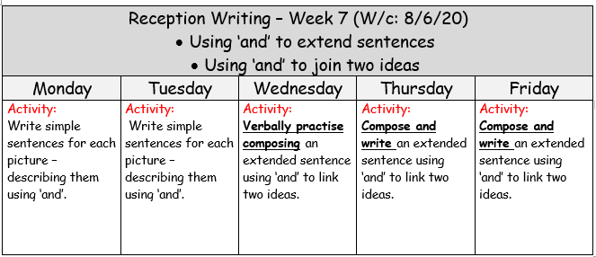

Slide 6
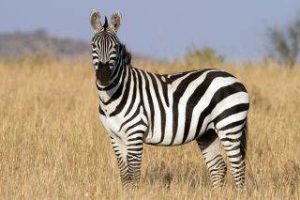

Monday:
Using ‘and’ to add extra description
Your task today is to describe the animal in the picture using the word ‘and’ to add detail.
Here’s an example:
The Zebra’s stripes are black white.

Slide 7
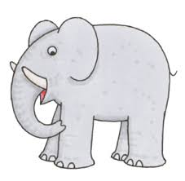
Monday:
Using ‘and’ to add extra description
Your task today is to describe the animal in the picture using the word ‘and’ to add detail.

Slide 8
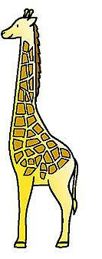
Monday:
Using ‘and’ to add extra description
Your task today is to describe the animal in the picture using the word ‘and’ to add detail.

Slide 9
Monday:
Using ‘and’ to add extra description
Can you think of other things to describe using the word ‘and’?

Slide 10
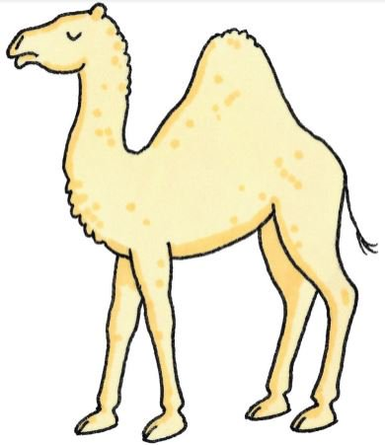
Tuesday:
Using ‘and’ to add extra description
Your task today is to describe the animal in the picture using the word ‘and’ to add detail.

Slide 11
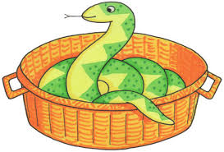
Tuesday:
Using ‘and’ to add extra description
Your task today is to describe the animal in the picture using the word ‘and’ to add detail.

Slide 12

Tuesday:
Using ‘and’ to add extra description
Your task today is to describe what you can see in the picture using the word ‘and’ to add detail.

Slide 13
Tuesday:
Using ‘and’ to add extra description
Can you think of any more things to describe using the word ‘and’?

Slide 14

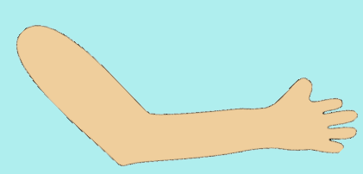
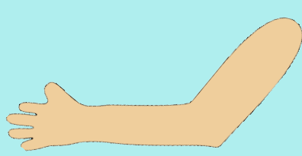

Wednesday:
Note for parents …
It is really difficult to provide work for the children to do at home which caters for all abilities. You will need to use your judgement to decide which aspects your child will focus on and whether they need to be challenged further or continue to practise. It is perfectly fine to continue ‘practising’ work we have been doing over the past few weeks. ☺
I am purely providing an extended challenge for those who want/need it to ensure that those children continue to be engaged with their learning and also make progress too.
If your child still needs to practise using ‘and’ to add more detail to their sentences, please continue to work on Monday/Tuesday’s slides. Think of some different contexts that they could write about continuing to work on this skill.
If your child requires an additional challenge, please look at the following activities for Wed/Thurs/Friday. They will be asked to use and to link two ideas, writing extended sentences. ☺
The dog is in bed
he is cuddling his teddy bear.

Slide 15

Wednesday:
Using ‘and’ to extend sentences, joining two ideas together.
I am going to think of 2 things to say about this picture. As I say my first idea I will hold my right arm up, fist pump in the middle when I say “and” then continue my second idea on my left arm. This helps to remind you to think of two different ideas and join them together using ‘and’.
We are just practising this verbally today!
The dog is in bed
he is cuddling his teddy bear.

Slide 16

Wednesday:
Using ‘and’ to extend sentences, joining two ideas together.
Your turn! ☺ I want you to tell me 2 things about this picture. Hold your right arm up when you say your first idea, fist pump in the middle when you say “and” then continue your second idea on your left arm.
We are just practising this verbally today!

Slide 17
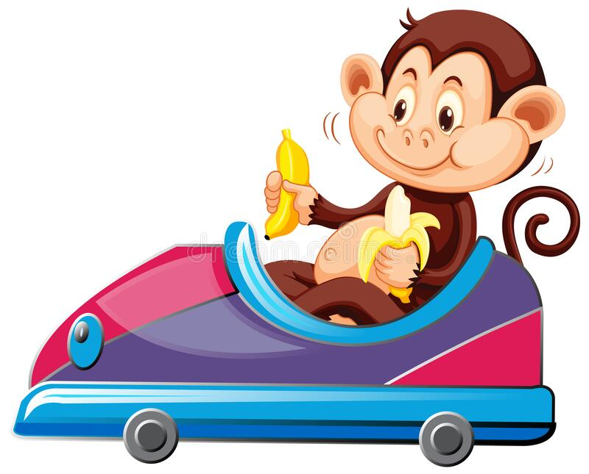
Wednesday:
Using ‘and’ to extend sentences, joining two ideas together.
Your turn! ☺ I want you to tell me 2 things about this picture. Hold your right arm up when you say your first idea, fist pump in the middle when you say “and” then continue your second idea on your left arm.
We are just practising this verbally today!

Slide 18

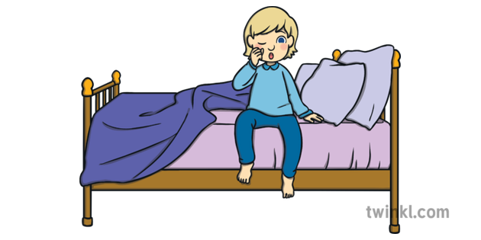
Wednesday:
Using ‘and’ to extend sentences, joining two ideas together.
Your turn! ☺ I want you to tell me 2 things about this picture. Hold your right arm up when you say your first idea, fist pump in the middle when you say “and” then continue your second idea on your left arm.
We are just practising this verbally today!

Slide 19
Wednesday:
Using ‘and’ to extend sentences, joining two ideas together.
Whilst at home or in the garden, practise thinking of two ideas to tell a grown-up. Remember to link these ideas together with ‘and’. ☺

Slide 20

Thursday:
Using ‘and’ to extend sentences, joining two ideas together.
This time I want you to look at the same pictures as yesterday and see if you can remember your ideas. Try and write a full sentence including ‘and’. ☺
Now write your sentence: The dog is in bed and he is cuddling his teddy bear.

Slide 21
Thursday:
Using ‘and’ to extend sentences, joining two ideas together.
This time I want you to look at the same pictures as yesterday and see if you can remember your ideas. Try and write a full sentence including ‘and’. ☺
Now write your sentence:

Slide 22
Thursday:
Using ‘and’ to extend sentences, joining two ideas together.
This time I want you to look at the same pictures as yesterday and see if you can remember your ideas. Try and write a full sentence including ‘and’. ☺
Now write your sentence:

Slide 23
Thursday:
Using ‘and’ to extend sentences, joining two ideas together.
This time I want you to look at the same pictures as yesterday and see if you can remember your ideas. Try and write a full sentence including ‘and’. ☺
Now write your sentence:

Slide 24
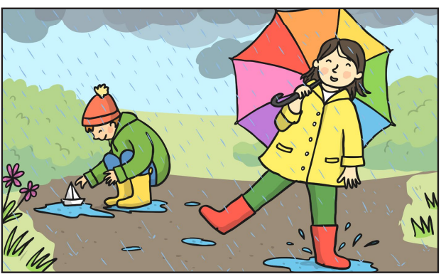
Friday:
Using ‘and’ to extend sentences, joining two ideas together.
We are continuing the same activity today but this time the pictures have lots more to write about. Maybe you could really challenge yourself to write more than one sentence for each? ☺
(Remember you must use ‘and’)
Now write your sentence(s):

Slide 25
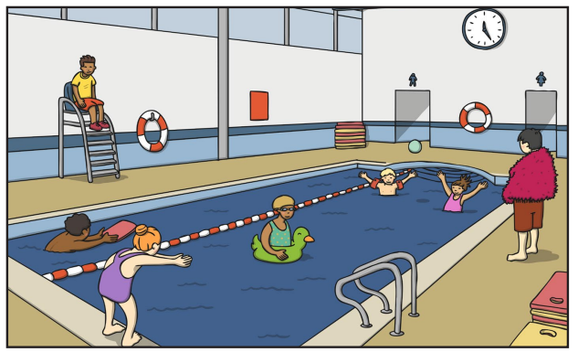
Friday:
Using ‘and’ to extend sentences, joining two ideas together.
We are continuing the same activity today but this time the pictures have lots more to write about. Maybe you could really challenge yourself to write more than one sentence for each? ☺
(Remember you must use ‘and’)
Now write your sentence(s):

Slide 26
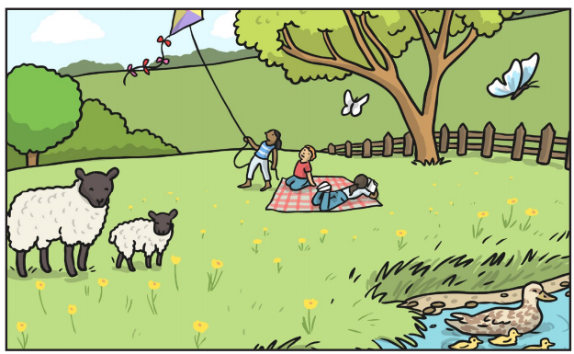
Friday:
Using ‘and’ to extend sentences, joining two ideas together.
We are continuing the same activity today but this time the pictures have lots more to write about. Maybe you could really challenge yourself to write more than one sentence for each? ☺
(Remember you must use ‘and’)
Now write your sentence(s):

Slide 27
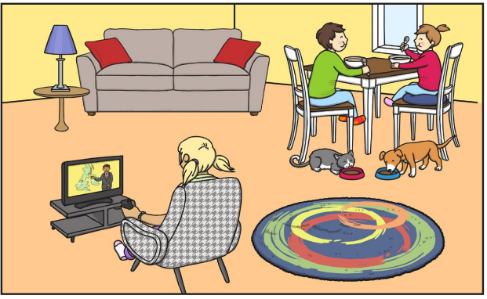
Friday:
Using ‘and’ to extend sentences, joining two ideas together.
We are continuing the same activity today but this time the pictures have lots more to write about. Maybe you could really challenge yourself to write more than one sentence for each? ☺
(Remember you must use ‘and’)
Now write your sentence(s):

Slide 28
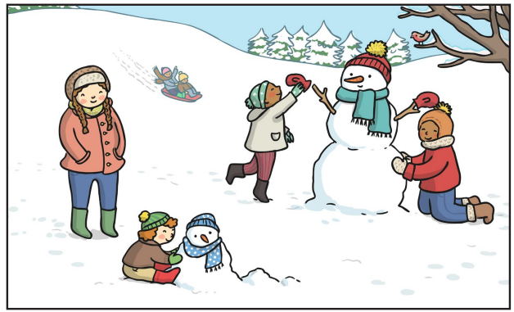
Friday:
Using ‘and’ to extend sentences, joining two ideas together.
We are continuing the same activity today but this time the pictures have lots more to write about. Maybe you could really challenge yourself to write more than one sentence for each? ☺
(Remember you must use ‘and’)
Now write your sentence(s):

