Slide 1
Writing in Reception
Week 12 (w/c: 13.7.20)
Transition from Reception to Year 1
Class RY to 1R

Slide 2

Writing in Reception
Notes for parents
Letter formation
It is really important that the children are forming their letters correctly, starting and finishing in the correct place. Please support your child with this ☺

Slide 3
Writing in Reception
Notes for parents
d h e l s p g
“Up into the sky”
“Stay sat in the grass”
“Go down into the soil”
In Reception we use ‘garden writing’ handwriting lines to explain to the children which letters need to be tall and which have tails under the line.

Slide 4
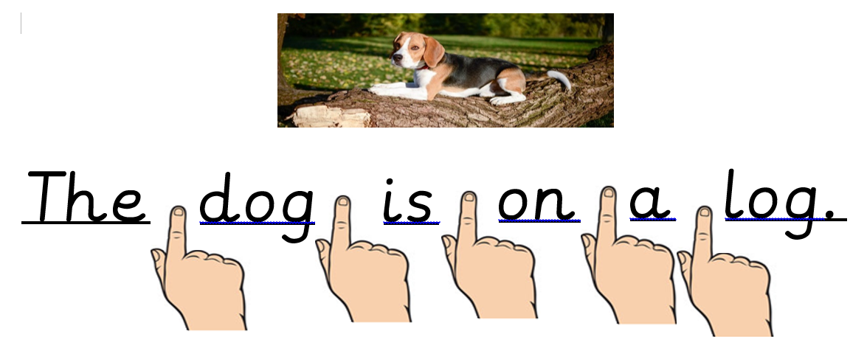
Writing in Reception
Notes for parents:
Please remind your children to use finger spaces between each word.

Slide 5
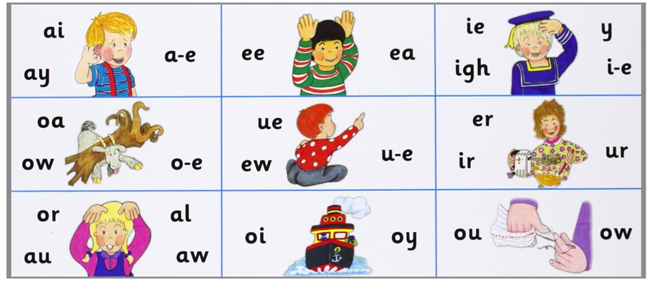
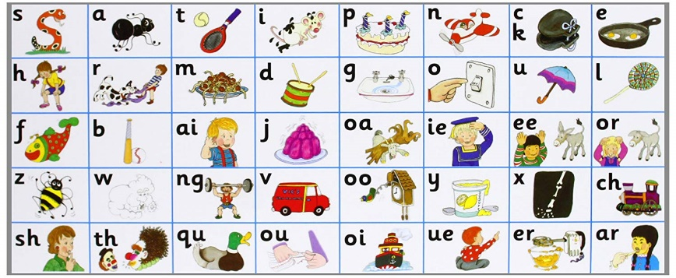
Writing in Reception
Notes for parents
When writing sentences, your child will not always spell words correctly. We encourage the children to have a go independently, using the newest sound mats to help them. They will need to segment (sound out the word) and then choose the correct digraph/trigraph/split digraph to write.
i.e. when writing the word ‘teacher’ your child needs to break the word down as:
t – ea – ch – er
There are different ways of writing ‘ea’ and ‘er’ so if they write:
‘teechur’ they will have used their phonics knowledge to select the appropriate sound however in this instance they have choose the wrong grapheme. This is reasonable for your child’s age.
If your child writes:
‘taicher’ you will need to talk them through what they have written and explain that ‘ai’ is not in teacher it is in fact the ‘ea’ sound. Look together to find the ‘ea’ ‘ee’ sounds on the sound mat and this will help them for next time.

Slide 6
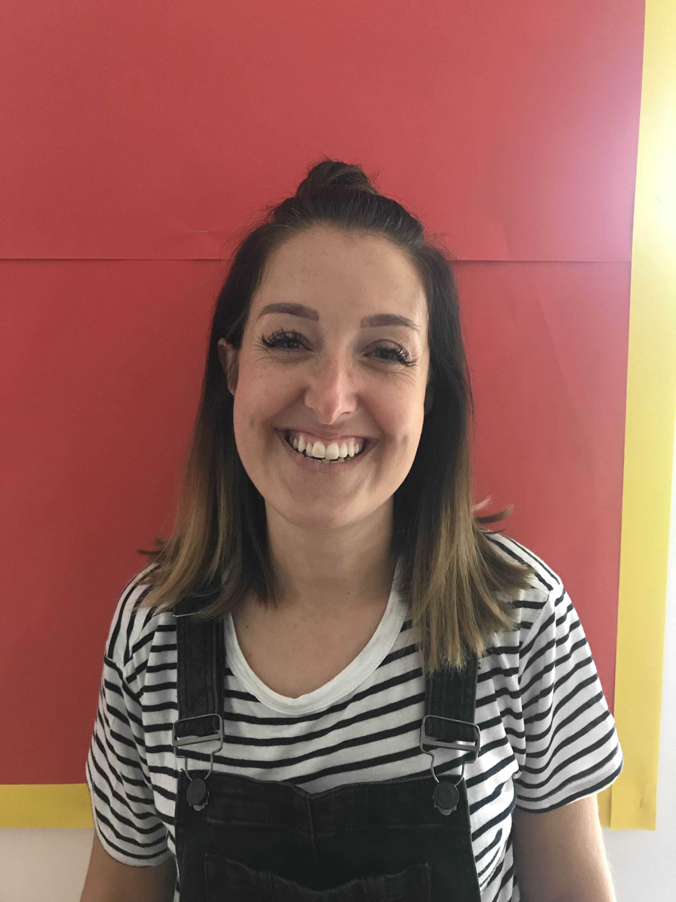
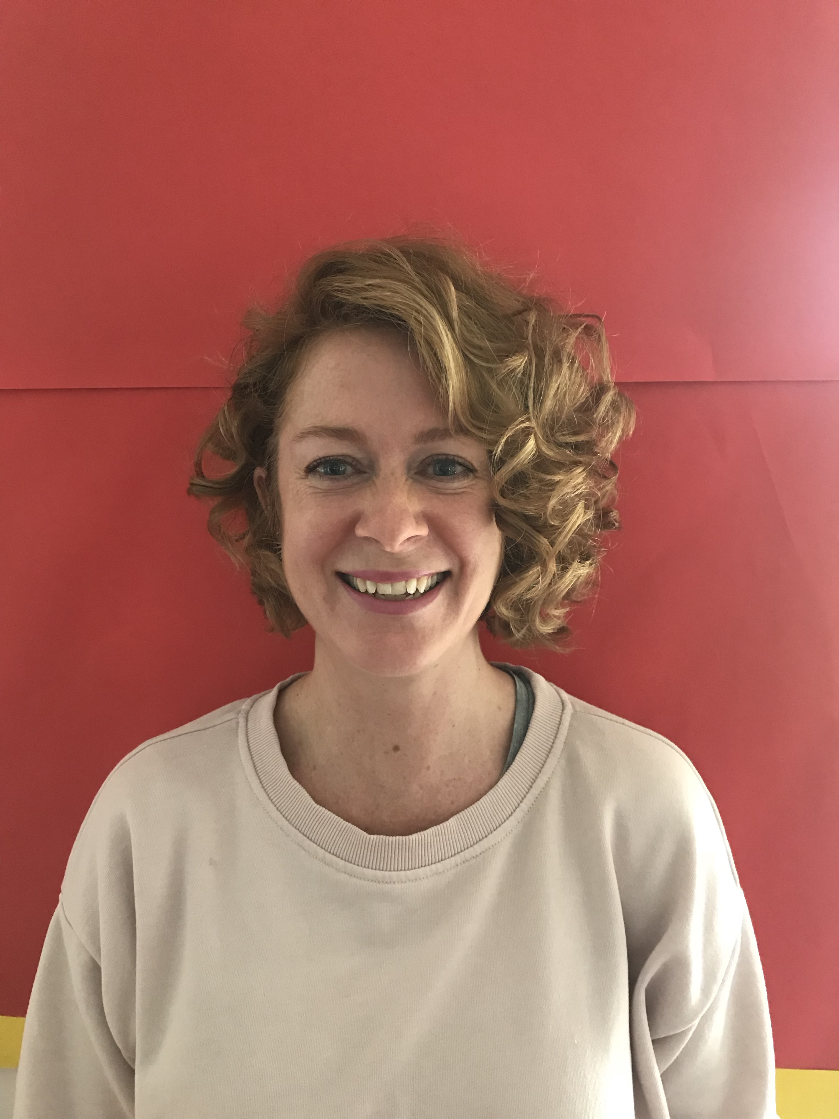
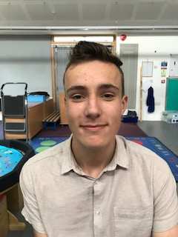
Transition to Year 1 ☺
The time has come to end our year in Reception.
What a year it has been!
This week we would like you to look back on your time in Reception with Mrs Yeomans and also think about moving on to Year 1 with Mrs Ross & Miss Wheeler ☺
Mrs Yeomans
Mrs Pothan
This week:
Monday: Reception Memories
Tuesday: All about your new teacher(s)
Wednesday: Tell your teacher your name & facts about you
Thursday: All about you
Friday: Things you are looking forward to about Y1 & any worries
Mr Giles

Slide 7
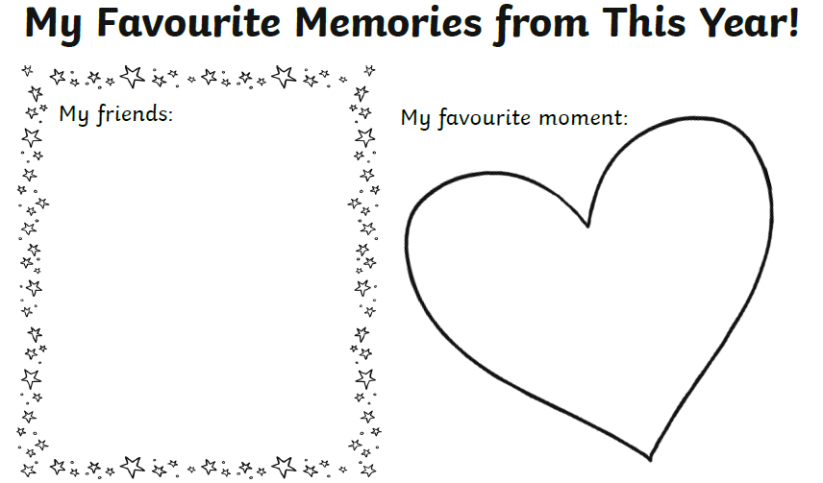

Monday: Memories from Reception (Printable version has been uploaded in the resources folder if you’d prefer)
It might be a nice idea to have a look on the Reception page on the school website to remind yourself of some of the great times we’ve had this year!
https://www.stcatherineskidderminster.co.uk/reception/
Here is your chance to fill in each section by writing and drawing a picture too if you wish ☺

Slide 8
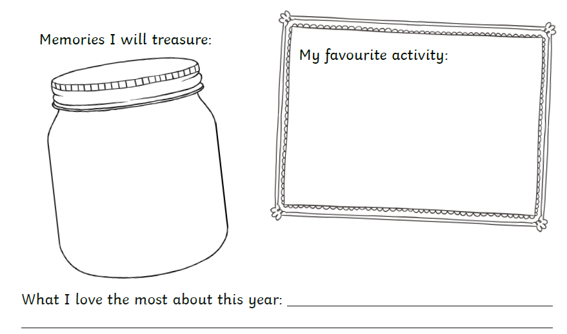
Monday: Memories from Reception (Printable version has been uploaded in the resources folder if you’d prefer)
It might be a nice idea to have a look on the Reception page on the school website to remind yourself of some of the great times we’ve had this year!
https://www.stcatherineskidderminster.co.uk/reception/
Here is your chance to fill in each section by writing and drawing a picture too if you wish ☺

Slide 9
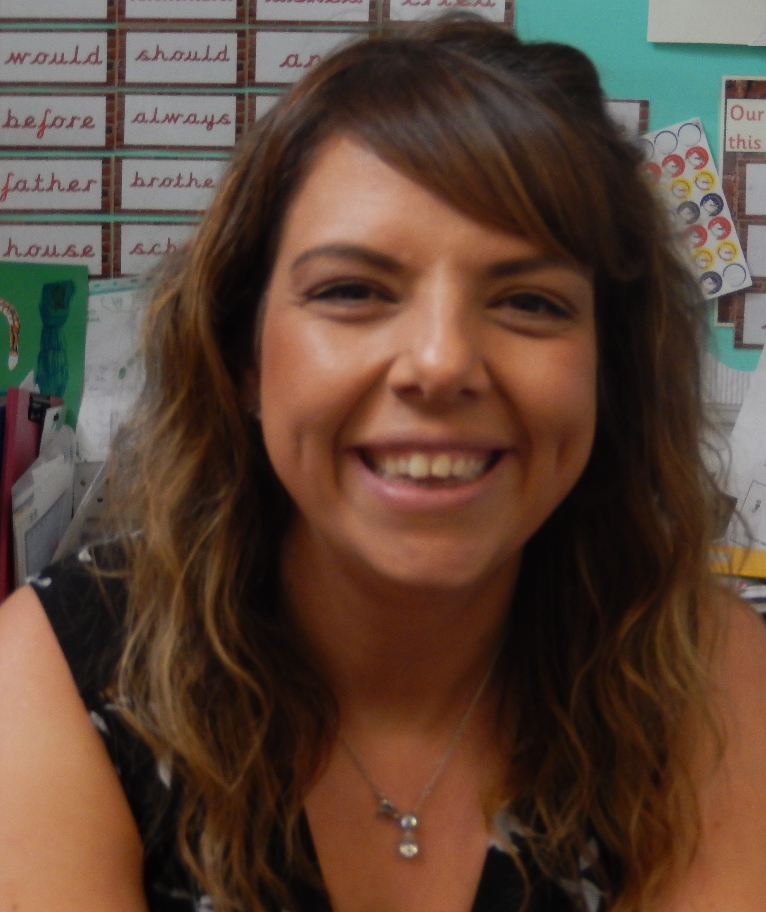
Tuesday: Read all about your new teacher:
Mrs Ross
Q1) What is your favourite colour?
I don’t have one particular favourite colour. I love all of the colours in the rainbow because they are bright and colourful!
Q2) Do you have any pet(s)?
Yes, I have a guinea pig called Freddie.
Q3) What is your favourite animal and why?
I love horses! I started horse riding when I was 5 years old.
Q4) If you could be a superhero who would you be and why?
I would be Elastigirl from the Incredibles because I would be able to stretch and reach anything, including my 2 year old son when he decides to run!
Q5) Do you have a favourite book?
I love all of the Supertato books by Sue Hendra.
I’m also a big Harry Potter fan.
Q6) What is your favourite food?
As a treat- chocolate! (Specifically a kit-kat chunky!)
Healthy choice would be mango. I love it! ☺
You could do a quiz all about Mrs Ross.
Get your grown up to ask you some questions about her and see if you can remember the answers she gave. ☺

Slide 10
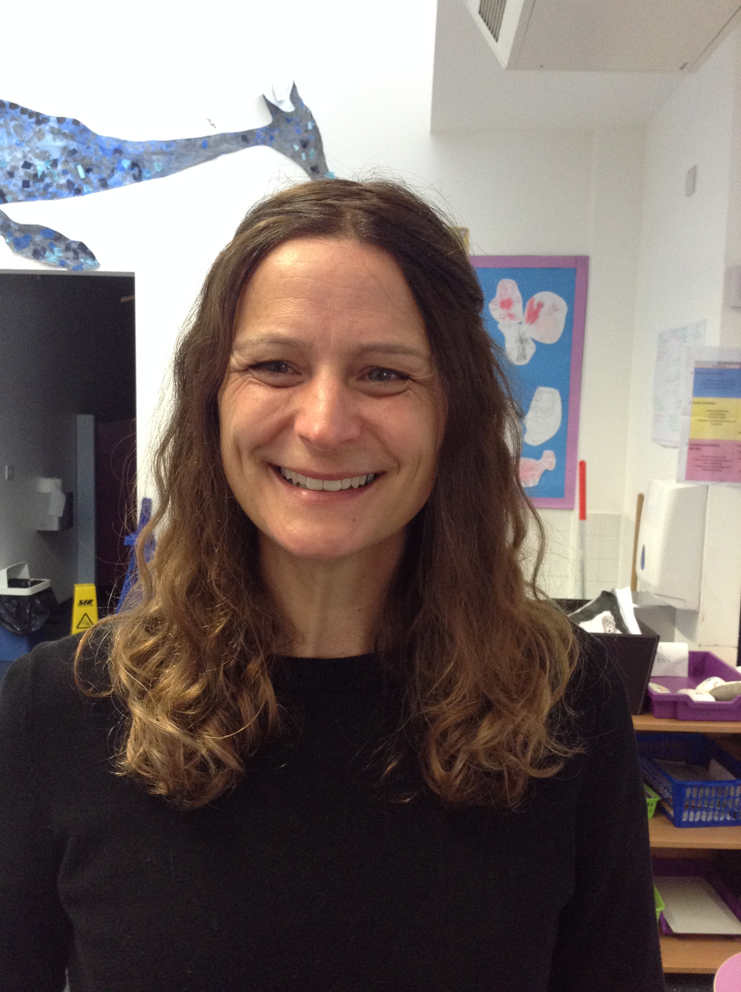
Tuesday: Read all about your new teacher:
Miss Wheeler
Q1) What is your favourite colour?
Green
Q2) Do you have any pet(s)?
Yes, I have a hamster ☺
Q3) What is your favourite animal and why?
I love whales because they are beautiful!
Q4) If you could be a superhero who would you be and why?
I would be Wonder Woman so I could help people.
Q5) Do you have a favourite book?
The Folk of the Faraway Tree
Q6) What is your favourite food?
I love Pizza! ☺
You could do a quiz all about Miss Wheeler.
Get your grown up to ask you some questions about her and see if you can remember the answers she gave. ☺

Slide 11
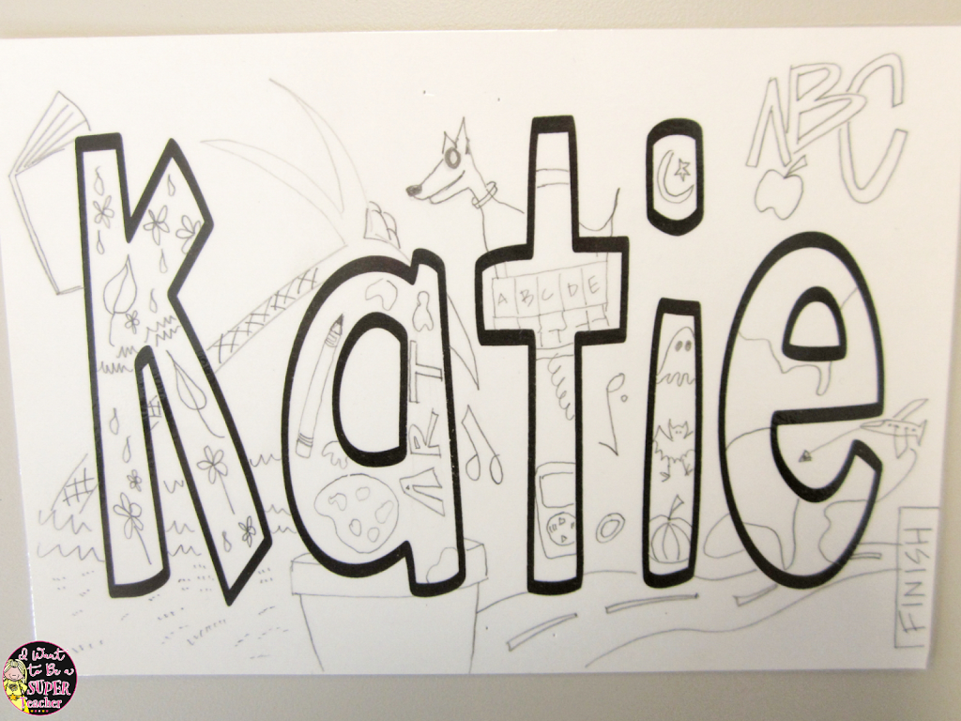
Wednesday: Tell your new teachers your name and a bit about you …
Draw your name in large bubble writing or print it off in fancy font.
Write lots of words/draw pictures all about you inside or around your name in lots of different colours.
Here is an example:

Slide 12
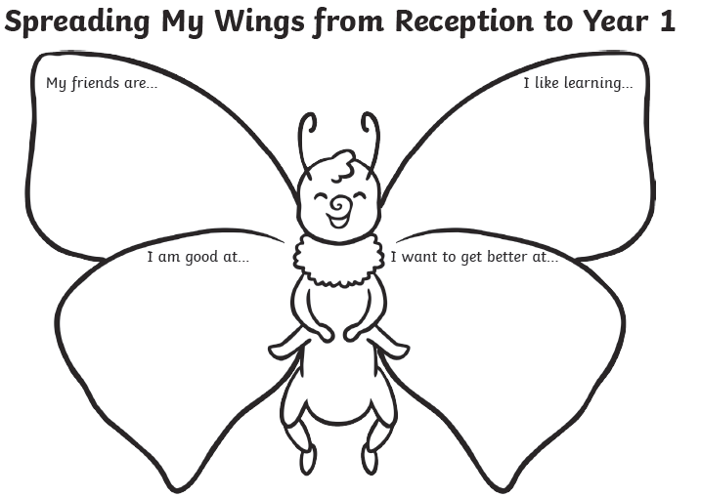

Thursday: All about you (Printable version has been uploaded in the resources folder if you’d prefer)
* Fill in each section by writing and drawing a picture too if you wish ☺ *
.
CL

Slide 13


Friday: Things I am looking forward to and any worries I may have…
Although growing up and moving to Year 1 can be very exciting, you may also be feeling a little nervous as you are not sure what to expect.
Today’s Task 1:
Today we would like you to first think about what you are most looking forward to about being in Year 1.
It may be that you are excited about having your own drawer to put all of your belongings…
You might feel very grown up to have your own table space in the classroom…
Maybe you are eager to find out what new things you will learn about in Year 1?

Slide 14
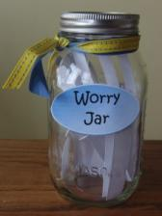
Friday: Write your worries away…
Today I would also like you to have a think and discuss with your grown ups at home any worries you may have about moving to Year 1.
Hopefully your grown up will be able to reassure you and find solutions to help you with these worries however, it may be that you have to wait until you start school in Year 1 before your worries disappear. ☺
Today’s task 2:
Write down any worries you have and put them into a jar to make your own ‘worry jar’.
When you feel your worry has gone away you can tear them up and hopefully your worry jar will be empty! ☺

