Slide 1
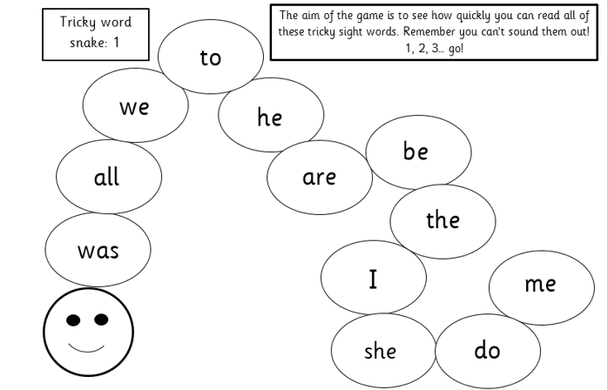
Phonics learning- Week 11
This is the final week for focusing on consonant blends
(Here is a link to explain/model consonant blends: https://www.youtube.com/watch?v=cS8bvbyWFZ4)
Some parents have mentioned that when reading, their child often finds words such as; ‘green’, ‘tree’, ‘drink’, ‘click’ tricky due to the sounds at the start of the word. They will often find these words hard to spell too, missing out that second sound.
This is due to the fact that the dr in drink is a ‘consonant blend’. Children often sound it out as d-r-i-nk but it then doesn’t sound right when trying to blend the d-r sounds. Instead we practise saying these blends clearly dr for drink.
I have kept the activity ideas on the slide for reading tricky words and we will continue to do dictation sentences for children to practise writing their tricky words.

Slide 2
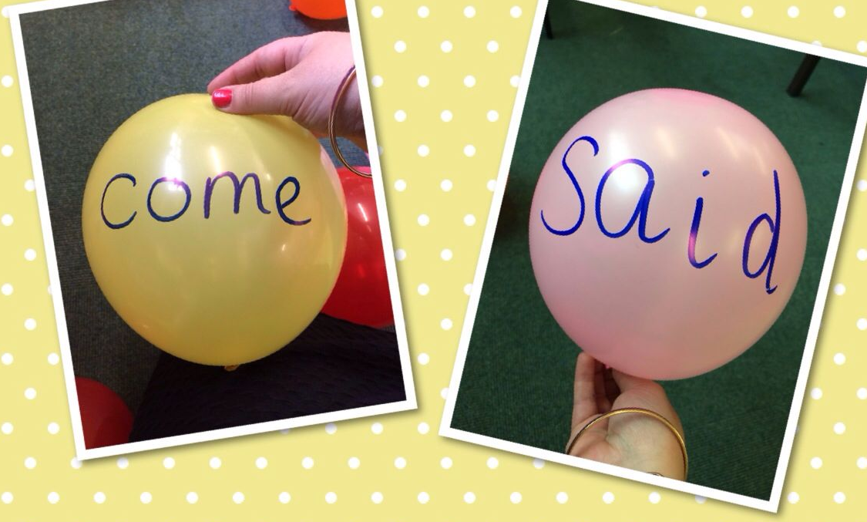
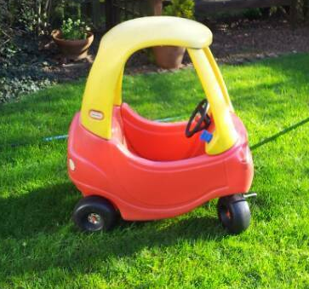
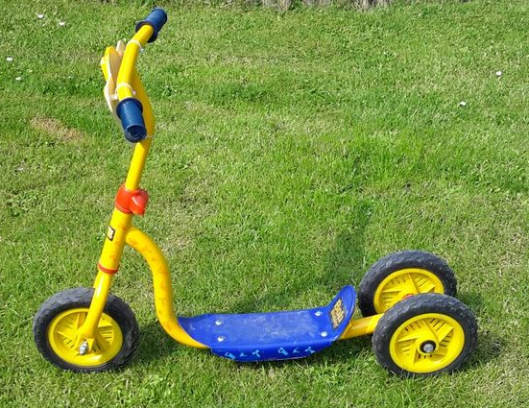
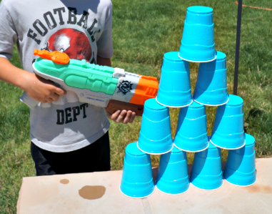
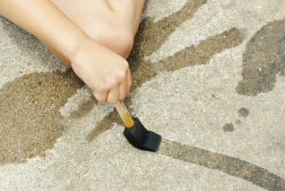
Reading tricky words
Activities to try
There are lots of different ways you can encourage your child to read tricky words. Have a look at the suggested list below and give them a try! ☺
Balloon pop! – Write tricky words on balloons/water balloons and your child has to read the word before they are allowed to pop it.
Traffic light game– Allow your child to ride around the garden pretending it’s a road. Adult shout traffic light signals such as STOP! They must then read a tricky word to be able to go again. You could position tricky words around the garden so they have to read each word before they pass.
Write tricky words on the patio slabs or fence in chalk for your child to read. When they read a word correctly they can either squirt a water pistol at the words, throw a water balloon or use a paintbrush with water to remove. You could also write tricky words on plastic cups and do the same activity.

Slide 3
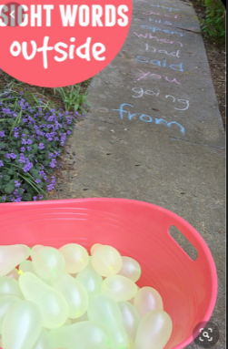
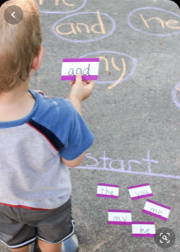
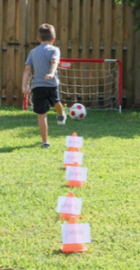
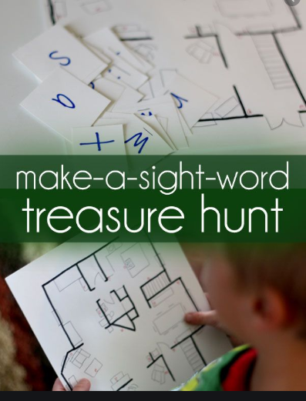
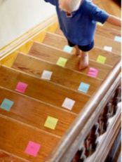
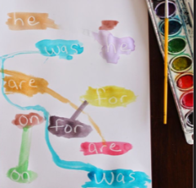
Reading tricky words activities to try
Here are lots more examples you could try (especially if the weather is nice!) ☺
Using water balloons to throw at each tricky word.
Please be careful with this one- look where you’re going when walking up and down the stairs! ☺ ☺
Use a white wax crayon or candle to write ‘secret tricky words’ for your child to paint/find. Use watered down paint! ☺
Your child must dribble around the cones, reading each tricky word as they go before scoring! ☺

Slide 4
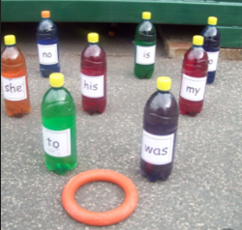
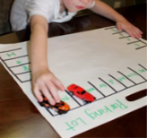
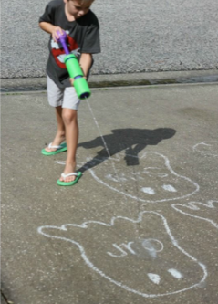
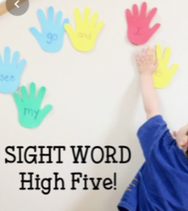
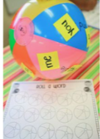
Reading tricky words activities to try
Here are lots more examples you could try (especially if the weather is nice!) ☺
You could do this with reading tricky words and/or phonics sounds! ☺
Tricky word skittles game! ☺

Slide 5
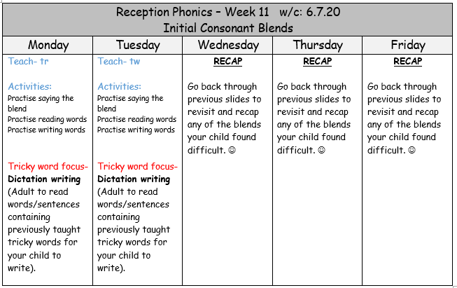

Slide 6
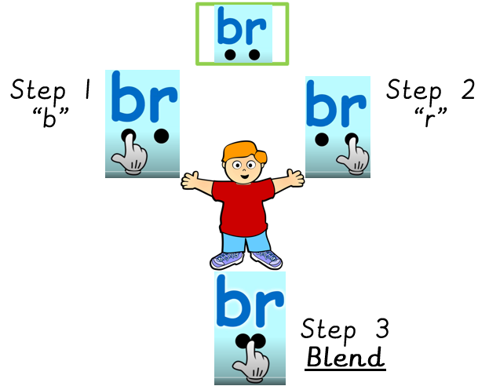
Familiarise yourself with what a consonant blend is … https://www.youtube.com/watch?v=cS8bvbyWFZ4
The next slides will give the children opportunity to practise:
Saying each ‘blend’ correctly
Reading words containing consonant blends
Writing words containing consonant blends

Slide 7


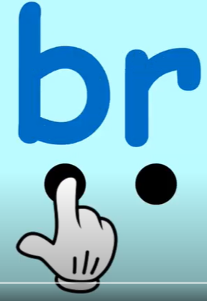
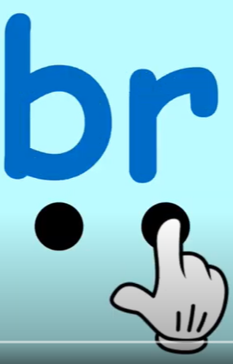


Example:
Step 1
“b”
Step 2
“r”
anch
Step 3
Blend

Slide 8
Monday: tr
tr
Begin by practising saying the separate letters slowly t/r, t/r. Then increase the speed until you are saying ‘tr’ together quickly.
t
r

Slide 9
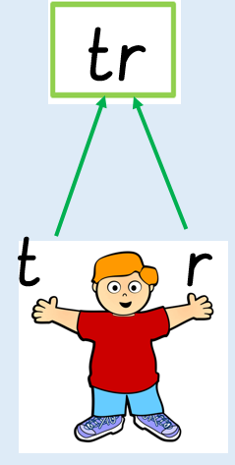
Monday- practise reading these words
try
tree
truck
trip
train
trim

Slide 10
Monday- practise writing these words…
Adult to read out these words one at a time for children to practise writing.
If they are finding it tricky, phoneme frames are an excellent tool to help with this (as demonstrated below)..
tree
truck
trip
train
try
tractor
trim
trumpet

Slide 11
Monday- Tricky word dictation
The adult will read the following sentences out slowly for the child to hear, remember and write.
Remind them to think about how the tricky word is spelt. Remember it’s a tricky word so you can’t use your phonics sounds to sound it out.
Once they have finished, look at your child’s work with them and praise them for their efforts! (This is not a test!)
If they have spelt the tricky word incorrectly – refer back to the tricky word snake to check how it is spelt – by encouraging your child to do this should mean they are more likely to remember the correct spelling next time. ☺

Slide 12
Monday- Tricky word dictation
* Tricky words are in bold to check afterwards *
Adult read out the following sentences for your child to write:
Once upon a time there lived an old man and a dog.

Slide 13
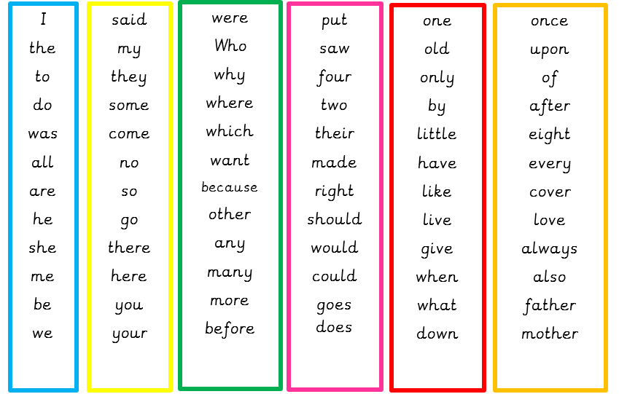
Tricky word list – If you want to challenge your child you can choose other tricky words. Try making up your own sentences for them to write. ☺

Slide 14
Tuesday: tw
tw
Begin by practising saying the separate letters slowly t/w, t/w. Then increase the speed until you are saying ‘tw’ together quickly.
t
w

Slide 15

Tuesday: practise reading these words
twin
twist
twirl
tweet
twig
twenty

Slide 16
Tuesday- practise writing these words…
Adult to read out these words one at a time for children to practise writing.
If they are finding it tricky, phoneme frames are an excellent tool to help with this (find them in the useful resources folder).
twin
twist
twirl
tweet
twenty
twig

Slide 17
Tuesday- Tricky word dictation
* Tricky words are in bold to check afterwards *
Adult read out the following sentences for your child to write:
I will go to bed after my shower.
I always read a story every night.

Slide 18
Tricky word list – If you want to challenge your child you can choose other tricky words. Try making up your own sentences for them to write. ☺

Slide 19
Wednesday, Thursday & Friday
We have looked at a lot of different consonant blends over the last few weeks.
You have the next three days to re-cap and revisit any previous sounds, tricky words and/or consonant blends that you found particularly difficult.
Well done – you have done some great phonics learning! ☺

