Slide 1
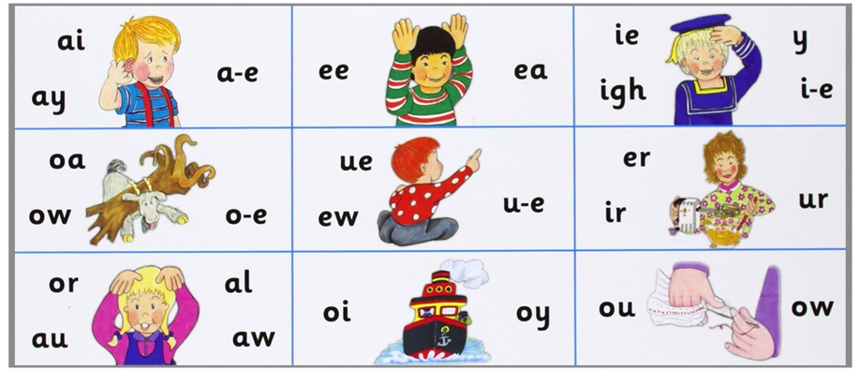

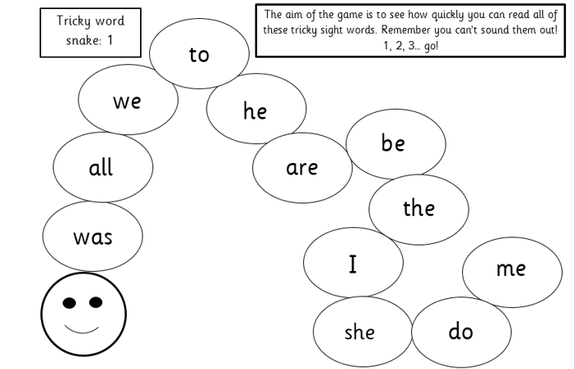
Phonics learning
Your child has previously been learning a new sound each day. This week is going to be a ‘recap week’ to consolidate what they have learned so far.
find the sound (sound mat)
do the action (action sheet)
read the sound within a word (reading ladders)
practise writing sentences
recognise and read tricky words within the text.
It is really important to also continue to practise recognising tricky words. The feedback we have had from parents is great! The children seem to really enjoy reading their tricky word snakes as fast as possible so please keep going with this! ☺

Slide 2
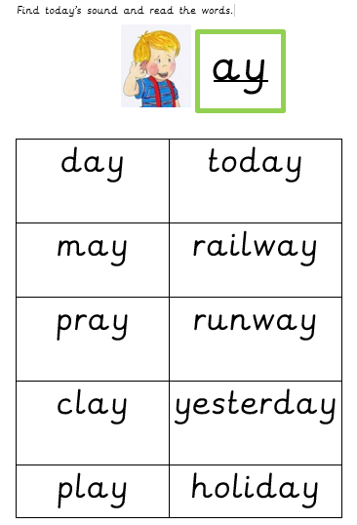
Phonics reading ladders
Encourage your child to segment (sound out) and blend each of these words on the appropriate reading ladder for each day.

Slide 3
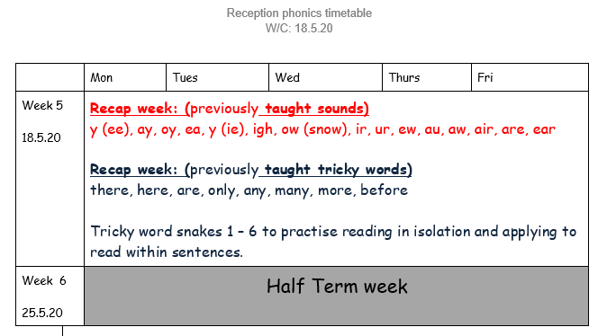

Slide 4
Week 5 w/c: 18.5.20

Slide 5



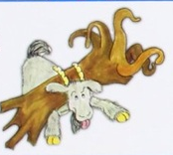


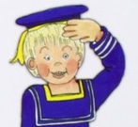


Quick game: point to the picture and say the sound …
“ay”
For example:

Slide 6
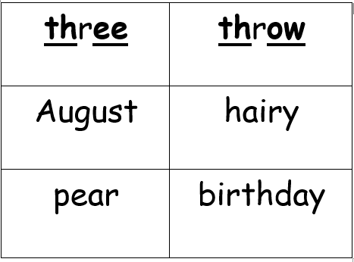
Monday – Read the words containing previously taught sounds.
The first two digraphs are underlined to help you. ☺

Slide 7

Monday – Can you think of any sentences you could write about these words?
Could you write a silly sentence including more than one of these words?

Slide 8
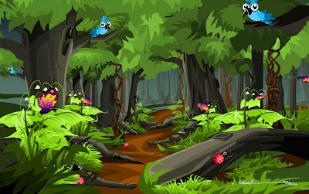

Monday – Can you read these sentences containing the previously taught tricky words? ☺
The little boy looked very lost.
He had not been here before.
What is he going to do now?

Slide 9
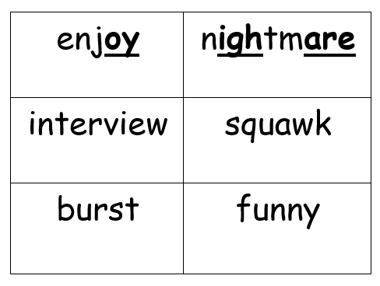
Tuesday – Read the words containing previously taught sounds.
The first two digraphs are underlined to help you. ☺

Slide 10
Tuesday – Can you think of any sentences you could write about these words?
Could you write a silly sentence including more than one of these words?

Slide 11
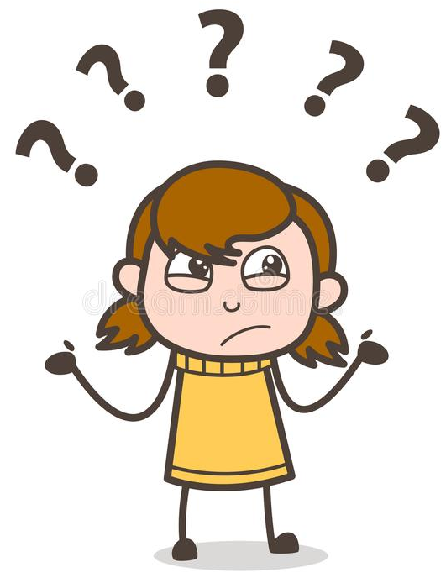

Tuesday – Can you read these sentences containing the previously taught tricky words? ☺
The girl asked “Where are you going?”
Mum said “I am only going over there.
Do you want to come with me?”

Slide 12
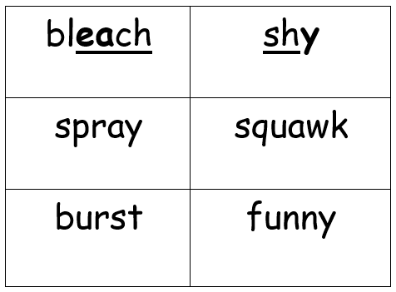
Wednesday – Read the words containing previously taught sounds.
The first two digraphs are underlined to help you. ☺

Slide 13
Wednesday – Can you think of any sentences you could write about these words?
Could you write a silly sentence including more than one of these words?

Slide 14
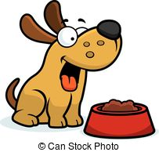
Wednesday – Can you read these sentences containing the previously taught tricky words? ☺
The dog did not want to eat any more of his dinner because he was too full up!

Slide 15
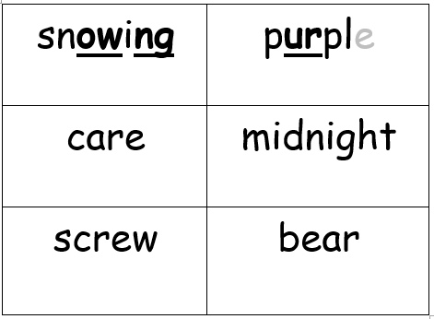
Thursday – Read the words containing previously taught sounds.
The first two digraphs are underlined to help you. ☺

Slide 16
Thursday – Can you think of any sentences you could write about these words?
Could you write a silly sentence including more than one of these words?

Slide 17

Thursday – Can you read these sentences containing the previously taught tricky words? ☺
There are only 218 days left until Christmas!

Slide 18
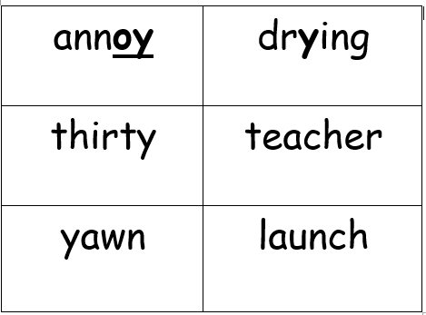
Friday – Read the words containing previously taught sounds.
The first two digraphs are underlined to help you. ☺

Slide 19
Friday – Can you think of any sentences you could write about these words?
Could you write a silly sentence including more than one of these words?

Slide 20

Friday – Can you read these sentences containing the previously taught tricky words? ☺
There are so many reasons to be happy so keep smiling!
☺

Slide 21
Tricky word snakes to continue practising… ☺

Slide 22
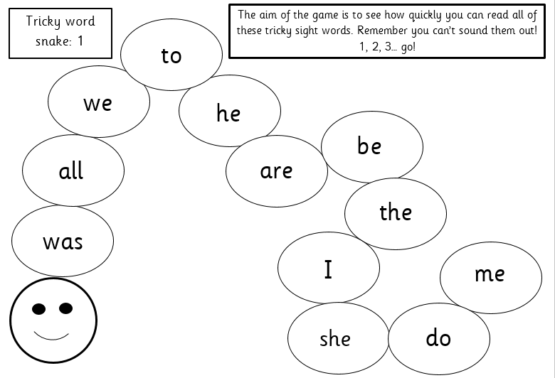

Slide 23
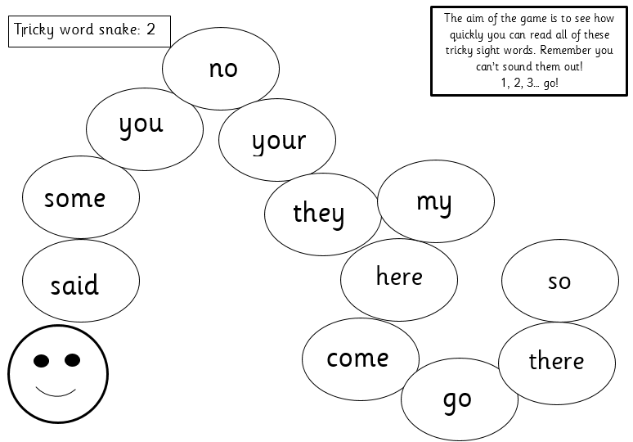

Slide 24
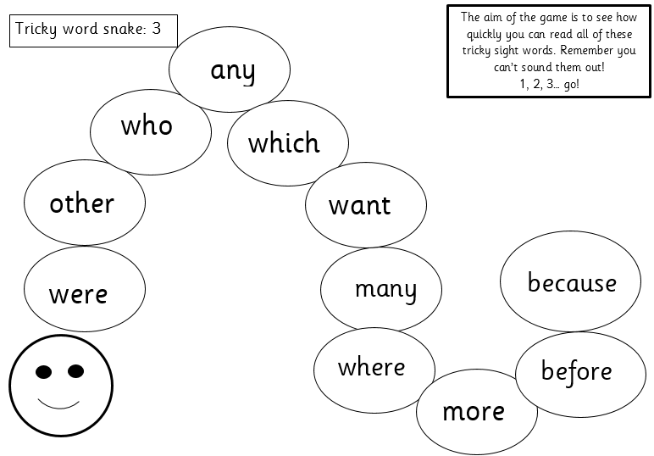

Slide 25
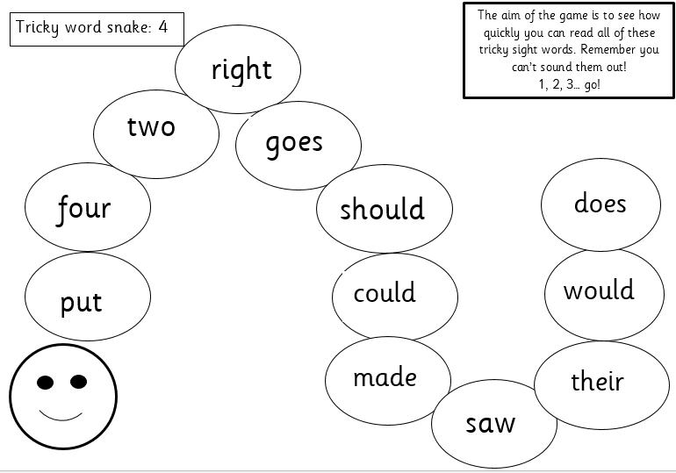

Slide 26
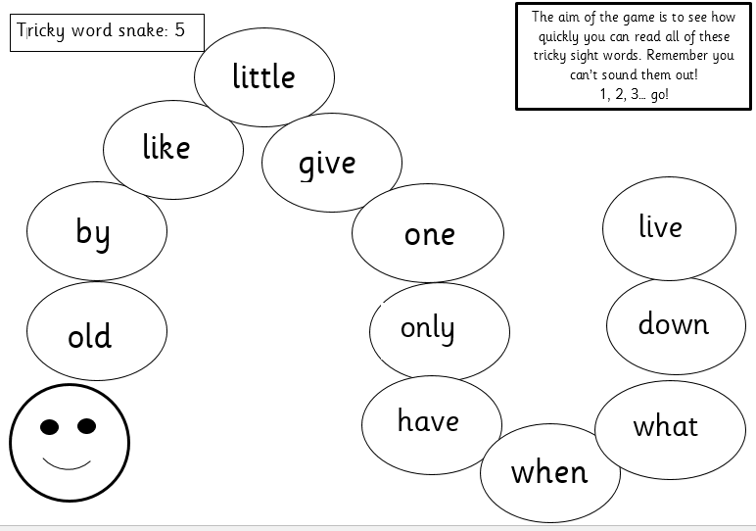

Slide 27


