Slide 1
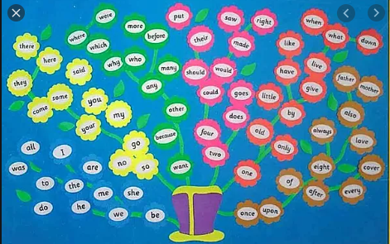
Tricky Words
Recap

Slide 2
Tricky Word Flashcards
Go through the slides one by one asking your child to say the tricky word.

Slide 3

I

Slide 4
the

Slide 5
to

Slide 6
do

Slide 7
was

Slide 8
all

Slide 9
are

Slide 10
he

Slide 11
she

Slide 12
me

Slide 13
be

Slide 14
we

Slide 15

said

Slide 16
my

Slide 17
they

Slide 18
some

Slide 19
come

Slide 20
no

Slide 21
so

Slide 22
go

Slide 23
there

Slide 24
here

Slide 25
you

Slide 26
your

Slide 27

were

Slide 28
who

Slide 29
why

Slide 30
where

Slide 31
want

Slide 32
because

Slide 33
other

Slide 34
any

Slide 35
many

Slide 36
more

Slide 37
before

Slide 38

put

Slide 39
saw

Slide 40
four

Slide 41
two

Slide 42
their

Slide 43
made

Slide 44
right

Slide 45
should

Slide 46
would

Slide 47
could

Slide 48
goes

Slide 49
does

Slide 50

one

Slide 51
old

Slide 52
only

Slide 53
by

Slide 54
little

Slide 55
have

Slide 56
like

Slide 57
live

Slide 58
give

Slide 59
when

Slide 60
what

Slide 61
down

Slide 62

once

Slide 63
upon

Slide 64
of

Slide 65
after

Slide 66
eight

Slide 67
every

Slide 68
cover

Slide 69
love

Slide 70
always

Slide 71
also

Slide 72
father

Slide 73
mother

Slide 74
Common exception words:
don’t
try

