Slide 1
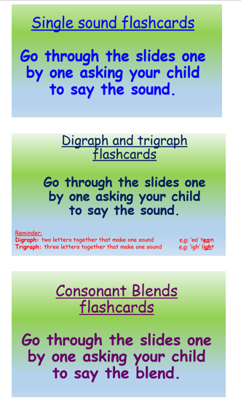
Phonics learning- Week 12
This week we are going to be recapping all of the digraphs, trigraphs and consonant blends that we have been learning throughout our ‘home learning time’ and previously in school.
I have made separate slides for single sounds, digraphs & trigraphs and consonant blends. This will be a great assessment tool to see how well your child has retained the sounds and see which they still need to practise.
Please choose the appropriate sounds to focus on for your child’s phonics ability. ☺

Slide 2
Single sound flashcards
Go through the slides one by one asking your child to say the sound.

Slide 3
s

Slide 4
a

Slide 5
t

Slide 6
i

Slide 7
p

Slide 8
n

Slide 9
c

Slide 10
k

Slide 11
e

Slide 12
h

Slide 13
r

Slide 14
m

Slide 15
d

Slide 16
g

Slide 17
o

Slide 18
u

Slide 19
l

Slide 20
f

Slide 21
b

Slide 22
j

Slide 23
z

Slide 24
w

Slide 25
v

Slide 26
y

Slide 27
x

Slide 28
q

