Slide 1
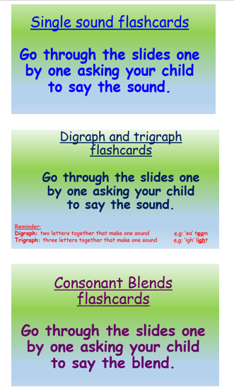
Phonics learning- Week 12
This week we are going to be recapping all of the digraphs, trigraphs and consonant blends that we have been learning throughout our ‘home learning time’ and previously in school.
I have made separate slides for single sounds, digraphs & trigraphs and consonant blends. This will be a great assessment tool to see how well your child has retained the sounds and see which they still need to practise.
Please choose the appropriate sounds to focus on for your child’s phonics ability. ☺

Slide 2
Digraph and trigraph flashcards
Go through the slides one by one asking your child to say the sound.
Reminder:
Digraph: two letters together that make one sound e.g: ‘ea’ team
Trigraph: three letters together that make one sound e.g: ‘igh’ light

Slide 3
ck
‘ck’ as in ‘back’

Slide 4
ff
‘ff’ as in ‘huff’

Slide 5
ll
‘ll’ as in ‘tell’

Slide 6
ss
‘ss’ as in ‘mess’

Slide 7
zz
‘zz’ as in ‘buzz’

Slide 8
ch
‘ch’ as in ‘chin’

Slide 9
sh
‘sh’ as in ‘shed’

Slide 10
th
‘th’ as in ‘thin’

Slide 11
ng
‘ng’ as in ‘strong’

Slide 12
ai
‘ai’ as in ‘sail’

Slide 13
ee
‘ee’ as in ‘tree’

Slide 14
igh
‘igh’ as in ‘night’

Slide 15
oa
‘oa’ as in ‘boat’

Slide 16
oo
‘oo’ as in ‘moon’

Slide 17
oo
‘oo’ as in ‘book’

Slide 18
ar
‘ar’ as in ‘car’

Slide 19
or
‘or’ as in ‘cord’

Slide 20
ow
‘ow’ as in ‘cow’

Slide 21
oi
‘oi’ as in ‘soil’

Slide 22
er
‘er’ as in ‘her’

Slide 23
ay
‘ay’ as in ‘day’

Slide 24
oy
‘oy’ as in ‘toy’

Slide 25
wh
‘wh’ as in ‘white’

Slide 26
ir
‘ir’ as in ‘bird’

Slide 27
ph
‘ph’ as in ‘phone’

Slide 28
ie
‘ie’ as in ‘tie’

Slide 29
ue
‘ue’ as in ‘true’

Slide 30
ew
‘ew’ as in ‘threw’

Slide 31
ea
‘ea’ as in ‘beach’

Slide 32
air
‘air’ as in ‘hair’

Slide 33
are
‘are’ as in ‘care’

Slide 34
nk
‘nk’ as in ‘pink’

Slide 35
ow
‘ow’ as in ‘snow’

Slide 36
aw
‘aw’ as in ‘yawn’

Slide 37
qu
‘qu’ as in ‘queen’

Slide 38
ur
‘ur’ as in ‘turn’

Slide 39
ou
‘ou’ as in ‘shout’

Slide 40
oe
‘oe’ as in ‘toe’

