Slide 1
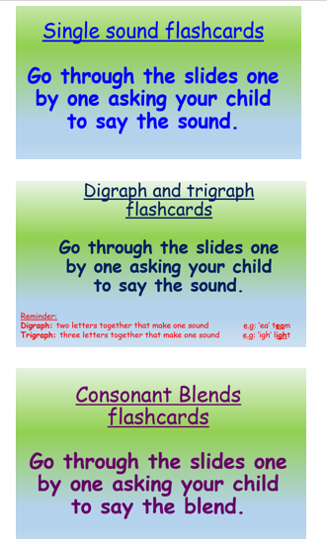
Phonics learning- Week 12
This week we are going to be recapping all of the digraphs, trigraphs and consonant blends that we have been learning throughout our ‘home learning time’ and previously in school.
I have made separate slides for single sounds, digraphs & trigraphs and consonant blends. This will be a great assessment tool to see how well your child has retained the sounds and see which they still need to practise.
Please choose the appropriate sounds to focus on for your child’s phonics ability. ☺

Slide 2
Consonant Blends Flashcards
Go through the slides one by one asking your child to say the blend.

Slide 3
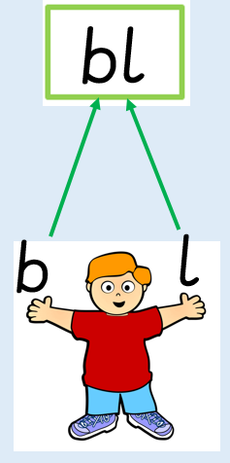
bl
‘black’

Slide 4
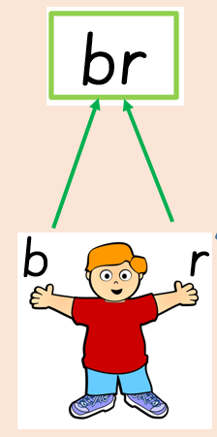
br
‘bright’

Slide 5
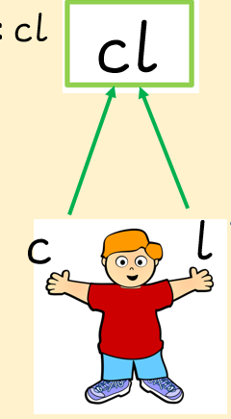
cl
‘clock’

Slide 6
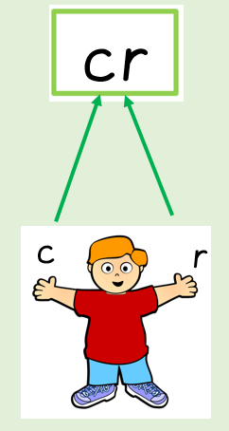
cr
‘crack’

Slide 7
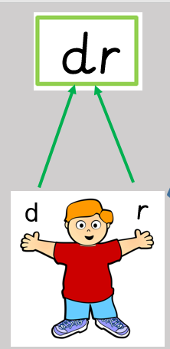
dr
‘drink’

Slide 8
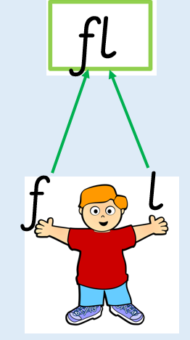
fl
‘flower’

Slide 9
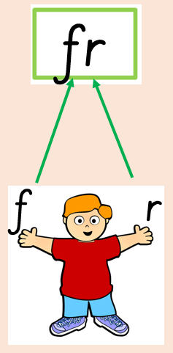
fr
‘fright’

Slide 10
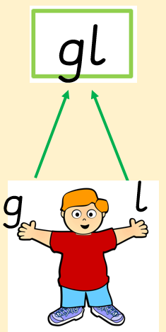
gl
‘glue’

Slide 11
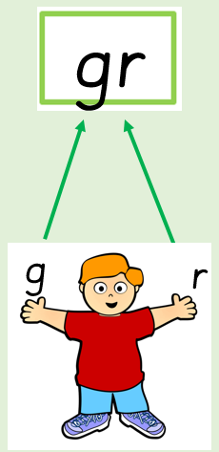
gr
‘grin’

Slide 12

sm
‘small’

Slide 13
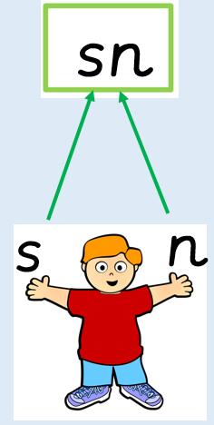
sn
‘snail’

Slide 14
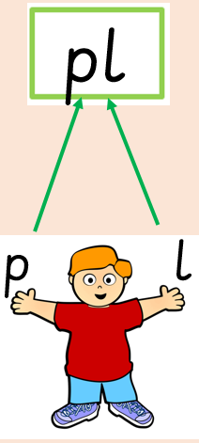
pl
‘plank’

Slide 15
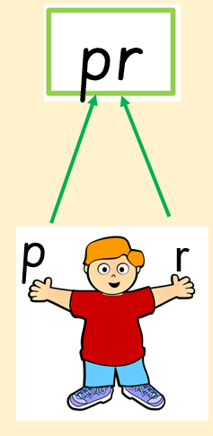
pr
‘pram’

Slide 16
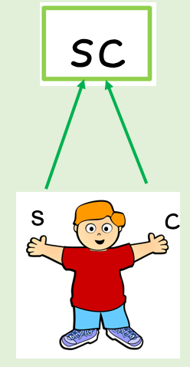
sc
‘scan’

Slide 17
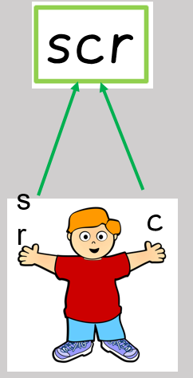
scr
‘screw’

Slide 18
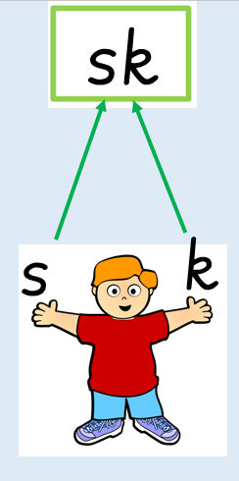
sk
‘skirt’

Slide 19
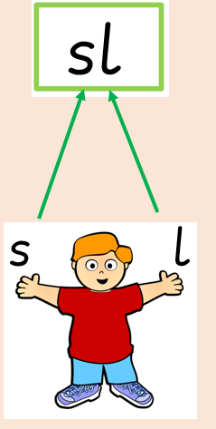
sl
‘slip’

Slide 20
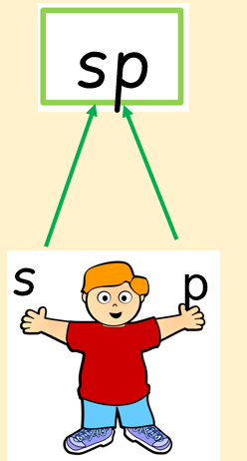
sp
‘spin’

Slide 21
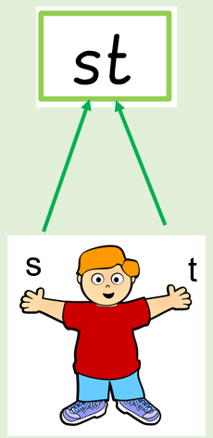
st
‘stand’

Slide 22
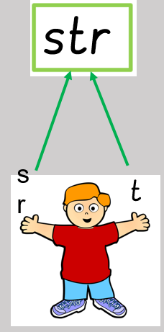
str
‘string’

Slide 23
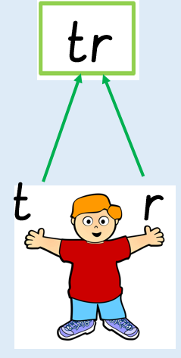
tr
‘truck’

Slide 24

tw
‘twin’

