Slide 1
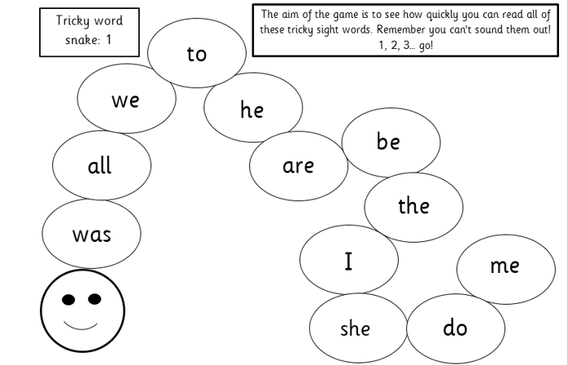
Phonics learning- Week 8
For the next few weeks we are going to be focussing on:
Initial Consonant Blends
(Here is a link to explain/model consonant blends: https://www.youtube.com/watch?v=cS8bvbyWFZ4)
Some parents have mentioned that when reading, their child often finds words such as; ‘green’, ‘tree’, ‘drink’, ‘click’ tricky due to the sounds at the start of the word. They will often find these words hard to spell too, missing out that second sound.
This is due to the fact that the dr in drink is a ‘consonant blend’. Children often sound it out as d-r-i-nk but it then doesn’t sound right when trying to blend the d-r sounds. Instead we practise saying these blends clearly dr for drink.
I have kept the activity ideas on the slide for reading tricky words and we will continue to do dictation sentences for children to practise writing their tricky words.

Slide 2
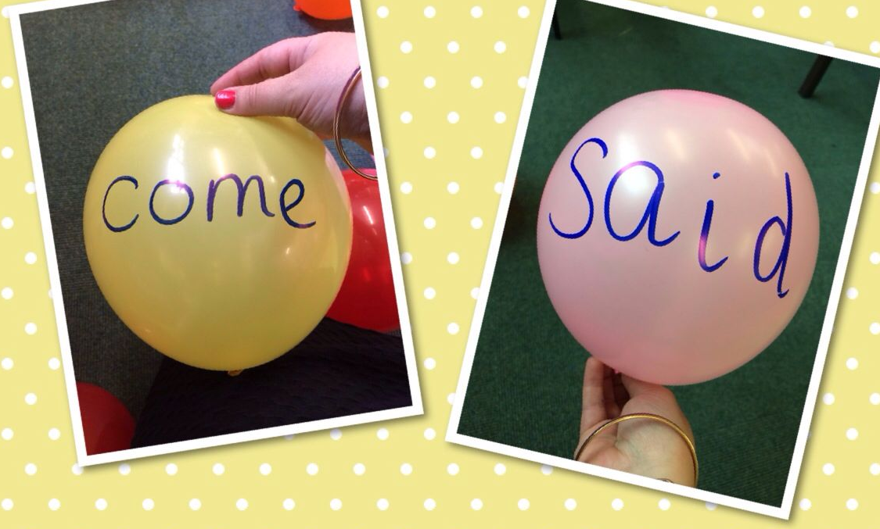
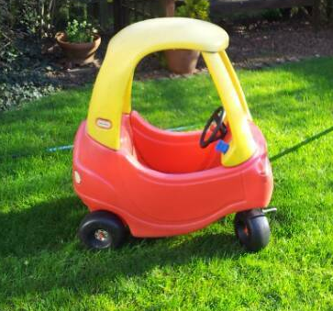
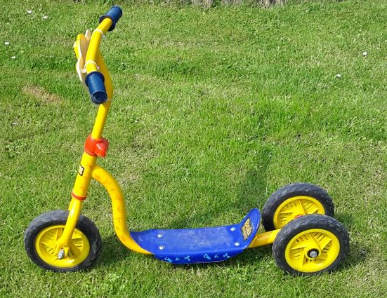
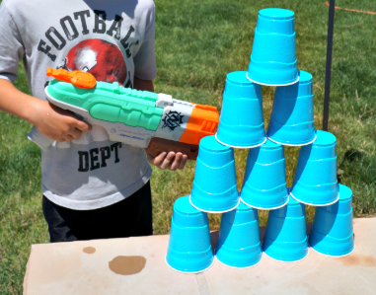
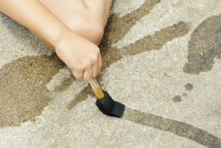
Reading tricky words
Activities to try
There are lots of different ways you can encourage your child to read tricky words. Have a look at the suggested list below and give them a try! ☺
Balloon pop! – Write tricky words on balloons/water balloons and your child has to read the word before they are allowed to pop it.
Traffic light game– Allow your child to ride around the garden pretending it’s a road. Adult shout traffic light signals such as STOP! They must then read a tricky word to be able to go again. You could position tricky words around the garden so they have to read each word before they pass.
Write tricky words on the patio slabs or fence in chalk for your child to read. When they read a word correctly they can either squirt a water pistol at the words, throw a water balloon or use a paintbrush with water to remove. You could also write tricky words on plastic cups and do the same activity.

Slide 3
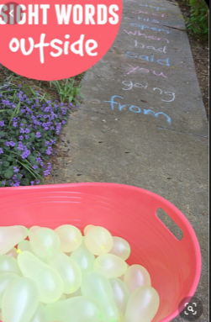
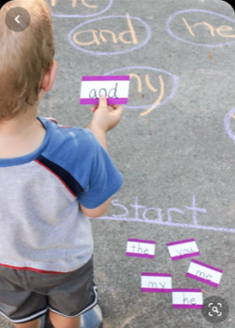
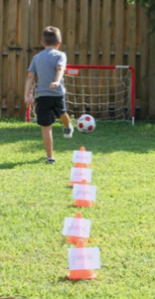
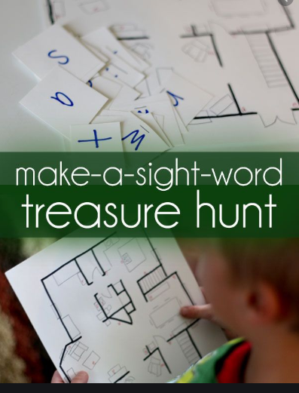
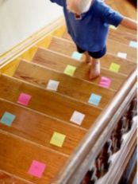
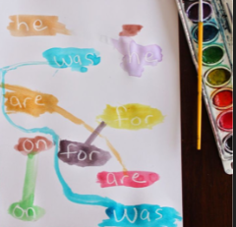
Reading tricky words activities to try
Here are lots more examples you could try (especially if the weather is nice!) ☺
Using water balloons to throw at each tricky word.
Please be careful with this one- look where you’re going when walking up and down the stairs! ☺ ☺
Use a white wax crayon or candle to write ‘secret tricky words’ for your child to paint/find. Use watered down paint! ☺
Your child must dribble around the cones, reading each tricky word as they go before scoring! ☺

Slide 4
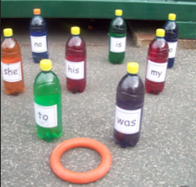
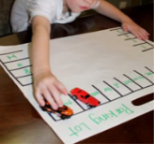
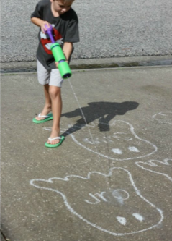
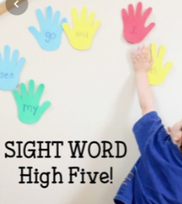
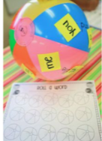
Reading tricky words activities to try
Here are lots more examples you could try (especially if the weather is nice!) ☺
You could do this with reading tricky words and/or phonics sounds! ☺
Tricky word skittles game! ☺

Slide 5
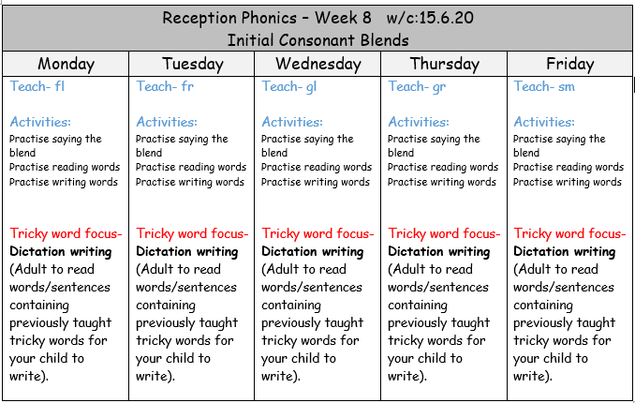

Slide 6
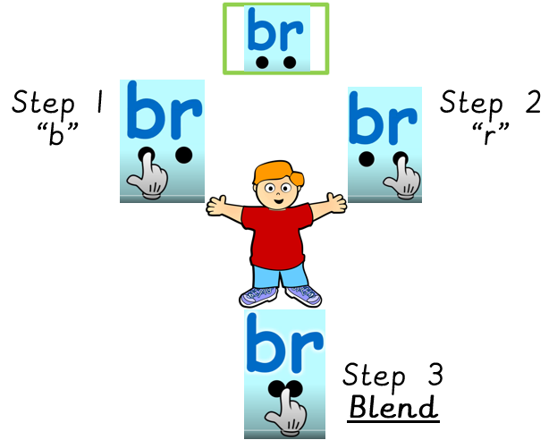
Familiarise yourself with what a consonant blend is … https://www.youtube.com/watch?v=cS8bvbyWFZ4
The next slides will give the children opportunity to practise:
Saying each ‘blend’ correctly
Reading words containing consonant blends
Writing words containing consonant blends

Slide 7


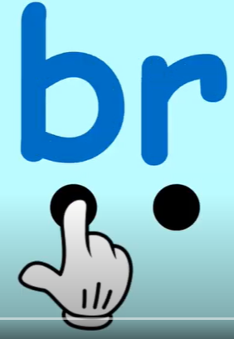
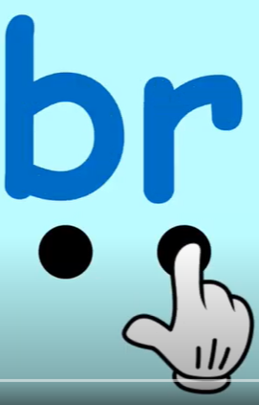
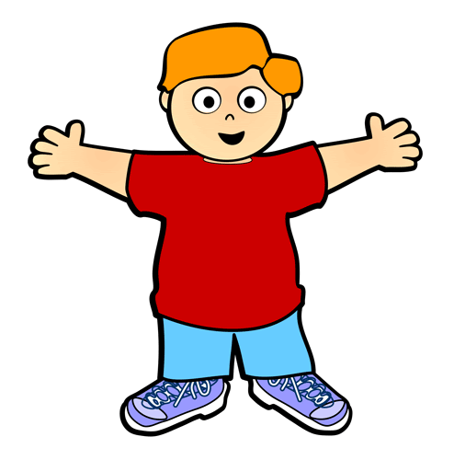

Example:
Step 1
“b”
Step 2
“r”
anch
Step 3
Blend

Slide 8
Monday: fl
fl
Begin by practising saying the separate letters slowly f/l, f/l. Then increase the speed until you are saying ‘fl’ together quickly.
f
l

Slide 9
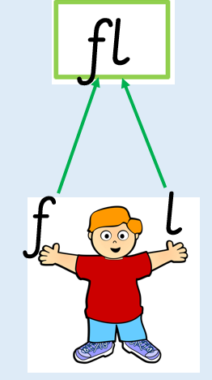
Monday- practise reading these words
float
flight
flower
flag
flew
flash

Slide 10
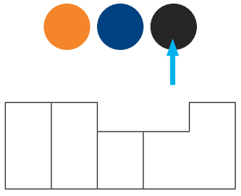
Monday- practise writing these words…
Adult to read out these words one at a time for children to practise writing.
If they are finding it tricky, phoneme frames are an excellent tool to help with this (as demonstrated below)..
flight
fly
flag
float
b
l
a
c
k
flash
flower
* Phoneme frames have been uploaded into the phonics useful resources folder. *
flew
flap

Slide 11
Monday- Tricky word dictation
The adult will read the following sentences out slowly for the child to hear, remember and write.
Remind them to think about how the tricky word is spelt. Remember it’s a tricky word so you can’t use your phonics sounds to sound it out.
Once they have finished, look at your child’s work with them and praise them for their efforts! (This is not a test!)
If they have spelt the tricky word incorrectly – refer back to the tricky word snake to check how it is spelt – by encouraging your child to do this should mean they are more likely to remember the correct spelling next time. ☺

Slide 12
Monday- Tricky word dictation
* Tricky words are in bold to check afterwards *
Adult read out the following sentences for your child to write:
She said no so I went on my own.
I want to go to the beach.

Slide 13
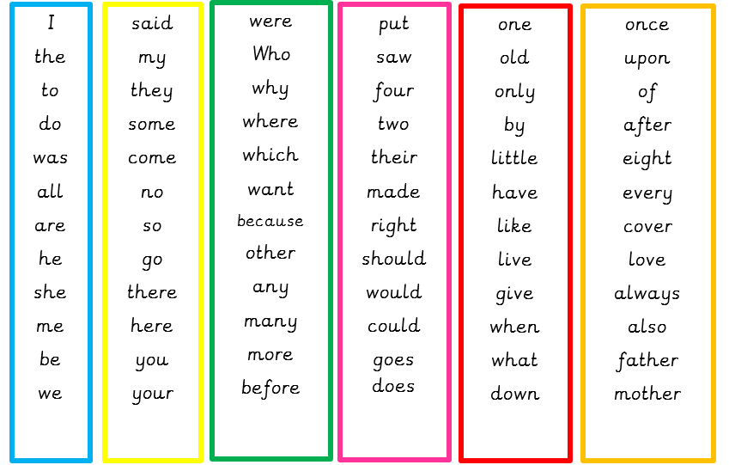
Tricky word list – If you want to challenge your child you can choose other tricky words. Try making up your own sentences for them to write. ☺

Slide 14
Tuesday: fr
fr
Begin by practising saying the separate letters slowly f/r, f/r. Then increase the speed until you are saying ‘fr’ together quickly.
f
r

Slide 15
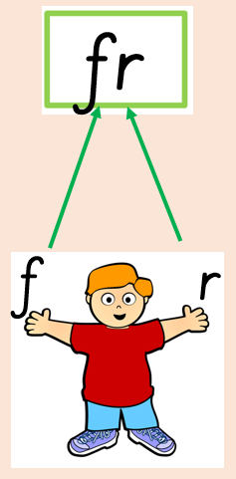
Tuesday: practise reading these words
frown
frog
fright
free
fresh
frost

Slide 16
Tuesday- practise writing these words…
Adult to read out these words one at a time for children to practise writing.
If they are finding it tricky, phoneme frames are an excellent tool to help with this (find them in the useful resources folder).
fry
frog
fright
free
fresh
frost
frown

Slide 17
Tuesday- Tricky word dictation
* Tricky words are in bold to check afterwards *
Adult read out the following sentences for your child to write:
He did not want to help me.
There are lots of birds in the sky today.

Slide 18
Tricky word list – If you want to challenge your child you can choose other tricky words. Try making up your own sentences for them to write. ☺

Slide 19
Wednesday: gl
gl
Begin by practising saying the separate letters slowly g/l, g/l. Then increase the speed until you are saying ‘gl’ together quickly.
g
l

Slide 20
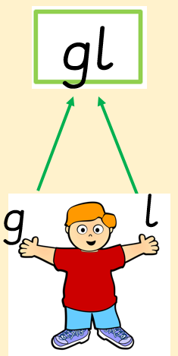
Wednesday: practise reading these words
glue
glad
glow
glitter
gloom
glass

Slide 21
Wednesday- practise writing these words…
Adult to read out these words one at a time for children to practise writing.
If they are finding it tricky, phoneme frames are an excellent tool to help with this (find them in the useful resources folder).
glue
glad
glow
glass
gloom
glitter

Slide 22
Wednesday- Tricky word dictation
* Tricky words are in bold to check afterwards *
Adult read out the following sentences for your child to write:
I love it here.
I love my mum because she gives me hugs.

Slide 23
Tricky word list – If you want to challenge your child you can choose other tricky words. Try making up your own sentences for them to write. ☺

Slide 24
Thursday: gr
gr
Begin by practising saying the separate letters slowly g/r, g/r. Then increase the speed until you are saying ‘gr’ together quickly.
g
r

Slide 25
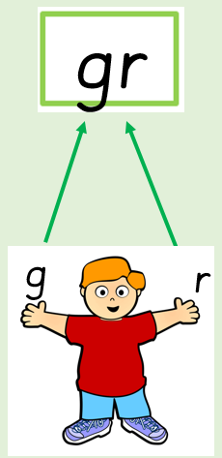
Thursday: practise reading these words
grab
ground
grill
green
grin
graph

Slide 26
Thursday- practise writing these words…
Adult to read out these words one at a time for children to practise writing.
If they are finding it tricky, phoneme frames are an excellent tool to help with this (find them in the useful resources folder).
grab
grow
green
graph
grin
ground
grill
playground

Slide 27
Thursday- Tricky word dictation
* Tricky words are in bold to check afterwards *
Adult read out the following sentences for your child to write:
Who is your best friend?
Why do you like them?

Slide 28
Tricky word list – If you want to challenge your child you can choose other tricky words. Try making up your own sentences for them to write. ☺

Slide 29
Friday: sm
sm
Begin by practising saying the separate letters slowly s/m, s/m. Then increase the speed until you are saying ‘sm’ together quickly.
s
m

Slide 30
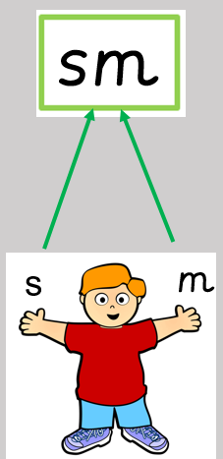
Friday: practise reading these words
smile
smart
smell
smash
small
smooth

Slide 31
Friday- practise writing these words…
Adult to read out these words one at a time for children to practise writing.
If they are finding it tricky, phoneme frames are an excellent tool to help with this (find them in the useful resources folder).
smart
smile
These words contain split digraphs which your child will not have covered yet in Reception. They will learn about these in Year 1 so do not worry if they are not sure about the i-e and o-e split digraphs.
smell
smoke
small
smirk
smash
smooth

Slide 32
Friday- Tricky word dictation
* Tricky words are in bold to check afterwards *
Adult read out the following sentences for your child to write:
Where are you going?
Which way is best?
I think we need to go the other way.

Slide 33
Tricky word list – If you want to challenge your child you can choose other tricky words. Try making up your own sentences for them to write. ☺

