Slide 1
Tricky word snakes
Work through reading each word on these tricky word snakes. Make it into a game so that it is FUN! ☺
See if they can beat their score when they try it again the following day!
When they are secure with all of the words, move onto the next snake. You can write any ‘difficult’ words on a post it note to stick up around the house to help ☺

Slide 2
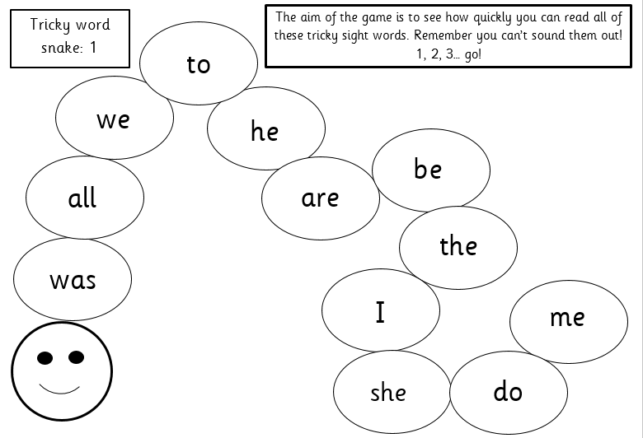

Slide 3
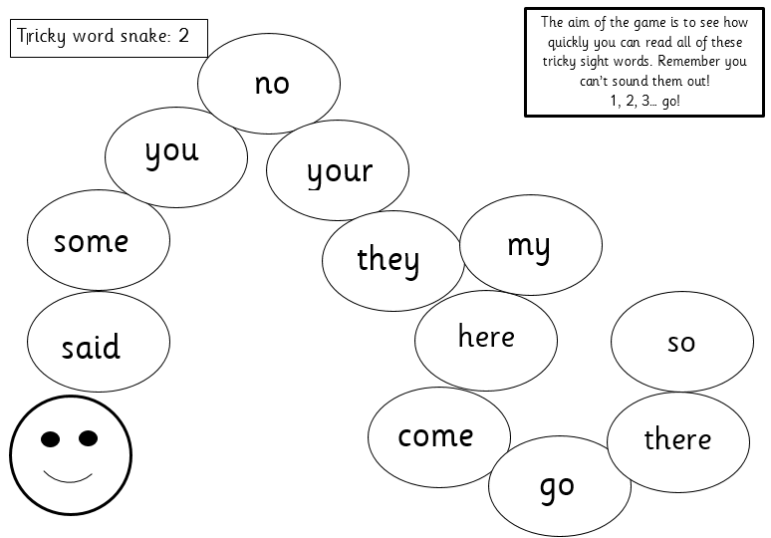

Slide 4
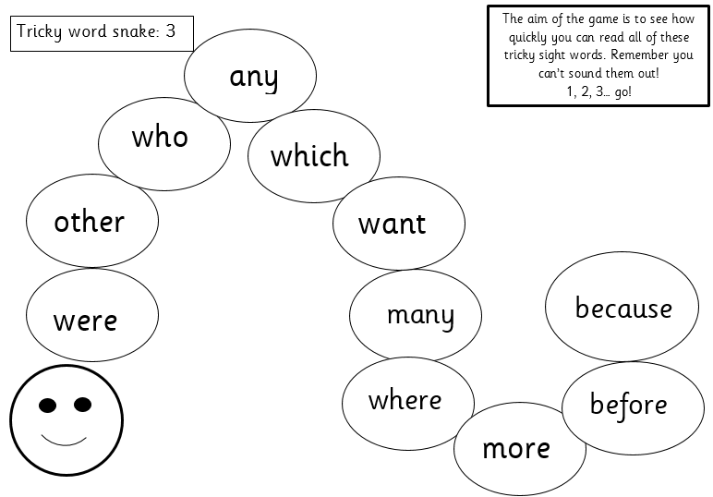

Slide 5
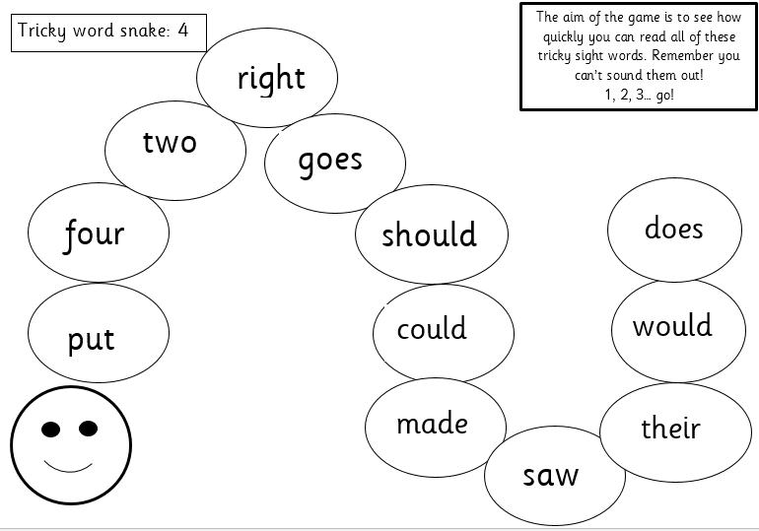

Slide 6
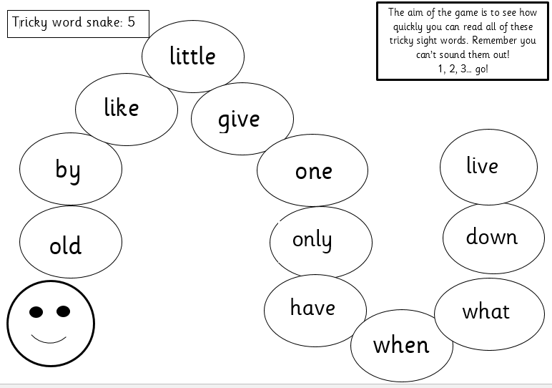

Slide 7


