Slide 1
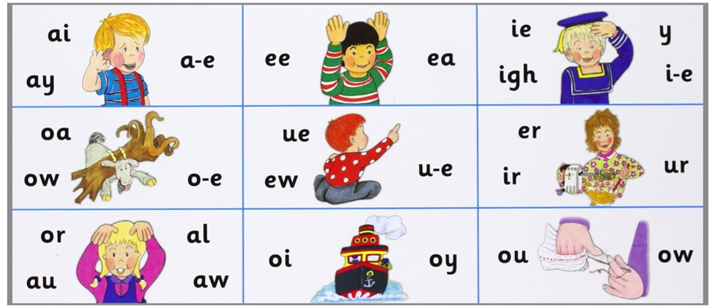

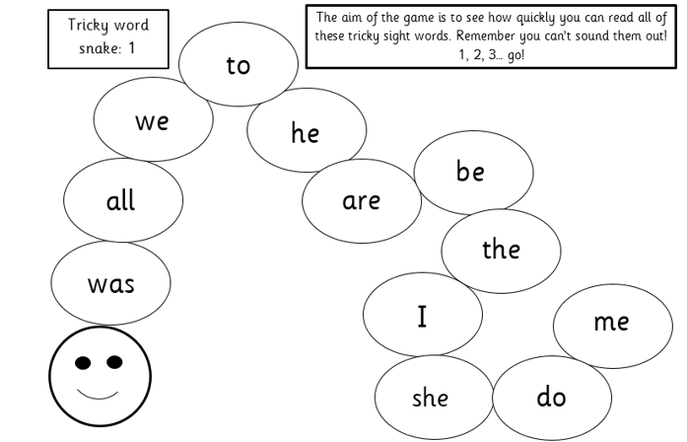
Phonics learning
Your child will learn a new sound each day. Work through the slides and use the resources to:
find the sound (sound mat)
do the action (action sheet)
read the sound (reading ladders)
write the sound (picture slides)
There are also 2 tricky words to read each week. Read them at the beginning of each session. You could put them around the house to practise through the day and look for them in reading.
Have a go with a tricky word snake each day too. How many words can they read in one minute? Stick to the same snake until they can complete it in a minute

Slide 2
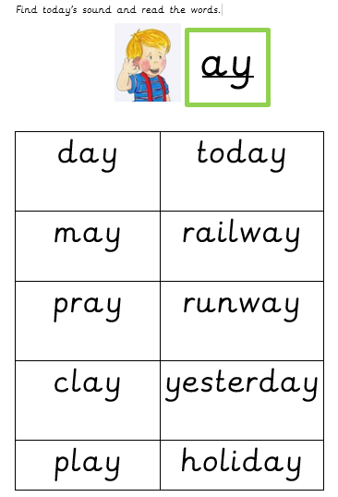
Phonics reading ladders
Encourage your child to segment (sound out) and blend each of these words on the appropriate reading ladder for each day.

Slide 3
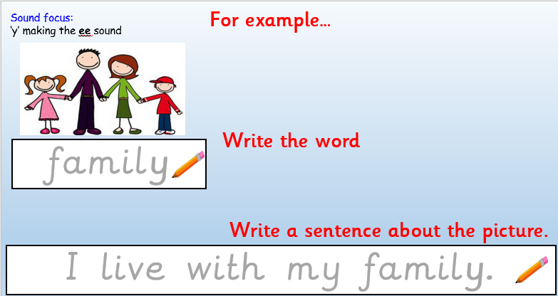
Applying to writing
Say what’s in the picture
Write the word
Write a sentence about the picture
Can you think of anymore words that contain these sounds?

Slide 4
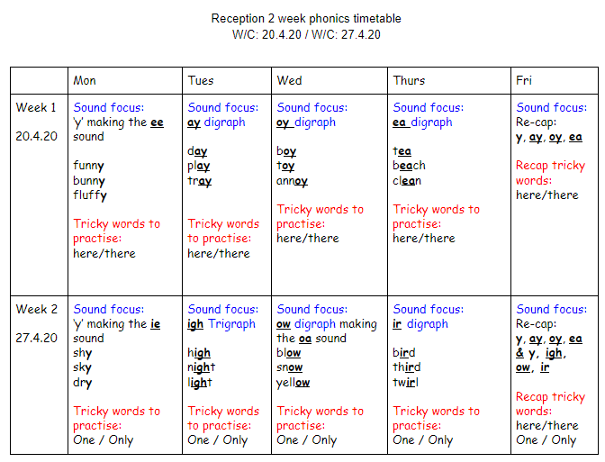

Slide 5
Week 1 w/c:20.4.20

Slide 6
Week 1
New ‘tricky words’ to learn:

Slide 7
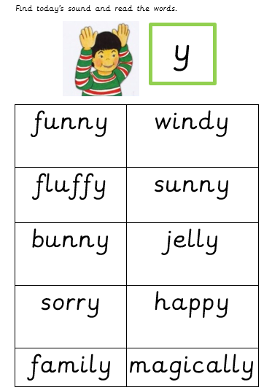
This is y, as in bunny (ee)
Find today’s sound on the sound mat and do the action!

Slide 9

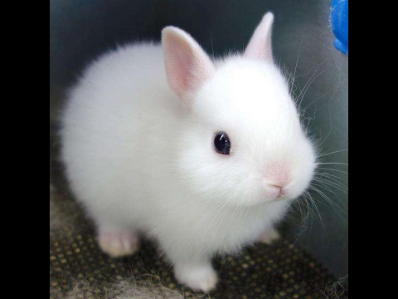
Sound focus:
‘y’ making the ee sound

Slide 10
Week 1
New ‘tricky words’ to learn:

Slide 11
This is ay, as in play
Find today’s sound on the sound mat and do the action!

Slide 13
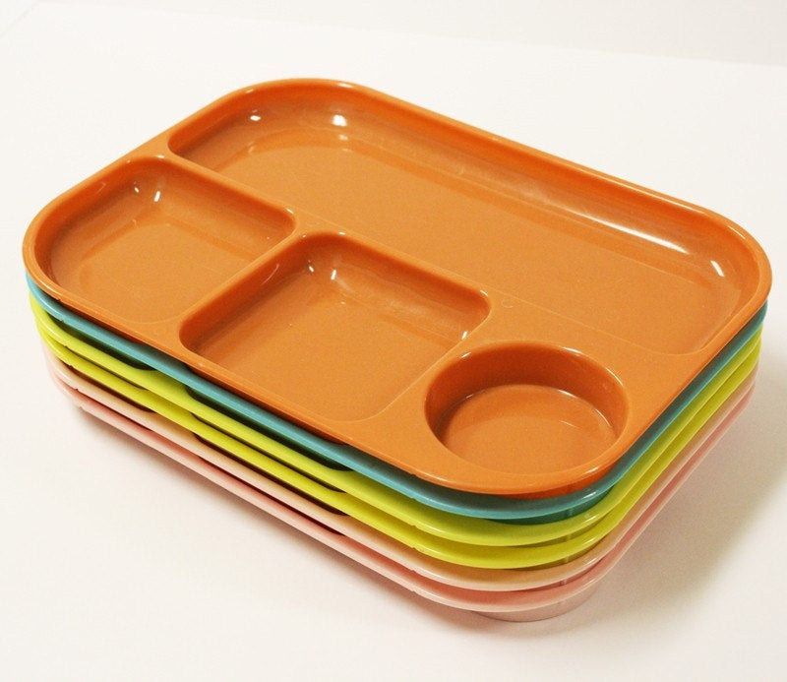

Sound focus: ay
I went on .

Slide 14
Week 1
New ‘tricky words’ to learn:

Slide 15
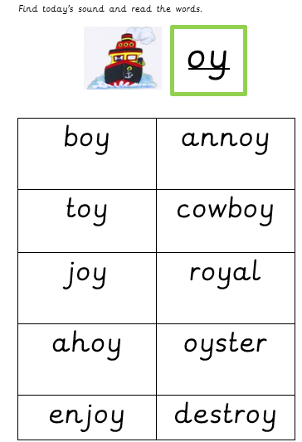
This is oy, as in boy
Find today’s sound on the sound mat and do the action!

Slide 17


Sound focus: oy
He has lots of .

Slide 18
Week 1
New ‘tricky words’ to learn:

Slide 19
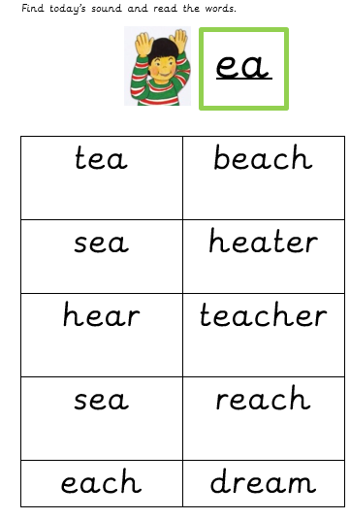
This is ea, as in tea
Find today’s sound on the sound mat and do the action!

Slide 21


Sound focus: ea
I built sandcastles on the .
A cup of .

Slide 22


Sound focus: ea
This is my .

Slide 23
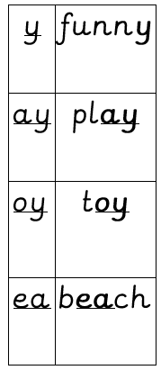
Recap: Week 1
Week 1 tricky words:
Suggested activities:
Read the word ladders again.
How many times can you find the sounds in a book?
Can you make nonsense words with these sounds?
Make some word cards with the reading ladder words and play pairs or snap with the sounds.

Slide 24
Week 2 w/c:27.4.20

Slide 25

Week 2
New ‘tricky words’ to learn:

Slide 26
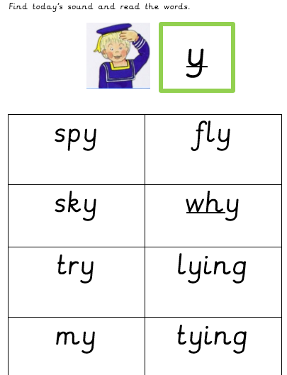
This is y, as in sky (ie)
Find today’s sound on the sound mat and do the action!

Slide 28


Sound focus: ‘y’ making the ie sound
There is a bird in the .

Slide 29
Week 2
New ‘tricky words’ to learn:

Slide 30
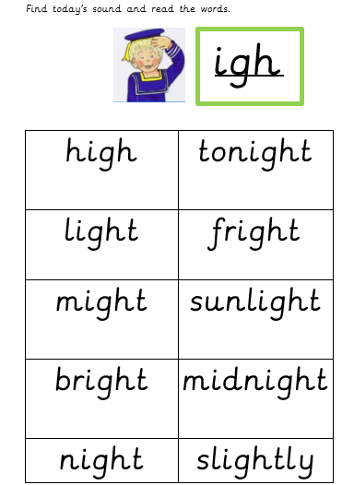
This is igh, as in night
Find today’s sound on the sound mat and do the action!

Slide 32

Sound focus: igh
This is Miss .
The is very !

Slide 33
Week 2
New ‘tricky words’ to learn:

Slide 34
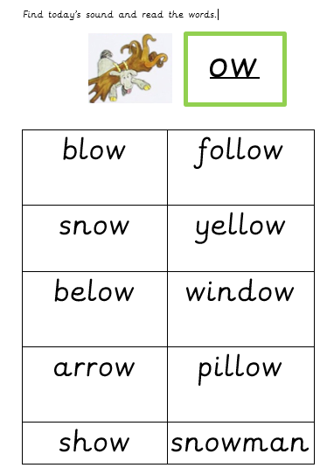
This is ow, as in blow
Find today’s sound on the sound mat and do the action!

Slide 36

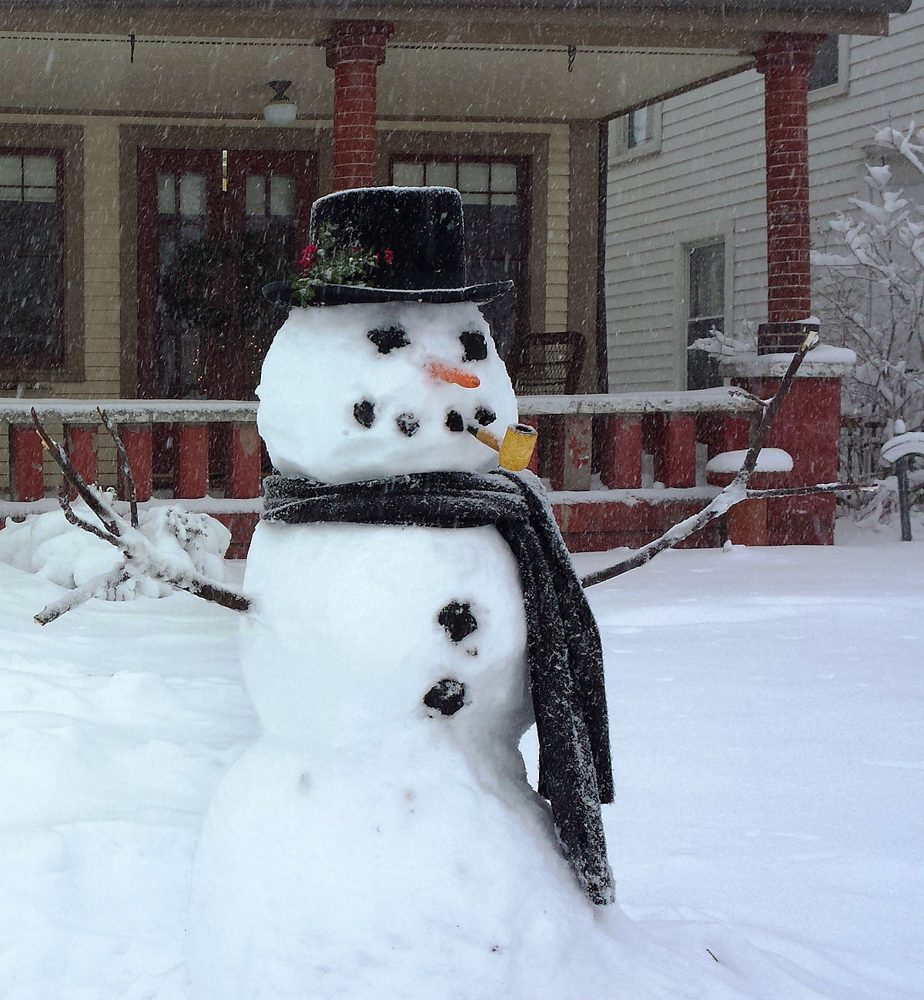
Sound focus: ow (making the oa sound)
I looked out of my
and saw …

Slide 37
Week 2
New ‘tricky words’ to learn:

Slide 38
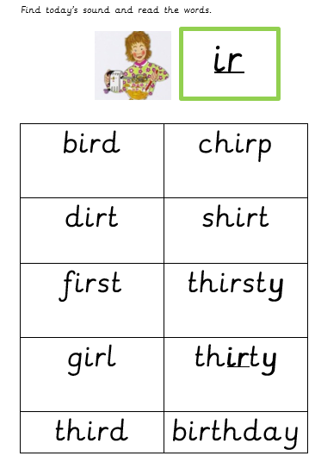
This is ir, as in bird
Find today’s sound on the sound mat and do the action!

Slide 40


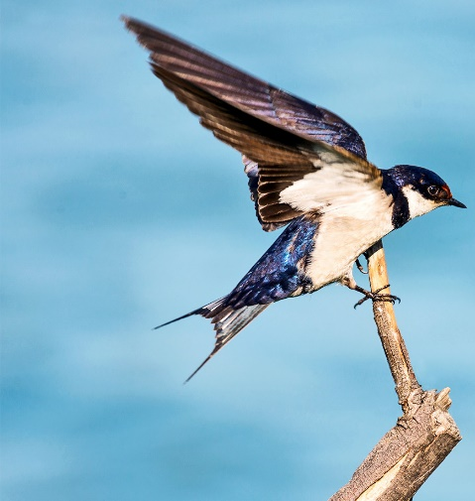
Sound focus: ir
I came in the race.

Slide 41
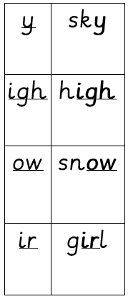
Recap: Week 2
Week 2 tricky words:
Suggested activities:
Read the word ladders again.
How many times can you find the sounds in a book?
Can you make nonsense words with these sounds?
Make some word cards with the reading ladder words and play pairs or snap with the sounds.

