Slide 1
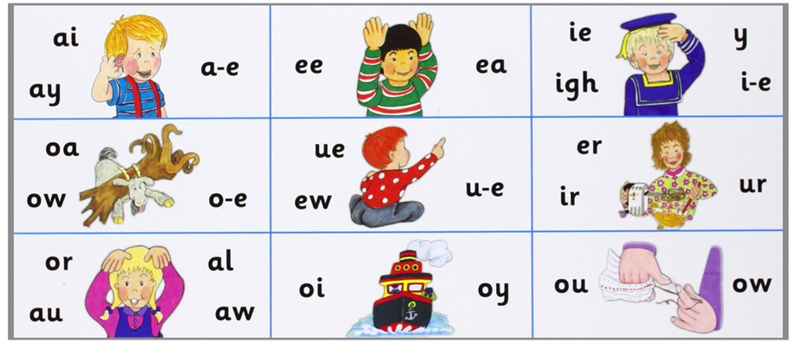

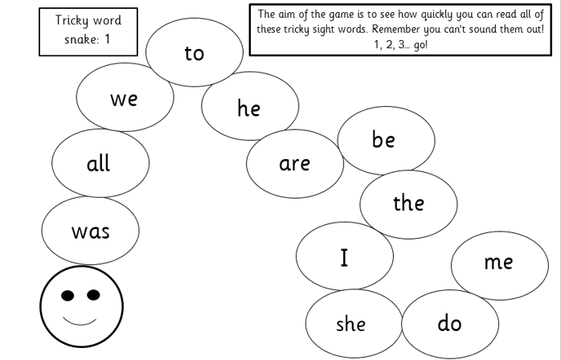
Phonics learning
Your child will learn a new sound each day. Work through the slides and use the resources to:
find the sound (sound mat)
do the action (action sheet)
read the sound (reading ladders)
write the sound (picture slides)
There are also 2 tricky words to read each week. Read them at the beginning of each session. You could put them around the house to practise through the day and look for them in reading.
Have a go with a tricky word snake each day too. How many words can they read in one minute? Stick to the same snake until they can complete it in a minute

Slide 2
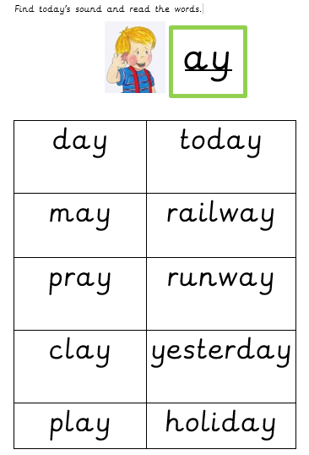
Phonics reading ladders
Encourage your child to segment (sound out) and blend each of these words on the appropriate reading ladder for each day.

Slide 3
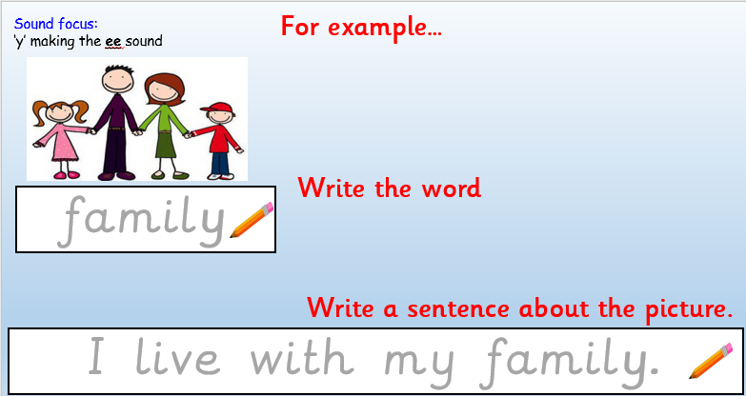
Applying to writing
Say what’s in the picture
Write the word
Write a sentence about the picture
Can you think of anymore words that contain these sounds?

Slide 4
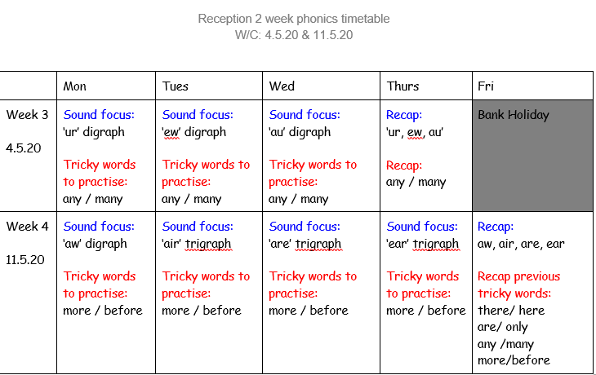

Slide 5
Week 3 w/c: 4.5.20

Slide 6

Week 3
New ‘tricky words’ to learn:
any
many

Slide 7
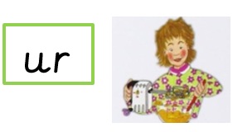
This is ur, as in turn
Find today’s sound on the sound mat and do the action!

Slide 8
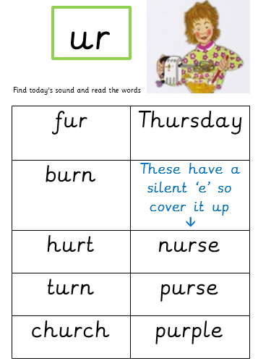

Slide 9


Sound focus:
‘ur’
He has himself.

Slide 10
Week 3
New ‘tricky words’ to learn:
any
many

Slide 11

This is ew, as in chew
Find today’s sound on the sound mat and do the action!

Slide 12
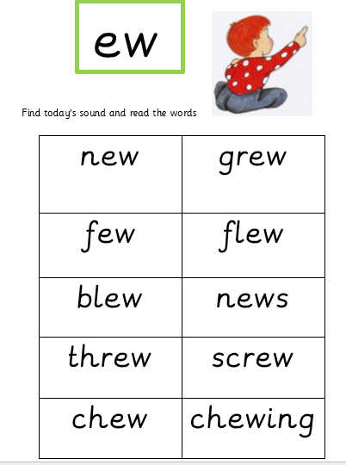

Slide 13


Sound focus: ew
You must the .

Slide 14
Week 3
New ‘tricky words’ to learn:
any
many

Slide 15


This is au, as in Paul
(sounds like or)
Find today’s sound on the sound mat and do the action!

Slide 16
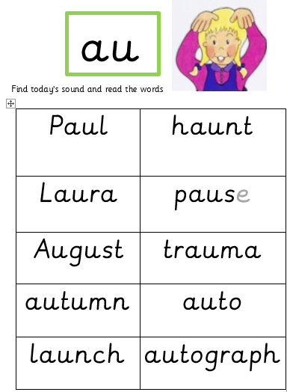

Slide 17

Sound focus: au
The Rocket was about to into space!

Slide 18
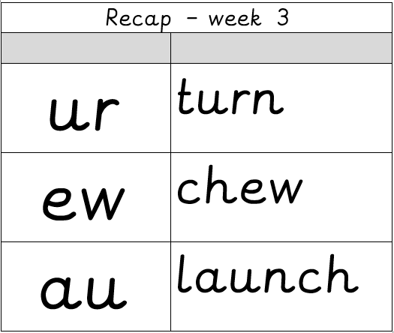


Recap: Week 3
Week 3 tricky words:
Suggested activities:
Read the word ladders again.
How many times can you find the sounds in a book?
Can you make nonsense words with these sounds?
Make some word cards with the reading ladder words and play pairs or snap with the sounds.

Slide 19
Week 4 w/c: 11.5.20

Slide 20

Week 4
New ‘tricky words’ to learn:
more
before

Slide 21

This is aw, as in lawn
(sounds like or)
Find today’s sound on the sound mat and do the action!

Slide 22
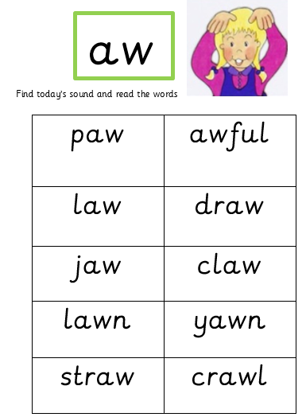

Slide 23

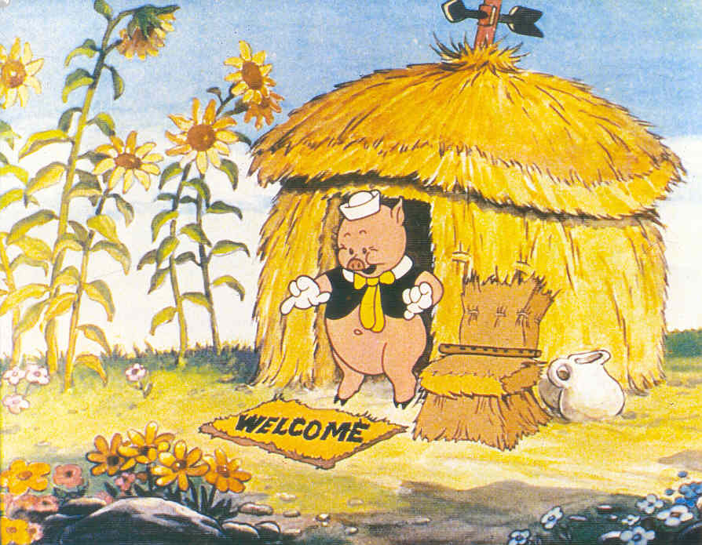
Sound focus: ‘aw’
This house is made out of .

Slide 24
The next three sessions are looking at the alternative sounds for: air, are & ear
We explain that they sound the same as one another but are written differently to spell different words.

Slide 25

air
This is air, as in hair

Slide 26
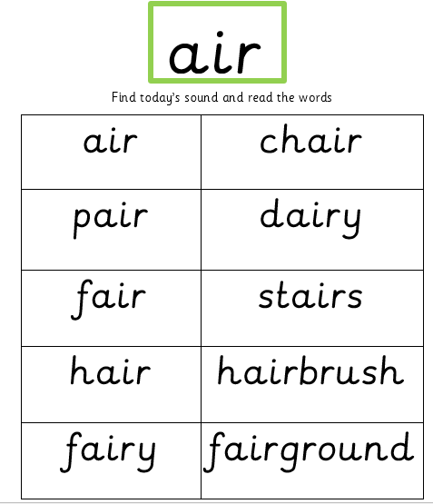

Slide 27
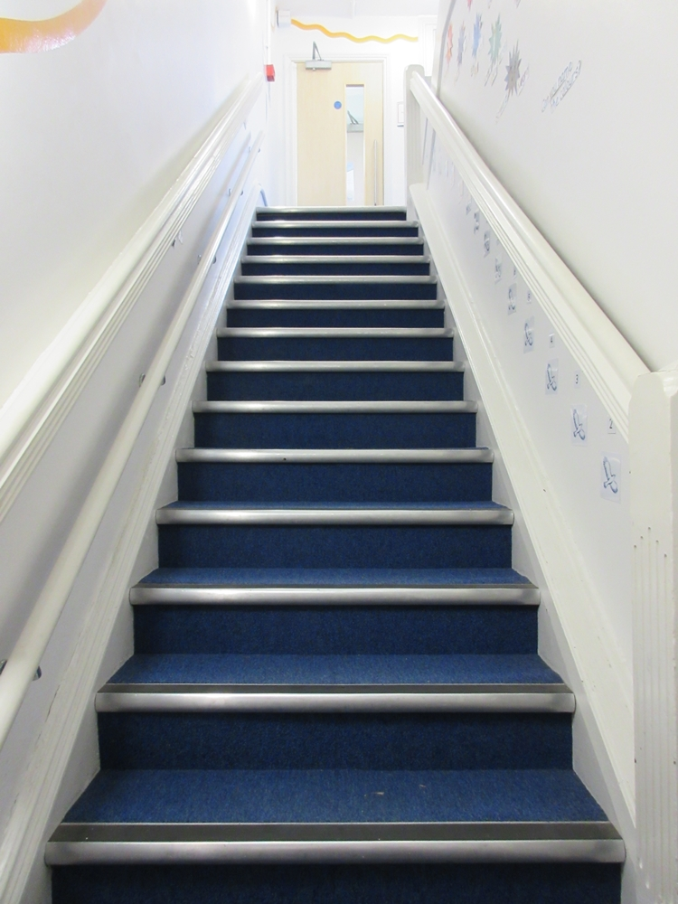

Sound focus: air
I like your .
.

Slide 28
Week 4
New ‘tricky words’ to learn:
more
before

Slide 29
are
This is ‘are’ as in care

Slide 30
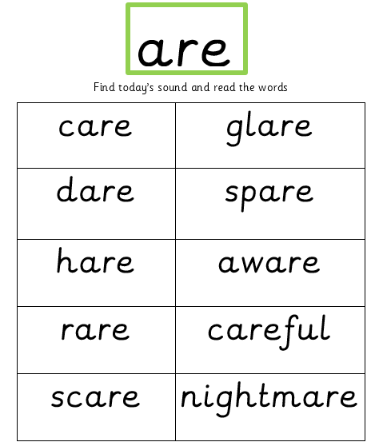

Slide 31
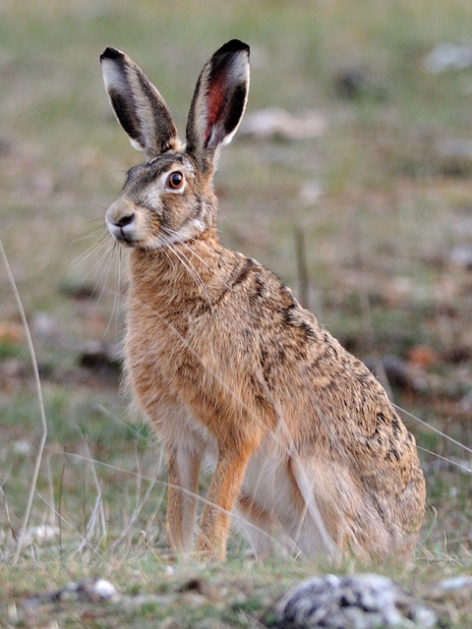
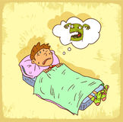
Sound focus: are (care)
v
v
I woke up crying because I had a .
v

Slide 32
Week 4
New ‘tricky words’ to learn:
more
before

Slide 33
ear
This is ‘ear’ as in pear

Slide 34
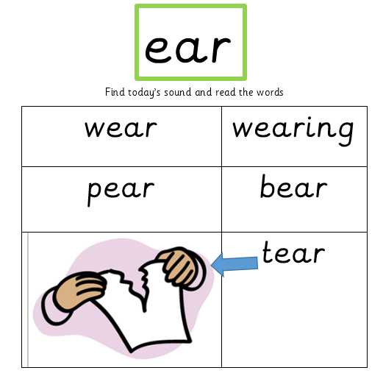

Slide 35
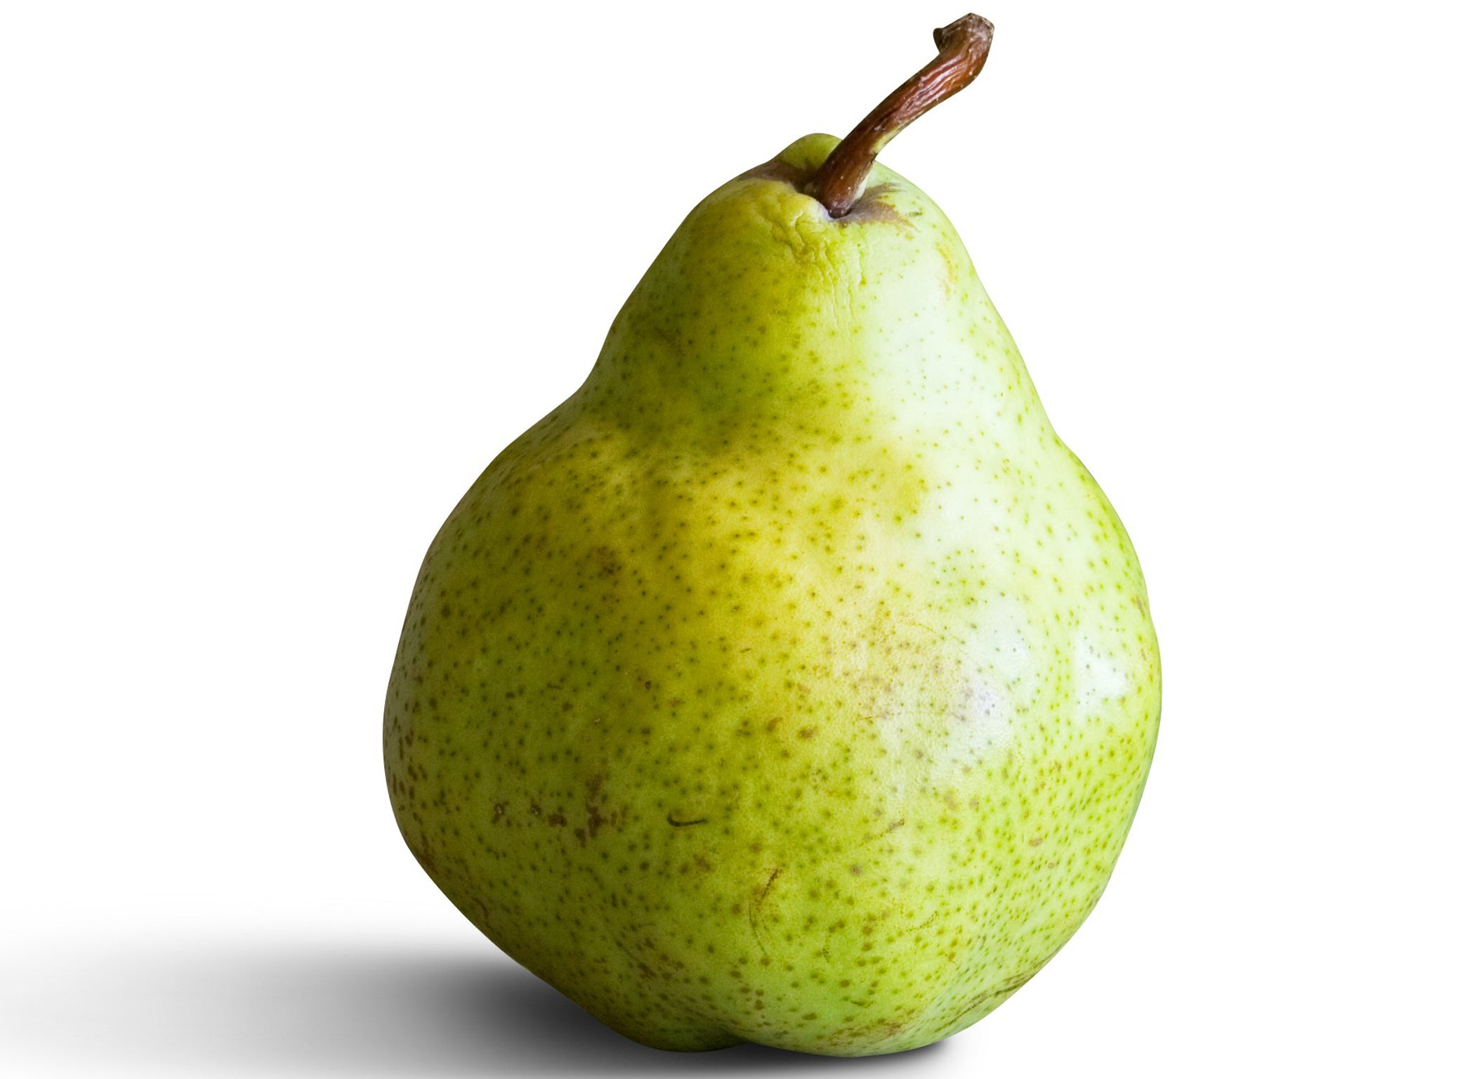
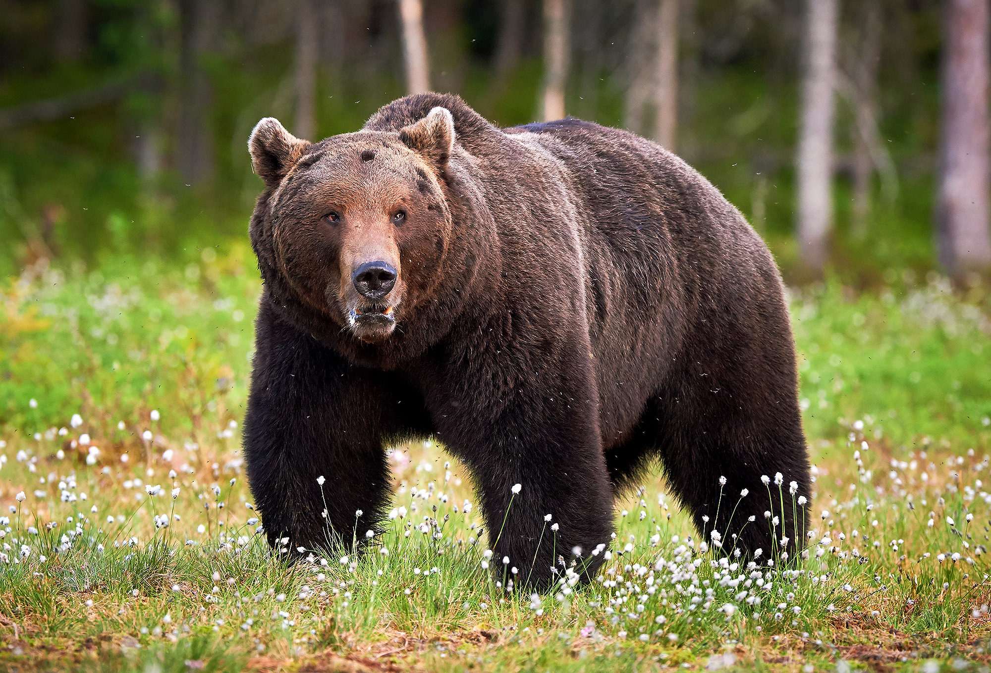

Sound focus: ear (bear)
v
v
v
v

Slide 36


Recap: Week 4
Week 4 tricky words:
Suggested activities:
Read the word ladders again.
How many times can you find the sounds in a book?
Can you make nonsense words with these sounds?
Make some word cards with the reading ladder words and play pairs or snap with the sounds.
aw air
are
ear

Slide 37

RECAP: previously taught tricky words
You could turn this into a game by writing these tricky words onto paper… You could write each word twice and play snap!

