Slide 1

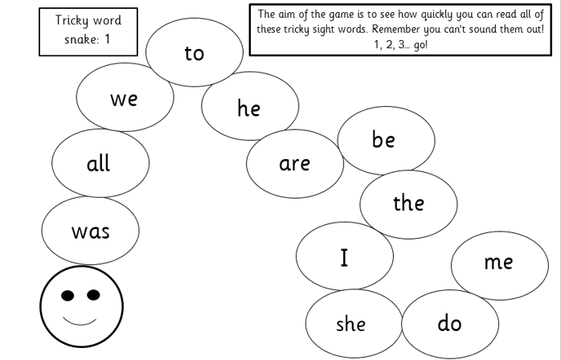
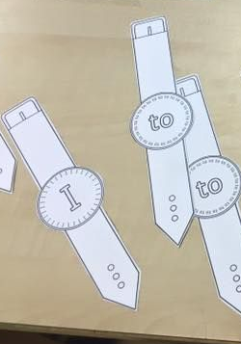
Phonics learning- Week 6
This week we will be recapping previously taught trigraphs.
We will be practising writing tricky words this week as feedback from parent’s informs us that the children are doing really well at reading them.
Please continue to encourage your child to practise reading the tricky words on their snakes. Don’t forget to move onto the next snake when they have completed the majority of the previously snake.
Any words that they are really finding difficult could be stuck up around the house/garden for your child to constantly see and/or make a pretend paper watch that they can wear on their arm. Throughout the day prompt them to read their focus tricky word ☺

Slide 2
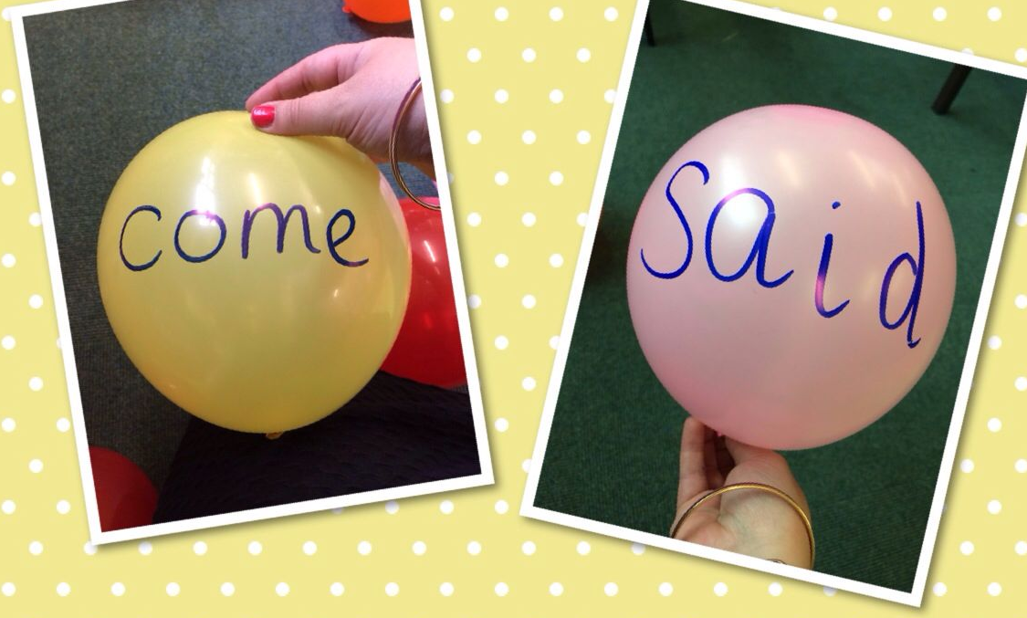
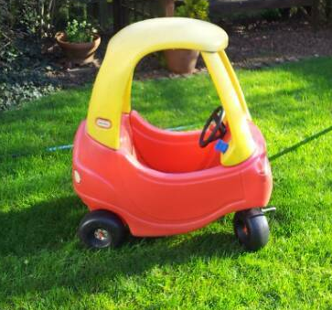
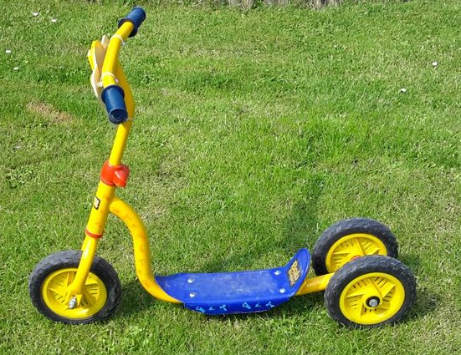
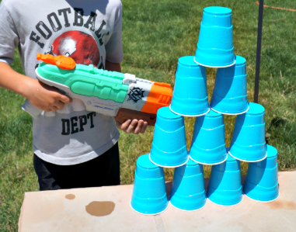
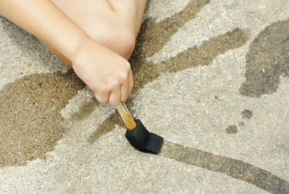
Reading tricky words
Activities to try
There are lots of different ways you can encourage your child to read tricky words. Have a look at the suggested list below and give them a try! ☺
Balloon pop! – Write tricky words on balloons/water balloons and your child has to read the word before they are allowed to pop it.
Traffic light game– Allow your child to ride around the garden pretending it’s a road. Adult shout traffic light signals such as STOP! They must then read a tricky word to be able to go again. You could position tricky words around the garden so they have to read each word before they pass.
Write tricky words on the patio slabs or fence in chalk for your child to read. When they read a word correctly they can either squirt a water pistol at the words, throw a water balloon or use a paintbrush with water to remove. You could also write tricky words on plastic cups and do the same activity.

Slide 3
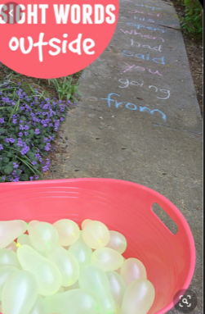
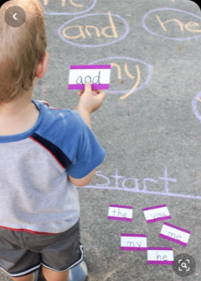
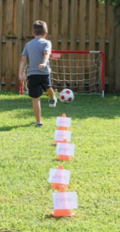
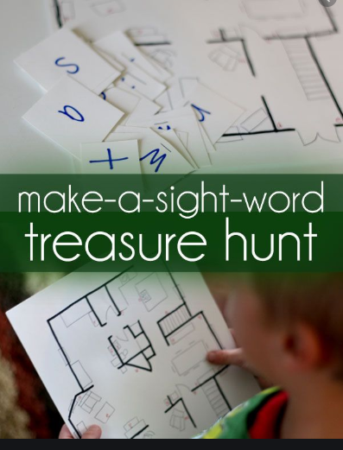
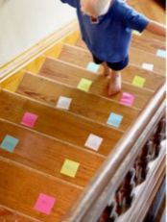
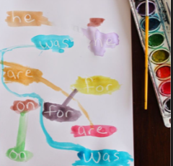
Reading tricky words activities to try
Here are lots more examples you could try (especially if the weather is nice!) ☺
Using water balloons to throw at each tricky word.
Please be careful with this one- look where you’re going when walking up and down the stairs! ☺ ☺
Use a white wax crayon or candle to write ‘secret tricky words’ for your child to paint/find. Use watered down paint! ☺
Your child must dribble around the cones, reading each tricky word as they go before scoring! ☺

Slide 4
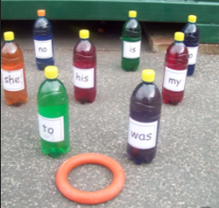
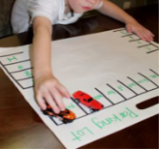
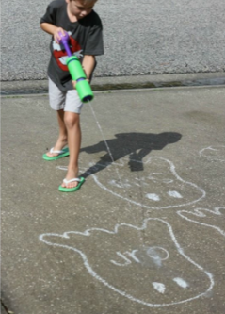
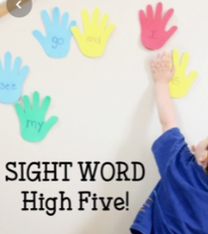
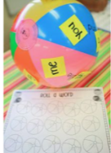
Reading tricky words activities to try
Here are lots more examples you could try (especially if the weather is nice!) ☺
You could do this with reading tricky words and/or phonics sounds! ☺
Tricky word skittles game! ☺

Slide 5
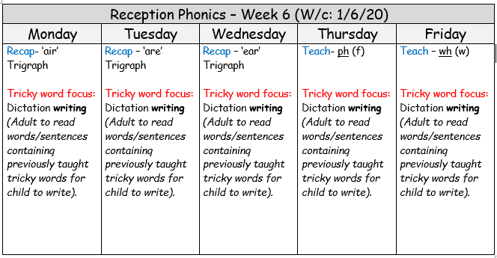
* Following parent’s feedback, we will start this week recapping the three trigraphs (air, are, ear) as they are more complex *

Slide 6
Week 6 w/c: 1.6.20

Slide 7
The next three sessions are looking at the alternative sounds for: air, are & ear
We explain that they sound the same as one another but are written differently to spell different words.

Slide 8

Monday
air
This is air, as in hair

Slide 9
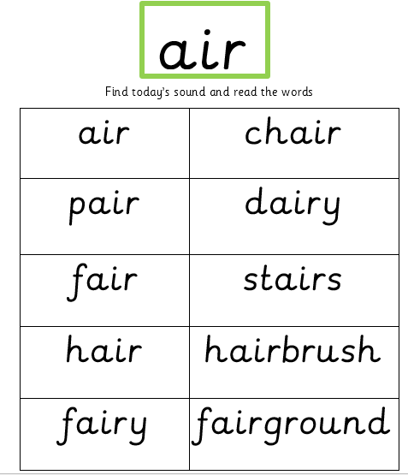
Monday

Slide 10
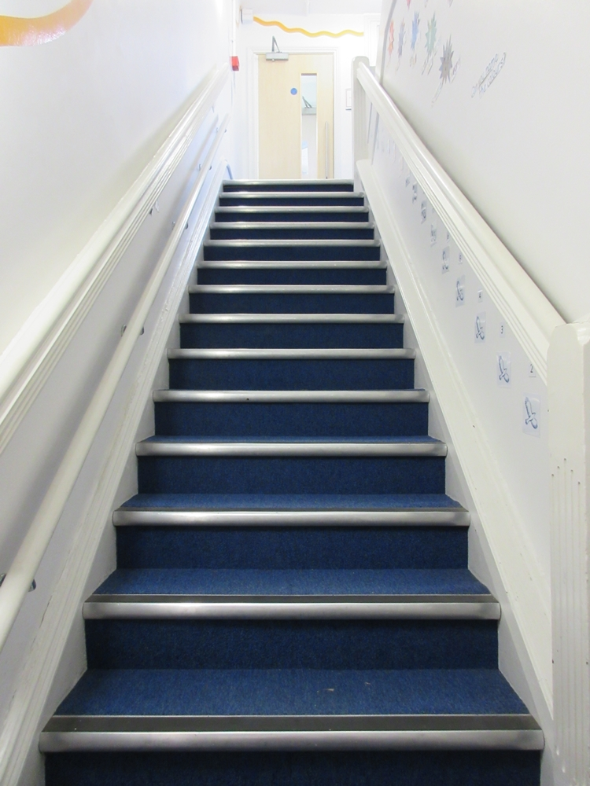
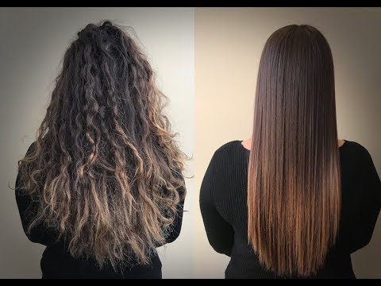
Monday
Sound focus: air
I like your .
.

Slide 11
Monday- Tricky word dictation
The adult will read the following sentences out slowly for the child to hear, remember and write.
Remind them to think about how the tricky word is spelt. Remember it’s a tricky word so you can’t use your phonics sounds to sound it out.
Once they have finished, look at your child’s work with them and praise them for their efforts! (This is not a test!)
If they have spelt the tricky word incorrectly – refer back to the tricky word snake to check how it is spelt – by encouraging your child to do this should mean they are more likely to remember the correct spelling next time. ☺

Slide 12
Monday- Tricky word dictation
* Tricky words are in bold to check afterwards *
Adult read out the following sentences for your child to write:
The boy did not want to go there.
I give my mummy a kiss before bed.

Slide 13
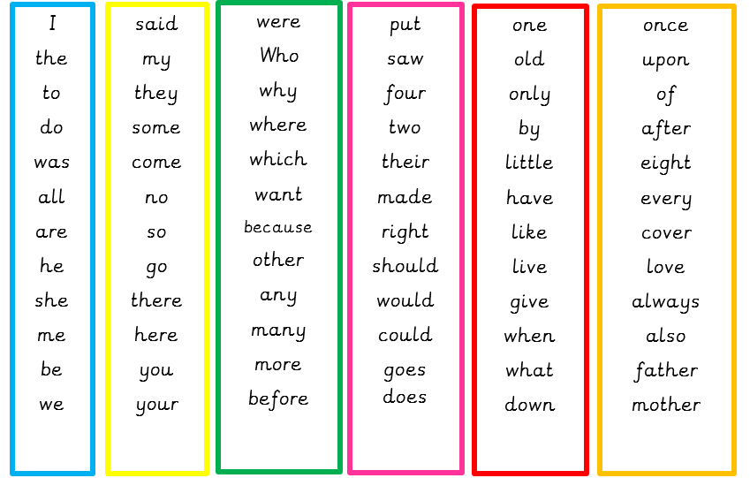
Tricky word list – If you want to challenge your child you can choose other tricky words. Try making up your own sentences for them to write. ☺

Slide 14
Tuesday
are
This is ‘are’ as in care

Slide 15
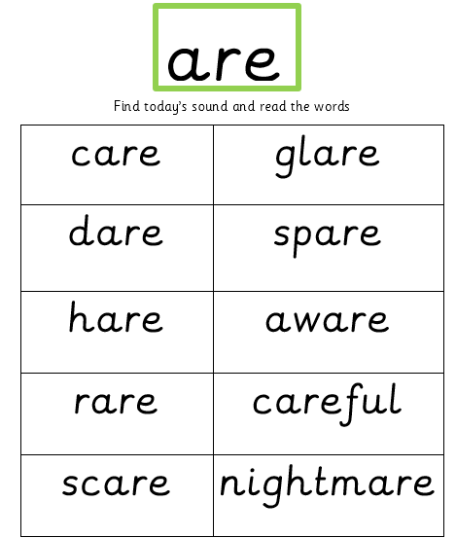
Tuesday

Slide 16
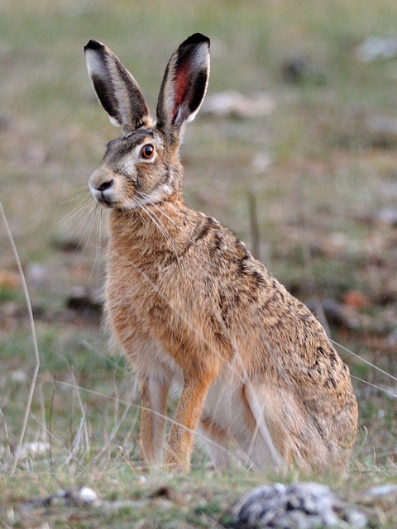
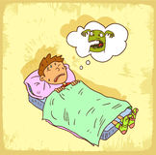
Tuesday
Sound focus: are (care)
v
v
I woke up crying because I had a .
v

Slide 17
Tuesday- Tricky word dictation
* Tricky words are in bold to check afterwards *
Adult read out the following sentences for your child to write:
I like to go to the shop.
I want some more work to do. ☺

Slide 18
Tricky word list – If you want to challenge your child you can choose other tricky words. Try making up your own sentences for them to write. ☺

Slide 19
Wednesday
ear
This is ‘ear’ as in pear

Slide 20
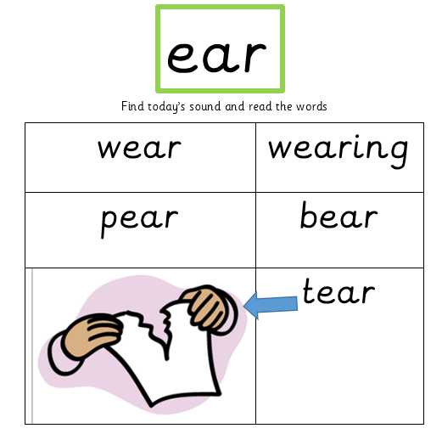
Wednesday

Slide 21
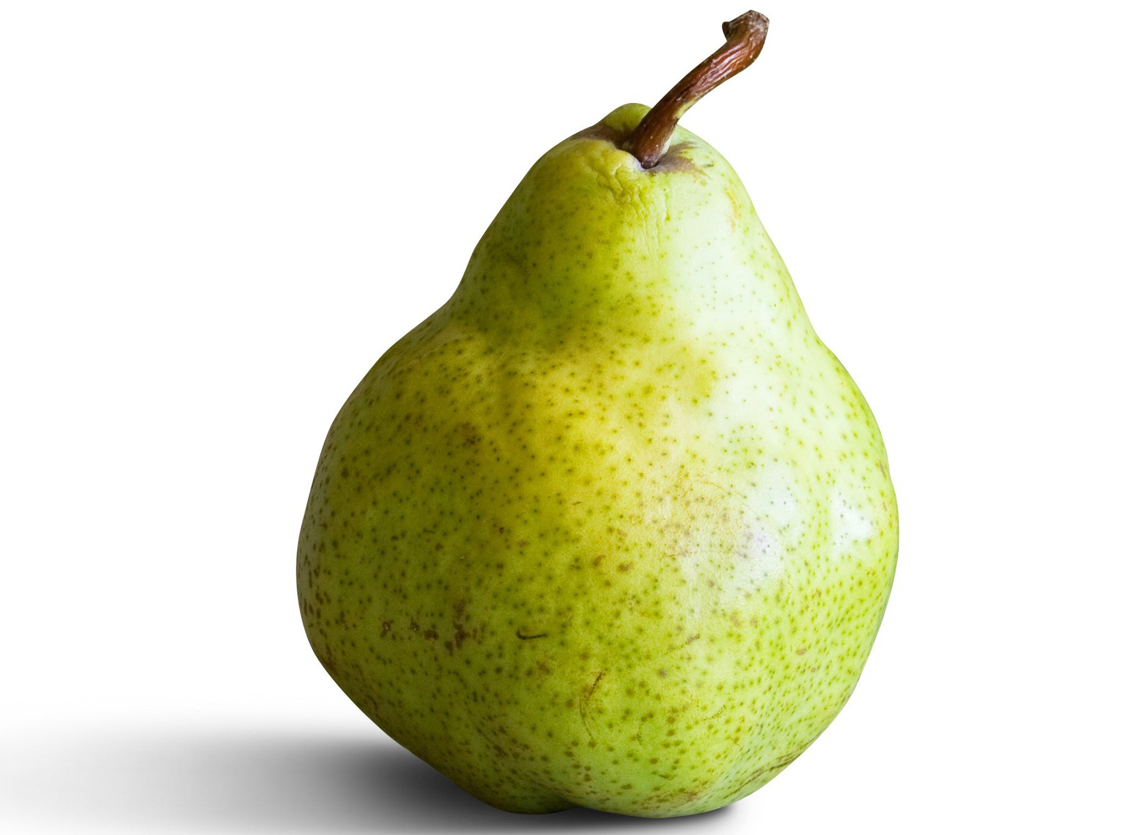
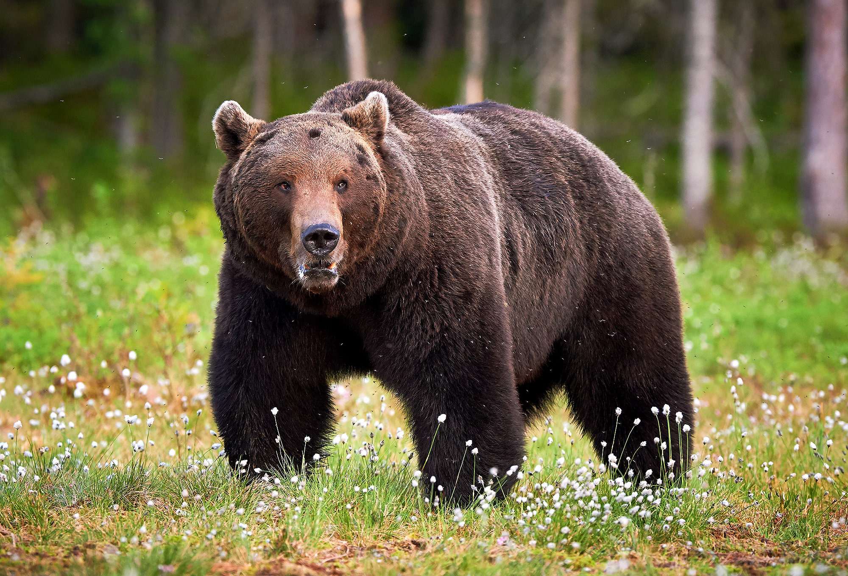

Wednesday
Sound focus: ear (bear)
v
v
v
v

Slide 22
Wednesday- Tricky word dictation
* Tricky words are in bold to check afterwards *
Adult read out the following sentences for your child to write:
How many sweets can I have?
Come here now!

Slide 23
Tricky word list – If you want to challenge your child you can choose other tricky words. Try making up your own sentences for them to write. ☺

Slide 24
Thursday
ph
This makes the ‘f’ sound

Slide 25
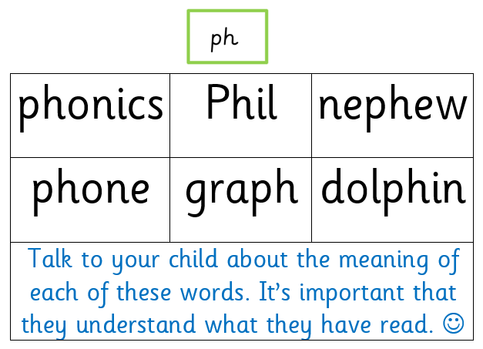
Thursday- Read these words

Slide 26
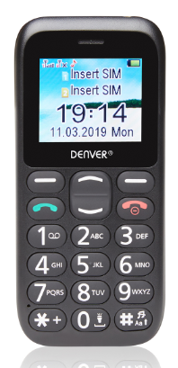
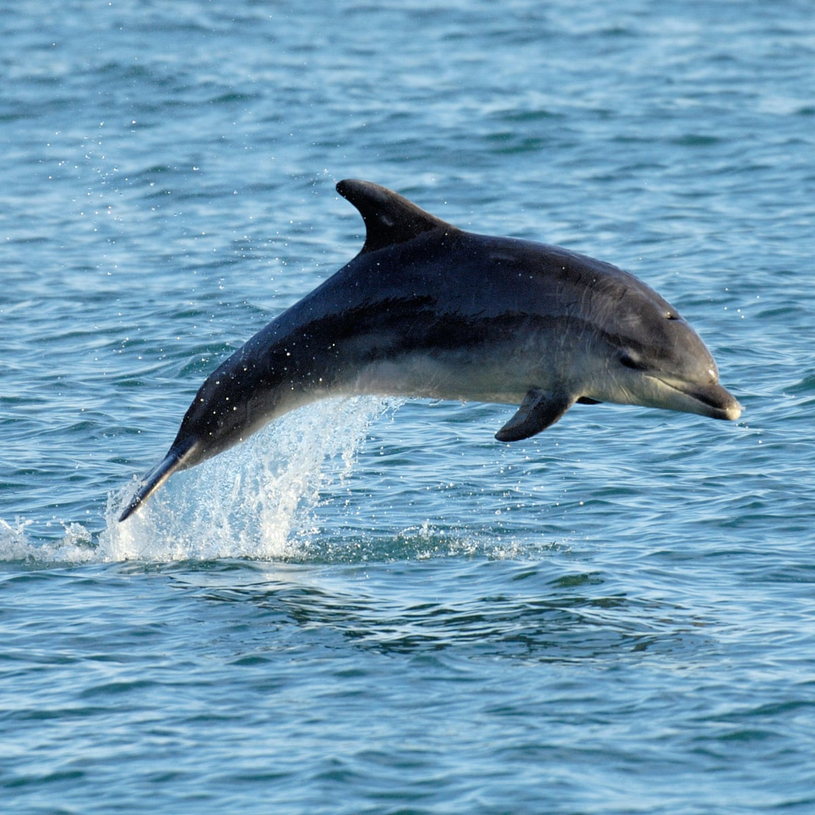
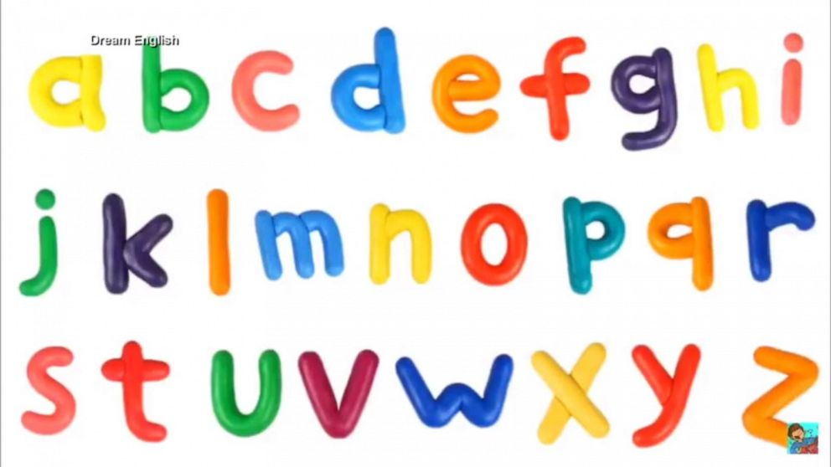
Thursday
Sound focus: ph ‘f’
v
v
v
There are 26 letters in the .

Slide 27
Thursday- Tricky word dictation
* Tricky words are in bold to check afterwards *
Adult read out the following sentences for your child to write: (please don’t expect your child to have used correct punctuation for speech at this stage).
“You can all sit down now” said Miss Knight.
Mr Giles could reach because he is taller than us.

Slide 28
Tricky word list – If you want to challenge your child you can choose other tricky words. Try making up your own sentences for them to write. ☺

Slide 29

Friday
wh
wh
Don’t say the ‘h’!
This makes the ‘w’ sound

Slide 30
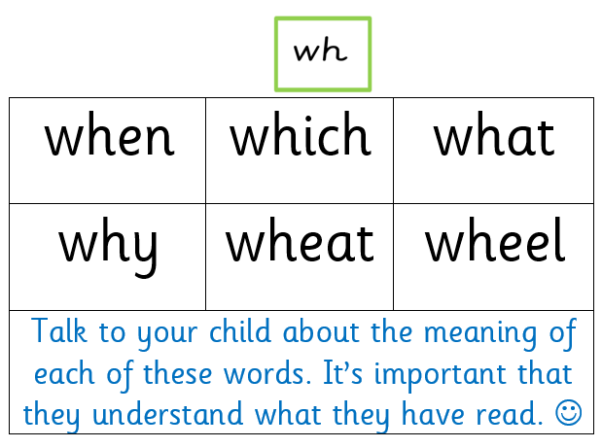
Friday- Read these words

Slide 31

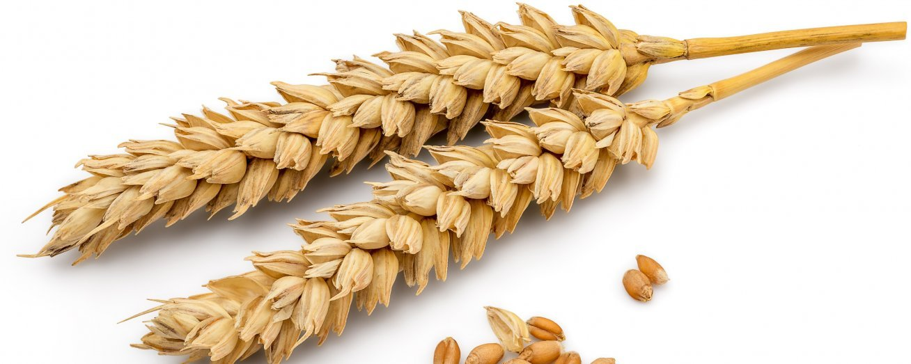



Friday
Sound focus: wh ‘w’
v
v
* The children will recognise these narrative prompts from school (who, what, when)*
v
v
v

Slide 32
Friday- Tricky word dictation
* Tricky words are in bold to check afterwards *
Adult read out the following sentences for your child to write: (please don’t expect your child to have used correct punctuation for speech at this stage).
“We will be doing phonics next” said Mrs Yeomans.
I want some more sunshine.

Slide 33
Tricky word list – If you want to challenge your child you can choose other tricky words. Try making up your own sentences for them to write. ☺

