Slide 1
Good MoRning Year 6!
Well done for working so hard - keep it up!
Please follow the instructions on each page to help you - we look forward to hear about how you have got on!
Mrs Jones and Miss Nolan

Slide 2
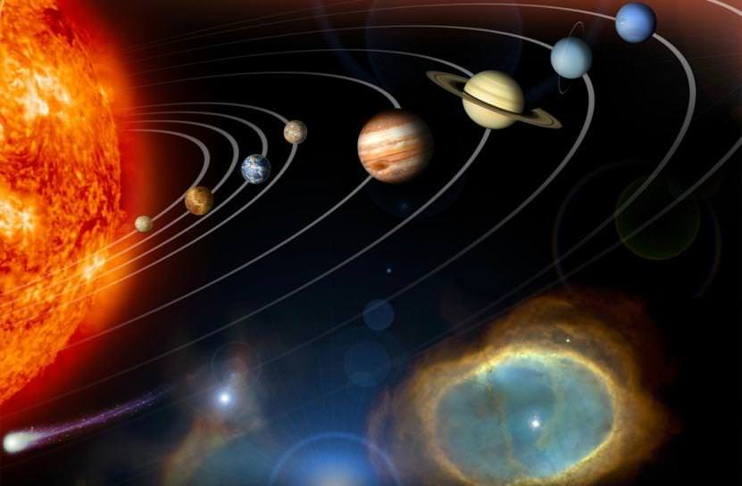
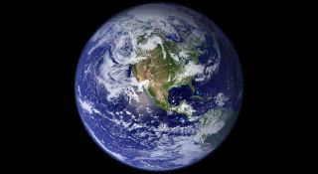
This week’s theme is
Space
Day 2 - 30.6.20

Slide 3
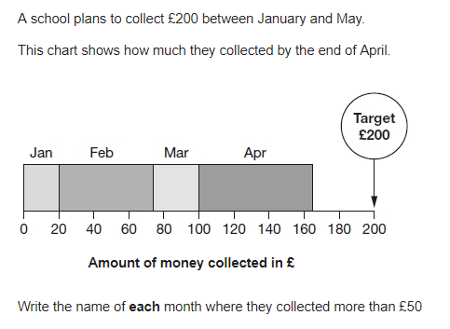

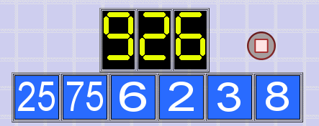
Morning Maths
8.
9.
10.
0.125 = __% = ?/?
26% x 90
⅓ x ⅙ =
1/7 ÷ 3 =
Write the digit in the hundredths column:
783.89278
6. If a is 20 what is:
7a x 10 - 2
7. 4x - 18 = x + 6
Notes:
Children complete in maths book.
They have 15 minutes to complete independently.
Spend 10 minutes at the end of the session going through the answers and the children self mark.

Slide 4
ANSWERS
8.
9.
10.
February
April
0.125 = 12.5% = 1/8
26% x 90 = 23.4
⅓ x ⅙ = 1/18
1/7 ÷ 3 = 1/21
Write the digit in the hundredths column:
783.89278
6. If a is 20 what is:
7a x 10 - 2
7 x 20 x 10 - 2 = 1398
7. 4x - 18 = x + 6
4x = x + 6 + 18
4x = x + 24
4x - x = 24
3x = 24
X = 24 ÷ 3
X = 8
£16,470
75 x 6 = 450
450 + 25 = 475
475 x 2 = 950
8 x 3 = 24
950 - 24 = 926

Slide 5
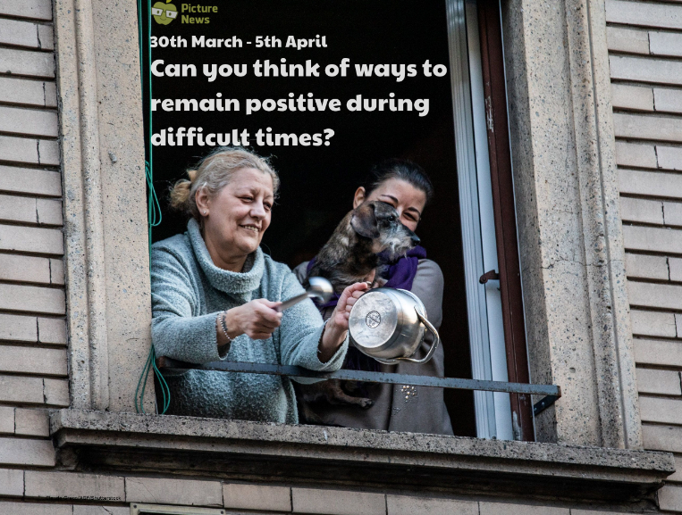
Class Based Worship

Slide 6
Class Based Worship
How do communities work together to help those who need support?
What is a community? What does it mean to you?

Slide 7
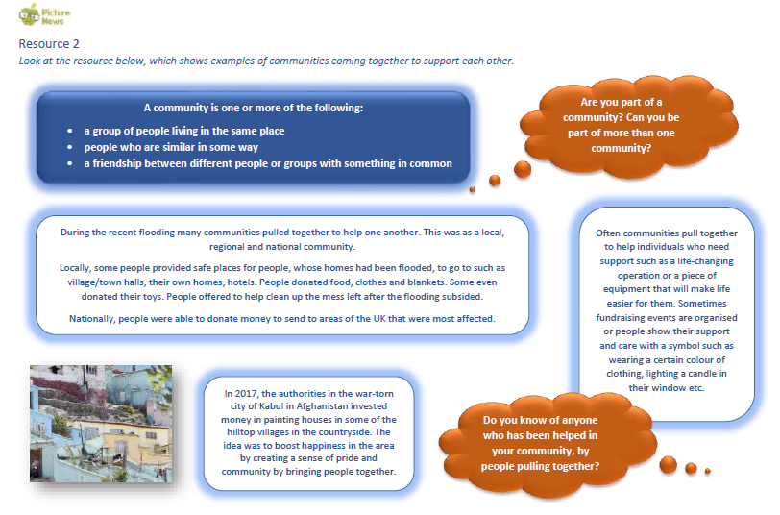

Slide 8
Class Based Worship
Focus on the ways people helped during the recent floods. Were you affected by them or did you know anyone who was? Did you help? Can you think of any other ways people helped one another in this time?
Look at what the city of Kabul did in Afghanistan to bring their community together. Do you think bright colours can help bring positivity and happiness? Can you think of anything being done in your local community that is helping to spread positivity?
Often people in their community will support and help others when it is needed. Can you think of ways people have helped each other during our current situation e.g. been shopping for someone in isolation, phoned someone to check they are okay, teachers sending work home?

Slide 9

Class Based Worship
Reflection
During times of difficulty, it is important we try to support and help people within our communities. We might find we need somebody to help us too!

Slide 10

St Catherine’s Classroom Beliefs
Mistakes are valuable.
Everyone can learn maths to the highest level.
Questions are really important.
Depth is more important than speed.
Maths is about making connections.

Slide 11
30.6.20
WALT: draw line graphs and solve problems involving line graphs.
Success Criteria:
Interpret
Data
X axis and y axis
Problem solving
Notes:
Notes:

Slide 12
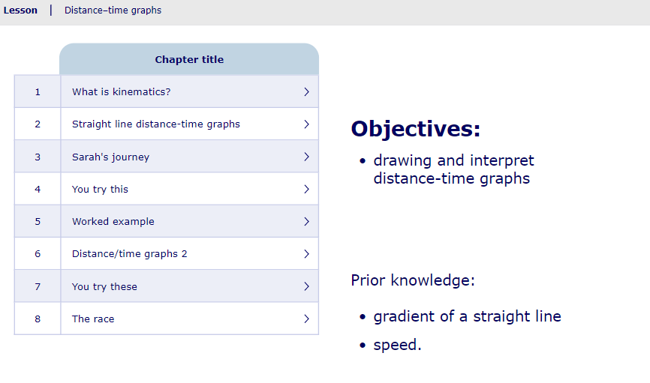
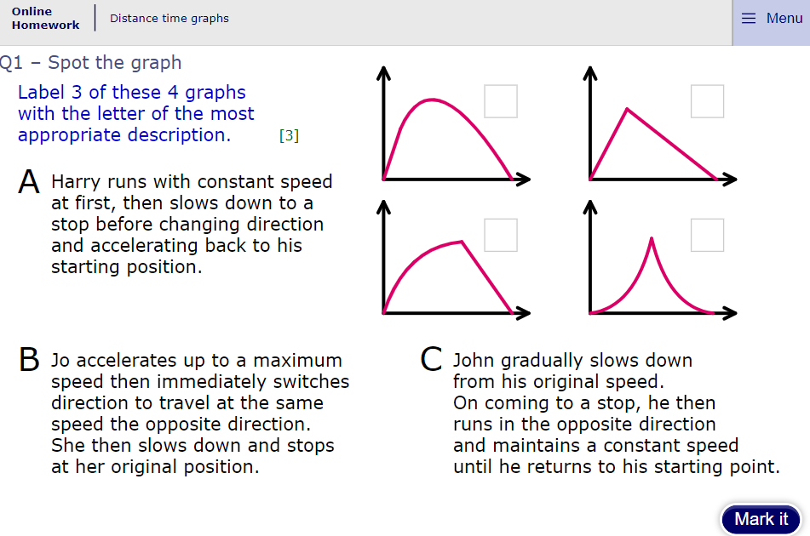
30.6.20
WALT: draw line graphs and solve problems involving line graphs.
Home Learning - If you are learning at home have a go at this MyMaths session.
https://app.mymaths.co.uk/217-lesson/distance-time-graphs
https://app.mymaths.co.uk/217-homework/distance-time-graphs
Notes:
Notes:

Slide 13
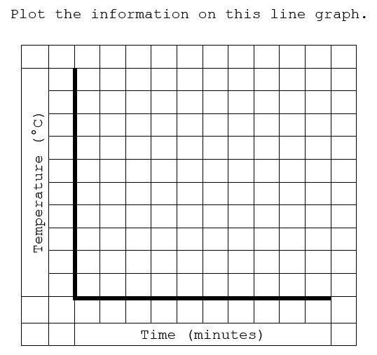
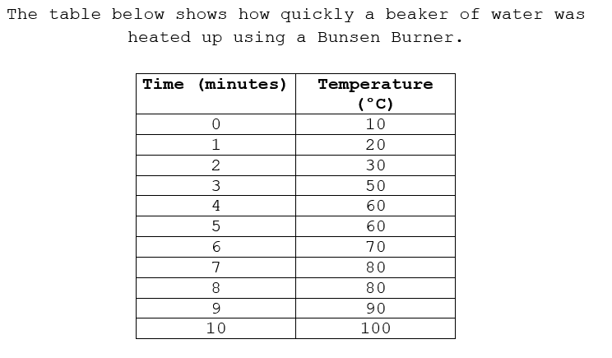
30.6.20
WALT: draw line graphs and solve problems involving line graphs.
Q1
Notes:
Notes: You may want to model this on the board to begin with. Then children can copy this and complete the information

Slide 14
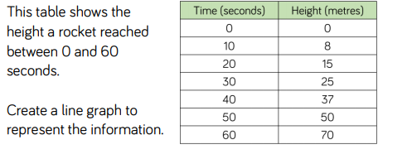
30.6.20
WALT: draw line graphs and solve problems involving line graphs.
Q2
Notes:
Notes: You may want to model this on the board to begin with. Then children can copy this and complete the information

Slide 15
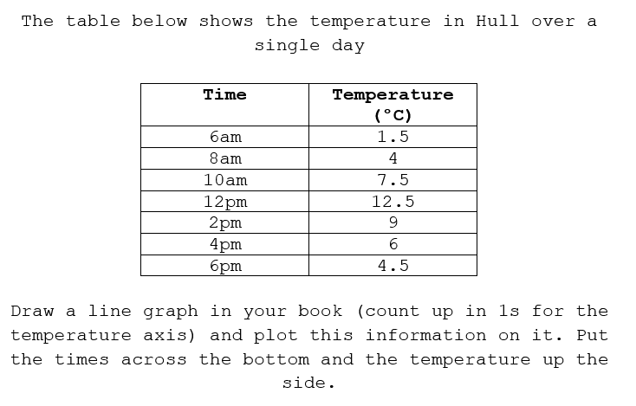
30.6.20
WALT: draw line graphs and solve problems involving line graphs.
Q3
Notes:
Notes:

Slide 16
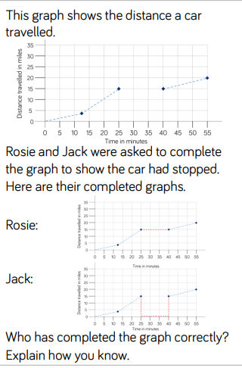
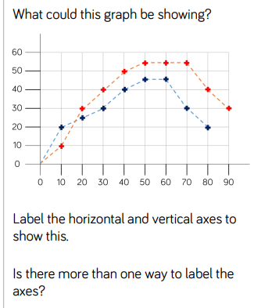
30.6.20
WALT: draw line graphs and solve problems involving line graphs.
Q4
Q5
Notes:
Notes:

Slide 17
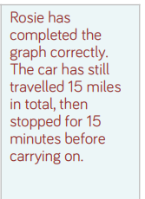
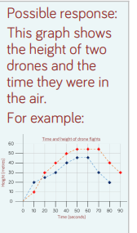
30.6.20
WALT: draw line graphs and solve problems involving line graphs.
Answers
Q4 .
Q5.
Notes:
Notes:

