Slide 1
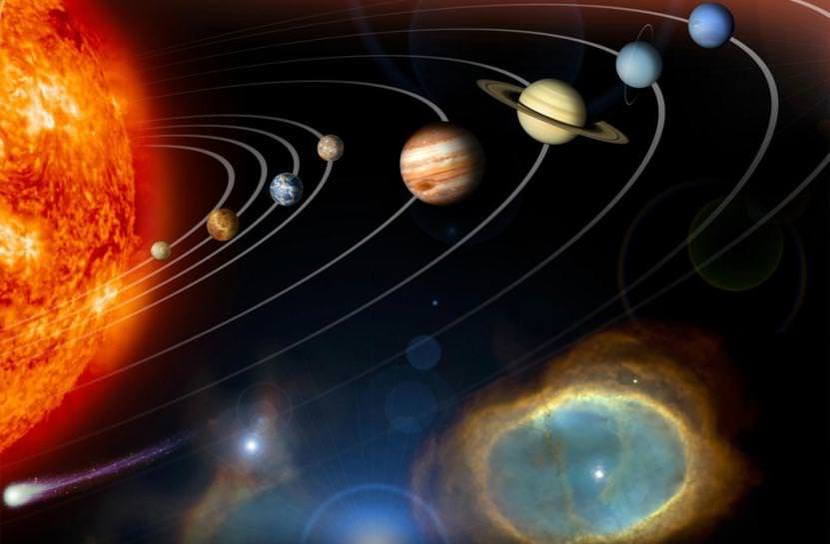
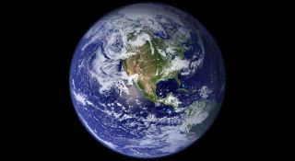
This week’s theme is
Space
Day 2 - 30.6.20

Slide 2

Spellings
Reading = Mars

Slide 3
Tuesday - Spelling and handwriting practice.
answer
scissors
knives
knowledge
environment
She accidently cut her finger with the scissors.
Copy out these words out twice in your best joined handwriting.
Notes:
Long date and title underlined.
Children copy the words twice in their books and then write the sentence. This is handwriting and spelling.
10 min activity

Slide 4
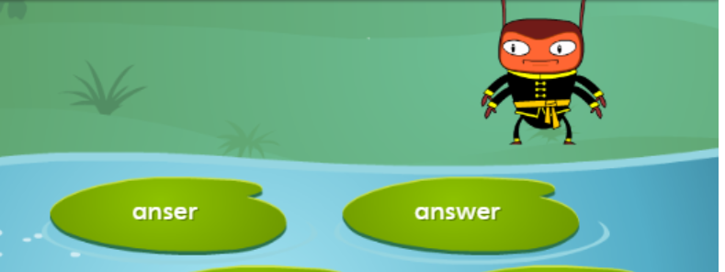
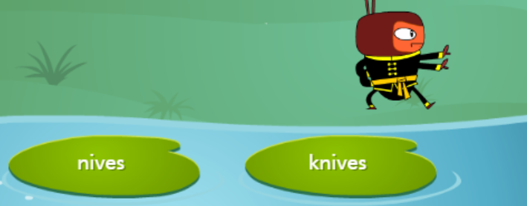
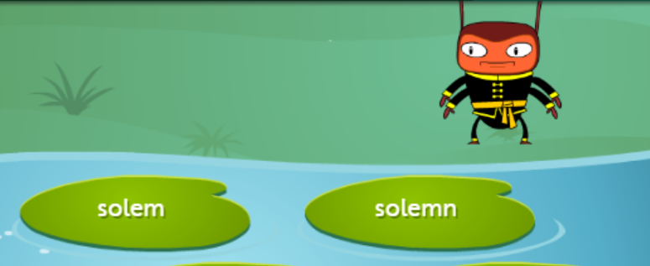
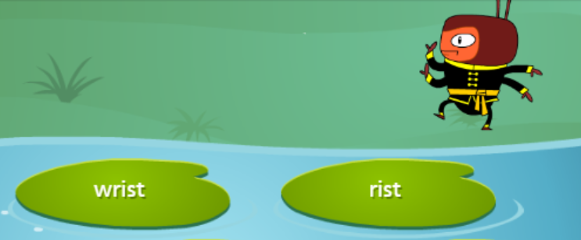
Tuesday - Spelling
Which Lily Pad should the Bug land on? Write down the correct spelling.
3.
4.

Slide 5
Tuesday - Spelling asnwers
Which Lily Pad should Mr Bug land on? Write down the correct spelling.
3.
4.

Slide 6
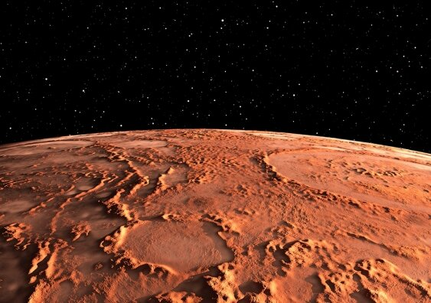
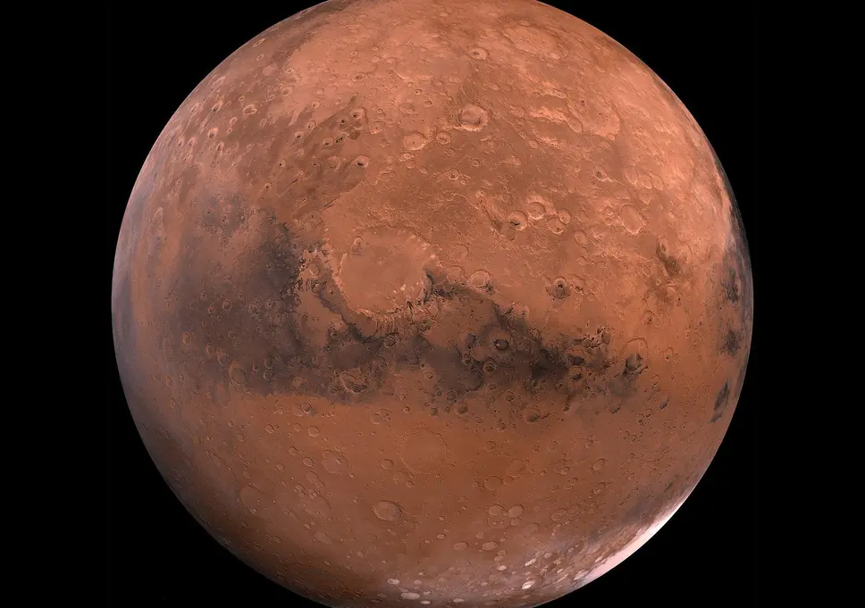
READING - Mars: The Red Planet
WALT: Make inferences using evidence from the text.

Slide 7
READING - Mars: The Red Planet
WALT: Make inferences using evidence from the text.
Mars is the fourth furthest planet from the Sun, located between Earth and Jupiter, and is the second smallest planet in our solar system after Mercury. Named after the Roman god of war, Mars is often described as ‘the Red Planet’ because of its reddish hue. The atmosphere on Mars is made up of mainly carbon dioxide, meaning that the planet does not yet support life.
Missions to Mars It is crucial to launch a mission to Mars at the right time because Earth and Mars are always moving. It is necessary to calculate the distance between the two planets at any one time and to prepare accordingly.
As of 2019, there have been 56 missions to Mars, of which only 26 have been successful. This shows just how difficult reaching the Red Planet can be. None of these missions have been manned by humans but there is currently one Mars rover operational. There are also six active satellites orbiting Mars, providing us with plenty of data about the planet.
Notes:
All children whisper read text independently first.
Choral read the text together - read aloud with the children
Discuss any vocabulary they are unsure about - children can annotate the text if needed.

Slide 8
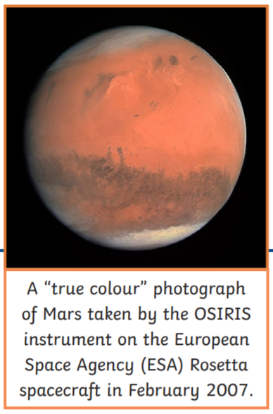
READING - Mars: The Red Planet
WALT: Make inferences using evidence from the text.
Why Mars?
Earth sits between Venus and Mars. Both planets are sometimes visible to the naked eye from Earth! The distance between them varies throughout their orbits of the Sun, but Mars is not the closest planet to Earth – Venus is. The closest possible distance between Earth and Venus is approximately 38 million kilometres, while the closest distance between Earth and Mars is around 55 million kilometres. Why, then, are most of Earth’s exploration efforts directed at the Red Planet? The answer lies in the environments of Mars and Venus.
Notes:
4. Read the questions with the children
5. Reread the text together and children underline any answers they can find to support the questions. See next slide for teachers notes and annotations.
6. Children write the answers to the questions in their books.

Slide 9
READING - Mars: The Red Planet
WALT: Make inferences using evidence from the text.
Venus, Earth’s smaller sister, is blisteringly hot and has a thick atmosphere which could melt a block of lead as easily as an ice cream on Earth. Mars, on the other hand, is smaller and much colder. It is the most habitable planet next to Earth because:
• its soil contains traces of water to extract;
• it gets enough sunlight to use solar power;
• gravity is 38% as strong as on Earth, which, it is believed, humans could adapt to;
• the atmosphere somewhat protects from the Sun’s radiation;
• Mars’ day, called a ‘sol’, is only a little longer than Earth’s.
The human race is very keen to prove that there is a possibility for life on other planets, and Mars is thought to be the most likely place to find that proof.
Notes:
4. Read the questions with the children
5. Reread the text together and children underline any answers they can find to support the questions. See next slide for teachers notes and annotations.
6. Children write the answers to the questions in their books.

Slide 10
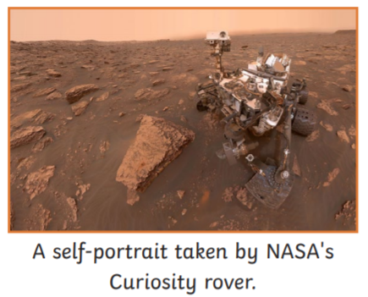
READING - Mars: The Red Planet
WALT: Make inferences using evidence from the text.
The Mars Rover
The Curiosity rover is a robotic car which is currently exploring the surface of the planet. It is nuclear-powered and the fourth rover sent to Mars in 16 years. It was launched on 26th November 2011 and landed on 6th August 2012. Curiosity uses the most advanced scientific equipment ever used on Mars. The main goals of the mission, which forms part of NASA’s Mars Science Laboratory, are to:
• study Martian climate and geology;
• search for water;
• find out whether Mars could have ever supported life.

Slide 11
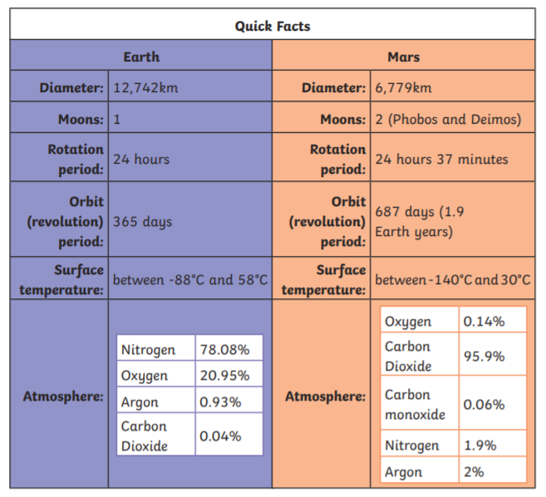
READING - Mars: The Red Planet
WALT: Make inferences using evidence from the text.
Glossary
geology – The science which deals with the physical structure and substance of a planet.
radiation – Energy emitted by the Sun, some of which is dangerous to humans when not absorbed by the atmosphere of a planet.

Slide 12
READING - Mars: The Red Planet
WALT: Make inferences using evidence from the text.
1. Find and copy the correct word to complete the sentence.
Mars is named after the god of…….
2. Which of these are reasons why Mars is a good place to explore?
Mars gets enough sunlight to use solar power.
A day on Mars is very short.
There is no gravity on Mars.
There is a little water in the soil on Mars.
3. How many moons does Mars have and what are their names?
4. What is a day called on Mars and how long is it?
5. Find and copy a word from the text which means ‘working'.

Slide 13
READING - Mars: The Red Planet Answers
WALT: Make inferences using evidence from the text.
1. Find and copy the correct word to complete the sentence.
Mars is named after the Roman god of war.
2. Which of these are reasons why Mars is a good place to explore?
Mars gets enough sunlight to use solar power.
A day on Mars is very short.
There is no gravity on Mars.
There is a little water in the soil on Mars.
Notes:
Teacher Guidance

Slide 14
READING - Mars: The Red Planet Answers
WALT: Make inferences using evidence from the text.
3. How many moons does Mars have and what are their names?
Mars has two moons named Phobos and Deimos.
4. What is a day called on Mars and how long is it?
A day on Mars is called a ‘sol’ and it is 24 hours and 37 minutes long.
5. Find and copy a word from the text which means ‘working'.
‘operational’ or ‘active’.
Notes:
Teacher Guidance

