Slide 1
Good MoRning Year 6!
Over half way through the week and you are doing great!
As always, please follow the instructions on each page to help you - we look forward to hear about how you have got on!
Mrs Jones, Miss Nolan and Mrs Crane

Slide 2
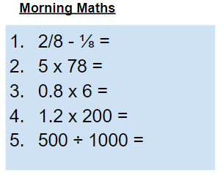
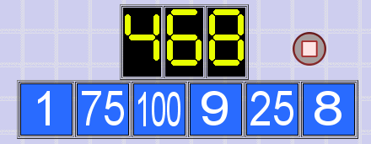
As always, our day will start with Morning Maths.
Give yourself 10 minutes to complete these questions and then try and tackle today’s countdown. If you finish within 10 minutes, check your work and see how many ways you can find to solve the countdown.
After 10 minutes, check your answers using the next slide and the countdown solver (linked below) to see how to solve today’s problem.
Click the link below and type in the numbers and target to see how the countdown could be solved!
http://www.maths-resources.com/countdown/

Slide 3
Answers
⅛
390
4.8
240
0.5

Slide 4

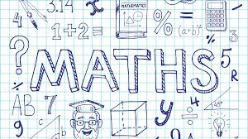
Maths today we will be learning about the interior angles of polygons.
We may not be learning together in the classroom, but it is important to still remember our classroom beliefs.
WALT: use knowledge of interior angles in polygons to solve problems.
Today we will not be using My Maths, but instead some White Rose videos and questions to help us to learn and then to test our understanding.

Slide 5
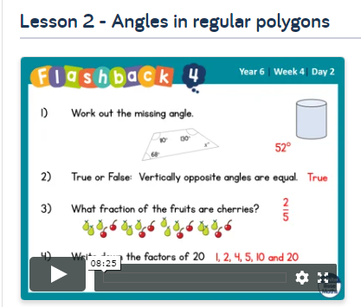

WALT: use knowledge of interior angles in polygons to solve problems.
To start the lesson, click on the image to the left of the screen. This will take you to the White Rose home learning website.
Click on:
Then scroll down to Lesson 2 - Angles in regular polygons and click play on the video. This will be a short video lesson.
Watch the video, pausing where necessary to have a go at the mini quizzes throughout.

Slide 6
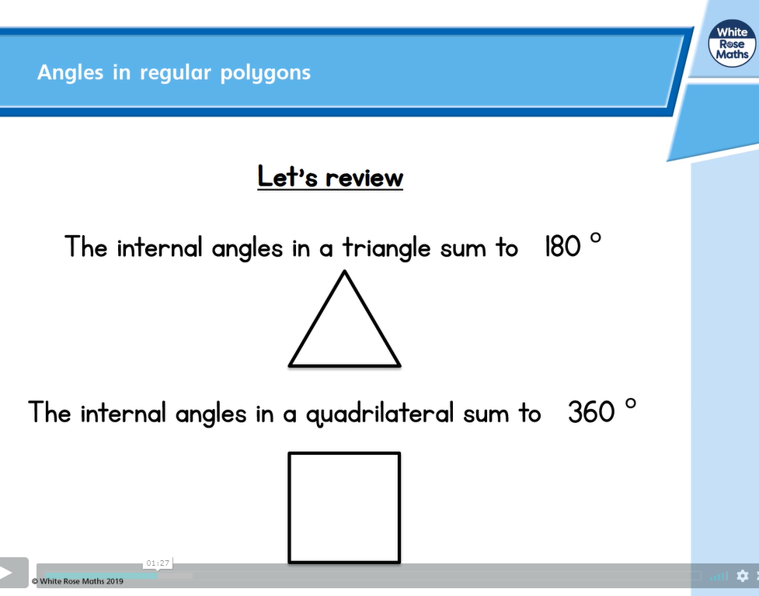
WALT: use knowledge of interior angles in polygons to solve problems.
A quick recap...

Slide 7
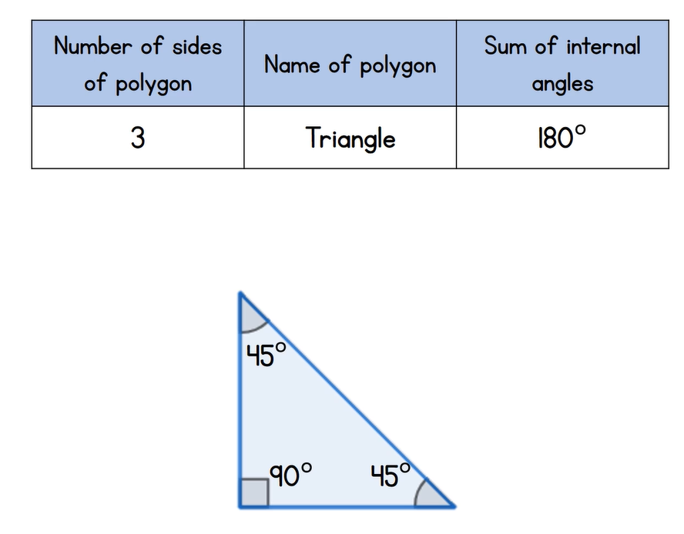
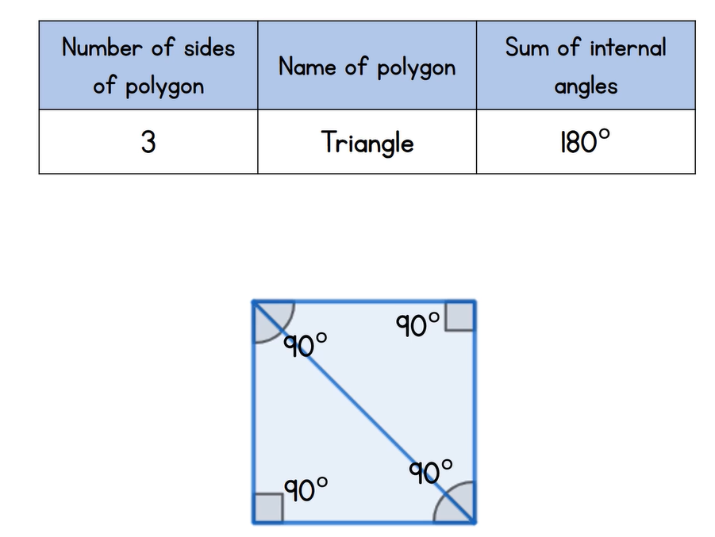
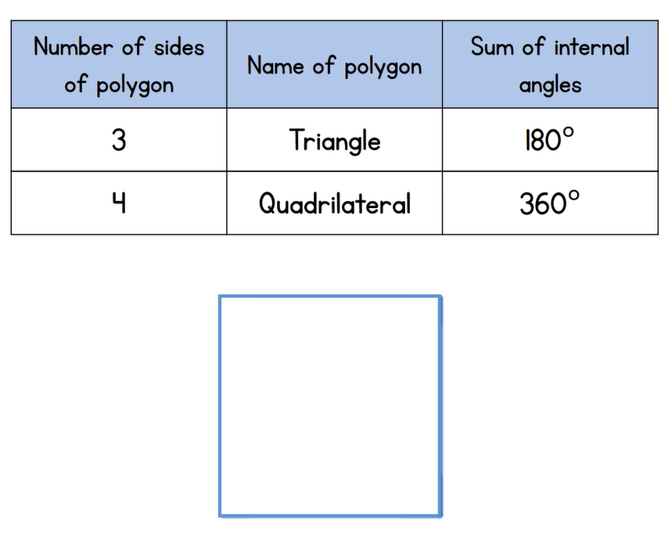
WALT: use knowledge of interior angles in polygons to solve problems.
A quick recap...

Slide 8
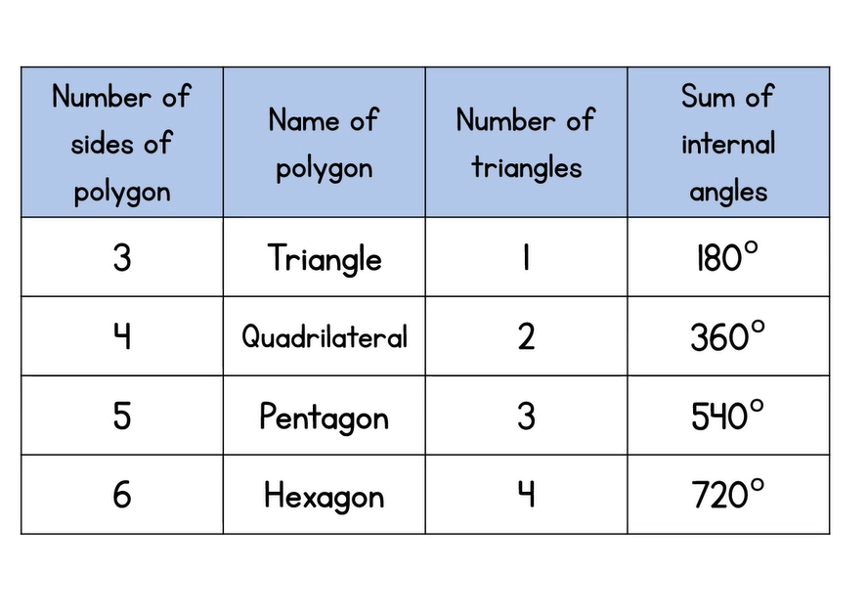
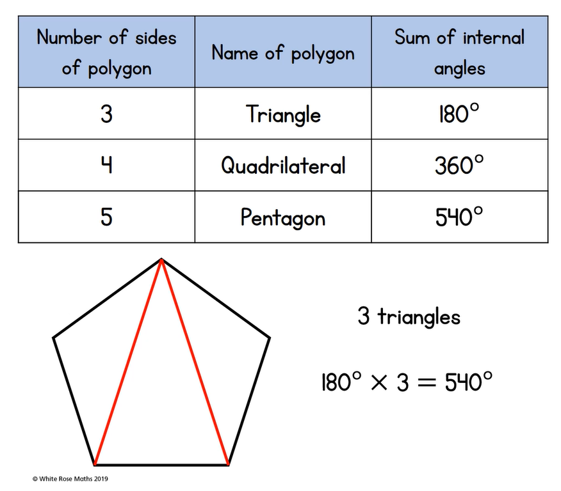
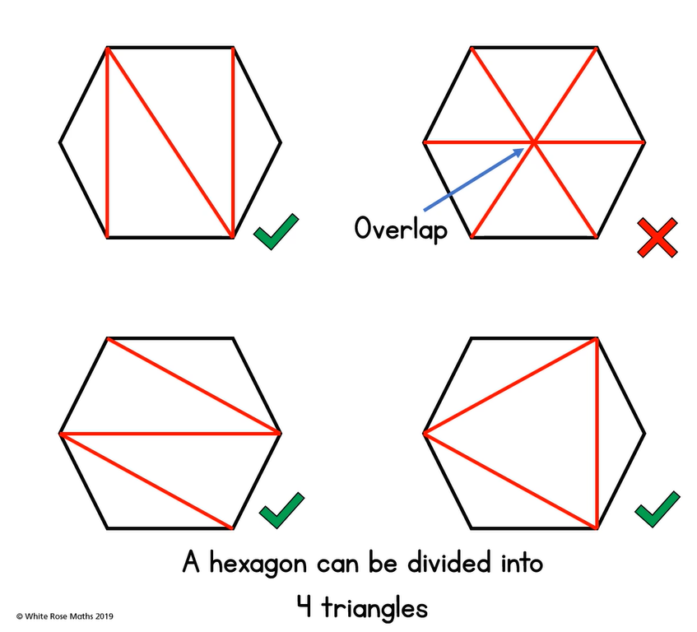
WALT: use knowledge of interior angles in polygons to solve problems.
A quick recap...

Slide 9
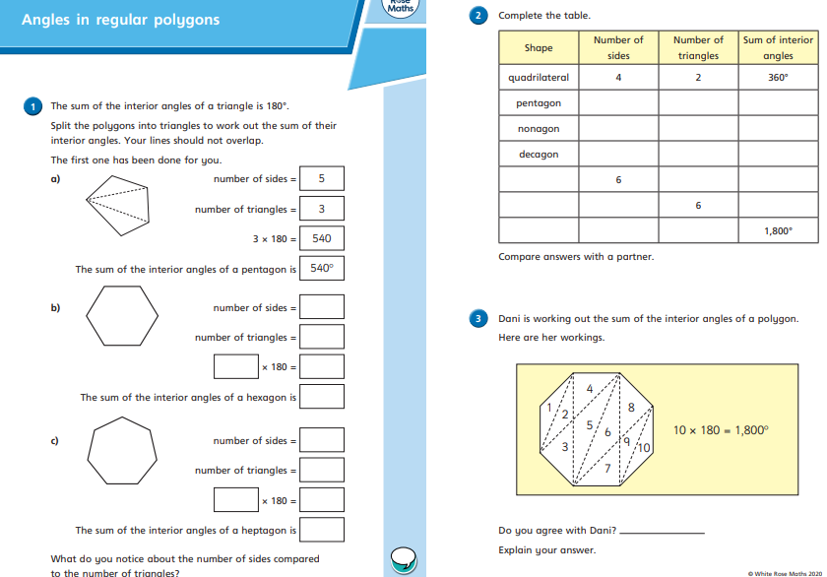
WALT: use knowledge of interior angles in polygons to solve problems.
Now click the image on the left of the screen, this will take you to a short test where you can test your understanding.
Have a go at the questions, writing down your answers on some paper. If you have a paper pack, the questions are on the next few slides.
Once you have completed, click the link below to mark your work against the answers.

Slide 10
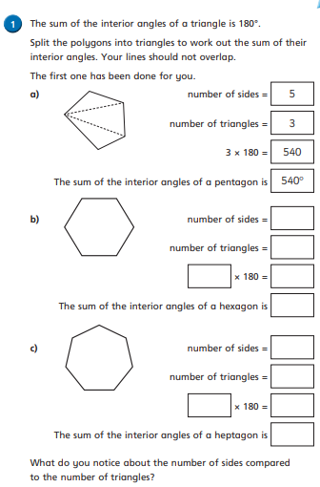
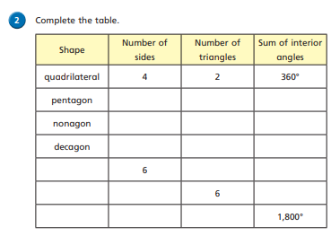
WALT: use knowledge of interior angles in polygons to solve problems.

Slide 11
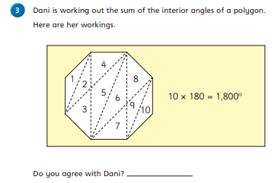
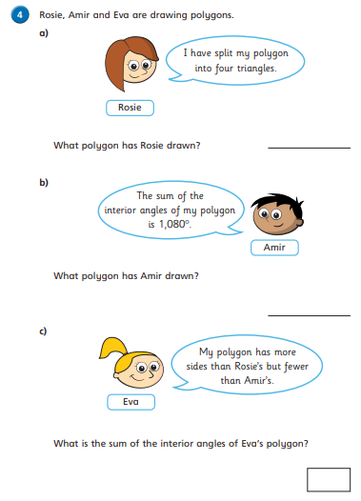
WALT: use knowledge of interior angles in polygons to solve problems.

Slide 12
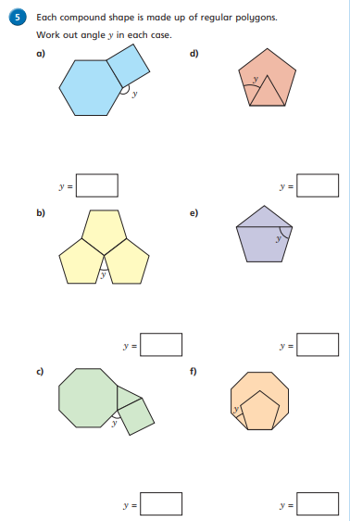
WALT: use knowledge of interior angles in polygons to solve problems.

Slide 13
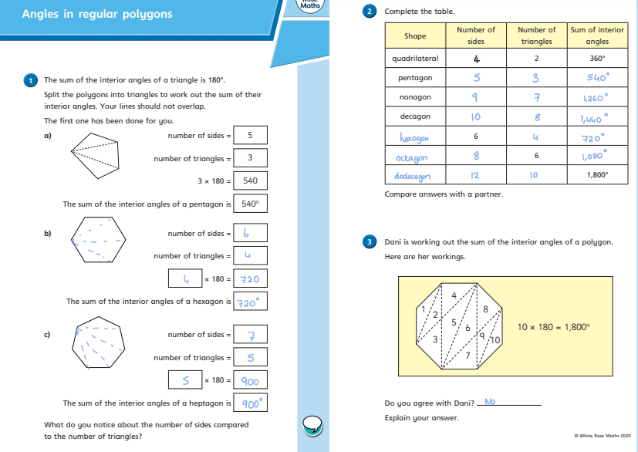
WALT: use knowledge of interior angles in polygons to solve problems.
Answers

Slide 14
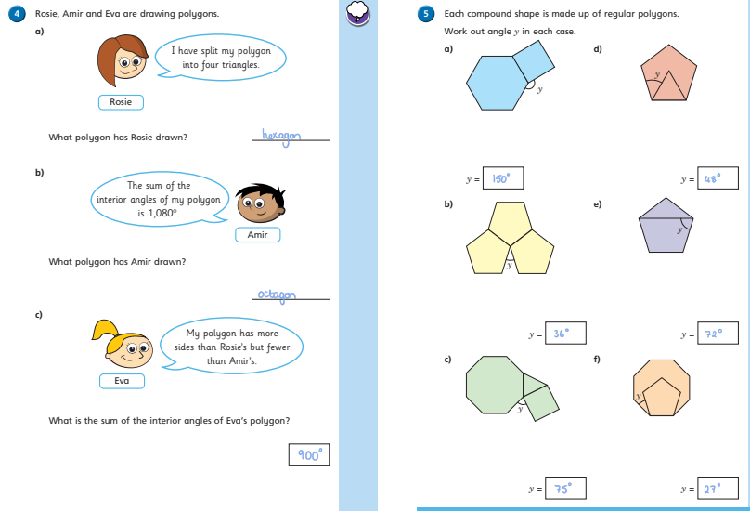
WALT: use knowledge of interior angles in polygons to solve problems.
Answers

Slide 15
Grammar
Conjunctions and Clauses
Today we will be recapping and learning more about conjunctions and clauses.
Please read through the next 6 slides and then try the challenges.

Slide 16
Clauses and Conjunctions
since
until
while

Slide 17
What do we remember about clauses?
Clauses are groups of words with an active verb; they make sense.
She looked around.
Lizzie was in darkness.
She could see nothing.
They are called single-clause sentences because one clause makes up the entire sentence.
These are all clauses because they have an active verb and they make sense.
They can stand alone so they are main clauses (also called independent clauses).

Slide 18
Independent clauses can be linked by and, or, but.
She looked around but she could see nothing.
Lizzie was in darkness and she could see nothing.
She looked around but she could see nothing.
Lizzie was in darkness and she could see nothing.
They are called multi-clause sentences because the sentence is made up of more than one clause.
The conjunctions
and, or and but
are
co-ordinating conjunctions.
They link independent clauses with equal importance to the meaning of the sentence.

Slide 19
Some sentences are made up of more than one clause.
Choose two independent clauses to link using and, or, but.
Seals love fish. | They can get quite plump at certain times of the year.
Seals enjoy playing in the icy sea. | They tend to huddle together in the cold.
Penguins are very clever. | They form a solid circle with their backs to the cold.
Penguin parents can take turns to keep the egg warm. | They can decide that one of them catches the fish.
Ideas
Seals love fish and they can get quite plump at certain times of the year.
Seals enjoy playing in the icy sea but they tend to huddle together in the cold.
Penguins are very clever and they form a solid circle with their backs to the cold.
Penguin parents can take turns to keep the egg warm or they can decide that one of them catches the fish.

Slide 20
Subordinating Conjunctions
Some conjunctions add extra information to an independent clause.
Conjunctions can give meaning to the links, to do with…
time
place
cause
condition
contrast
when
while
since
as
before
after
until
where
wherever
because
as
since
if
unless
even if
although
though
whereas
while

Slide 21
Subordinating conjunctions link
main clauses to subordinate clauses.
Lizzie was in darkness although she could sense that someone else was there.
She could see nothing even if she opened her eyes wide.
When she heard a sound, she looked around nervously.
These are still called multi-clause sentences because the sentence is made up of more than one clause.
These sentences are made up of a main clause (which carries the most important information) and…
…a subordinate clause which adds to the meaning of the main clause but cannot stand alone.

Slide 22
Challenge Which is the main clause and subordinate clause
in each of these multi-clause sentences?
Without getting out of her sleeping bag, she could see the seals.
They still looked pretty sleepy, although it was hard to tell.
While lying there thinking of not much, she heard the sound of a helicopter.
When she was sure what it was, Lizzie got out of her sleeping bag.
She wanted to be up when the helicopter landed.
Before the noise had died down, she was outside and running toward it.

Slide 23
Answers Which is the main clause and subordinate clause
in each of these multi-clause sentences?
Without getting out of her sleeping bag, she could see the seals.
They still looked pretty sleepy although it was hard to tell.
While lying there thinking of not much, she heard the sound of a helicopter.
When she was sure what it was, Lizzie got out of her sleeping bag.
She wanted to be up when the helicopter landed.
Before the noise had died down, she was up and running toward it.

Slide 24
Close Read
Today’s English Lesson will be a close read activity based on the Wind in the Willows by Kenneth Grahame Gipsy Caravan
Teacher Notes
The purpose of a close read activity is to gain an understanding of the text by reading it multiple times.
Close Read Instructions:
Read the blurb about the text to gain an idea of the context. Share your thoughts with an adult or sibling.
Look at the vocabulary highlighted. Do you know what the words mean? If you are unsure, read the vocabulary slide to gain a better understanding.
Read the text to yourself and ask yourself the following questions:
What did I just read? What did it say? You can make notes or annotate the text.
Now read the text again with an adult - this will help you gain a better understanding.
Read the questions and now reread the text again to find evidence that will support your answers.
Answer the questions in writing.
All close read texts are age appropriate.

Slide 25

Close read - Wind in the Willows by Kenneth Grahame
WALT: make inferences and deductions using evidence from the text.
Blurb
Leaving his spring-cleaning behind him, timid Mole ventures beyond the familiar comfort of his burrow and makes a new friend in Ratty, who lives by the riverbank. Together they spend long summer days enjoying the delights of the river; but when they meet the reckless Mr Toad, they find themselves caught up in a series of strange adventures in order to help Toad out of trouble, and return him to the safety of Toad Hall.

Slide 26
Close read Wind in the Willows - Text
WALT: make inferences and deductions using evidence from the text.
‘They had a pleasant ramble that day over grassy downs and along narrow by-lanes, and camped as before, on a common, only this time the two guests took care that Toad should do his fair share of work. In consequence, when the time came for starting next morning, Toad was by no means so rapturous about the simplicity of the primitive life, and indeed attempted to resume his place in his bunk, whence he was hauled by force. Their way lay, as before, across country by narrow lanes, and it was not till the afternoon that they came out on the high-road, their first high-road; and there disaster, fleet and unforeseen, sprang out on them disaster—momentous indeed to their expedition, but simply overwhelming in its effect on the after-career of Toad.
They were strolling along the high-road easily, the Mole by the horse's head, talking to him, since the horse had complained that he was being frightfully left out of it, and nobody considered him in the least; the Toad and the Water Rat walking behind the cart talking together—at least Toad was talking, and Rat was saying at intervals, 'Yes, precisely; and what did you say to him?'—and thinking all the time of something very different, when far behind them they heard a faint warning hum, like the drone of a distant bee. Glancing back, they saw a small cloud of dust, with a dark centre of energy, advancing on them at incredible speed, while from out the dust a faint 'Pooppoop!' wailed like an uneasy animal in pain. Hardly regarding it, they turned to resume their conversation, when in an instant (as it seemed) the peaceful scene was changed, and with a blast of wind and a whirl of sound that made them jump for the nearest ditch. It was on them!

Slide 27
Close read Wind in the Willows- Text
WALT: make inferences and deductions using evidence from the text.
The 'Poop-poop' rang with a brazen shout in their ears, they had a moment's glimpse of an interior of glittering plate-glass and rich morocco and the magnificent motor-car, immense, breath-snatching, passionate, with its pilot tense and hugging his wheel, possessed all earth and air for the fraction of a second, flung an enveloping cloud of dust that blinded and enwrapped them utterly, and then dwindled to a speck in the far distance, changed back into a droning bee once more.
The old grey horse, dreaming, as he plodded along, of his quiet paddock, in a new raw situation such as this simply abandoned himself to his natural emotions. Rearing, plunging, backing steadily, in spite of all the Mole's efforts at his head, and all the Mole's lively language directed at his better feelings, he drove the cart backwards towards the deep ditch at the side of the road. It wavered an instant—then there was a heartrending crash—and the canary-coloured cart, their pride and their joy, lay on its side in the ditch, an irredeemable wreck.
The Rat danced up and down in the road, simply transported with passion. 'You villains!' he shouted, shaking both fists, 'You scoundrels, you highwaymen, you—you—road-hogs!—I'll have the law on you! I'll report you! I'll take you through all the Courts!' His home-sickness had quite slipped away from him, and for the moment he was the skipper of the canary-coloured vessel driven on a shoal by the reckless jockeying of rival manners, and he was trying to recollect all the fine and biting things he used to say to masters of steam-launches when their wash, as they drove too near the bank, used to flood his parlour-carpet at home.

Slide 28
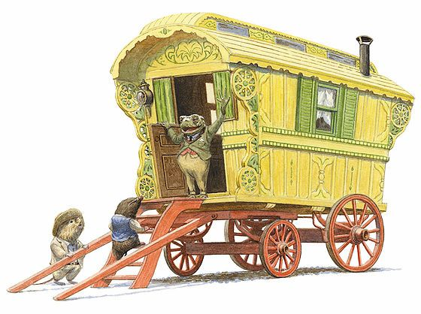
Close read Wind in the Willows- Text
WALT: make inferences and deductions using evidence from the text.
Toad sat straight down in the middle of the dusty road, his legs stretched out before him, and stared fixedly in the direction of the disappearing motor-car. He breathed short, his face wore a placid satisfied expression, and at intervals he faintly murmured 'Poop-poop!'’

Slide 29
Close read - Wind in the Willows - Vocabulary
WALT: make inferences and deductions using evidence from the text.
Meaning of words:
Rapturous - feeling, or expressing great pleasure or enthusiasm.
primitive- being the first or earliest of the kind or in existence, especially in an early age of the world: primitive forms of life.
Momentous - of great importance or significance, especially in having a bearing on future events.
Intervals - a pause or break in activity.
enveloping - wrap up, cover, or surround completely.
Droning - make a continuous low humming sound.
Jockeying - to attempt to get power or get into a better position

Slide 30
Close read - Wind in the Willows Questions
WALT: make inferences and deductions using evidence from the text.
1. Where did Toad, Mole and Ratty’s ramble in the gipsy caravan take them before they camped on a common?
2. What had Mole and Ratty done that meant that when they set off the next morning Toad was less rapturous about the simplicity of the primitive life?
3. Where were Mole, Toad and Ratty when they heard the faint warning hum and what were they doing?
4. How can you tell that Ratty was not listening to Toad as they were walking along behind the cart?
5. Use a dictionary to help find the meanings of the following words as used in the passage:
common
Irredeemable
placid

Slide 31
Close read - Wind in the Willows Questions
WALT: make inferences and deductions using evidence from the text.
1. Where did Toad, Mole and Ratty’s ramble in the gipsy caravan take them before they camped on a common?
Toad, Mole and Ratty’s ramble in the gipsy caravan took them over grassy downs and along narrow by-lanes before they camped on the common.
2. What had Mole and Ratty done that meant that when they set off the next morning Toad was less rapturous about the simplicity of the primitive life?
Mole and Ratty made sure that Toad did his fair share of the work which meant that Toad was less rapturous about the simplicity of the primitive life.
3. Where were Mole, Toad and Ratty when they heard the faint warning hum and what were they doing?
They were strolling along the high-road when they heard the faint warning hum, Mole was walking along talking to the horse and Toad and Ratty were walking behind the cart talking together.
4. How can you tell that Ratty was not listening to Toad as they were walking along behind the cart?
You can tell that Ratty was not listening to Toad as they were walking along behind the cart because he was thinking all the time about something very different whilst Toad was talking.
5. Use a dictionary to help find the meanings of the following words as used in the passage:
common
Irredeemable
placid
Common - a piece of open land for public use
irredeemable - not able to be saved
placid - calm, peaceful

Slide 32

Good Afternoon Year 6!
Let’s start our afternoon with a quick burst of energy!
Get your PE kit at the ready because at the start of each afternoon session we will be joining Joe Wicks for our daily workout.
Do as much as you can and over the week you should find you are getting fitter and finding it easier.
Let’s go!
Click the youtube link below and select today’s date from the videos listed.
https://www.youtube.com/channel/UCAxW1XT0iEJo0TYlRfn6rYQ

Slide 33

Computing
Search Engines
What is the web?

Slide 34
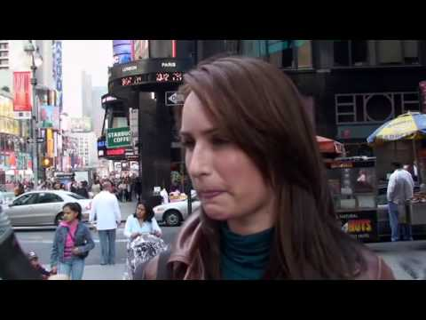
Search Engines
There are a lot of names and terms associated with the internet, the web, browsers, and search engines. Sorting them out can get confusing!

Slide 35


The internet is a global network of computers. It is millions of computers around the world, all connected.
People often think of the internet as a cloud in space. In reality, every computer in the "inter-network", or internet, is connected by actual wires -- ethernet cables, phone lines, and fiber optic wiring on the ocean floor!
Google Confidential and Proprietary

Slide 36
What is the web?
People often use the words "the internet" and "the web" interchangeably. Is there a difference?
The World Wide Web is just one part of the internet. The internet also includes e-mail, instant messaging, multiplayer gaming, and FTP (peer-to-peer file sharing).
Google Confidential and Proprietary

Slide 37
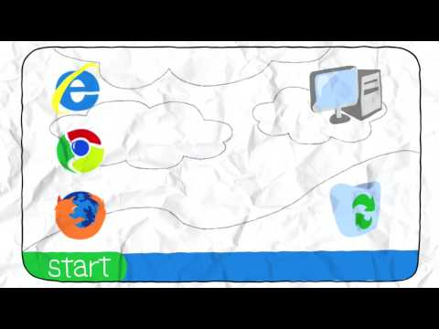
A browser is a tool that allows you to access the world wide web.
Google Confidential and Proprietary

Slide 38
Websites vs. Webpages
A website is a collection of webpages that belong to one domain or owner.
A webpage is a single document (which can include images, videos, charts, etc) viewable through a web browser.
For example, www.sandiegozoo.org is a website for the San Diego Zoo. "Hours & Directions" is one webpage on the website.
Google Confidential and Proprietary

Slide 39
What is a web address?
A web address is the identifying address for a file, or webpage, on the internet.
Typing a web address into the browser bar, or address bar, allows you to access this file on the internet. Another word for "web address" is URL.
An example of a web address is http://www.google.com.
Google Confidential and Proprietary

Slide 40


What is a search engine?
A search engine is a program to help you find webpages on the internet.
Search engines do not search the whole web, but only an index of the web.
Some examples of search engines include Google, Bing, Yahoo, and Ask.
Google Confidential and Proprietary

Slide 41

Can you remember what each of these words mean? How are these terms different? How are they related?
• The Internet
• The Web
• Browser
• Search Engine
• Website vs. Webpage
• Web Address (URL)
Google Confidential and Proprietary

Slide 42
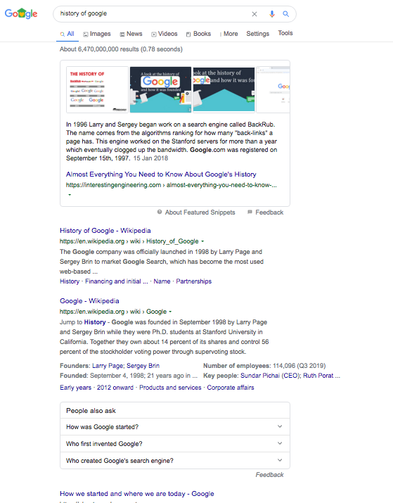
1
2
Google Results Page
Search result
Search tools (modify your search for images, videos or news to refine your results)
Featured snippet (this is a longer extract from a relevant page)
Organic search results (these include a title, a link, a snippet or extract, and shortcut links)
Related searches (These link to websites that have additional information to your search)
3
4
5

Slide 43
Titles and Snippets
The titles and snippets on search engines’ results pages are only a tiny bit of information.
You need to click on the link in order to see where the information has come from and find more information.
Google Confidential and Proprietary

Slide 44
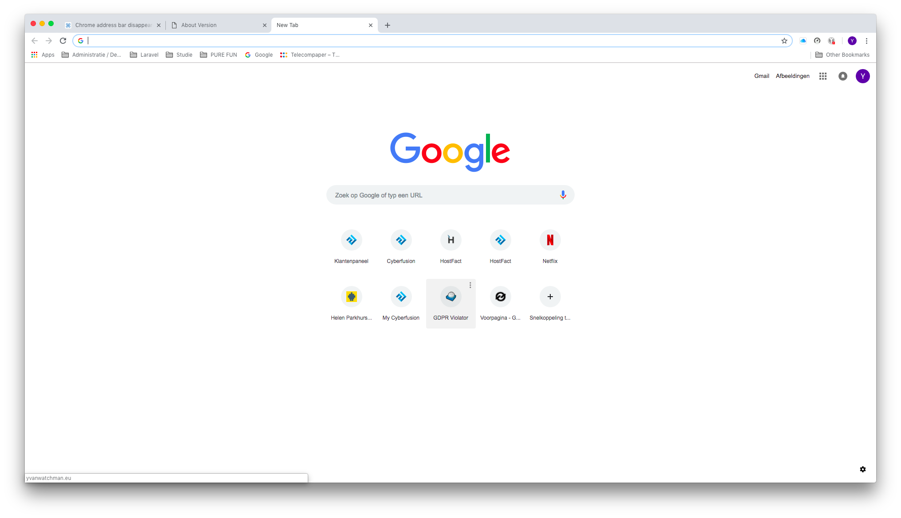
1
Hint!
If you are using the browser, Chrome, you do not have to type google.com into the address bar (1).
You can type your search query straight into the address bar.
Try it out! Type ‘Kidderminster schools” straight into the address bar in your search engine and see what happens.
Google Confidential and Proprietary

Slide 45
What to ask
You might have a question you want to find the answer to using a search engine. For example, you want to find a good place for a walk near your house.
You can type in, “Good places to walk near me”, and it would generate results.
Many of the words in the question are unnecessary.
You can get the same or better results by being clear and simple. For most searches, you don’t need to use prepositions or articles.
To find the best results, you would type, “Walks route Kidderminster”.
This sentence isn’t grammatically correct, but Google is only interested in your KEYWORDS.
Google Confidential and Proprietary

Slide 46
Activity
Find the following information using the fewest words possible.
Don’t forget to actually CLICK ON THE RESULT and read the information on the original webpage to make sure that the information is current and correct.
How many footballers are there in England, Scotland and Wales?
Where are the best places to see wild monkeys?
I want to go on holiday to a place on a different continent. This place must be a capital city. It must be near the sea. It must be warm in October.
I want to make a meal that is healthy using ingredients available in the UK during springtime. I want to make this meal in under 30 minutes and it must include chicken thighs.
Google Confidential and Proprietary

Slide 47

Well done on a great day!
Enjoy your evening and be ready for more learning tomorrow...

