Slide 1
Good MoRning Year 6!
Well done for working so hard - keep it up!
Please follow the instructions on each page to help you - we look forward to hear about how you have got on!
Mrs Jones and Miss Nolan

Slide 2
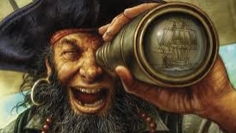
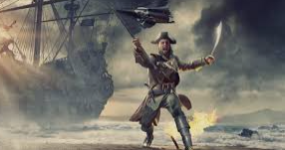
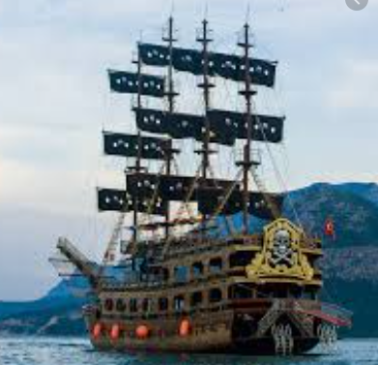

This week’s theme is
Pirates!
Day 2 - 23.6.20

Slide 3
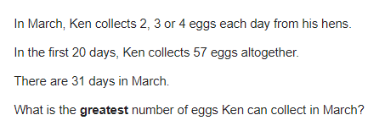
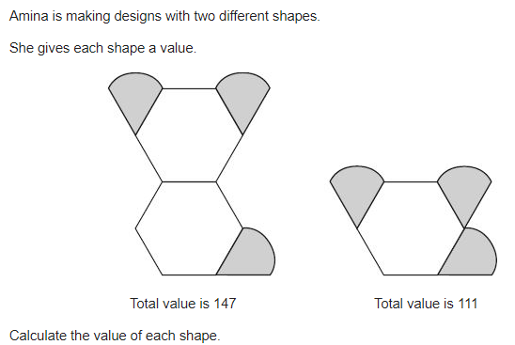
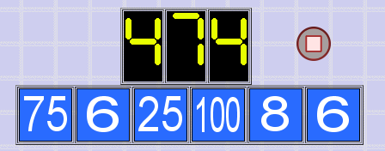
Morning Maths - Give yourself 15 - 20 minutes to complete these questions and then try and tackle today’s countdown.
8.
9.
10.
A square has a length of 6cm. Find the perimeter.
A cube has a length of 8cm. Find the volume.
67 x 0.1 =
2 ⅔ x 90 =
6 - 2.45 =
6. 67% of 520 =
7. 0.45 = ?/?
Notes:
Children complete in maths book.
They have 15 minutes to complete independently.
Spend 10 minutes at the end of the session going through the answers and the children self mark.

Slide 4
Now mark your work using these answers.
31-20 = 11
11x4 = 44
44 + 57 = 101 eggs
8.
9.
10.
A square has a length of 6cm. Find the perimeter. 6 x 4 = 24cm
A cube has a length of 8cm. Find the volume. 8 x 8 x 8 = 512cm2
67 x 0.1 = 6.7
2 ⅔ x 90 = 240
6 - 2.45 = 3.55
6. 67% of 520 = 348.4
7. 0.45 = 45/100
147-111 = 36
Hexagon = 36
111 - 36 = 75
75 / 3 = 25
Droplet = 25
My answer : 474
75 + 6 = 81
81 x 6 = 486
486 - 8 = 478
100 ÷ 25 = 4
478 - 4 = 474

Slide 5
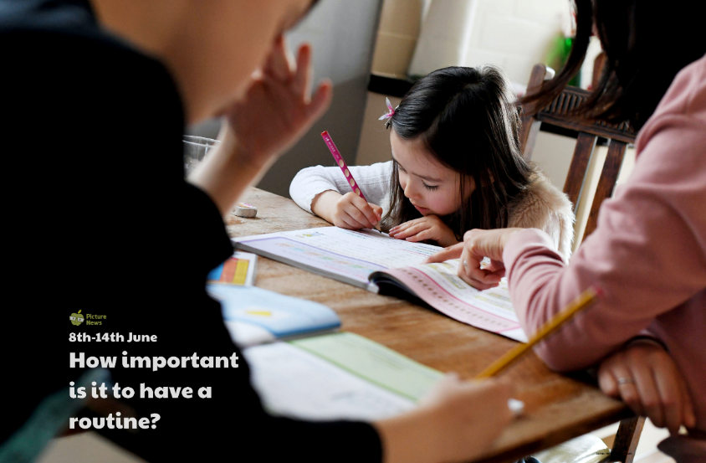
Daily Worship
What would our lives be like without any routine?
Listen, think, share
• Write the word ‘routine’. Can you describe what a routine is?
• Do you have any routines? Think about the morning. Do you get up at a similar time each day, get dressed, have breakfast, brush teeth, wash in a specific order?
• Think about your school. Are there any routines you follow there such as register, assembly, breaks, lunch? Can you create a timetable for a typical day at school? Do you like knowing what you are going to do and when?
Notes:
Routine is a sequence of actions that are regularly followed.

Slide 6
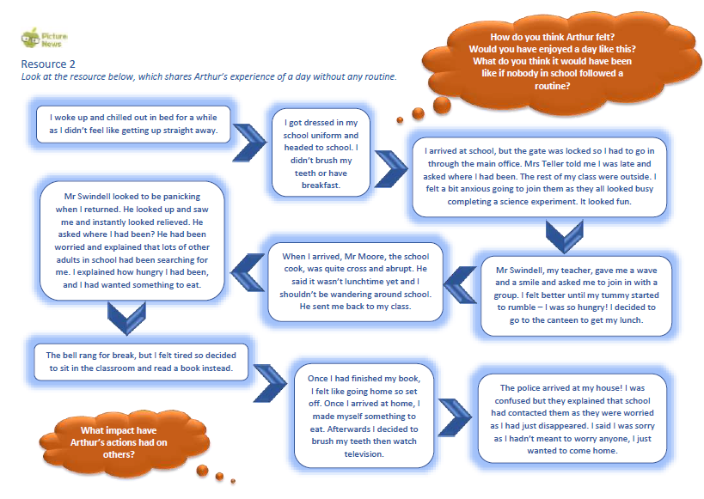
Notes:
Discuss questions in orange bubbles.

Slide 7

Daily Worship
Think about when not following a routine might be enjoyable and have less impact on others e.g. the weekend. Are there still parts of the day that might have a routine? Would you still brush your teeth?
Why do we have routines? List some of the reasons such as saves time, encourages good habits, provides us with structure.
Do you like routines or not? Why do you think you feel this way?

Slide 8
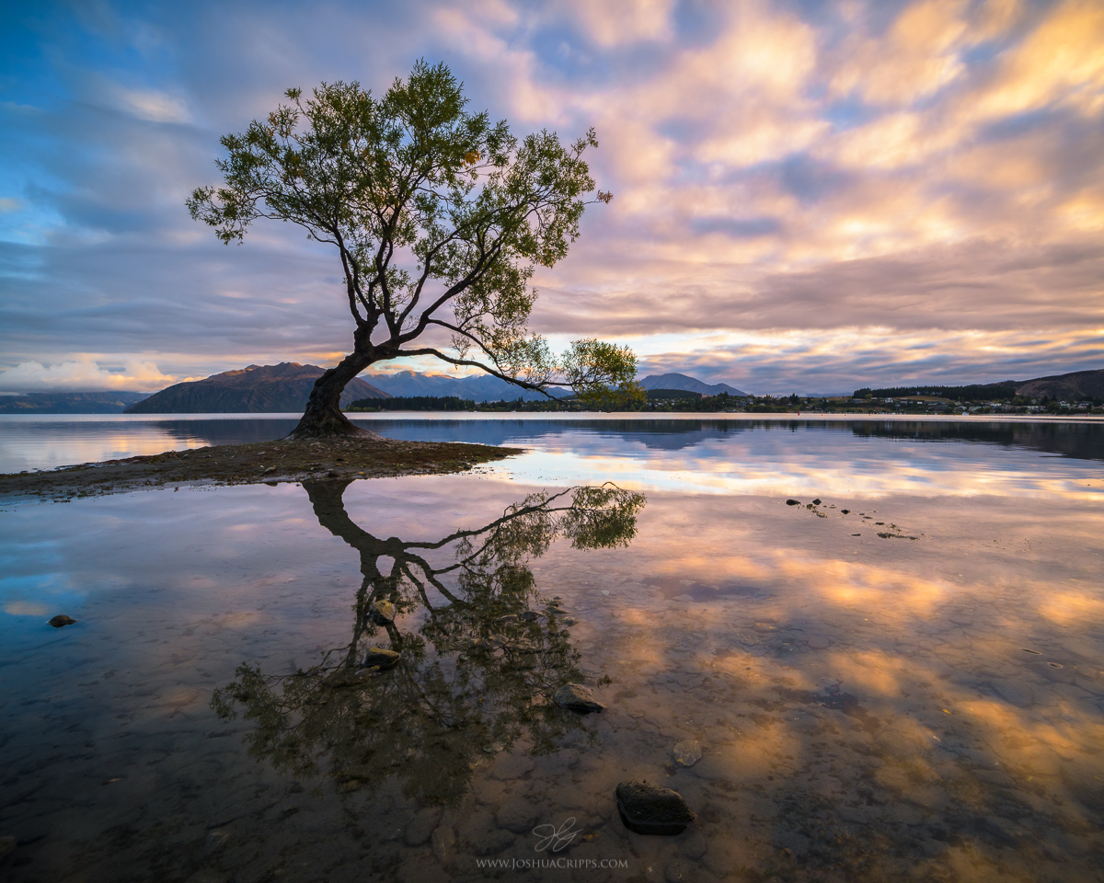
Daily Worship
Reflection
Without any routine at all, life can become chaotic! Some people prefer a strict routine whereas others prefer a more relaxed approach. It is important to find out what works for you and helps you get the most from life.

Slide 9

St Catherine’s Classroom Beliefs
Mistakes are valuable.
Everyone can learn maths to the highest level.
Questions are really important.
Depth is more important than speed.
Maths is about making connections.

Slide 10
23.6.20
WALT: solve a range of problems using mathematical knowledge.
Success Criteria:
Four operations
FDP
shape , space and measure
Statistics.
Notes:
Notes:

Slide 11
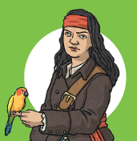
23.6.20
WALT: solve a range of problems using mathematical knowledge.
Challenge 1 - Pirate Flags!
Look at the flags designed on cm square grids.
What is the area of each flag?
What is the perimeter of each flag?
Colour the flags in according to the fractions.
You can use the slides or look at the separate word document.
Notes:
Notes: Sheet available in resources

Slide 12
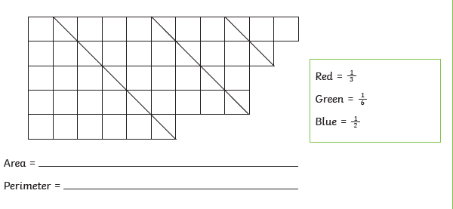
23.6.20
WALT: solve a range of problems using mathematical knowledge.
Flag 1
Notes:
Notes: Sheet available in resources

Slide 13
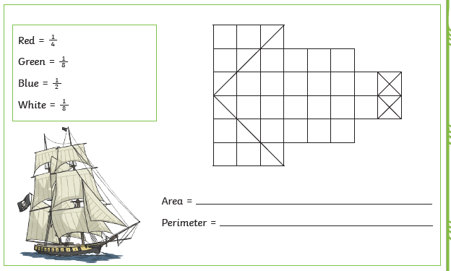
23.6.20
WALT: solve a range of problems using mathematical knowledge.
Flag 2
Notes:
Notes: Sheet available in resources

Slide 14
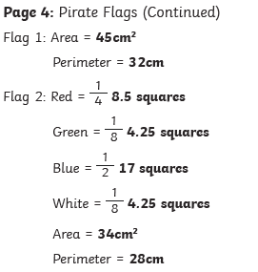
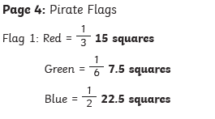
23.6.20
WALT: solve a range of problems using mathematical knowledge.
ANSWERS
Notes:
Notes: Sheet available in resources

Slide 15
23.6.20
WALT: solve a range of problems using mathematical knowledge.
Challenge 2 - Decimal Mosaic!
Solve the calculations to reveal the hidden picture!
Each answer has a special colour.
See separate sheet to see the calculations in more detail.
Notes:
Notes: Sheet available in resources

Slide 16
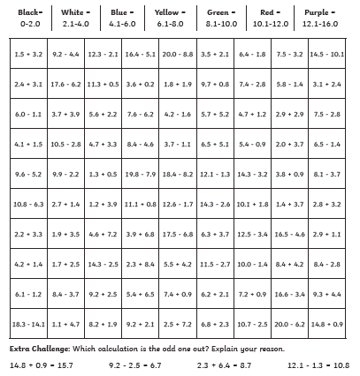
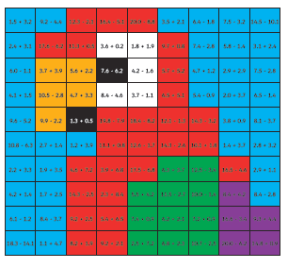
23.6.20
WALT: solve a range of problems using mathematical knowledge.
ANSWER BELOW - MOVE ME TO REVEAL!
Notes:
Notes: Sheet available in resources

Slide 17

Spellings
Reading = World Oceans

Slide 18
Tuesday - Spelling and handwriting practice.
personal
petrol
removal
several
spiteful
We arranged for the removal of the old car.
Copy out these words out twice in your best joined handwriting.

Slide 19
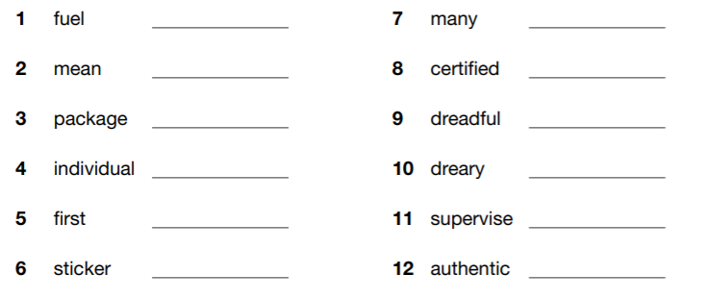
Tuesday- Spelling
awful
control decimal dismal
hostel
initial
label
national official original
parcel personal petrol removal several spiteful
Which of the words are synonyms for these words?

Slide 20

Tuesday- Spelling Answers
Which of your words are synonyms for these words?
Check the answers below and see how many you got correct.

Slide 21
Reading Activity
Teacher Notes
The purpose of a close read activity is to gain an understanding of the text by reading it multiple times.
Close Read Instructions:
Look at the vocabulary. Do you know what the words mean? If you are unsure, note down the words and use a dictionary (this could be online) to find out their meaning.
Read the text to yourself and ask yourself the following questions:
What did I just read? What did it say? You can make notes or annotate the text.
Now read the text again (you could do this wit an adult) - this will help you gain a better understanding.
Read the questions and now reread the text again to find evidence that will support your answers.
Answer the questions in writing.
All close read texts are age appropriate.

Slide 22
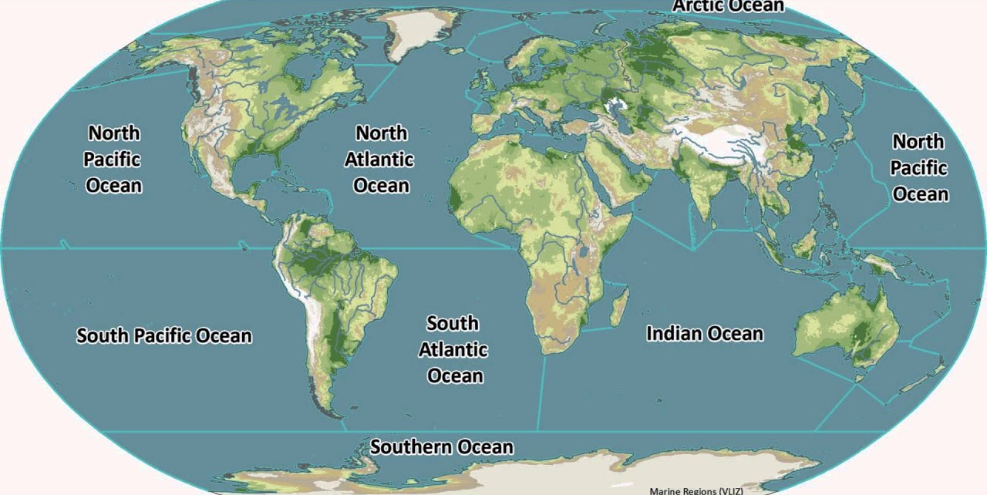
READING - World Oceans
WALT: Make inferences using evidence from the text.

Slide 23
READING - World Oceans
WALT: Make inferences using evidence from the text.
In 1992, the Canadian government first proposed setting up a World Ocean Day during the Earth Summit in Rio de Janeiro. The United Nations (UN) officially recognised 8th June as World Oceans Day in December 2008. The objective of the day then and now is to raise awareness of the vital importance of our oceans and the role they play in sustaining a healthy planet. It also aims to inform and educate people about the negative impact that human actions have on the ocean and the importance of finding ways in which to conserve, protect and sustain the ocean for the future.
Oceans cover over 70% of the Earth’s surface and they contain around 96% of all the water on the planet. Oceans are the world’s largest habitat and are home to a wide variety of creatures and living organisms. There are 5 oceans on Earth: the Pacific, the Atlantic, the Arctic, the Indian and the Southern.

Slide 24
READING - World Oceans
WALT: Make inferences using evidence from the text.
Interesting Fact
Covering around 30% of the Earth’s surface, the Pacific Ocean is Earth’s largest ocean. The name ‘Pacific Ocean’ means ‘peaceful sea’ in Latin.
Although largely unexplored, the oceans play a major role in everyday life all around the globe. They provide about 70% of the oxygen that we breathe, and many people consider them to be the lungs of our planet. Another of the ocean’s important roles is to soak up energy in the form of heat and distribute it evenly throughout the Earth. It also helps to absorb about one-quarter of the carbon dioxide (CO2) that we humans create when we burn fossil fuels such as oil, coal and natural gas.

Slide 25
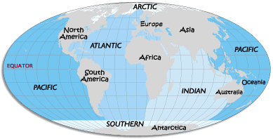
READING - World Oceans
WALT: Make inferences using evidence from the text.
Did You Know…?
The Great Barrier Reef, which is in the Pacific Ocean and measures around 2,600km, is visible from the Moon! It is one of the planet’s richest ocean habitats and is home to more than 1,500 species of fish, 134 species of sharks and rays and more than 30 species of vulnerable marine mammals.

Slide 26
READING - World Oceans
WALT: Make inferences using evidence from the text.
1. Why do you think it took 16 years for the UN to recognise World Oceans Day?
2. Find and copy one word that is a synonym for ‘crucial’.
3. How much of the Earth’s water is contained in oceans? Tick one.
70%
50%
96%
69%

Slide 27
READING - World Oceans
WALT: Make inferences using evidence from the text.
4. Which ocean means peaceful sea in Latin?
5. Although largely unexplored… What does the subordinate clause tell us about the ocean?
6. What is created when we burn fossil fuels? Tick one.
oxygen
carbon dioxide
nitrogen
carbon monoxide

Slide 28
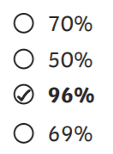
READING - World Oceans Answers
WALT: Make inferences using evidence from the text.
1. Why do you think it took 16 years for the UN to recognise World Oceans Day?
Own responses, such as: I think that it took 16 years for the UN to recognise World Oceans Day because the oceans have slowly become more and more polluted since 1992 and in 2008, the UN could not ignore the problem any longer.
2. Find and copy one word that is a synonym for ‘crucial’.
vital
3. How much of the Earth’s water is contained in oceans? Tick one.
70%
50%
96%
69%

Slide 29
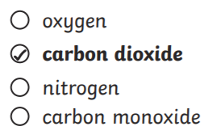
READING - World Oceans Answers
WALT: Make inferences using evidence from the text.
4. Which ocean means peaceful sea in Latin?
the Pacific
5. Although largely unexplored… What does the subordinate clause tell us about the ocean?
Own responses, such as: The subordinate clause, ‘Although largely unexplored…’ tells us that a large part of the ocean remains undiscovered and that we don’t actually know much about what is in the ocean.
6. What is created when we burn fossil fuels? Tick one.
oxygen
carbon dioxide
nitrogen
carbon monoxide

